Slide 1


Describing, Visualising and Exploring Data CAP Pathway: Intro to Statistics
Dr Liam J.B. Hill
MA Psychology | MSc Public Health | PhD Child Health
@liamjbhill.bksy.social liam.hill@ed.ac.uk Research Profile: ORCID.ORG/0000-0002-4069-5121

Slide 2

Sampling in Quant. Research
Our Sample
A “Small” world
Sampling- process of selecting a representative group from the population under study
Target population– group that we are interested in studying
A representative sample –a sample that has the key characteristics of the population.
Generalisability –the ability to generalize information from the sample to the population
The Target
Population
A “Big” world
Implications
of this?
Image source

Slide 3
Descriptive Stats. describe characteristics of the data
in YOUR sample
Inferential Models test relationship between variables within YOUR sample
These are imperfect estimates of such parameters in the Target Population (i.e. the “Big World”) and so…
We always need to be mindful of the uncertainty inherent in these statistical values.
I think of any statistic I create as my ‘best guess’ of what the true value in the population might be, based on my sample.

Slide 4
An Example:
Relevant to Descriptive Statistics…
Knowing the mean in a sample does not mean I know the mean in the pop. for certain.
Can I be absolutely certain that the mean weight I’ve calculated is the same as the mean weight of the population I want to generalise too (i.e. all apples in the world)?
I have six apples in a fruit bowl in front of me.
I weigh them and work out their mean weight.
I then want to make a statement about how much an apple weighs.

Slide 5
What did we learn
We can describe a sample using measures of central tendency (e.g. mean, median)
We should be very careful NOT to make premature inferences about the wider population based on descriptions of data in our sample alone.
We are more justified to do this once we’ve run some inferential tests (session 3)
When reporting central tendency values these should always be accompanied by values estimating dispersion around this ‘average’ (e.g. Std. Dev., Confid. Intrvls)
Helps to start quantifying the level of uncertainty in how easily generalisable our data is.

Slide 6
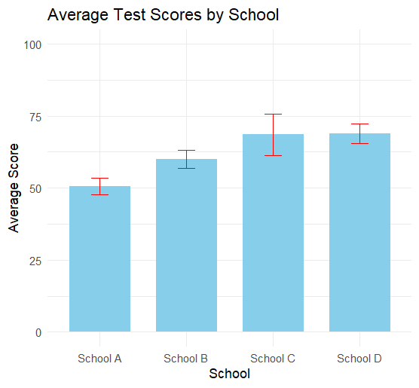
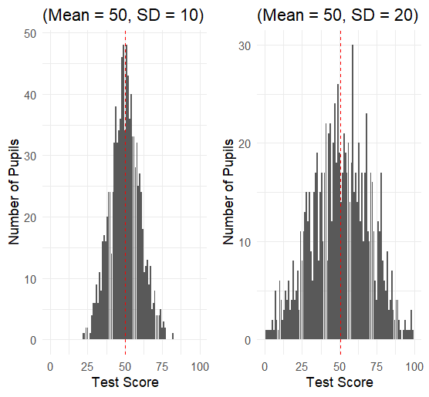
Further illustrations
Same Central Tendency but different dispersion!
Measures of Dispersion:
The range (Max – Min)
Interquartile Range
Confidence Intervals
Gives numerical or visual representations of uncertainty in estimates of the mean, given the level of variation in your sample (can be based on the Std. Dev., Std. Error)
Minimum
Median
Maximum
25%
IQR
25%

Slide 7
SPSS analysis workflow
Collect your Data
This will be highly project specific
(seek advice from supervisor)
Import and prepare (“Wrangle”) your Data
Initially, report and describe but DO NOT “INFER”
DESCRIPTIVE STATISTICAL ANALYSIS
Describe and Explore your Data (Session 1)
To interpret your results you will need to refer back to your Descriptive Statistics.
This is when you can make inference about patterns!
INFERENTIAL STATISTICAL ANALYSIS
Test hypotheses using your Data (Session 3)

Slide 8

Download and import some data!
Download the dataset for this session from the Workshop website, clicking on the hyperlink for it:
Open SPSS on your computer
Using the drop-down menu, select File > Open > Data
Navigate to where you downloaded the dataset to, select it, and click Open.

