Slide 1
Section 2: Visualising your Data

Slide 2
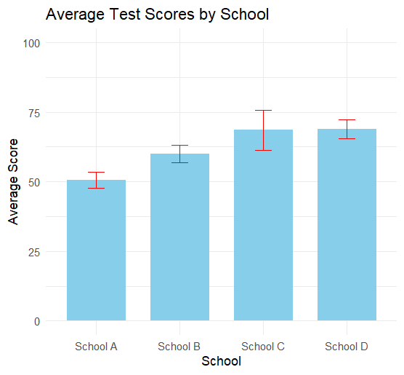
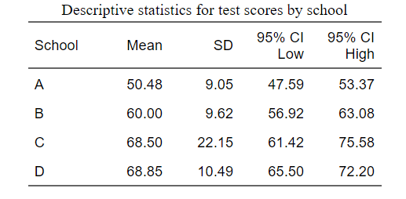
Visualising your data using Graphs
Graphs are also useful tool for exploring your data (section 3)
Why visualise if I’ve already described, as in section 1?
Easier to understand relationships visually:
…than numerically:

Slide 3
Scatterplots
Two continuous variables
Use: Graphs > Chart Builder
Choose: Scatter/Dot
On variables: prosocial_sum by peer_probs_sum

Slide 4
Bar graphs
One to Two categorical variables and one continuous variable
Example 1:
Use: Graphs > Chart Builder
Choose: Bar (Simple Bar)
On variables: prosocial_sum by Sex_at_birth
Example 2:
Use: Graphs > Chart Builder
Choose: Bar (Clustered Bar)
On variables: prosocial_sum by Sex_at_birth AND Ethnicity
You’ll also learn a little bit about how to exclude cases from your dataset

Slide 5
Boxplots
Will come back to these in the next section.
Use: Graphs > Chart Builder
Choose: Boxplot
On variables: prosocial_sum by Sex_at_birth
Useful visualisation tool for spotting outliers!

