Slide 1
Section 2: T-Tests
Is there, on average, a difference in Maths Anxiety between pairs of groups using different revision strategies?
We cram
We wing it!
We use
Active Learning

Slide 2
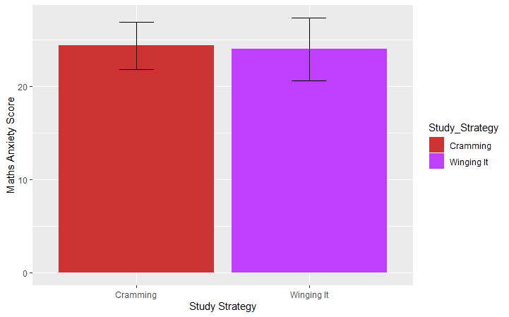
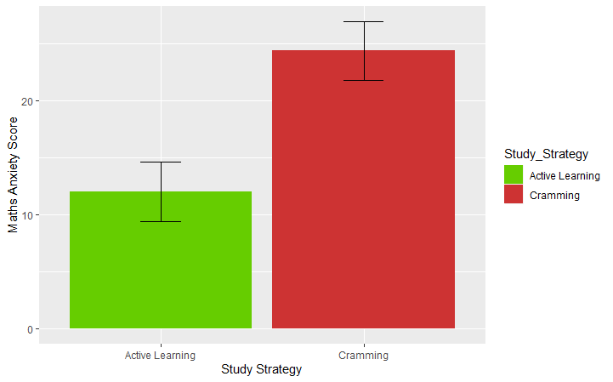
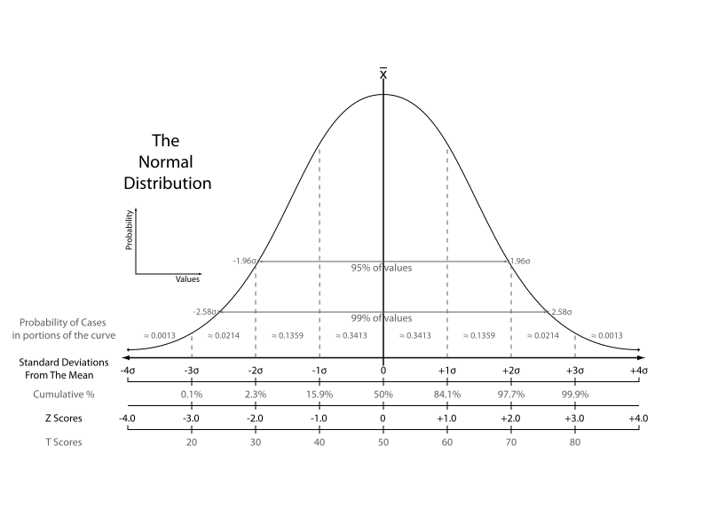


Tests of “mean difference” (t-tests)
H₀ predicts the
mean diff. = 0
$${\overline{x}}_{Cram}−{\overline{x}}_{Wing}$$
$${\overline{x}}_{Cram}−{\overline{x}}_{Actv}$$

Slide 3
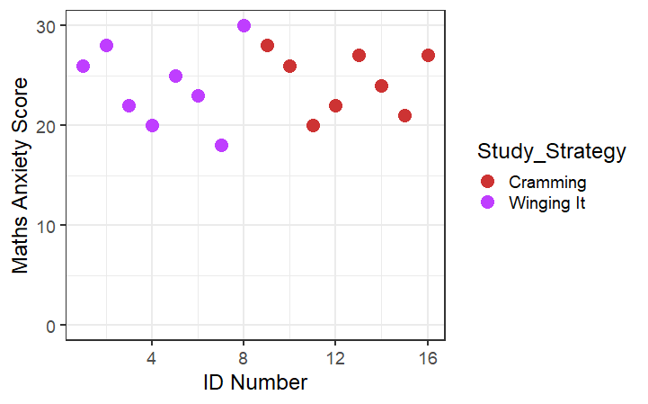
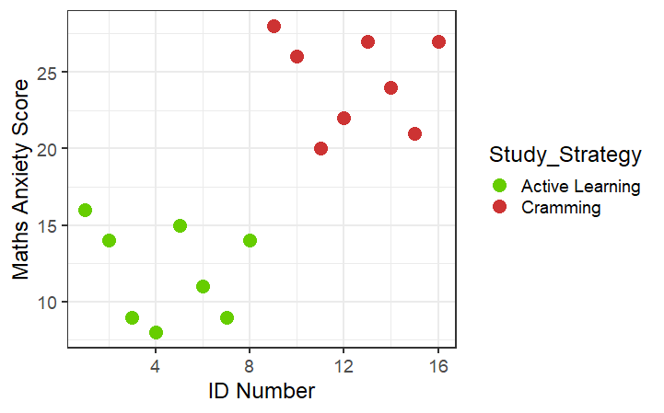
Tests of “mean difference” (t-tests)
Another way of thinking about this: does group membership info improve prediction?
Note: Can also use a regression model approach (GLM)
The Grand Mean(s)
The Group Means

Slide 4
Exercises
Independent samples (like the last few slides) t-tests
Paired samples t-tests
Effect sizes (standardised versions or mean-diff + confidence interval?)

