Slide 1


Describing, Visualising and Exploring Data CAP Pathway: Intro to Statistics
Dr Liam J.B. Hill
MA Psychology | MSc Public Health | PhD Child Health
@liamjbhill.bksy.social liam.hill@ed.ac.uk Research Profile: ORCID.ORG/0000-0002-4069-5121

Slide 2

Sampling in Quant. Research
Our Sample
A “Small” world
Sampling- process of selecting a representative group from the population under study
Target population– group that we are interested in studying
A representative sample –a sample that has the key characteristics of the population.
Generalisability –the ability to generalize information from the sample to the population
The Target
Population
A “Big” world
Implications
of this?
Image source

Slide 3
Descriptive Stats. describe characteristics of the data
in YOUR sample
Inferential Models test relationship between variables within YOUR sample
These are imperfect estimates of such parameters in the Target Population (i.e. the “Big World”) and so…
We always need to be mindful of the uncertainty inherent in these statistical values.
I think of any statistic I create as my ‘best guess’ of what the true value in the population might be, based on my sample.

Slide 4
An Example:
Relevant to Descriptive Statistics…
Knowing the mean in a sample does not mean I know the mean in the pop. for certain.
Can I be absolutely certain that the mean weight I’ve calculated is the same as the mean weight of the population I want to generalise too (i.e. all apples in the world)?
I have six apples in a fruit bowl in front of me.
I weigh them and work out their mean weight.
I then want to make a statement about how much an apple weighs.

Slide 5
What did we learn
We can describe a sample using measures of central tendency (e.g. mean, median)
We should be very careful NOT to make premature inferences about the wider population based on descriptions of data in our sample alone.
We are more justified to do this once we’ve run some inferential tests (session 3)
When reporting central tendency values these should always be accompanied by values estimating dispersion around this ‘average’ (e.g. Std. Dev., Confid. Intrvls)
Helps to start quantifying the level of uncertainty in how easily generalisable our data is.

Slide 6
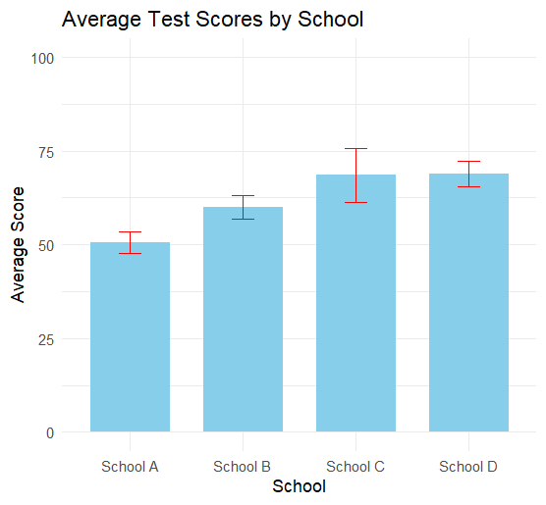
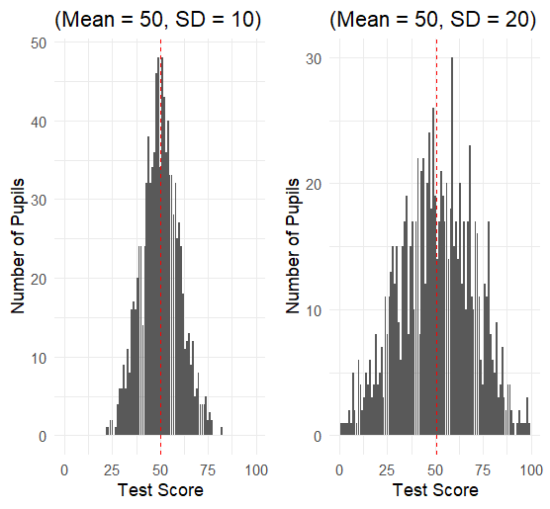
Further illustrations
Same Central Tendency but different dispersion!
Measures of Dispersion:
The range (Max – Min)
Interquartile Range
Confidence Intervals
Gives numerical or visual representations of uncertainty in estimates of the mean, given the level of variation in your sample (can be based on the Std. Dev., Std. Error)
Minimum
Median
Maximum
25%
IQR
25%

Slide 7
SPSS analysis workflow
Collect your Data
This will be highly project specific
(seek advice from supervisor)
Import and prepare (“Wrangle”) your Data
Initially, report and describe but DO NOT “INFER”
DESCRIPTIVE STATISTICAL ANALYSIS
Describe and Explore your Data (Session 1)
To interpret your results you will need to refer back to your Descriptive Statistics.
This is when you can make inference about patterns!
INFERENTIAL STATISTICAL ANALYSIS
Test hypotheses using your Data (Session 3)

Slide 8

Download and import some data!
Download the dataset for this session from the Workshop website, clicking on the hyperlink for it:
Open SPSS on your computer
Using the drop-down menu, select File > Open > Data
Navigate to where you downloaded the dataset to, select it, and click Open.

Slide 9
Section 1: Describing your Data

Slide 10

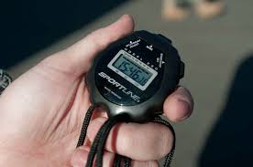
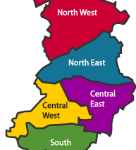

Primarily working with 2 types of data
Continuous (Scale) Data or Categorical (Nominal/Ordinal) data?
Type of measurement | Scale of measurement | Coded in Variable View as…
Continuous | interval, ratio | “scale”
Categorical | nominal, ordinal | “nominal”, “ordinal”
Categorical Variables can also be binary
Con-Interval:
No. of Catches
Con-Ratio:
Change in RT after training
Cat-Nominal: School District
Cat-Ordinal:
Race placing

Slide 11
Summarising Continuous Data
Summarising using measures of Central Tendency and Dispersion!
Use: Analyze > Descriptives > Explore
On variable: Gest_Age_Wks
Mean
5% Tirmmed Mean
Median
Std. Error
95% Confidence Intervals
Variance
Std. Deviation
Range (Min to Max)
Interquartile Range
Skewness
Kurtosis

Slide 12
Summarising Categorical Data
Summarising using Counts and/or Frequencies.
(e.g. proportions, percentages)
Use: Analyze > Descriptives > Frequencies
On variable: p_confidence
In this exercise you’ll also learn a little bit about how to handle missingness in your data.

Slide 13
Summarising Combinations
Comparing a Continuous Outcome across levels within a Categorical Variable:
Use: Analyze > Descriptives > Explore
On variables: Gest_Age_Wks by Sex_at_birth
Comparing categorical distribution of one variable across levels of a second Categorical Variable
Use: Analyze > Descriptives > Crosstabs
On variables: p_confidence by ethnicity

Slide 14
Section 2: Visualising your Data

Slide 15
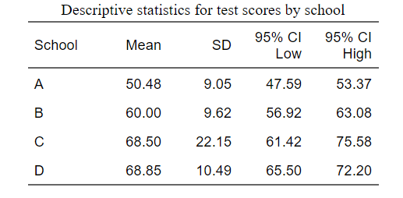
Visualising your data using Graphs
Graphs are also useful tool for exploring your data (section 3)
Why visualise if I’ve already described, as in section 1?
Easier to understand relationships visually:
…than numerically:

Slide 16
Scatterplots
Two continuous variables
Use: Graphs > Chart Builder
Choose: Scatter/Dot
On variables: prosocial_sum by peer_probs_sum

Slide 17
Bar graphs
One to Two categorical variables and one continuous variable
Example 1:
Use: Graphs > Chart Builder
Choose: Bar (Simple Bar)
On variables: prosocial_sum by Sex_at_birth
Example 2:
Use: Graphs > Chart Builder
Choose: Bar (Clustered Bar)
On variables: prosocial_sum by Sex_at_birth AND Ethnicity
You’ll also learn a little bit about how to exclude cases from your dataset

Slide 18
Boxplots
Will come back to these in the next section.
Use: Graphs > Chart Builder
Choose: Boxplot
On variables: prosocial_sum by Sex_at_birth
Useful visualisation tool for spotting outliers!

Slide 19
Section 3: Exploring your Data

Slide 20
Exploring IS IMPORTANT
BEFORE we get on to Hypothesis Testing we need to explore our data thoroughly. Some things I’d always check for:
Extreme Values (i.e. outliers)
More subtle ‘Skewness’
Low cell counts
All of the above are example of things that can lead to our data “violating assumptions” that increase the risk of our parametric inferential statistical tests results being biased.
But not always!

Slide 21
Extreme Values
Check for them using boxplots (again!)
Use: Graphs > Chart Builder
Choose: Boxplot
On variables: prosocial_sum by Sex_at_birth
How would you handle the outliers we’re seeing here?

Slide 22
Skewness
How you handle skew is very case specific.
Ask me more about this later in the day, if you want!
Check for visually
Use: Analyze > Descriptives > Explore
On variable: Gest_Age_Wks
This time: Ask for Statistics & Plots in the output
Check for using normality tests too?

Slide 23
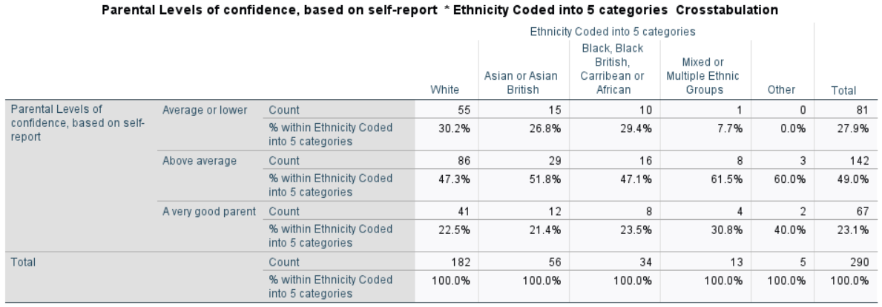
Low Cell counts
Check for in your descriptive statistics.
We already sort of looked at this, when we used Crosstabs earlier.
Cells with fewer than 5 cases in them are something we’ll talk about this afternoon too, when looking at chi-squared tests.

