Slide 1
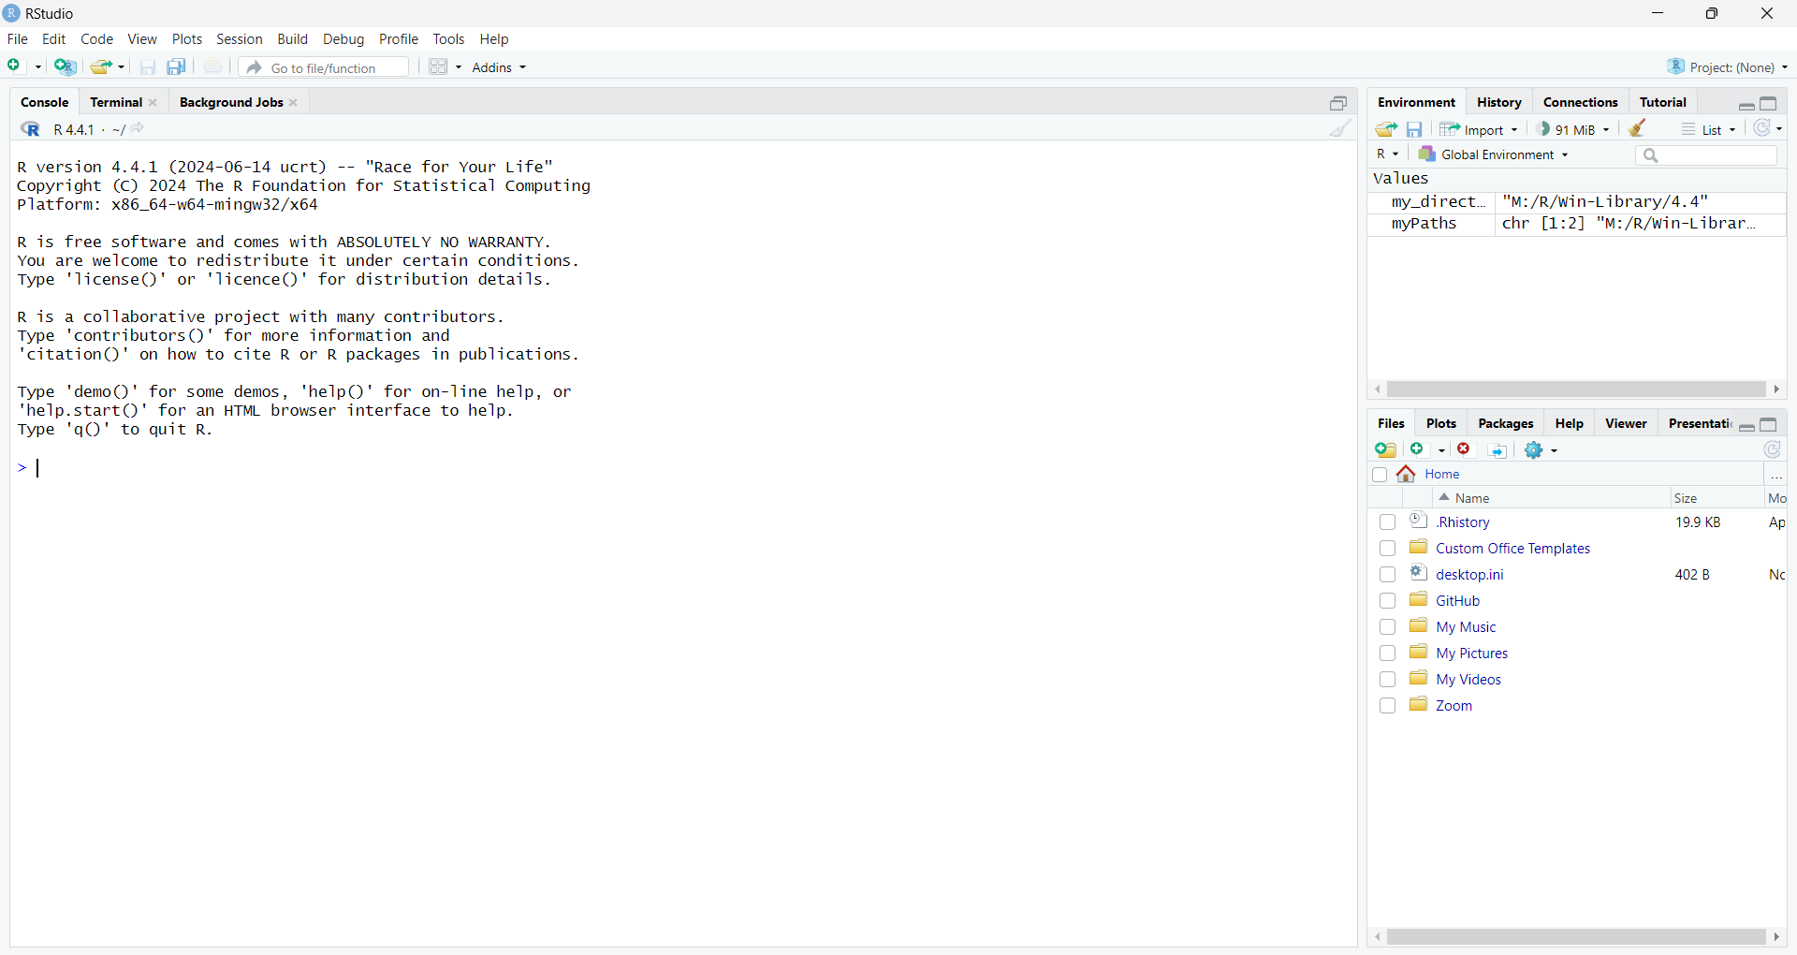

Slide 2
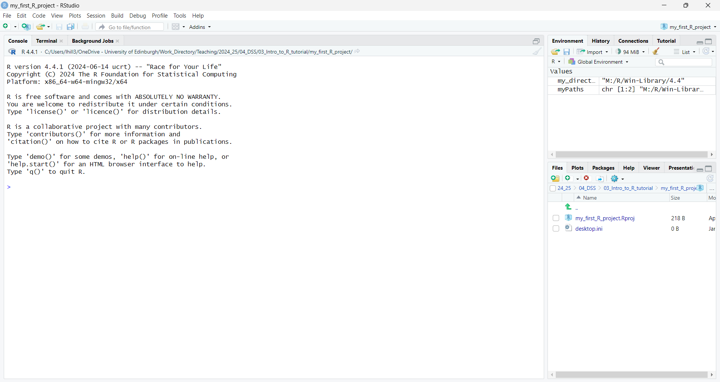

Slide 3
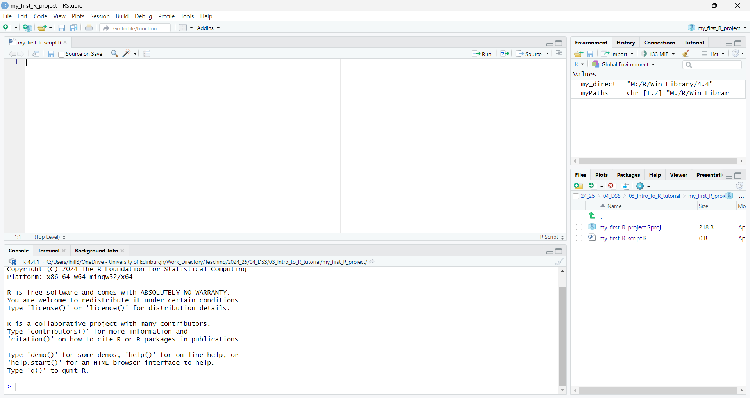
Here it all is!

Slide 4
Write your instructions for R in the Code Editor
These datasets exist as ‘objects’ that you can instruct R to perform further actions on
Click ‘Run’ and RStudio will pass on your instructions to R
Update data in these objects (e.g. compute new variables)
Analyse data in objects to output results here…
R will then act upon your instruction and communicate its response (if necessary) in the console
Your code can instruct R to upload datasets into the environment

Slide 5
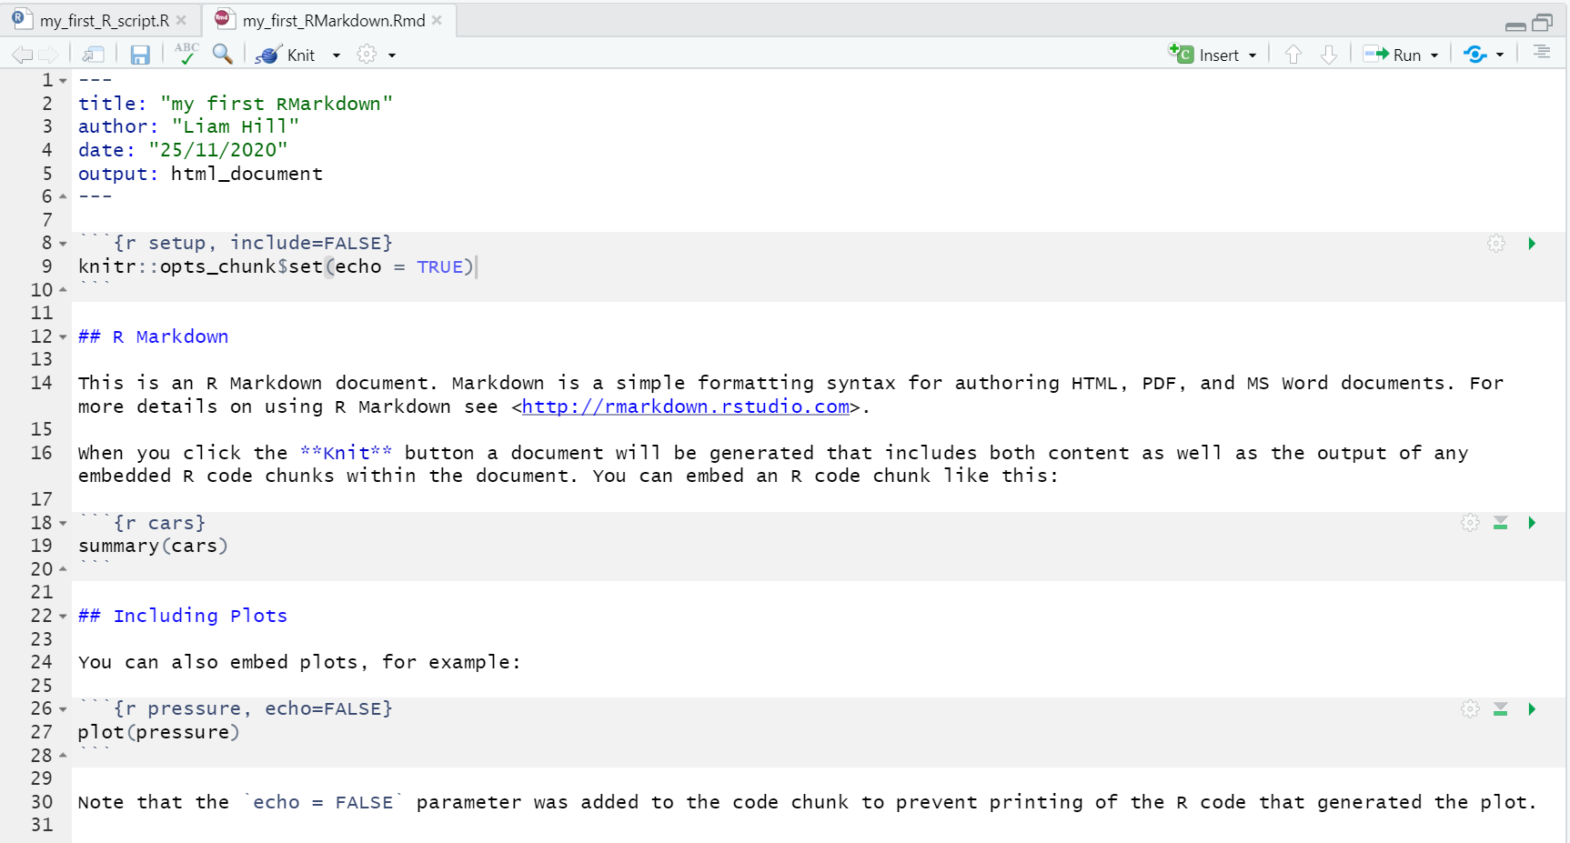
7.2.1.
7.2.2.
7.2.3.
7.2.4.
7.2.5.
7.2.6.

Slide 6
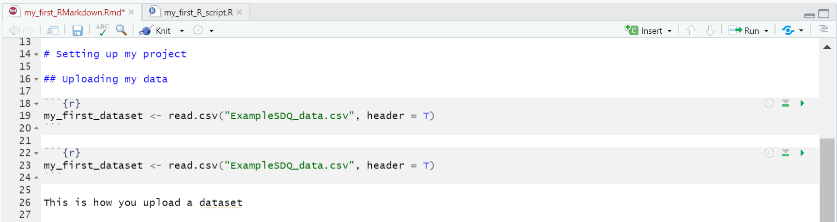

Slide 7
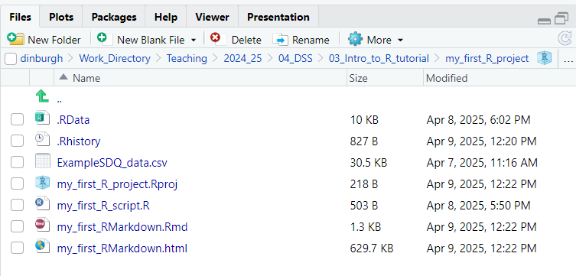

Slide 8
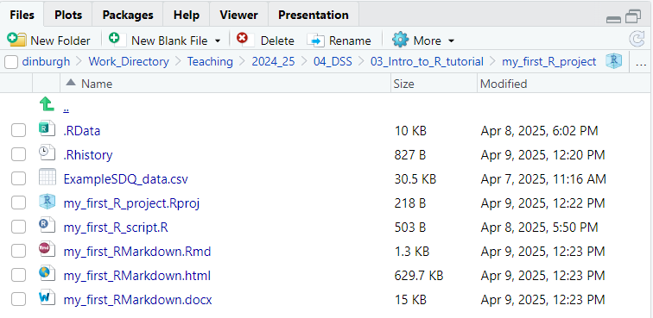

Slide 9
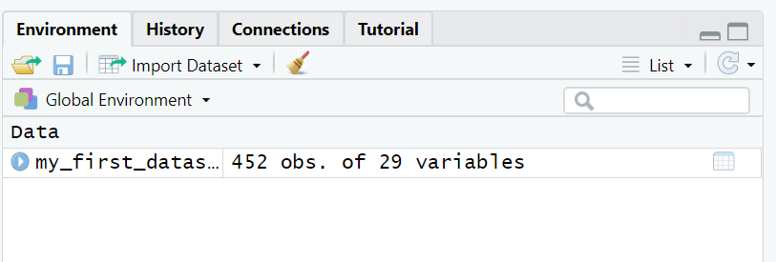

Slide 10
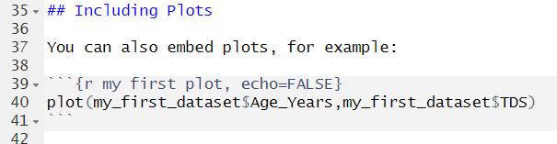

Slide 11
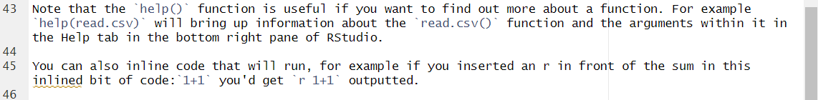

Slide 12
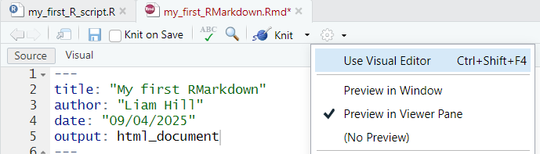

Slide 13
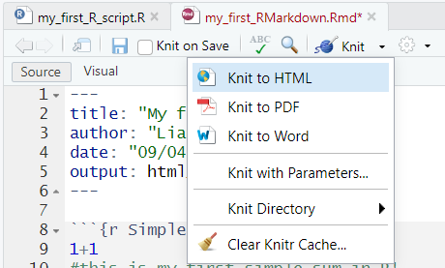

Slide 14
