Slide 1
Assessing SIMD Programming Paradigms in C++: A Comparative Analysis of Execution Time Across Vector Manipulation Algorithms (Dissertation Presentation)
Liam Weitzel
Supervised by: Mr Greenwood
School of Mathematics, Computer Science and Engineering
Liverpool Hope University, UK

Slide 2
Outline
Introduction
Research approach and methods
Results
Discussion
Future Work

Slide 3
Introduction
Motivation
Aim & research question

Slide 4
Literature review
What is auto-vectorization?
James Rainders
What are OpenMP directives?
What are intrinsics?
Formalized assembly
What are high-level SIMD libraries?
The consesus on performance
What is the difference between Vectorized logic vs Scalar logic?
Sources of error

Slide 5
Research approach and methods
What are we comparing?
Measurements
The problems
Bash script
Ran for 9 hours

Slide 6
Results

Slide 7
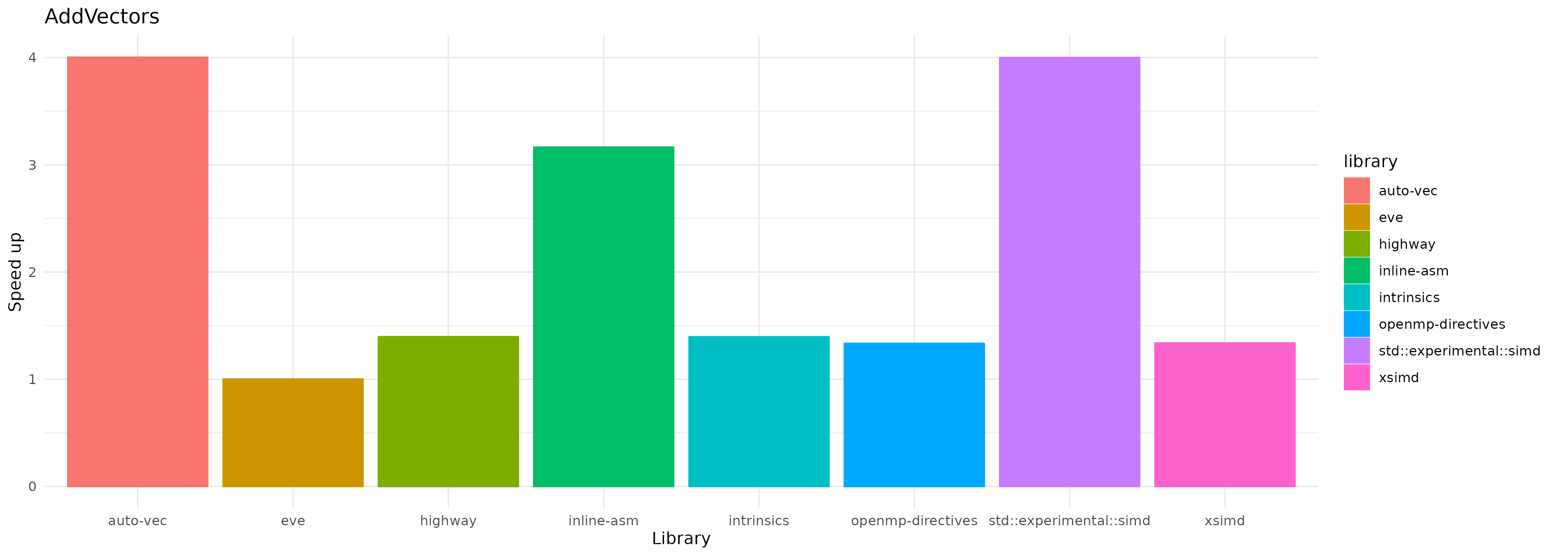
Auto-vectorization and std::experimental::simd 4x faster than unvectorized solution. Benchmark: `add vectors`

Slide 8
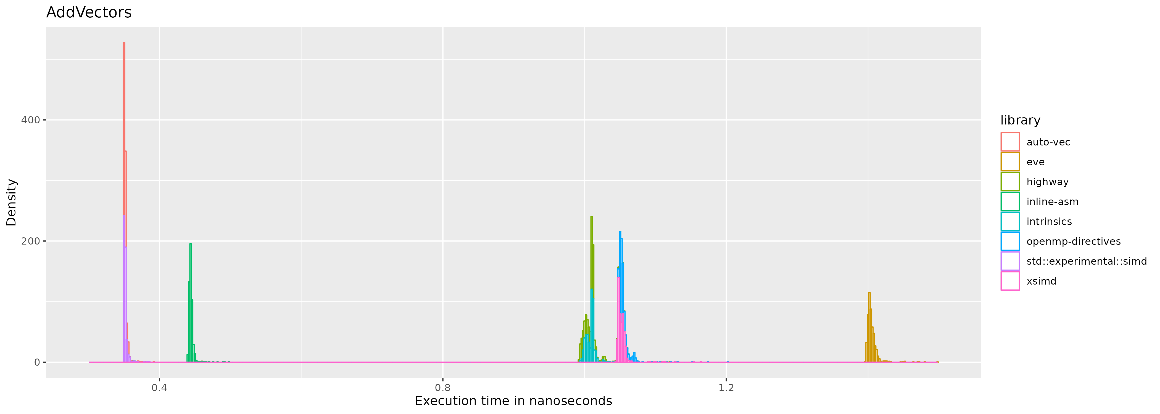
Auto-vectorization and std::experimental::simd 4x faster than unvectorized solution. Benchmark: `add vectors`

Slide 9
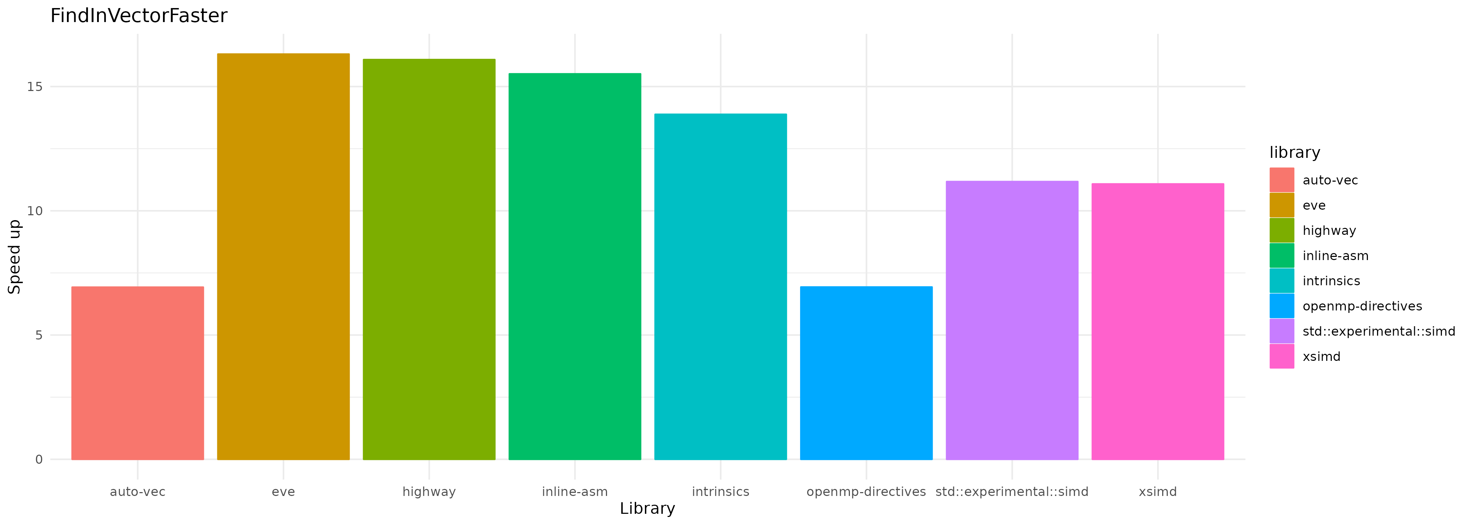
EVE 16x faster than unvectorized solution. Benchmark: `find in vector faster`

Slide 10
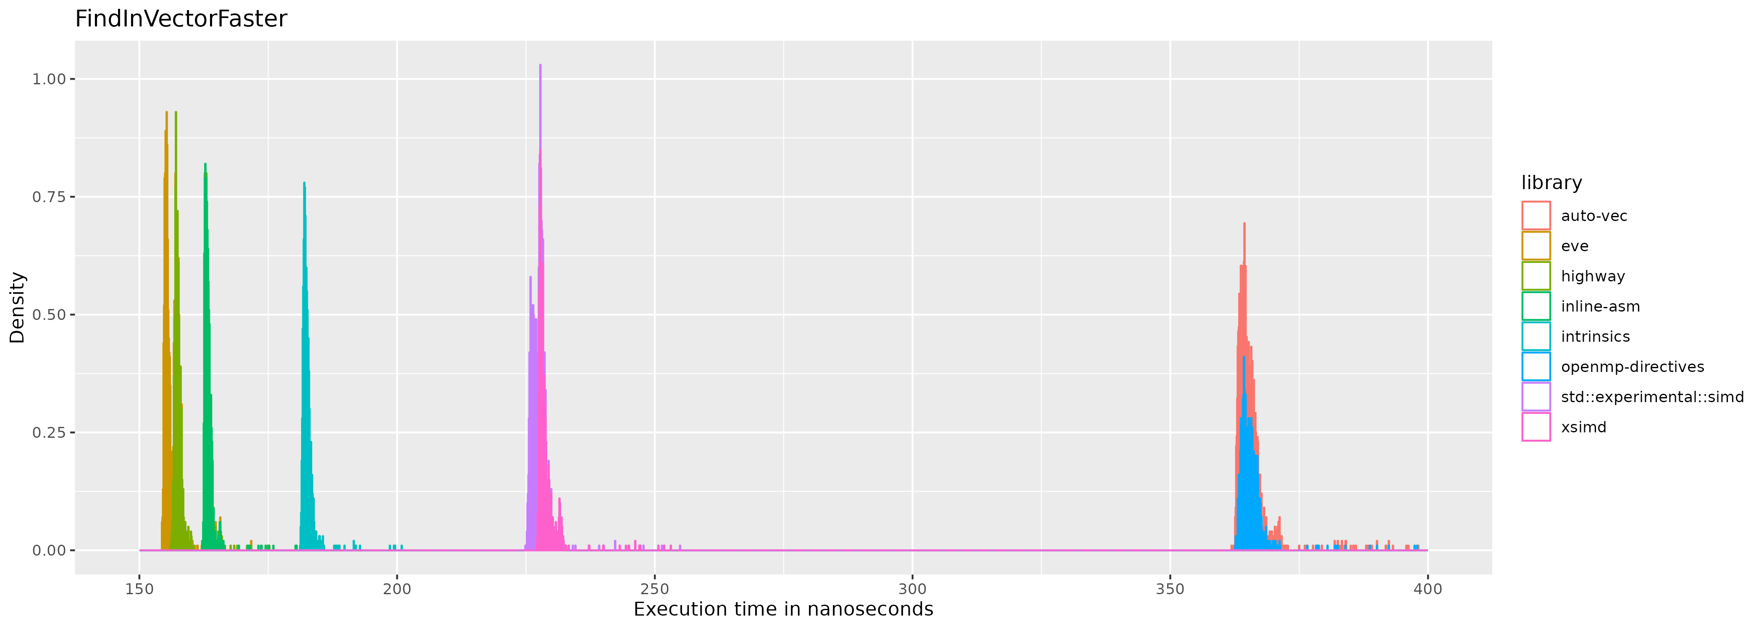
EVE 16x faster than unvectorized solution. Benchmark: `find in vector faster`

Slide 11
Discussion
Why did some paradigms run faster?
Add vectors
Find in vector
Find in vector faster
Reverse vector
Sum vector

Slide 12
Future Work
Why did std::experimental::simd perform the way it did?
Why did 'vpshufd' not get used in reverse vector?
Are the results going to be the same on other host machines?

Slide 13
Conclusion and evaluation
“Which SIMD programming paradigm in C++ is the fastest benchmarked on various vector manipulation algorithms?”
SIMD logic vs scalar logic

