Slide 1
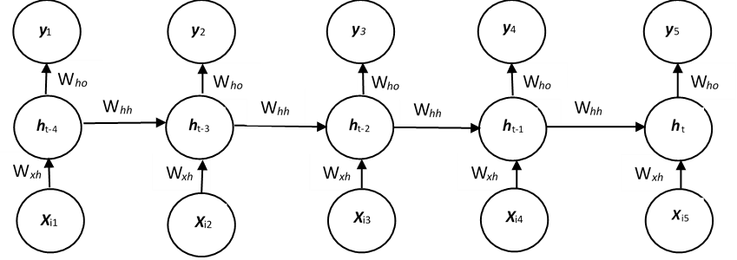
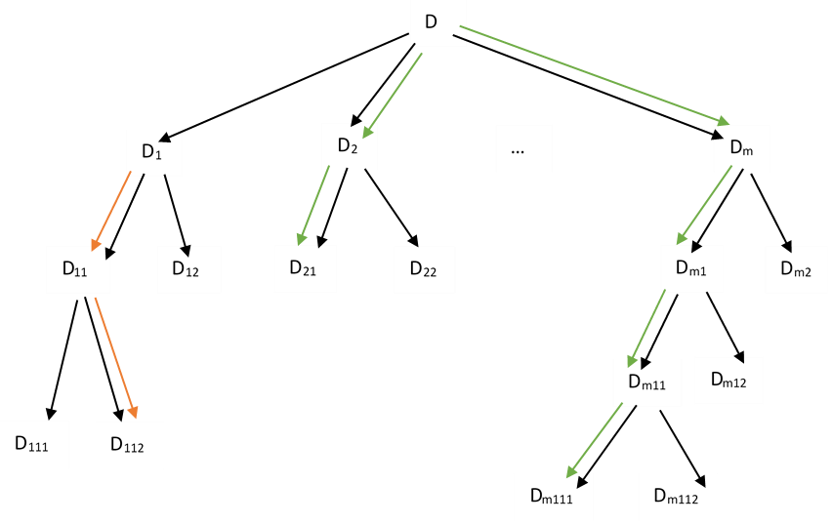
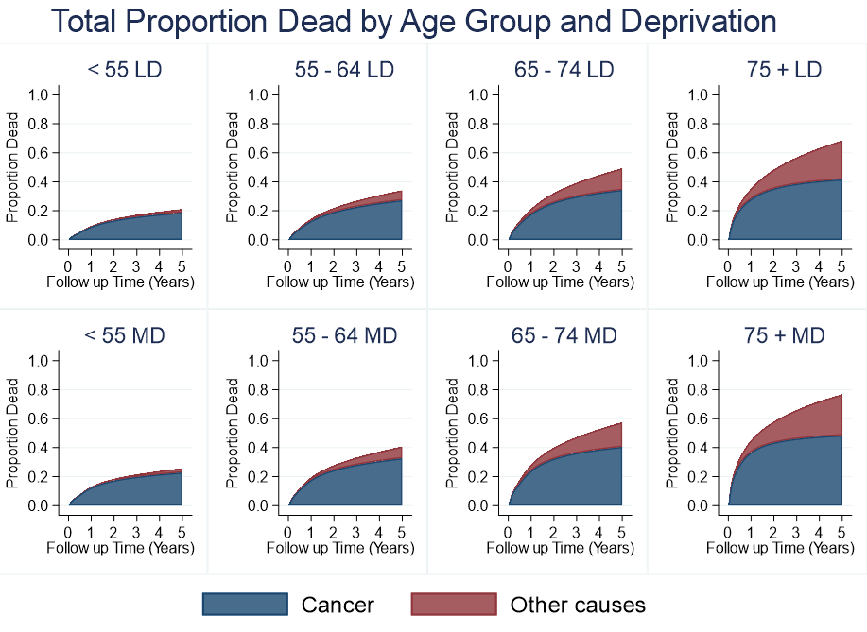
Machine Learning in Survival Analysis
Liam Wilkinson

Slide 2
Background
-> Survival analysis is the study of predicting some time to an event (usually death) or can be the prediction of factors that affect risk of an event (inference)
-> Machine learning automates model building by “learning” from past experiences, poor predictive qualities => re-estimate the model until some model fitting criteria has been met – minimize error; maximise likelihood
Aims
-> Use machine learning methods for risk prediction
-> Evaluate the performance of each machine learning method under a variety of situations with a simulation study
-> Which machine learning methods work best and when?

Slide 3
Background
-> Artificial Neural Networks: Models the relationship between a set of inputs and output using artificial neurons. Just like the brain uses biological neurons to improve learning capacity, a neural network uses artificial neurons to improve the learning capacity of the model.
-> Support Vector Regression: Support vector regression attempts to fit a regression line in a higher dimensional space such that each survival time fits within a certain error threshold either side of the regression line.
-> Random Survival Forests: An ensemble method – take the average decision from at least 500 binary survival trees and use this as the decision of the forest.

Slide 4
Cox-Time Neural Network
-> Uses the output from a neural network g(X_{i}, θ) as the linear predictor in the Cox model h(t|X_{i}) = h₀(t)exp[g(X_{i,} θ)]
-> θ is a vector representing all of the weights to be optimized during training the neural network
-> To generate estimates of survival – the baseline cumulative hazard is estimated by the Breslow estimator
-> Can extend to non-proportional hazards by including time as an input in the input phase which allows the network to model interactions between the covariates and time

Slide 5
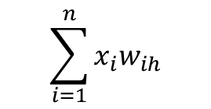

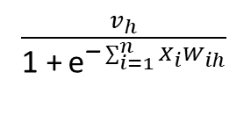

Cox-Time Neural Network
$$\sum_{i=1}^{n}{x_{i}w_{ih}}$$
$\frac{\text{1}}{\text{1 +} {\text{e}}^{\text{−}\sum_{i=1}^{n}{X_{i}W_{ih}}}}$
X₁
w₁₁
h₁
w₁₂
$\frac{v_{h}}{\text{1 +} {\text{e}}^{\text{−}\sum_{i=1}^{n}{X_{i}W_{ih}}}}$
w_{1m}
v₁
w₂₁
X₂
w₂₂
v₂
h₂
g(X_{i}, θ)
w_{2m}
…
…
w_{n1}
w_{n2}
V_{m}
w_{nm}
X_{n}
h_{m}
Linear Predictor for Cox Model
Input Layer
Hidden Layer
Logistic Activation Function f(x) = $\frac{\text{1}}{\text{1 +} {\text{e}}^{\text{−}\text{x}}}$

Slide 6
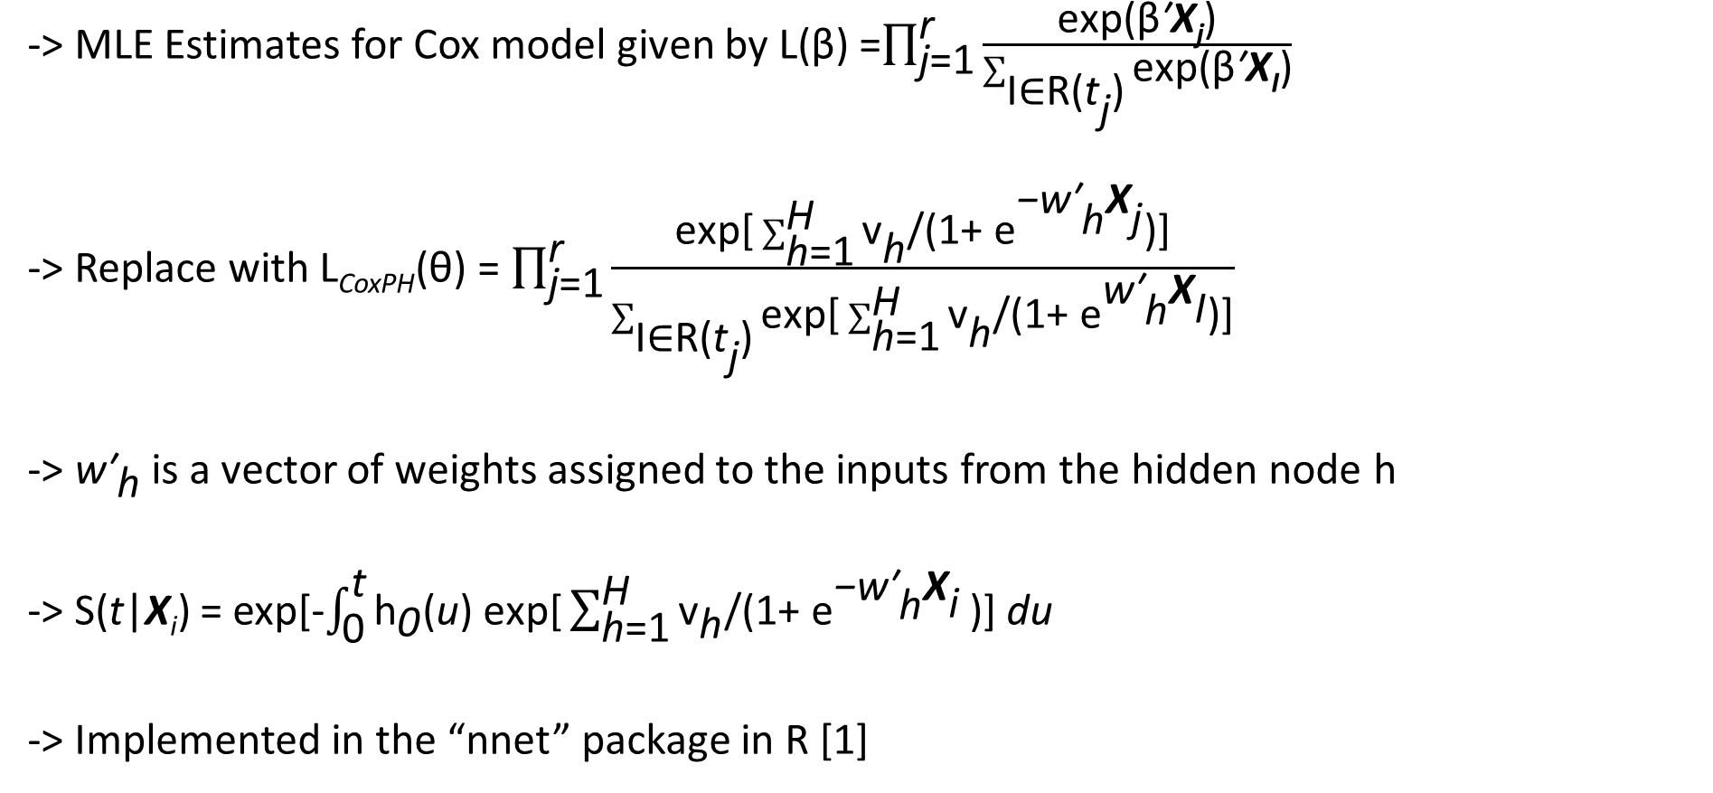
Cox-Time Neural Network
-> MLE Estimates for Cox model given by L(β) =$\prod_{\text{j}\text{=1}}^{\text{r}}{\frac{\text{exp}\text{(}\text{β}\text{′}\text{X}\text{j}\text{)}}{\sum_{\text{I}\text{∈}\text{R}\text{(}{\text{t}}_{\text{j}}\text{)}}{\text{exp}\text{(}\text{β}\text{′}\text{X}\text{I}\text{)}}}}$
-> Replace with L_{CoxPH}(θ) = $\prod_{\text{j}\text{=1}}^{\text{r}}{\frac{\text{exp}\text{[}\sum_{\text{h}\text{=1}}^{\text{H}}{{\text{v}}_{\text{h}}\text{/(1+ }{\text{e}}^{\text{−}{\text{w}\text{′}}_{\text{h}}{\text{X}}_{\text{j}}}}\text{)]}}{\sum_{\text{I}\text{∈}\text{R}\text{(}{\text{t}}_{\text{j}}\text{)}}{\text{exp}\text{[}\sum_{\text{h}\text{=1}}^{\text{H}}{{\text{v}}_{\text{h}}\text{/(1+ }{\text{e}}^{{\text{w}\text{′}}_{\text{h}}{\text{X}}_{\text{I}}}}\text{)]}}}}$
-> ${\text{w}\text{′}}_{\text{h}}$ is a vector of weights assigned to the inputs from the hidden node h
-> S(t|X_{i}) = exp[-$\int_{\text{0}}^{\text{t}}{{\text{h}}_{\text{0}}\text{(}\text{u}\text{) }\text{exp}\text{[}\sum_{\text{h}\text{=1}}^{\text{H}}{{\text{v}}_{\text{h}}\text{/(1+ }{\text{e}}^{\text{−}{\text{w}\text{′}}_{\text{h}}{\text{X}}_{\text{i}}}}\text{)] }\text{du}}$
-> Implemented in the “nnet” package in R [1]

Slide 7
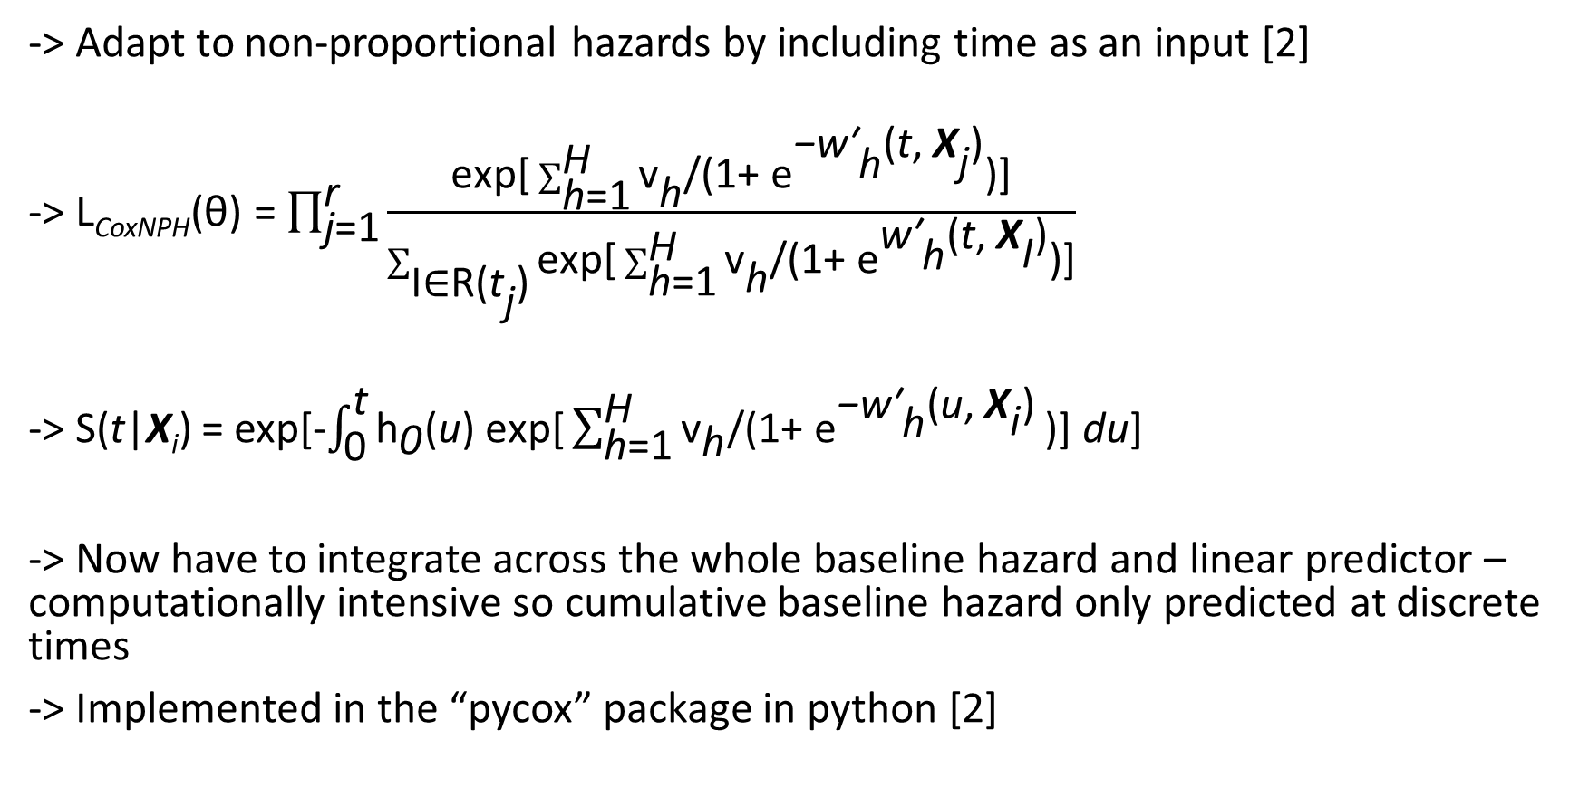
Cox-Time Neural Network
-> Adapt to non-proportional hazards by including time as an input [2]
-> L_{CoxNPH}(θ) = $\prod_{\text{j}\text{=1}}^{\text{r}}{\frac{\text{exp}\text{[}\sum_{\text{h}\text{=1}}^{\text{H}}{{\text{v}}_{\text{h}}\text{/(1+ }{\text{e}}^{\text{−}{\text{w}\text{′}}_{\text{h}}{\text{(}\text{t}\text{, }\text{X}}_{\text{j}}\text{)}}}\text{)]}}{\sum_{\text{I}\text{∈}\text{R}\text{(}{\text{t}}_{\text{j}}\text{)}}{\text{exp}\text{[}\sum_{\text{h}\text{=1}}^{\text{H}}{{\text{v}}_{\text{h}}\text{/(1+ }{\text{e}}^{{\text{w}\text{′}}_{\text{h}}{\text{(}\text{t}\text{, }\text{X}}_{\text{I}}\text{)}}}\text{)]}}}}$
-> S(t|X_{i}) = exp[-$\int_{\text{0}}^{\text{t}}{{\text{h}}_{\text{0}}\text{(}\text{u}\text{) }\text{exp}\text{[}\sum_{\text{h}\text{=1}}^{\text{H}}{{\text{v}}_{\text{h}}\text{/(1+ }{\text{e}}^{\text{−}{\text{w}\text{′}}_{\text{h}}{\text{(}\text{u}\text{, }\text{X}}_{\text{i}}\text{)}}}\text{)] }\text{du}\text{]}}$
-> Now have to integrate across the whole baseline hazard and linear predictor – computationally intensive so cumulative baseline hazard only predicted at discrete times
-> Implemented in the “pycox” package in python [2]

Slide 8
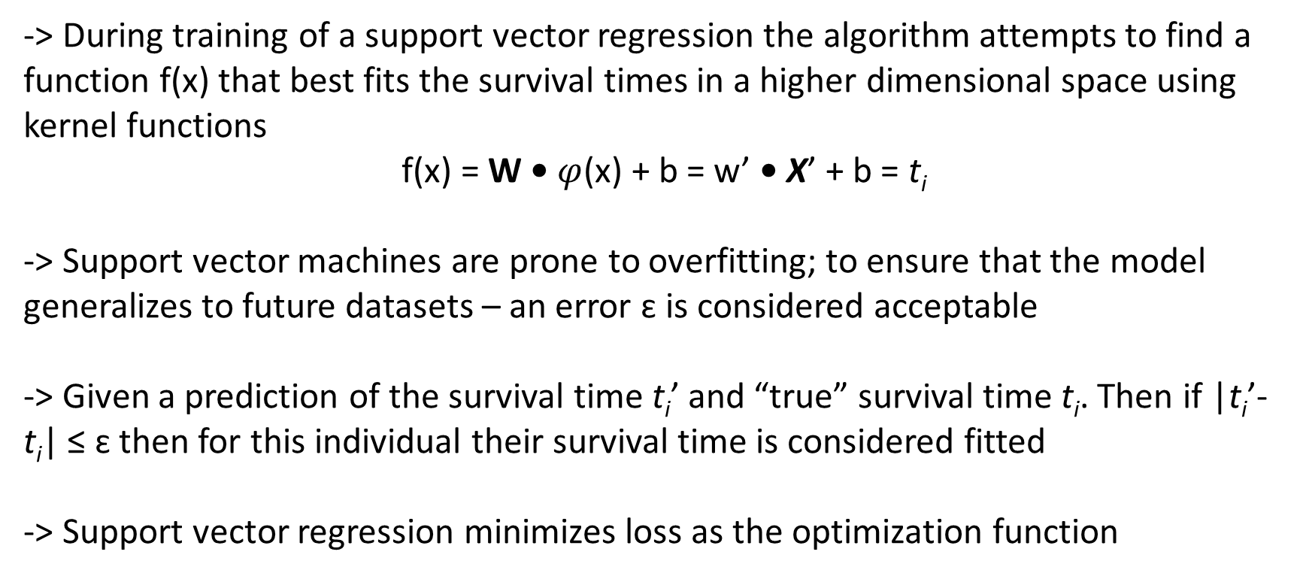
Support Vector Regression
-> During training of a support vector regression the algorithm attempts to find a function f(x) that best fits the survival times in a higher dimensional space using kernel functions
f(x) = W • $φ$(x) + b = w’ • X’ + b = t_{i}
-> Support vector machines are prone to overfitting; to ensure that the model generalizes to future datasets – an error ԑ is considered acceptable
-> Given a prediction of the survival time t_{i}’ and “true” survival time t_{i}. Then if |t_{i}’- t_{i}| ≤ ԑ then for this individual their survival time is considered fitted
-> Support vector regression minimizes loss as the optimization function

Slide 9
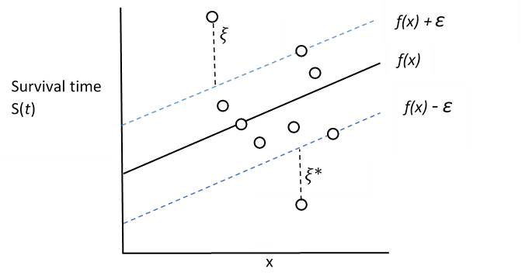

Support Vector Regression
-> Slack variables $ξ$,$ξ\text{∗}$are what allow incorrect predictions in the optimization phase
-> Slack variables are how far outside the “acceptable” range the predictions are
-> Any survival time that is outside the acceptable error range will be penalised by adding a cost C proportional to the size of $ξ$ to the total loss

Slide 10
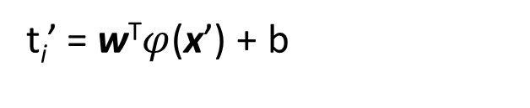






Support Vector Regression
-> Uncensored observations are penalized for all incorrect predictions
-> Censored observations are only penalized for predictions of survival time less than their observed censoring times [3]
Uncensored Observations
Censored Observations
Loss
Loss
$$\text{C}$$
$$\text{C}$$
$$\text{C}$$
t_{i}’ = w^{T}$φ$(x’) + b
$$\text{−}\text{ε}$$
t_{i} - t_{i}’
t_{i} - t_{i}’
t_{i}
$$\text{ε}$$
$$\text{−}\text{ε}$$
t_{i}
-> Implemented in the “survivalsvm” package in R [4]

Slide 11



Random Survival Forests
-> Random Survival Forests are an ensemble method – take the average decision from the binary survival trees in the forest and use this as the decision of the forest [5]
-> Binary Survival trees are trees grown by recursive splitting of tree nodes – use the variable with the highest log-rank test statistic
-> Split D by the covariate that maximizes the survival difference between D₁ and D₂
-> Split D₁ by the covariate that maximizes the survival difference between D₁₁ and D₁₂
-> Split D₂ by the covariate that maximizes the survival difference between D₂₁ and D₂₂
….
-> Eventually the nodes cannot be split anymore as every observation in the node has a similar survival time – these are terminal nodes
D₁
D₂
D₁₁
D₁₂
D₂₁
D₂₂
$$⋮$$
$$⋮$$

Slide 12
Random Survival Forests
-> Draw m bootstrap samples from D – the same size as the original dataset
-> Grow a binary survival tree for each of the bootstrap samples
-> At each split, randomly select a subset of the covariates and choose the covariate in the subset that maximises survival difference in the resulting nodes
D
D₁
D₂
…
D_{m}
D₁₁
D₁₂
D₂₁
D₂₂
D_{m1}
D_{m2}
D_{m11}
D_{m12}
D₁₁₁
D₁₁₂
D_{m111}
D_{m112}

Slide 13
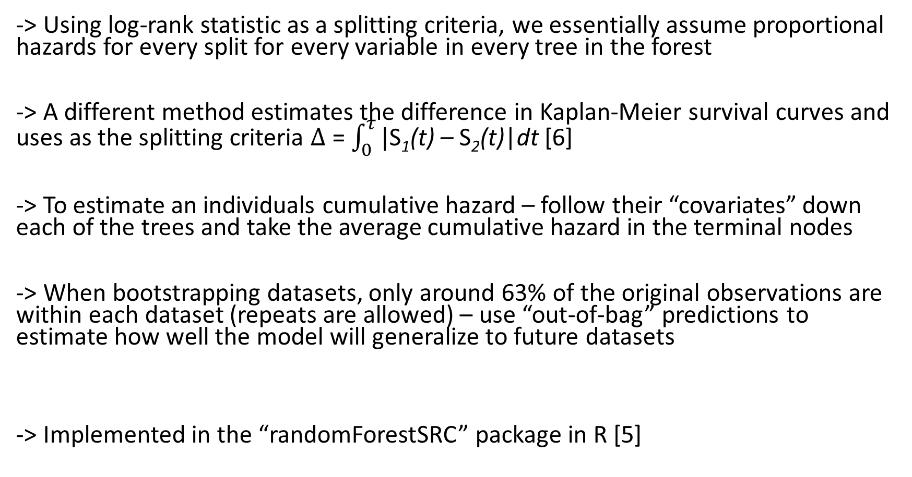
Random Survival Forests
-> Using log-rank statistic as a splitting criteria, we essentially assume proportional hazards for every split for every variable in every tree in the forest
-> A different method estimates the difference in Kaplan-Meier survival curves and uses as the splitting criteria $∆$ = $\int_{0}^{τ}{|}$S₁(t) – S₂(t)|dt [6]
-> To estimate an individuals cumulative hazard – follow their “covariates” down each of the trees and take the average cumulative hazard in the terminal nodes
-> When bootstrapping datasets, only around 63% of the original observations are within each dataset (repeats are allowed) – use “out-of-bag” predictions to estimate how well the model will generalize to future datasets
-> Implemented in the “randomForestSRC” package in R [5]

Slide 14
Rotterdam Breast Cancer Dataset
-> 2982 breast cancer patients followed up for a 10 year period from surgery to remove the primary tumour – around 50% of individuals had relapsed by end of 10 year follow up
-> Covariates recorded – age at surgery; year of surgery; pre/post-menopause?; size of tumour; number of positive nodes; cancer differentiation grade; progesterone receptors; prognostic value of oestrogen receptors; hormonal therapy?; chemotherapy?; Did the patient relapse? Did the cancer spread to another location?

Slide 15
Timetable
-> Simulation Study: Weeks 5-9: Plan and conduct a simulation study looking at how well each machine learning method performs in a variety of situations
-> 2 simulation studies for both proportional and nonproportional hazards
-> Simulate survival data from the Rotterdam Breast cancer dataset, use Weibull model to simulate proportional hazards data, use flexible parametric approach to simulate data with non-proportional hazards
-> Simulate datasets of different sizes to examine performance of each method
-> Keep track of the time taken for the results to be generated – compare with flexible parametric approach
-> Performance measures – bias; C-Index; compare survival estimates with Kaplan-Meier equivalents
-> Calibration, discrimination

Slide 16
Timetable
-> Analysis: Weeks 10-11: Analyse the Rotterdam breast cancer with the three machine learning methods and compare to flexible parametric estimates
-> Conclusion: Week 12: Which methods work best and when?
– proportional/non-proportional hazards?
– Is performance based on the number of covariates in the sample?
– Is performance based on the size of the dataset?
– Do the machine learning methods outperform flexible parametric models? In what situations?
Writing up alongside.

Slide 17
References
[1] Venables, W. N. & Ripley, B. D. (2002) Modern Applied Statistics with S. Fourth Edition. Springer, New York. ISBN 0-387-95457-0
[2] Kvamme, H., Borgan, O. and Scheel, I. (2019). Time-to-Event Prediction with Neural Networks and Cox Regression. Journal of Machine Learning Research. 20 (1), 1-30.
[3] Shivaswamy, P.K, Chu,W and Jansche,M.(2007). A support vector approach to censored targets. In Seventh IEEE International Conference on Data Mining (ICDM 2007), 655–660.
[4] Fouodo, C. et al. (2018). Support Vector Machines for Survival Analysis with R. The R Journal. 10 (1), 413.
[5] Ishwaran, H. et al. (2008). Random Survival Forests. The Annals of Applied Statistics. 2 (3), 841-860.
[6] Lin, X and Xu, Q. (2010). A new method for the comparison of survival distributions. Pharmaceutical Statistics. 9 (1), 67-76.

