Slide 1






Rockbuster Stealth
Data Analysis Project
By: Liam Anderson

Slide 2
Table of Contents
Overview | Overview of project goals
Sales and Customer Count | Geographically where are customers and revenue coming from
Top Movies and Categories | What is generating the most revenue?
Descriptive Statistics | Overview of customer base
Top Customers | Who are our most profitable customers?

Slide 3
Project Overview
Launching an Online Video Rental Service
Rockbuster Stealth LLC, a global movie rental company, has faced significant competition from streaming services like Netflix and Amazon Prime. In response, the management team plans to leverage its existing movie licenses to launch an online video rental service to remain competitive in the evolving digital entertainment market.
Leveraging Data Analytics to Support Strategic Initiatives
The business intelligence (BI) department at Rockbuster Stealth was tasked with supporting the new service's launch strategy. The analysis aimed to address various departmental queries and present clear, actionable findings to the Rockbuster Stealth Management Board.

Slide 4
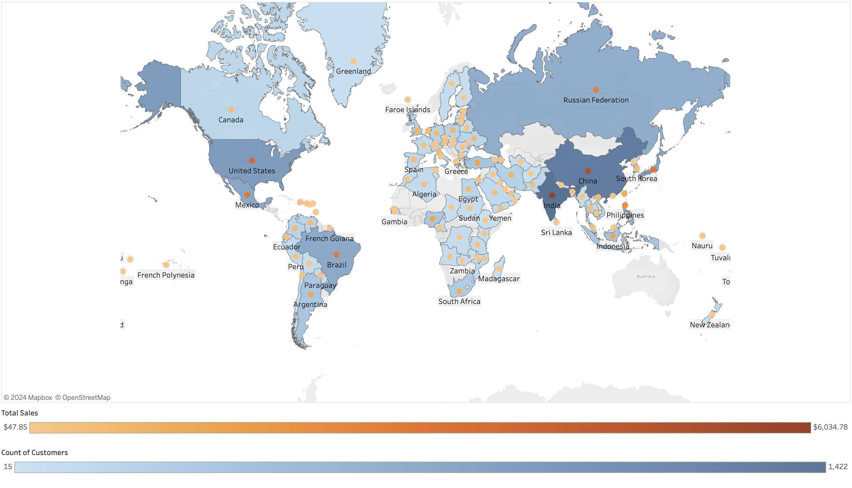
Customers and Sales Geographically
Countries with most customers and Sales:
India, China, United States, Japan, Mexico, Brazil
Cities with the most customers:
London, Saint-Denis, Aurora, Cape Coral

Slide 5
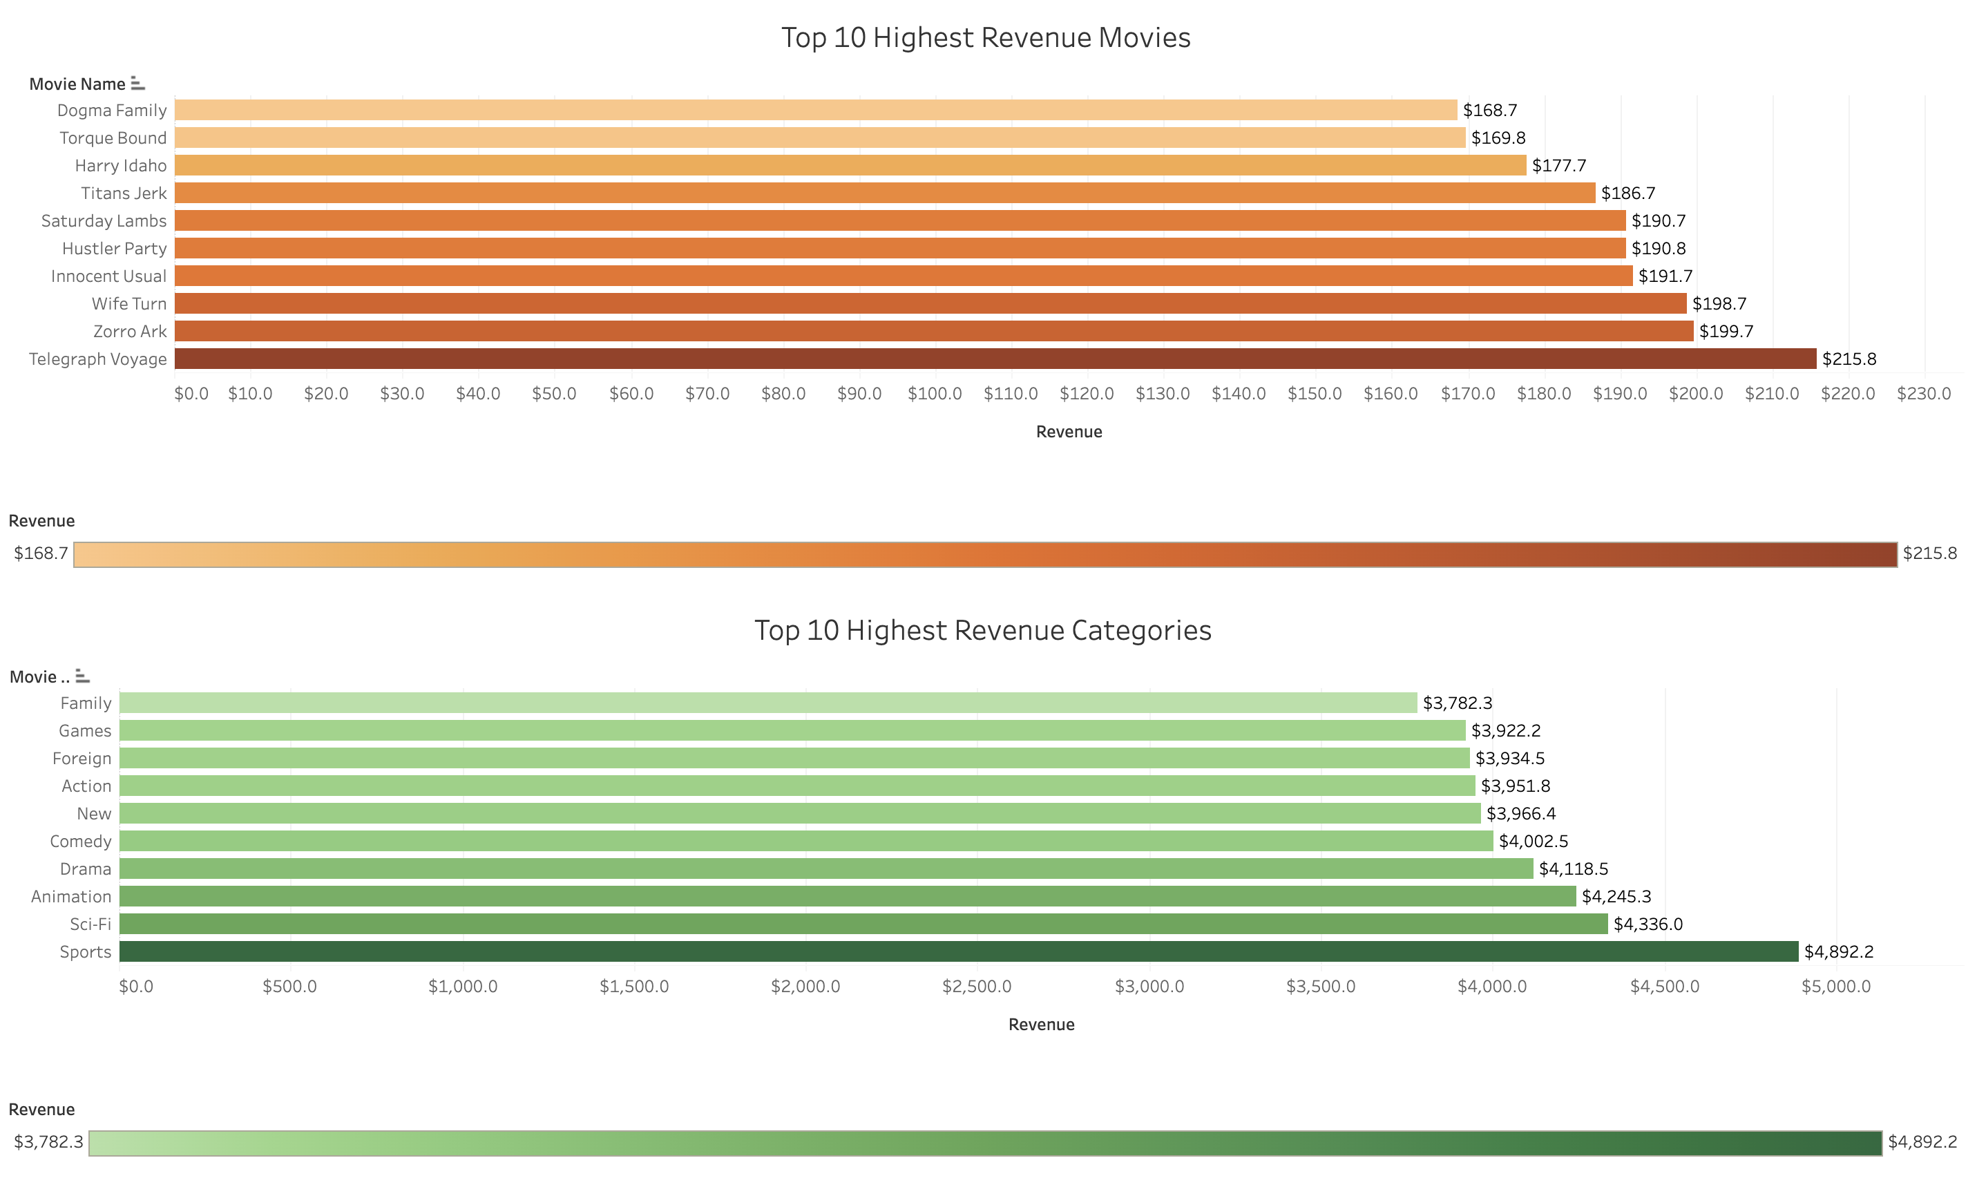
Movie and Category Revenue
Highest Revenue Movies:
Telegraph Voyage, Zorro Ark, Wife Turn, Innocent Usual
Highest Revenue Categories:
Sports, Sci-Fi, Animation, Drama, Comedy

Slide 6
Rockbuster Descriptive Statistics
Avg. days movies are rented
2.98
$4.20
Avg. Rental cost for customer
Maximum days movie was rented
4.99
$19.98
Avg. Replacement Cost of movies
Minimum days movie was rented
0.99
109
Customers in 109 different countries
Count of films
1000
6
Movies in 6 different languages

Slide 7
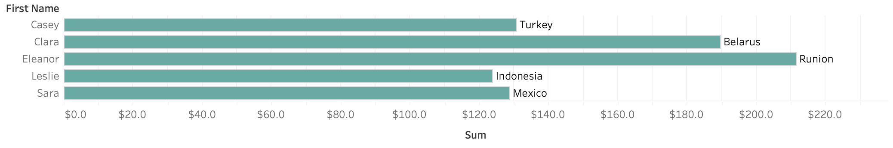
Top Customers
Top 5 customers:
Eleanor Hunt - $211.6
Clara Shaw - $189.6
Casey Mena - $130.7
Sara Perry – $128.7
Leslie Seward - $123.7

Slide 8
Conclusion and Recommendations
To maximize growth and remain competitive Rockbuster should launch an online video service which could help maximize revenue for the company. Some suggestions to launch this are:
Use marketing resources on mainly India, China, United States, Japan, Mexico, Brazil. There are already customers in these countries and by focusing on these countries there could be room for growth
Focusing on the Sports, Sci-Fi, Animation, Drama, and Comedy categories. Ways to focus on these categories could be to acquire new movies and market these categories to consumers.
Creating rewards for loyal and high paying customers can help keep customer loyal to the brand and give incentives for other members to rent more.

Slide 9

Thanks!
Tableau Links:
https://public.tableau.com/shared/N6HMHSNX3?:display_count=n&:origin=viz_share_link
https://public.tableau.com/views/RockbusterMovieandCategoryRevenue/Dashboard2?:language=enUS&:sid=&:display_count=n&:origin=viz_share_link
https://public.tableau.com/views/Book1_17192435452030/Sheet1?:language=en-US&publish=yes&:sid=&:display_count=n&:origin=viz_share_link

