Slide 1
<Profiler>
<Liam Bryant>
Supervisor:
<Dr.><Daniel Craig>

Slide 2
Context & Objectives
The main idea of the Profiler is to create an application that recognizes known individuals from a database and displays information like name, age and occupation. Once the information id collected there is the question of, “what can I do with this data”.
Use a USB camera hooked up to an Arduino Uno device to create a security camera
Allow the application to record the date, time and location that the person was seen.
Give administrative privileges to certain individuals to make changes to the database. This is done for security.

Slide 3
Technologies & System Architecture
Explain the technologies you are using and why you selected them.
The main language I will be using for this project is python. Python has various libraries for facial recognition and can connect to MySQL to access user details
MySQL is also used to contain the following information, name, age, occupation, admin status and image path.

Slide 4
Development & Deployment
The objectives completed so far are.
GitHub repository is up and running and project code is being committed.
User menu is running which means the user has the options to view the camera, add users or log off.
MySQL database is setup with the required tables setup

Slide 5
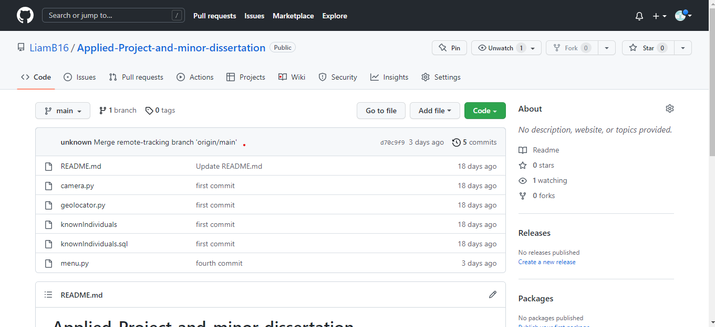
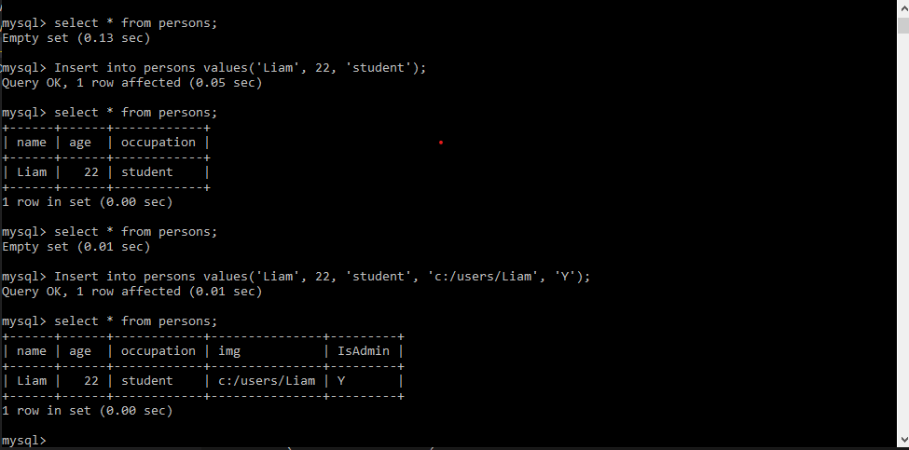
Development & Deployment

Slide 6
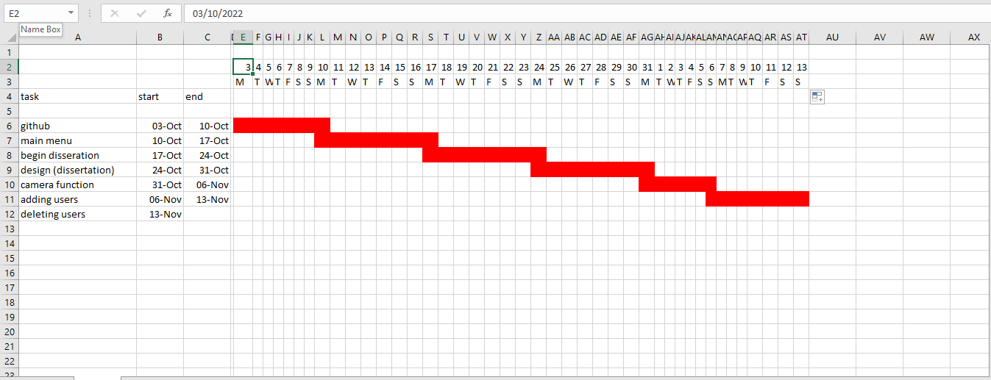
Work Plan

