Slide 1
Honours Project Presentation
Liam De Buffalo – S2213159

Slide 2
Project Introduction
Social Media and Smartphones are part of life for most
Concerns about young people developing an overdependence on such devices
Potential solutions have been introduced
  Mobile apps
  Psychological methods
Gap of apps that use both
Notes:
2022 - 85% of adults in the United States own a smartphone
SA & SMA – subset of behavioural addiction
Factors behind SA & SMA – being brought up with the internet + not much of a need for face-to-face comms, stress of life – form of escapism
Potential treatments – CBT – improvements in mental health, sleep quality, sm usage
Mobile apps – usage restriction and usage tracking, 3rd in downloads shows “need” for it – ease of access

Slide 3
Project Purpose
Create a mobile app that integrates psychological intervention methods and usage tracking
Evaluate if the app lowers the overall usage of a user

Slide 4
Demonstration of Artefact

Slide 5
Evaluation

Slide 6
Evaluation Method
Was there a decrease in usage?
Was the app a factor?
Mixed Method approach
Participants given the app for 3 weeks, then a survey
Notes:
Mixed method approach – quantitative – app usage data from participants
qualitative – survey data from participants

Slide 7
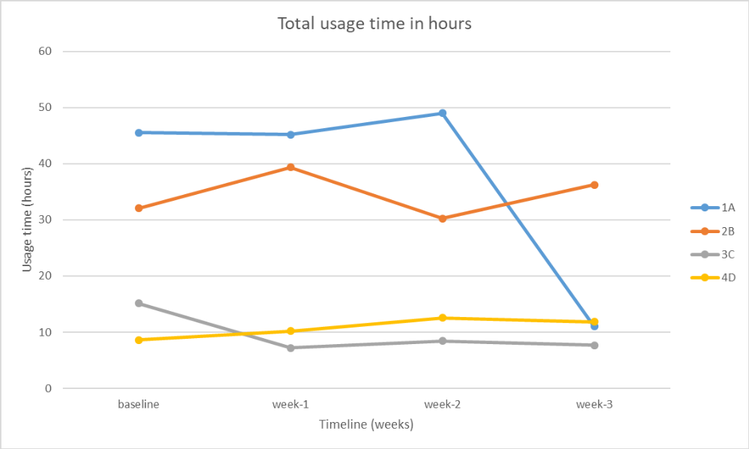
Evaluation Findings

Slide 8
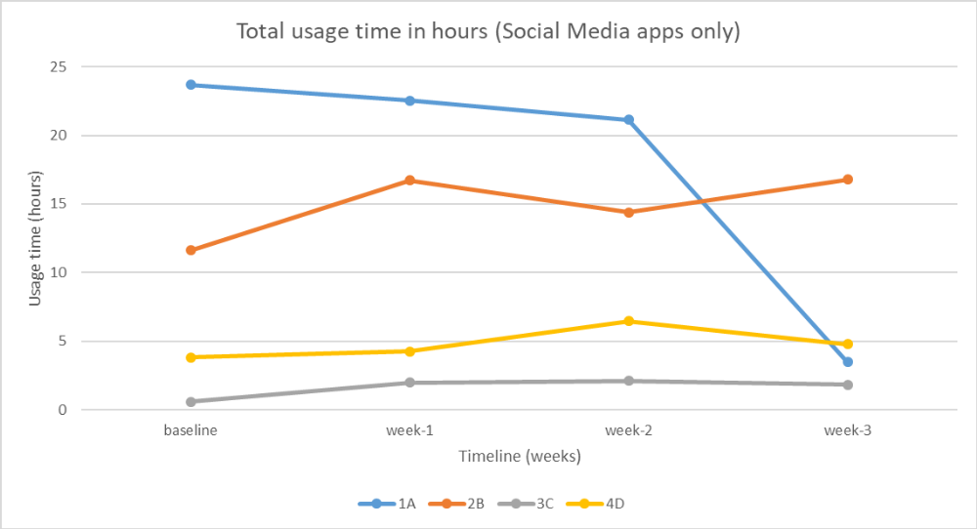
Evaluation Findings
Notes:
Smartphones can be used for productivity, hence the other graph

Slide 9
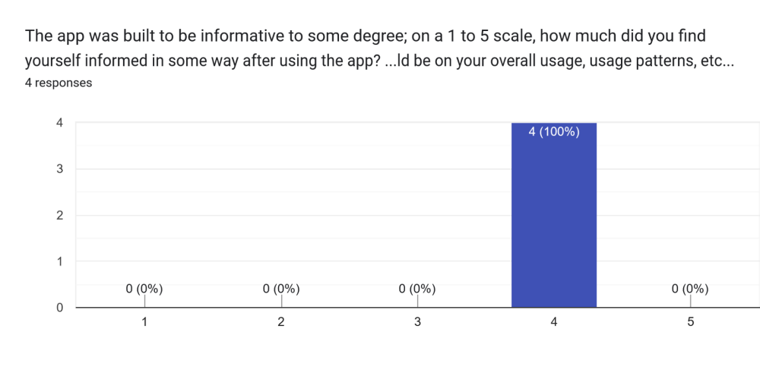
Evaluation Findings

Slide 10
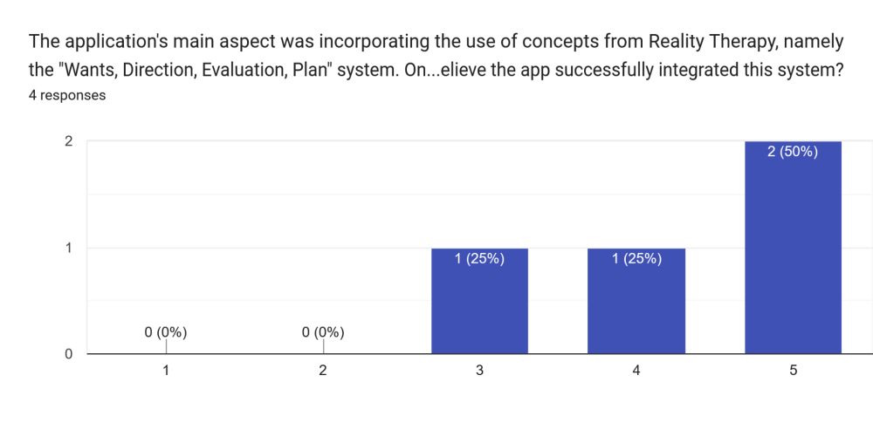
Evaluation Findings

Slide 11
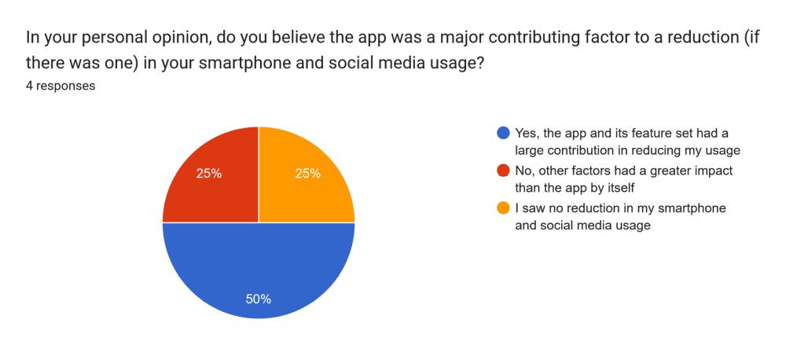
Evaluation Findings

Slide 12
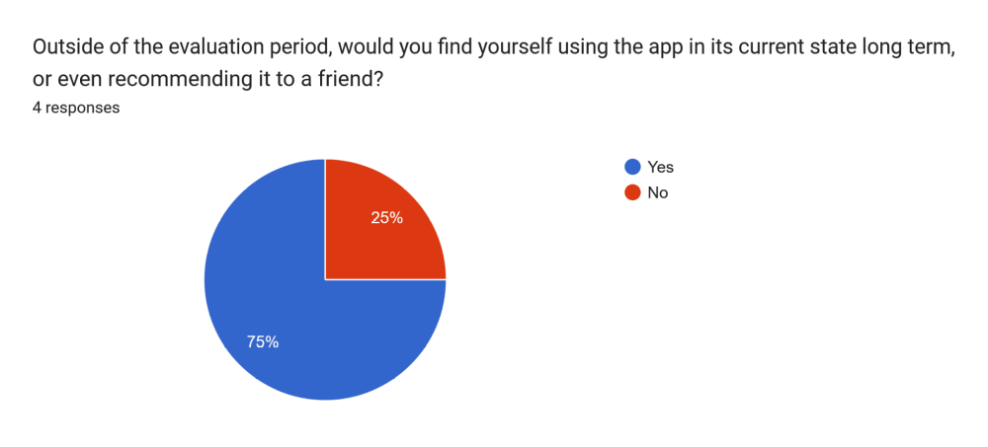
Evaluation Findings

Slide 13
Conclusion
Somewhat successful
  Some decreases in usage from some participants
  Survey responses attribute the app to the usage decrease
Therefore meets aim and hypothesis to an extent

