Slide 1
2018 Semester#1 Analog Circuits Design AFL axel.flament@YNCREA.fr

Slide 2
Outline
What we will study during this course
How you will be evaluated

Slide 3
What we will study
Basics in electronics
1 bipolar transistor amplifier
Multi-stage amplifier
Frequency response of amplifiers
CAD Tool
Power stages
6 skill-blocks
Objective : To make you able to design alone a simple circuit

Slide 4
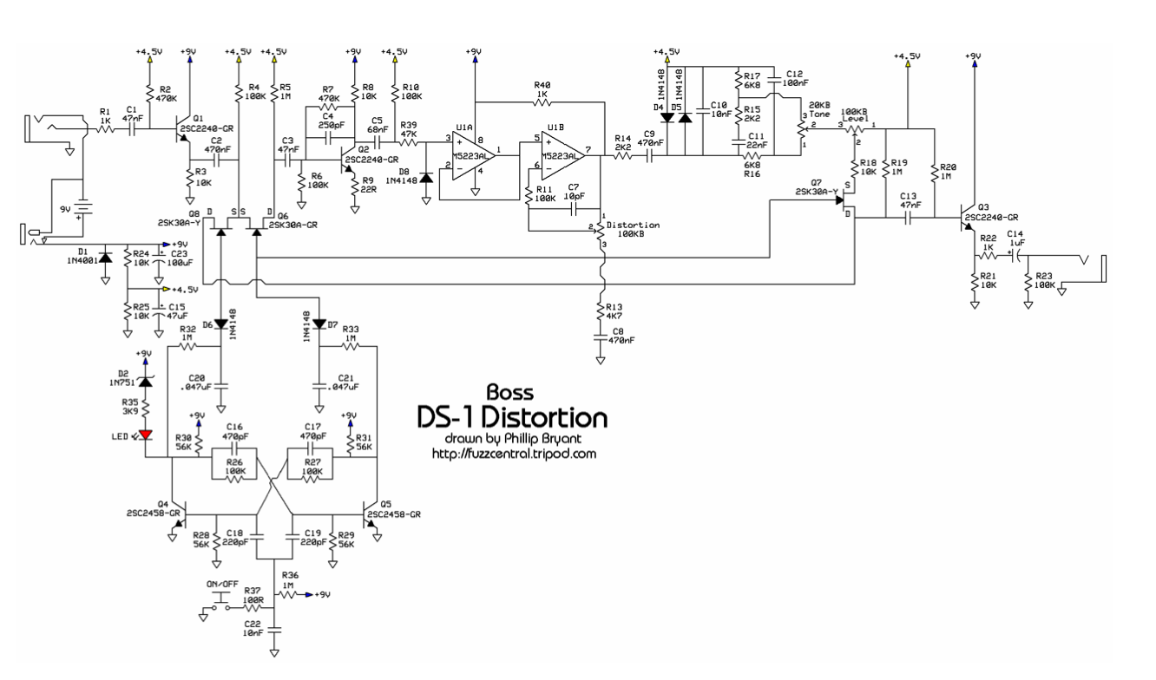
For instance…

Slide 5
Outline
What we will study during this course
How you will be evaluated

Slide 6
How you will be evaluated
2 items
Exam
Homework
Every week you will have some exercises to do for the next lesson
Your grade will decrease every time you do not hand your work back in
Involvement during the class
(1 sheet to fulfill every week (2 minutes to do it)
Should motivate you as the lessons go on
Appreciate your strengths and weaknesses
Consequently, be more precise for revising)
My objectives :
Teach something useful (!) for electronic engineers
100 % success at the first attempt of the exam

Slide 7
Basic Electronics
Signals
Frequency Spectrum of signals
Analog and Digital Signals
Some useful networks Theorems (Thevenin, Norton, Source absorption, Kirchhoff’s laws, impedance calculation)
Amplifiers (signal amplification, amplifier symbol, voltage gain, power and current gain, saturation, non-linear TF, biasing)
Circuit models for amplifiers
Frequency response of amplifiers (BW, STC Networks)

Slide 8
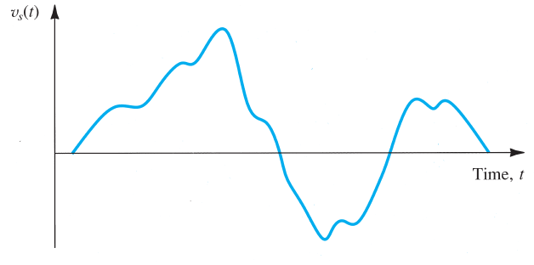
Signals
Signals contain information
To extract information, processing is needed
Convert signal into electric signal (voltage or current) : transducers (out of the scope)
Signal source can be of 2 types (equivalent) : Thevenin is preferred when R_{s} is low
Information = change of magnitude as a function of time

Slide 9
Signals
Source impedance?
Not desirable
Inevitable !
Limits the ability of the source to deliver its « full strength signal » to a load
For the Thevenin equivalent model, find the voltage appearing across a load R_{L}. What is the condition R_{s} must satisfy for this voltage to be the closest to V_{s}? Same exercise for the Norton equivalent model.

Slide 10
Signals
A signal source has an open-circuit voltage of 10mV and a short-circuit-current of 10µA. What is the source resistance?
A signal source represented by a Thevenin equivalent has V_{s} = 10mV and R_{s} = 1kΩ. A R_{L} load resistance is connected. Find the voltage appearing across the load for R_{L} = 100kΩ, 10kΩ, 1kΩ, 100 Ω. What is the lowest value of R_{L} for which the output voltage is at least 80% of the source voltage?
A signal source represented by a Norton equivalent has I_{s} = 10µA and R_{s} = 100kΩ. A R_{L} load resistance is connected. Find the current flowing through the load for R_{L} = 1kΩ, 10kΩ, 100kΩ, 1MΩ. What is the highest value of R_{L} for which the output current is at least 80% of the source current?

Slide 11
Basic Electronics
Signals
Frequency Spectrum of signals
Analog and Digital Signals
Some useful networks Theorems (Thevenin, Norton, Source absorption, Kirchhoff’s laws, impedance calculation)
Amplifiers (signal amplification, amplifier symbol, voltage gain, power and current gain, saturation, non-linear TF, biasing)
Circuit models for amplifiers
Frequency response of amplifiers (BW, STC Networks)

Slide 12
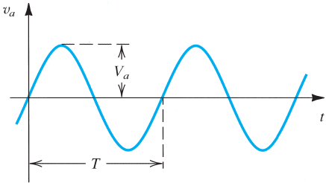
Frequency Spectrum of Signals
Fourier series/Fourier Transform : mathematical tool
Any (voltage or current) signal can be represented by a sum of sine-wave signals at different frequencies and amplitudes
Sine-wave voltage : V = V_{pk} sin(w.t + Φ)
1/T(seconds) = frequency in Hz
w = 2*pi*f = angular frequency in rad/s
V_{pk} = peak Voltage
Φ = phase
V_{rms} = V_{pk} / sqrt(2)

Slide 13
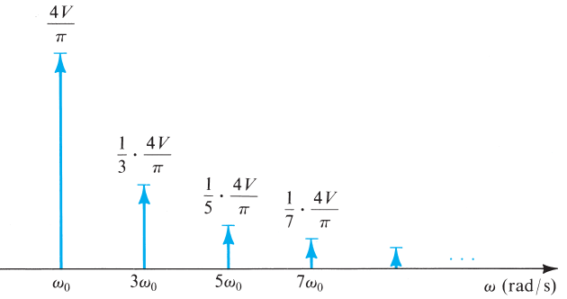
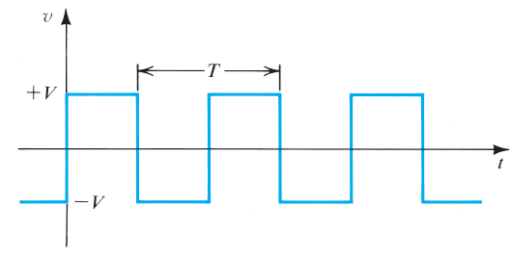
Frequency Spectrum of Signals - Example
Square-wave Fourier series gives :
v(t) = (4V/pi) x (sin w₀.t + 1/3 x sin 3w₀.t + 1/5 x sin 5w₀.t + …)
Where V is the amplitude of the square wave and w₀ = 2*pi/T is called the fundamental frequency
Periodic in time ⬄ Discrete in frequency
Non periodic in time ⬄ Continuous in frequency

Slide 14
Frequency Spectrum of Signals - Exercises
Find the frequencies f and w of a sine-wave signal with a period of 1ms
What is the period T of sine waveforms characterized by frequencies of f=50Hz, f =10⁻³Hz, f=1MHz ?
When the square-wave signal of the previous slide is applied to a resistor R, the total power dissipated may be calculated using the relationship P = 1/T ∫₀^{T} (v²/R)dt or indirectly by summing the contribution of each of the harmonic components (P = P₁+P₂+P₃…) which may be found directly from rms values. Verify that the 2 approaches are equivalent. What fraction of energy of the square wave is contained in its fundamental? In its 5 1st harmonics? The 7 1st? In what number of harmonics is 90% of the energy?

Slide 15
Basic Electronics
Signals
Frequency Spectrum of signals
Analog and Digital Signals
Some useful networks Theorems (Thevenin, Norton, Source absorption, Kirchhoff’s laws, impedance calculation)
Amplifiers (signal amplification, amplifier symbol, voltage gain, power and current gain, saturation, non-linear TF, biasing)
Circuit models for amplifiers
Frequency response of amplifiers (BW, STC Networks)

Slide 16

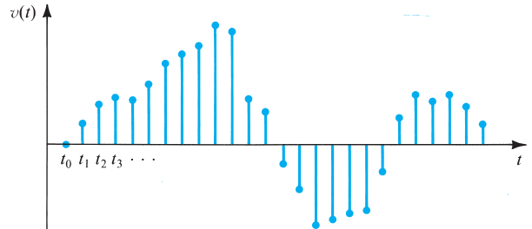
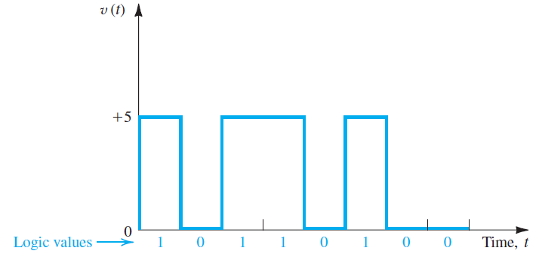
Analog and digital Signals
Analog signal (can take any value)
Circuits that processes theses signals are called analog circuits
Sampling is a process that measures the signal at equal intervals of time (but it is still an analog signal)
If the amplitude is represented by a finite number of digits, a quantization step has been processed : digital signal
The simplest : binary number system :
each digit is 1 or 0, can be 2 voltage levels

Slide 17
Analog and Digital Signals
If we use N binary digits (bits) to represent each sample of the analog signal, then the digitized sample value is :
D = b₀2⁰ + b₁2¹ + b₂2² + … + b_{N-1}2^{N-1}
b₀ is the LSB, b_{N-1} is the MSB
If N increases, the digital signal approximates closer the analog signal : the quantization error decreases, but digital circuits are more complicated
Ex : Consider a 4-bit digital signal b₃b₂b₁b₀ used to represent an analog signal that varies from 0 to 15V
Give D corresponding to V=0V, 1V, 2V, 15V
What change in V causes a change from 0 to 1 in b₀? In b₁? b₂? b₃?
If V = 5.2V, what do you expect D to be? What is the resulting error (in %) ?

Slide 18
Basic Electronics
Signals
Frequency Spectrum of signals
Analog and Digital Signals
Some useful networks Theorems (Thevenin, Norton, Source absorption, Kirchhoff’s laws, impedance calculation)
Amplifiers (signal amplification, amplifier symbol, voltage gain, power and current gain, saturation, non-linear TF, biasing)
Circuit models for amplifiers
Frequency response of amplifiers (BW, STC Networks)

Slide 19
Some useful network theorems
Kirchhoff's first law The principle of conservation of electric charge implies that:
At any node (junction) in an electrical circuit, the sum of currents flowing into that node is equal to the sum of currents flowing out of that node
Kirchhoff's second law The principle of conservation of energy implies that
The sum of the electrical voltage around any closed network is zero
Impedance calculation : to calculate an equivalent impedance, put a voltage source V_{test} (with a I_{test} current flowing through this source) between the 2 terminals of interest, and calculate V_{test}/I_{test}

Slide 20
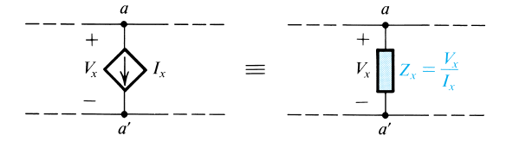
Some Useful Networks Theorems
Superposition theorem
The response in any branch of a linear circuit having more than one independent source equals the algebraic sum of the responses caused by each independent source acting alone, where all the other independent sources are replaced by their internal impedances
Source absorption theorem
If a voltage-controlled current source is controlled by the voltage at its terminals, we can replace the source by the impedance Z = V / I
Voltage and current dividers are supposed to be known

Slide 21
Some useful Network Theorems
Thevenin’s theorem :
Used to represent a part of a network by a voltage source V_{th} and a series impedance Z_{th}
To determine the equivalent impedance Z_{th}, reduce all independent sources to 0 (short-circuit voltage sources, open-circuit current sources), and calculate the impedance
To determine V_{th}, open-circuit the 2 terminals and measure (or calculate) the voltage that appears between these 2 terminals
Norton’s theorem (dual of Thevenin theorem)
Used to represent a part of a network by a current source I_{n} and a shunt impedance Z_{n}
To determine the equivalent impedance Z_{n}, reduce all independent sources to 0 (short-circuit voltage sources, open-circuit current sources), and calculate the impedance
To determine I_{n}, short-circuit the 2 terminals and measure (or calculate) the current that flows through these 2 terminals

Slide 22
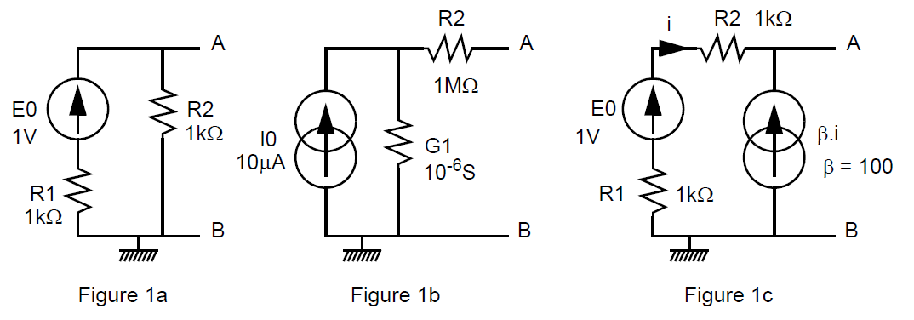
Some useful Network Theorems
Find the Thevenin and Norton equivalent between A and B :

Slide 23
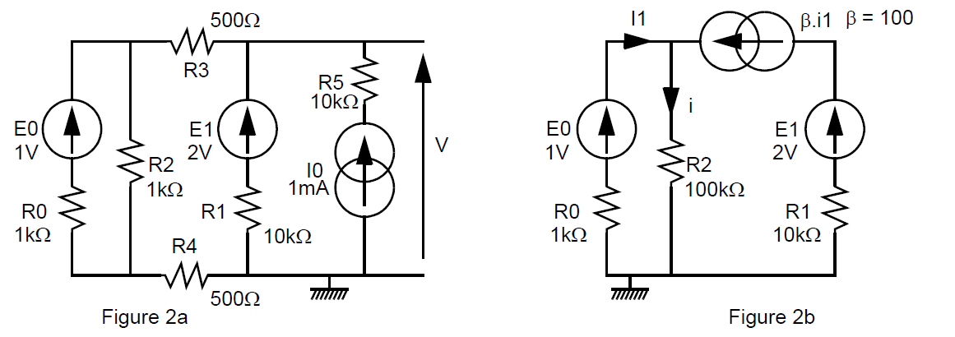
Some useful Network Theorems
Use the superposition theorem to find V (figure 2a) and i (Figure 2b)

Slide 24
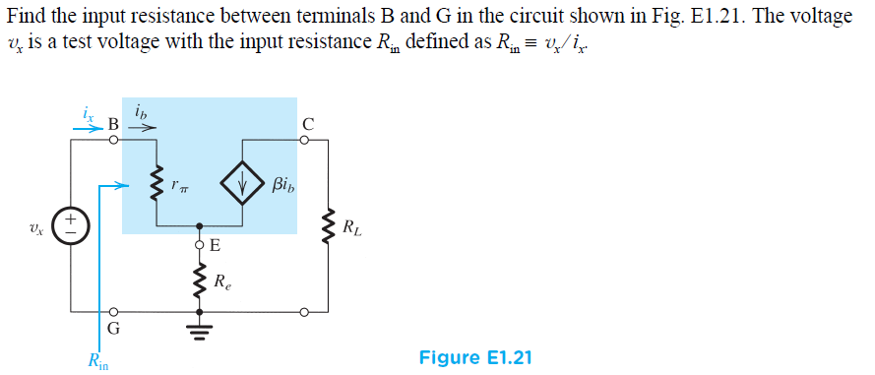
Some useful Network Theorems
Find the equivalent impedance looking into « E ».

Slide 25
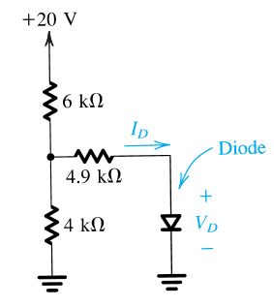
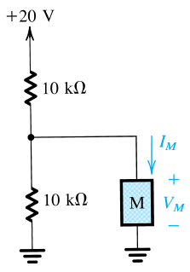
Exercices
This diode has a voltage drop of 0.7V. Use Thevenin’s theorem to find I_{D}.
The 2-terminal device M has a current I_{M}=1mA independent of the voltage V_{M} across it. Use Norton’s theorem to simplify the circuit and hence calculate V_{M}.

Slide 26
Basic Electronics
Signals
Frequency Spectrum of signals
Analog and Digital Signals
Some useful networks Theorems (Thevenin, Norton, Source absorption, Kirchhoff’s laws, impedance calculation)
Amplifiers (signal amplification, amplifier symbol, voltage gain, power and current gain, saturation, non-linear TF, biasing)
Circuit models for amplifiers
Frequency response of amplifiers (BW, STC Networks)

Slide 27

Amplifiers
Weak signals from transducer, amplification needed
Linear amplification (« no change in the shape »)
Any change is called distortion
V_{out} (t) = A. V_{in} (t), A is the amplifier Gain, linear
V_{out} (t) = A. V_{in} (t) + B. V_{in} ²(t) + C. V_{in} ³(t) , nonlinear distortion
If the purpose of the amplifier is to make the signal magnitude larger, it is usually known as voltage amplifier (ex : pre-amp in the audio system)
If the purpose of the amplifier is to deliver power to the load (ex : drive a loudspeaker), it is usually known as power amplifier (ex : output power amp in the audio system) : modest voltage gain but high current gain

Slide 28
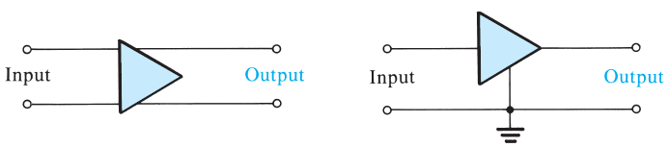
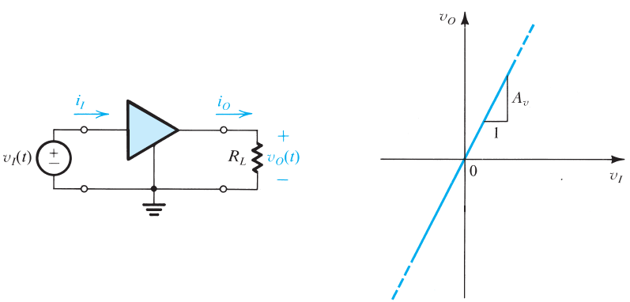
Amplifiers – Gain definitions
Voltage Gain = V_{o}/V_{i}
Power Gain = load Power/input power = V_{o}I_{o} /V_{i}I_{i}
Current Gain = I_{o}/I_{i}
Power Gain = Voltage Gain x Current Gain
Voltage Gain in dB = 20log₁₀(abs(V_{o}/V_{i}))
Current Gain in dB = 20log₁₀(abs(I_{o}/I_{i}))
Power Gain in dB = 10log₁₀(V_{o}I_{o} /V_{i}I_{i})

Slide 29
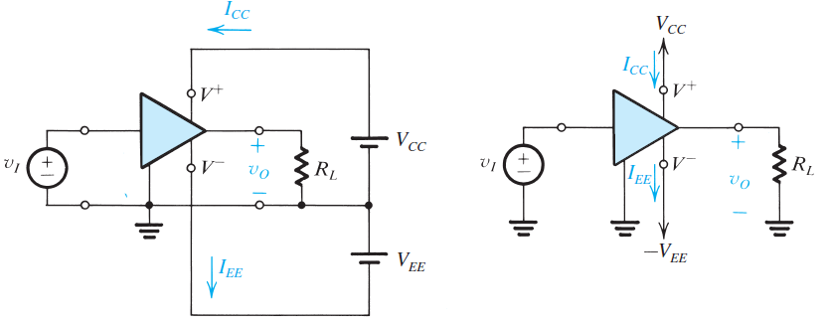
Amplifiers
Power delivered to the load > Input power
The additional power comes from the supplies :
P_{dc} = V_{CC}I_{CC}+|V_{EE}|I_{EE}
P_{dc} + P_{in} = P_{out} + P_{dissipated}
Efficiency : η = (P_{out} /P_{dc}) x 100

Slide 30
Amplifiers - Example
An amplifier operates from ± 10V power supplies. It is fed with a sinusoidal voltage having 1V_{pk} and delivers a sinusoidal voltage output of 9V_{pk} to a 1kΩ load. The amp draws a current of 9.5mA from each of its 2 power supplies. The input current of the amp is found to be sinusoidal with 0,1mA_{pk}. Find the voltage gain, the current gain, the power gain, the power drawn from the dc supplies, the power dissipated in the amp, and the amp efficiency.
An amp has a voltage gain of 100V/V and a current gain of 1000A/A. Express the gains in dB and find the power gain.
An amp operating from a single 15V supply provides a 12V_{pk to pk} sine-wave signal to a 1kΩ load, and draws negligible current from the signal source. The dc current drawn from the supply is 8mA. What is the power dissipated in the amp and what is the amplifier efficiency?

Slide 31
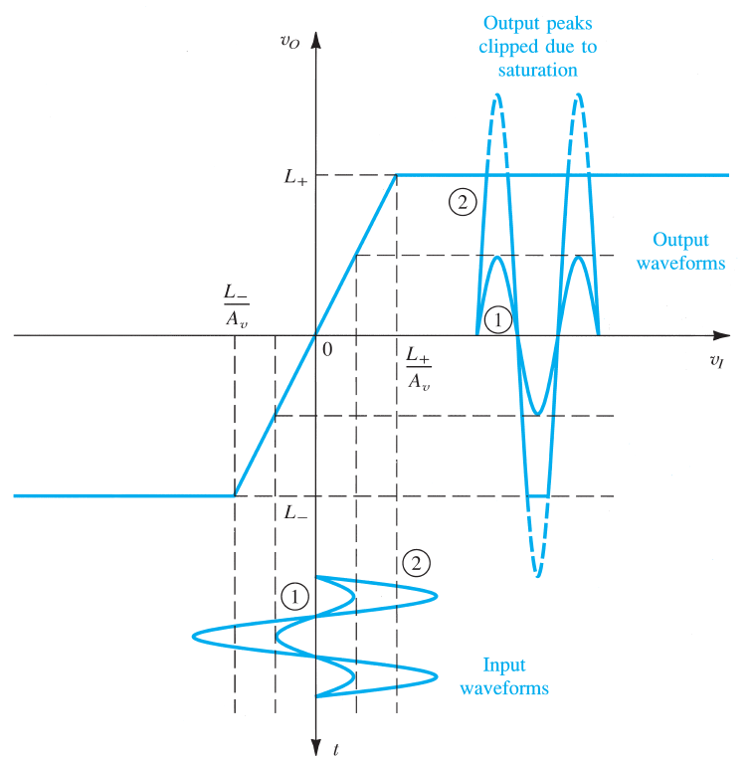
Amplifiers – saturation
Amplifier transfer characteristic is linear over a limited range of input and output voltages
Limited by the supply voltages
And the amp design…
Input is limited :
Boundaries = [L⁻/A , L⁺/A]

Slide 32
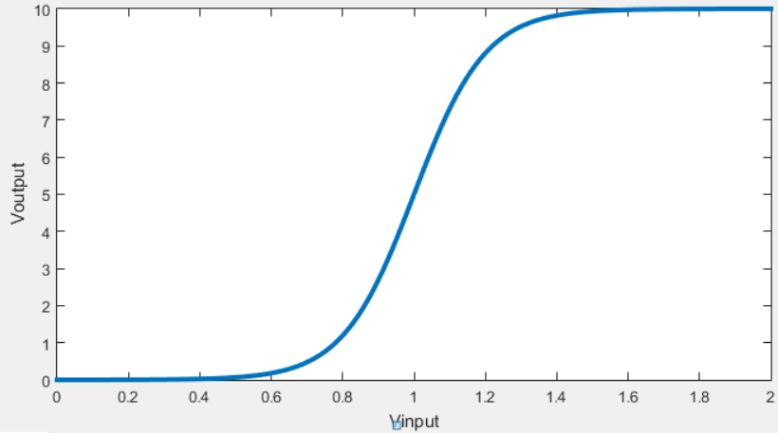
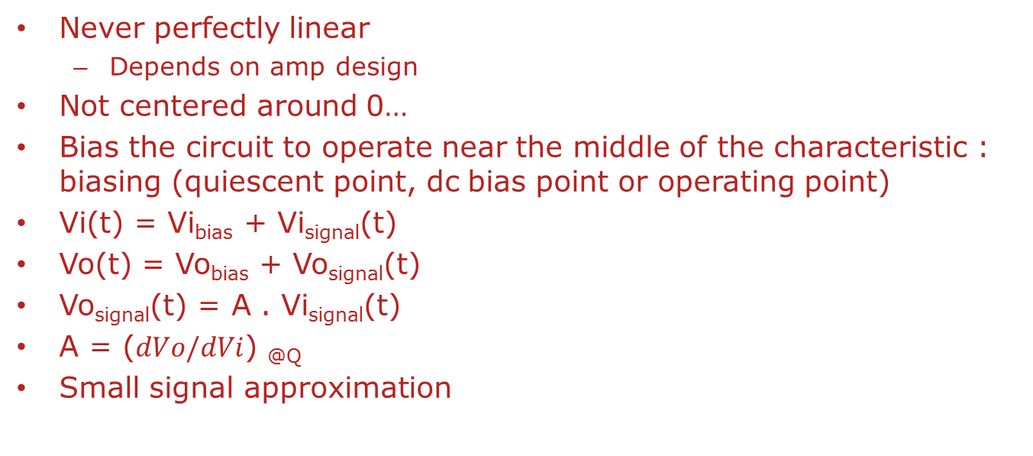
Amplifier – Nonlinearity and BIASING
Never perfectly linear
Depends on amp design
Not centered around 0…
Bias the circuit to operate near the middle of the characteristic : biasing (quiescent point, dc bias point or operating point)
Vi(t) = Vi_{bias} + Vi_{signal}(t)
Vo(t) = Vo_{bias} + Vo_{signal}(t)
Vo_{signal}(t) = A . Vi_{signal}(t)
A = ($dVo/dVi$) _{@Q}
Small signal approximation
Q
Slope = A

Slide 33
Amplifiers-ex
A transistor amp has the transfer characteristic :
V_{o} = 10-10⁻¹¹exp(40.Vi), which applies for V_{i}>0V and V_{o}>0,3V
Find the limits L⁻ and L⁺ and the corresponding values of V_{i}
Find the value of the DC bias voltage that results in V_{o} = 5V and the voltage gain at the corresponding operating point.
For this operating point, calculate the change in output voltage if Vi_{signal}(t) = 1mV, 5mV, 10mV for the small signal gain found before
Re-calculate with the real transfer function the change in output voltages for the same changes in Vi_{signal}(t) at the same operating point

Slide 34
Basic Electronics
Signals
Frequency Spectrum of signals
Analog and Digital Signals
Some useful networks Theorems (Thevenin, Norton, Source absorption, Kirchhoff’s laws, impedance calculation)
Amplifiers (signal amplification, amplifier symbol, voltage gain, power and current gain, saturation, non-linear TF, biasing)
Circuit models for amplifiers
Frequency response of amplifiers (BW, STC Networks)

Slide 35
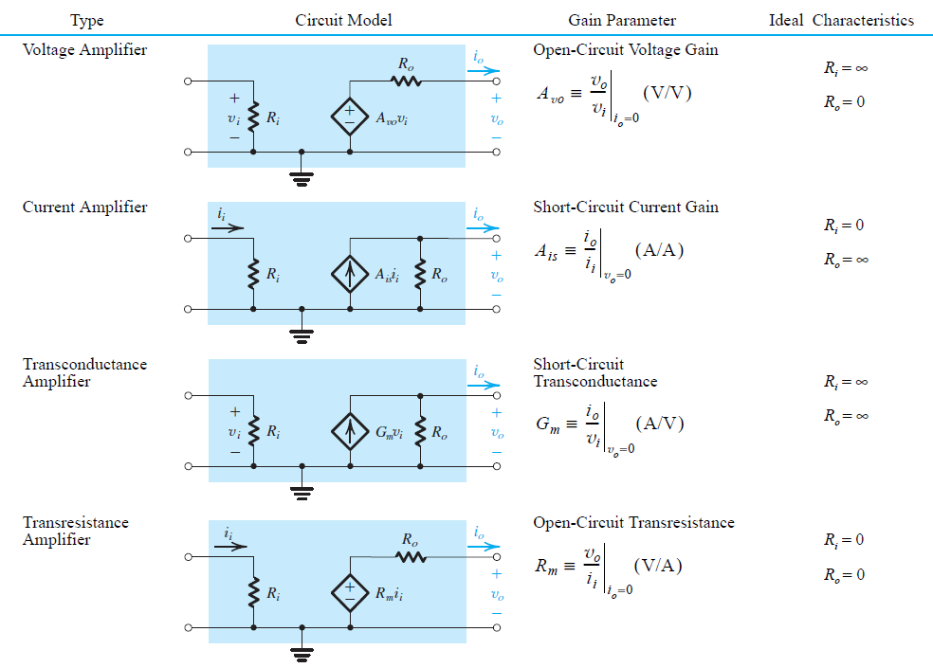
Circuit models for Amplifiers
Amps use 1 to … ?20 transistors
To use the amp as a building block in a system, we must use a model of its behavior
4 types of amps depending on the input and output signals
Unilateral models !

Slide 36
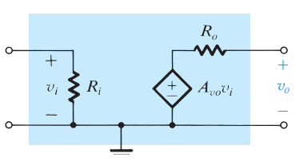
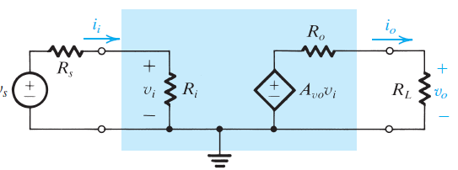
Circuit models for Amplifiers
Ex : voltage amplifier
This model consists in
Voltage-controlled voltage source
Input res (amp draws current from the source)
Output res (load draws current from the amp)
When a load and a source is connected :
V_{o} = A_{v0}.V_{i}. R_{L} / (R_{L} +R₀)
A_{v0} is the open-circuit voltage gain
V_{i} = R_{i} / (R_{i}+R_{S}) V_{S}
The overall voltage gain is the product
of the 2 previous « gains »

Slide 37
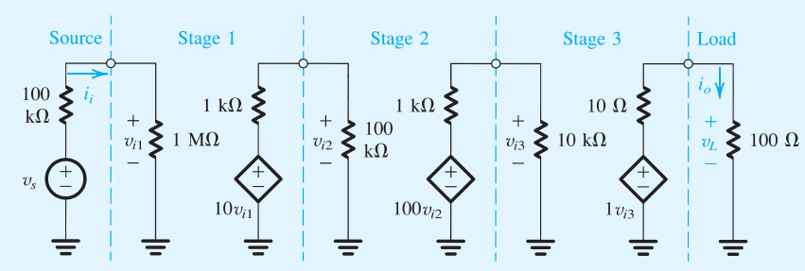
Circuit models for amplifiers - EX
To meet the specifications, amps are generally made of a cascade of 2 or more stages, each being designed for a specific purpose (ex : input stage with a high R_{i}, output stage with a low R_{o})
For this example, find the overall voltage gain, the current gain, the power gain

Slide 38
Circuit models for amplifiers - Ex
What would the overall voltage gain of this amp be without stage 3?
If V_{s}=1mV, find V_{i1}, V_{i2}, V_{i3}, V_{L}
Model this amp (without source and load) with the voltage amp model. What are the values of R_{i}, Av and R_{o}?
If R_{L} = 10Ω, what is the overall voltage gain?
Same question for R_{L} = 1kΩ ?

Slide 39
Circuit Models for Amplifiers - Ex
A transducer characterized by a voltage of 1Vrms and a resistance of 1MΩ is available to drive a 10Ω load. If connected directly, what voltage and power levels result at the load? If a unity-gain buffer amplifier with a 1MΩ input resistance and a 10Ω output resistance is interposed between source and load, what do the output voltage and power levels become? Find the voltage gain and the power gain, both in dB.
The output voltage of a voltage amp has been found to decrease by 20% when a 1kΩ load resistor is connected. What is the value of the output resistance of the amp?
An amp with a voltage gain of +40dB, an input res of 10kΩ and an output res of 1kΩ is used to drive a 1kΩ load. What is the value of the open-circuit voltage gain? Find the value of power gain in dB.

Slide 40
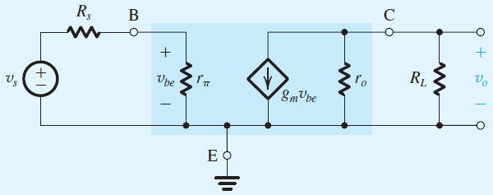
Circuit Models for Amplifiers - Ex
The Bipolar Junction Transistor is a 3-terminal device that when powered-up by a dc source can be modeled by this linear circuit
The 3 terminals are Base, Collector and Emitter
This model is a transconductance amplifier represented by an input res (r_{π}), a short-circuit conductance (gm) and an output res (r_{o})
With the emitter used as a common terminal for input and output, we have a common-emitter amp. Find the voltage gain (NA : R_{S}=5kΩ, r_{π} = 2,5kΩ, g_{m} = 40mA/V, r_{o}=100kΩ, R_{L}=5kΩ).
What would this gain be without r_{o}?

Slide 41
Basic Electronics
Signals
Frequency Spectrum of signals
Analog and Digital Signals
Some useful networks Theorems (Thevenin, Norton, Source absorption, Kirchhoff’s laws, impedance calculation)
Amplifiers (signal amplification, amplifier symbol, voltage gain, power and current gain, saturation, non-linear TF, biasing)
Circuit models for amplifiers
Frequency response of amplifiers (BW, STC Networks)

Slide 42
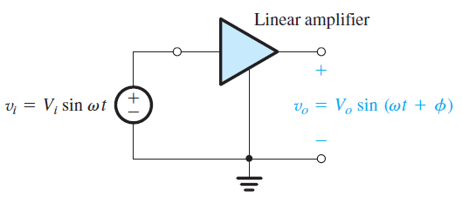
Frequency response of amplifiers
The input signal can always be expressed as a sum of sinusoidal signals. What is the response of an amp to input sinusoids at different frequencies ? Such an analysis is called frequency response !
Whenever an input sinusoid is fed to a linear amp, the output is a sinusoid at the same frequency !
Measure Amplitude and phase
Modify the frequency of the input signal

Slide 43
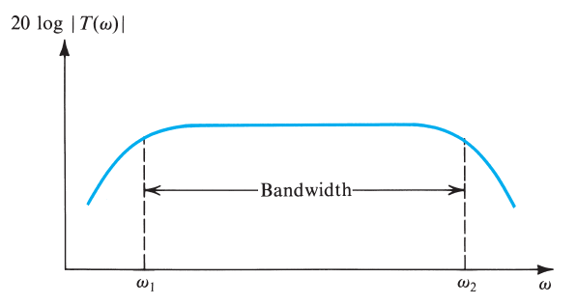
Frequency response of amplifiers
Gain almost constant between w₁ and w₂
The band of frequencies over which the gain is almost constant (to within 3dB usually) is called the amplifier bandwidth
Must include the reactive components (inductors and capacitors)
Z_{L} = jLw = Ls
Z_{C} = -j/(Cw) = 1/(jCw) = 1/sC
The TF of the amp becomes
a complex function, whose magnitude
is the gain of the amp, and whose
angle is the phase

Slide 44
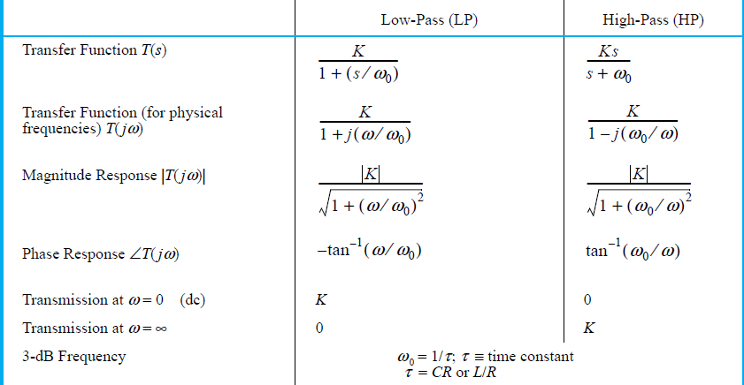
STC (Single-Time constant) Networks
STC network is composed of (or can be reduced to) one reactive element and one resistance
τ= L/R or τ= RC

Slide 45
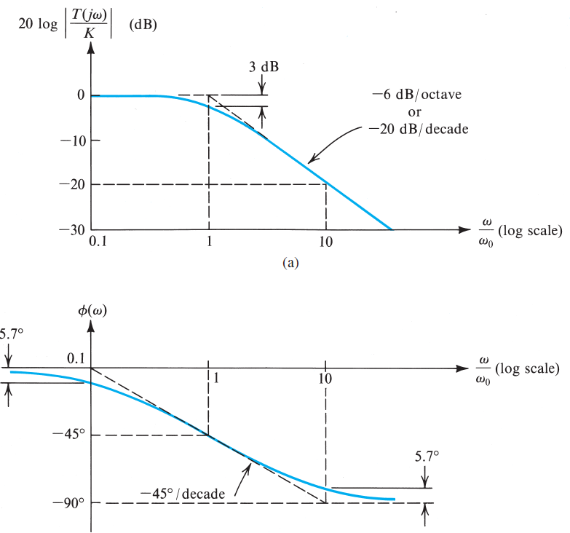
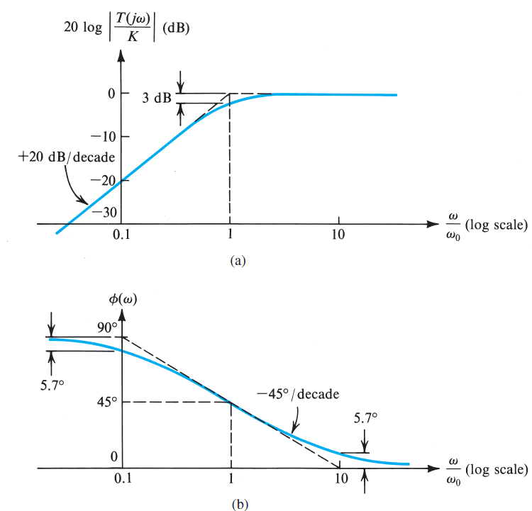
STC Networks
LP
HP

Slide 46
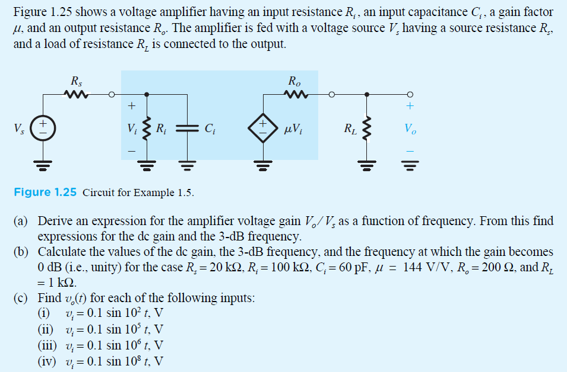
STC - exercices

Slide 47
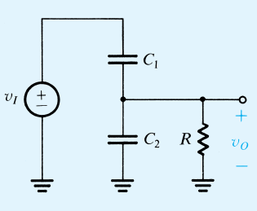
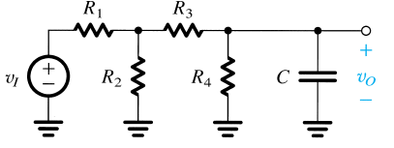
STC Exercices
Evaluate the time-constant
Reduce the independent excitation to 0
If there is one reactive component, calculate the equivalent res between the 2 terminals of the reactive component, T = R_{eq}C or L/R_{eq}
If there is one resistance, calculate the equivalent reactive element between the 2 terminals of the res, T=RC_{eq} or L_{eq}/R
Ex : find T

Slide 48
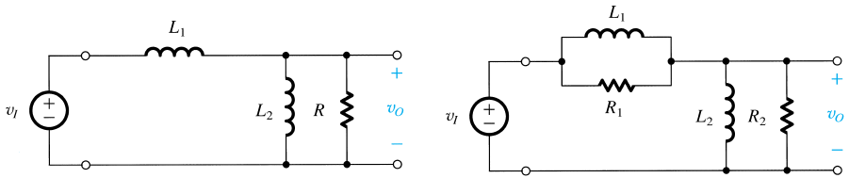
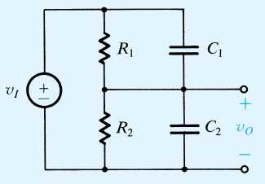
STC Exercices
Find T

Slide 49
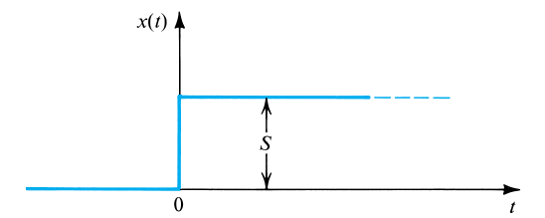
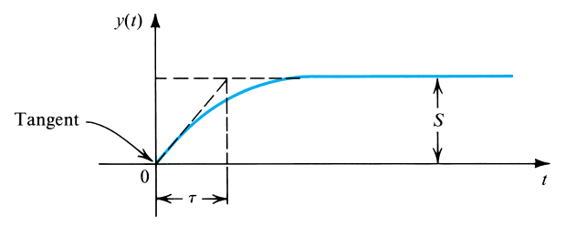
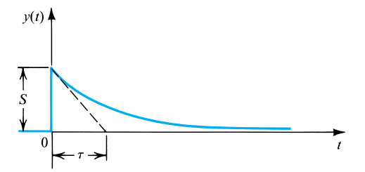

STC Networks – step response
Y∞ = 1
Y₀₊ = 0
H(s)=K/(1+Ts)
Y∞ = 0
Y₀₊ = 1
H(s) = Ks/(s+1/T)

Slide 50
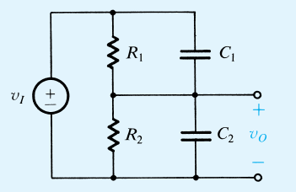
STC Networks-step response
For an input V_{i} that is a 10V-step, find the condition under which the output V₀ is a perfect step.

Slide 51
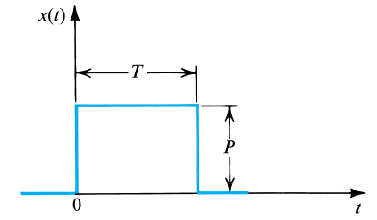
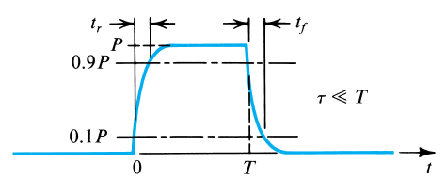
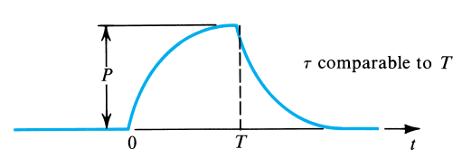
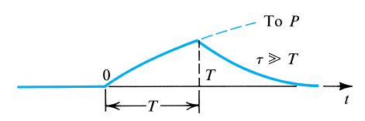
STC Networks – Pulse response of LP
t_{r}=t_{f} = 2,2T = 0,35/f₀
Slows down the system
Almost linear: 1-exp(-t/T) = 1-(1-t/T) = t/T
Acts like an integrator !

Slide 52
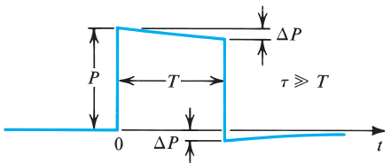
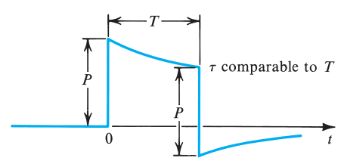
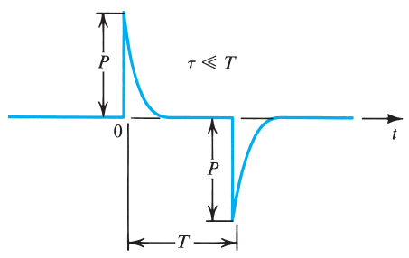
STC Networks – Pulse response of HP
Used to couple a pulse from a part of the circuit to another
Almost linear decay
« sag »=100. ΔP/P with ΔP=PT/τ
undershoot
Acts like a derivator !

Slide 53
STC Networks – pulse response
Find the rise and fall times of a 1µs-pulse after it has passed through a LP RC circuit with a corner frequency of 10MHz
The output of an amp stage is connected to the input of another stage via a capacitance C. If the first stage has an output resistance of 10kΩ, and the second stage has an input resistance of 40kΩ, find the minimum value of C such that a 10µs pulse exhibits less than 1% sag.
A HP STC circuit with a time constant of 100µs is excited by a pulse of 1V height and 100µs width. Calculate the value of the undershoot in the output waveform

Slide 54
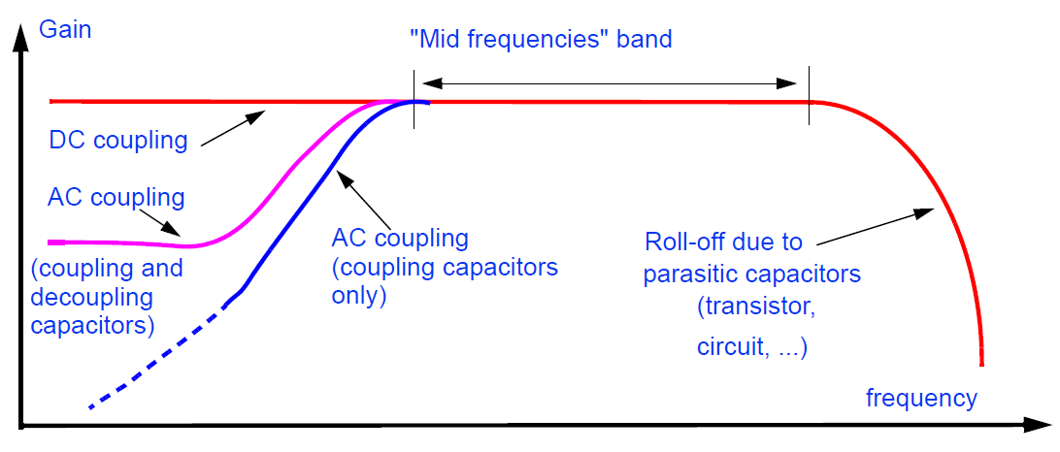
Classification of amplifiers

Slide 55
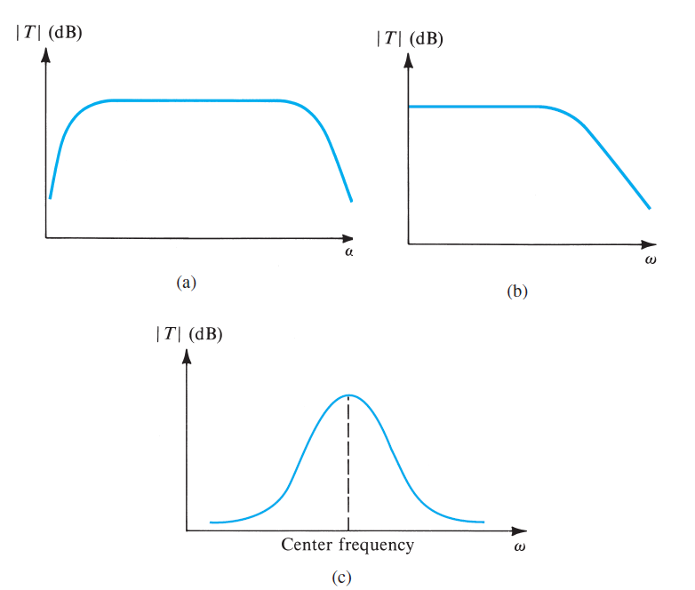
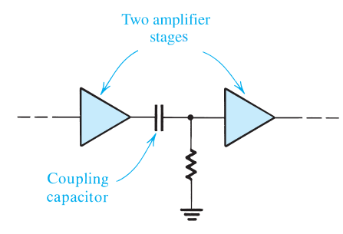
Classification of amplifiers
(a) capacitively coupled amp or ac amp
(b) directly coupled amp or dc amp
(c) tuned or bandpass amp

Slide 56
Classification of amp - exercises
Consider a voltage amp having a frequency response of LP STC with a dc gain of 60dB and 3dB frequency of 1000Hz. Find the gain in dB at f=10Hz,10kHz, 100kHz and 1MHz.
Consider this transconductance amp with R_{i}=5kΩ, R₀=50kΩ, and G_{m} = 10mA/V. Il the amp load consists of a res R in parallel with a cap C, the voltage TF V₀/V_{i} is of STC type. What is the lowest value that R_{L} can have while a dc gain of 40dB is obtained? With this value of R_{L}, find the highest value that C can have while a 3dB BW of at least 100kHz is obtained.

