Slide 1
2018 Semester#1 Analog Circuits Design AFL axel.flament@YNCREA.fr

Slide 2
Bipolar Junction Transistor
Physical structure and modes of operation
Operation of the NPN in Active Mode
PNP Transistor, circuit symbols
Graphical representation of Transistor characteristics
Analysis of transistor circuits at DC
The BJT as an amplifier
Small-signal equivalent model

Slide 3
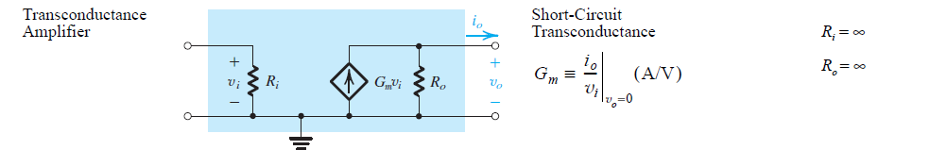
BJT - Intro
3 terminal device : Base, Emitter, Collector
Principle : Use of a voltage between 2 terminals to control the current flowing in the 3rd terminal → « controlled source »
+ : High-frequency operation, reliability, high-current driving capabilities
- : « not-so-high » input impedance, power consuming
Bipolar : holes and electrons are involved in current

Slide 4
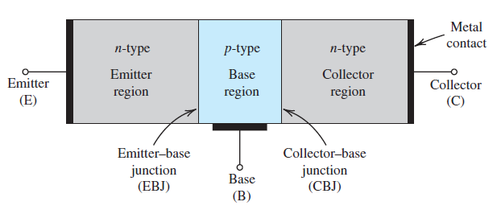
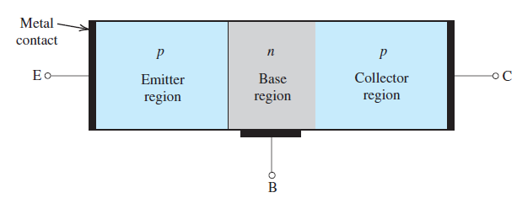
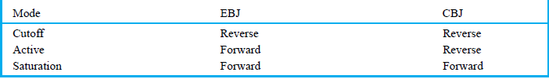
Physical structure and modes of operation
For amplifier design, we only use Active mode !

Slide 5
Bipolar Junction Transistor
Physical structure and modes of operation
Operation of the NPN in Active Mode
PNP Transistor, circuit symbols
Graphical representation of Transistor characteristics
Analysis of transistor circuits at DC
The BJT as an amplifier
Small-signal equivalent model

Slide 6
Operation of the NPN in Active Mode
Assume the active mode : EBJ is forward-biased, CBJ is reversed-biased :
V_{BE} ~ 0,6V
V_{BC}<< 0,6V
I_{C} = I_{S} exp(V_{BE} / V_{t})
I_{C} is the collector current
I_{S} is the saturation current (depending on geometry of the base, doping, etc…)
V_{BE} is the base-emitter voltage
V_{t} is the thermal voltage = kT/q = 25mV @ 25°C, with k = Boltzmann constant, T the room temperature and q the electron charge
I_{C} = β I_{B}, β is the common-emitter current gain (depending on geometry, doping…), from 50 to 1000 ! Usually : 100-200
I_{E} = I_{C} + I_{B} (or I_{C} = αI_{E} )
V_{bc}
I_{B}
NPN
I_{C}
B
C
V_{be}
E
I_{E}

Slide 7
Operation of the NPN in Active Mode-exercices
Consider a NPN transistor with V_{BE} = 0,7V @ I_{C} = 1mA. Find V_{BE} for I_{C}=0,1mA and I_{C}=10mA.
Transistors of a certain type are specified to have β values in the range of 50 to 150. Find their α values
Measurement of an NPN BJT in a particular circuit shows the base current to be 14,46µA, the emitter current to be 1,46mA and V_{BE} = 0,7V. Calculate α, β and I_{S}
Calculate β of 2 transistors for which α = 0,98 and 0,99. For collector currents of 10mA, find the base current of each transistor

Slide 8
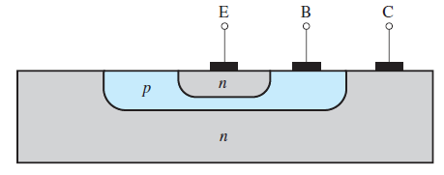
Operation of the NPN in Active Mode
Cross section of an NPN BJT
Not symmetrical, emitter and collector can not be interchanged !

Slide 9
Bipolar Junction Transistor
Physical structure and modes of operation
Operation of the NPN in Active Mode
PNP Transistor, circuit symbols
Graphical representation of Transistor characteristics
Analysis of transistor circuits at DC
The BJT as an amplifier
Small-signal equivalent model

Slide 10
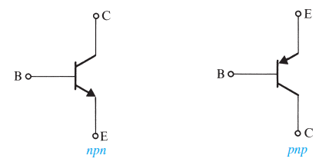
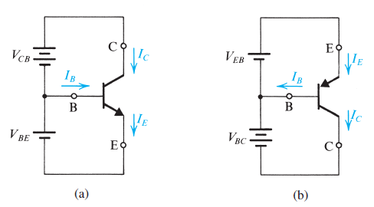
NPN & PNP Transistors – representation and conventions
V_{BE} _{NPN} = 0,7V
V_{BE} _{PNP} = -0,7V
Currents are positive

Slide 11
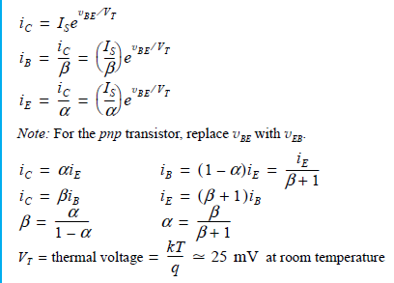
Summary of BJT I-V relationships in active mode

Slide 12
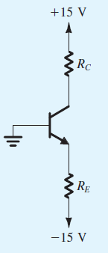
Ex
This transistor has β=100 and V_{BE} = 0,7V@I_{C}=1mA
Design the circuit (i.e. find the values of resistances) so that a current of 2mA flows through the collector and a voltage of +5V appears at the collector. Verify that the transistor is in the active mode.
Repeat the exercise with power supplies of ±1,5V, V_{BE} = 0,8V@I_{C}=1mA. (I_{C} = 2mA and V_{C} = 0,5V)

Slide 13
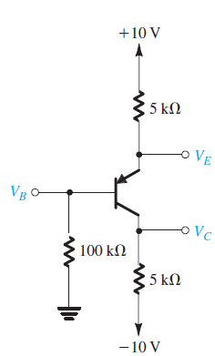
EX
In this circuit, measurement indicates V_{B} to be 1V and V_{E} to be 1,7V. What are β and α for this transistor? What is the voltage V_{C}?

Slide 14
Bipolar Junction Transistor
Physical structure and modes of operation
Operation of the NPN in Active Mode
PNP Transistor, circuit symbols
Graphical representation of Transistor characteristics
Analysis of transistor circuits at DC
The BJT as an amplifier
Small-signal equivalent model

Slide 15
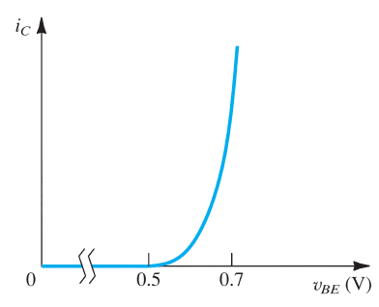
Graphical representation of Transistor characteristics
I_{C} = I_{S} exp(V_{BE}/V_{t})
Identical to the diode i-v relationship
At constant current, V_{BE} changes by -2mV/°C

Slide 16
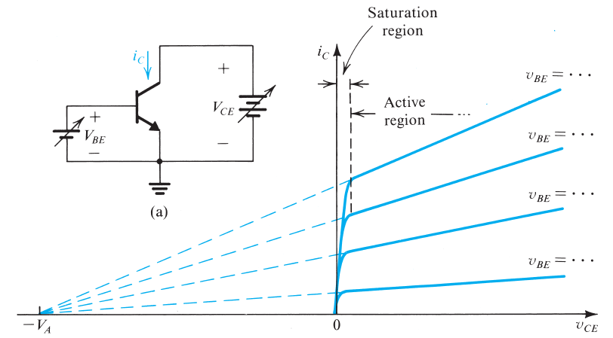
Dependence of Ic on Vc – Early Effect
V_{A} is the Early voltage (typ. 50 to 100V)
I_{C} = [I_{S} exp(V_{BE}/V_{t})](1+V_{CE}/V_{A})
r₀ = (δI_{C}/ δV_{CE})⁻¹@V_{BE}=cst
Solving it into the I_{C} equation,
we find that
r₀=(V_{A}+V_{CE})/I_{C} = V_{A}/I_{C’ (current} _{without Early Effect)}
(r₀ is the output resistance looking
into the collector)

Slide 17
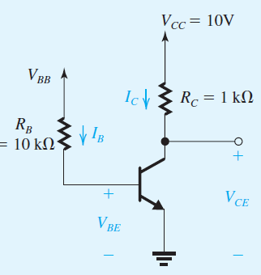
Graphical representation of Transistor characteristics Exercises
Find the output resistance of a BJT for which V_{A}=100V at I_{C} = 0,1mA, 1mA, 10mA
Consider a BJT for which V_{A}=100V. At V_{CE}=1V, V_{BE} is adjusted to yield a collector current of 1mA. V_{CE} is then raised to 11V (and the same V_{BE} is maintained). What is the new value of I_{C}?
For this circuit, find the voltage V_{BB} that results in the transistor to operate (a) in the active mode with V_{C}=5V, (b) at the edge of saturation (V_{CE}=0,3V), (c) in deep saturation (V_{CE}=0,2V, β_{forced} =10). For simplicity, assume that V_{BE} = 0,7V=cst and β=50

Slide 18
Bipolar Junction Transistor
Physical structure and modes of operation
Operation of the NPN in Active Mode
PNP Transistor, circuit symbols
Graphical representation of Transistor characteristics
Analysis of transistor circuits at DC
The BJT as an amplifier
Small-signal equivalent model

Slide 19
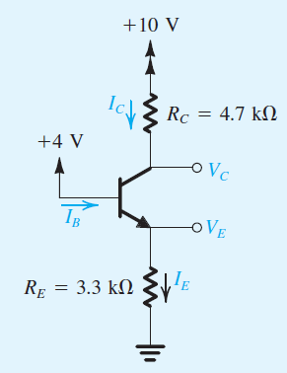
Analysis of transistor circuits at DC
In which mode is the transistor operating?
Suppose it is the active mode…calculate each currents and voltages…and verify !
β = 100
Assume V_{BE} =cst= 0,7V
Re-do the exercise with V_{B}=6V
Re-re-do the exercise with V_{B}=0V

Slide 20
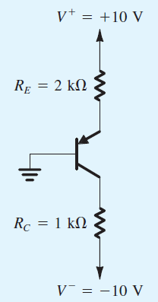
Analysis of transistor circuits at DC
Determine the voltage at all nodes and the current through all branches
Is the mode of operation sensitive to β ?
Find the largest value of R_{C} ensuring the transistor to be in the active mode
Redesign the circuit to have I_{C}=1mA and V_{CB}=-4V

Slide 21
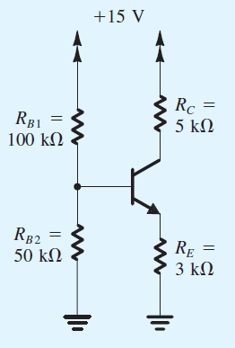
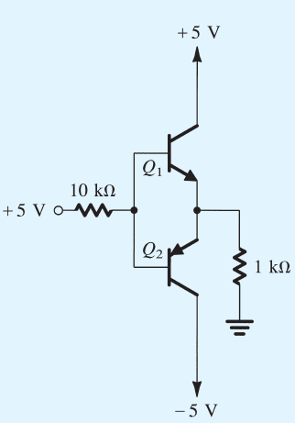
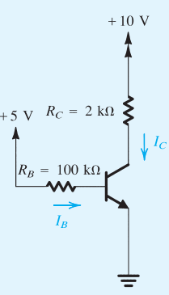
Analysis of transistor circuits at DC
Find all the voltage and currents (β=100)
Is the mode of operation sensitive to β ?
Find all the voltage and currents (β=100)
Find all the voltage and currents (β=100)

Slide 22
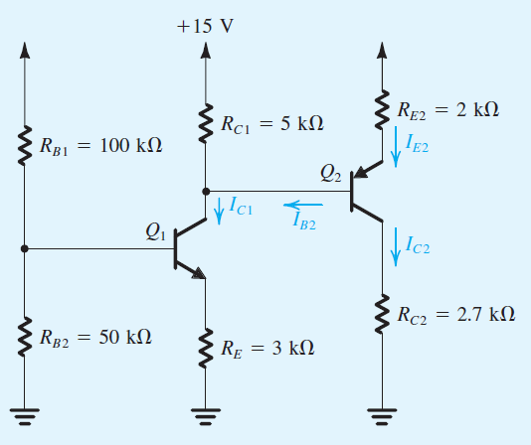
Analysis of transistor circuits at DC
Find all the voltages and currents (β=100)
What is the total current drawn from the supply? Hence find the power dissipated in the circuit

Slide 23
Bipolar Junction Transistor
Physical structure and modes of operation
Operation of the NPN in Active Mode
PNP Transistor, circuit symbols
Graphical representation of Transistor characteristics
Analysis of transistor circuits at DC
The BJT as an amplifier
Small-signal equivalent model

Slide 24
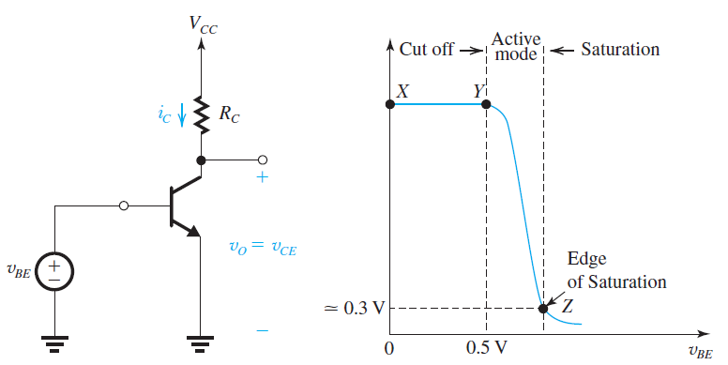
The BJT as an amplifier
When operating in active mode, the BJT behaves as a voltage-controlled current source
V_{BE} controls I_{C}
But non-linear relationship… (discussed later)
We have seen that VCCS is the base of transconductance amp, but we are interested in voltage amp
How to transform a current to a
voltage?
V_{o} =V_{CC} – R_{C}I_{C}
V_{o} =V_{CC} – R_{C}I_{S} exp(V_{BE}/V_{T})
_{Non linear !!}

Slide 25
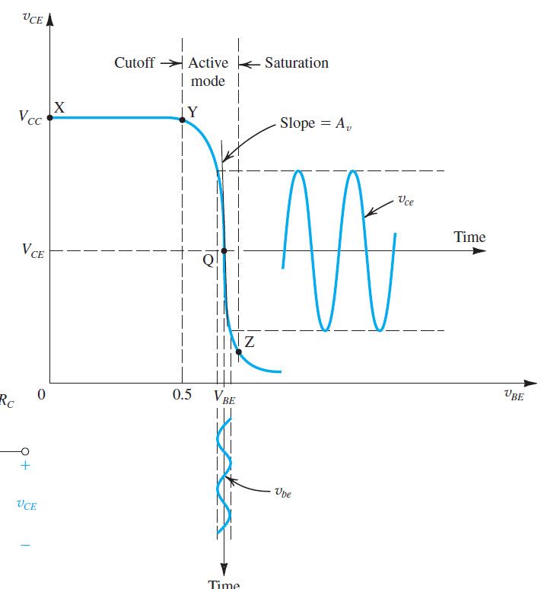
The BJT as an Amplifier
Biased somewhere in the sloppy region
Input signal is V_{BEbias} + V_{BE} _{signal}
V_{BEsignal} must be small !
This is how linear amplification is achieved with a strongly non linear device

Slide 26
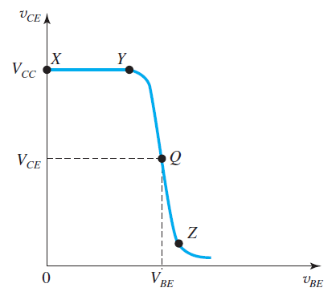

Small-signal voltage gain
If V_{BEsignal} is small, the output voltage will be nearly proportional to V_{BEsignal} with a gain that is the slope of the characteristic
$A_{V}$ =( $\frac{∂V_{CE}}{∂V_{BE}}$ ) @ V_{BEbias}
Or V_{CE} =V_{CC} – R_{C}I_{S} exp(V_{BE}/V_{T})
A_{V} = – R_{C}I_{S} exp(V_{BE}/V_{T}) / V_{T} = – R_{C} (I_{C} / V_{T} )

Slide 27
Small-signal voltage gain ex
Consider a amp circuit using a BJT (I_{S}=10⁻¹⁵A, R_{C} = 6,8kΩ, V_{CC}=10V)
Determine the value of V_{BE} required to operate at V_{CE}=3,2V. What is the value of I_{C} ?
Find the voltage gain at that point.
Find the positive increment of V_{BE} that will lead to saturation (V_{CEsat} = 0,3V)
Find the negative increment of V_{BE} that will lead to within 1% cut-off (V_{CE} = 0,99V_{CC})
Find the value of RC that will give a gain of -320
What is the largest negative swing at the output? What is the corresponding input signal largest swing (suppose amp is linear)?

Slide 28
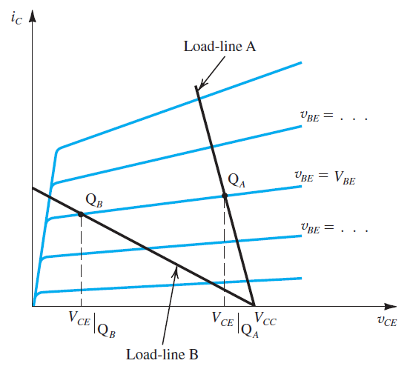
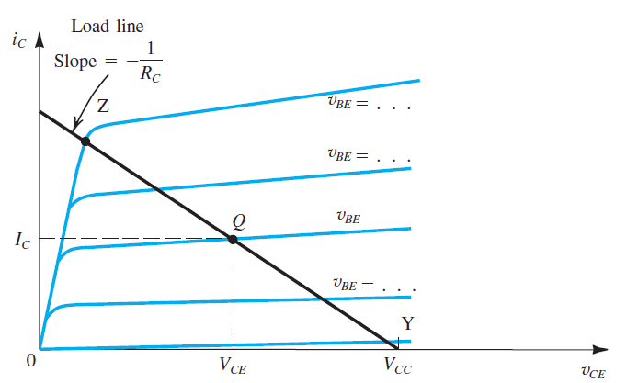
Load-line and biasing
Trade-off : gain vs swing

Slide 29
Bipolar Junction Transistor
Physical structure and modes of operation
Operation of the NPN in Active Mode
PNP Transistor, circuit symbols
Graphical representation of Transistor characteristics
Analysis of transistor circuits at DC
The BJT as an amplifier
Small-signal equivalent model

Slide 30
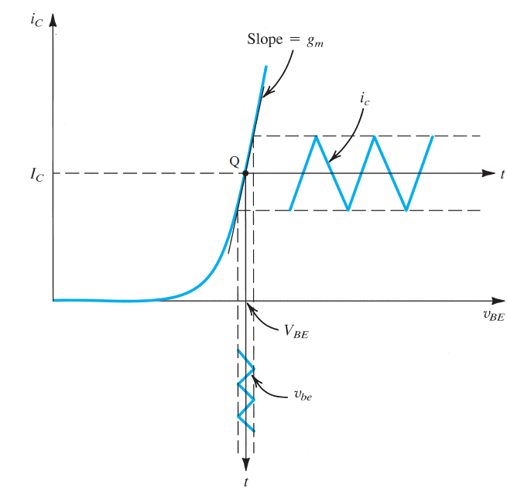
Small-signal operations and models
I_{C} = I_{S} exp(V_{BE}/V_{T})
V_{BE} = V_{BEbias} + V_{BEsignal}
I_{C} = I_{S} exp((V_{BEbias} + V_{BEsignal} )/V_{T})
= I_{S} exp(V_{BEbias}/V_{T}) exp(V_{BEsignal}/V_{T})
If V_{BEsignal} is small (<<V_{T}) :
exp(V_{BEsignal}/V_{T}) ~ 1+ V_{BEsignal}/V_{T}
So I_{C} = I_{S} exp(V_{BEbias}/V_{T}) (1+V_{BEsignal}/V_{T}) = I_{Cbias} (1+V_{BEsignal}/V_{T})
I_{Csignal} = I_{Cbias} . V_{BEsignal}/V_{T} = g_{m} V_{BEsignal} with g_{m} = I_{Cbias}/V_{T}
I_{Bsignal} = I_{Csignal} / β = g_{m} V_{BEsignal} / β
The impedance seen from the base is V_{BEsignal} / I_{bsignal} = β/g_{m} = r_{π}

Slide 31
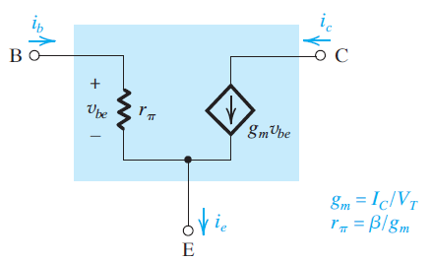
Small-signal operations and models
Hybrid П-model (valid for both NPN and PNP with no change in polarities!)

Slide 32
Small-signal operations and models
Methodology
Eliminate signal sources
Calculate DC voltages and currents
Calculate the small-signal parameters (g_{m} and r_{π} )
Replace the BJT with its small-signal model
Eliminate DC sources
Analyze the circuit (input/output impedance, gain)

Slide 33
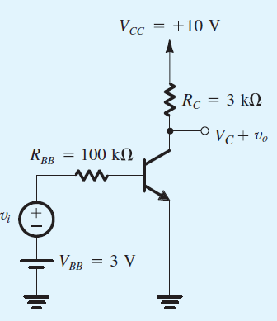
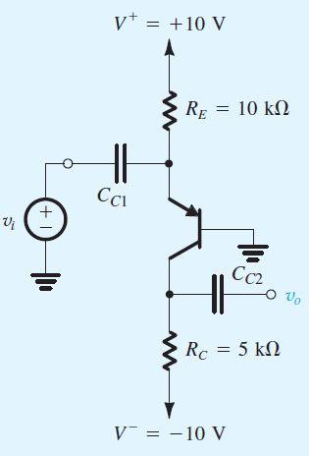
Small-signal operations and models
Determine the voltage gain (β=100) for both circuits
Assume that v_{i} has a triangular waveform, determine the maximum amplitude that v_{i} is allowed to have. Then, with the amplitude of v_{i} set to this value, give the waveforms of the total quantities i_{B}(t), v_{BE}(t), i_{C}(t), and v_{C}(t).

Slide 34
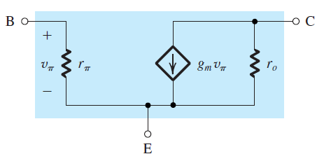
Small-signal operations and models
Augmenting the model with Early Effect
r₀ = V_{A}/I_{Cbias}

Slide 35
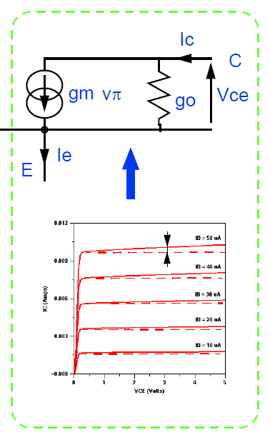
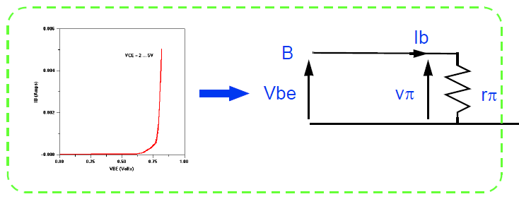
g_{m} = I_{Cbias}/V_{T}
r_{π} = β/g_{m}
r₀ = V_{A}/I_{Cbias}

Slide 36
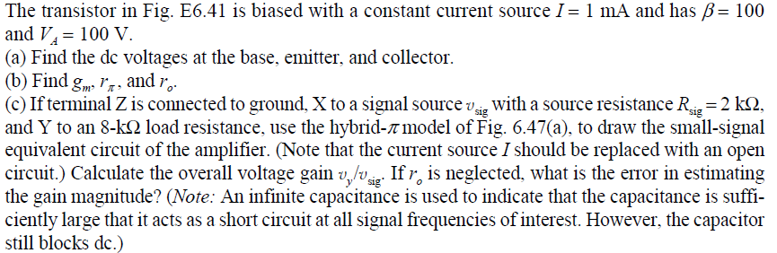
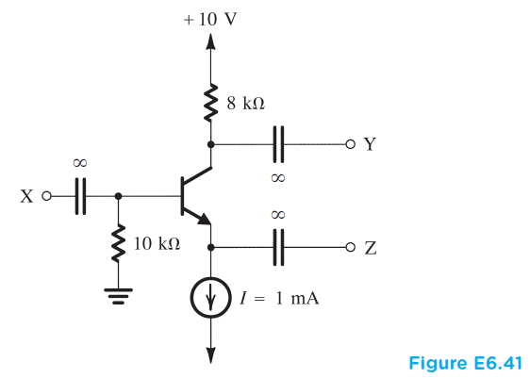
Small-signal exercise

Slide 37
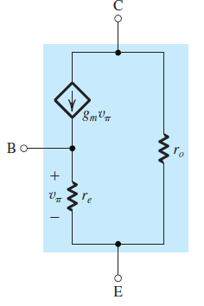
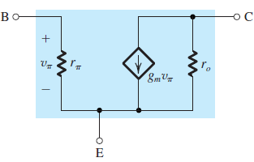

Summary

