Slide 1
2018 Semester#1 Analog Circuits Design AFL axel.flament@YNCREA.fr

Slide 2
Basic BJT Amplifiers configurations
Characterizing amplifiers
3 basic configurations
The common-emitter amp
The common-emitter amp with an emitter resistance
The common-base amp
The common-collector amp or emitter follower
Biasing in BJT amps
Common-emitter Full Design
Summary

Slide 3
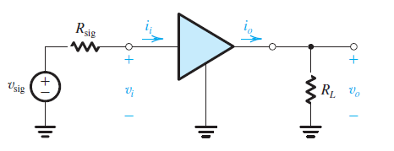
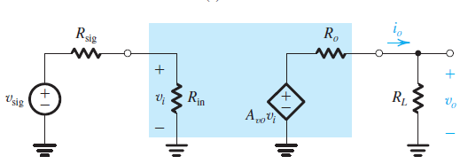
Characterizing amplifiers
R_{in}
Voltage dividing effect
May depend on R_{L}
A_{v0}, open-circuit voltage gain
V_{o}/V_{i} when R_{L} is infinite
R_{out}
Calculated when V_{sig} = 0
Does not depend on R_{sig}
Voltage dividing effect

Slide 4
Basic BJT Amplifiers configurations
Characterizing amplifiers
3 basic configurations
The common-emitter amp
The common-emitter amp with an emitter resistance
The common-base amp
The common-collector amp or emitter follower
Biasing in BJT amps
Common-emitter Full Design
Summary

Slide 5
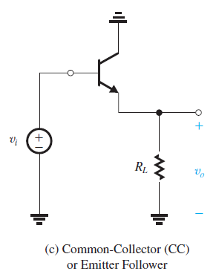
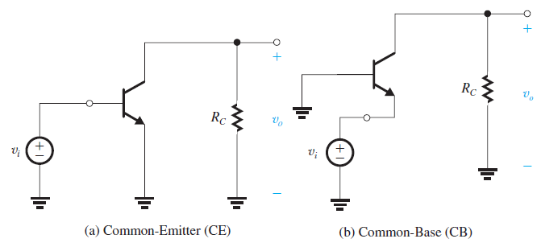
3 basic configurations
Connect 1 of the 3 terminals to ground, thus creating a 2-port networks with the grounded terminal being common to the input and output ports

Slide 6
Basic BJT Amplifiers configurations
Characterizing amplifiers
3 basic configurations
The common-emitter amp
The common-emitter amp with an emitter resistance
The common-base amp
The common-collector amp or emitter follower
Biasing in BJT amps
Common-emitter Full Design
Summary

Slide 7
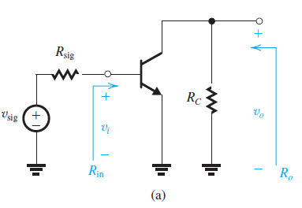
Common-Emitter amp
Most used amp
R_{C} is part of the amp
A load will appear in parallel with R_{C}
R_{in} ? A_{v0} ? R_{out}?

Slide 8
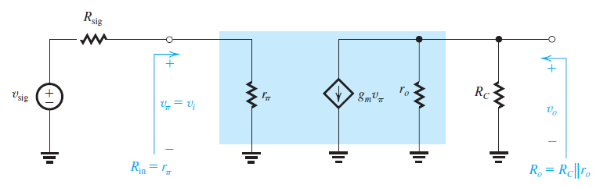
Analysis
Replace BJT by its small-signal equivalent model
V₀ = -g_{m}v_{π}(r₀//R_{C}) → V₀/V_{i} = -g_{m}(r₀//R_{C})

Slide 9
Observations
R_{in} = r_{π} = β/g_{m}, moderate to low value (range of kΩ). Directly depending on β and inversely proportional to I_{C}. To obtain a higher input res, I_{C} must be lowered but this lowers the gain (trade-off).
R_{O} is moderate to high in value (range of kΩ). To lower R_{O}, R_{C} should be reduced, but it reduces the gain as well
Gain is high, but the bandwidth is limited (we will see it later)

Slide 10
Common-emitter ex
A common-emitter amp utilizes a BJT with β=100, and V_{A}=100V, is biased at I_{C} = 1mA and has a collector resistance R_{C} = 5kΩ. Find R_{in}, R₀, and A_{V0}. If the amp is fed with a signal source having a res R_{S} = 5kΩ, and a load res R_{L} = 5kΩ is connected to the output terminal, find the resulting gain.

Slide 11
Basic BJT Amplifiers configurations
Characterizing amplifiers
3 basic configurations
The common-emitter amp
The common-emitter amp with an emitter resistance
The common-base amp
The common-collector amp or emitter follower
Biasing in BJT amps
Common-emitter Full Design
Summary

Slide 12
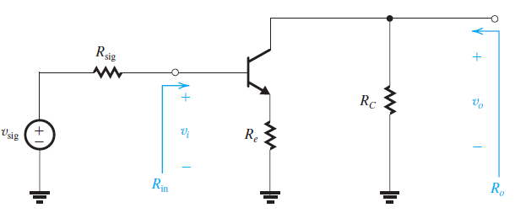
The common-emitter amp with an emitter resistance
Connecting a res at the emitter leads to several major changes in common-emitter amp characteristics…
R_{in} ? R_{O}? A_{V0}? (neglect the Early effect)

Slide 13
The common-emitter amp with an emitter resistance
R_{in}= r_{π} + (β+1)R_{E}
R₀ = R_{C}
A_{v0} ~ -g_{m}R_{C}/(1+g_{m}R_{E}) ~ -R_{C}/R_{E}
Comparison with the CE amp :
R_{in} is much higher
The gain is much lower (by the same amount) – trade-off !
Input dynamic is improved
The overall gain is less dependent on β
BW is significantly improved (we will see it later)
R_{E} provides negative feedback that stabilizes IC (out of scope)
R_{E} is called Emitter degeneration resistance
This amp is called a degenerated common-emitter

Slide 14
Basic BJT Amplifiers configurations
Characterizing amplifiers
3 basic configurations
The common-emitter amp
The common-emitter amp with an emitter resistance
The common-base amp
The common-collector amp or emitter follower
Biasing in BJT amps
Common-emitter Full Design
Summary

Slide 15
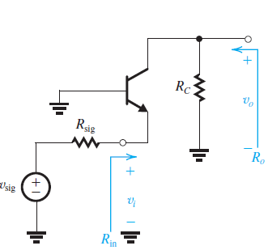
The common-base amp
R_{in} ? R_{O}? A_{V0}? (neglect the Early effect)

Slide 16
The common-base amp
R_{in}= r_{π} / (β+1)
R₀ = R_{C}
A_{v0} ~ g_{m}R_{C}
Observations :
R_{in} is very low (not so good, except for specific applications)
The gain is high
R_{out} is high
BW is very good (we will see it later)

Slide 17
Common-Base Amp EX
Consider a CB amp utilizing a BJT (β=100) biased at I_{C} = 1mA and with R_{C} = 5kΩ. Determine R_{in}, A_{V0} and R₀. If the amp is loaded with R_{L} = 5kΩ what value of A_{V} results? What is the overall gain if R_{sig} = 5kΩ?
A CB amp is required to amplify a signal delivered by a coaxial cable having a characteristic res of 50 Ω. What bias current I_{C} should be utilized to obtain R_{in} that is matched to the cable res? To obtain an overall voltage gain of 40V/V, what should the total res in the collector (i.e. R_{C}//R_{L}) be?

Slide 18
Basic BJT Amplifiers configurations
Characterizing amplifiers
3 basic configurations
The common-emitter amp
The common-emitter amp with an emitter resistance
The common-base amp
The common-collector amp or emitter follower
Biasing in BJT amps
Common-emitter Full Design
Summary

Slide 19
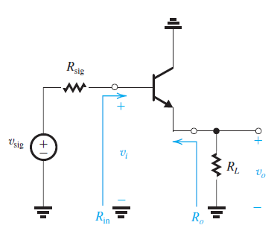
The common-collector amp or emitter follower
R_{in} ? R_{O}? A_{V0}?

Slide 20
The common-collector amp or emitter follower
R_{in}= r_{π} + (β+1)R_{L}
R₀ = (r_{π} + R_{sig}) / (β+1)
A_{v0} ~ g_{m}R_{E} / (1+ g_{m}R_{E}) ~ 1
Observations :
R_{in} is high
The voltage gain is close to unity (but current gain is very high)
R_{out} is low
Bilateral… (out of scope)
Acts as a buffer amp !

Slide 21
Basic BJT Amplifiers configurations
Characterizing amplifiers
3 basic configurations
The common-emitter amp
The common-emitter amp with an emitter resistance
The common-base amp
The common-collector amp or emitter follower
Biasing in BJT amps
Common-emitter Full Design
Summary

Slide 22
BIASING in BJT amps
Biasing = establish a constant DC current in the collector of the BJT
Predictable current
Insensitive to variations (temp, β)
Allow maximum output swing

Slide 23
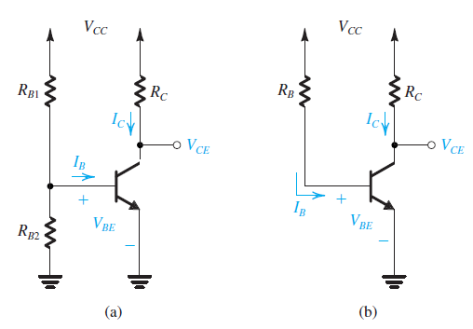
BIASING in BJT amps
Bad

Slide 24
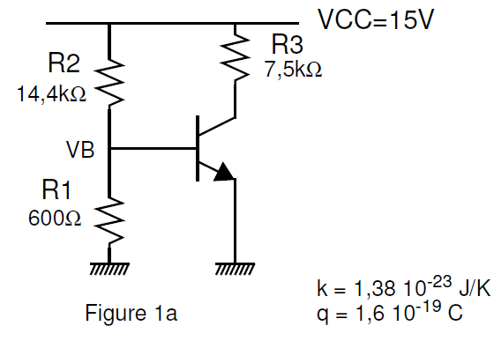
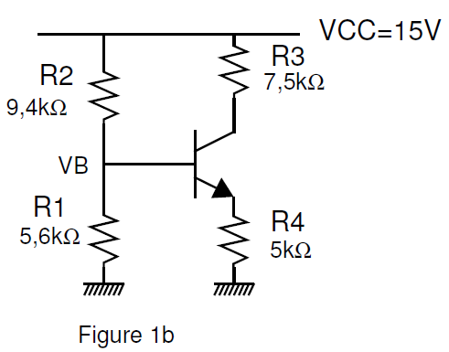
BIASING in BJT amps ex
Figure 1a:
What is the value of V_{B}? (neglect I_{B})
Find I_{C} (I_{S} = 85fA, T = 300K, no Early effect, V_{T} = 25,8mV)
If R₂ is 5% higher and R₁ 5% lower than their nominal values, what does I_{C} value become?
Figure 1b:
What is the value of I_{C}? (neglect I_{B,} V_{BE} = 0,6V)
Write the relationship between V_{B}, V_{BE} and I_{C} (V_{B}= V_{E}+V_{BE}…)
By differentiating the latter equation, find a condition that make I_{C} variations (as a function of V_{B}) independent of BJT parameters. If we have the same V_{B} variations as in the 1st figure, what would I_{C} be?

Slide 25
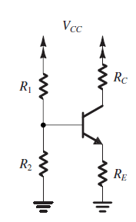
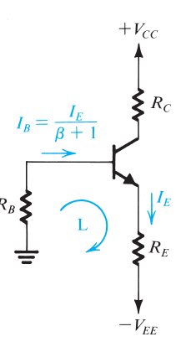
BIASING in BJT amps
Classical discrete-circuit bias arrangement
High R1 and R2 ensure low power consumption
Low R1 and R2 ensure insensitivity to β…
A 2-power-supply version :

Slide 26
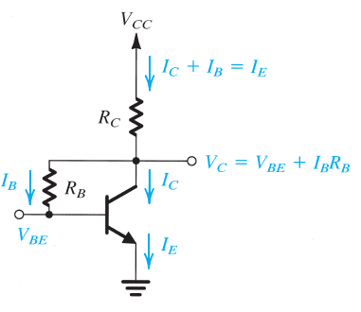
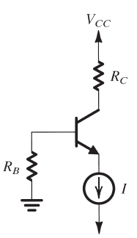
BIASING in BJT amps
Collector-to-Base Feedback res :
R_{B} provides negative feedback
Care must be taken not to forward-
bias Collector-base diode
Using a constant current source
Independent of β and R_{B} !
We will see later how to design
a current source

Slide 27
Basic BJT Amplifiers configurations
Characterizing amplifiers
3 basic configurations
The common-emitter amp
The common-emitter amp with an emitter resistance
The common-base amp
The common-collector amp or emitter follower
Biasing in BJT amps
Common-emitter Full Design
Summary

Slide 28
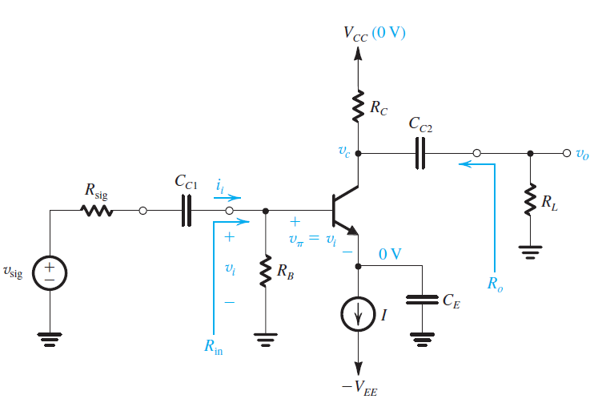
BJT amp – common emitter example – full design
Coupling Cap (low impedance for signal, high impedance for DC in order not to disturb biasing)
Bypass or decoupling Cap (low impedance to ground for signal)

Slide 29
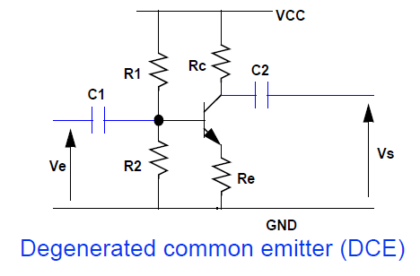
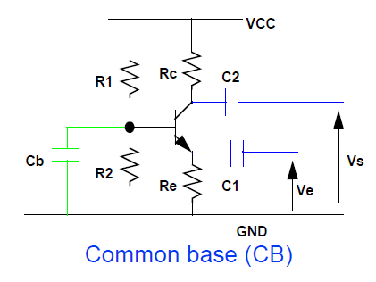
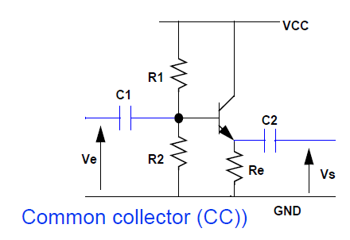
Other configurations ex

Slide 30
Basic BJT Amplifiers configurations
Characterizing amplifiers
3 basic configurations
The common-emitter amp
The common-emitter amp with an emitter resistance
The common-base amp
The common-collector amp or emitter follower
Biasing in BJT amps
Common-emitter Full Design
Summary

Slide 31
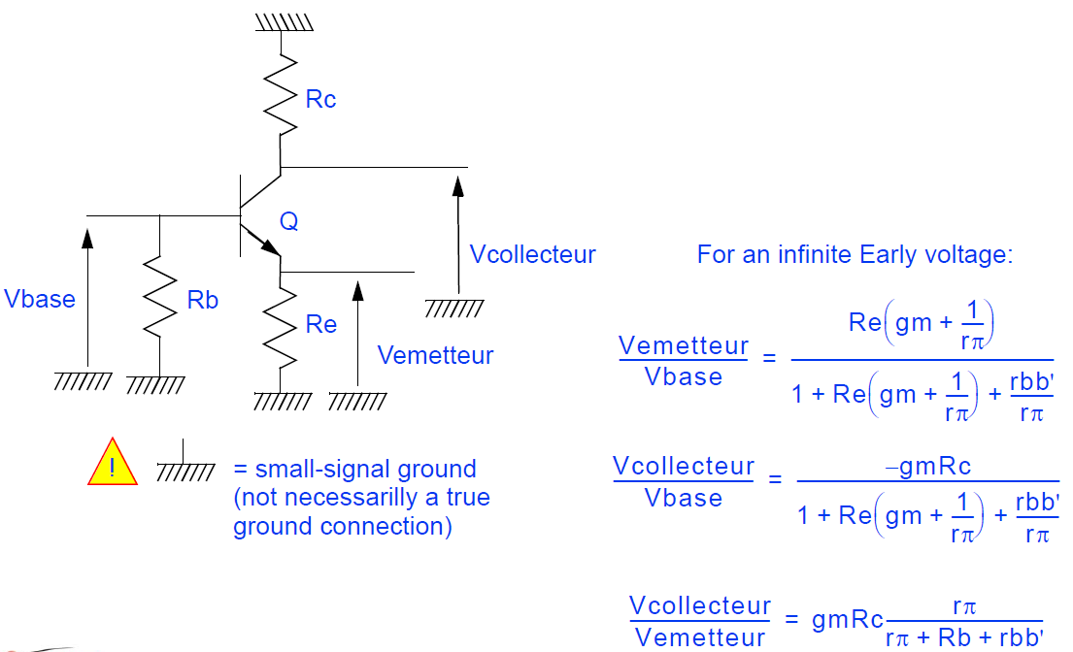
Standards voltage Gains formulas

Slide 32
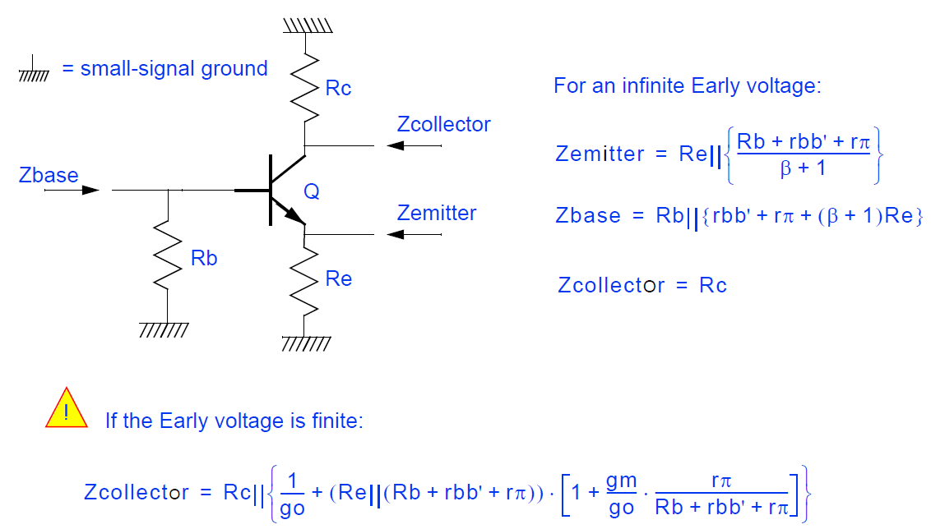
Standard impedances expressions

