Slide 1
2018 Semester#1 Analog Circuits Design AFL axel.flament@YNCREA.fr

Slide 2
Multistage amplifiers and differential pair
Introduction – need for multistage amp
Methodology of calculation
The differential pair
Introduction
Large signal operation
Small signal operation, common-mode voltage and differential-mode voltage

Slide 3
Introduction
For a voltage amp :
R_{in} >>
R_{out} <<
High gain
BW ?
This can not be achieved with the 3 basic configurations, but we can use them in a cascaded way to achieve good requirements
1st stage : high R_{in}
Middle stages : gain but also DC level shifts, differential or single-ended conversion… (we will see them later)
Last stage : low R_{out} or power stage…

Slide 4
Multistage amplifiers and differential pair
Introduction – need for multistage amp
Methodology of calculation
The differential pair
Introduction
Large signal operation
Small signal operation, common-mode voltage and differential-mode voltage

Slide 5
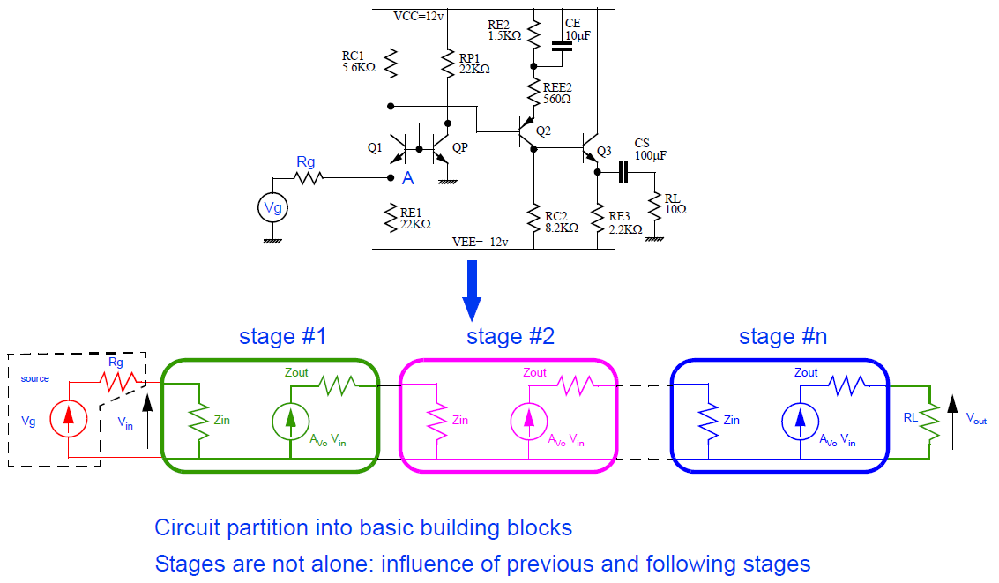
Methodology

Slide 6
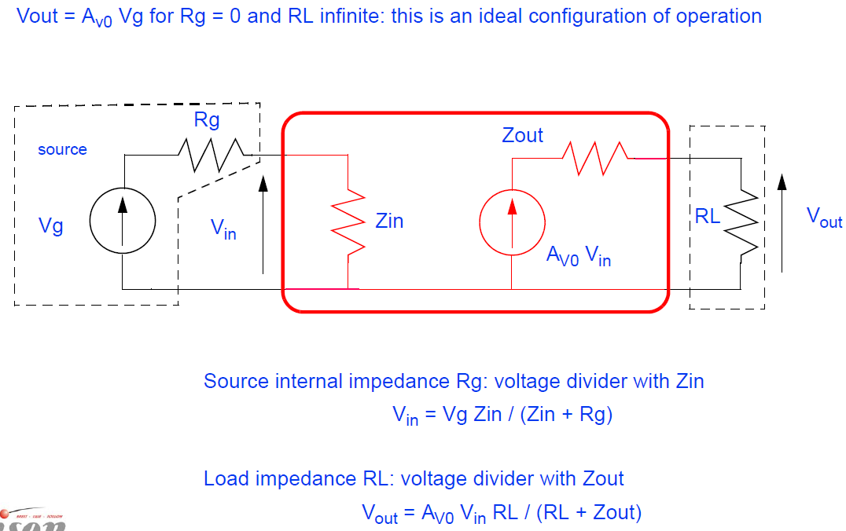
Methodology

Slide 7
Methodology
Operating point determination : currents, small-signal parameters…
Circuit partition : source, basic stages, load
For each stage, starting from the last :
Determine the load at its output
Calculate the loaded gain
Determine its input impedance, this will be the load for its previous stage
Calculate the overall gain
Product of the individual loaded gains
Do not forget the input voltage divider with R_{sig}

Slide 8
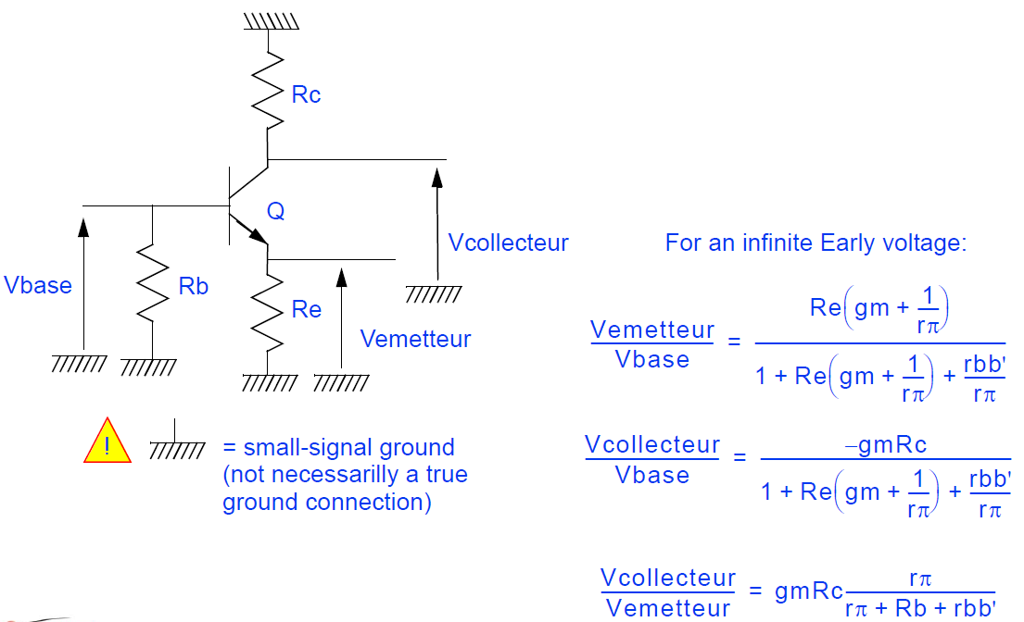
Standards voltage Gains formulas

Slide 9
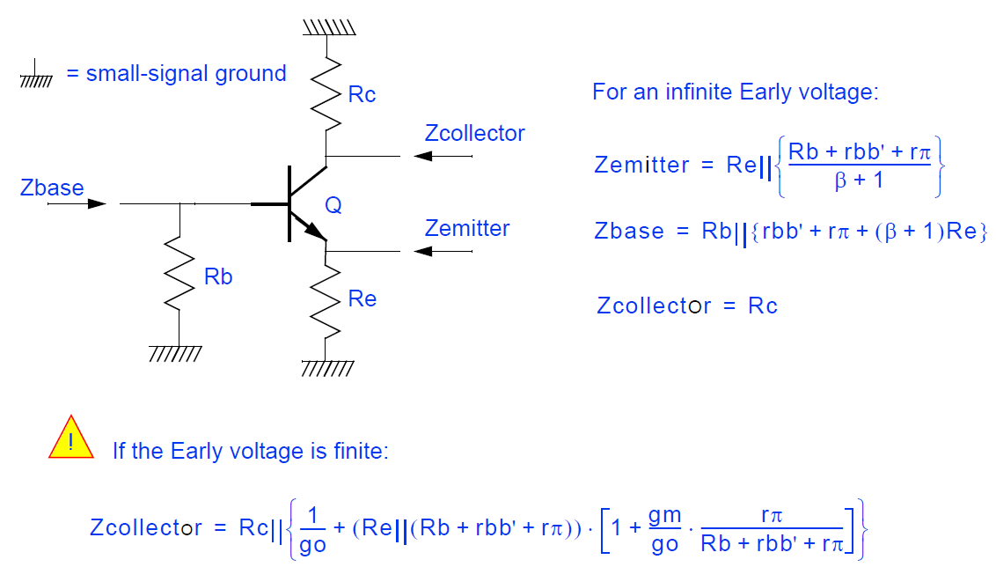
Standard impedances expressions

Slide 10
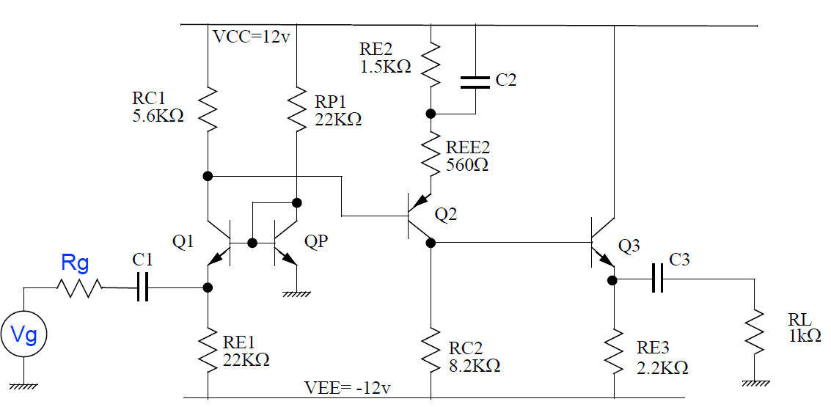
Example
Calculate the overall gain of this amplifier (β=100), R_{in} and R_{out}
50Ω

Slide 11
Multistage amplifiers and differential pair
Introduction – need for multistage amp
Methodology of calculation
The differential pair
Introduction
Large signal operation
Small signal operation, common-mode voltage and differential-mode voltage

Slide 12
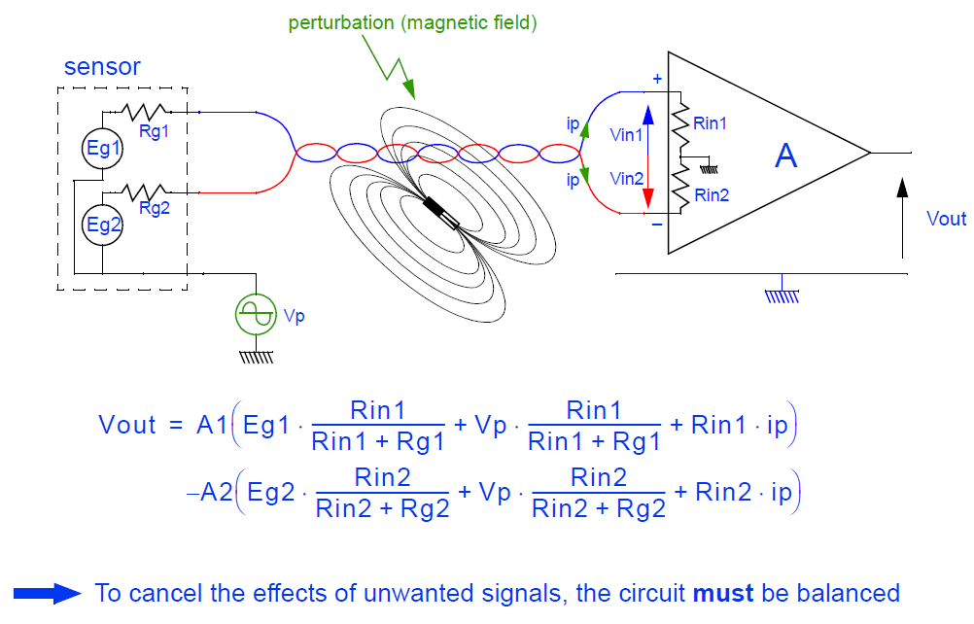
The differential Pair - Introduction
Most widely used circuit (ex : input stage of op amp)
Less sensitive to noise and interference than single-ended amps
Can couple more easily to other amp stage (no coupling caps needed), well suited for IC

Slide 13
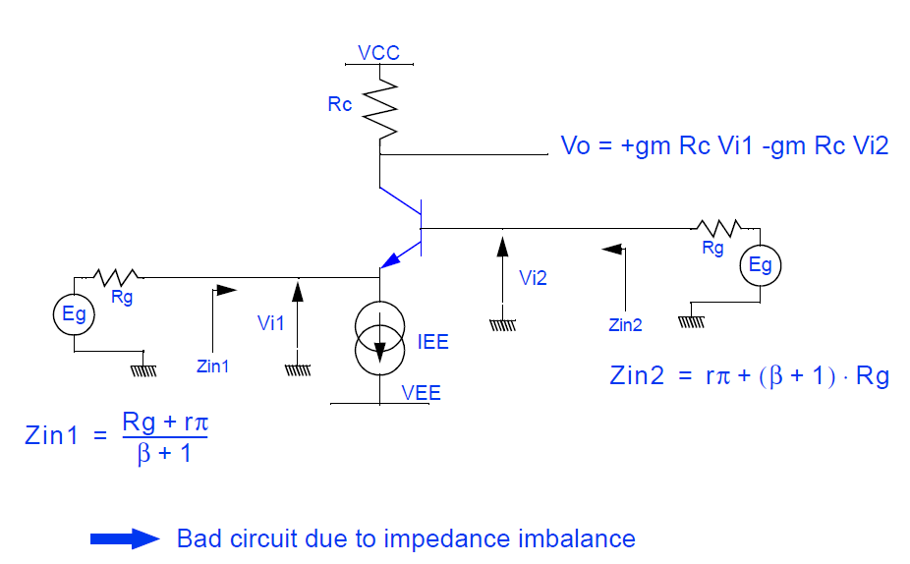
The differential amp – bad example

Slide 14
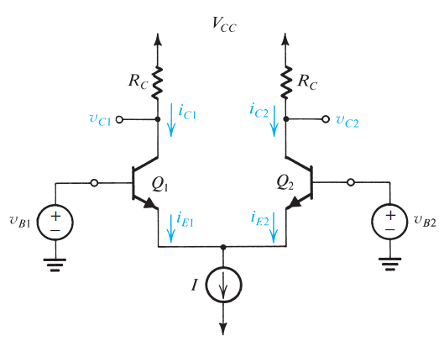
The differential pair

Slide 15
Multistage amplifiers and differential pair
Introduction – need for multistage amp
Methodology of calculation
The differential pair
Introduction
Large signal operation
Small signal operation, common-mode voltage and differential-mode voltage

Slide 16
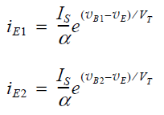
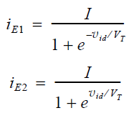
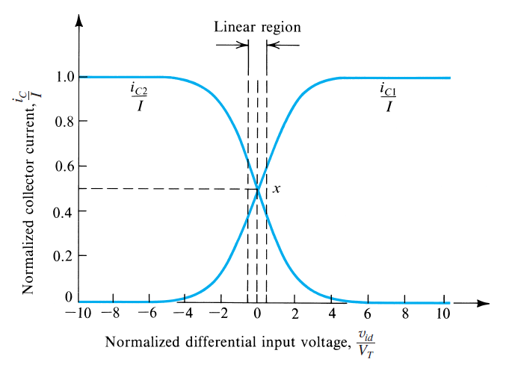


Large signal operation

Slide 17
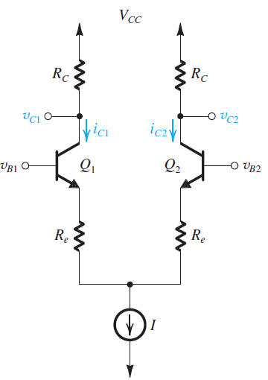
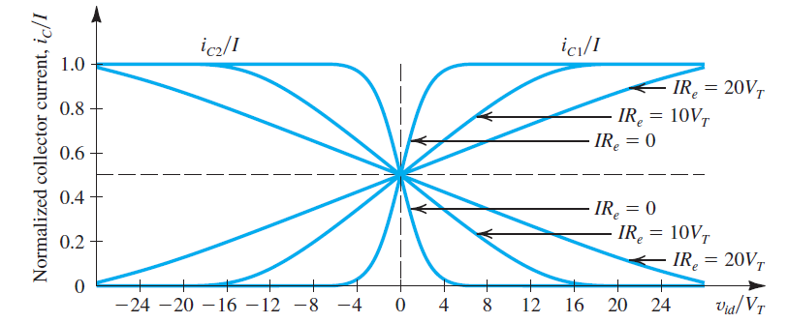
Large signal operation

Slide 18
Multistage amplifiers and differential pair
Introduction – need for multistage amp
Methodology of calculation
The differential pair
Introduction
Large signal operation
Small signal operation, common-mode voltage and differential-mode voltage

Slide 19
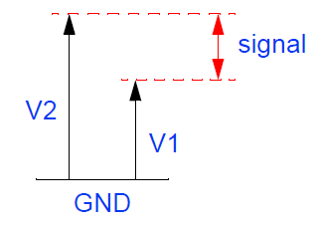
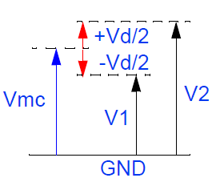
Small-signal operation
Common-mode and differential-mode
Any pair of voltages V₁ and V₂ can be expressed as : V_{1,2} = V_{cm} ±V_{d}/2
Wanted signal : V₂-V₁ = V_{d}
Unwanted signal : (V₂+V₁)/2 = V_{cm}
Goals : Favor diff mode / cancel common mode
The circuit must be balanced (gains and impedances !)
Study the circuit in both “modes” (common-mode and diff-mode)

Slide 20
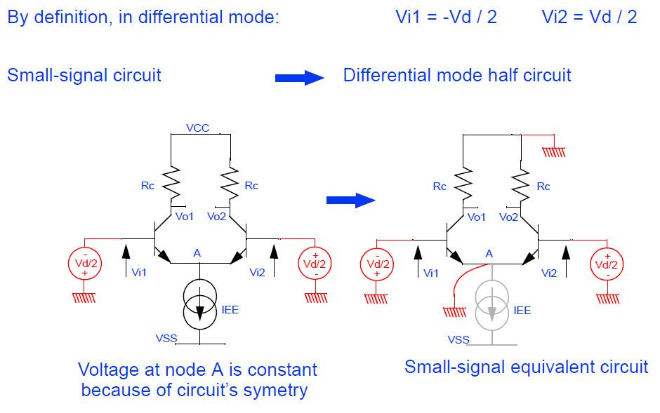
Small-signal operation – differential mode

Slide 21
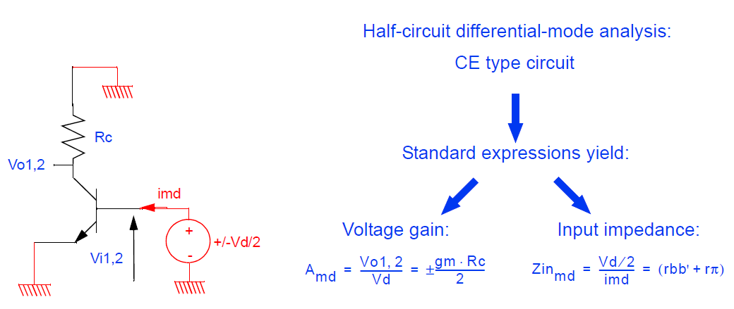
Small-signal operation – differential mode

Slide 22
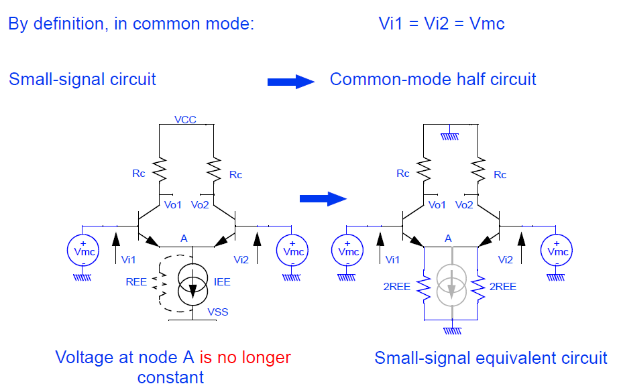
Small-signal operation – common-mode

Slide 23
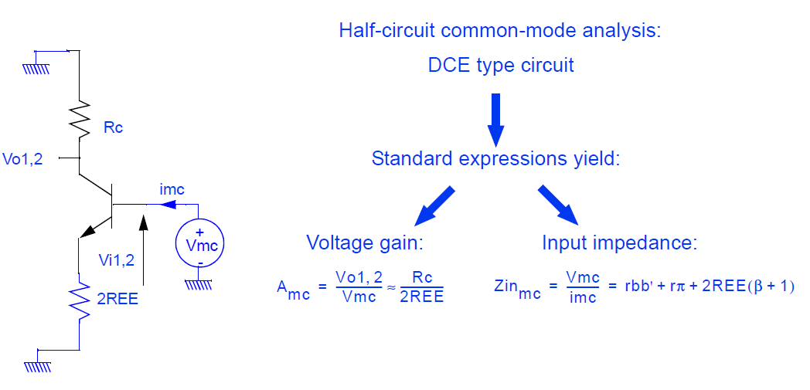
Small-signal operation– common-mode

Slide 24
Quality criterion
Quality of the circuit can be expressed as the ratio of “wanted gain” vs “unwanted gain” :
CMRR (common-mode rejection ratio) = A_{dm}/A_{cm}
CMRR (dB) = 20 log10 (A_{dm}/A_{cm})
Example :
A_{dm} = 100, A_{cm} = 0,01
V_{d} = 10mV, V_{cm}=0,5 V
Vo = 100 x 10 mV + 0,01 x 0,5V = 1V + 0,005V = 1,005V (instead of ideally 1V…)
CMRR = 100/0,01 = 10 000 = 80dB

Slide 25
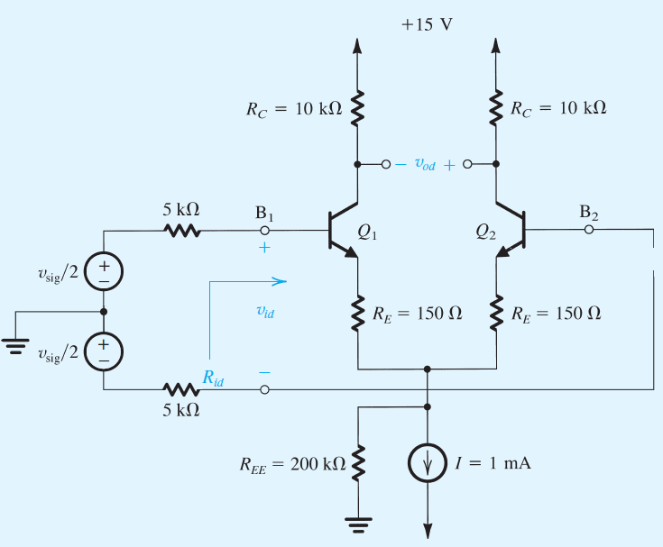
Differential pair - example
For this amp, evaluate :
The input diff Res R_{id}
The overall diff voltage gain (neglect Early effect)
The common-mode gain (in single-ended output and diff output)
The CMRR in dB

