Slide 1
2018 Semester#1 Analog Circuits Design AFL axel.flament@YNCREA.fr

Slide 2
Current mirrors and active loads
Current sources – introduction
Current mirrors
Active loads

Slide 3
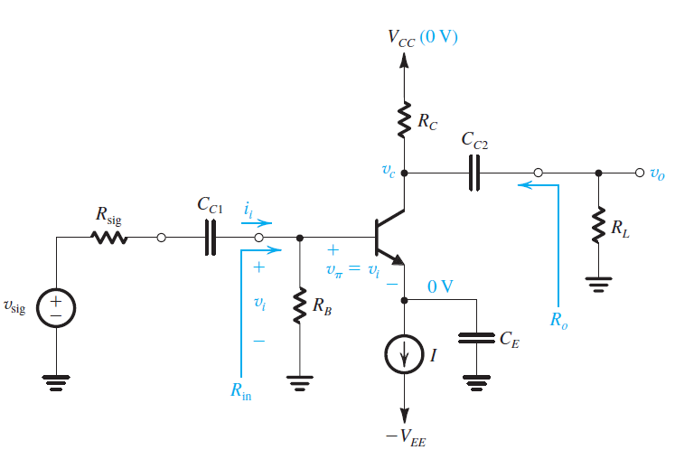
Introduction
We have seen the full design schematic
Almost full design : current source is missing

Slide 4
Introduction
In IC chips with a lot of amplifiers, a constant DC current is generated at one location and then replicated next to the amps (current steering)
Because the effort of a stable, precise, current source is only made once, and not for every amp !
How to duplicate current from a nice and clean current reference?
The idea is that BJTs are voltage-controlled current sources
If 2 BJTs share the same V_{BE}, they will “produce” the same current

Slide 5
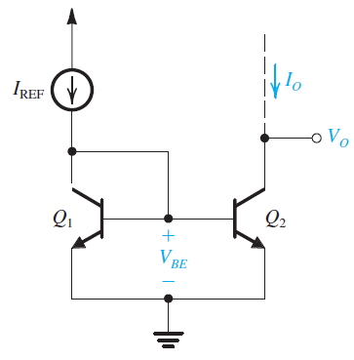
Introduction – the basic BJT current mirror
Ideally :
I₀ = I_{ref} or a multiple part of it
The output impedance of the current source is infinite

Slide 6
Current mirrors and active loads
Current sources – introduction
Current mirrors
Active loads

Slide 7
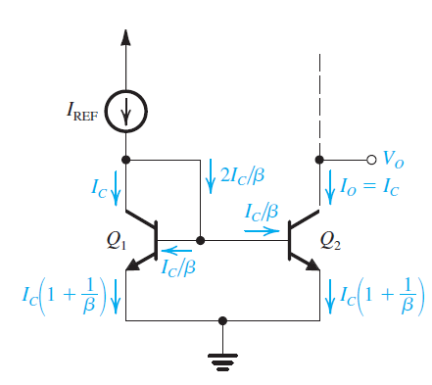
Basic current mirror
Q1 and Q2 must operate in the active mode !
V_{CEQ2} > 0,3V
I₀/I_{ref} = I_{S2}/I_{S1} = Emitter Area of Q2/emitter area of Q1
Use of transistors in parallel if the ratio is an integer
β is finite…
I_{ref} = I_{C} +2 I_{C}/β
So I₀/I_{ref} = 1/(1+2/β)
β=100 → error = 2%
Output res is R₀ = V_{A}/I₀
I₀ = I_{ref} only when VCEs are equal
I₀ = I_{ref} ( 1+ (V₀-V_{BE})/V_{A})

Slide 8
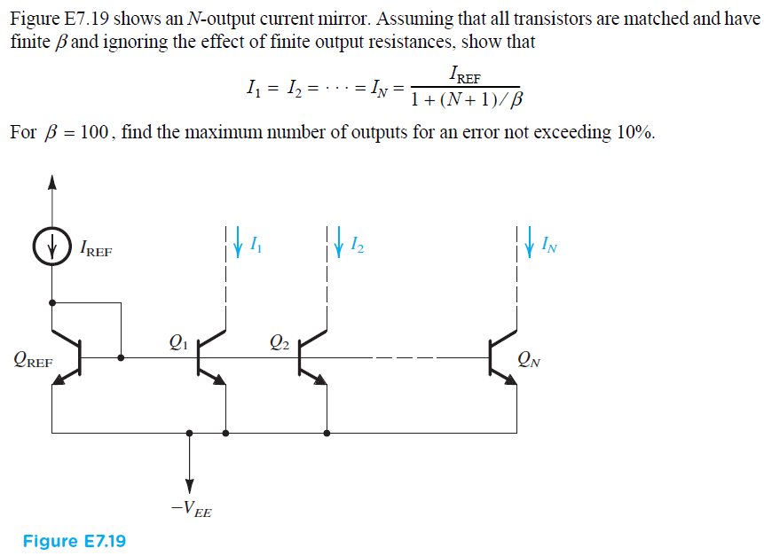
Basic current mirror - ex
Consider a BJT current mirror with a nominal current transfer ratio of 1. The BJTs have I_{S} = 1e⁻¹⁵A, β=100, V_{A}=100V. For I_{ref}=1mA, find I₀ when V₀=5V. Find the output resistance.

Slide 9
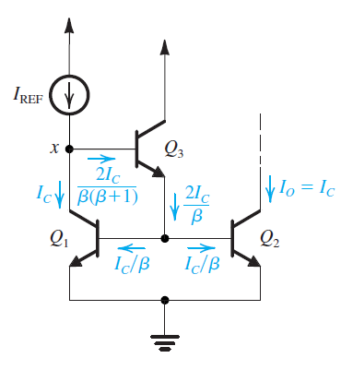
Improved current mirrors
Base-current compensation
I₀/I_{ref} = 1/(1+2/(β²+ β))
β=100 → error = 0,02%
R₀ = V_{A}/I₀

Slide 10
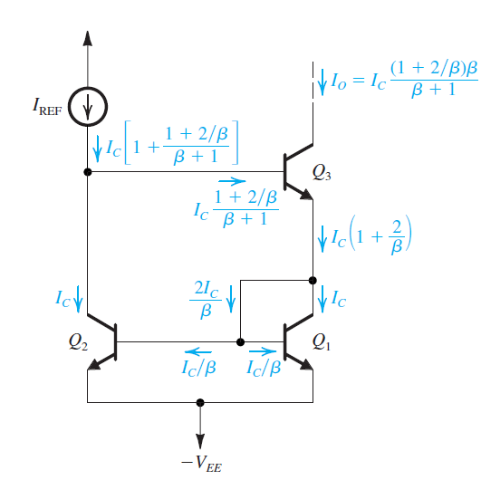
Improved current mirrors
Wilson current mirrors
I₀/I_{ref} = 1/(1+2/(β(β+2))
R₀ = β₃ x R₀₃ /2
But : additional V_{BE} drop
for good operation

Slide 11
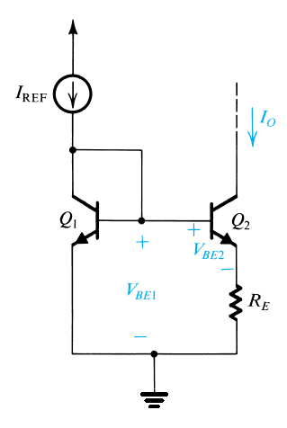
Improved current mirrors
Widlar current mirrors
V_{BE1} = V_{T} ln(I_{ref}/I_{S})
V_{BE2} = V_{T} ln(I₀/I_{S})
V_{BE2 –} V_{BE1} = V_{T} ln(I₀/I_{ref})
I₀R_{E} = V_{T} ln(I₀/I_{ref})
Error is similar to the basic current
source
R_{out} ~ r₀ ( 1+ g_{m} (R_{E}//r_{π}))
Pros : generate low current with
« not so high » resistors / High output res

Slide 12
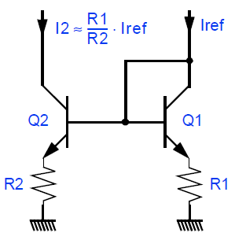
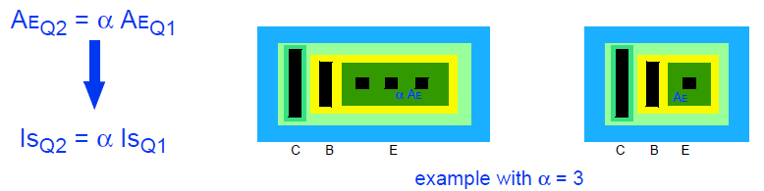
Current ratio
R₂I₂ = R₁I₁ + V_{T}ln(I₂ I_{S1} /I_{ref} I_{S2})
error
I₂ = I₁ (R₁/R₂)+ V_{T}ln(I₂/I_{ref}) / R₂
The error can be canceled if the BJT
emitter area is equal to the ratio of
desired currents (ratio of resistances)

Slide 13
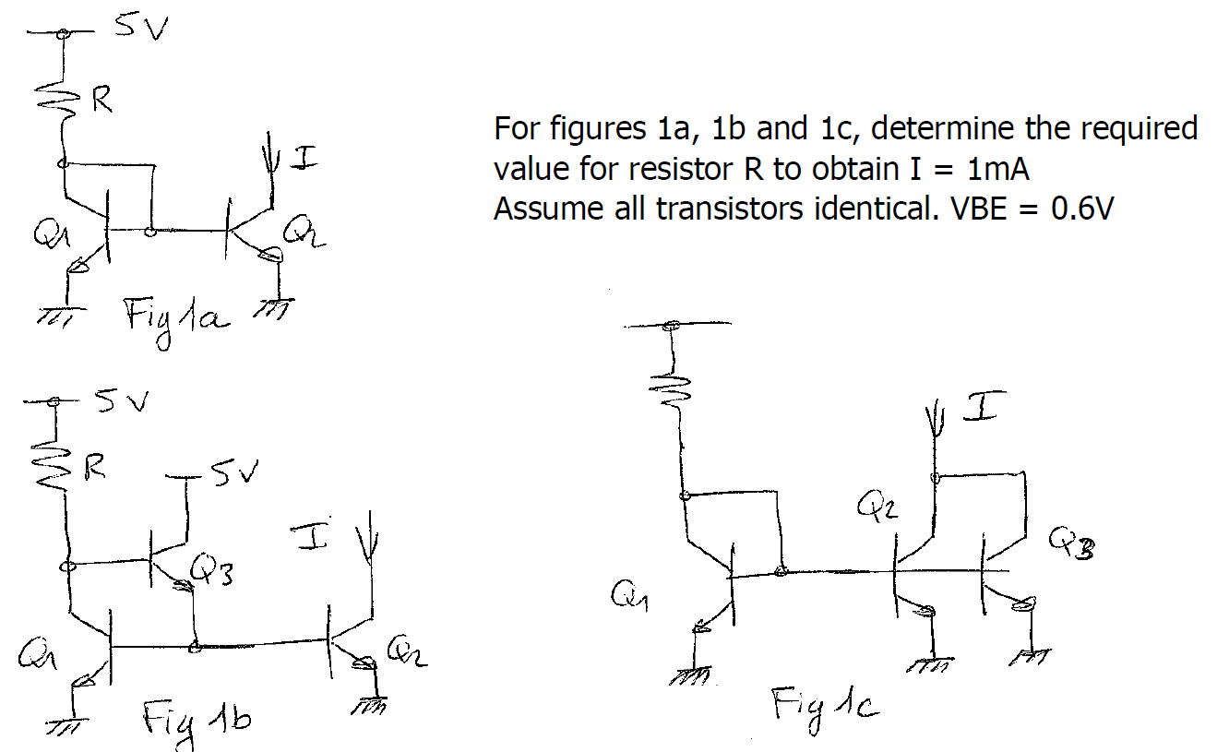
Current Mirrors Ex

Slide 14
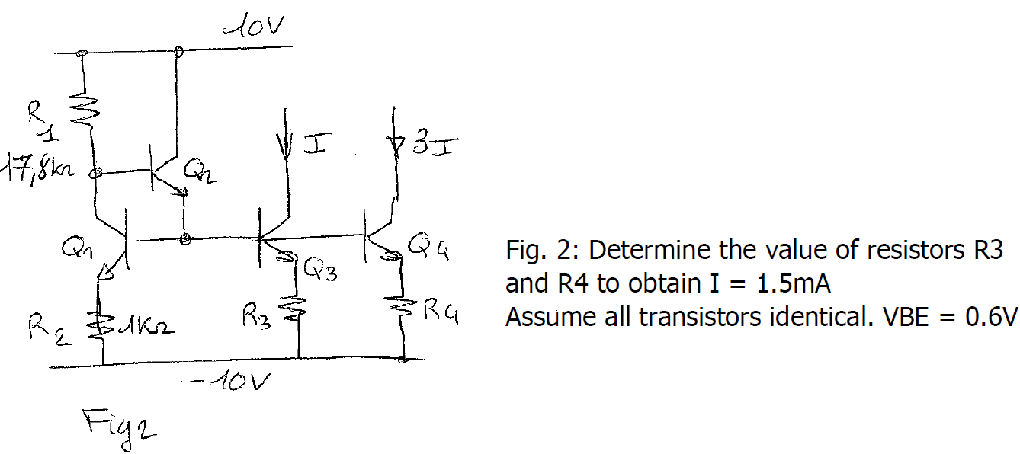
Current Mirrors Ex

Slide 15
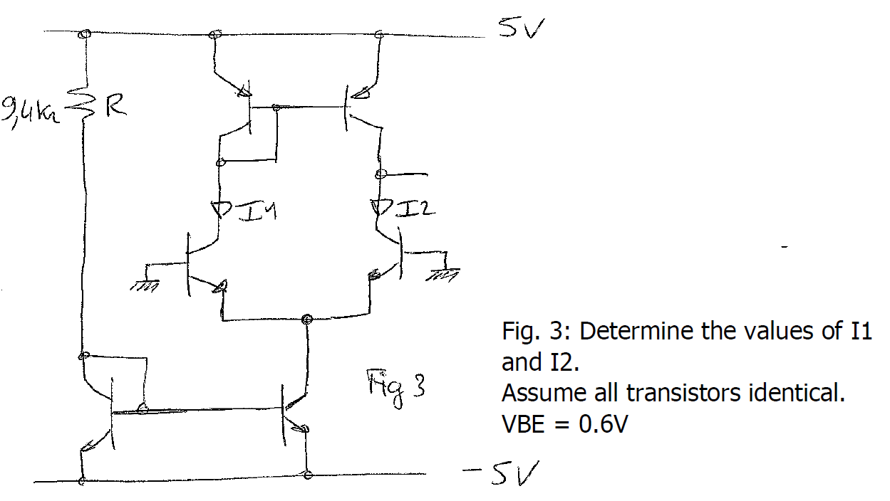
Current Mirrors Ex

Slide 16
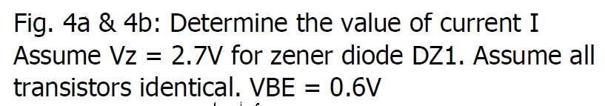
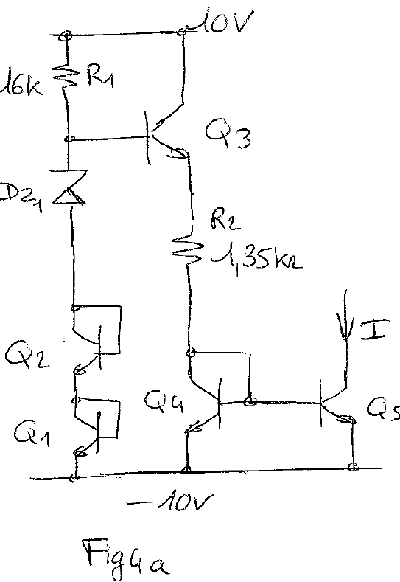
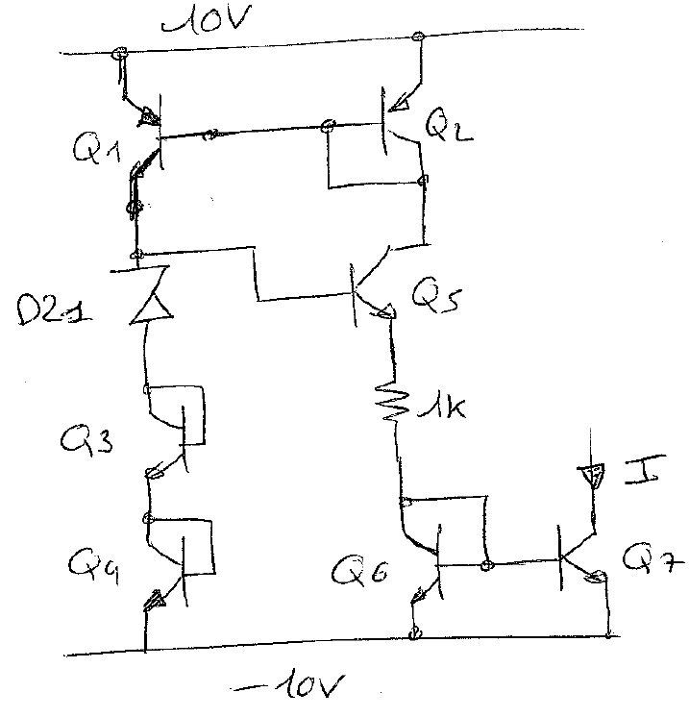
Current Mirrors Ex

Slide 17
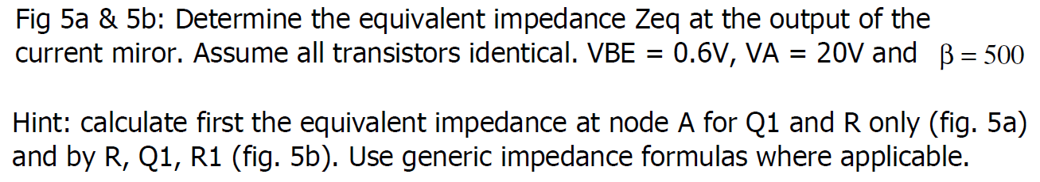
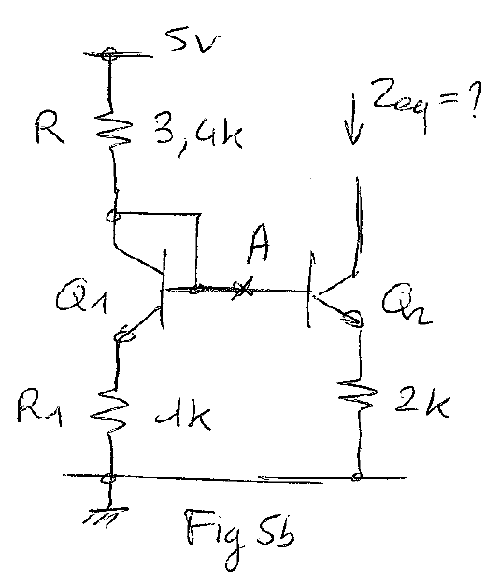
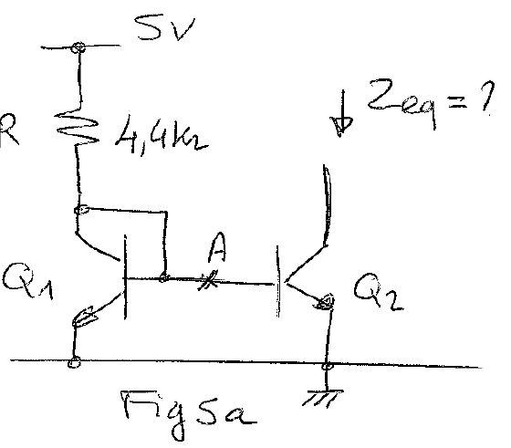
Current Mirrors Ex

Slide 18
Current mirrors and active loads
Current sources – introduction
Current mirrors
Active loads

Slide 19
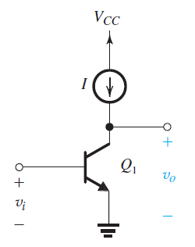
Active loads
Basic gain cell : CE
R_{C} is replaced by a current-source
Difficult to implement high and precise
value of res in IC
Output res of current-source is very high
Good for high gain !
The CE is said to be “current-source loaded” or “active loaded”

Slide 20
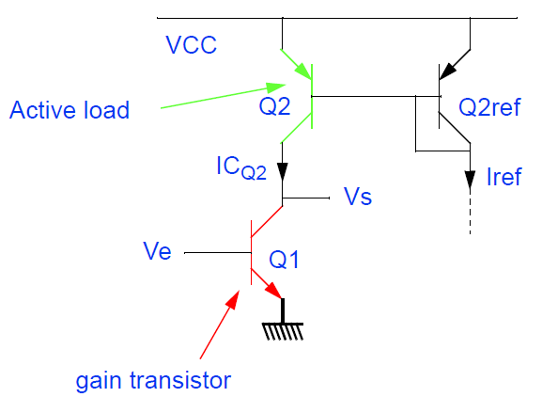
Active Loads
Gain = g_{m1} x (r₀₁//r₀₂)
r₀₁= r₀₂ because V_{A1}=V_{A2} and I_{C1}=I_{C2}
Gain = (I_{C1}/V_{T}) x r₀₁/2
Gain = (I_{C1}/V_{T}) x V_{A}/2IC₁
Gain = V_{A}/2V_{T} = 20 V_{A}

Slide 21
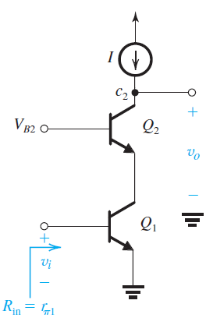
Increasing voltage gain again
How can we increase the gain??
Circuit that passes the
g_{m1}V_{e} current from Q1 to Q2 but exhibits
a much larger output impedance
Current buffer (pass the current
and raise the resistance level)
Common-base circuit can achieve this !
Current gain is 1
Output impedance is high
This circuit is called a cascode
One can also cascode the current source…

Slide 22
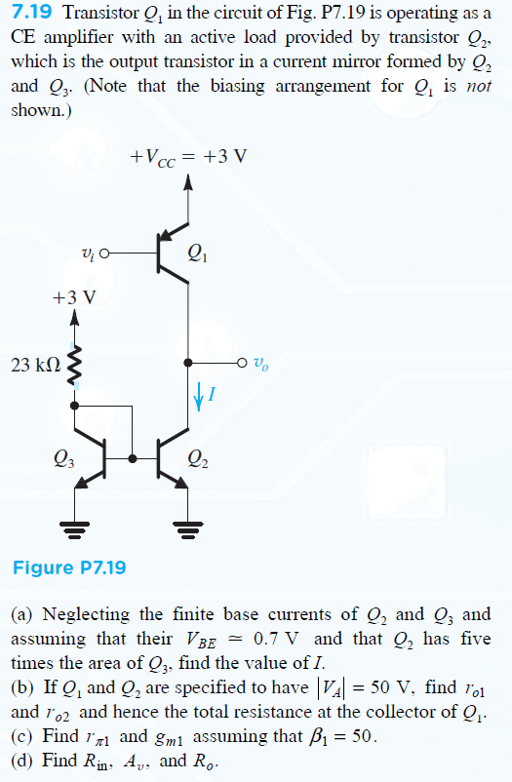
Active loads ex

