Slide 1
2018 Semester#1 Analog Circuits Design AFL axel.flament@YNCREA.fr

Slide 2
Frequency response
Introduction
Low-frequency response
BJT internal caps
High-frequency response

Slide 3
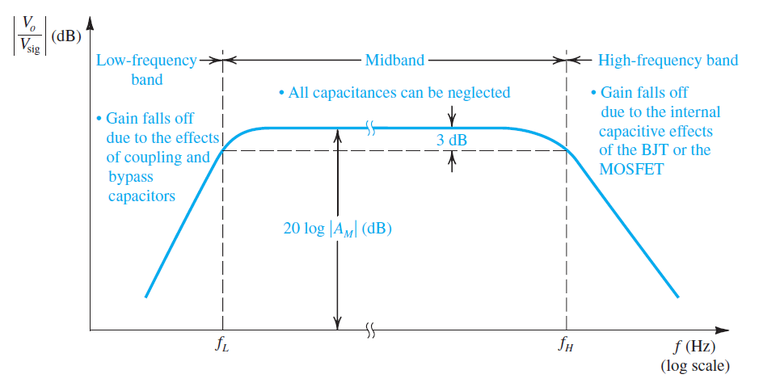
Midband
BJT Internal caps = OC
(De) coupling caps = SC

Slide 4
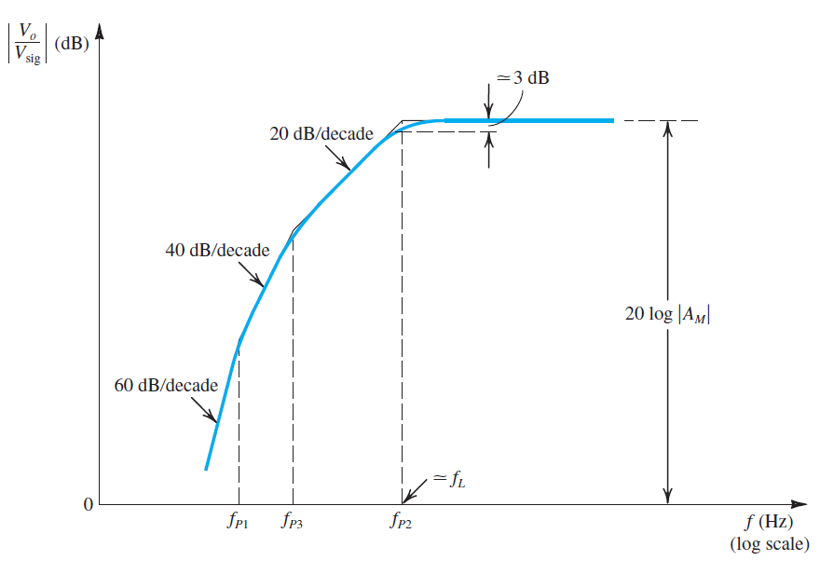
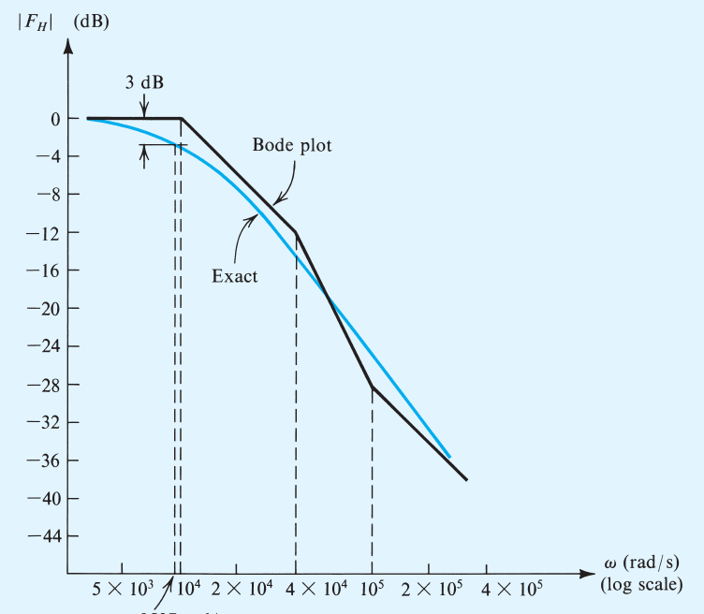
Introduction
Each pole is related to a time-constant : we need to choose proper values of caps !

Slide 5
Frequency response
Introduction
Low-frequency response
BJT internal caps
High-frequency response

Slide 6
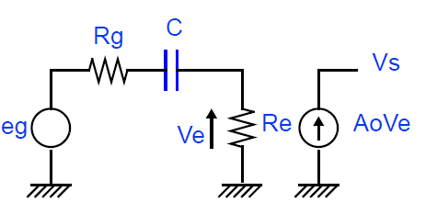
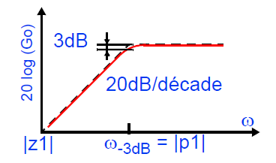

Low-frequency response
Coupling cap example
Evaluate the time constant
Not always sufficient !
Analytical approach (calculate
the transfer function)
$$\frac{V_{S}}{eg}=A_{0}\frac{R_{e}}{R_{e}+R_{g}} \frac{s}{s+\frac{1}{\left(R_{e}+R_{g}\right)C}}$$
Zero @DC
Negative real part pole
Midband gain

Slide 7
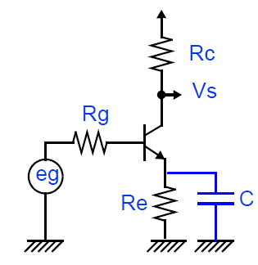
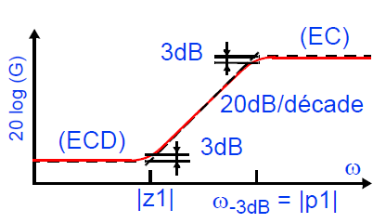
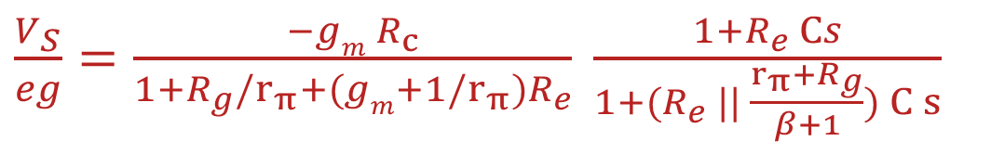
Low-frequency response
Decoupling cap example
Same approach !
Negative real part zero
$\frac{V_{S}}{eg}=\frac{{−gm R}_{c}}{1+R_{g}{/r}_{π}+(gm+1{/r}_{π})R_{e}} \frac{1+R_{e} Cs}{1+{(R}_{e} || \frac{r_{π}+R_{g}}{β+1}) C s}$
Negative real part pole
gain

Slide 8
Low-frequency response
Approximate calculus for -3dB BW:
If the poles are “spaced enough”, i.e. p₁>>p₂>>p₃ etc. (at least a factor of 10), we can assume that there is a dominant pole : p₁
SCTC (short-circuit time constant) method
Find the time constant relative to each (de)coupling cap, considering the others as short-circuit
The equivalent cutoff frequency is the sum of all the frequencies
Ex: p₁ = 100Hz, p₂=10Hz, p₃ = 1Hz
Method 1 : p₁ is dominant : F_{cutoff} = 100Hz
SCTC method : F_{cutoff} = 100+10+1 = 111Hz
Analytical answer : F_{cutoff} = 102Hz…

Slide 9
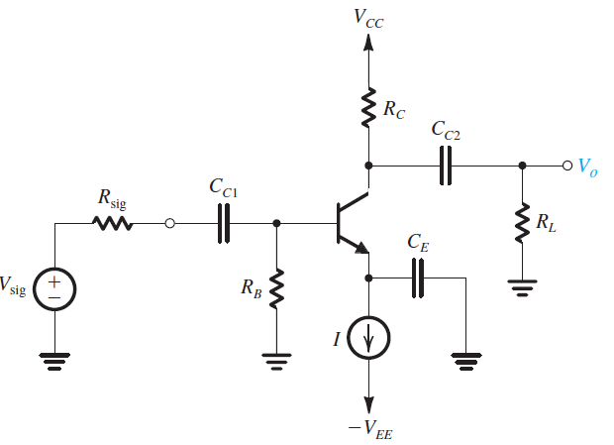
Low-frequency response ex
R_{B}=100kΩ, R_{C} = 8kΩ, R_{L} = 5kΩ, R_{sig} = 5kΩ
β=100, g_{m}=40mA/V, r_{π}=2,5kΩ
Determine the values of C_{c1}, C_{c2} and C_{E} for having a low cutoff frequency of 100Hz (Hint : select C_{E} in order that its associated pole contributes to 80% of the total cutoff frequency)

Slide 10
Frequency response
Introduction
Low-frequency response
BJT internal caps
High-frequency response

Slide 11
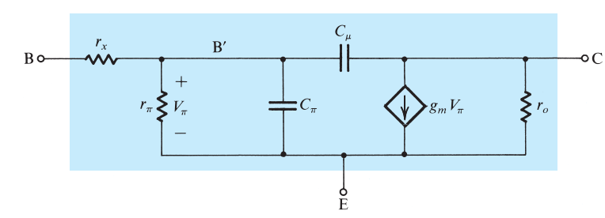
BJT internal caps
High-frequency small-signal BJT model
The origins of these caps are out of the scope of this lesson
Cπ ~ 1-50pF
Cµ ~ 0,1-1pF

Slide 12
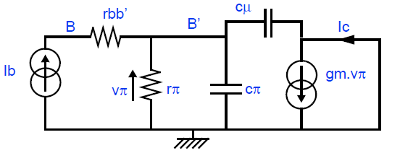
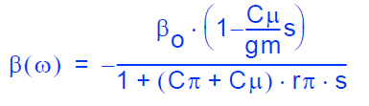
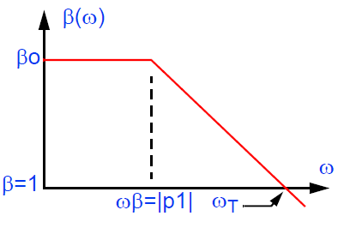

BJT Cutoff frequency
β is the I_{C}/I_{B} ratio when collector and emitter are grounded
Positive real part zero
Negative real part pole
$$ω_{T}= β_{0} ω_{β}= \frac{g_{m}}{\left(C_{π}+C_{μ}\right)}$$

Slide 13
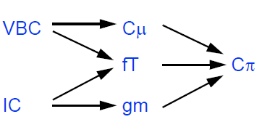
BJT caps values
In datasheets, you will not find C_{π} value, but f_{T} instead
To find the values :

Slide 14
Frequency response
Introduction
Low-frequency response
BJT internal caps
High-frequency response

Slide 15
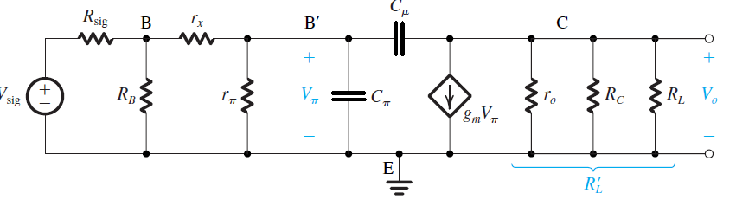
High-frequency response of CE
De(coupling) cap exhibits very low
impedance → short-circuited

Slide 16

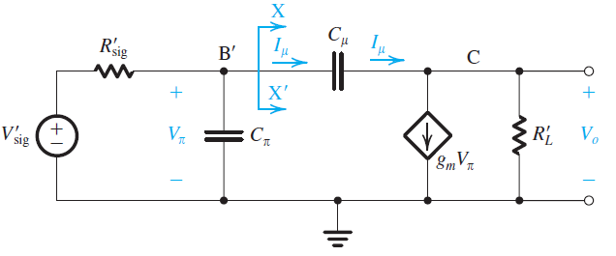


High-frequency response of CE
Thevenin theorem used to simplify the circuit
Analytical approach (give the real answer)
OCTC method (give approximate values)

Slide 17
High-frequency response of CE – analytical approach
Very tedious…
Z₁ = g_{m}/C_{µ}
p₁ ~ (R_{sig}R_{L}C_{µ}g_{m})⁻¹
P₂ ~g_{m}/C_{π}
Generally p₁<<p₂<<z₁
P₁ is dominant

Slide 18
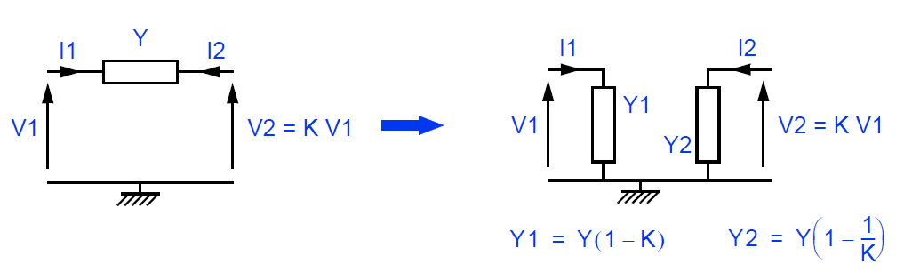
Miller’s theorem
Hopefully, a simple transformation allows to simplify the circuit and analysis

Slide 19
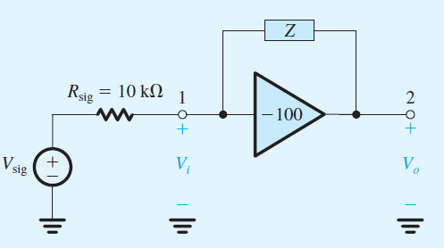
Miller Theorem - ex
This Figure shows an ideal voltage amp having a gain of -100V/V with an impedance Z connected between its input and output terminals. Find the Miller equivalent circuit when Z is (a) a 1MΩ res, (b) a 1pF cap. In each case, determine V₀/V_{sig}

Slide 20
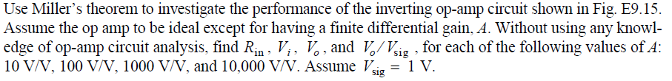
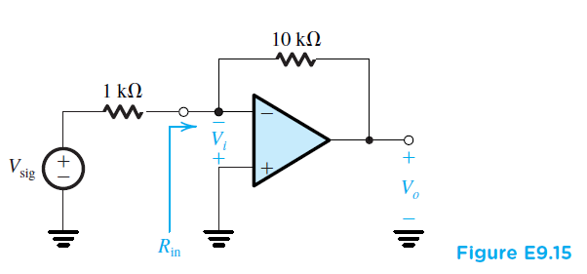
Miller Theorem Ex

Slide 21
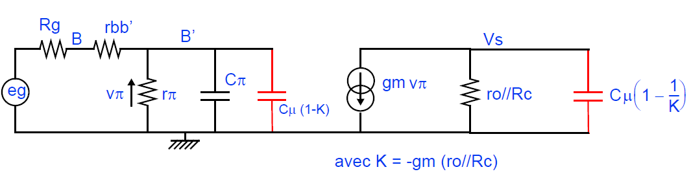
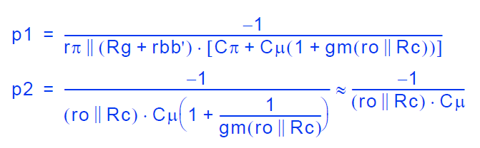
Miller’s theorem applied to CE
P₁ is well estimated (it matters because it is the dominant pole)
P₂ is underestimated (can be a 20 times lower value than real value)
Z₁ is ignored!

Slide 22
High Frequency Cutoff frequency
Approximate calculus for -3dB BW:
If the poles are “spaced enough”, i.e. p₁<<p₂<<p₃ etc. (at least a factor of 10), we can assume that there is a dominant pole : p₁
OCTC (short-circuit time constant) method
Find the time constant relative to each internal BJT cap, considering the others as open-circuit ((de)coupling caps are short-circuited !)
The equivalent cutoff time constant is the sum of all the time constants
Ex: p₁ = 100MHz, p₂=1GHz, p₃ = 10GHz
Method 1 : p₁ is dominant : F_{cutoff} = 100MHz
OCTC method : F_{cutoff} =((1/1e8)+(1/1e9)+(1/1e10))⁻¹ = 90,9MHz (more precise)

Slide 23
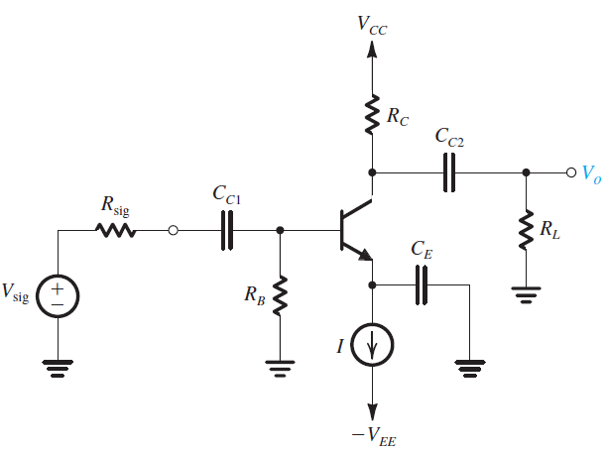
High frequency response - ex
Find the midband gain and the upper 3dB-frequency of this amp (suppose that p1 dominates, use Miller approximation).
V_{CC}=V_{EE}=10V, I=1mA, R_{B}=100kΩ, R_{C} = 8kΩ, R_{L} = 5kΩ, R_{sig} = 5kΩ, β=100, V_{A}=100V, C_{µ} = 1pF, f_{T} = 800MHz
Find the value of R_{L} that reduces the gain to half the value. What does F_{c} become?

Slide 24
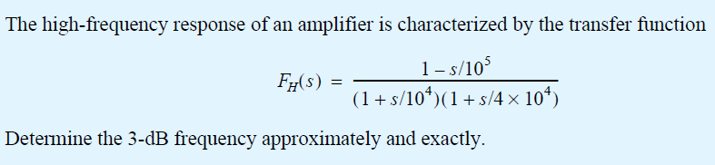
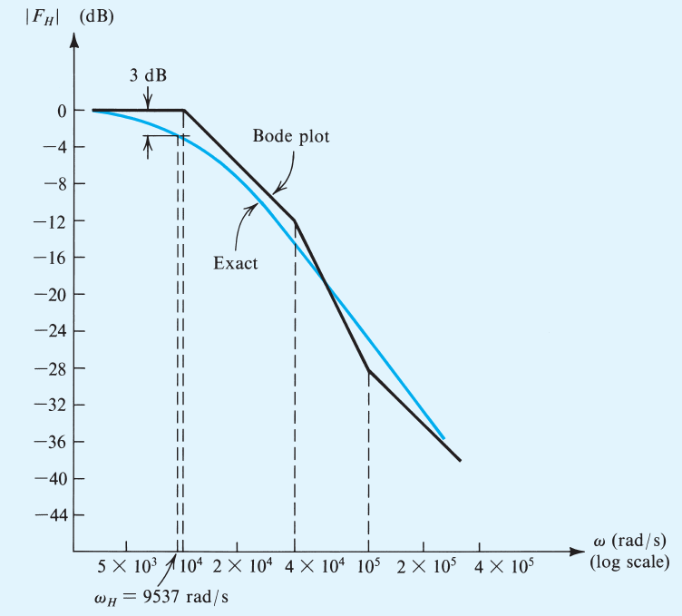
High frequency response - ex

Slide 25
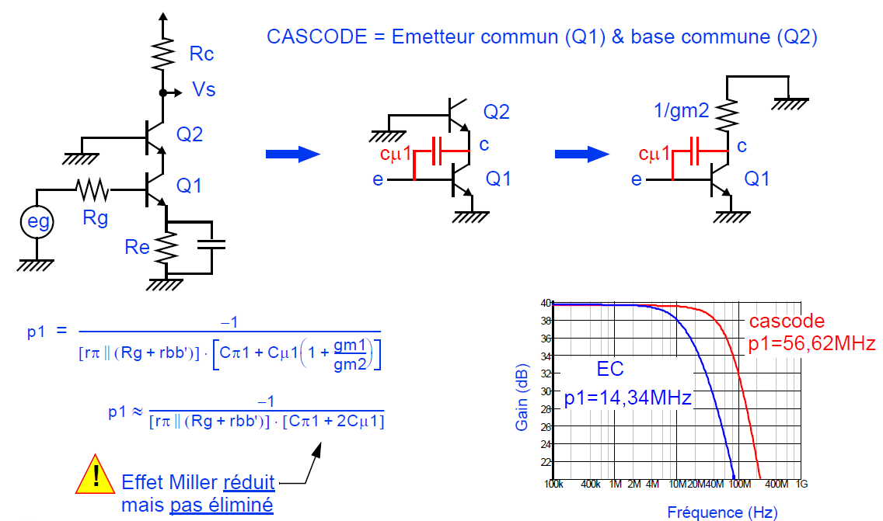
Frequency response of the cascode

Slide 26
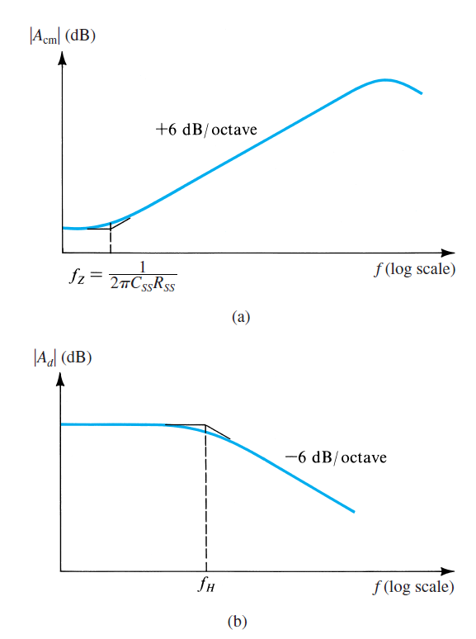
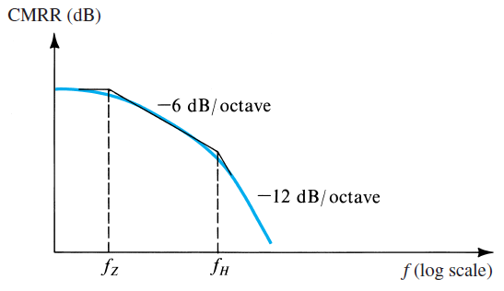
Frequency response
Not in the scope of the lesson :
Frequency response of current mirrors
Frequency response of differential amp
Diff mode
Common mode

Slide 27
Cascode - Ex

