Slide 1
2018 Semester#1 Analog Circuits Design AFL axel.flament@YNCREA.fr

Slide 2
Output stages and Power Amplifiers
Introduction
Emitter Follower
Class of operation
Thermal considerations

Slide 3
Output stages and PA - introduction
Delivers signal to the load
Small output impedance
Small-signal approximation must be used with care
Linearity is important
THD (Total Harmonic Distortion) ~ 0,1% for Hi-Fi audio PA
Efficient
Dissipated power in the output transistors must be low (junction temperature proportional to P_{diss})
η = P_{delivered to the load} / P_{delivered from the supplies}

Slide 4
Output stages and Power Amplifiers
Introduction
Emitter Follower
Class of operation
Thermal considerations

Slide 5
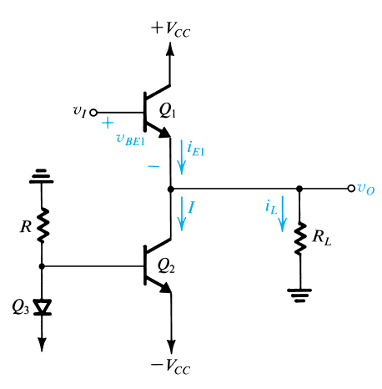
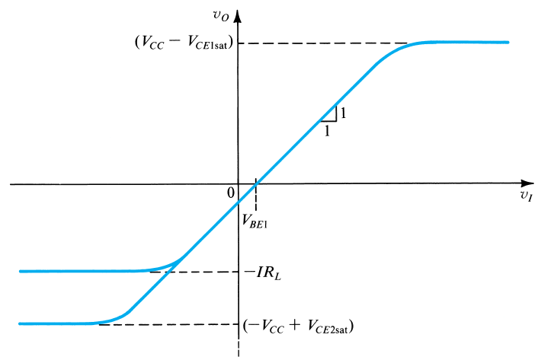
Emitter follower
i_{E} = I + I_{L}
I must be greater than the largest negative I_{L} to ensure Q1 always operates in active-mode
Class A
V_{O} = V_{I} – V_{BE1}
V_{0max} = V_{CC} – V_{CEsatQ1}
V_{0min} = -IR_{L} (Q₁ is off)
Or V_{omin} = –V_{CC} + V_{CEsatQ2} (Q₂ saturates)
if I>|- V_{CC} + V_{CEsatQ2} | / R_{L})

Slide 6
Emitter follower - ex
For this amp, V_{CC}=15V, V_{CEsat} = 0,2V, V_{BE} = 0,7V, β is very high. Find R to establish a bias current sufficiently large to allow the largest possible output swing for R_{L} = 1kΩ (Q3 is a current mirror). Determine the resulting output signal swing and the min and max emitter currents for Q₁
For this amp, I = 14,8mA, consider the case in which V₀ is limited to the range -10V to +10V (V_{BEQ1}=0,6V @ I_{EQ1} = 1mA, α = 1). Find V_{I} corresponding to V₀ = -10, 0 and +10V. At each of these points, use small-signal analysis to determine the gain V_{O}/V_{I}.

Slide 7
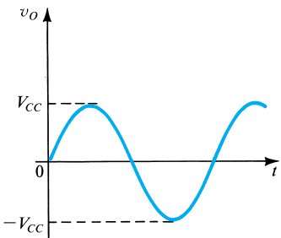
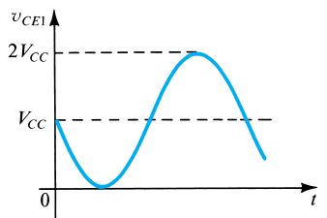
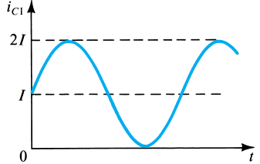
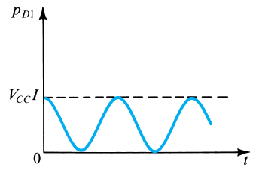
Emitter follower - Waveforms
R_{L} = V_{CC}/I

Slide 8
Emitter Follower - Ex
For this amp, V_{CC}=10V, I=100mA, and R_{L}=100Ω.
Find the power dissipated in Q1 and Q2 under quiescent conditions (V₀=0V)
For a sinusoidal output voltage of maximum possible amplitude (neglecting V_{CEsat}), find the average power dissipation in Q1 and Q2. Find the load power. (Hint : sketch the waveforms)

Slide 9
Emitter follower - Efficiency
R_{L} = V_{CC}/I
η = P_{delivered to the load} / P_{delivered from the supplies} (average values !)
P_{L} = V_{0rms}²/R_{L} = 0,5 V_{0pk}²/R_{L} = 0,5 V_{CC}²/R_{L} = 0,5 V_{CC} I
P_{delivered} = P_{VCC} + P_{-VCC} = V_{CC} I_{EQ1} + (-V_{CC}) I_{EQ2}
= V_{CC} I + (-V_{CC}) (-I)
= 2 V_{CC} I
η = V_{0pk}²/(4V_{CC}R_{L}I)
= 25% (best case)

Slide 10
Emitter follower - EX
V_{CC}=10V, I=100mA, R_{L} = 100Ω
If the output voltage is a 8V_{pk} sinusoid, find :
The power delivered to the load
The average power drawn from the supplies
The power-conversion efficiency

Slide 11
Output stages and Power Amplifiers
Introduction
Emitter Follower
Classes of operation – efficiency improvement
Thermal considerations

Slide 12
Issue
How to improve PA efficiency?
P_{delivered to the load} will always be V_{0rms}²/RL
P_{delivered from the supplies} can be lowered if output transistors do not conduct all the time…
We can imagine that Q1 and/or Q2 can conduct for a certain amount of time, reducing power consumption
PAs are classified relatively to their transistor conduction time
This one is a class A PA (Q1 always conducting)

Slide 13
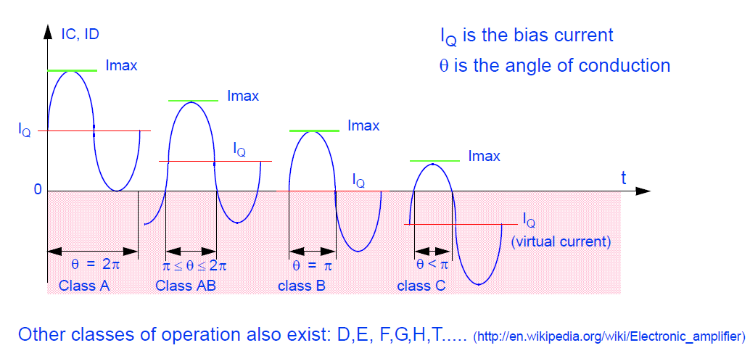
Class of operation
I_{Q} decreases → consumption decreases, efficiency increases !

Slide 14
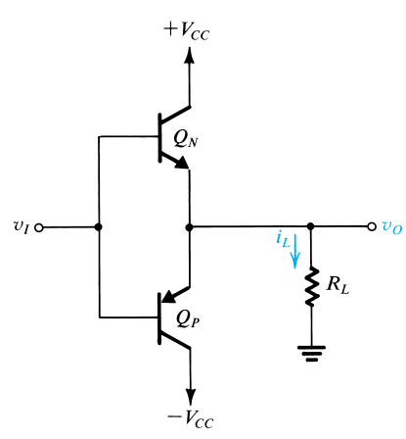
Class B PA
v_{I} = 0 : both BJTs are off, V₀=0
When v_{I} rises and exceeds about 0,5V, Q_{N} starts conducting and acts as a Emitter Follower : V₀ = V_{I}-V_{BEN}, Q_{P} is off
When v_{I} goes negative, same behavior with Q_{P}
Class B PA is biased at zero current and conducts only when signal is present
Other name : Push-pull (Q_{N} pushed the current into the load, Q_{P} pulls the current from the load)
(strictly speaking, it is a class C, because of non-zero V_{BE}s)

Slide 15
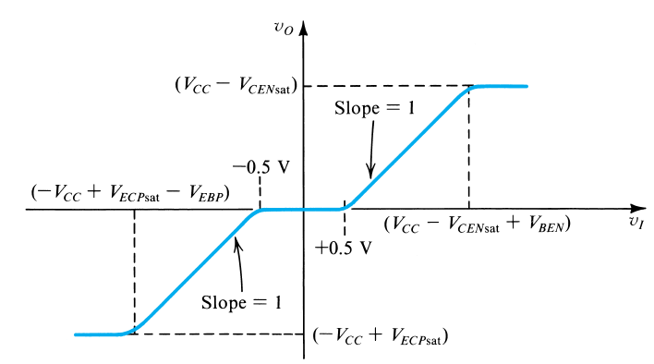
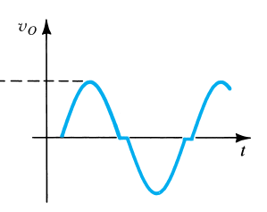
Class B PA
V_{0max} = V_{CC}-V_{CEsatN}
v_{I} _{max} = V_{CC}-V_{CEsatN} + V_{BEN}
V_{omin}= -V_{CC}-V_{CEsatP}
v_{I min} = -V_{CC}-V_{CEsatP} + V_{BEP}
Cross-over distortion !

Slide 16
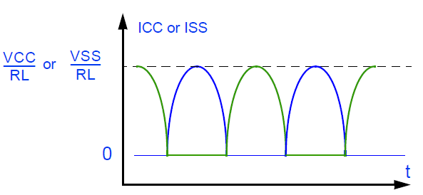
Class B efficiency
η = P_{delivered to the load} / P_{delivered from the supplies} (average values !)
P_{L} = V_{0rms}²/R_{L} = 0,5 V_{0pk}²/R_{L} = 0,5 V_{CC}²/R_{L}
P_{delivered} = P_{QN} + P_{QP} = V_{CC} I_{EQN} + (-V_{CC}) (-I_{EQP})
= V_{CC} V_{0pk}/(pi R_{L}) - V_{CC} (-V_{0pk}/(pi R_{L}))
= V_{CC}²/(pi R_{L}) + V_{CC}²/(pi R_{L})
= 2V_{CC}²/(pi R_{L})
η = pi/4 = 78,5% (best case)

Slide 17
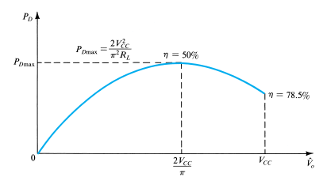
Class B – Power dissipated by transistors
P_{diss} = P_{supplies} – P_{load}
= 2V_{CC} V_{0pk}/(pi R_{L}) - 0,5 V_{0pk}²/R_{L}
The worst case is found by differentiating this equation :
V_{0pk} = 2V_{CC}/pi
P_{diss} max = 2V_{CC}²/ (pi²R_{L})

Slide 18
Class B - ex
It is required to design a class B output stage to deliver an average output power of 20W to an 8Ω load. The power supply is to be selected such that V_{CC} is about 5V greater than the pk voltage (This avoids transistor saturation and the associated nonlinear distortion). Determine the supply voltage required, the pk current drawn from each supply, the total supply power, and the power-conversion efficiency. Determine the maximum power that each transistor must be able to dissipate safely.

Slide 19
Class B - ex
For this class B PA, let V_{CC}=6V and R_{L} = 4Ω. If the output is a sinusoid with 4.5V_{pk} amplitude, find:
The output power
The average power drawn from each supply
The power efficiency obtained at this output voltage
The peak currents supplied by v_{I}, assuming β_{N} = β_{P} =50
The max power that each transistor must be capable of dissipating safely

Slide 20
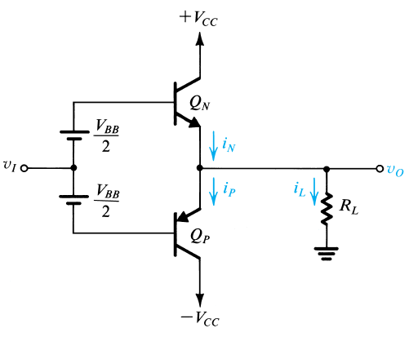
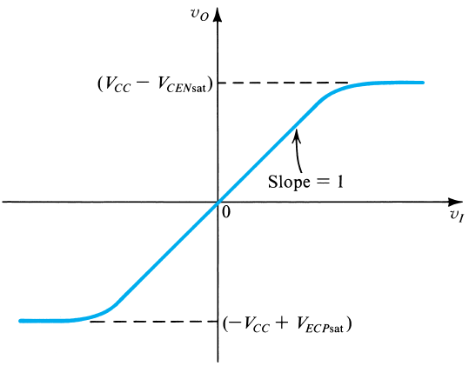
Class AB
In order to get rid of cross-over distortion, Q_{N} and Q_{P} could be biased at a small non-zero current (class AB)
When v_{I} rises, V_{BN} rises by the same amount V₀= V_{I}+V_{BB}/2-V_{BEN}, i_{N} rises, so V_{BEN} rises, so V_{BEP} decreases
For power calculation, it is the same as class B except that each transistor dissipates V_{CC}I_{Q} @ V_{I} = 0

Slide 21
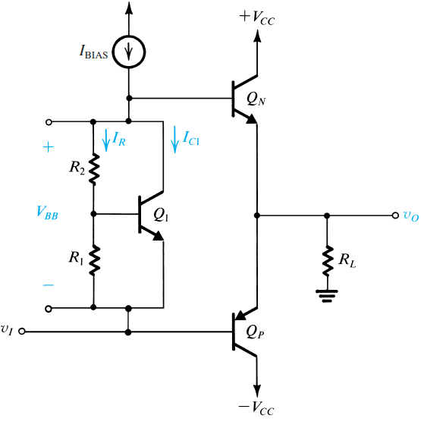
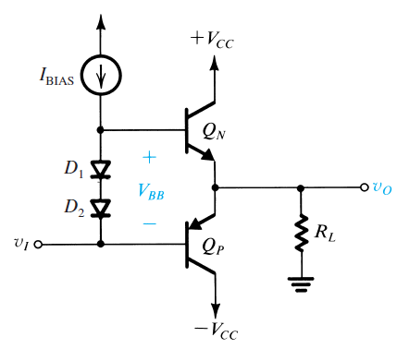
Generating VBB
I_{R} = V_{BE1}/R₁
V_{BB} = (R₁+R₂)I_{R} = V_{BE1} (1+R₂/R₁)
V_{BE} multiplier
Thermal feedback
Diodes biasing
Thermal feedback

Slide 22
VBE multiplier - ex
Consider a V_{BE} multiplier with R1=R2=1.2kΩ, utilizing a transistor that has V_{BE}=0,6V @ I_{C}=1mA, and a very high β. Find the value of the current I_{bias} that should be supplied to the multiplier to obtain a terminal voltage of 1,2V. Find the value of I_{bias} that will result in the terminal voltage changing from the 1,2V value by +50mV, +100mV, +200mV, -50mV, -100mV, -200mV

Slide 23
Output stages and Power Amplifiers
Introduction
Emitter Follower
Class of operation
Thermal considerations

Slide 24
Thermal considerations – power BJT
Transistors that must conduct currents in the Ampere range and to withstand power in the W – tens of W range differ in their physical structure, packaging, specifications from the small-signal transistors considered before…
The dissipated power is converted into heat, which raises the junction temperature T_{J}. Above T_{Jmax} (150-200°C) the transistor may be destroyed !
The heat will be conducted from the junction to the case, and from the case to the ambient air : T_{J}-T_{A} = θ_{J→A} P_{diss} where θ_{J→A} is the thermal resistance between junction and ambient air
θ_{J→A} must be low (depends mainly on packaging, specified in datasheets)

Slide 25
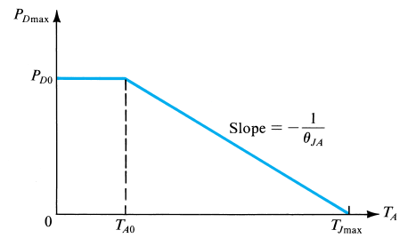
Thermal considerations – Ex
Power-derating curve
A BJT is specified to have a max P_{diss} of 2W at an ambient temperature T_{A0} of 25°C and a T_{Jmax} of 150°C. Find the thermal resistance, the maximum power that can be dissipated @ T_{A} = 50°C, and T_{J} if the device is operating at T_{A} = 25°C and is dissipating 1W.

Slide 26
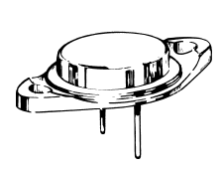
Thermal resistance
θ_{J→A} = θ_{J→C} + θ_{C→A}
θ_{J→C} is fixed by the device and packaging
Can be reduced when a large metal plate is in contact with the collector (ex: TO3)
The circuit designer can reduce θ_{C→A}, by means of bolting the transistor into a larger metal surface (heat sink)
θ_{C→A} = θ_{C→S} + θ_{S→A}, can be low !

Slide 27
Thermal resistance - EX
A BJT is specified to have T_{Jmax} = 150°C and to be capable of dissipating maximum power as follows :
40W@T_{C}=25°C,
2W @ T_{A} = 25°C.
Above 25°C, the maximum power dissipation is to be derated linearly with θ_{J→C} = 3,12°C/W and θ_{J→A} = 62,5°C/W
Find the maximum power that can be dissipated safely by this transistor when operated in free air (T_{A}=50°C)
Find the max power that can be dissipated safely when operated at T_{A}=50°C, but with a heat sink for which θ_{C→S} = 0,5°C/W and θ_{S→A} = 4°C/W. Find T_{C} and T_{S}
Find the max power that can be dissipated safely if an “infinite heat sink” is used at T_{A}=50°C

