Slide 1
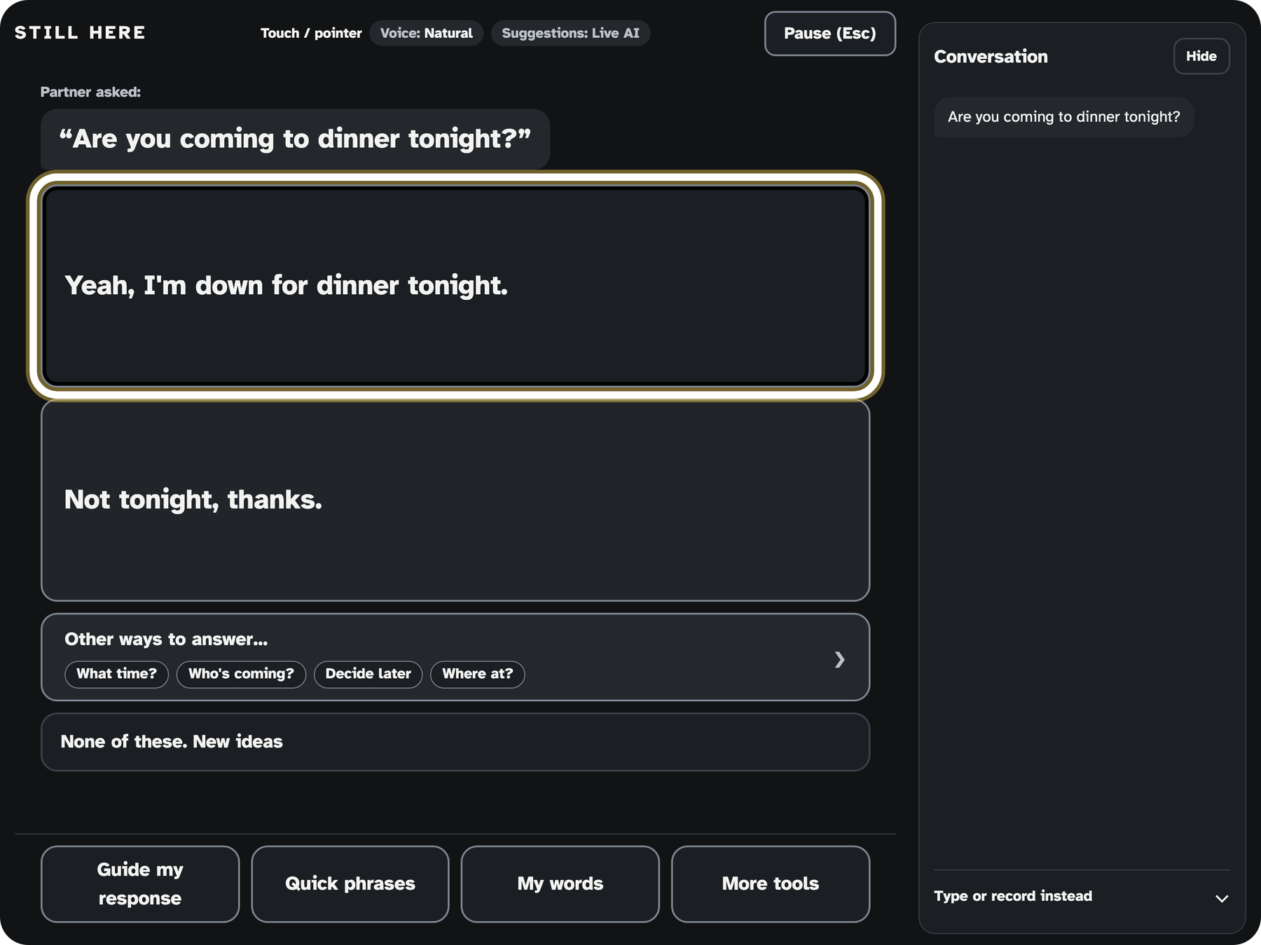

Be part of the conversation while it's still happening.
Liam Howeth · Richard Oduma · SASEHacks for Good
Notes:
Hi, we're Liam and Richard, and this is Still Here. It helps people who can't speak or use their hands join a conversation while it's still happening.

Slide 2

Built for people living with ALS
What is ALS?
Also helps
A progressive disease that destroys the nerve cells controlling muscles. People lose movement, speech, and breathing. Thinking often stays intact.¹
Locked-in syndrome
Cerebral palsy
High spinal cord injury
Muscular dystrophy or MS
Most people with ALS lose their speech.²
Intubated hospital patients
5M+
Americans can't rely on speech³
$10,000+
eye-gaze devices⁴
¹ ALS Association, "What is ALS?" and "Changes in Thinking" (accessed 2026-10-24). ² Eshghi et al., Scientific Reports 12:15713 (2022). ³ CommunicationFIRST, organization estimate (accessed 2026-10-24). ⁴ Montana AT Program, Tobii I-16 eye-gaze device, est. $10,695 (older model).
Notes:
Imagine a friend asks, "Are you coming to dinner tonight?" and by the time you spell out an answer, everyone has moved on. We built for ALS first because most people with ALS lose their speech while their thinking often stays intact, and that is exactly what Still Here needs. The same face controls can also help people with locked-in syndrome, cerebral palsy, high spinal cord injury, and patients who cannot speak for a while, like after intubation.

Slide 3





Listen. Suggest. Choose. Speak.
Listen
Suggest
Choose
Speak
Partner just talks
Two best replies + other ways
Eyebrows move, blink picks
Natural voice
Any phone or tablet. No special hardware.
Notes:
Still Here listens when the partner talks and suggests the two best replies, plus other ways to answer. The person raises their eyebrows to move and does a long blink to choose. The chosen reply is spoken in a natural voice, on an everyday phone or tablet with a front camera, no eye tracker or special hardware. Today we've tested it on an iPad; phones are next.

Slide 4




Your face is the controller
Raise eyebrows
Next option
Keep them up
Keep moving
Drop your jaw
Go back
Long blink
Choose and speak
One-minute calibration learns your face. Partner just talks.
Notes:
There is no touch screen tapping and no eye tracker. Raising your eyebrows moves to the next option, keeping them up keeps moving, dropping your jaw goes back, and a long blink chooses and speaks. A one-minute calibration learns each person's face, and the partner simply talks.

Slide 5
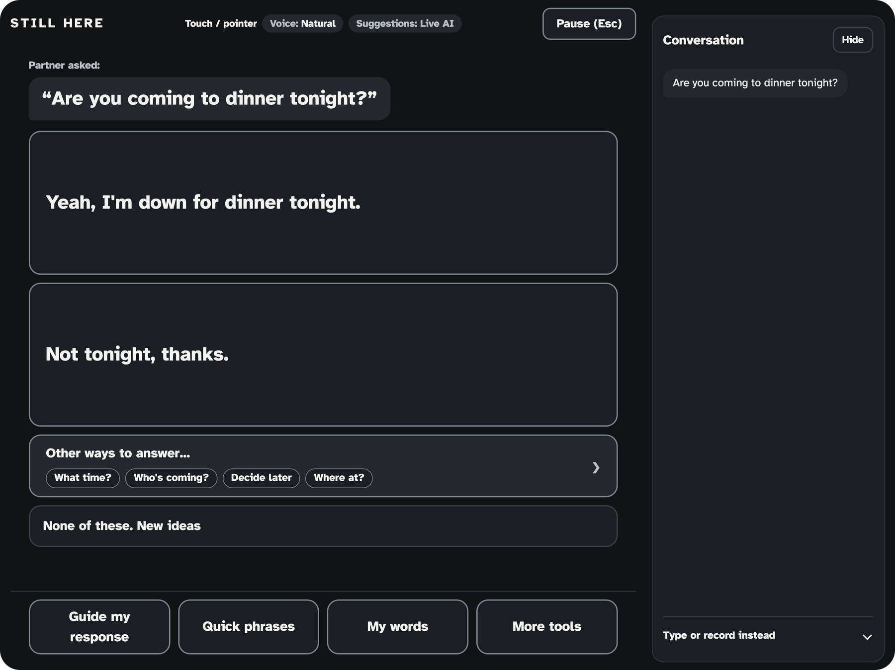
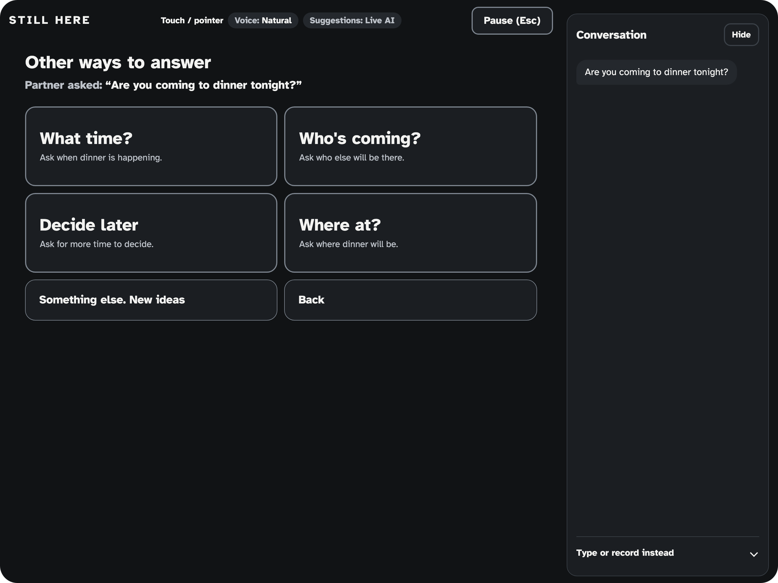
One blink to answer
Two best replies
Or pick a direction
Current build, iPad-size browser view, Live AI replies (wording varies run to run).
Notes:
Here is the dinner question on the iPad. Two likely replies appear, and one long blink speaks the highlighted one. If neither fits, Other ways to answer lets the person pick a direction instead. Nothing is spoken unless the person chooses it.

Slide 6
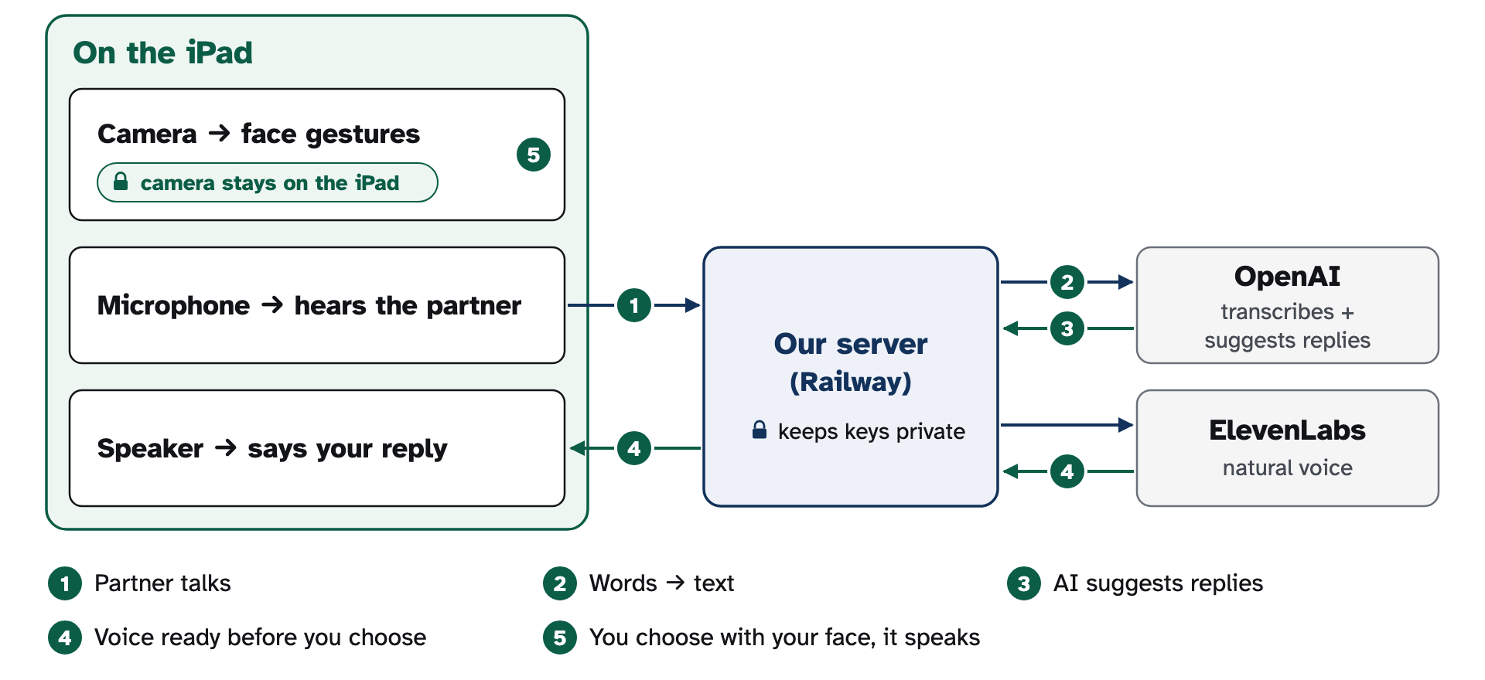



Simple, private, personal
Calibrated to your face
Camera stays on the iPad
Learns you, with permission
Your words. Your choice.
Next: test with people with ALS · phones and offline · personal voice
Notes:
Face tracking runs on the iPad, so camera frames stay on the device by design, and a short calibration learns each person's face. Our server keeps the API keys private and calls OpenAI for replies and ElevenLabs for the voice, and learning is off by default and keeps only what the person approves. Next, we want to test with people with ALS, bring it to phones and offline use, and add a personal voice. Your words, your choice. Thank you.

