Slide 1
Introduction

Slide 2
Introduction/Business Problem:
The aim of this report is to detail prospective locations for establishing a new Indian themed restaurant.
Starting a restaurant is tricky. You need to hire good staff and keep them happy, source great produce, pay your bills, manage your clientele. Importantly, you also need to set up your restaurant in an area that gets you an adequate supply of diners.
This analysis will explore whether it is better to be away from other restaurants because they might take your customers, or close because the number of people looking to eat will be higher?
For this analysis, we will be examining the Australian city of Canberra.

Slide 3
Data

Slide 4
What data was used?
The data we used comes from the Foursquare API
From Foursquare we were able to obtain a number of features of restaurants around Canberra:
Name
Location
Restaurant type (e.g. North Indian, Chinese, Thai)
The number of people who have liked the restaurant

Slide 5
Methodology

Slide 6
Obtaining and analyzing the data
The Foursquare “api.foursquare.com/v2/venues/search?...” query only returns up to 50 restaurants for a given location
To overcome this, six separate locations where chosen around Canberra
Restaurants were plotted on a map of Canberra using the Folium library
To obtain the number of likes, an “api.foursquare.com/v2/venues/{}/likes?...” query was performed for each restaurant.

Slide 7



As the distance between restaurants was of interest, a function to calculate distance from Longitude and Latitude was written.
It is based on the Haversine formula, where:
This function was used to create a distance matrix detailing the distance between each restaurant and every other restaurant.

Slide 8
The machine learning operation DBSCAN used the distance matrix to cluster the restaurants.
A cluster was defined with epsilon = 500m.
A cluster needed to contain at least three restaurants.
Following the DBSCAN operation, clusters were examined in a box plot, as this provided a clear representation of the cluster mean, standard deviation and outliers.

Slide 9
Results

Slide 10
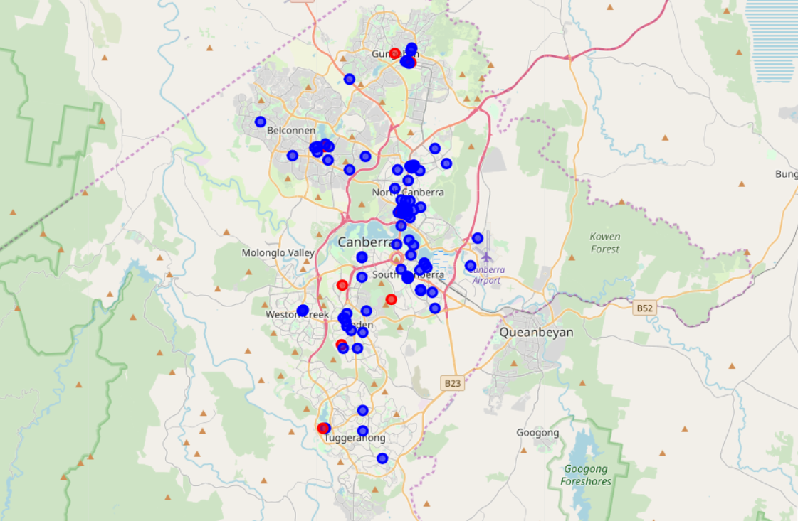
Restaurants in Canberra
Red icons represent Indian restaurants and blue icons represent all other restaurants.

Slide 11
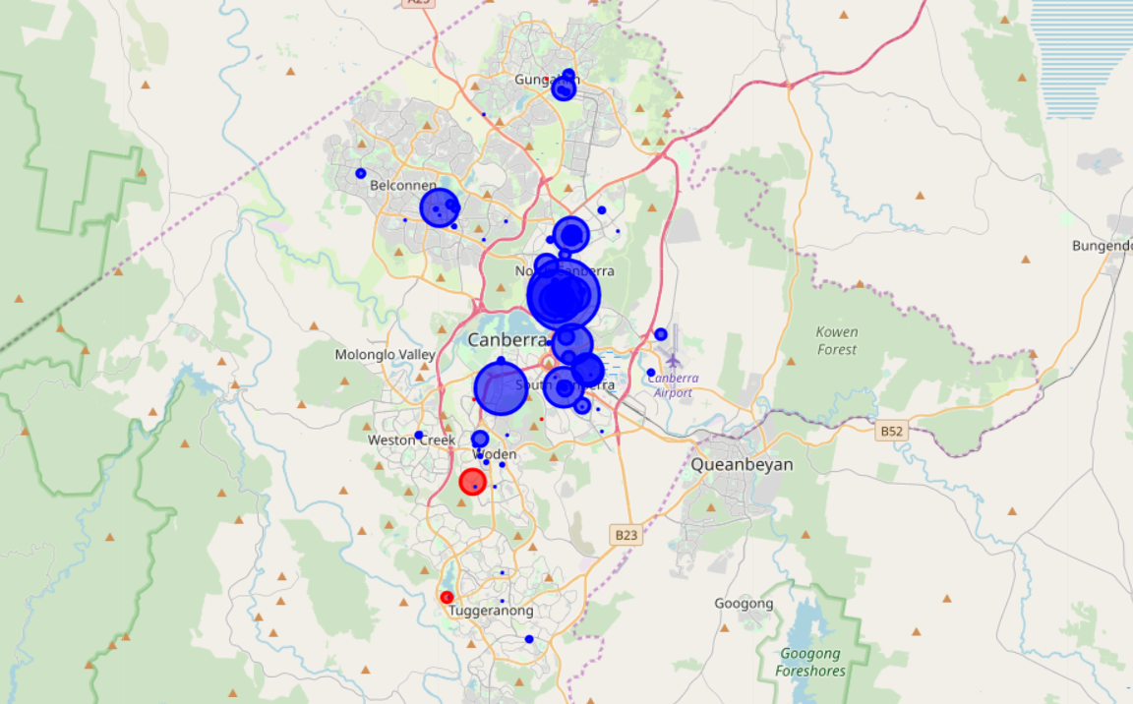
Restaurants in Canberra (including likes)
The markers in this figure vary on size depending on how many likes they receive (larger icons have received more likes)

Slide 12
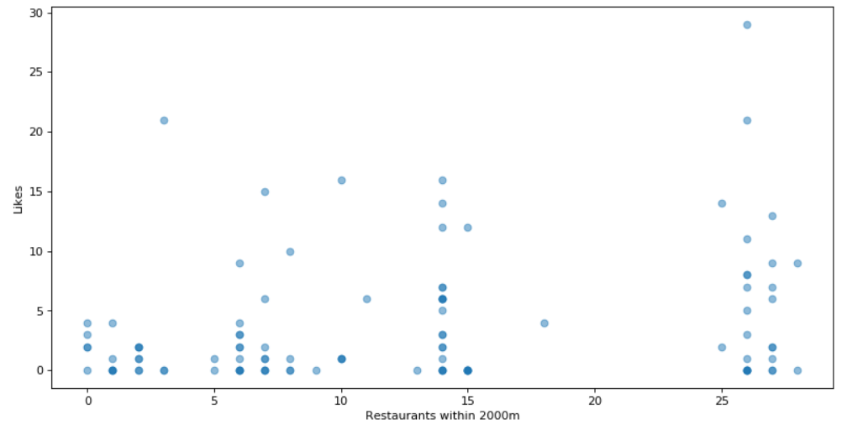
Number of nearby restaurants vs likes
This analysis shows a scatter plot of likes a restaurant receives against how many restaurants are near it. This is different from DBSCAN as it only looks at each restaurant’s neighbours, not core or border clustering.

Slide 13
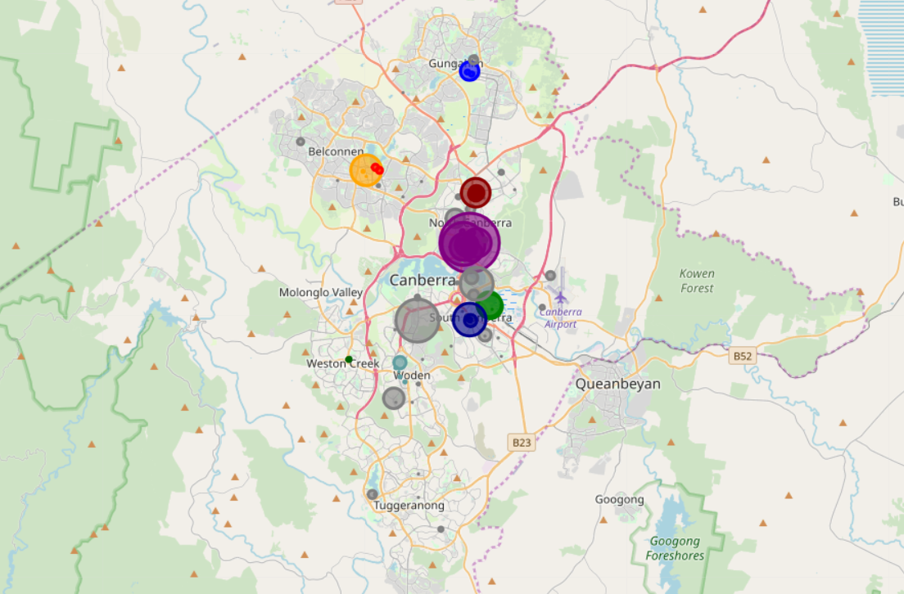
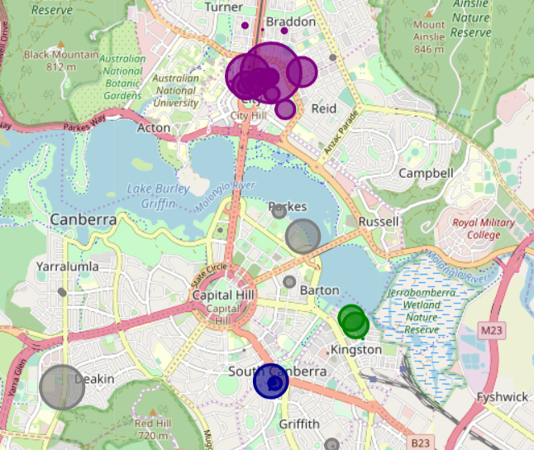
DBSCAN Clustering
This shows a DBSCAN of Canberra Restaurants. Epsilon = 500m and a cluster requires a minimum of 3 restaurants.

Slide 14
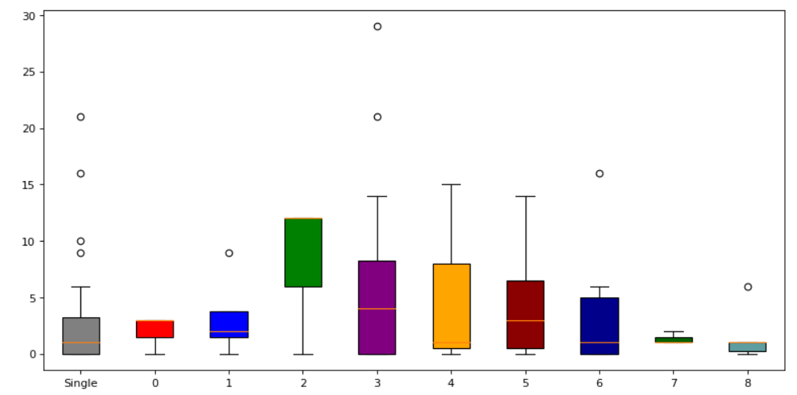
Box plot of Likes for each cluster
The colour of the box plot corresponds to the colour of the cluster on the previous slide.

Slide 15
Discussion

Slide 16
Discussing the results
Canberra’s restaurants have a number of clusters throughout the territory
Restaurants not in a cluster tend to have a less likes
Similarly, restaurants with fewer restaurants near them tend to have less like. This can be seen in the scatter plot
The ‘Green’ cluster near ‘Kingston’ has the highest mean in the box plot, but has a small sample size
The ‘Purple’ Cluster has the second highest value and a much larger sample size
Restaurants not in a cluster, shown as ‘Grey’, have a low mean score but a significant number of outliers
Not all restaurants in Canberra are shown in Foursquare

Slide 17
Conclusion

Slide 18
Where should you set up a restaurant?
This analysis only examines location and ‘likes’ based on Foursquare data
Establishing a restaurant requires a lot more analysis than location and ‘likes’
If all other factors were equal, I would recommend setting up a restaurant in the ‘Green’ cluster
The ‘Green’ cluster has restaurants with a high median number of ‘likes’, and no other Indian Restaurants nearby.

