Slide 1
Made using symbols from SlidesCarnival - Messala presentation template

Slide 2
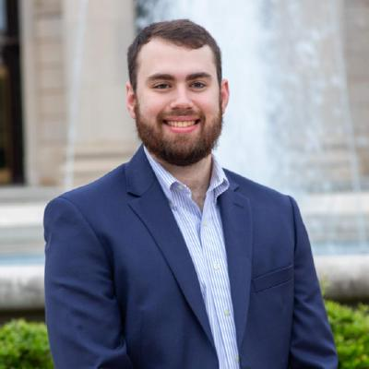
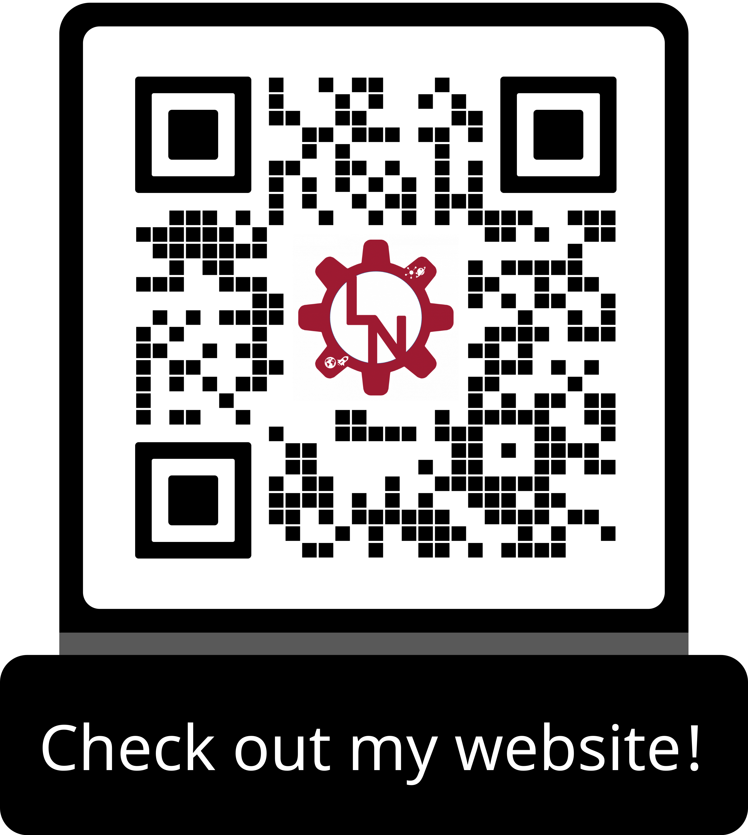
Tel: (610) 952 – 7556
Email: lmnester@crimson.ua.edu
Website: https://liamnester.github.io/
LinkedIn: https://www.linkedin.com/in/liamnester/
GitHub: https://github.com/LiamEngMan
Liam Nester
Mechanical Engineer

