Slide 1
Travis CI Introduction
Liam Norman

Slide 4
“People OFTEN underestimate the time they spend debugging. They underestimate how much time they can spend chasing a long bug. With testing, I know straight away when I have added a bug. That lets me fix the bug immediately. there are few things more frustrating or time wasting than debugging. Wouldn’t it be a hell of a lot quicker if we just didn’t create the bugs in the first place”
- Martin Fowler

Slide 5

What is CI?
“A software development practice where members of a team integrate their work frequently … verified by an automated build (including tests) to detect integration errors” - Martin Fowler
When you combine the process with automated testing using PHPUnit, PHPSpec, Codeception etc… then continuous integration can enable your code to be dependable.

Slide 6
WHAT IS TRAVIS CI?
A hosted continuous integration platform that is free for all open source projects hosted on Github
With just a file called .travis.yml describing some details about a project, you can trigger automated builds with every change to your code base
For commercial projects, there is also travis-ci.com which is the same as travis-ci.org but allows for private repos

Slide 7
TRAVIS CI IS…
Open source (github.com/travis-ci)
Distributed - allows users to contribute build capacities by connecting a VM that runs a build agent on the travis servers.
Features an advanced build system

Slide 8
Why use travis?
Nothing to install, Travis has a web-based interface as opposed to a heavy java application that you have to host yourself
Free to use for open-source projects!
Integrates nicely with GitHub without any developer effort!
Has a much shallower learning curve than it’s competitors

Slide 9
The build SYSTEM
Travis CI runs builds in isolated virtual machines which do not persist state across builds.
This ensures your builds run in an environment built from scratch.
Build systems can be very simple or connect to a variety of services such as Redis, Memcached etc…
The build system allows for access to various data stores such as MySQL, MariaDB, PostgreSQL, SQLite, ElasticSearch, CouchDB etc…
Builds by default run on Linux Trusty (14.04 LTS).

Slide 10
Getting started…
Sign up with travis-ci.org using your GitHub Account
Enable the repositories that you want Travis to build against.
travis-ci.org only lets you build against public repositories (as the platform promotes open-source development)

Slide 12
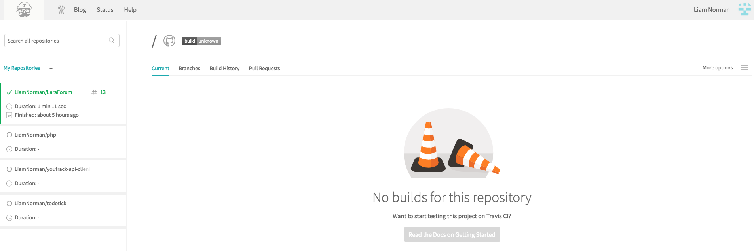

Slide 13
SETUP TRAVIS WITH LARAVEL & PHPUNIT
An example of a Travis setup that I use on a Laravel 5.4 / PHP 7.1 application
Testing database runs against a MySQL database. I could use SQLite but prefer to keep the database environments the same between production and testing environments.
This is just an example to get you setup and using Travis. You can expand this as needed.
RTFM - https://docs.travis-ci.com/

Slide 14
SETUP TRAVIS WITH LARAVEL & PHPUNIT Step 1 - .TRAVIS.YML
Add a .travis.yml file to your application directory
Configure .travis.yml
Add various PHP versions to build against (if necessary)
Add services if needed (Redis, Memcached etc…)

Slide 15
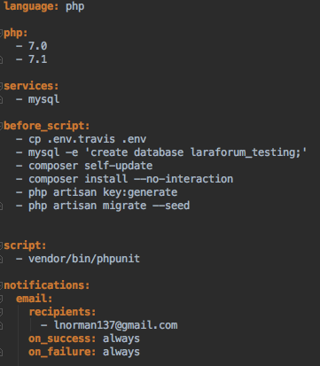
MY .TRAVIS.YML

Slide 16
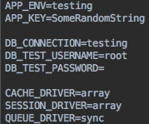
SETUP TRAVIS WITH LARAVEL & PHPUNIT Step 2 - .env.travis

Slide 17
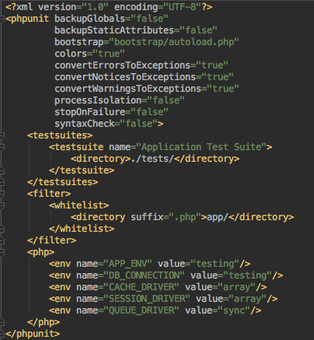
SETUP TRAVIS WITH LARAVEL & PHPUNIT Step 3 - PHPUNIT.xml

Slide 18
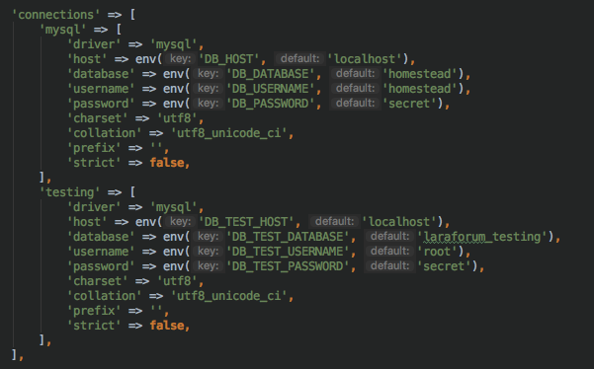
SETUP TRAVIS WITH LARAVEL & PHPUNIT Step 4 - database config
Located in config/database.php, add the below

Slide 19
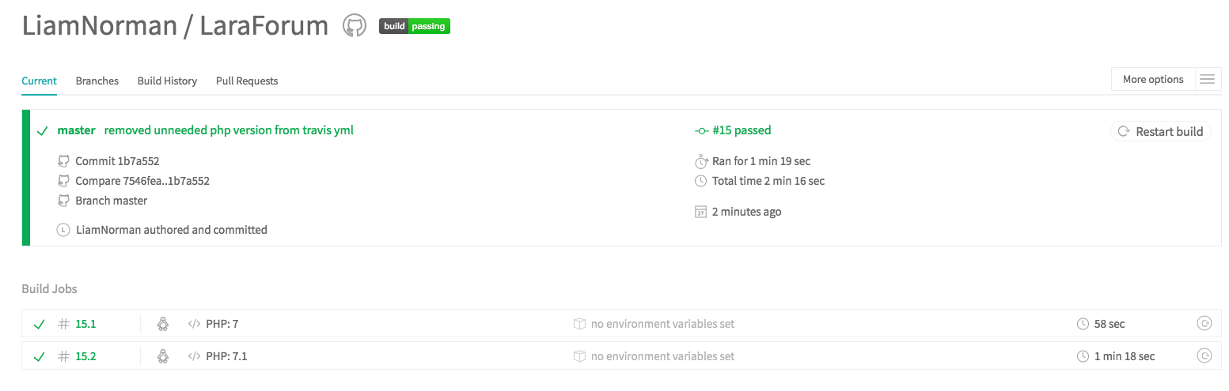
GET pushing code
Commit some code on master (by default, travis checks the master branch. More on this later…)
Push some code and as long as you have a .travis.yml file, travis will build against it using a isolated VM.

Slide 20
LIVE BUILD LOG
You can see the build log (which updates in real time) for every test.
You can also see the travis config used for that test (incase the config changes over time).

Slide 21
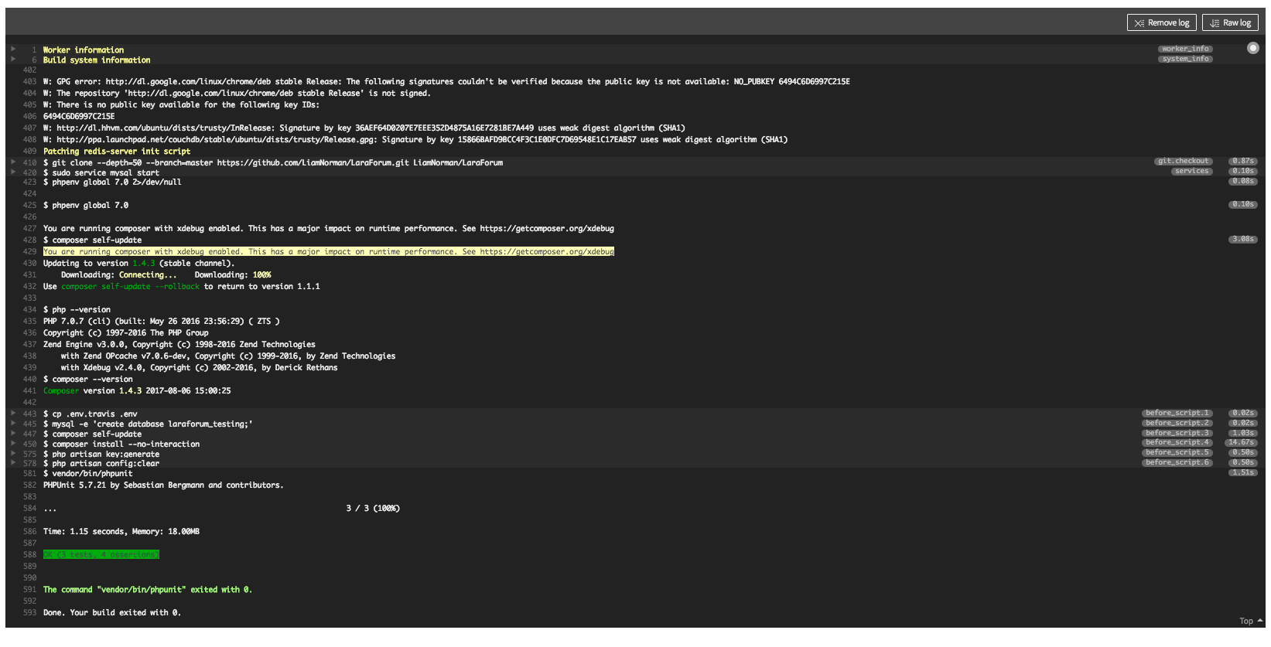

Slide 22
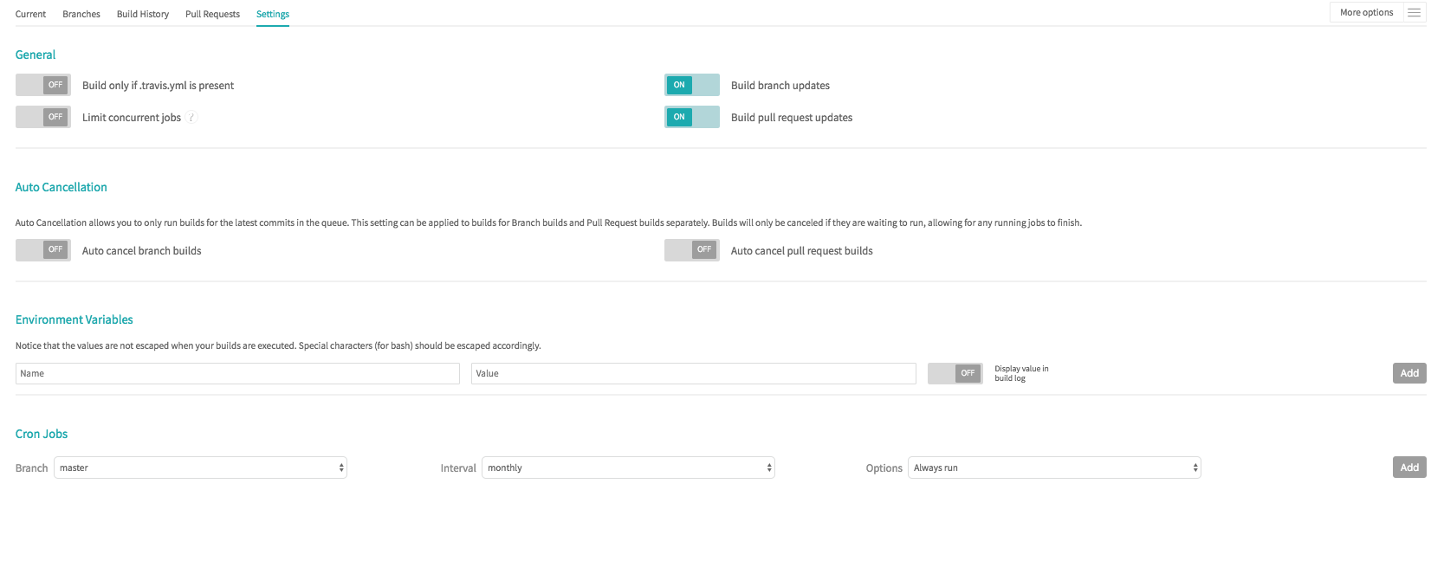
TRAVIS REPO SETTINGS

Slide 23
ANNOUNCE YOUR BUILD STATUS - Notifications
Travis supports various build notifications such as:
Build status on PR’s
Build status on repo’s (a fancy badge)
Email notifications
IRC notifications
Slack, Campfire etc…

Slide 24
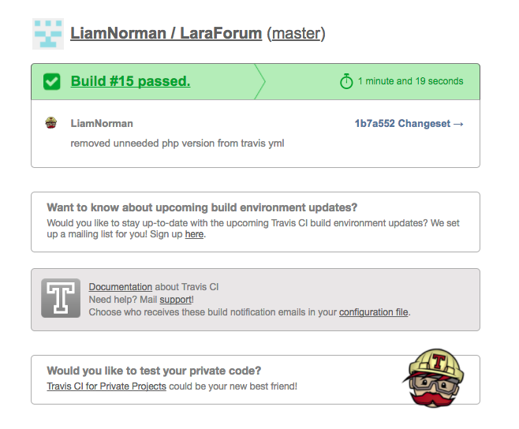
EMAIL NOTIFICATION

Slide 25

A SNEAK PEEK INTO THE TRAVIS CLI
Travis CLI is a ruby command line application.
Ensure you have ruby installed:
Install the travis gem
Verify travis cli is installed using travis -version

Slide 26
A SNEAK PEEK INTO THE TRAVIS CLI - Login
Login using “travis login” and enter your GitHub credentials.
This will generate an OAuth token which will allow you to run commands against your travis enabled repo’s.

Slide 27
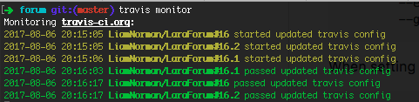
A sneak peek into the travis cli - monitor
Travis monitor allows you to see a live stream of what is occurring within your repo’s such as build notifications, build progress, build failures etc…

Slide 28
A sneak peek into the travis cli - LINT
Lint checks a .travis.yml file for any issues, it will by default read the .travis.yml file in the current directory
“travis lint”

Slide 29
A sneak peek into the travis cli - Whatsup
“travis whatsup” allows you to see recent action on your repo’s.
$ travis whatsup
mysociety/fixmystreet started: #154
eloquent/typhoon started: #228
Pajk/apipie-rails started: #84
qcubed/framework failed: a#21
...

Slide 30
BEYOND THE SCOPE: Travis CI supports CD
Travis CI allows you to implement continuous deployment by configuring various deployment environments such as AWS, Heroku, Google Firebase etc…
Unfortunately, this is beyond the scope of this presentation or we will be here for years but each environment is documented here - https://docs.travis-ci.com/user/deployment/

Slide 31
DEMO TIME :)

Slide 32
Talk Materials
View the talk materials online here including all the configuration files discussed for my sample travis application - https://github.com/LiamNorman/TravisCITalk-PHPAugust2017

Slide 33
THANKS

