Slide 1
Eigen Markup Language en JSON
Project door:
Liam Wouters
Siebe Wijnants
Axel De Leeuw
Michel Dierckx

Slide 2
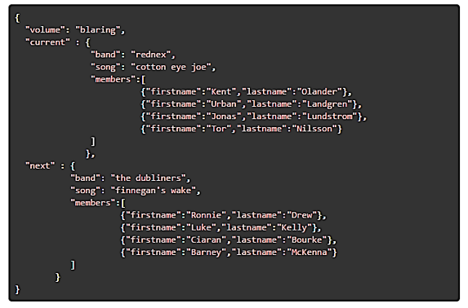
JSON: Grammar
https://www.json.org/json-en.html

Slide 3
JSON: Tokenization
=> opeenvolging van strings, integers, speciale tekens, …

Slide 4
JSON Schema
{
"type": "object",
"properties":
{
"name": {"type":"string"},
"age": {"type": "int", "maximum":100, "minimum":0}
}
"required":["name"]
}

Slide 5
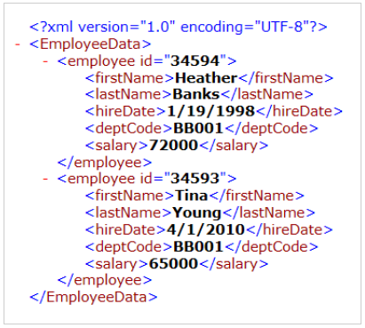
Eigen Markup Language

Slide 6
EML: Tokenization
<person>
<name>”Siebe”</name>
<age>19</age>
</person>
<P>
<A>V1</A>
<B>V2</B>
</P>
=>

Slide 7
Parsers
CYK
LL
LR
Earley

Slide 8
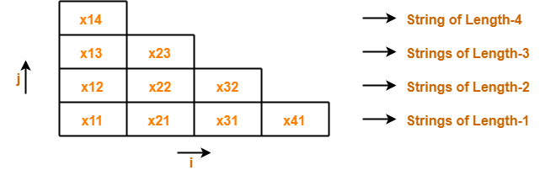
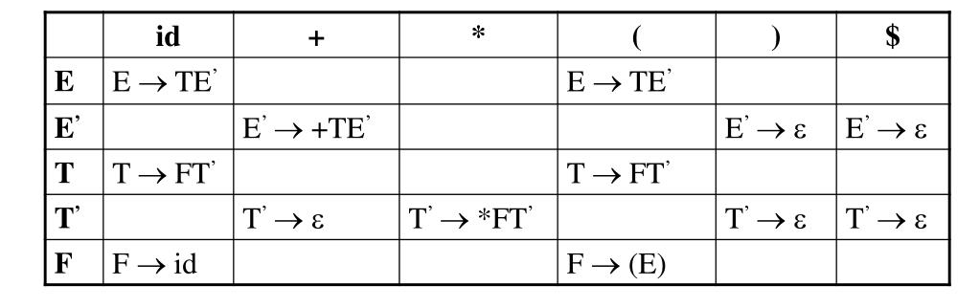
Import TOi
CYK Algorithm | CYK Algorithm Example | Gate Vidyalay
PPT - Top-Down Parsing PowerPoint Presentation, free download - ID:5876027 (slideserve.com)

Slide 9
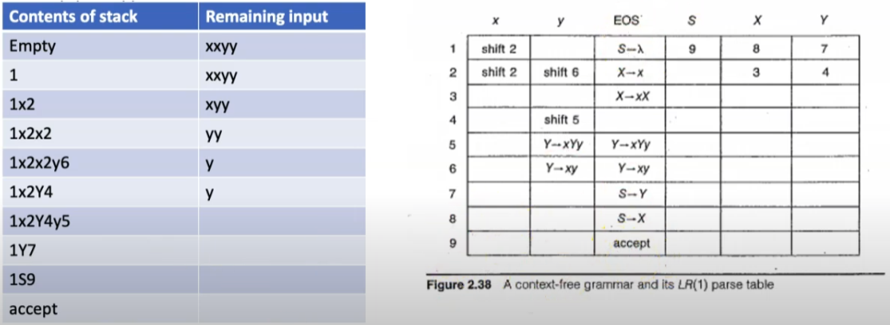
LR(1) Parser
Opbouwen van de LR(1) parse table

Slide 10
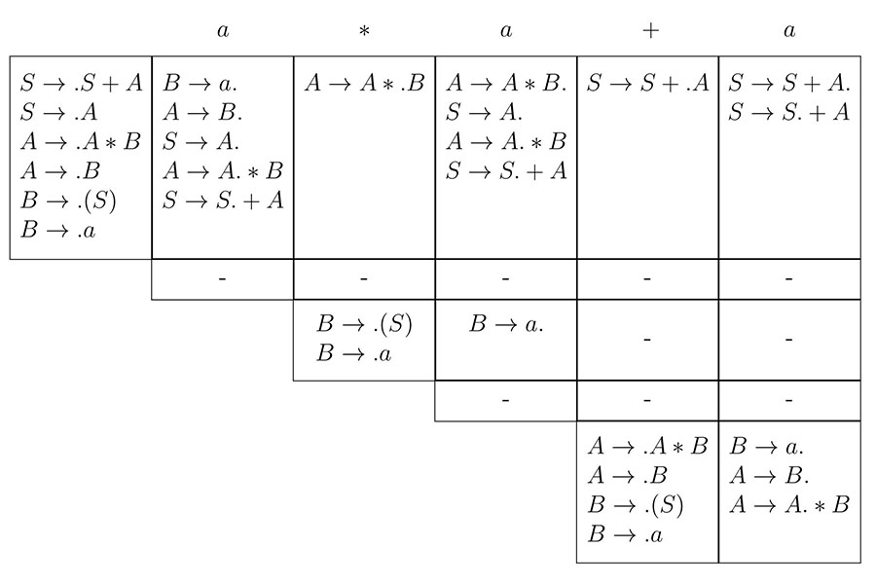
Earley Parser
chart parser
krachtiger dan LR en LL
kan bijna alle mogelijke CFG’s parsen
https://en.wikipedia.org/wiki/Earley_parser

Slide 11
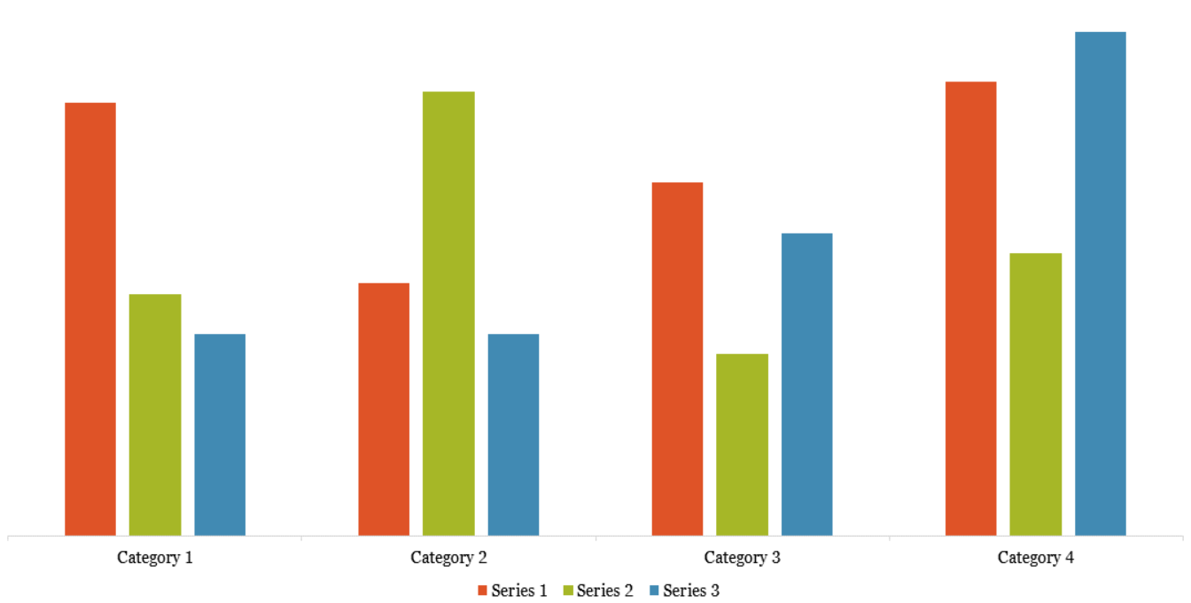
Performance Vergelijken
Verschillende input files: (JSON, EML) veel verschillende groottes.
Parsers vergelijken
Conclusie, waarom?

Slide 12
EML <-> JSON Conversion
Parsers bouwen correcte datastructuur, correct afbreken op gefaalde parse
{
"fruit": "Apple",
"size": "Large",
"amount": 5
}
<root>
<amount>5</amount>
<fruit>Apple</fruit>
<size>Large</size>
</root>

Slide 13
EML <-> JSON Conversion
Datatypes onderscheiden uit de files
{
"fruit": "Apple",
"size": "Large",
"weight": 2.1
}
<root>
<weight>2.1</weight>
<fruit>Apple</fruit>
<size>Large</size>
</root>

Slide 14
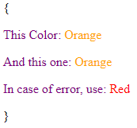
Syntax Highlighting

Slide 15
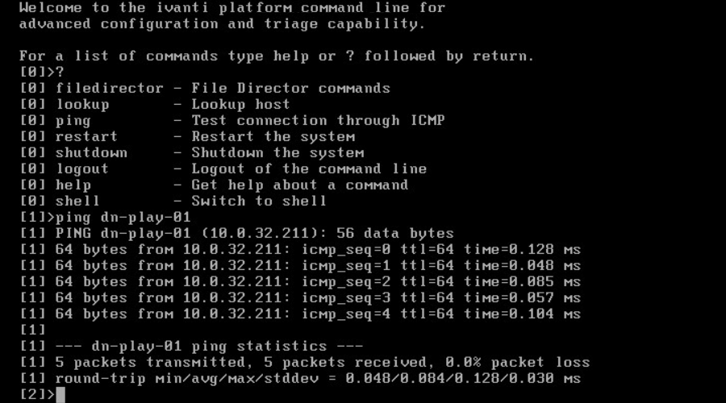
Command-Line Interface
Command Line Interface (ivanti.com)

