Slide 1

ACTIVE MODE MAP · SCM-PIT · MULTI75G
Reconstructing the full complex spectrum
amplitude, phase, bias dependence, and honest error bars
Both forward models (two-segment Euler–Bernoulli and the geometry-faithful FEM), each bare and with a discrepancy GP, and a model-light GP baseline — reconstructing the mode-A contact resonance from 8 of 101 measured positions and now carrying the phase channel, not only log-amplitude.
Dense_Grid_A · 101 positions × 412 frequencies · 14 August 2026

Slide 2
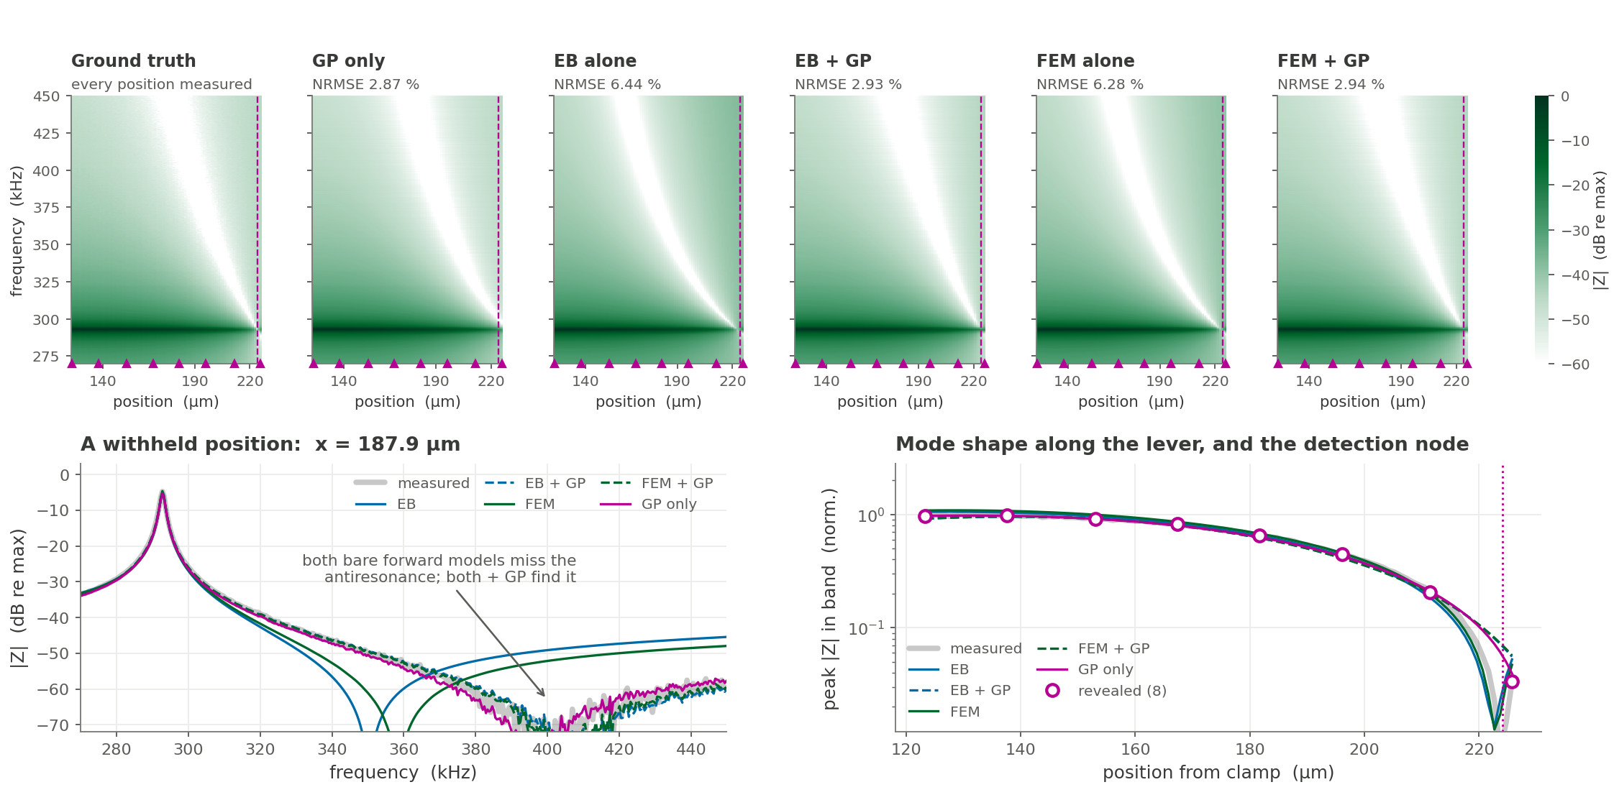
RECONSTRUCTED SPECTRUM · 1 OF 2
Amplitude: 8 of 101 positions reproduce the map to 2.9 %
Bare physics 6.3–6.4 %; with the GP either model reaches 2.9 %, the same as the GP alone. Both libraries were rebuilt here and reproduce the published log-amplitude arms exactly (EB 6.53 / 2.41, FEM 6.31 / 1.94, GP 3.41 %).
It earns its place at the node. EB + GP and FEM + GP both land 0.15 µm from the true 224.09 µm; bare EB is 1.8 µm out, bare FEM 1.0 µm, and the GP alone never finds a crossing in span — 3 µm out at every budget from 4 to 30 positions.
Do NOT read the fitted k₁ off this slide. EB fits 374 N/m here and FEM 1254, but neither is identified by band A: the mode-2 ratio puts EB at 1044 N/m, essentially Hertz. See slide 5.
2

Slide 3
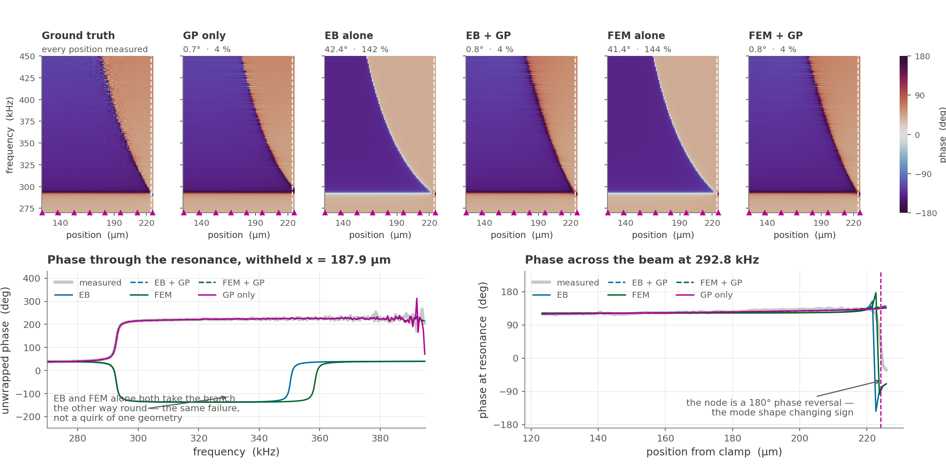
RECONSTRUCTED SPECTRUM · 2 OF 2
Phase: both forward models get it wrong the same way
EB alone 42.4°, FEM alone 41.4° — 142 % and 144 % on the complex field, worse than predicting zero. One complex gain absorbs the detector’s reference phase, so what is left is model error. Two unrelated models, independently fitted and operating at k₁ values 3× apart, fail by the same 41–42° and take the antiresonance branch the same wrong way.
Not a mis-set resonance either. Refitting f_res and damping against the complex residual only makes it worse — the discrepancy is structural.
3

Slide 4
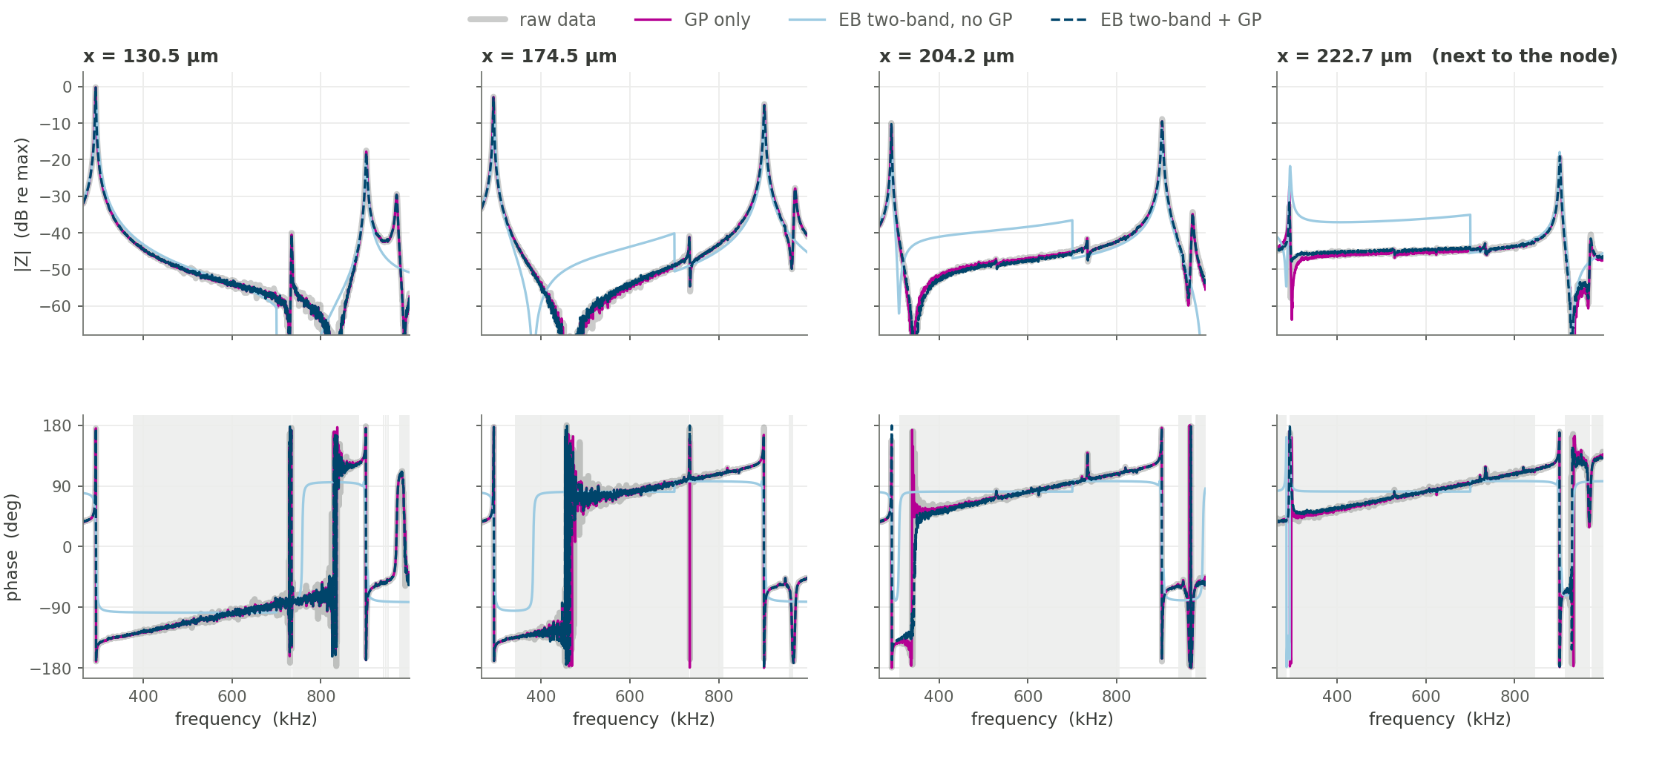
RECONSTRUCTION VS RAW DATA · 1 OF 2
Transfer functions at withheld positions
Four positions none of the arms was shown, across 265–1000 kHz so both contact modes are in frame. Median |error| over all 93 withheld positions: 0.29 dB for EB two-band + GP and 0.30 dB for the GP alone, against 3.33 dB for the bare two-band physics — which misplaces the antiresonance and inverts the phase branch, visible as the pale blue line leaving the data between the two modes. Grey bands mark raw |Z| below 3× the noise floor, where the measured phase is not reliable and nothing should match it.
4

Slide 5
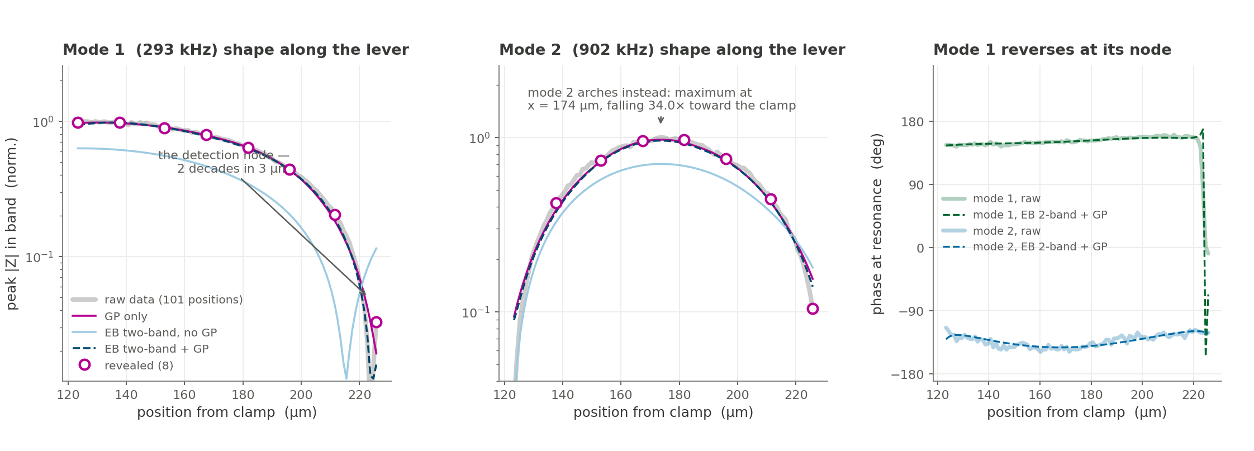
RECONSTRUCTION VS RAW DATA · 2 OF 2
Resonance mode shapes, both flexural modes
Mode 1 collapses two decades into the last 3 µm; mode 2 arches instead, peaking at x = 174 µm with no node anywhere in the measured span. Peak-amplitude error over the withheld positions: mode 1 3.8 % and mode 2 6.4 % for EB two-band + GP, against 7.9 % / 6.2 % for the GP alone and 67 % / 23 % for the bare physics. The right-hand panel is the consequence — mode 1 reverses 180° at its node and mode 2 never does, because it has none here.
5

Slide 6
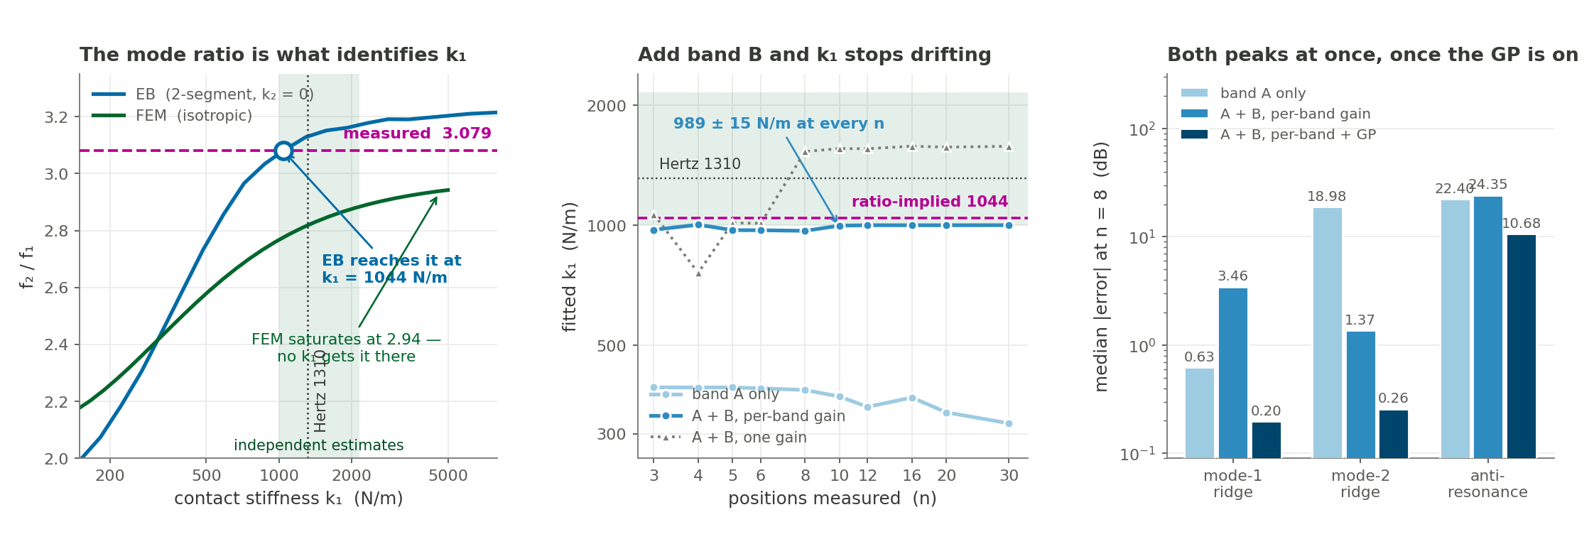
FITTING BOTH PEAKS
k₁ is not identifiable from band A — the mode ratio identifies it
EB reaches the measured f₂/f₁ = 3.079 at k₁ = 1044 N/m — essentially the Hertz value. Over k₁ = 328 → 1291 N/m, f₁ moves 3.8 % while the ratio moves 28 %: the ratio is 7.3× the more sensitive channel. Band A carries the mode shape, band B carries the stiffness. FEM is the model that cannot get there — isotropic saturates at 2.942 over the whole ladder, frictionless at 2.66.
Fit both windows with a gain per band and k₁ locks to 989 ± 15 N/m at every n from 3 to 30, with mode 2 inside one 437 Hz bin. Band A alone sits at 318–392 and drifts DOWN as n grows; one global gain swings 760–1580. The per-band gain ratio is −9.51 ± 1.24 dB, i.e. mode 2 couples 2.99× weaker — against 3.11× measured independently from the domain-flip data. The gain is measuring the drive asymmetry, not hiding it.
6

Slide 7
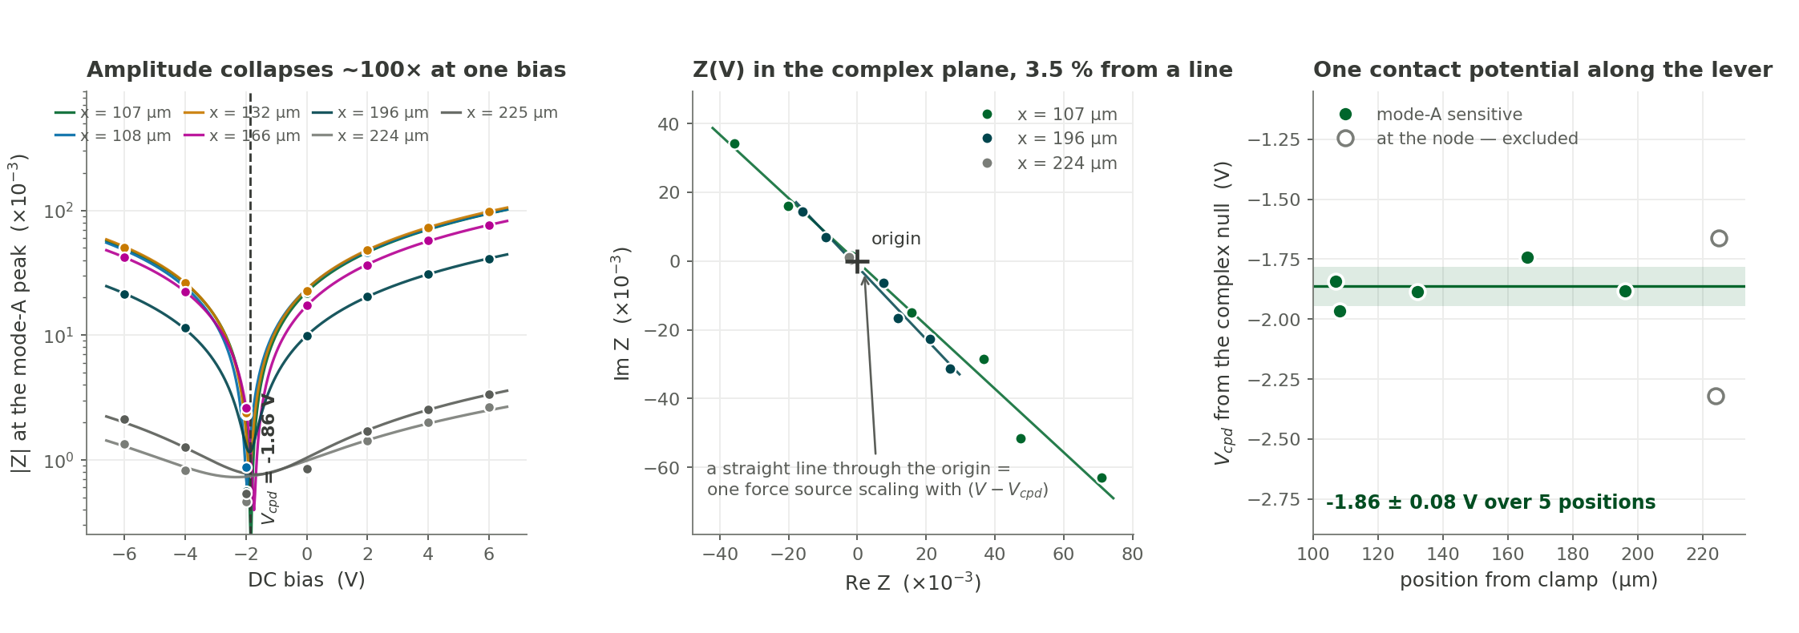
BIAS DEPENDENCE · 1 OF 2
The bias response is large, and it is electrostatic
7 biases (−6 … +6 V) × 7 positions, 1000 nN, 1 V AC electrical drive on the tip. Each spectrum is read at its OWN resonance peak.
A 100× cancellation in the middle of the sweep, not at an end. Monotonic drift cannot do that, and the bias order was identical at every position — so the V-shape is the evidence that this is bias and not time.
Z(V) is a straight line through the origin to 3.5–4.4 %. That is the signature of one force source scaling with (V − V_cpd). V_cpd = −1.86 ± 0.08 V, flat along the lever — a tip–sample property, reproduced at five independent engages.
Q = 206 ± 4 at V = 0, and f_res moves less than 1 kHz across ±6 V. Still: randomise the condition order next time — this effect was big enough to be unambiguous; a 10 % effect would not be.
7

Slide 8
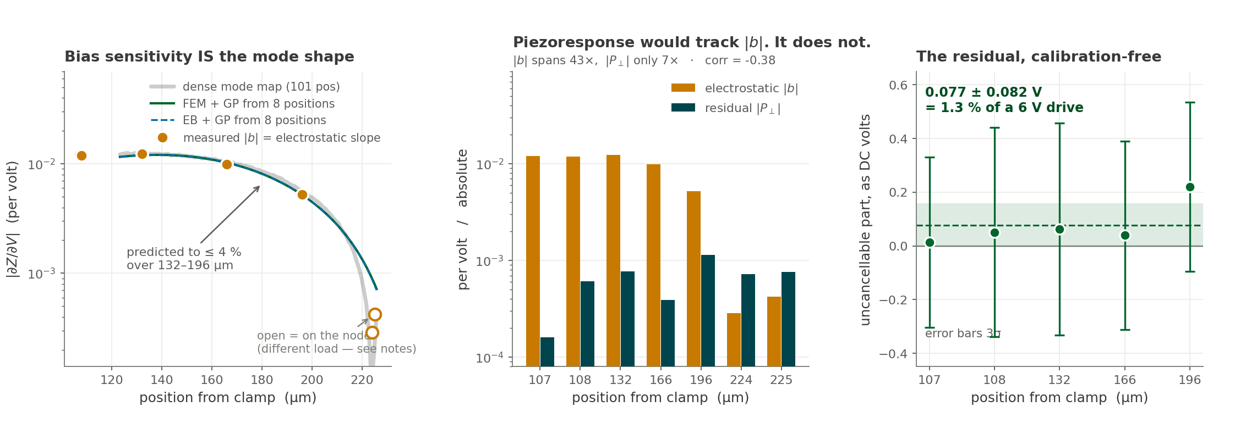
BIAS DEPENDENCE · 2 OF 2
The mode map predicts the bias sensitivity
Splitting Z(V) into the part that cancels (the electrostatic slope b) and the part that cannot (|P⊥|, the perpendicular distance from the origin to the fitted line).
|∂Z/∂V| along the lever IS the mode-A shape. The 8-position FEM + GP reconstruction predicts the measured electrostatic slope to ≤ 4 % over 132–196 µm with a single free scale — the sparse map is a calibration for the bias experiment.
The residual is instrumental, not tip–sample. |b| varies 43× along the beam; |P⊥| only 7×, and corr(log|P⊥|, log|b|) = −0.38. A piezoresponse is driven at the tip like the electrostatic force, so it must be detected through the same mode shape — it would have collapsed at the node too.
No measurable piezoresponse: 0.077 ± 0.082 V equivalent DC offset, 1.3 % of a 6 V drive. The two positions at 224/225 µm look significant (P/SE ≈ 9–10) only because the detection has nulled |b| there.
8

Slide 9
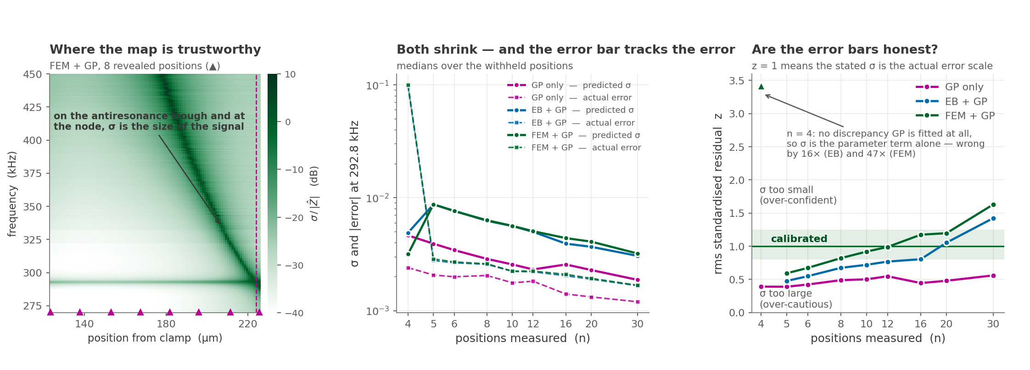
UNCERTAINTY FROM THE DATA
How much of the map do we actually believe?
σ is the predictive sd of one real component of Z. Noise floor, gain, GP length scale and per-frequency variance all come from the revealed block; the withheld positions only ever score.
σ ≈ |Z| exactly on the features worth measuring. The antiresonance trough and the node are where the signal is smallest and the reconstruction least constrained. The discrepancy GP carries ~4× more of σ there than the parameter fit does.
Both physics arms start cautious and end over-confident. z runs 0.59 → 0.99 → 1.63 for FEM + GP and 0.48 → 0.77 → 1.42 for EB + GP over n = 5 → 12 → 30, while GP only sits at 0.4–0.6 throughout. At n = 4 no discrepancy GP is fitted and σ is wrong by 16× / 47×.
9

Slide 10
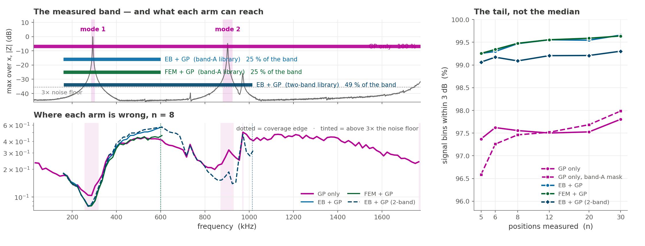
THE FULL MEASURED BAND
Across 25 kHz – 1.775 MHz the arms do not share a domain
The physics arms cover 25 % of the measured band; the two-band EB library 49 %; the GP 100 %. A band-A library spans u = f/f_res = 0.55–2.05, i.e. 161–600 kHz. Mode 2 sits at u = 3.08 and is simply outside it — and predict_cplx clips, so asking for it returns the library edge: plausible-looking and wrong. Every wide-band score here is masked to the arm’s own coverage.
10

Slide 11
THE FULL MEASURED BAND · VERDICT
Physics wins the tail; the GP wins the coverage
median |error| (dB), n = 8
GP only
EB + GP
FEM + GP
EB + GP (2-band)
below mode 1
0.17
—
—
—
mode 1 ridge
0.12
0.10
0.10
0.11
mode 1 antiresonance
0.31
0.30
0.28
0.32
valley, modes 1–2
0.40
0.53
0.44
0.52
mode 2 flank
0.25
—
—
0.22
mode 2 ridge
0.30
—
—
0.18
above mode 2
0.37
—
—
—
signal bins within 3 dB
97.6 %
99.5 %
99.5 %
99.1 %
coverage of the band
100 %
25 %
25 %
49 %
On the medians the arms are within a hair of each other; on the tail they are not. 99.1–99.5 % of signal bins land within 3 dB for every physics arm against 96.6–98.0 % for the GP, at every budget from 5 to 30 positions. The physics prior does not make the typical bin better — it removes the bad ones.
GP alone from n = 5 is already close to its own ceiling. Median on signal bins 0.20 → 0.12 dB and mode 2 0.37 → 0.16 dB from n = 5 to 30, but the 3 dB fraction barely moves: 97.4 → 97.8 %. Past n ≈ 12 more positions buy the GP almost nothing, and it still never locates the node.
The two-band EB arm reads both modes — and it pins k₁ to 984 ± 3 N/m at every n from 5 to 30. A 0.6 % spread, against 319–394 N/m from band A alone, with mode 2 to 0.18 dB. It needed a 48-point coarse grid: at 16 points the fit settles in a k₁ ≈ 500 basin scoring 0.61 where k₁ = 1008 scores 0.35.
11

Slide 12
STATUS
What is new, what is missing, what is next
New in this pass
Three corrections
Open
— All three libraries re-stitched to KEEP the complex channel — the published builds discarded the phase (FEM at np.abs(), EB by storing log|z|). Each reproduces its published log-amplitude arm exactly.
— Six arms reconstruct amplitude and phase with a per-component predictive σ, split into a parameter term and a discrepancy term.
— Scoring extended from band A to the whole measured 25 kHz – 1.775 MHz, with each arm masked to its own library coverage.
— The bias series is re-analysed on its own resonance peak and tied to the sparse mode map for the first time.
— Reading a physical contact stiffness off a band-A fit. k₁ is not identifiable there in either model: EB fits 374 N/m but reaches the measured mode ratio at 1044. The older “only FEM recovers a physical k₁” claim was already overturned on 2026-08-12; slide 2 now says so.
— An earlier draft said the EB library could not be rebuilt because eb_models.py and geometry.py were missing. They are not — they live in EB-Solver-CResonance/fem_eb_comparison/py, not in that repo’s src/, which holds only the eb_cr_afm package.
— twoband.fit2g’s 16-point coarse grid in log k₁ is too sparse: at n = 5–8 it settles at k₁ ≈ 500 N/m, where k₁ = 1008 scores 0.35 against 0.61. With 48 points k₁ locks to 984 ± 3 N/m at every n. The published two-band stability at small n was the grid straddling the right basin, not robustness.
— Nothing physical exists above ~1 MHz: even the extended library stops at u = 3.45. Modes above 2 need a further extension, or the GP.
— The shared 41° phase error is the live physics question — two unrelated forward models failing identically points at the drive or detection model, not the beam.
— Re-derive the GP variance so σ stays calibrated past n = 12; randomise the condition order in the next bias series; and the GP’s 2.2 % beyond-3 dB tail is still unexplained.
Everything here is leakage-safe: each reconstructor sees only the revealed indices, their spectra and the frequency axis. Scripts: libraries/build_femlib_cplx.py, buildlib_cplx.py, buildlib_x_cplx.py, src/cplxrec.py, src/bias.py, src/run_wideband.py, figures/d_*.py.
12

