Slide 1

In computer science Mutual Exclusion is
a property of Concurrency Control, which
is instituted for the purpose of preventing
Race Conditions.

Slide 2




1
2
3

Slide 3







?
-1
?
?
-1
+2
0

Slide 4
ORDER
RESULT
CORRECTNESS

Slide 5

RACE CONDITION
G1
read
write
DATA
write
write
G2

Slide 6

READ WRITE ONCE
MUTEX
WRITE ONCE, READ MANY
RWMUTEX

Slide 7

Mutex
write
G1
LOCK
read
G2
DATA
UNLOCK
read
G3

Slide 8
RWMutex
write
G1
RLOCK
read
G2
RUNLOCK
DATA
read
G3
LOCK
UNLOCK
write
G4

Slide 9
?
G1
G2
G3
i++
i++
i++
var i
i could be 1
i could be 2
i could be 3

Slide 10
i++
INDIVISIBLE
ATOMIC
get value of i
increment value of i
UNINTERRUPTIBLE
store value of i

Slide 11

G1
G2
G3
i++
+1
i++
+1
i++
G1
G2
G3
+1
0
1
2
i++
+1
i++
+1
i++
+1
WRITE
WRITE
WRITE
READ
READ
READ
0
0
0
1
2
3
READ
WRITE
READ
WRITE
READ
WRITE
1
1
1
lock
MUTEX
var i
unlock
1
0
var i
0
3

Slide 12
Atomic
Not Atomic
Atomic
READ
WRITE
INCREMENT
IS THAT SO?

Slide 13
G1
G2
G3
i++
+1
i++
+1
i++
+1
0
0
1
READ
WRITE
READ
WRITE
READ
WRITE
1
1
2
lock
MUTEX
unlock
var i
2
0

Slide 14
Single Go Routine Context
var x
G1
read x
write x
NO MUTEX

Slide 15
Main Go Routine Context
var x
G1
read x
NEEDS MUTEX
Main G
write x

Slide 16
Multiple Go Routines
Read Only Context
var x
G1
read x
G2
read x
G3
read x
NO MUTEX

Slide 17
Multiple Go Routines
Read Write Context
var x
G1
read x
write x
G2
read x
write x
G3
read x
write x
NEEDS MUTEX

Slide 18
Fine Grained Context
Coarse Grained Context
var x
var x
G1
read x
write x
G1
read x
write x
G2
read x
write x
G2
read x
write x
G3
read x
write x
G3
read x
write x
lock
lock
lock
unlock
unlock
unlock

Slide 19
OS Context
Different Locations
OS Context
Same Location
d1
d2
d3
d
Go
read d1
write d1
Go
read d
write d
Node.js
read d2
write d2
Node.js
read d
write d
Python
read d
write d
Python
read d3
write d3
NO LOCK
NEEDS LOCK

Slide 20



John
WTF?
Mike
101
102
103

Slide 21

MUTEX LOCK
G1
G2
lock()
lock()
unlock()
unlock()
DEADLOCK

Slide 22
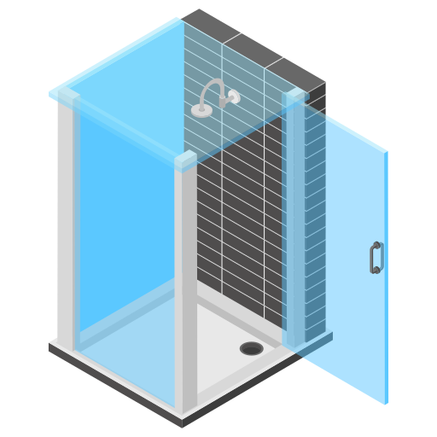






Mike
Jane
John
17m
30m
15m

Slide 23
Mutex
released
G1
G2
acquired
waiting
released
acquired
waiting
G2 work
G1 work

Slide 24



3
REFILL
1

Slide 25

MUTEX LOCK
Scheduler
Queue
G1
G2
G1
G2
acquire
sleep
work
acquire
sleep
work
release
release
100µs
100µs

Slide 26





Slide 27

MUTEX LOCK
G1
2
G2
lock()
var left
lock()
condition
condition
var right
unlock()
unlock()
wait()
Hallway
wait()
John
Alice

Slide 28
sync.Locker
type Locker interface {
Lock()
Unlock()
}

Slide 29

CPU REGISTERS
Go Routines
CPU
G1
ASM
G2
data
G3

Slide 30
Go Routines
Go Scheduler
G1
lock
G2
G2
data
G3
G3
unlock

Slide 31
Prefer Atomics over Mutexes for simple data
Use Mutex for write heavy scenarios
Use RWMutex for read heavy / mixed scenarios
Prefer Fine Grained Context where possible (limit the context)
Don’t use the mutex longer than you need to (avoid extra hold time)
Use types, a local mutex and methods over direct mutex calls
Avoid Contention by distributing work evenly
Avoid Starvation by testing for mutex fairness
Use sync.Locker for generic code that uses a mutex

