Slide 1
PYTHON WEB PROJECT
PRESENTATION
PYTHON
Led by Vladimir Poghosyan, ACA

Slide 2
TABLE OF CONTENTS
06
03
About the Project
Our Team
04
Major Requirements
06
Used Libraries
04
Database Diagram
05
Our Team
07
Our Team
08
Our Team
09
Our Team
10
Our Team

Slide 3
ABOUT THE PROJECT
The main object of the project is to create a web site where a person could register, fill in his/her skills from drop-down skill list and search jobs appropriate to his/her profile. The site gives a percentage compliance for specified jobs.

Slide 4
—SOMEONE FAMOUS
“This is a quote. Words full of wisdom that someone important said and can make the reader get inspired.”

Slide 5
USED LIBRARIES
flask
Secrets
urllib
flask_login
bs4
flask_sqlalchemy
json
flask_bcrypt
hashlib
flask_wtf
sqlite
wtforms
PIL

Slide 6








PROJECT FOLDERS` STRUCTURES
Project
App
DB
dbmgr.py
my_db.db
database.sql
new_db.py
Main
__init__.py
forms.py
models.py
run.py
Scrap
scrap.py
data.json
skill.json
job_skills.json
Scripts
auth
about.html
auth.py
account.html
main
home.html
main.py
job.html
Static
Presentation.pptx
css
img
js
lib
html
jobs.html
layout.html
requirements.txt
login.html
README.md
register.html

Slide 7
MAJOR REQUIREMENTS
Front End
Back End
Scrapping
Database
Notes:
GYUYGYFGFYGH

Slide 8

FRONT-END
Inherit from layout.html

Slide 9
PAGE STRUCTURE
layout.html
filename.html
database
{% block content%}

Slide 10
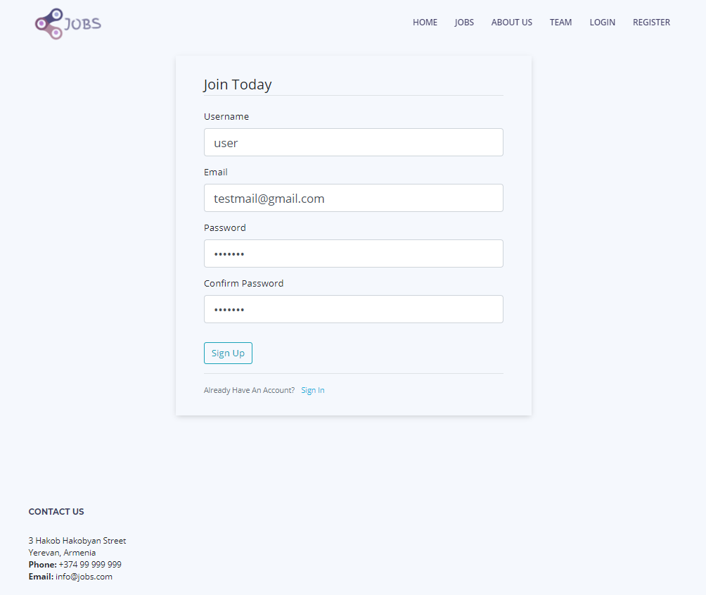
Registration form

Slide 11
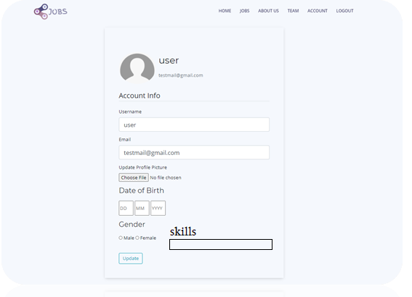
Account editing

Slide 12
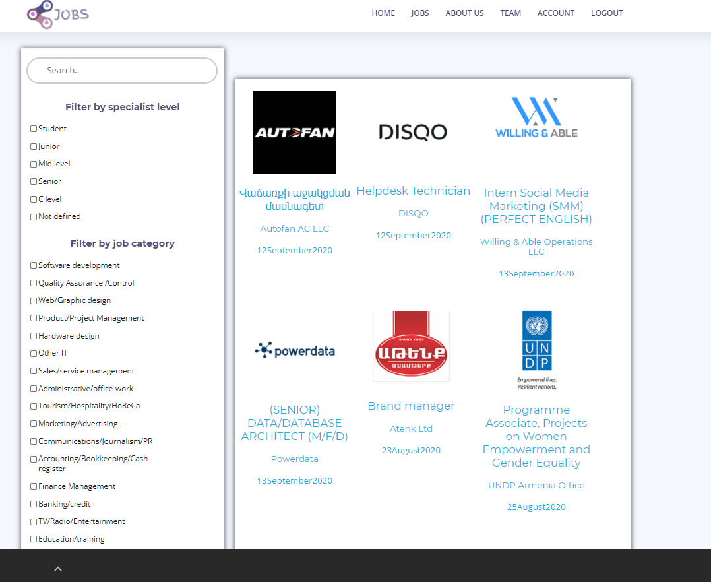

Slide 13
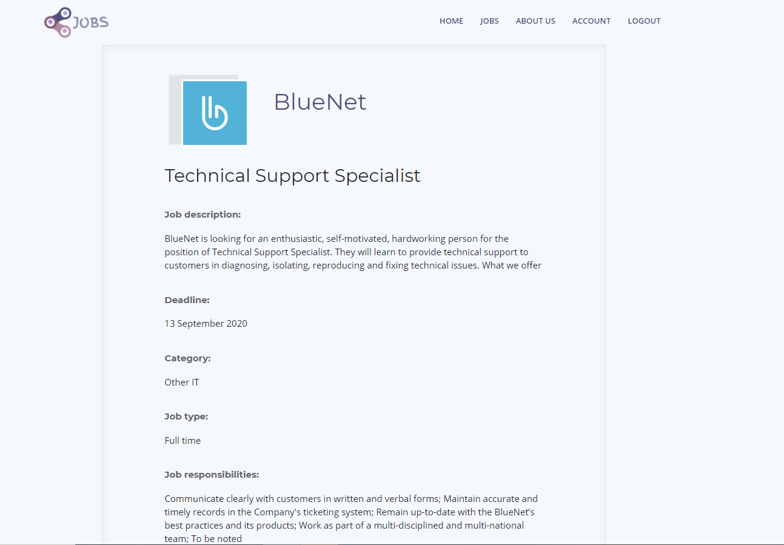
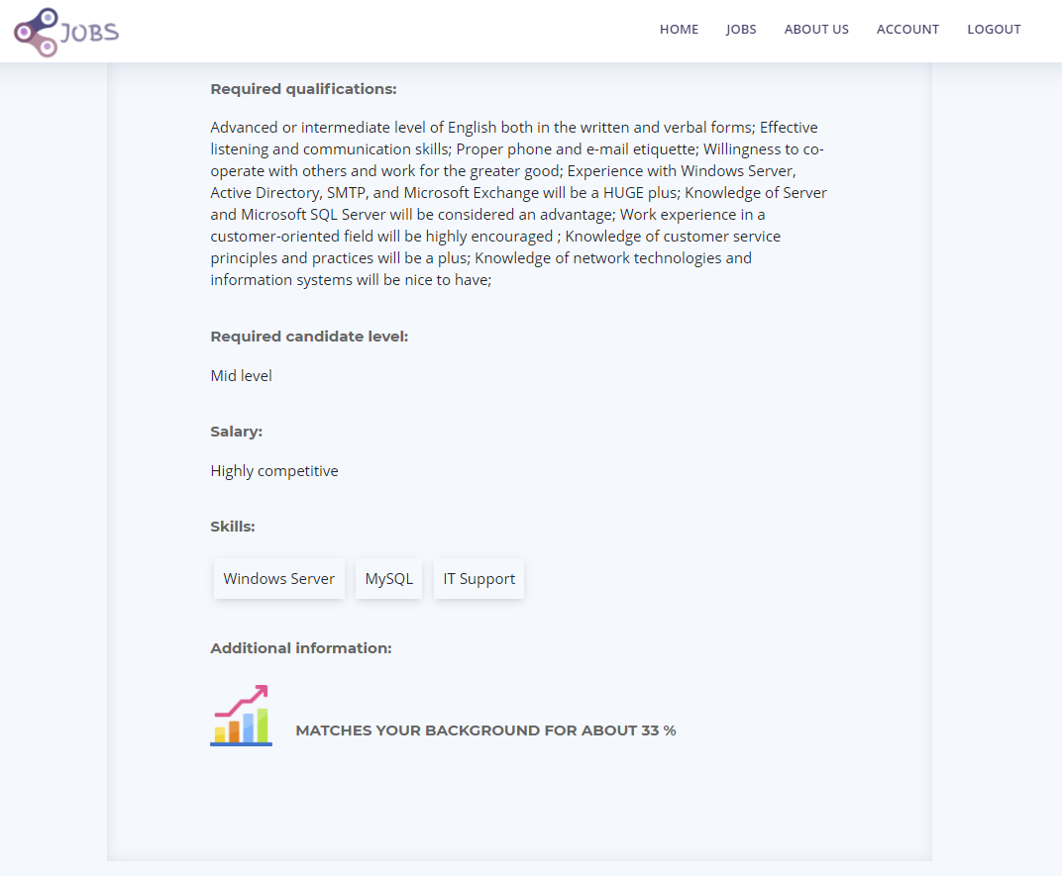

Slide 14
BACK-END
Put printscreen

Slide 15
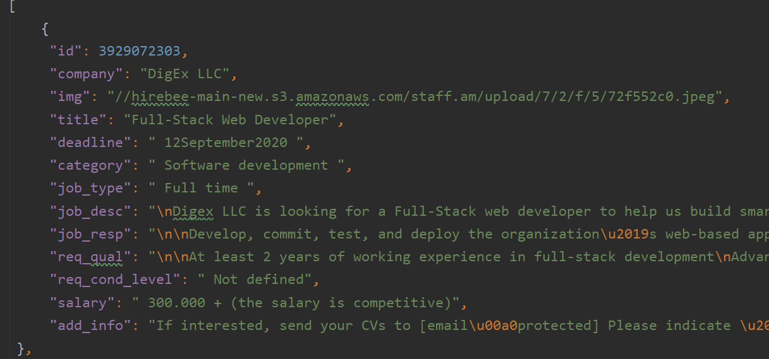
SCRAPPING
BeautifulSoup Library
Scrapping Per Page from www.staff.am
Dumping data to JSON datastorage
Filling values in database from JSON by appropriate columns

Slide 16
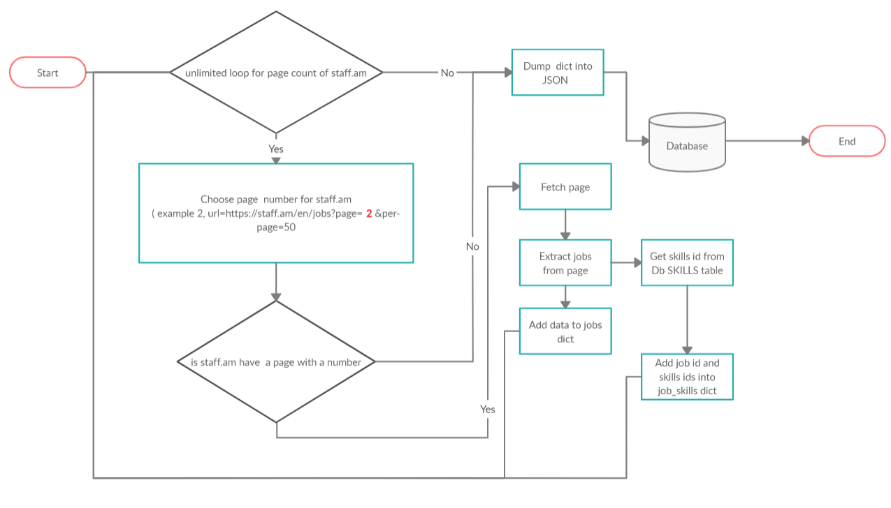

Slide 17
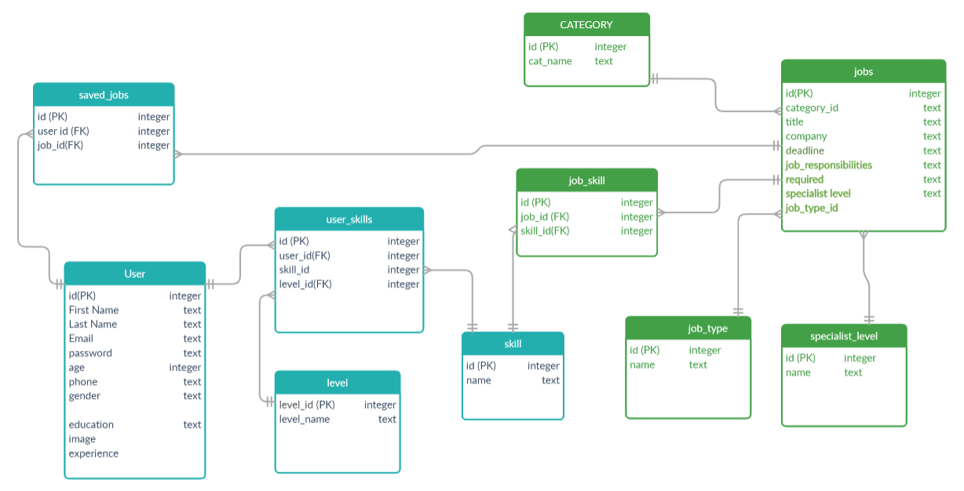
DATABASE DIAGRAM

Slide 18
A VIDEO IS A GOOD IDEA

Slide 19


THE TEAM
Artur Mkrtchyan
Tatev Alaverdyan
Sona Kirakosyan
Liana Varosyan

Slide 20
THANKS!
Does anyone have any question?
addyouremail@freepik.com

