Slide 1
PYTHON WEB PROJECT
PRESENTATION
PYTHON
Led by Vladimir Poghosyan, ACA

Slide 2
TABLE OF CONTENTS
06
03
About the Project
Our Team
04
Major Requirements
06
Used Libraries
04
Database Diagram
05
Our Team
07
Our Team
08
Our Team
09
Our Team
10
Our Team

Slide 3
ABOUT THE PROJECT
The main object of the project is to create a web site where a person could register, fill in his/her skills from drop-down skill list and search jobs appropriate to his/her profile. The site gives a percentage compliance for specified jobs.

Slide 4
—SOMEONE FAMOUS
“This is a quote. Words full of wisdom that someone important said and can make the reader get inspired.”

Slide 5
USED LIBRARIES
flask
Secrets
urllib
flask_login
bs4
flask_sqlalchemy
json
flask_bcrypt
hashlib
flask_wtf
sqlite
wtforms
PIL

Slide 6








PROJECT FOLDERS` STRUCTURES
Project
App
DB
dbmgr.py
my_db.db
database.sql
new_db.py
Main
__init__.py
forms.py
models.py
run.py
Scrap
scrap.py
data.json
skill.json
job_skills.json
Scripts
auth
about.html
auth.py
account.html
main
home.html
main.py
job.html
Static
Presentation.pptx
css
img
js
lib
html
jobs.html
layout.html
requirements.txt
login.html
README.md
register.html

Slide 7
MAJOR REQUIREMENTS
Front End
Back End
Scrapping
Database
Notes:
GYUYGYFGFYGH

Slide 8

FRONT-END
Inherit from layout.html

Slide 9
PAGE STRUCTURE
layout.html
filename.html
database
{% block content%}

Slide 10
REGISTRATION
forms.py
Customizing the user register form, adding username, email and password validations
auth.py
Registering the user by hashing the password and saving the data in the User table of the database, rendering the register.html template
Key characteristics Password hashing Email and password fields’ validation as ‘required’ Validation on duplication of username and e-mail and flashing the corresponding message Confirmation of the inputted password Saving the inputted data in the database
database.sql
Storing the data in a User’s table
register.html
Illustrating the front-end of the register page

Slide 11
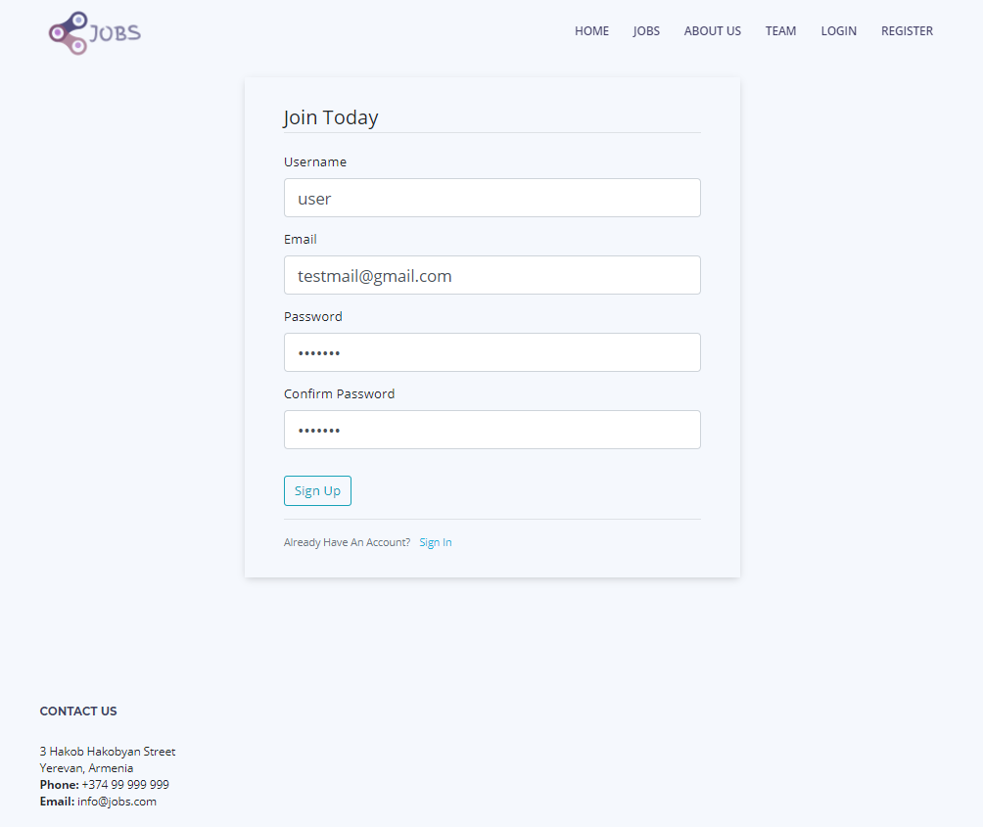
REGISTRATION
Used libraries Flask_wtf ---> FlaskForm Wtforms.validators ---> DataRequired, Length, Email, EqualTo, ValidationError Wtforms ---> StringField, PasswordField, SubmitField Flask_sqlalchemy ---> SQLAlchemy Flask ---> render_template, redirect, url_for, request, flash Flask_bcrypt ---> Bcrypt

Slide 12
LOGIN
__init__.py Creation of the LoginManager class in the configuration of the application
auth.py Logging the authorized users in with the login_user function. Checking the correspondence with the database
Key characteristics Login with hashed password Email and password fields’ validation as ‘required’ Option of remembering the user Validation on unsuccessful login and flashing the corresponding message Decoration of views that require users to be logged in with the login_required decorator
models.py Provision of a user_loader callback. Inheriting user class from UserMixin
database.sql
Storing the data in a User’s table
forms.py Customizing the user login form
login.html Illustrating the front-end of the login page

Slide 13
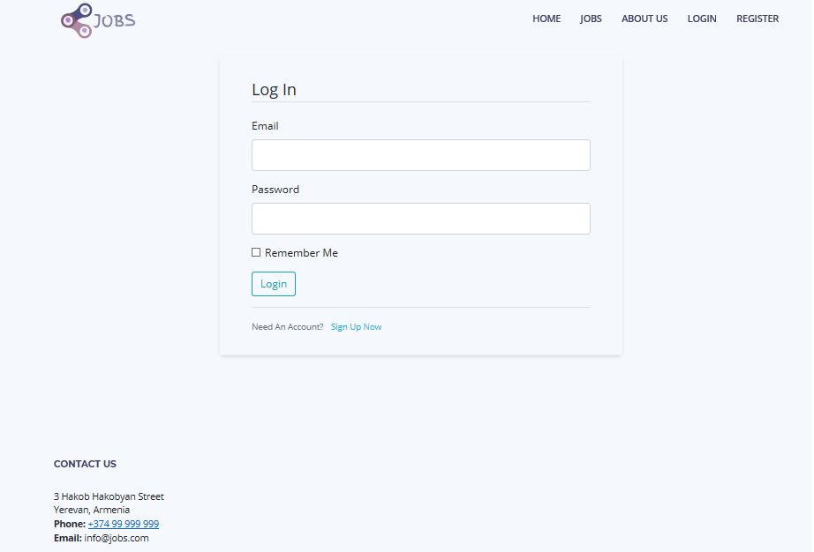
LOGIN
Used libraries Flask_login ---> LoginManager, UserMixin, login_user, current_user, logout_user, login_required Flask_bcrypt ---> Bcrypt Flask_sqlalchemy ---> SQLAlchemy Wtforms ---> StringField, PasswordField, SubmitField, BooleanField Wtforms.validators ---> DataRequired Flask ---> render_template, redirect, url_for, request, flash

Slide 14
ACCOUNT
forms.py
Customizing the user account form with an update option, adding username, email and picture validations
auth.py
Creating/updating the users account and saving the data in the User’s table, rendering the account.html template
Key characteristics Account update, including saving the profile picture Validation on the profile picture to correspond to certain file formats In case of account update, validation on duplication of username and e-mail and flashing the corresponding message Flashing a corresponding message on the successful update of the account Saving the inputted data in the database
database.sql
Storing the data in a User’s table
account.html
Illustrating the front-end of the account page

Slide 15
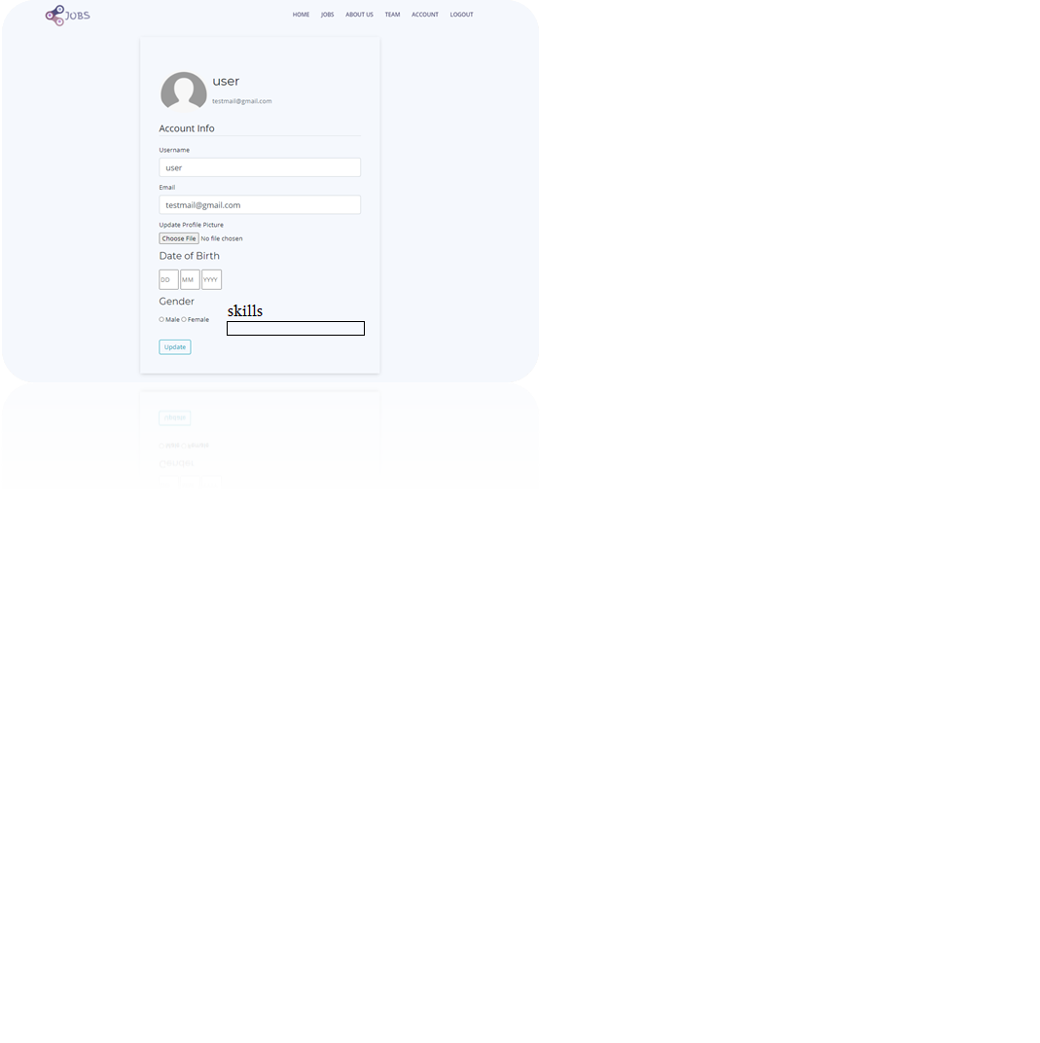
ACCOUNT
Used libraries Flask_wtf ---> FlaskForm Wtforms.validators ---> DataRequired, Length, Email, ValidationError Wtforms ---> StringField, SubmitField Flask_wtf.file ---> FileField, FileAllowed Flask_sqlalchemy ---> SQLAlchemy PIL ---> Image Os, secrets Flask ---> render_template, redirect, url_for, request, flash

Slide 16
Registration form

Slide 17
Account editing

Slide 18
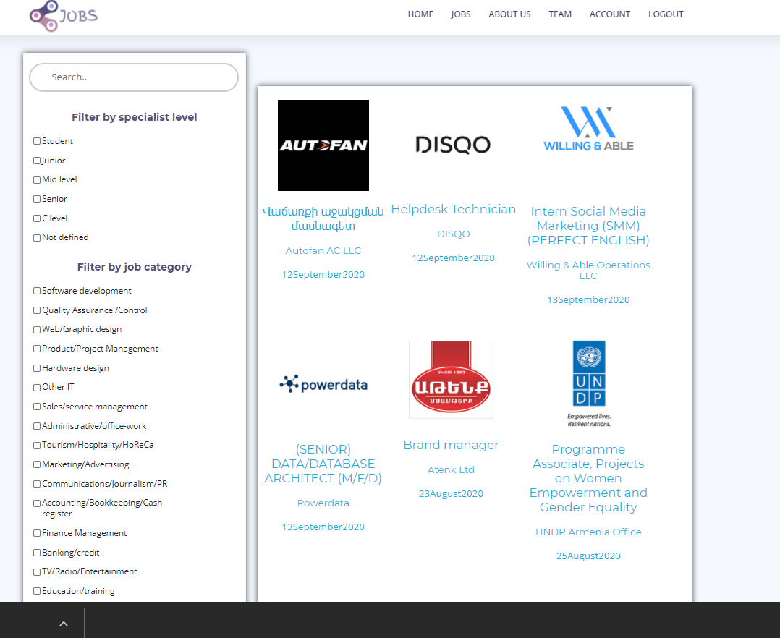

Slide 19
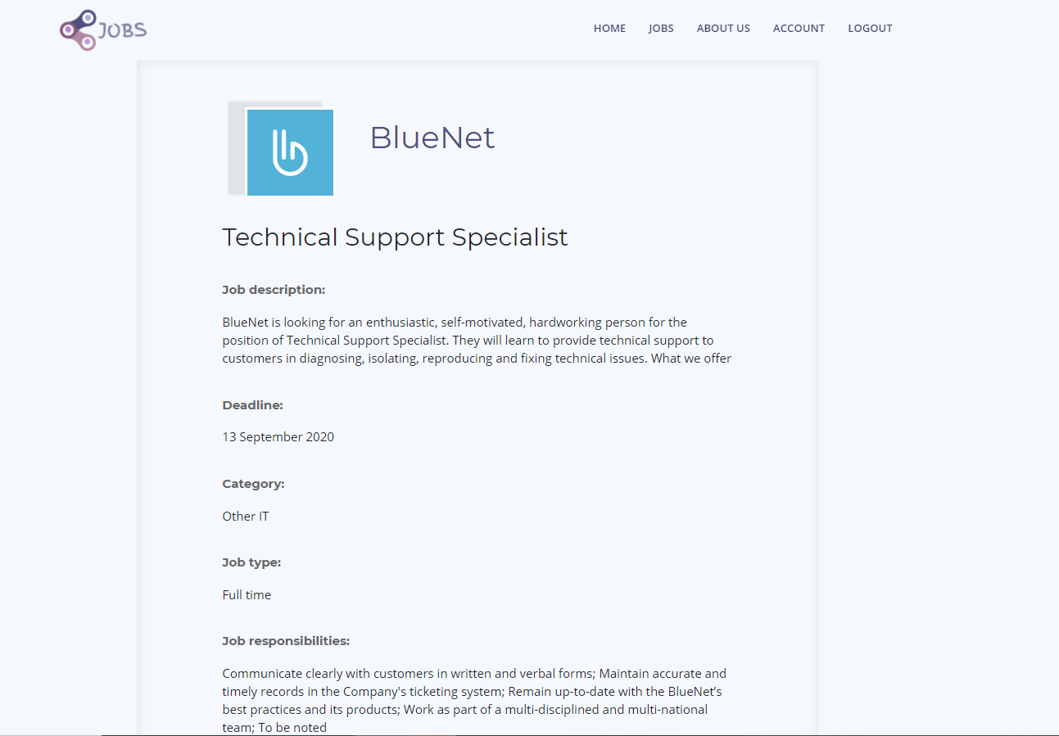
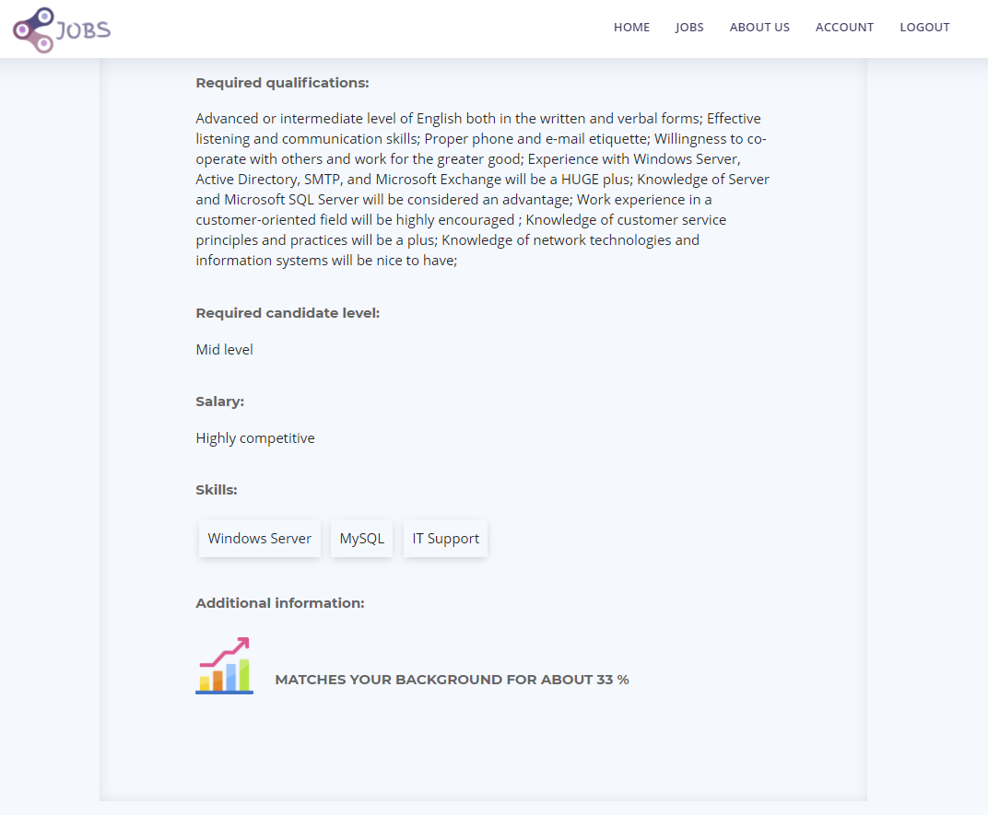

Slide 20
BACK-END
Put printscreen

Slide 21
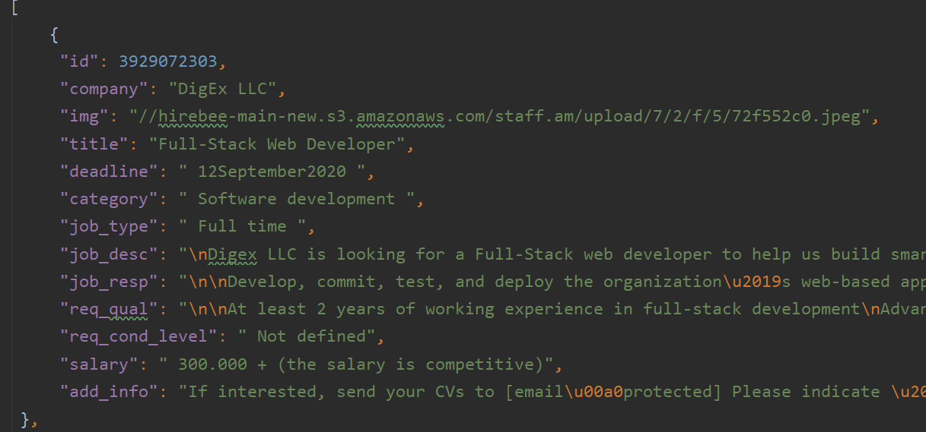
SCRAPPING
BeautifulSoup Library
Scrapping Per Page from www.staff.am
Dumping data to JSON datastorage
Filling values in database from JSON by appropriate columns

Slide 22
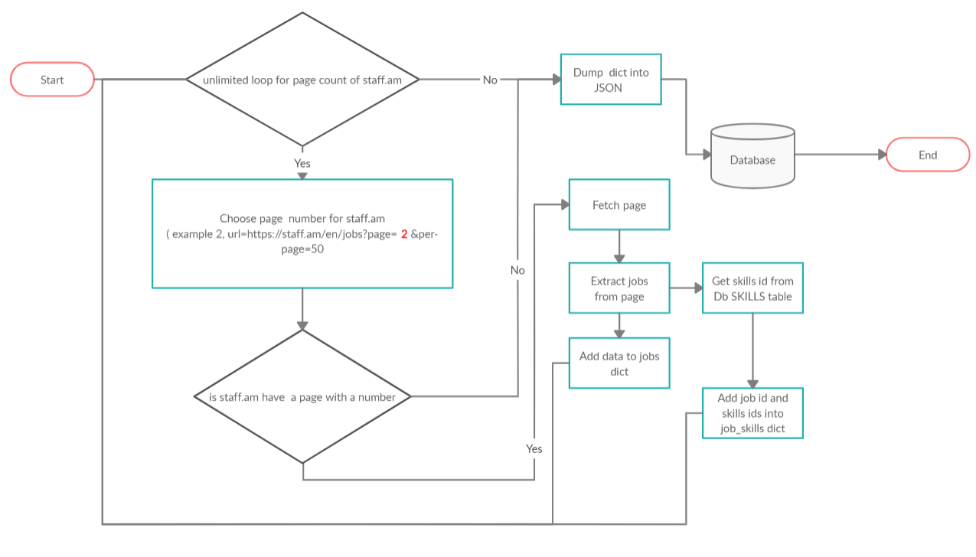

Slide 23
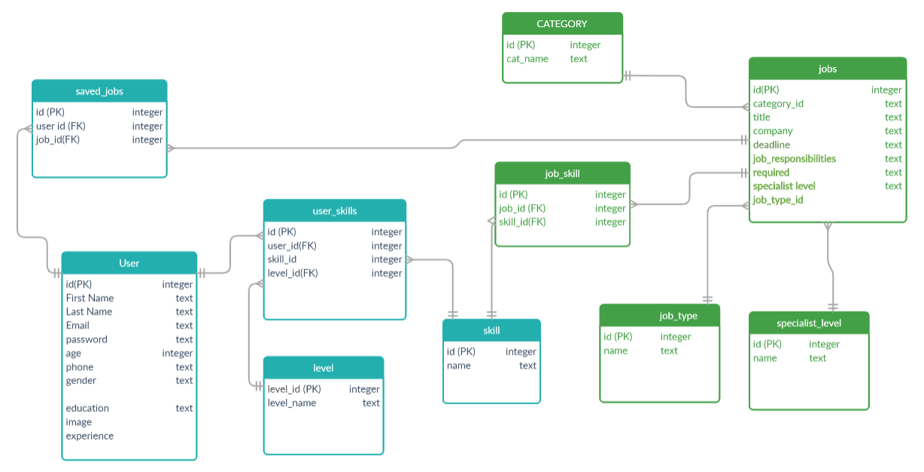
DATABASE DIAGRAM

Slide 24
A VIDEO IS A GOOD IDEA

Slide 25


THE TEAM
Artur Mkrtchyan
Tatev Alaverdyan
Sona Kirakosyan
Liana Varosyan

Slide 26
THANKS!
Does anyone have any question?
addyouremail@freepik.com

