Slide 1
PYTHON WEB PROJECT
PRESENTATION
PYTHON
Led by Vladimir Poghosyan, ACA

Slide 2
TABLE OF CONTENTS
06
03
About the Project
Our Team
04
Major Requirements
06
Used Libraries
04
Database Diagram
05
Our Team
07
Our Team
08
Our Team
09
Our Team
10
Our Team

Slide 3
ABOUT THE PROJECT
The main object of the project is to create a web site where a person could register, fill in his/her skills from drop-down skill list and search jobs appropriate to his/her profile. The site gives a percentage compliance for specified jobs.

Slide 4
—SOMEONE FAMOUS
“This is a quote. Words full of wisdom that someone important said and can make the reader get inspired.”

Slide 5
OUR GOALS
EXPANSION
POSITIONING
USABILITY

Slide 6
USED LIBRARIES
flask
flask_login
flask_sqlalchemy
flask_bcrypt
flask_wtf
wtforms
new_version.models

Slide 7
MAJOR REQUIREMENTS
Front End
Back End
Scrapping
Database
Notes:
GYUYGYFGFYGH

Slide 8

FRONT-END
Inherit from layout.html

Slide 9
/jobs
DB
query.all()
JOBS (table)
layout.html
home.html
{% block content%}

Slide 10
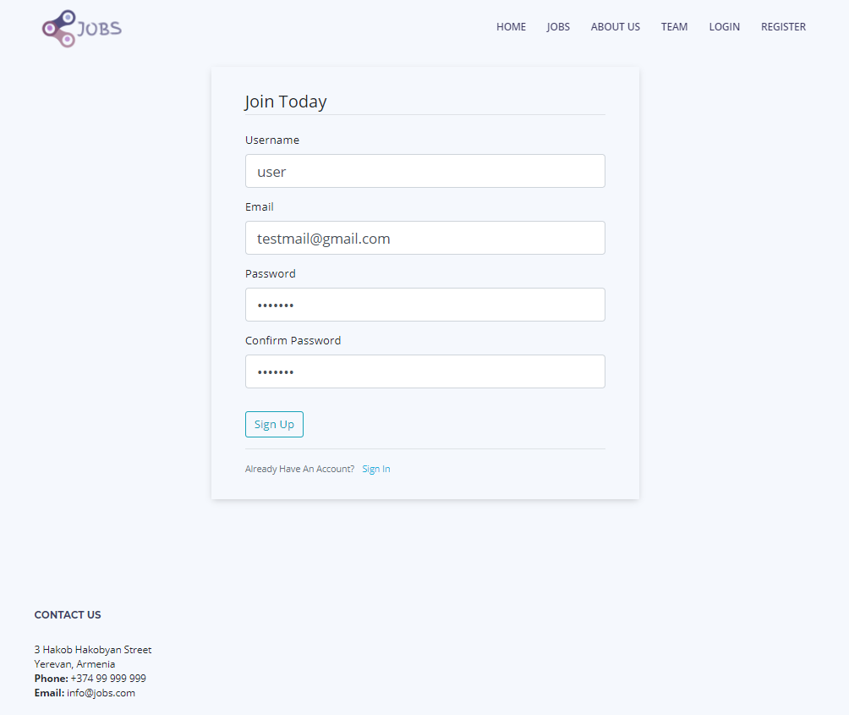
Registration form
Fill personal data
Duplicate mail restriction
Password hash with bycrypt
Send the all data to database

Slide 11
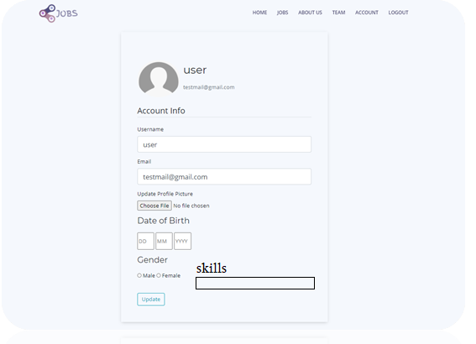
Account editing
Edit personal data
Send & update
Fill personal data

Slide 12
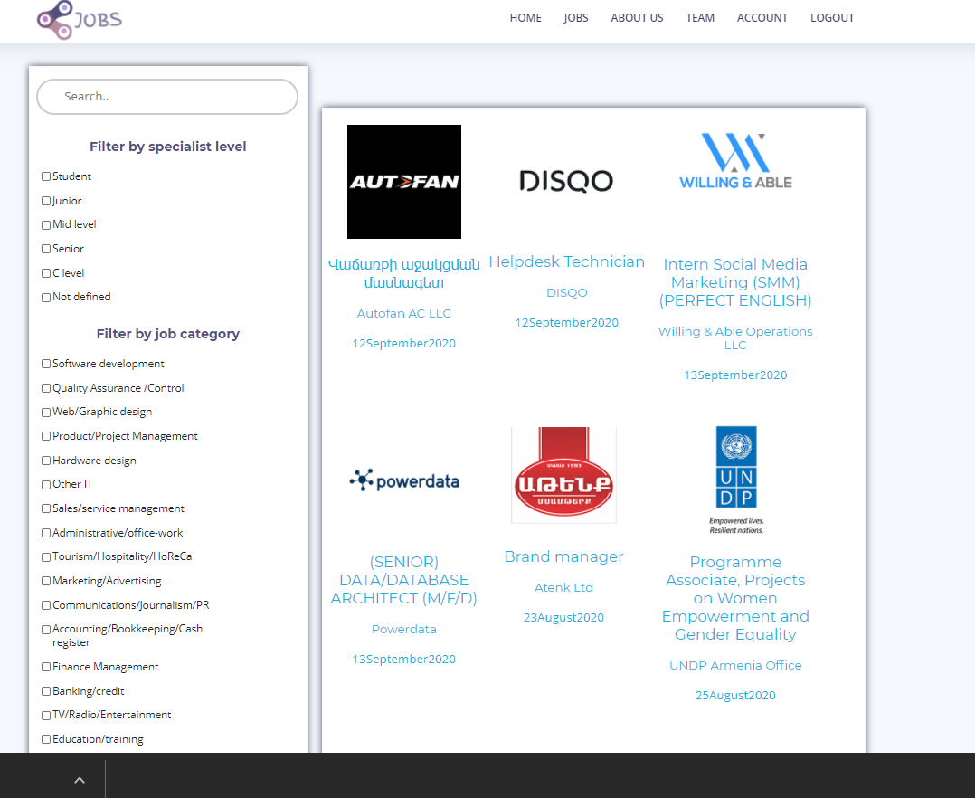

Slide 13
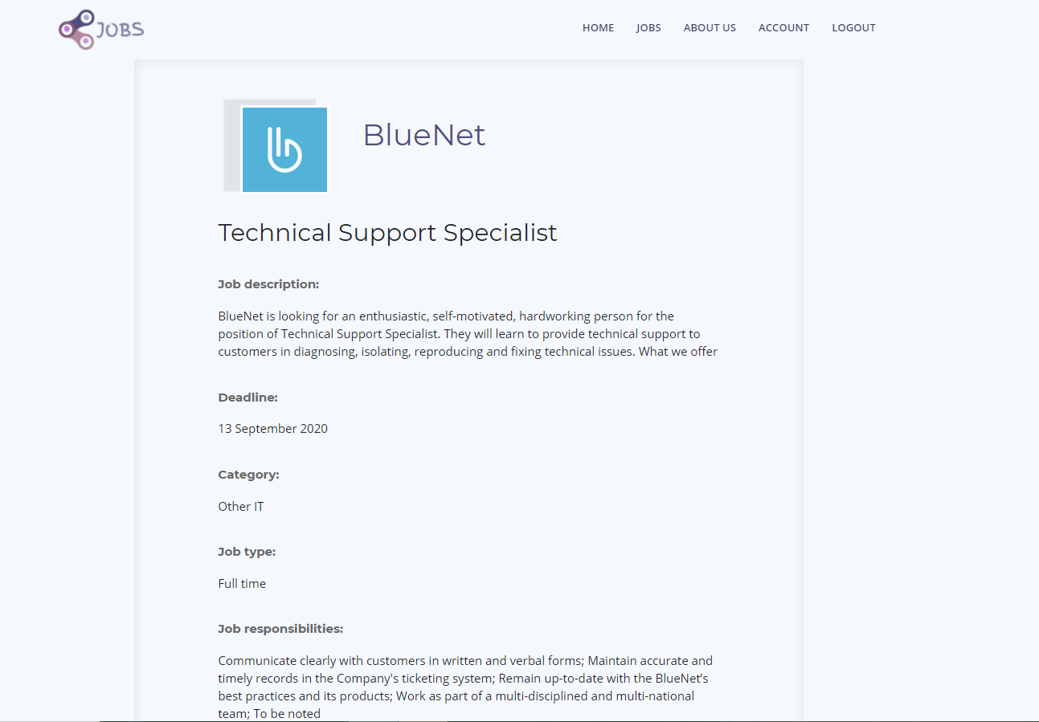
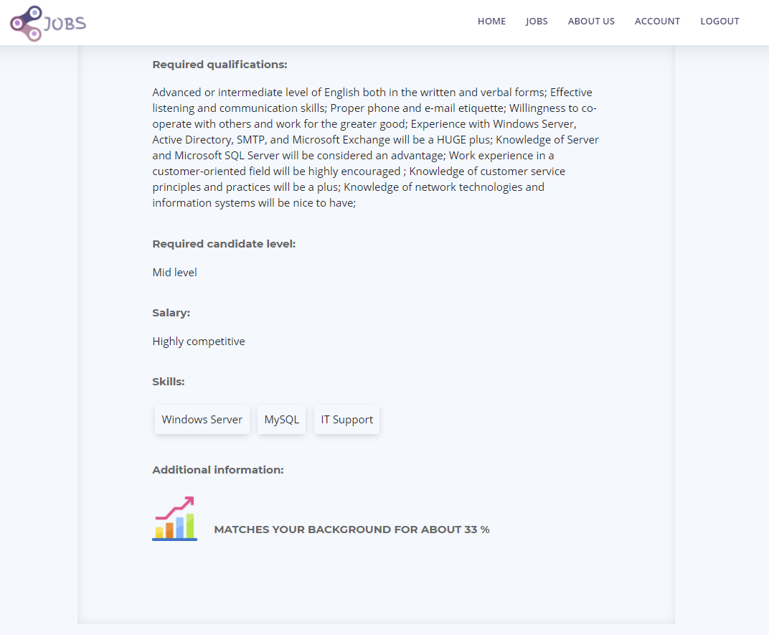

Slide 14
BACK-END
Put printscreen

Slide 15
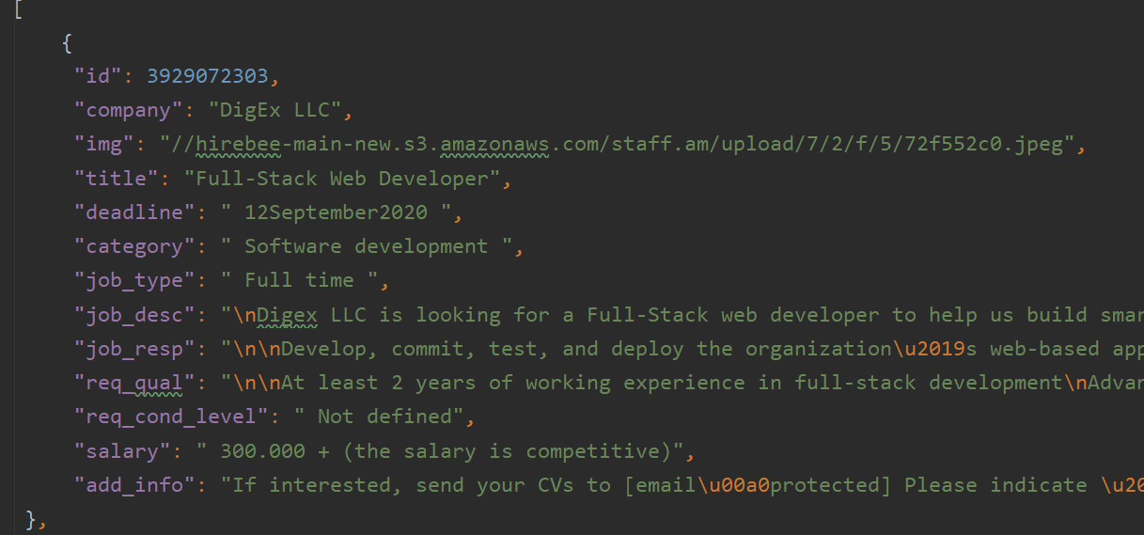
SCRAPPING
BeautifulSoup Library
Scrapping Per Page from www.staff.am
Dumping data to JSON datastorage
Filling values in database from JSON by appropriate columns

Slide 16
SCRAPPING
BeautifulSoup Library
Scrapping Per Page from www.staff.am
Dumping data to JSON datastorage
Filling values in database from JSON by appropriate columns

Slide 17
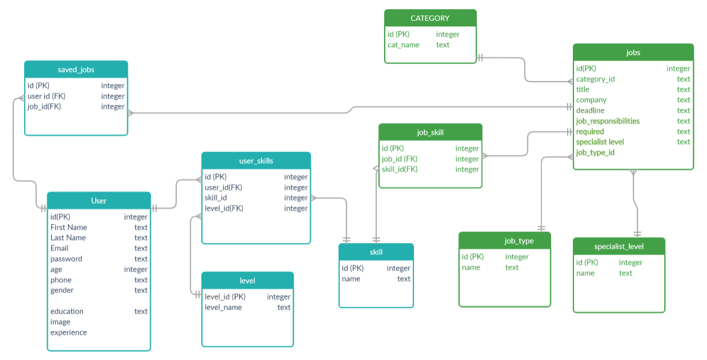
DATABASE DIAGRAM

Slide 18
A VIDEO

Slide 19


THE TEAM
Artur Mkrtchyan
Tatev Alaverdyan
Sona Kirakosyan
Liana Varosyan

Slide 20
THANKS!
Does anyone have any question?
addyouremail@freepik.com

