Slide 1
Interfaces
IVector
QVariant GetValue(int index)
int GetCount()
IIntVector
int GetAt(int index)
IDateTime
QDateTime GetAt(int index)
IDoubleVector
double GetAt(int index)
IStringVector
QString GetAt(int index)

Slide 2
Interfaces
IFieldData
Int GetCount()
Field GetField()
IIntVector GetIntData()
IDoubleVector GetDoubleData()
IStringVector GetStringData()
IDateTime GetDateTimeData()
IFieldCollection
IFieldData* GetFieldData(Field field)
int GetCount ()
Field GetField(int index)
int GetFieldIndex(Field field)

Slide 3
Interfaces
IDataDirectory
FieldList getFields()
QVariantList getFieldValues()
IDataProvider
void setSelection(CSelection const& oSelection)
IFieldCollectionPtr GetData(FieldList const& lstField)

Slide 4
Interfaces
IAnalyser
void setConfig(const Configuration &)
void setData(const DataSelection &)
QWidget *getView()
void run()

Slide 5
Classes
Cselection
struct SFieldValueSelection
{ ESelectionPatten eSelectionType; QString sPattern;
QVariantList arrSelectedValues; };

Slide 6
CConfiguration
void setName(QString const& )
QString getName() const
void setType(QString const& )
QString getType() const
void setVersion(int )
int getVersion() const
bool isValid() const
void setParameter(QString const& , const QVariant )
QVariant getParameter(QString const& ) const
int getParamCount() const;
bool isEmpty() const;
bool isContained(QString const& ) const
void clearParameters()
void reset()
void load(QString const& )
void save(QString const& ) const

Slide 7
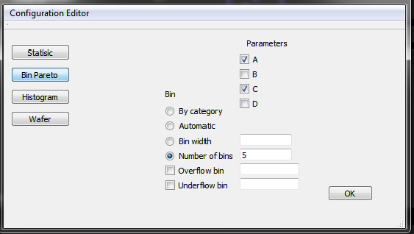

Slide 8
