Slide 1

Data Directory
Map
File1 -> Lot1, Wafer1
File2 -> Lot1, Wafer2
File3 -> Lot3, Wafer5
Data Directory scans all files and gets mapping between field names and file names.

Slide 2
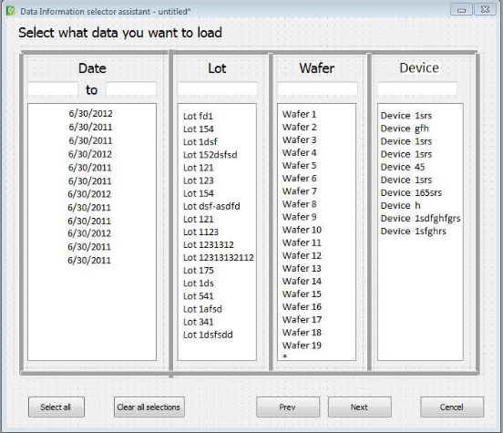
Data Directory
Data Directory is given as input of dialog. User select some values and Selection object is created according that selection.
Selection

Slide 3
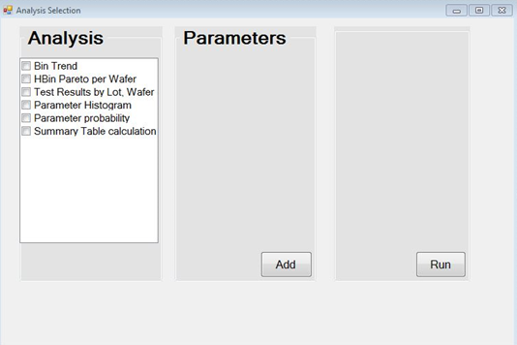
User select analyses types. Configuration List objet is created with selected analyses.
Analysis dialog supports New and Edit functions.
New – create new analysis type and add it to analyses list.
Edit - modify already exist analysis and then use changed version.
Configuration Manager
Configuration List

Slide 4
Data Directory
Analysis Manager
Analysis Manager gets Data Directory, Selection and Configuration List as input. Analysis Manager controls analyses dialog and runs one or more analysis according Configuration List.
Selection
Configuration List
RUN

Slide 5
Data Provider
DataStore
SetSelection(Selection)
FieldDataCollection
GetData(FieldList)
Loader
Parser
Convert to DataTypes(e.g. BinData, BinDefinition)
DataStore contains FieldDataCollection.
DataProvider has GetData function, it is used for getting all fields values(e.g. wafer, lot, bin). GetData function converts FieldList to DataTypes and pass it to Loader. Loader finds and returns fields values from DataStore.
DataProvider gets Selection object with SetSelection function.

Slide 6
Data Provider
Run()
GetData(FieldList(Wafer, Bin, BinType ))
FieldCollection->GetFieldData(Bin)
FieldData->GetIntData()
IntVec->GetAt(index)
Analysis Module
Configuration
Analysis module gets DataProvider and Configuration as input.
Analysis Module has Run function, which will begin to do some specific steps for analysis. Run function call GetData with some field names. GetData returns FieldCollection. For each field call GetFieldData pass field name and get single FiledData. Find out the type of returned values and call corresponding Get function (e.g. GetIntData), get Vector (e.g. IntVec). Loop over vector and call GetAt with index and get all necessary values.

