Slide 1
Lecture 6: Representing Words
Kai-Wei Chang
CS @ UCLA
kw@kwchang.net
Couse webpage: https://uclanlp.github.io/CS269-17/

Slide 2
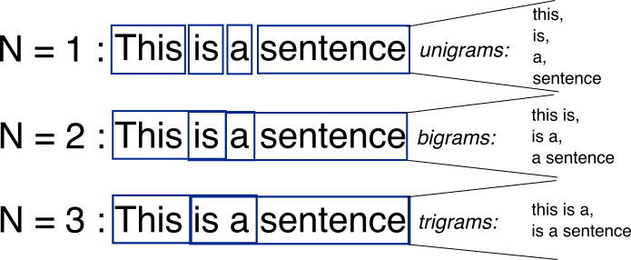
Bag-of-Words with N-grams
N-grams: a contiguous sequence of n tokens from a given piece of text
http://recognize-speech.com/language-model/n-gram-model/comparison

Slide 3
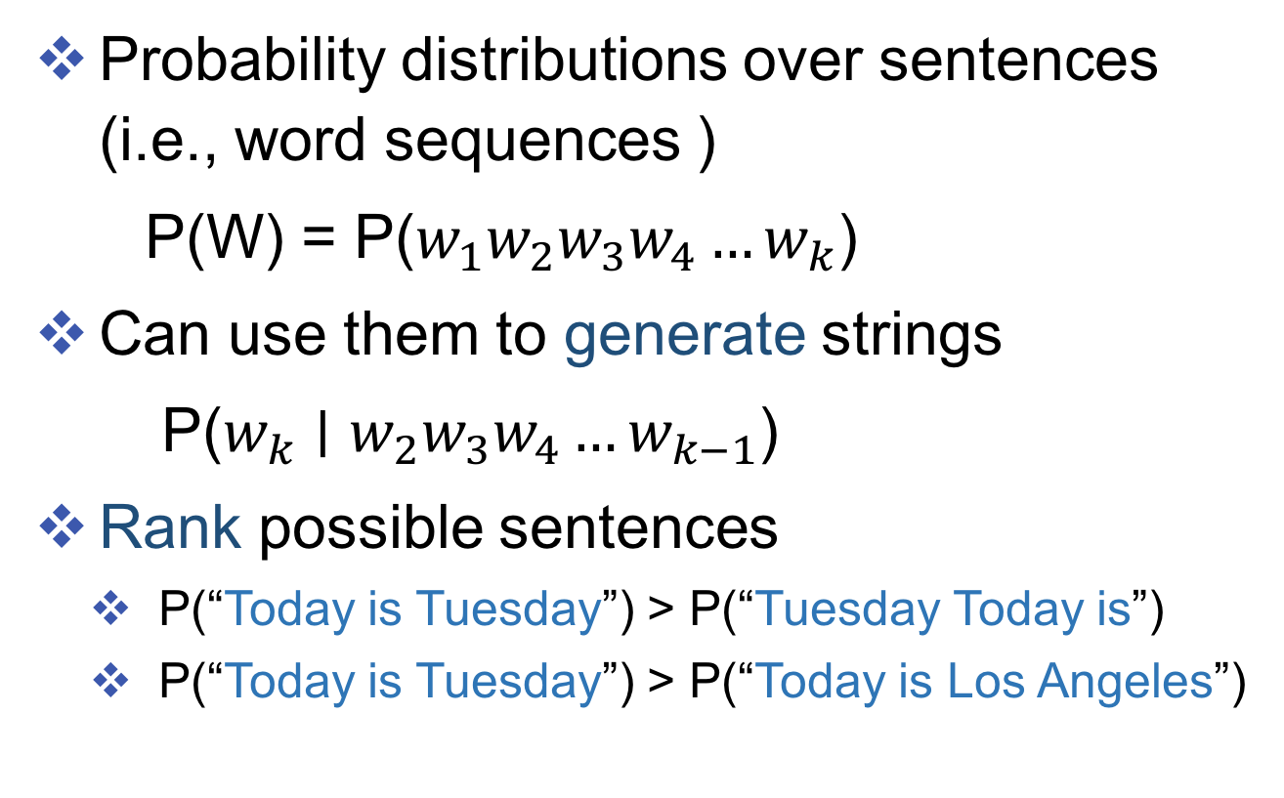
Language model
Probability distributions over sentences (i.e., word sequences )
P(W) = P($w_{1}w_{2}w_{3}w_{4}…w_{k}$)
Can use them to generate strings
P($w_{k}∣w_{2}w_{3}w_{4}…w_{k−1}$)
Rank possible sentences
P(“Today is Tuesday”) > P(“Tuesday Today is”)
P(“Today is Tuesday”) > P(“Today is Los Angeles”)

Slide 4
N-Gram Models
Unigram model: $P\left(w_{1}\right)P\left(w_{2}\right)P\left(w_{3}\right)…P(w_{n})$
Bigram model: $P\left(w_{1}\right)P\left(w_{2}|w_{1}\right)P\left(w_{3}|w_{2}\right)…P(w_{n}|w_{n−1})$
Trigram model:
$P\left(w_{1}\right)P\left(w_{2}|w_{1}\right)P\left(w_{3}|w_{2},w_{1}\right)…P(w_{n}|w_{n−1}w_{n−2})$
N-gram model:
$P\left(w_{1}\right)P\left(w_{2}|w_{1}\right)$… $P(w_{n}|w_{n−1}w_{n−2}…w_{n−N})$

Slide 5
Random language via n-gram
http://www.cs.jhu.edu/~jason/465/PowerPoint/lect01,3tr-ngram-gen.pdf
https://research.googleblog.com/2006/08/all-our-n-gram-are-belong-to-you.html
Collection of n-gram

Slide 6
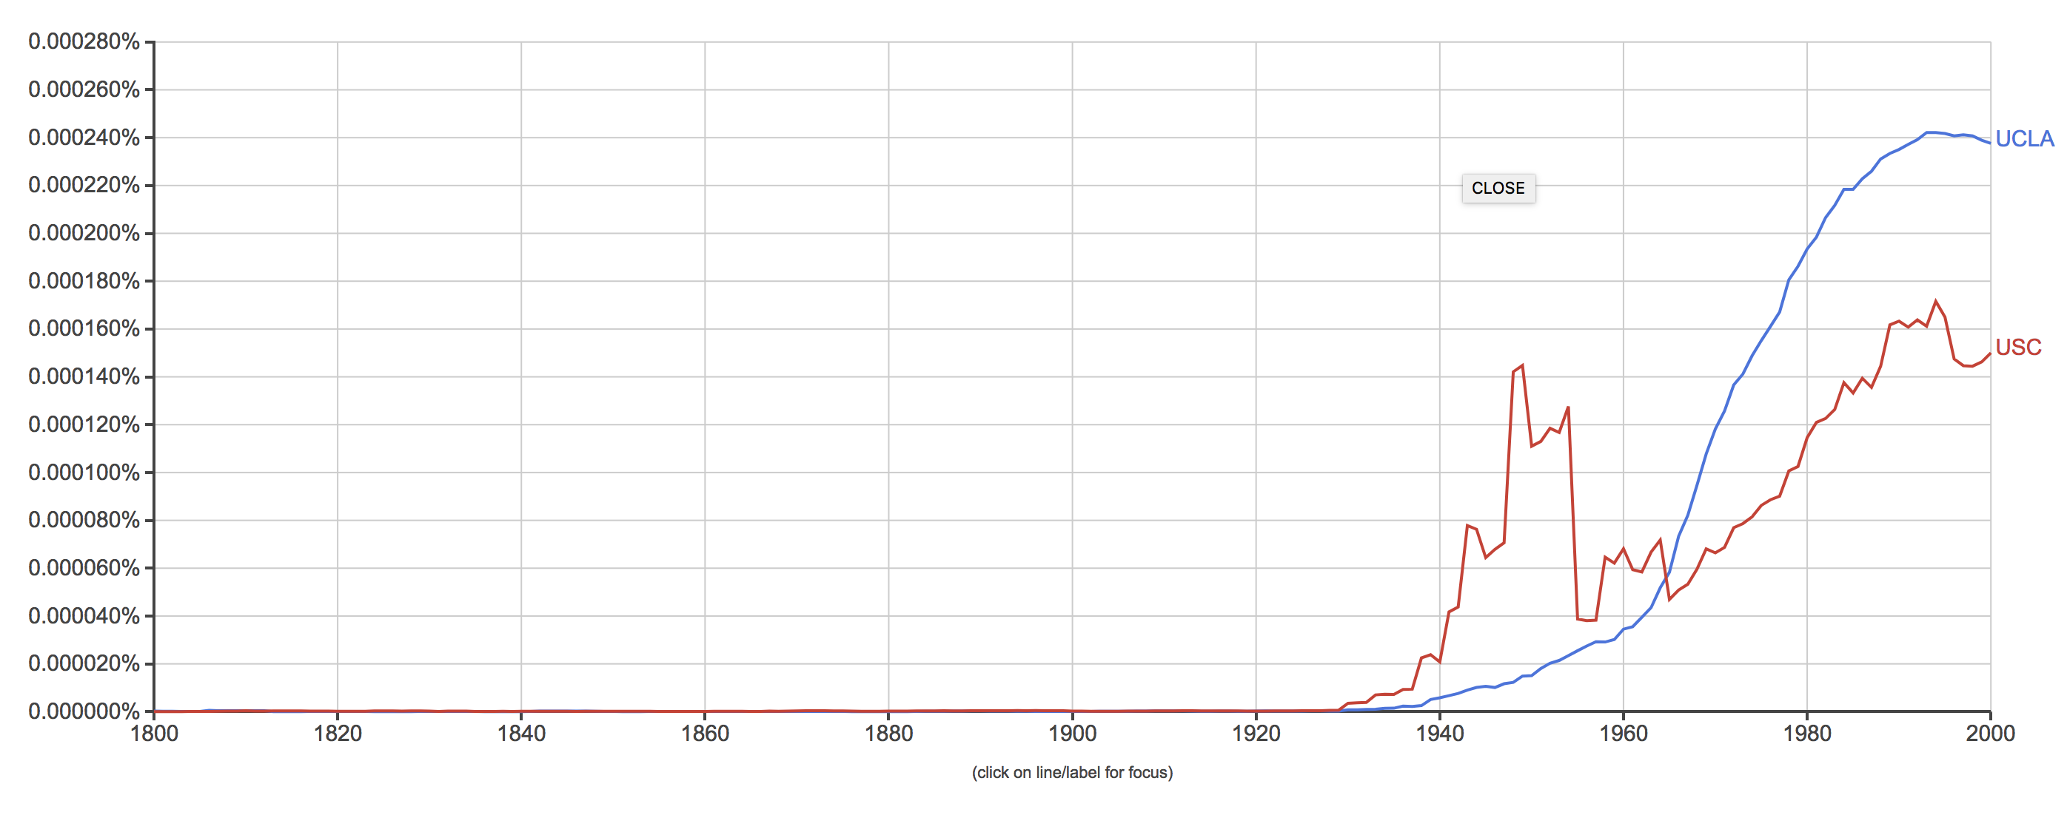
N-Gram Viewer
https://books.google.com/ngrams

Slide 7
How to represent words?
N-gram -- cannot capture word similarity
Word clusters
Brown Clustering
Part-of-speech tagging
Continuous space representation
Word embedding

Slide 8
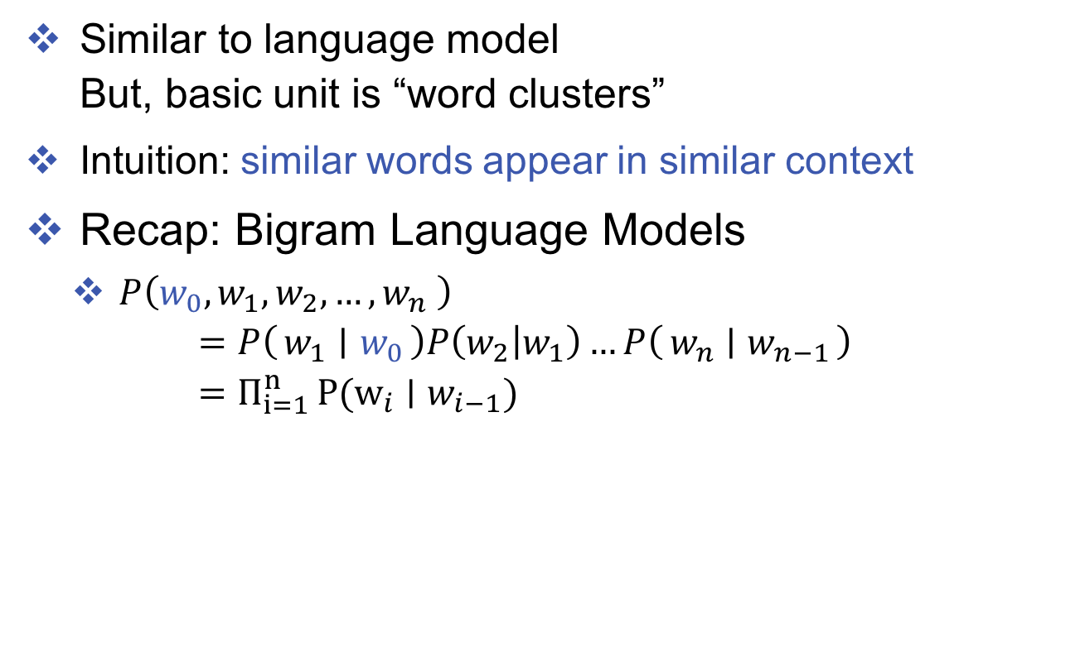
Brown Clustering
Similar to language model But, basic unit is “word clusters”
Intuition: similar words appear in similar context
Recap: Bigram Language Models
$P\left({w_{0},w}_{1},w_{2},…, w_{n} \right)$
$$=P\left(w_{1} ∣ w_{0}\right)P\left(w_{2} | w_{1}\right)…P\left(w_{n} ∣ w_{n−1}\right) \\ =Π_{i=1 }^{n}P(w_{i}∣w_{i−1})$$
$w_{0}$ is a dummy word representing ”begin of a sentence”

Slide 9
Motivation example
”a dog is chasing a cat”
$P\left(w_{0}, “a”,”dog”,…, “cat” \right)$
$$=P\left(”a” ∣ w_{0}\right)P\left(”dog” | ”a”\right)…P\left(”cat” ∣ ”a”\right)$$
Assume Every word belongs to a cluster
Cluster 3
a
the
Cluster 46
dog cat fox rabbit
bird boy
Cluster 64
is
was
Cluster 64
chasing
following
biting…

Slide 10
Motivation example
Assume every word belongs to a cluster
“a dog is chasing a cat”
C3
C46
C64
C8
C3
C46
Cluster 3
a
the
Cluster 46
dog cat fox rabbit
bird boy
Cluster 64
is
was
Cluster 8
chasing
following
biting…

Slide 11
Motivation example
Assume every word belongs to a cluster
“a dog is chasing a cat”
C3
C46
C64
C8
C3
C46
a dog is chasing a cat
Cluster 3
a
the
Cluster 46
dog cat fox rabbit
bird boy
Cluster 64
is
was
Cluster 8
chasing
following
biting…

Slide 12
Motivation example
Assume every word belongs to a cluster
“the boy is following a rabbit”
C3
C46
C64
C8
C3
C46
the boy is following a rabbit
Cluster 3
a
the
Cluster 46
dog cat fox rabbit
bird boy
Cluster 64
is
was
Cluster 8
chasing
following
biting…

Slide 13
Motivation example
Assume every word belongs to a cluster
“a fox was chasing a bird”
C3
C46
C64
C8
C3
C46
a fox was chasing a bird
Cluster 3
a
the
Cluster 46
dog cat fox rabbit
bird boy
Cluster 64
is
was
Cluster 8
chasing
following
biting…

Slide 14
Brown Clustering
Let $C\left(w\right)$ denote the cluster that $w$ belongs to
“a dog is chasing a cat”
C3
C46
C64
C8
C3
C46
a dog is chasing a cat
P(C(dog)|C(a))
P(cat|C(cat))
Cluster 3
a
the
Cluster 46
dog cat fox rabbit
bird boy
Cluster 64
is
was
Cluster 8
chasing
following
biting…

Slide 15
Brown clustering model
P(“a dog is chasing a cat”)
= P(C(“a”)|$C_{0}$) P(C(“dog”)|C(“a”)) P(C(“dog”)|C(“a”))… P(“a”|C(“a”))P(“dog”|C(“dog”))...
C3
C46
C64
C8
C3
C46
a dog is chasing a cat
P(C(dog)|C(a))
P(cat|C(cat))
Cluster 3
a
the
Cluster 46
dog cat fox rabbit
bird boy
Cluster 64
is
was
Cluster 8
chasing
following
biting…

Slide 16
Brown clustering model
P(“a dog is chasing a cat”)
= P(C(“a”)|$C_{0}$) P(C(“dog”)|C(“a”)) P(C(“dog”)|C(“a”))… P(“a”|C(“a”))P(“dog”|C(“dog”))...
In general
$P\left({w_{0},w}_{1},w_{2},…, w_{n} \right)$
$$=P\left(C(w_{1}) ∣ C\left(w_{0}\right)\right)P\left(C(w_{2}) | {C(w}_{1})\right)…P\left(C\left(w_{n}\right) ∣ C\left(w_{n−1}\right)\right)$$ $P(w_{1}|C\left(w_{1}\right)P\left(w_{2} | C\left(w_{2}\right)\right)…P(w_{n}|C\left(w_{n}\right))$ $=Π_{i=1 }^{n}P\left(C\left(w_{i}\right) ∣ C\left(w_{i−1}\right)\right)P(w_{i}∣C\left(w_{i}\right))$

Slide 17
Model parameters
$P\left({w_{0},w}_{1},w_{2},…, w_{n} \right)$
$=Π_{i=1 }^{n}P\left(C\left(w_{i}\right) ∣ C\left(w_{i−1}\right)\right)P(w_{i}∣C\left(w_{i}\right))$
Parameter set 1:
$$P({C(w}_{i})|C\left(w_{i−1}\right))$$
Parameter set 2:
$$P(w_{i}|C\left(w_{i}\right))$$
C3
C46
C64
C8
C3
C46
a dog is chasing a cat
Parameter set 3:
$$C\left(w_{i}\right)$$
Cluster 3
a
the
Cluster 46
dog cat fox rabbit
bird boy
Cluster 64
is
was
Cluster 8
chasing
following
biting…

Slide 18
Model parameters
$P\left({w_{0},w}_{1},w_{2},…, w_{n} \right)$
$=Π_{i=1 }^{n}P\left(C\left(w_{i}\right) ∣ C\left(w_{i−1}\right)\right)P(w_{i}∣C\left(w_{i}\right))$
A vocabulary set $W$
A function $C:W→\{1, 2, 3,…k \}$
A partition of vocabulary into k classes
Conditional probability $P(c′∣c)$ for $c,c^{′}∈\left\{1,…,k\right\}$
Conditional probability $P(w∣c)$ for $c,c^{′}∈\left\{1,…,k\right\}, w∈c$
$θ$ represents the set of conditional probability parameters
C represents the clustering

Slide 19
Log likelihood
LL($θ, C$) = log $P\left({w_{0},w}_{1},w_{2},…, w_{n} ∣ θ, C\right)$
$={log Π}_{i=1 }^{n}P\left(C\left(w_{i}\right) ∣ C\left(w_{i−1}\right)\right)P(w_{i}∣C\left(w_{i}\right))$
$$=∑_{i=1 }^{n}[log P\left(C\left(w_{i}\right) ∣ C\left(w_{i−1}\right)\right)+\log{P(w_{i}∣C\left(w_{i}\right)) }]$$
Maximizing LL($θ, C$) can be done by alternatively update $θ$ and $C$
$\max_{θ∈Θ} LL(θ,C)$
$\max_{C} LL(θ,C)$

Slide 20
$$\max_{θ∈Θ} LL(θ,C)$$
LL($θ, C$) = log $P\left({w_{0},w}_{1},w_{2},…, w_{n} ∣ θ, C\right)$
$={log Π}_{i=1 }^{n}P\left(C\left(w_{i}\right) ∣ C\left(w_{i−1}\right)\right)P(w_{i}∣C\left(w_{i}\right))$
$$=∑_{i=1 }^{n}[log P\left(C\left(w_{i}\right) ∣ C\left(w_{i−1}\right)\right)+\log{P(w_{i}∣C\left(w_{i}\right)) }]$$
$P(c′∣c)$ = $\frac{\#(c^{′},c)}{\#c}$
$P(w∣c)$ = $\frac{\#(w,c)}{\#c}$
This part is the same as training a POS tagging model
See section 9.2:
http://ciml.info/dl/v0_99/ciml-v0_99-ch09.pdf

Slide 21
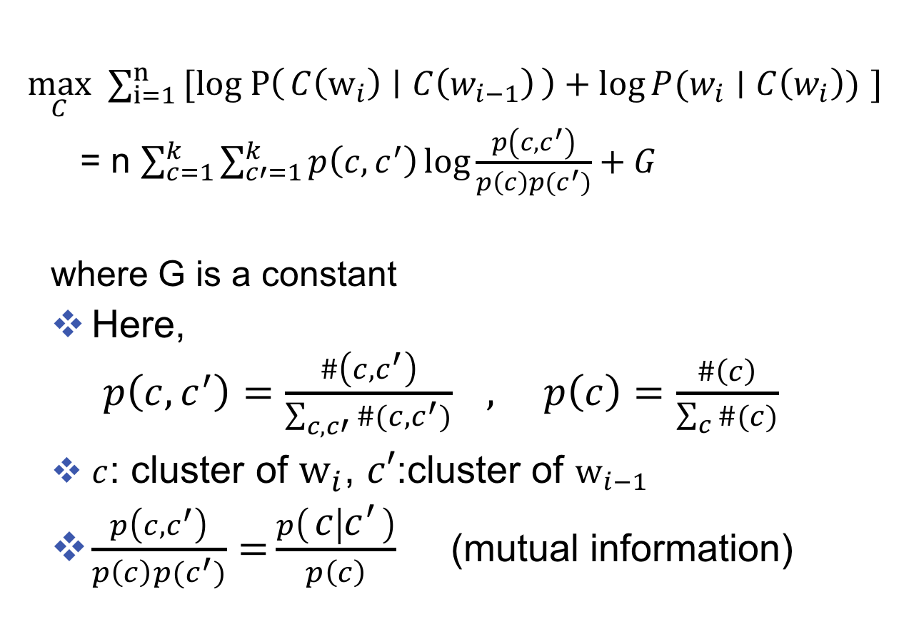
$$\max_{C} LL(θ,C)$$
$\max_{C} ∑_{i=1 }^{n}[log P\left(C\left(w_{i}\right) ∣ C\left(w_{i−1}\right)\right)+\log{P(w_{i}∣C\left(w_{i}\right)) }]$
= n $\sum_{c=1}^{k}{\sum_{c′=1}^{k}{p\left(c,c^{′}\right)\log{\frac{p\left(c,c^{′}\right)}{p\left(c\right)p(c^{′})}+G}}}$
where G is a constant
Here, $p\left(c,c^{′}\right)=\frac{\#\left(c,c^{′}\right)}{\sum_{c,c′}{\#(c,c^{′})}} , p\left(c\right)=\frac{\#\left(c\right)}{\sum_{c}{\#(c)}}$
$c$: cluster of $w_{i}$, $c′$:cluster of $w_{i−1}$
$\frac{p\left(c,c^{′}\right)}{p\left(c\right)p(c^{′})}={\frac{p\left(c ∣ c^{′}\right)}{p\left(c\right)}}$ (mutual information)
See classnote here:
http://web.cs.ucla.edu/~kwchang/teaching/NLP16/slides/classnote.pdf

Slide 22
Algorithm 1
Start with |V| clusters each word is in its own cluster
The goal is to get k clusters
We run |V|-k merge steps:
Pick 2 clusters and merge them
Each step pick the merge maximizing$LL(θ,C)$
Cost? (can be improved to ${ O(\left|V\right|}^{3})$) O(|V|-k)${ O(\left|V\right|}^{2}) O{ (\left|V\right|}^{2})$ = ${ O(\left|V\right|}^{5})$
#Iters #pairs compute LL

Slide 23
Algorithm 2
m : a hyper-parameter, sort words by frequency
Take the top m most frequent words, put each of them in its own cluster $c_{1},c_{2},c_{3}, …c_{m}$
For $i=\left(m+1\right)…|V|$
Create a new cluster $c_{m+1 }$ (we have m+1 clusters)
Choose two cluster from m+1 clusters based on $LL\left(θ,C\right)$ and merge $⇒$ back to m clusters
Carry out (m-1) final merges $⇒$ full hierarchy
Running time $O\left(\left|V\right|m^{2}+n\right)$ , n=#words in corpus

Slide 24
Example clusters (Brown+1992)

Slide 25
Example Hierarchy(Miller+2004)

