Slide 1
Final Project
Kai-Wei Chang
CS @ UCLA
kw@kwchang.net
Couse webpage: https://uclanlp.github.io/CS269-17/

Slide 2
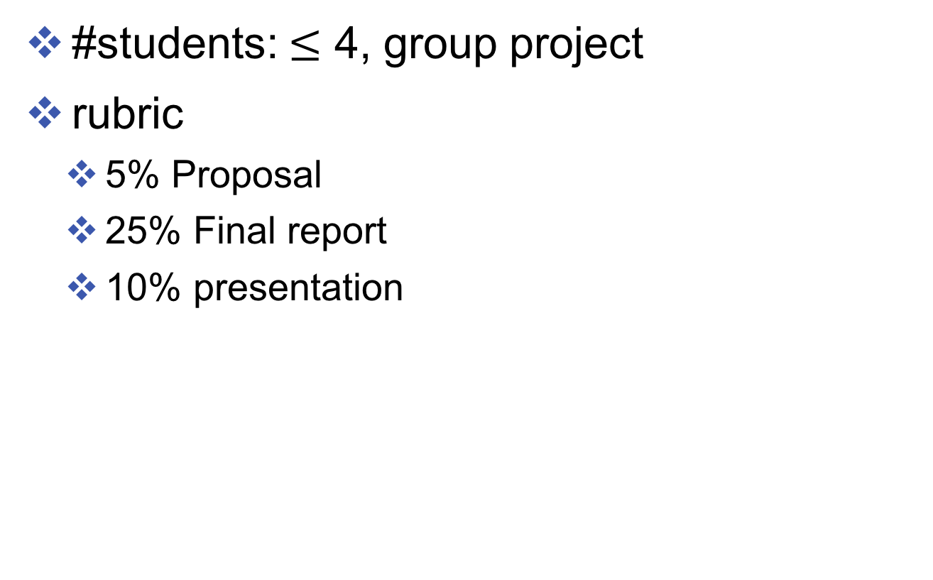
Requirement
#students: $≤$ 4, group project
rubric
5% Proposal
25% Final report
10% presentation

Slide 3
Final Report
Can be in PDF format, a jupyter notebook, or a webpage.
Less than 4 pages.

Slide 4
Project types
List of potential ideas: https://goo.gl/W9RuoZ
Shared task
Research project
NLP/ML applications
Literature survey / Reimplementing
Building a library / Demo

Slide 5
General Steps
Define your task
How to evaluate?
Where to get data/ how to split data (use pre-split data is possible) / Define your evaluation metric
Understand your problem
Implement simple baseline and/or existing approaches
Error analysis (e.g., https://arxiv.org/pdf/1606.02858v2.pdf)

Slide 6
General Steps
Implement a non-trivial approach
Sanity check / Unit testing / Parameter tuning
Analysis
Error analysis / Discussion/ Ablation study / Visualization
Improve your approach

Slide 7
Useful tools
https://uclanlp.github.io/CS269-17/resource
Machine learning toolbox:
Scikit learn,
Pytorch, DyNet, Tensorflow
NLP toolbox:
NLTK, SpyCy

Slide 8
Paper summary
Individual project
Pick a paper from ACL, EMNLP, NIPS, ICML, UAI, AAAI, …
Example: https://www.salesforce.com/products/einstein/ai-research/tl-dr-reinforced-model-abstractive-summarization/
https://research.googleblog.com/2017/08/transformer-novel-neural-network.html
https://github.com/uclanlp/reducingbias/blob/master/src/fairCRF_gender_ratio.ipynb

