Slide 1
GuideXP
A simple way to create self-guided tours
Liang Hong u6303287
Rutai Sun u6227336
Danny Feng u6611178
Yuanze Niu u6401780
Yu Qiu u6063921
Kelin Zhu u5746348

Slide 2
Introduction
What is GuideXP?
Cloud-based approach to audio guides - Cross-platform
Key stakeholders
Visitors, Artists, galleries and museums
Vision
Cross-promotion between institutions
Data driven recommendation
Tailored experiences (AR/VR)

Slide 3
Team Roles
Kelin Zhu : project manager
Rutai Sun : back-end(logic,algorithm)
Liang Hong : database(mongodb,test)
Yuanze Niu : front-end (HTML,CSS), Documentation
Danny Feng : front-end (JavaScript), Cloud
Yu Qiu : back-end, API

Slide 4
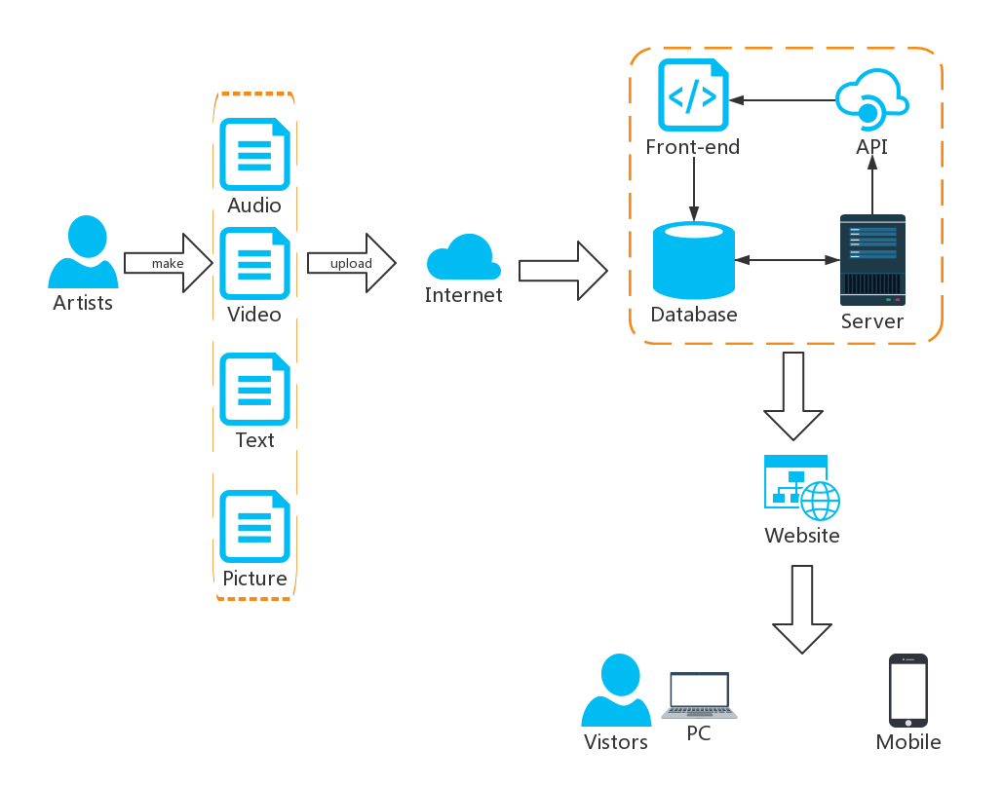
UX design

Slide 5
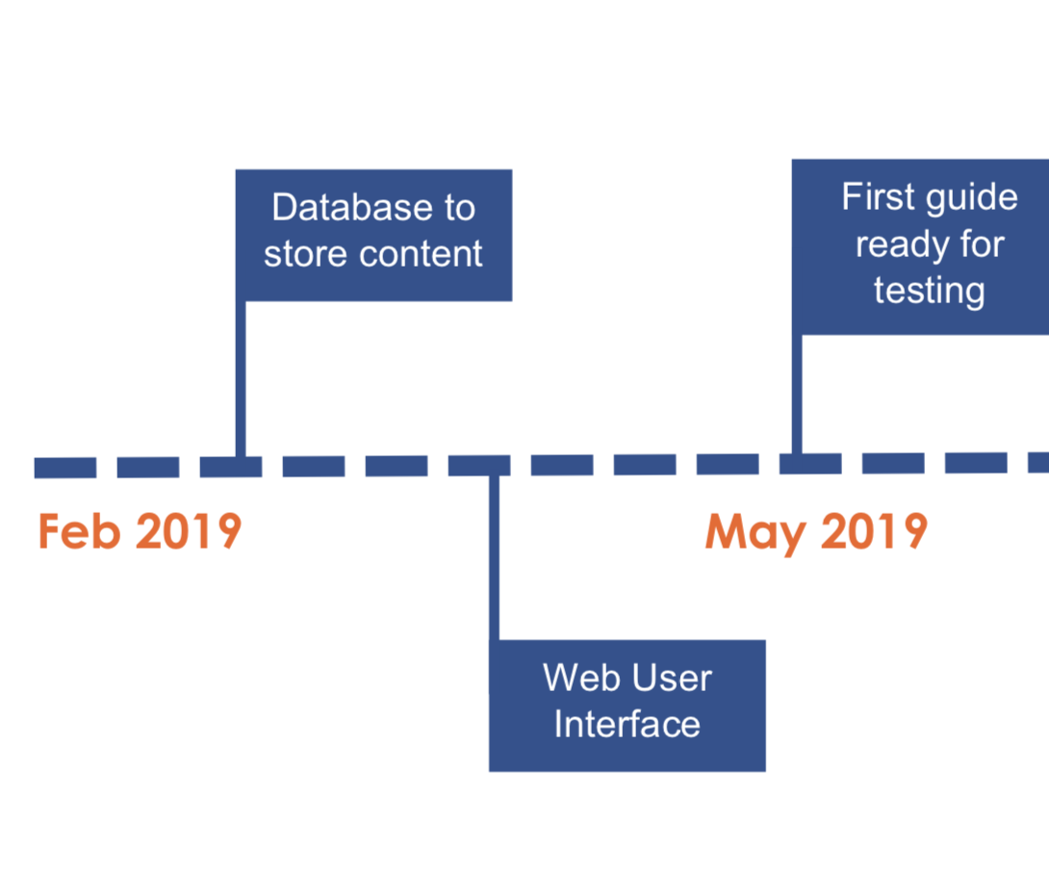
Schedule & Roadmap
Week | Schedule
Week 2~3 | Discovery of requirements.
Week 4~5 | Bulid the database
Week 6~9 | Design the website structure , logical function. Implement the User Interface(UI).
Week 10~11 | Implement the Application Program Interface (API).
Week 12 | Test, debug and gather feedback from clients.

Slide 6
Resources & Risk
Resourse:
Python
JavaScript
MongoDB(uncertain)
Risk:
Cost over budget
Project extension
Failure to meet customer requirements
Ineffective teamwork

Slide 7
Thank you!

