Slide 1
GuideXP
A simple way to create self-guided tours
Liang Hong u6303287
Rutai Sun u6227336
Danny Feng u6611178
Yuanze Niu u6401780
Yu Qiu u6063921
Kelin Zhu u5746348

Slide 2
DISCOVERY

Slide 3
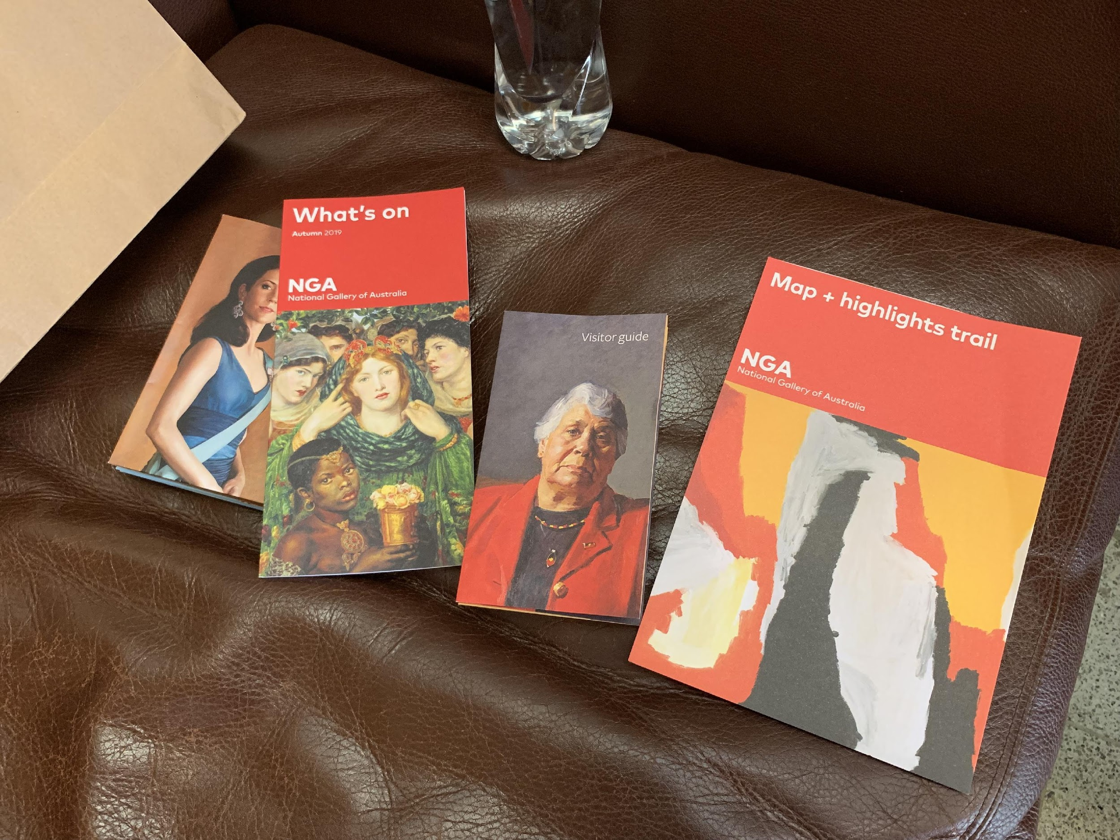

Slide 4
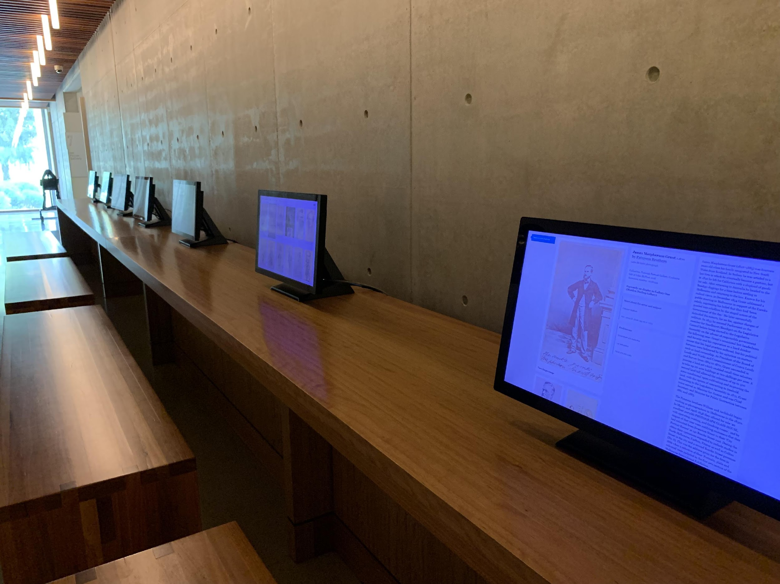

Slide 5
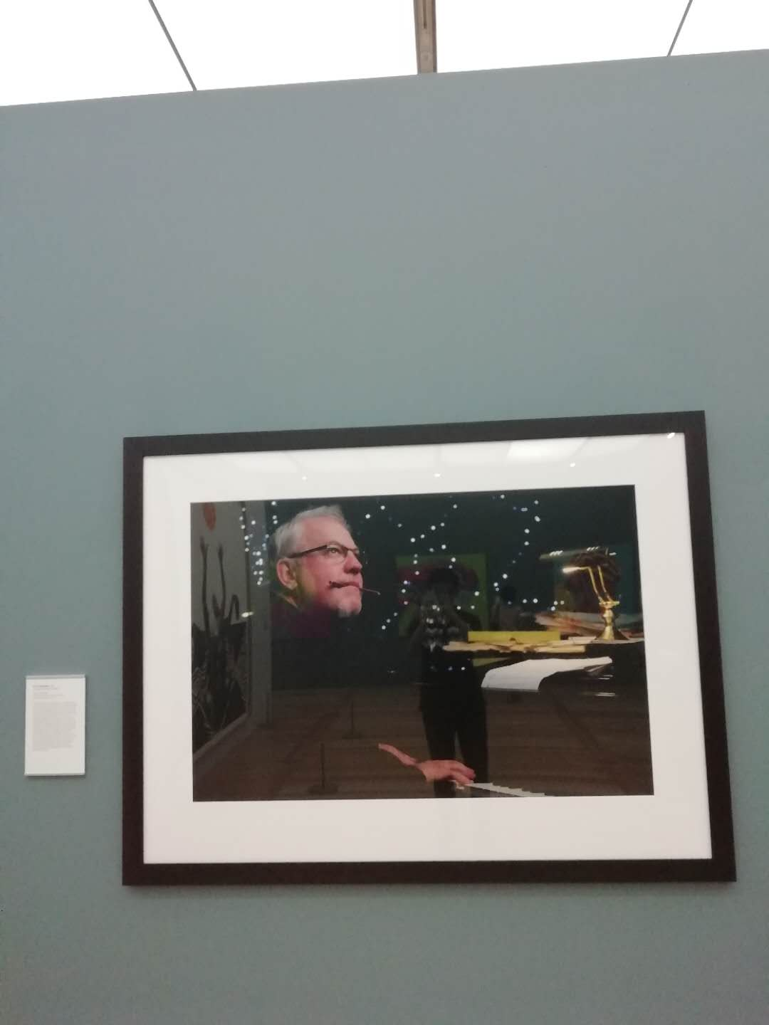

Slide 6
DECISION MAKING

Slide 7





See “Decision Log” in our GitHub for more details

Slide 8
OUTPUTS

Slide 9
Outputs
Architechture map
ER diagram of database
Django, React basic code
UX / UI Interaction Prototype
Environment setup (Local, virtual machine)
Documentations (Meeting minutes, Decision log, User’s story)

Slide 10
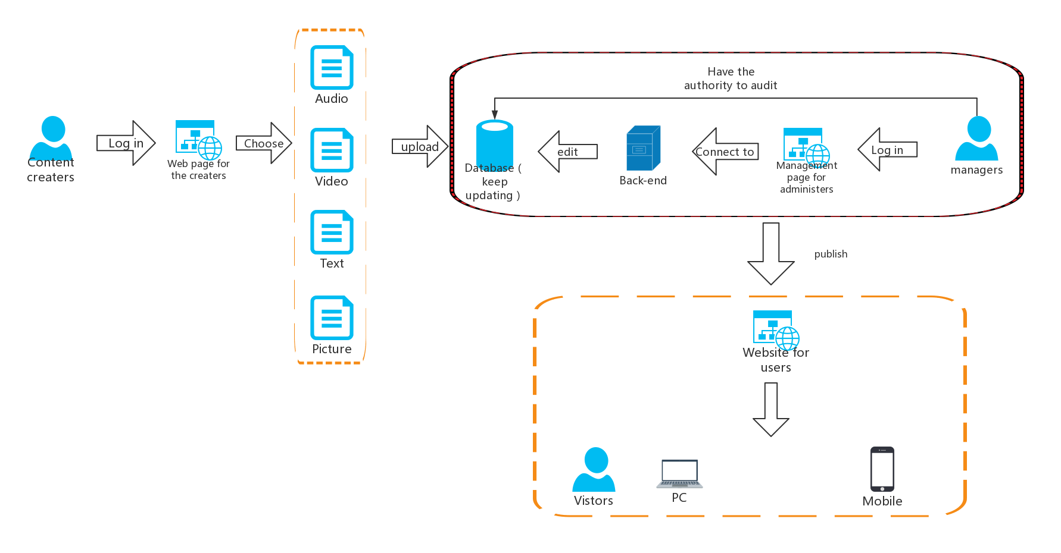
Architecture Map

Slide 11
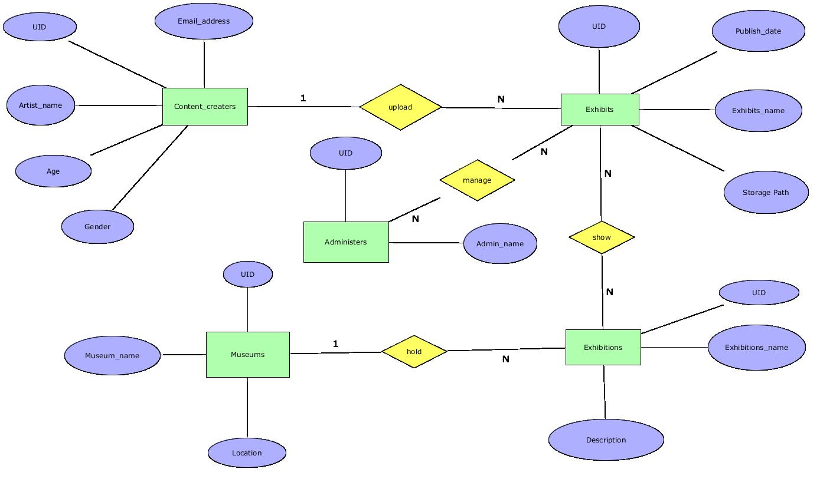
ER diagram

Slide 12
Django
show a simple example

Slide 13
User Interface (UI)

Slide 14
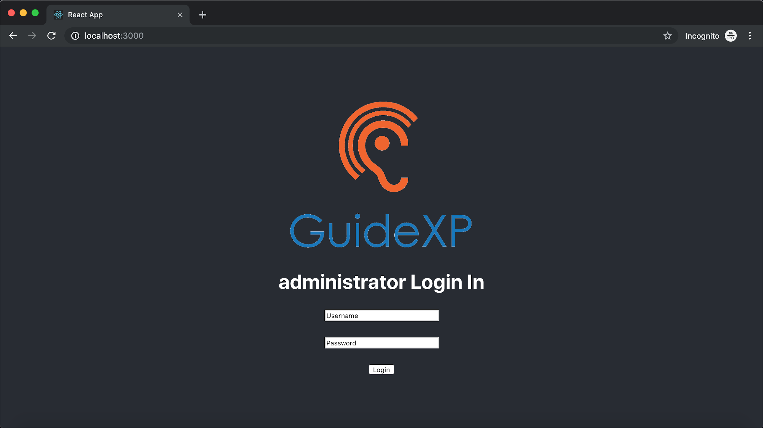
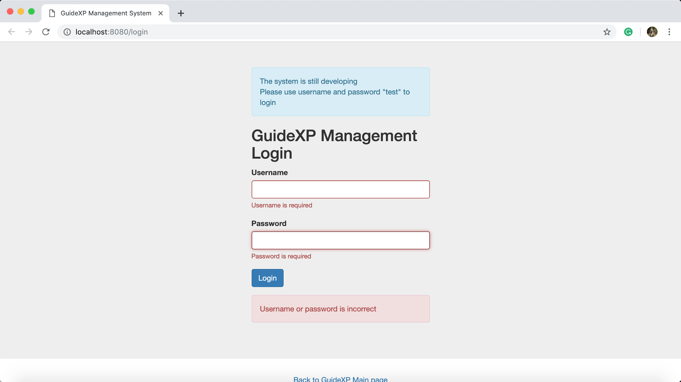
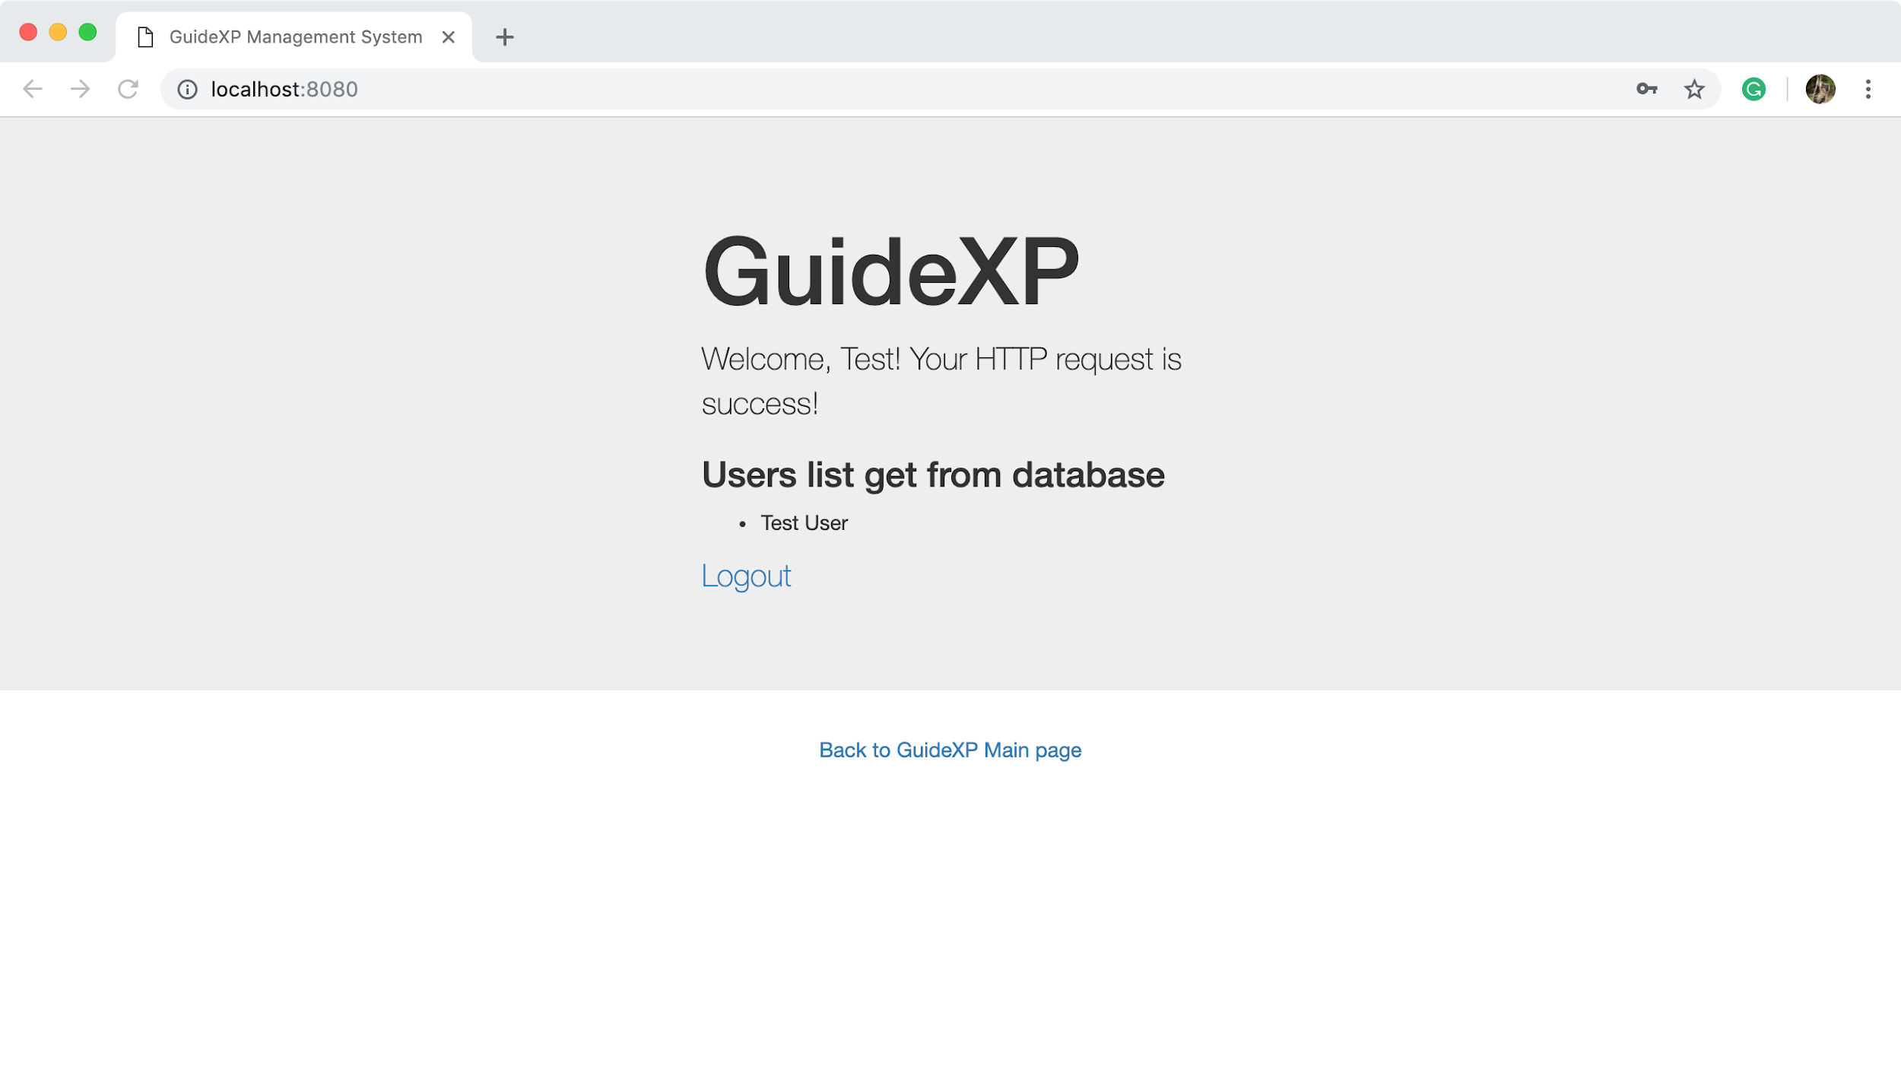
User Interface (UI)
Related link
https://github.com/DannyFirmin/GuideXP/tree/master/front-end

Slide 15
Environment setup
Eventually we need to run our code on sever
We set up a javascript npm package manager, LAMP environment and Linux virtual machine on every member's laptop at this stage.

Slide 16
COMMUNICATION

Slide 17
Communication
One client meeting every week
One group meeting every week
Slack, WeChat
Trello

Slide 18
REFLECTION

Slide 19
Reflection
Server -- Replace server
Operations of database -- Data security
API -- Decentral system
UI -- Beautify interface

Slide 20
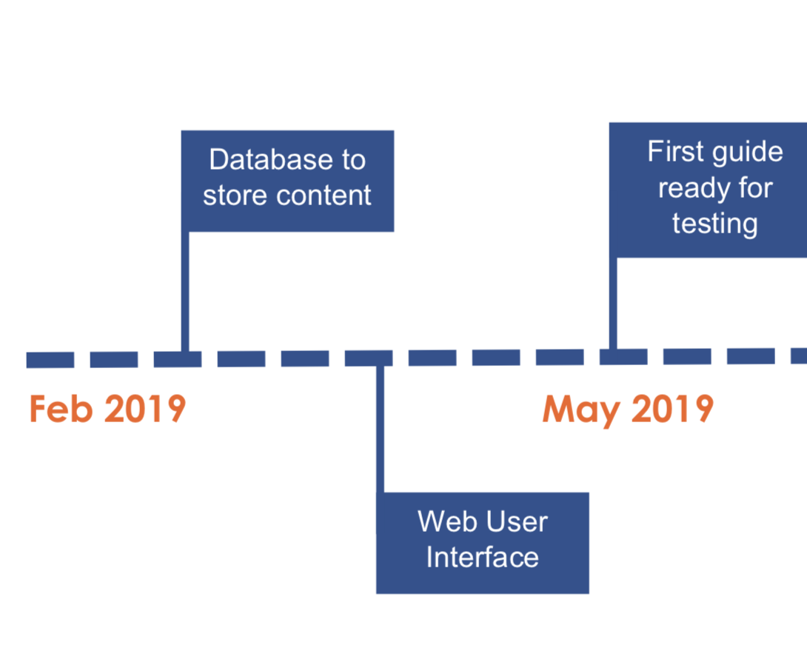
Schedule & Roadmap
Week 6~9 | Improve data base, design the website structure , logical function. Implement the User Interface(UI).
Week 10~11 | Implement the Application Program Interface (API).
Week 12 | Test, debug and gather feedback from clients.

Slide 21
Thank you!

