Slide 1
GuideXP
A simple way to create self-guided tours
Liang Hong u6303287
Rutai Sun u6227336
Danny Feng u6611178
Yuanze Niu u6401780
Yu Qiu u6063921
Kelin Zhu u5746348

Slide 2
DECISION MAKING

Slide 3





See “Decision Log” in our GitHub for more details

Slide 4
OUTPUTS

Slide 5
Outputs
The manage system for superusers
The guide website for visitors
API
Server
Documentations (Meeting minutes, Decision log, User’s story)

Slide 6
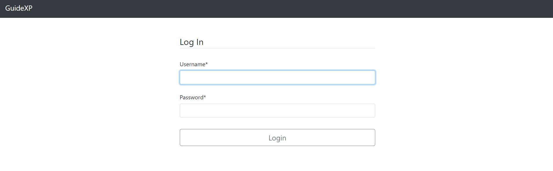
Manage system for administers
1.Login

Slide 7
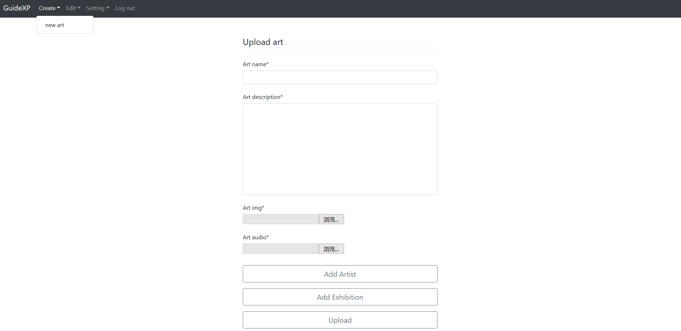
Manage system for administers
2.Create files

Slide 8
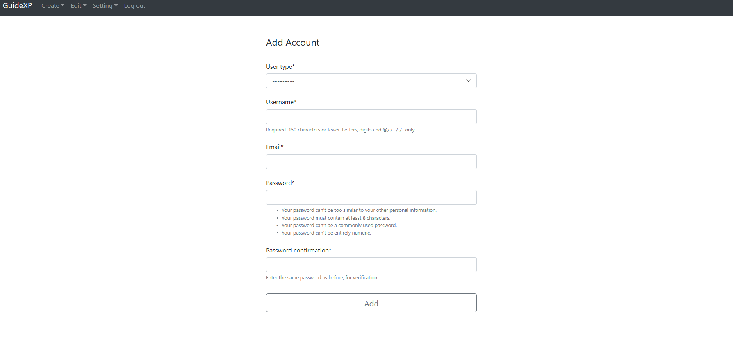
Manage system for administers
2.1setting(example:add new account)

Slide 9
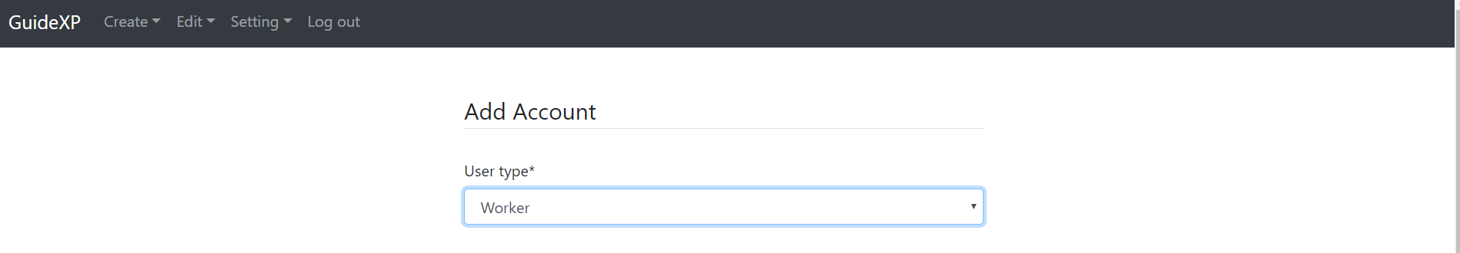
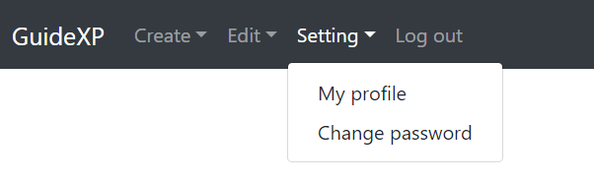
Manage system for administers
2.2 Restrictions for different user types

Slide 10
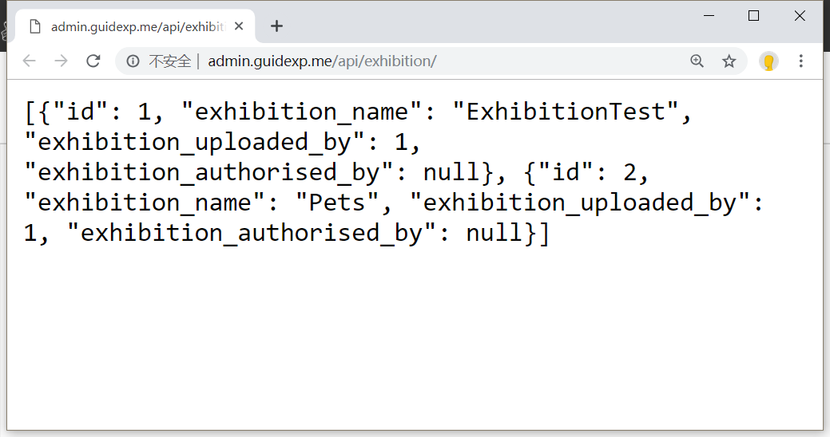
API

Slide 11
DEMO

Slide 12
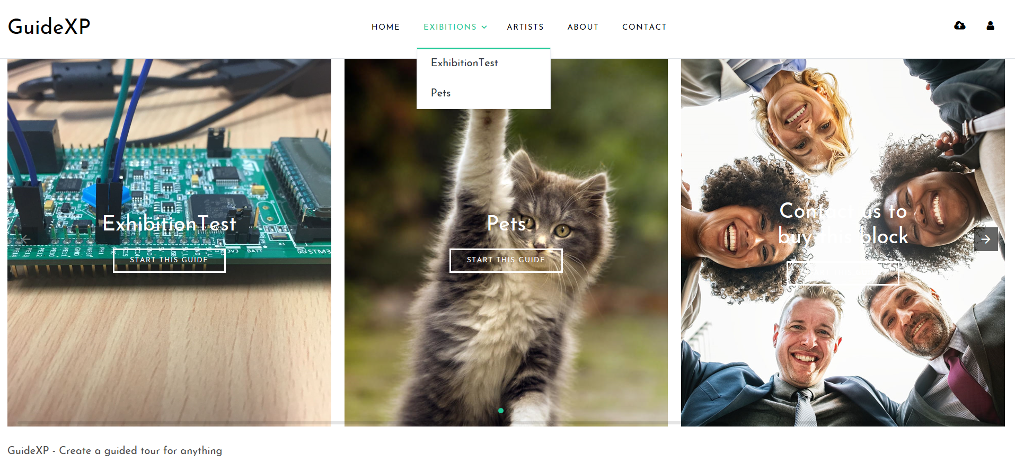
The guide website for visitors
1.Homepage

Slide 13
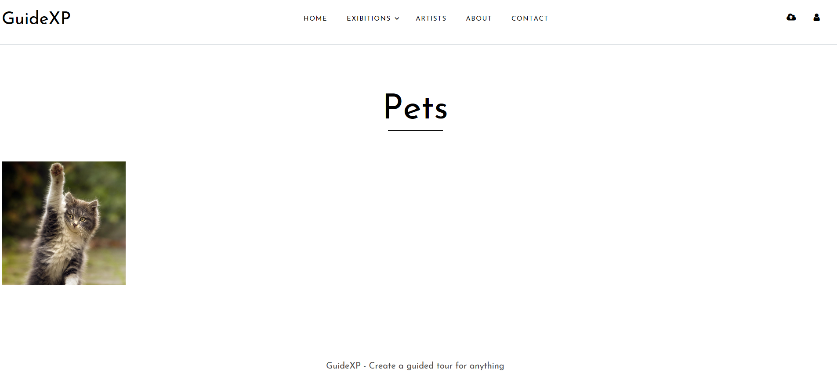
The guide website for visitors
2.Arts in an exhibition

Slide 14
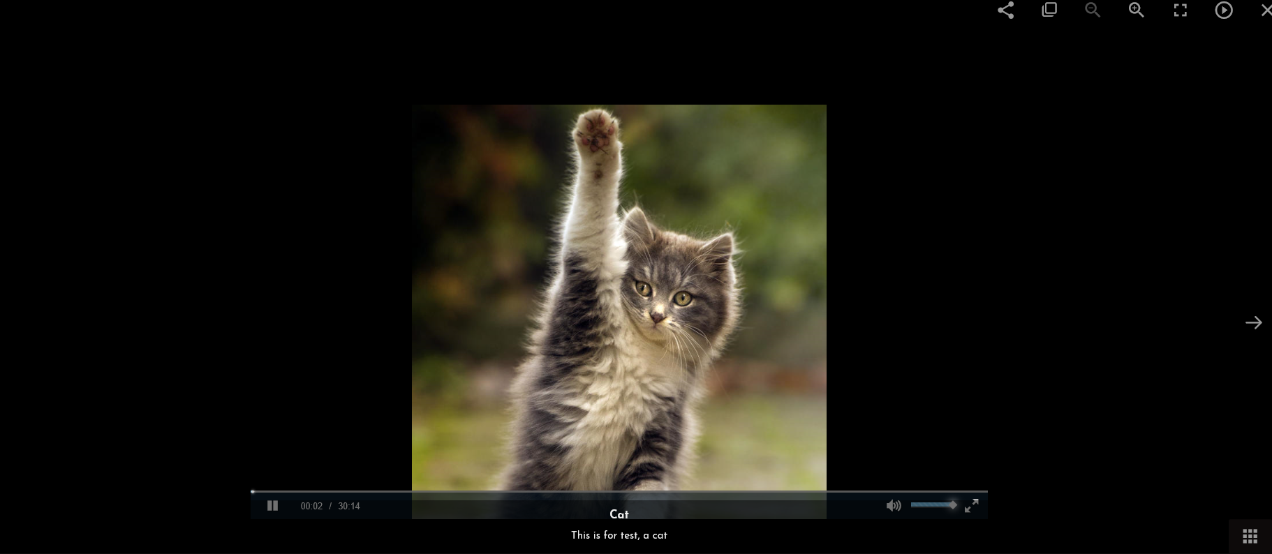
The guide website for visitors
3.Arts in an exhibition
3.Audio and text

Slide 15
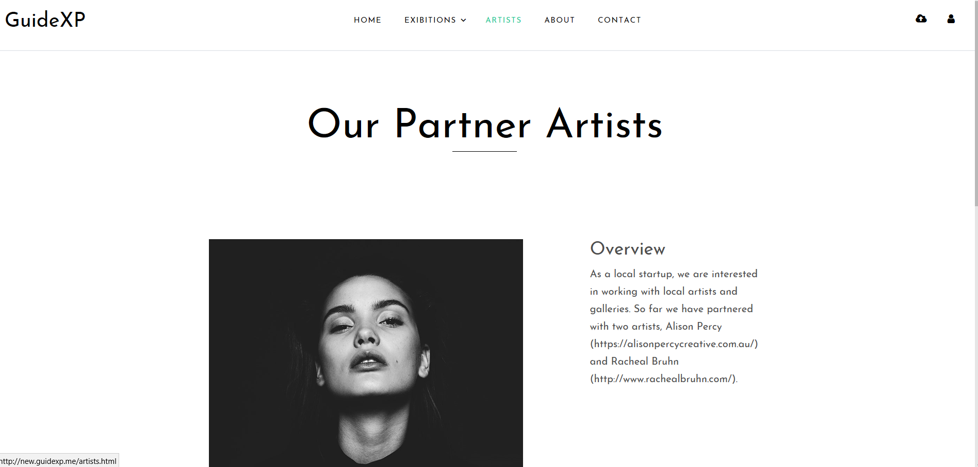
The guide website for visitors
4.Artists

Slide 16
Server
Configured Amazon Web Services (AWS) - Elastic Compute Cloud (EC2)
Configured Crazy Domains AU for DNS and domains
Configured nginx/Ubuntu 18.04

Slide 17
COMMUNICATION

Slide 18
Communication
One client meeting every week
One group meeting every week
Slack, WeChat, GitHub
Trello
Three full-time working days

Slide 19
REFLECTION

Slide 20
Reflection -- prepare for the next stage
Operations of database -- Data security, more operations
UI -- Improve views
Guide website -- Improve the guide function, for example add location of a gallery or museum
Manage system -- Increase the system function, such as verify the account by emails
API -- Try to optimise the API

Slide 21
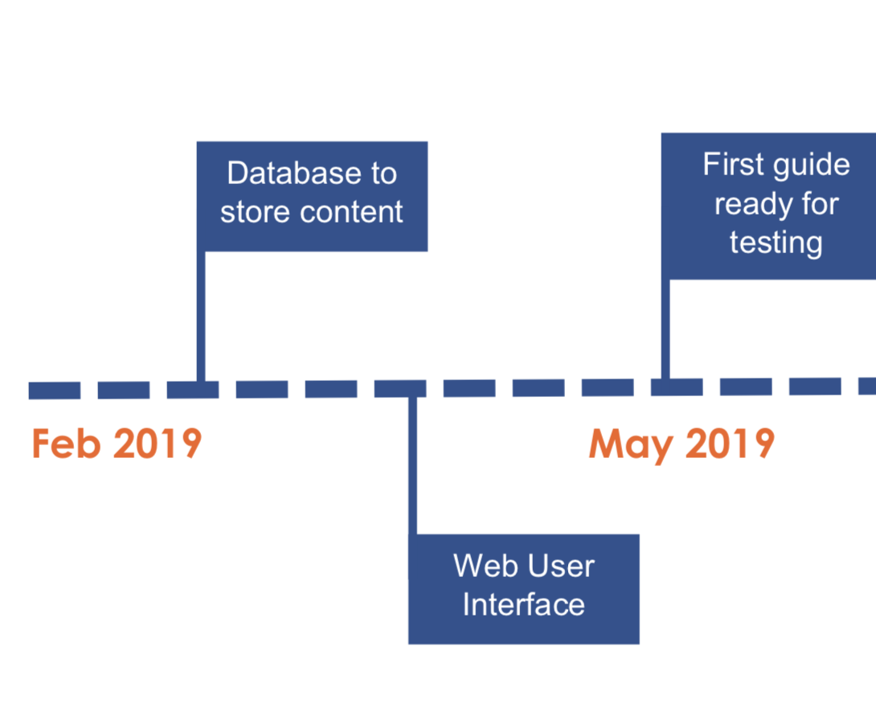
Schedule & Roadmap
Week 10~11 | Try our best to test, debug and improve according to the feedback from clients.
Week 12 | Finalization and pass onto our client.

Slide 22
GitHub account
The account for our source code:
Account: guidexp-marker
Password: guidexp8715

Slide 23
Thank you!

