Slide 1
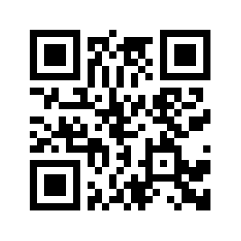
Before we begin, please visit
http://new.guidexp.me/audit/
or Scan this QR code
We need to collect your information so that we can gain you access to our source code on GitHub and Agile Management System on Trello

Slide 2
The Revolution of Exhibition Guide
GuideXP
Liang Hong u6303287
Rutai Sun u6227336
Danny Feng u6611178
Yuanze Niu u6401780
Yu Qiu u6063921
Kelin Zhu u5746348
Tianai Qiu u6744700

Slide 3
Introduction
online guide
multi-language
QR code

Slide 4
Outputs
Project milestone & Schedule
Documentations
-Meeting minutes
-Decision log
-User’s story
-Statement of Work
-Setup PHP with Nginx on Linux Server
-GuideXP Internal Files Access Application (html+CSS+php)

Slide 5
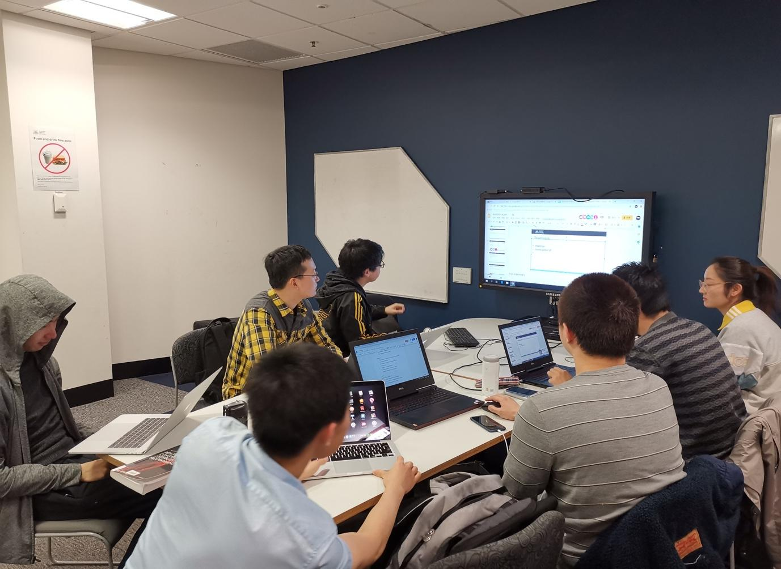
Teamwork
Meetings
One client meeting every week
One group meeting every week
Investigation of National Capital Exhibition

Slide 6
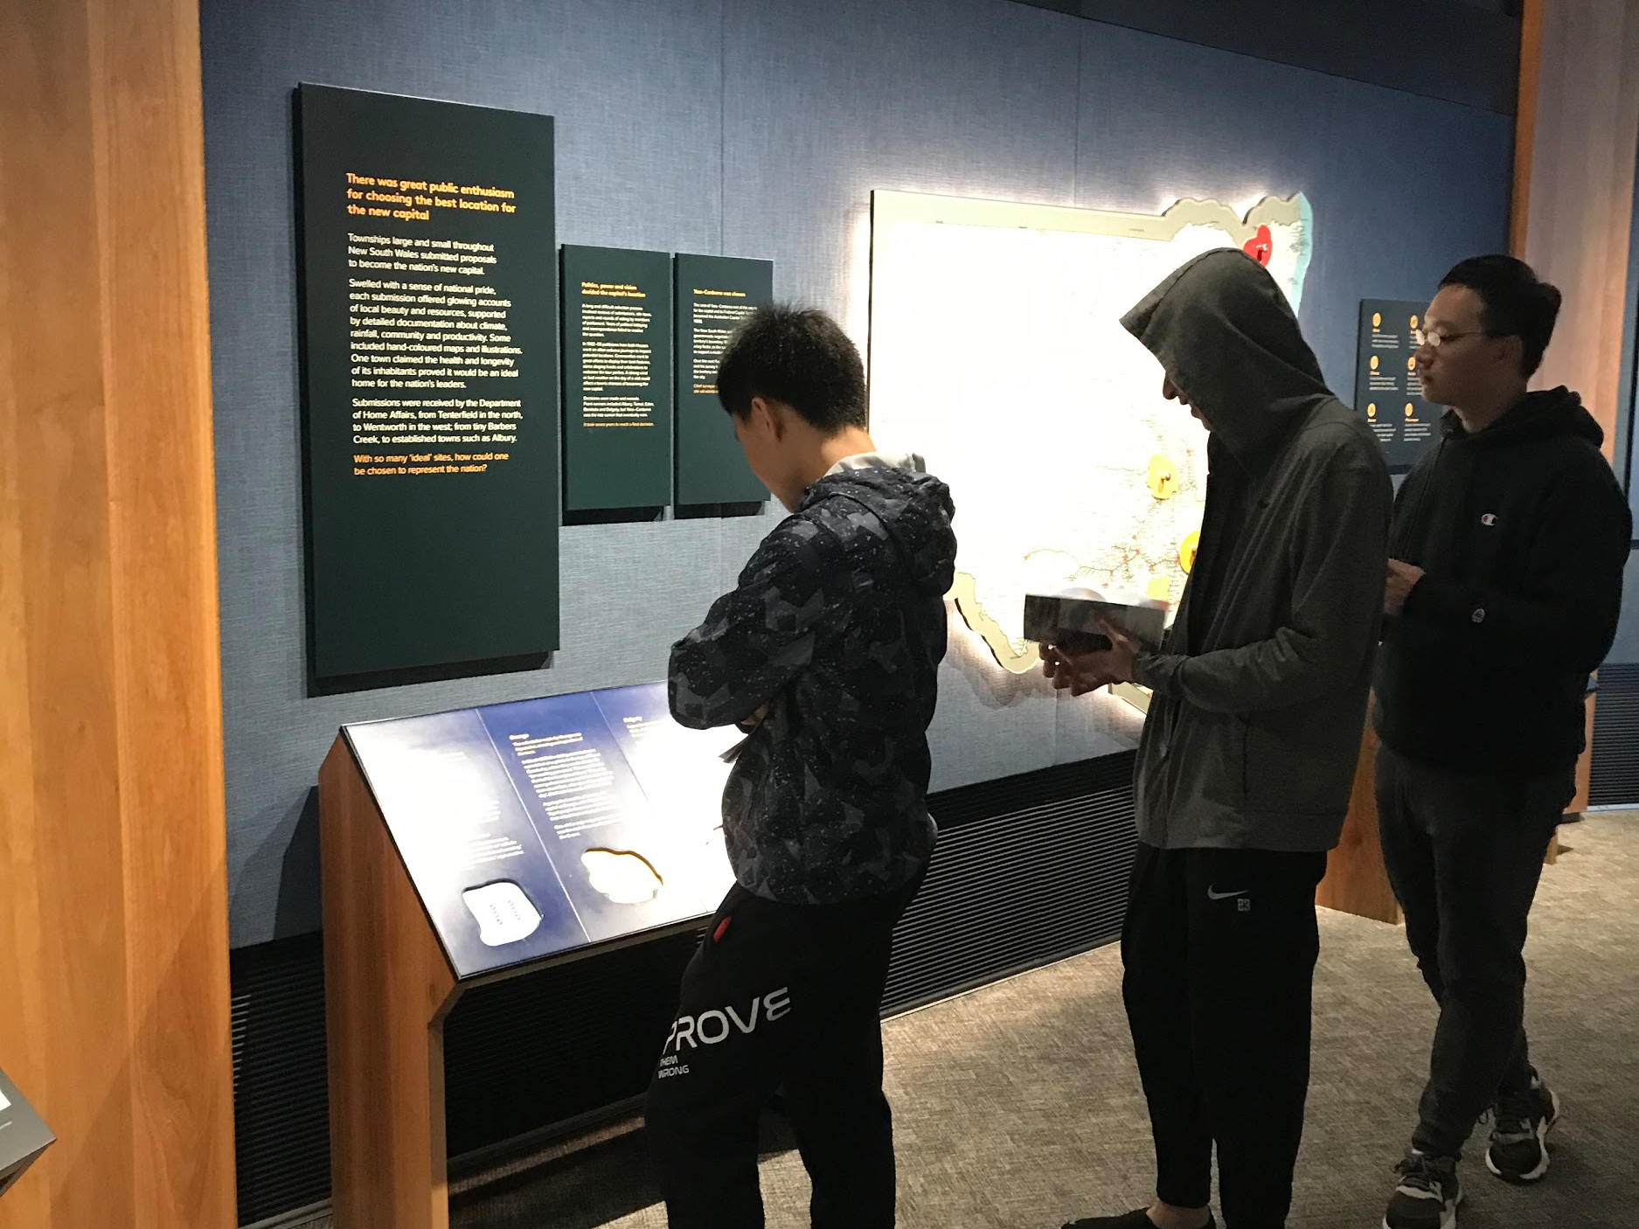
Decision Making (Field Trip)
Doing research to discover requirement in the real world
This help us making better decision

Slide 7
Decision Making
Discovering
Architechture
Planning
Management (Agile - Scurm & Kanban)
Technical (Django, bootstrap, jQuery)

Slide 8
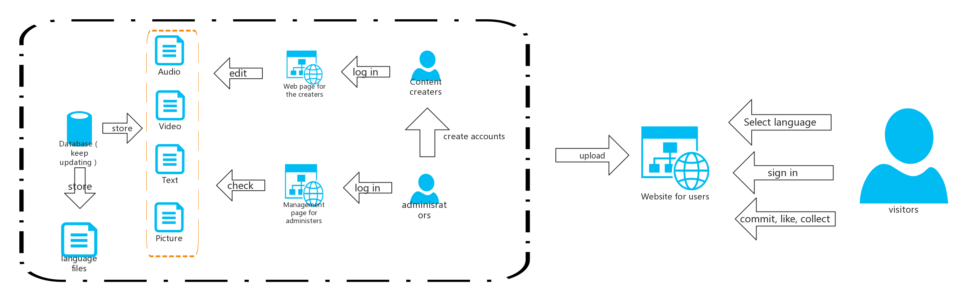
Architechture design

Slide 9
Decision Making - Planning
Show Trello
Week 2-3 | Requirements discovery
Week 4-5 | Optimize existing system (Code Refactoring) and add searching functions
Week 6-7 | Build a prototype guide for National Captial Exhbition
Week 8-9 | Improve the both visitor and admin system, add new functions
Week 10-11 | Multi-language support
Week 12 | Test, debug & pass onto clients

Slide 10
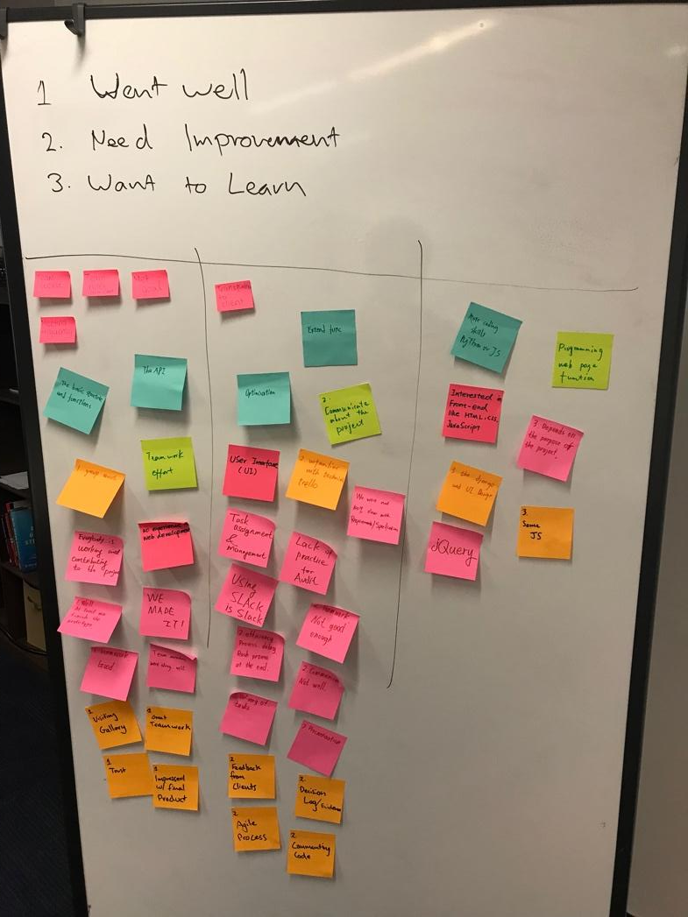
Reflection-- prepare for the next stage
Last semester -- Main problems that need impovement:
Lack of skills
Less communication
-- More communication with clients and tutor.
Low effetioncy
-- Srum -- Complete the weekly schedule ontime.

Slide 11
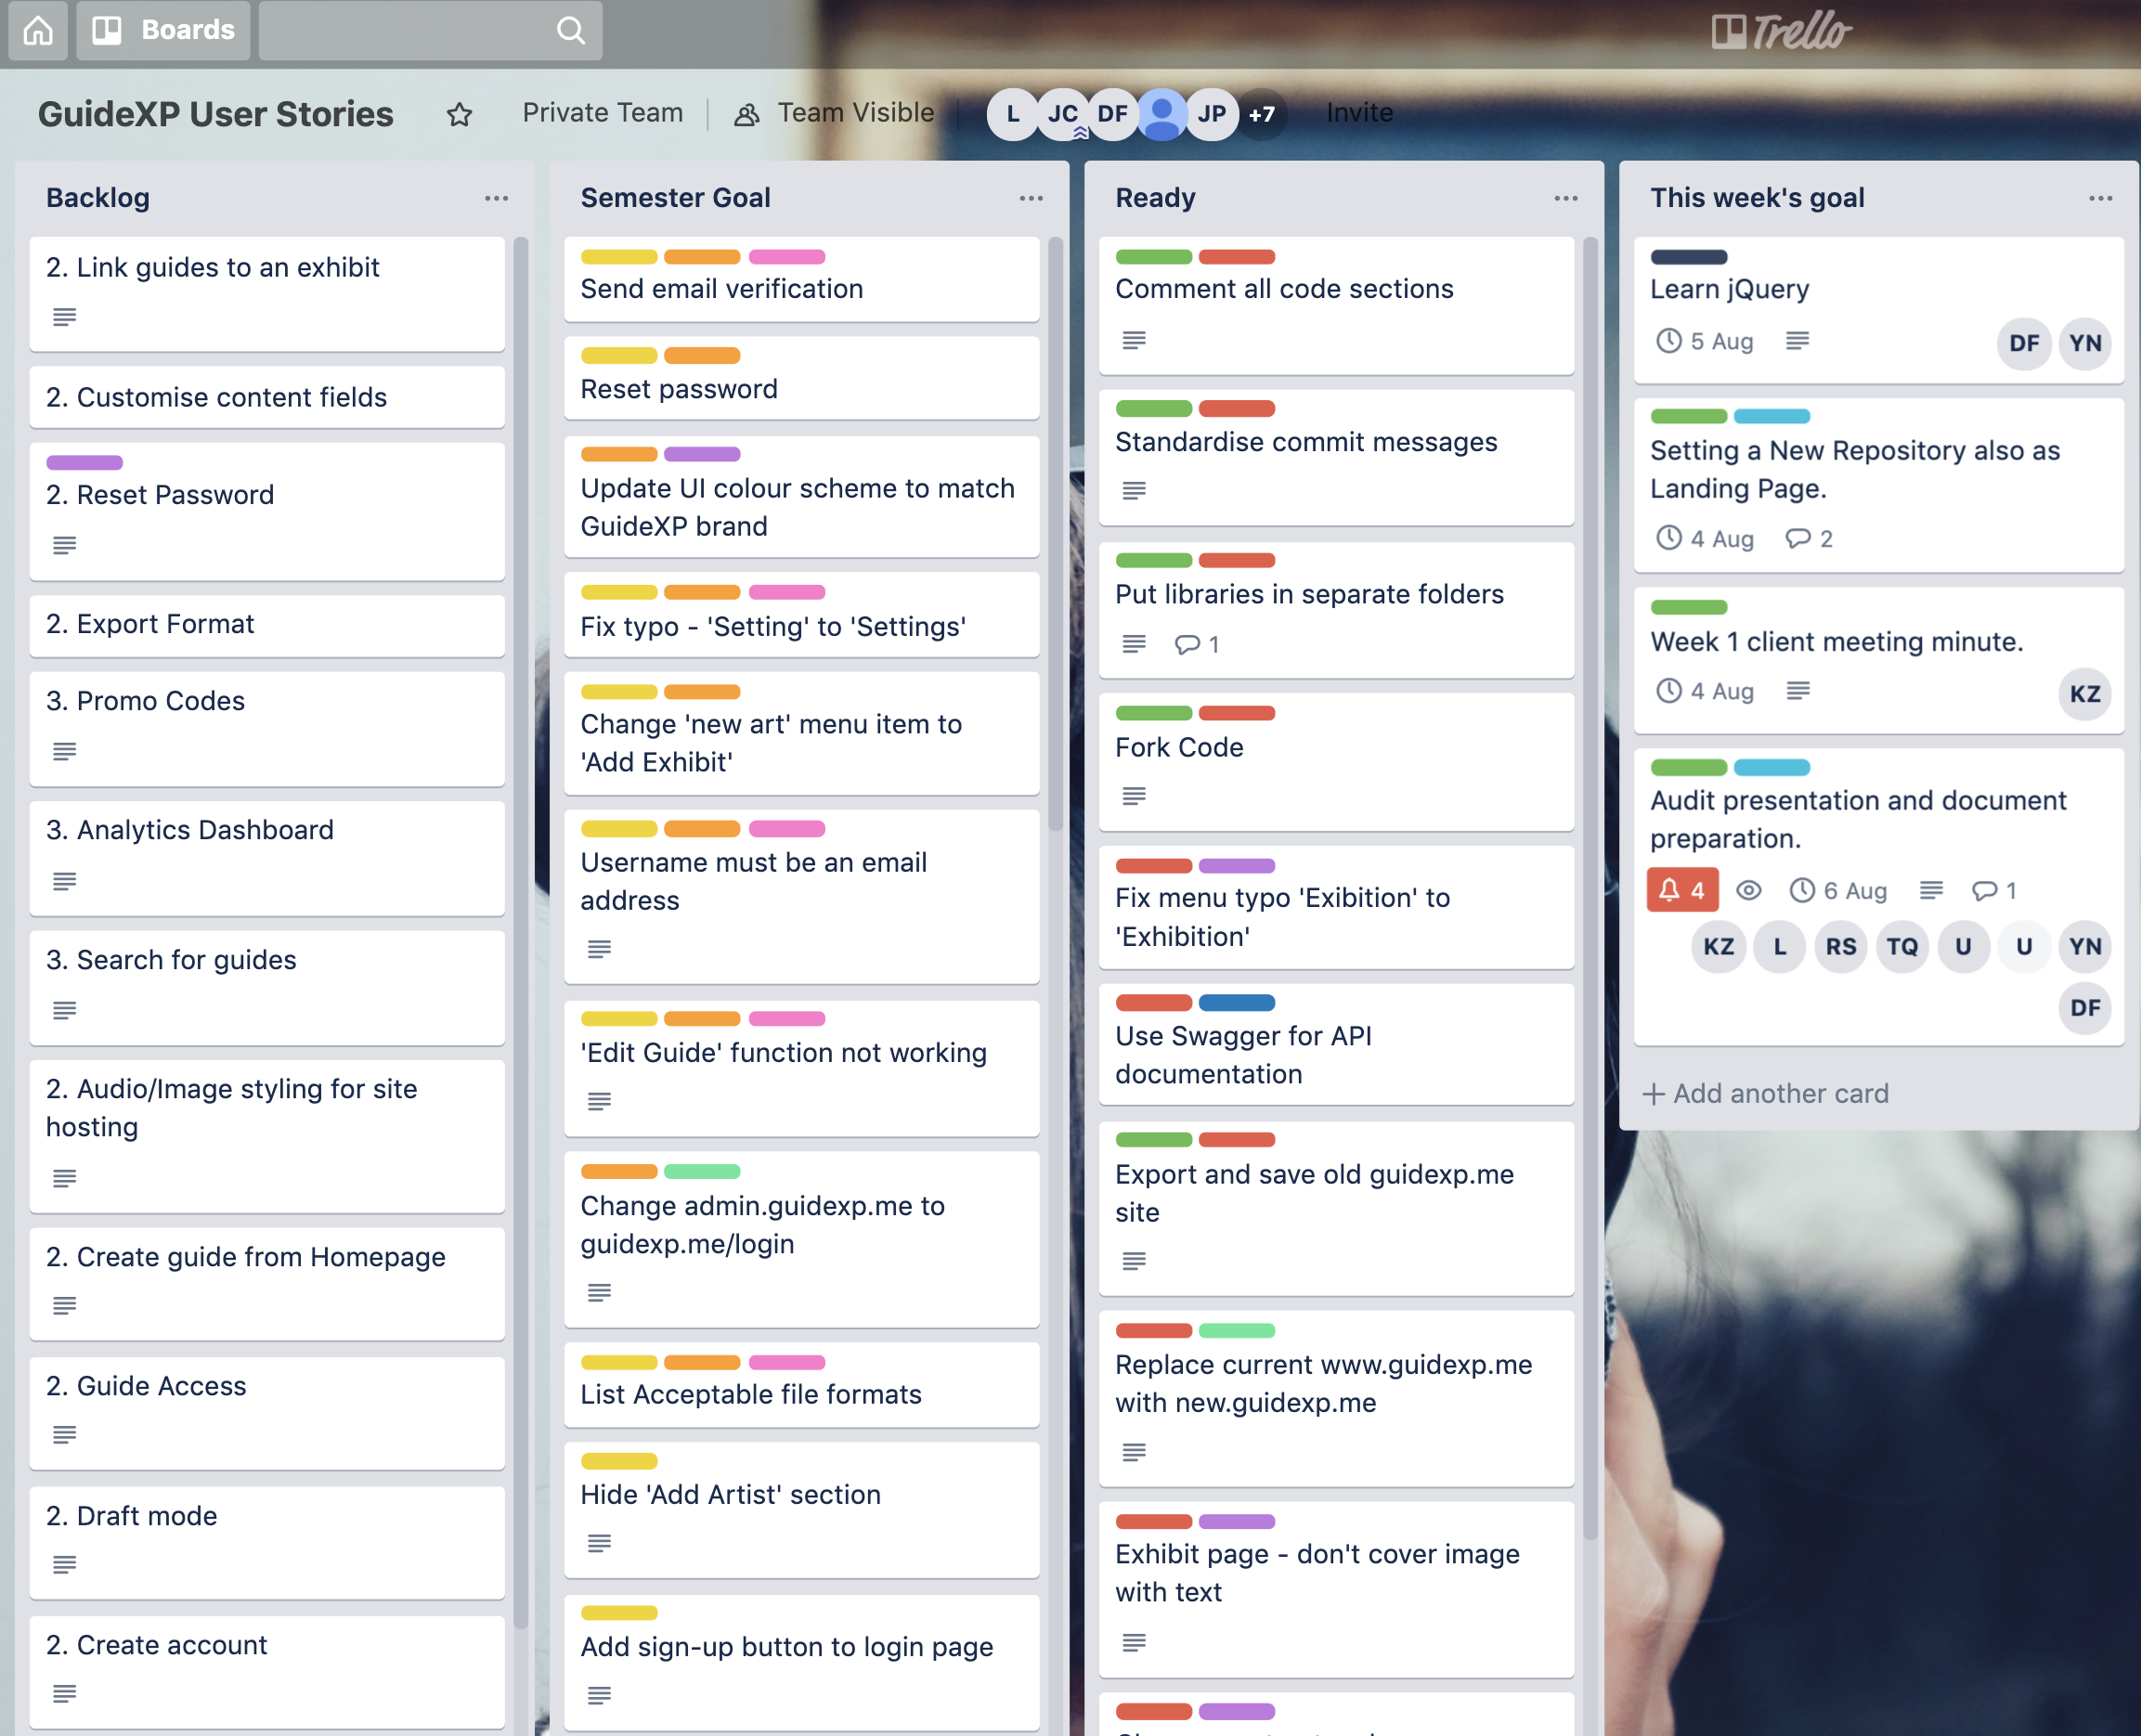
Communication
Slack, GitHub
Trello
Team Activities

Slide 12
Thank you!

