Slide 1
Development flow
Armstrong 03-31-2015

Slide 2
Agenda
Development evolution
Software Configuration Management
Current process
V model
ENG-100 Consumer Product Development and Release
ENG-112 Consumer Software Design Method
ENG-116 Consumer Engineering Design Review Procedure
Garmin product development process
APAC derivative product develop flow overview

Slide 3



ENG-116 Consumer Engineering Design Review Procedure
Purpose
Define procedures for design review
Scope
Primary design reviews
Secondary design reviews
Decision
Review goal met
Review goal not met / Mitigation plan defined
Review goal not met / No mitigation plan

Slide 4
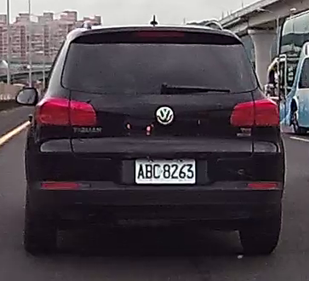
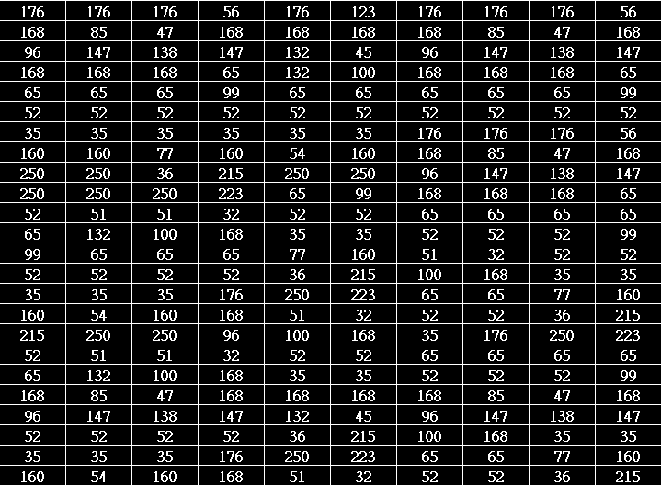
How to teach machine to see a car?
Rectangle shape
Symmetry
Entropy
Contrast
Computer sees

Slide 5
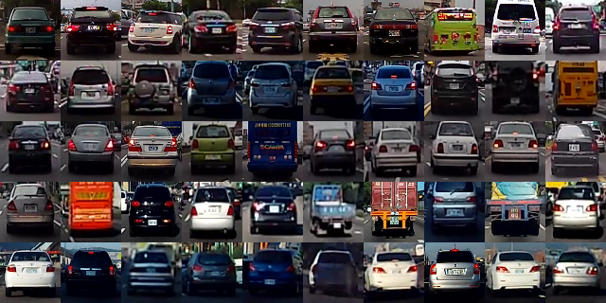
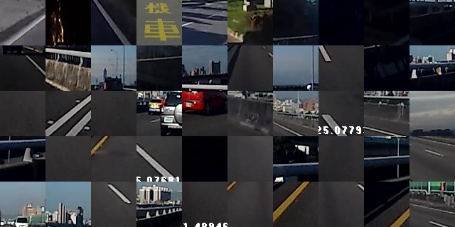
Learn from label data(supervised)
Cars
Background

Slide 6
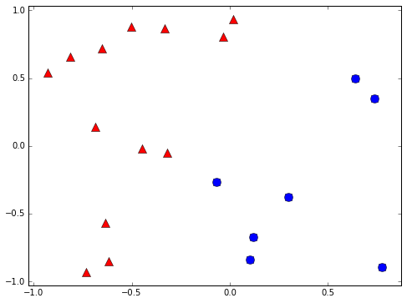
Binary classifier
Is it a car? { yes, no }
Will stock market go up or down? { up, down }
Will you sleep well or bad tonight? { well, bad }
+1
-1

Slide 7
Weak classifier
Error rate is better than random guessing
Strong classifier
Weak classifier
Error rate
0
1/2
1
?

Slide 8
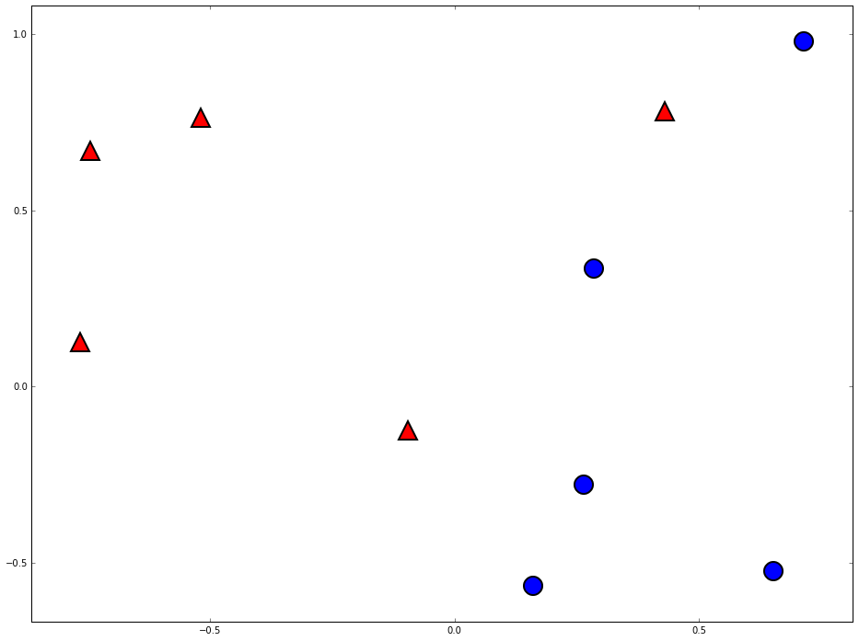
Weak classifier example
+1
+1

Slide 9
Weak classifier learner
Find the weak classifier with minimum error
Data
Weak classifier learner
Weak classifier
Weak classifier pool

Slide 10
Can weak classifier combine to do better

Slide 11
Two heads are better than one

Slide 12
Error of g1
Error of G(x)
Error of g2
Error of g3

Slide 13
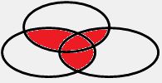
The diversity is important

Slide 14
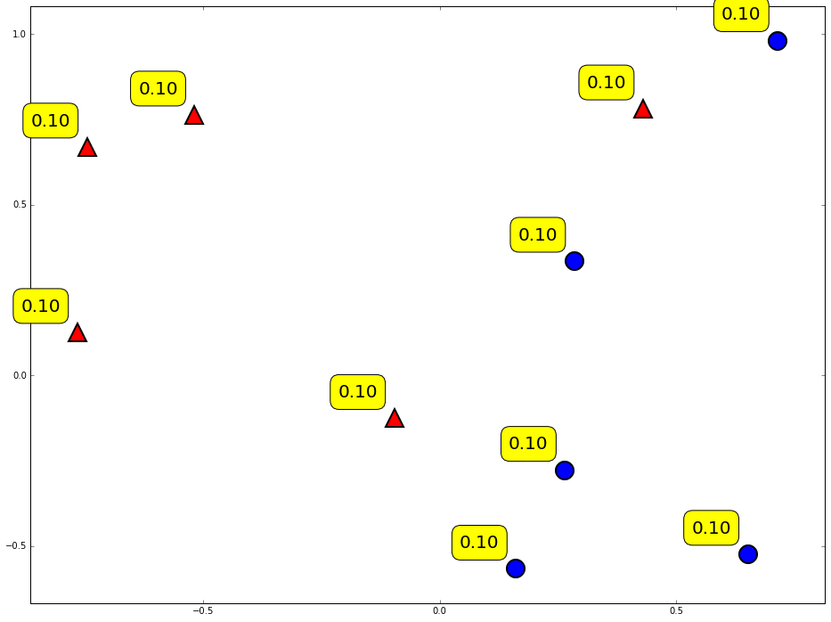
Weight of data

Slide 15
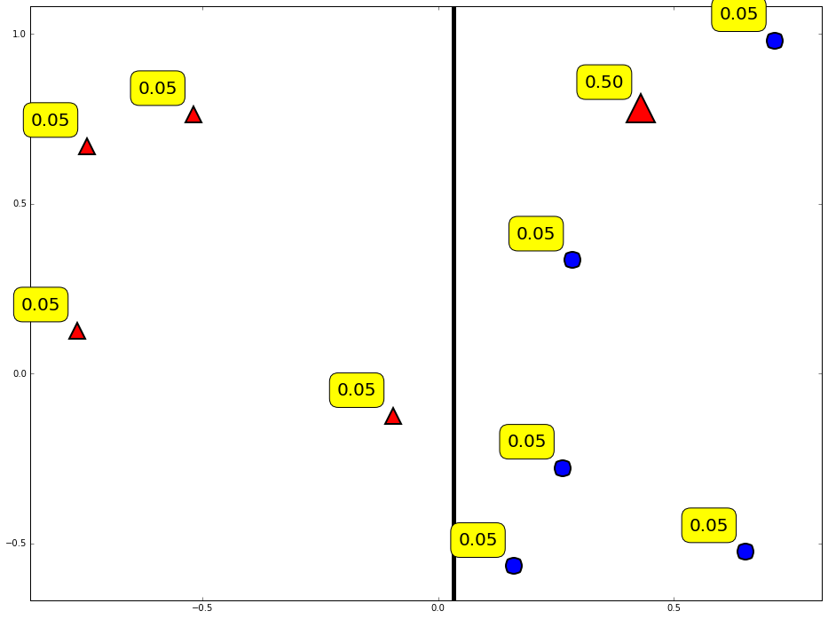
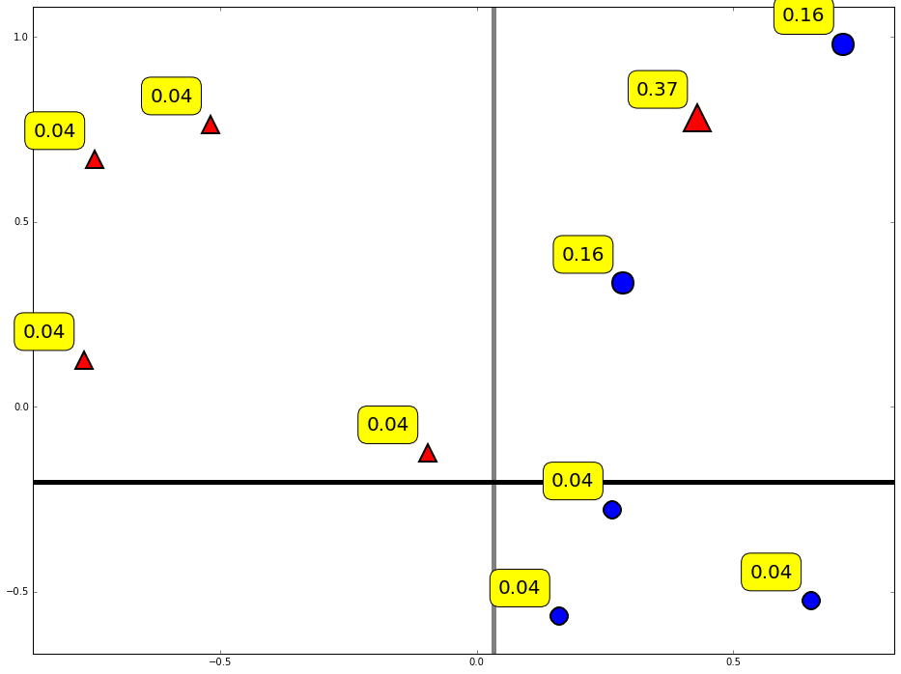
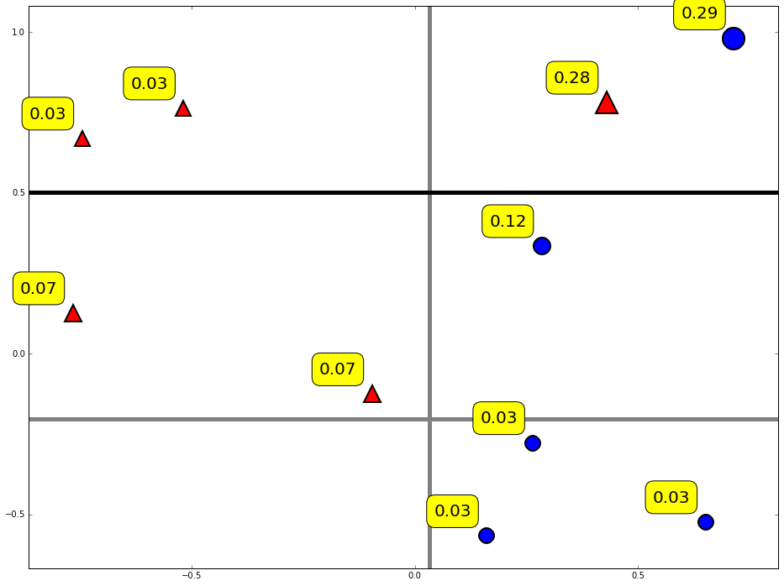
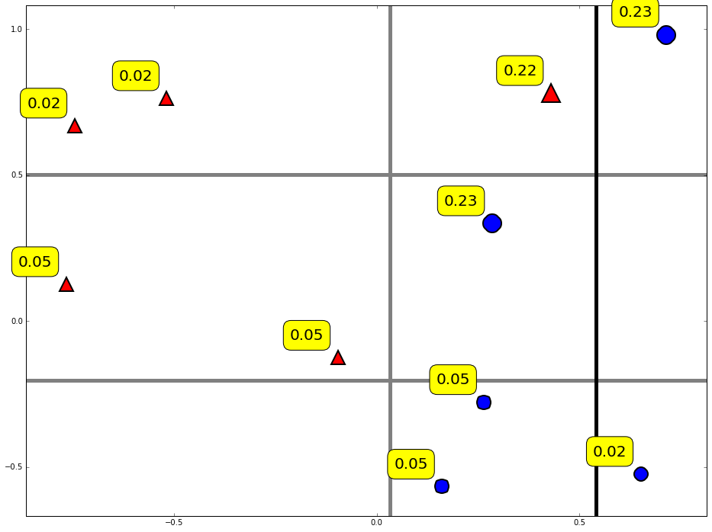
Reweight data

Slide 16
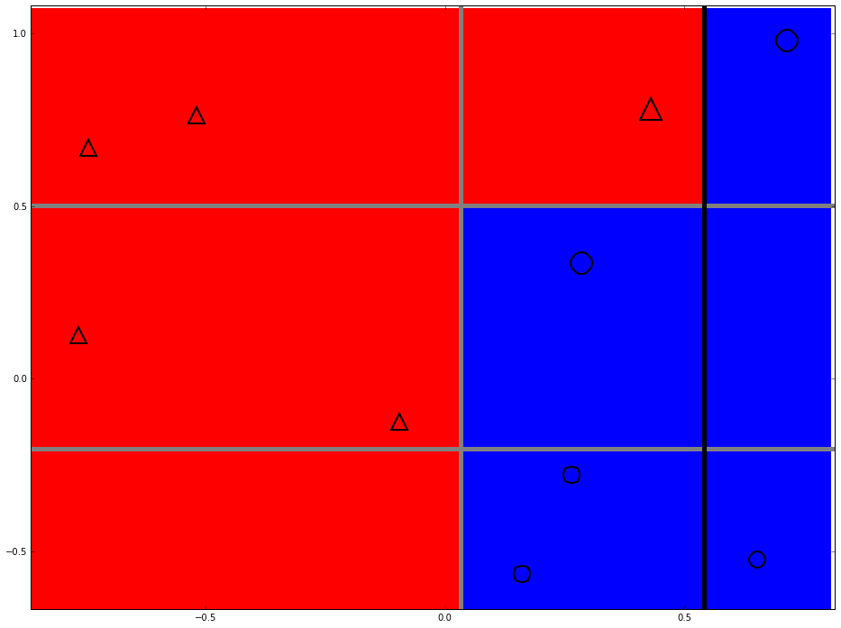
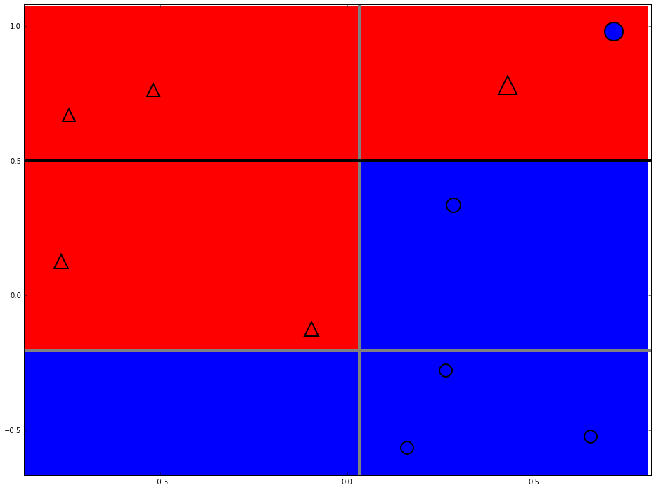
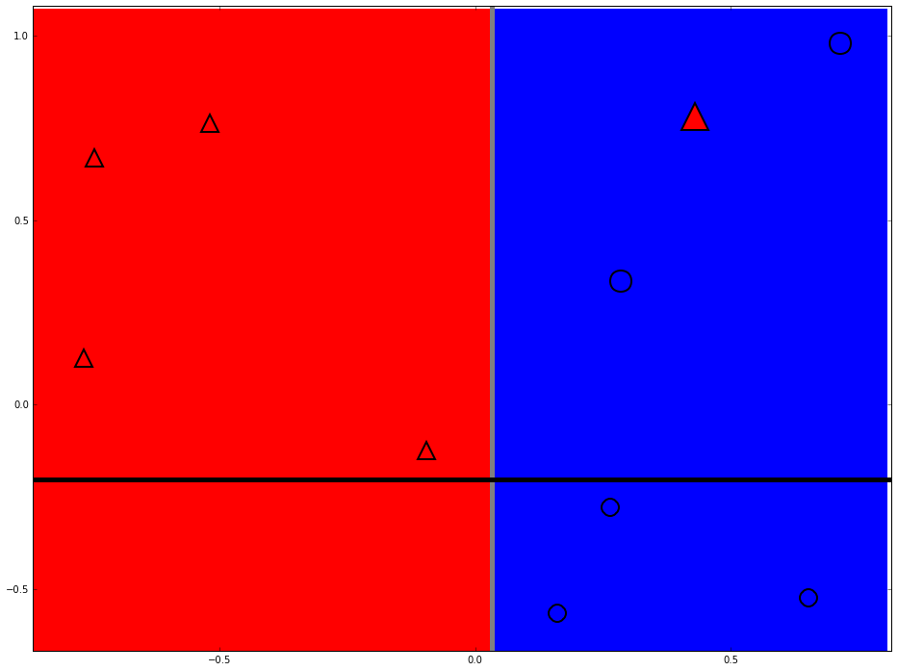
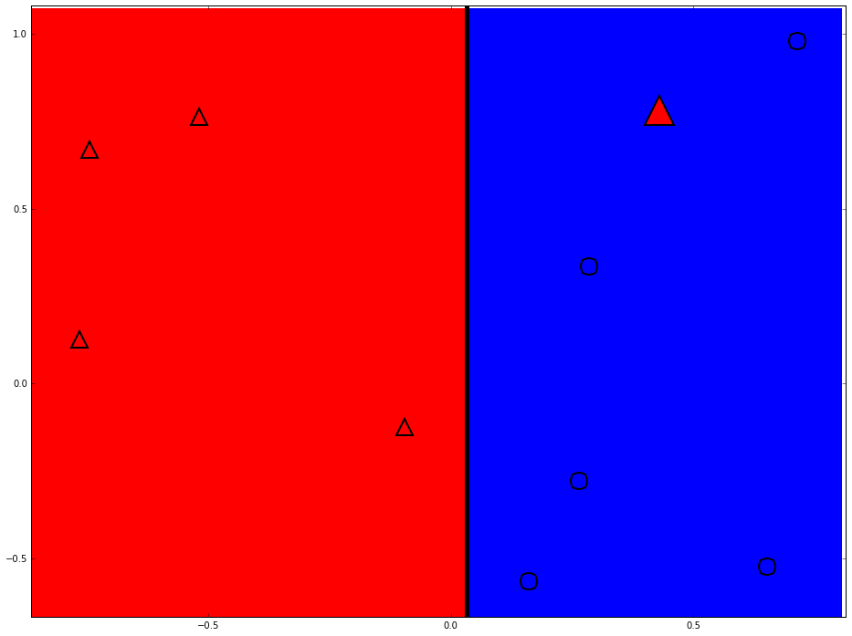
Strong classifier

Slide 17
Thanks

