Slide 1
Development flow
Armstrong 03-31-2015

Slide 2
Agenda
Development evolution
Software Configuration Management
Current process
V model
ENG-100 Consumer Product Development and Release
ENG-112 Consumer Software Design Method
ENG-116 Consumer Engineering Design Review Procedure
Garmin product development process
APAC derivative product develop flow overview

Slide 3
Development evolution
Member
One person/project
Source control
No source control
Code review
No code review
Test
Engineer test
Release flow
Engineer release
→ multiple persons/project
→ multiple
teams/project
→ SVN
→ Git
→ Traceable
→ Gerrit
→ QA
→ SQE + QA
→ QA verify
→ TD016

Slide 4
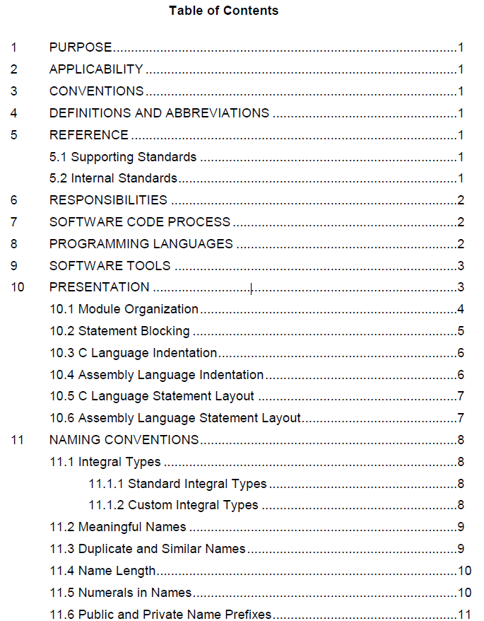
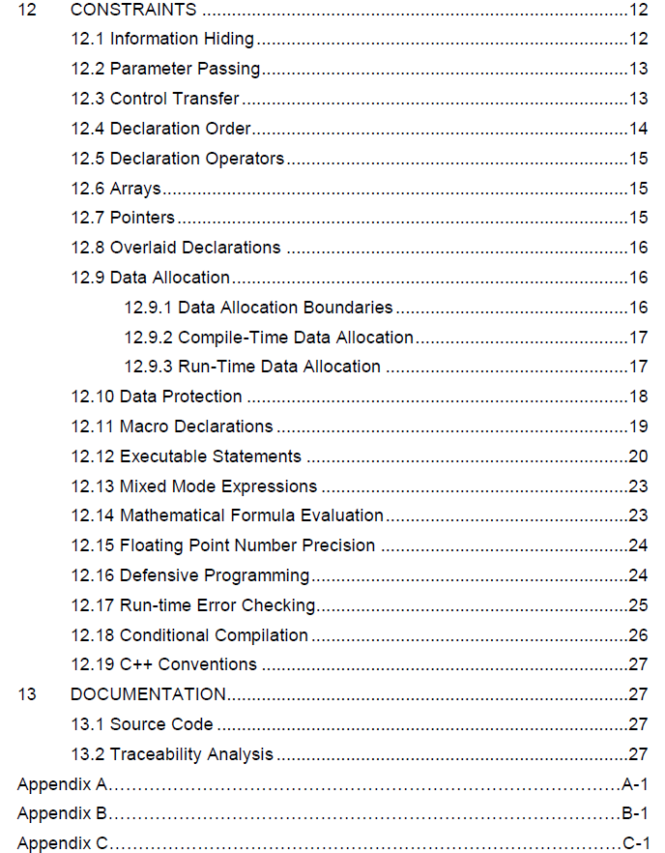
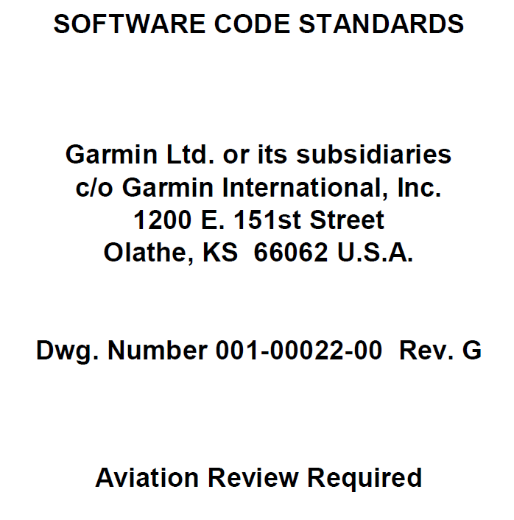
Development evolution
Coding style - 001-00022-00

Slide 5
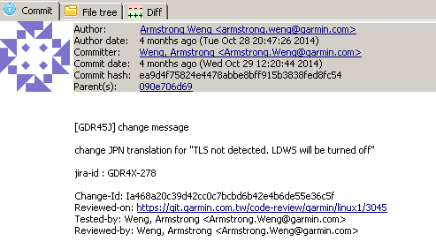
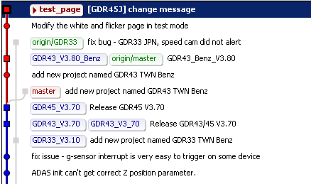
Software Configuration Management
Garmin use git as an SCM
Branch
New feature
New project
Tag
Release SW
Commit log

Slide 6
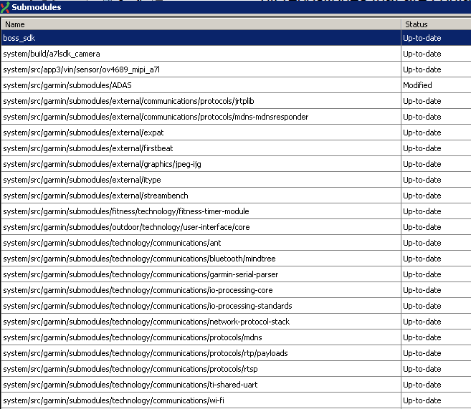
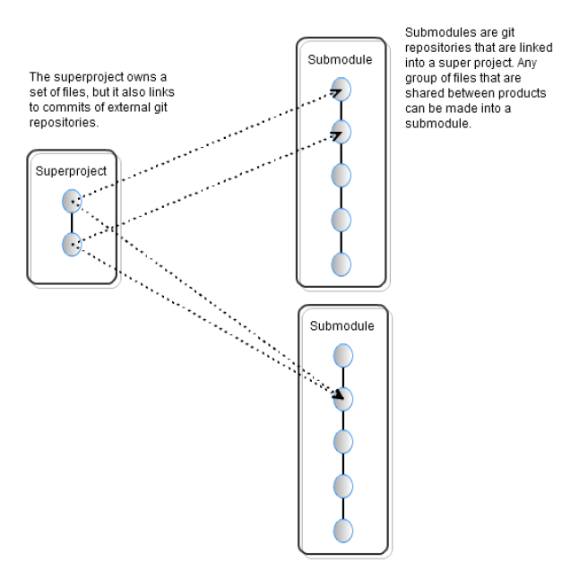
Software Configuration Management
Code reuse - submodule
ADAS
Ti-shared-UART
Garmin-includes
Nonvol-fm
Tech-log
Utilities
…

Slide 7
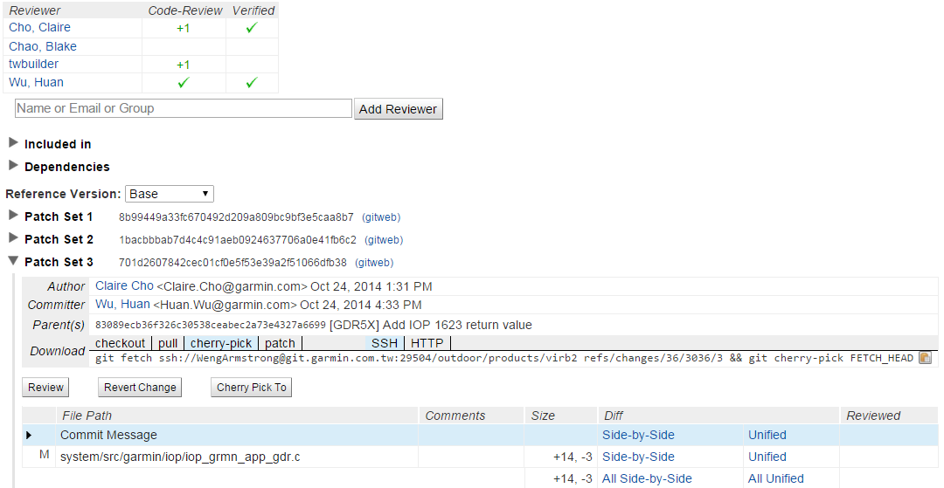
Software Configuration Management
Gerrit and code review
Jenkins
Default reviewer
Build verification
Commit code
Review code
Pass
Project leader
Submit code
Fail
Gerrit
Git

Slide 8
Current process
Multi-media team
Follow ENG – 100 on new project
Top level design review
Detail design review
Factory prototype design review
Pilot run design review
Product validation review
Confluence
EE
Requirement
Optical/SW
Requirement
VOC
Production Line
Jira
UX
project
Kick off
Prototype run
Pilot run
TD016 to QA
MP
EE
Requirement
Optical/SW
Requirement
VOC
Production Line
Repository
Jira project
Function ready
Final release
Requirement
PM
MKT
Boss
SW engineer
Jira
Project
SQE verify
Jira
Feature
Pool
QA test plan
SW
Quality
Center

Slide 9
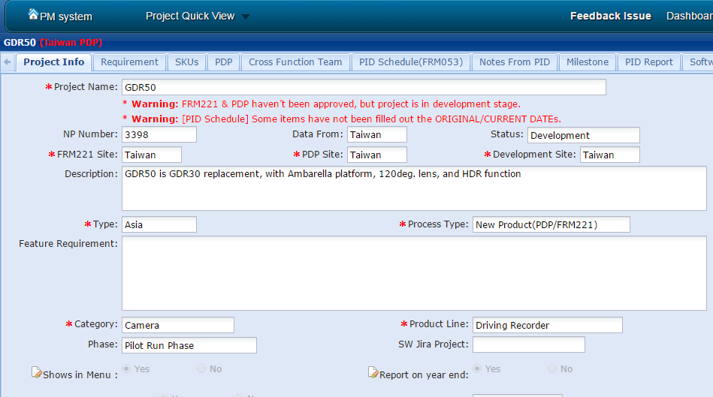
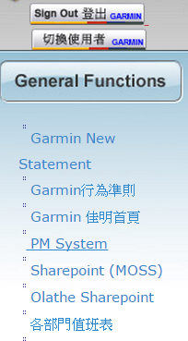
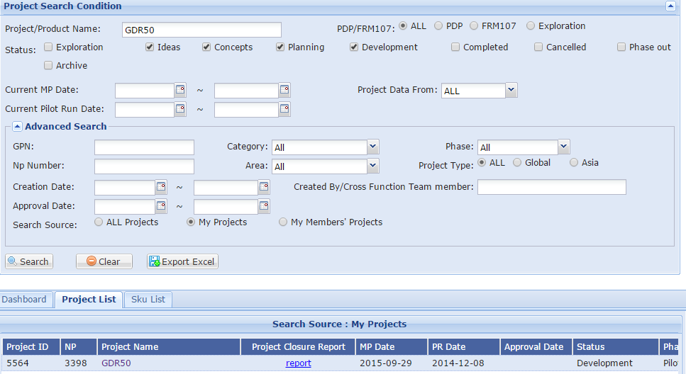
Current process
Email
Jira
EE
SW
JIRA
Confluence
SQE
Email
SW
Project system
Project system
PM system
QA
TD016
Jira
ME

Slide 10
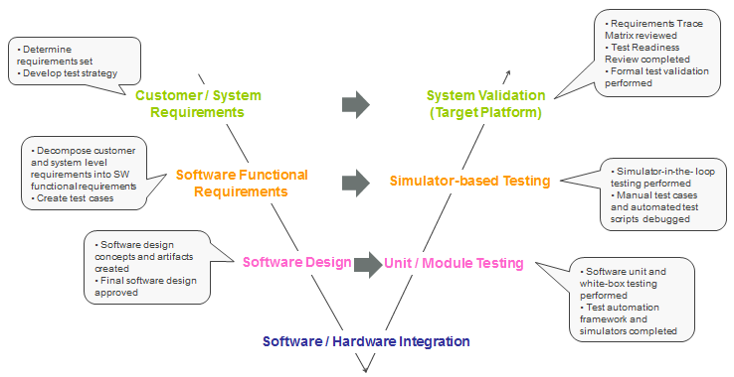
V model
Proven Software Development Process

Slide 11
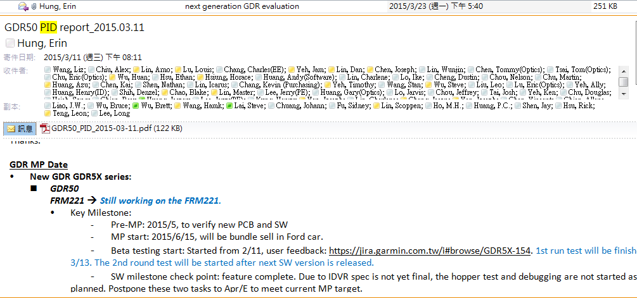
ENG100 - Consumer Product Development and Release
Purpose
The process by which consumer products are developed at Garmin
Responsibilities
Project manager(Engineering PM): development process, all design review goals have been met
Project engineer(EE): technical leadership for development activities
Product manager(Marketing): communicate customers and market
PID
Bi-weekly held after PDP approved
Progress, Challenge, and Todo.
Major issues will be included in the PID report

Slide 12
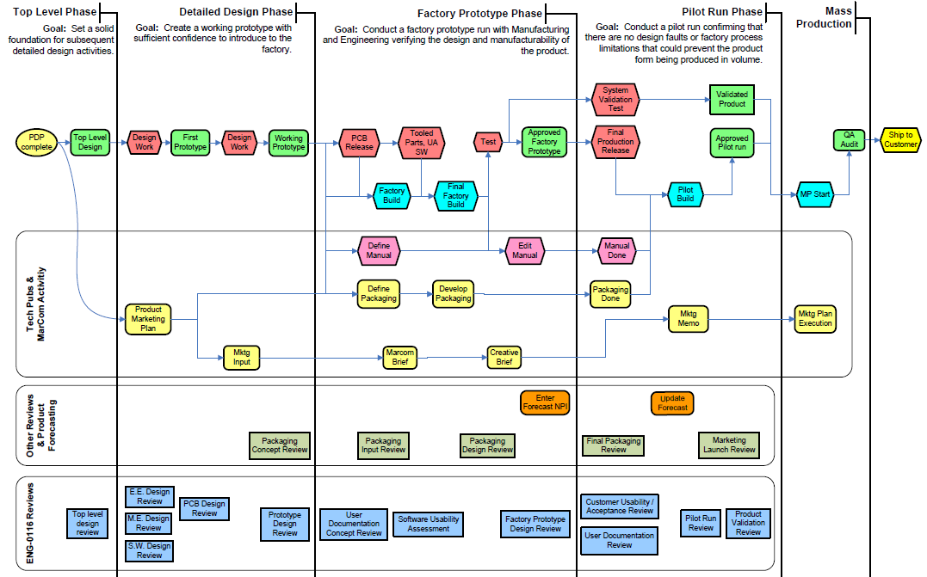
ENG100 - Consumer Product Development and Release
Development Process Overview
TOP Level
Detail Design
Factory Prototype
Pilot Run
MP
ENG-112
ENG-116

Slide 13
ENG-112 Consumer Software Design Method
Purpose
Describes how Garmin consumer SW is designed, developed, and maintained
Scope
All Consumer SW products except
Internal use
OEM
SW operates on 3rd party hardware

Slide 14
ENG-112 Consumer Software Design Method
Lead SW engineer
Establish soft task priorities, assign tasks
Collaborate with lead EE
Detail design review
Monitor progress milestone
Collaborate with other departments(Cartography, IT, … )
PID
Ensure compliance, royalty, and 3rd party agreements
Other assignment by manager or team leader
SW engineer(s)
Execute the design and development of product SW
Integrating product SW with hardware
SW release
Report task progress to manager, team leader, or lead SW engineer
Other assignment

Slide 15
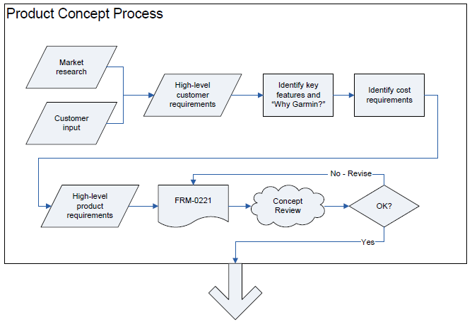
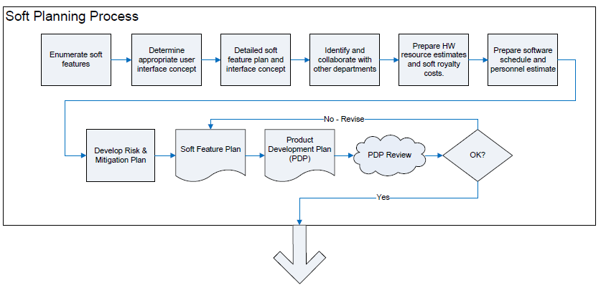
ENG-112 Consumer Software Design Method
Product Concept (FRM-221) or PDP (FRM-346)

Slide 16
ENG-112 Consumer Software Design Method
Top-Level Design Phase
Goal - set a solid foundation for subsequent detailed design
A summary of application software
What shall be completed at Detailed Design Phase
What shall be evaluated at Prototype Design Review
Verification criteria for new soft features
A summary of HW/SW interface software: (by lead EE)
Overview of HW/SW integration work
How to test and validate
Factory test SW support
Memory resource will be allocated to BB, system code, nonvol, built-in maps
A preliminary test plan
GPN(Garmin Part Numbers), BOM(Bills of Material), royalty-bearing items.
Top level design review (conduct with ENG-116)

Slide 17
ENG-112 Consumer Software Design Method
Detail design Phase
Goal - produce a Working Prototype with sufficient confidence to introduce the product to the factory
Establish SW configuration
Low-Level SW
Support of both HW and SW design review
HWM software development
Establish IOP
Support for SW diagnostics such as exception report, memory consumption…
Application SW (high level)
Simulate the target hardware platform
Soft feature development
Feature priority
Detailed design review (conduct with ENG-116)
Working prototype design review (conduct with ENG-116)

Slide 18



ENG-116 Consumer Engineering Design Review Procedure
Purpose
Define procedures for design review
Scope
Primary design reviews
Secondary design reviews
Decision
Review goal met
Review goal not met / Mitigation plan defined
Review goal not met / No mitigation plan

Slide 19
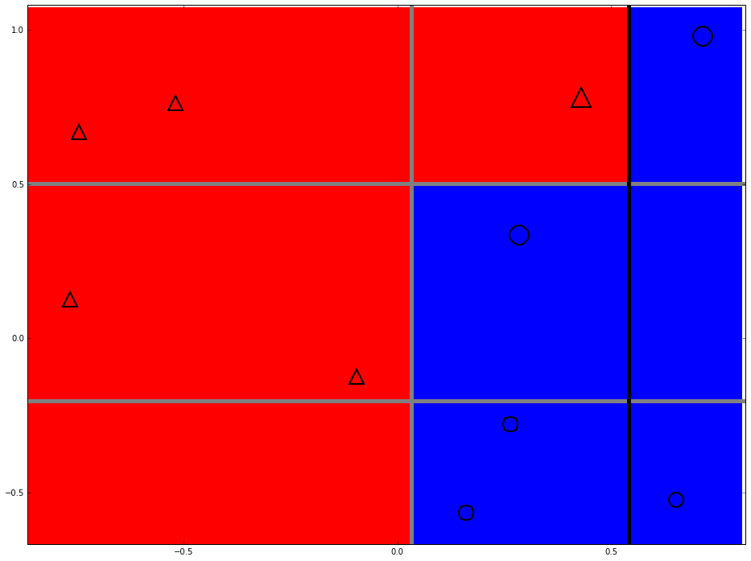
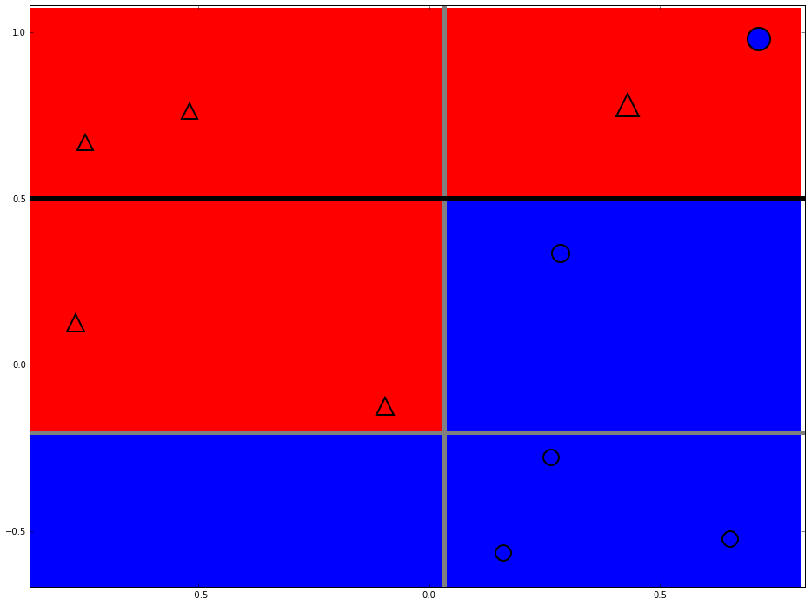
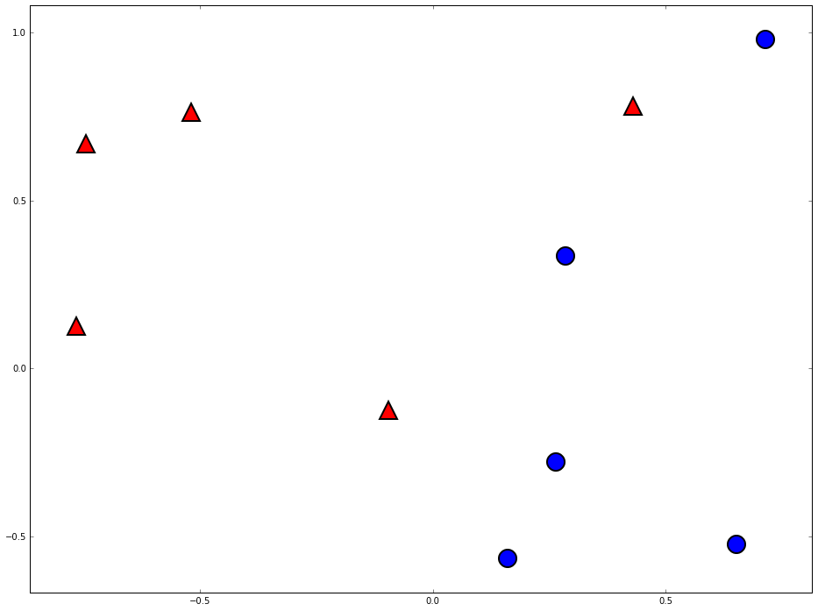
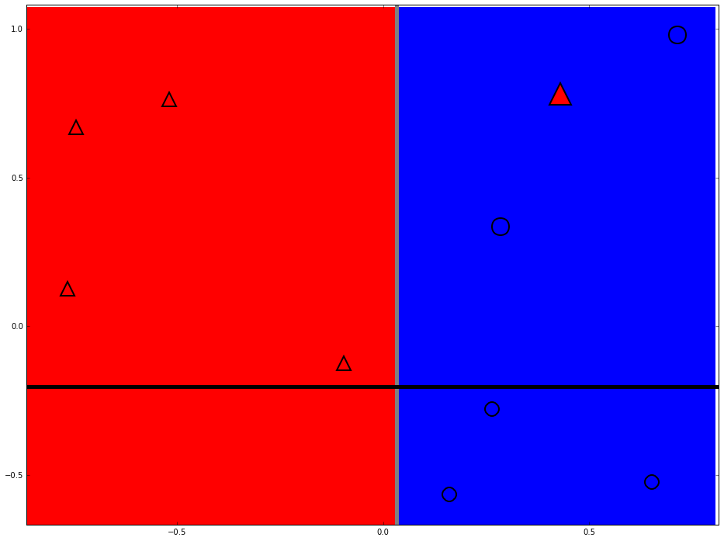
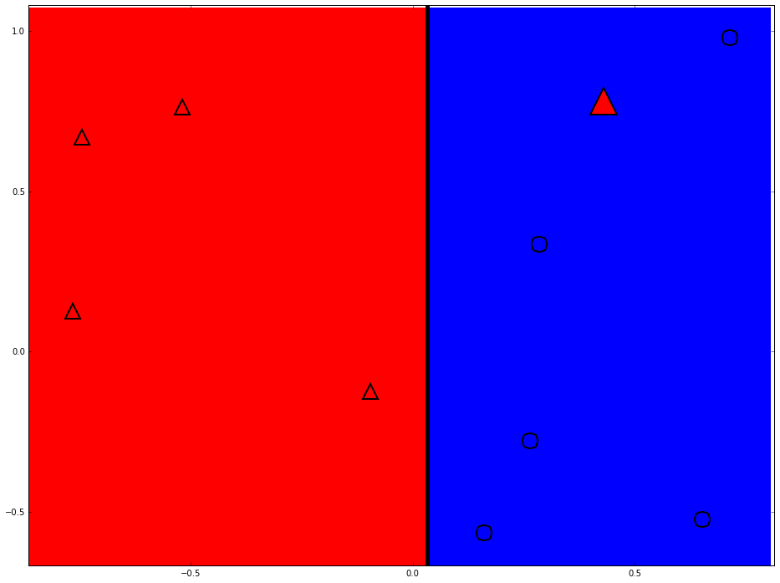
Strong classifier

Slide 20
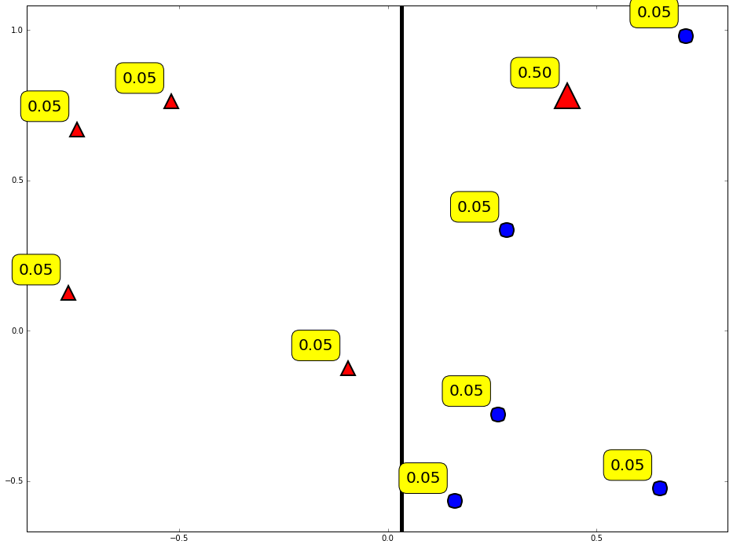
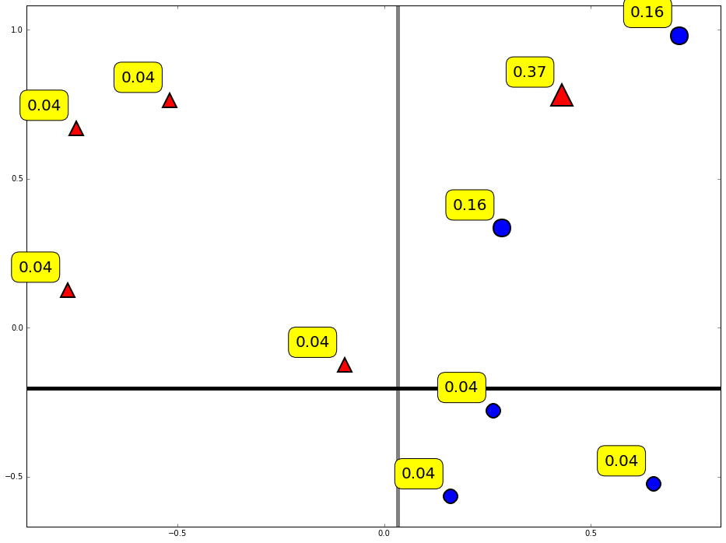
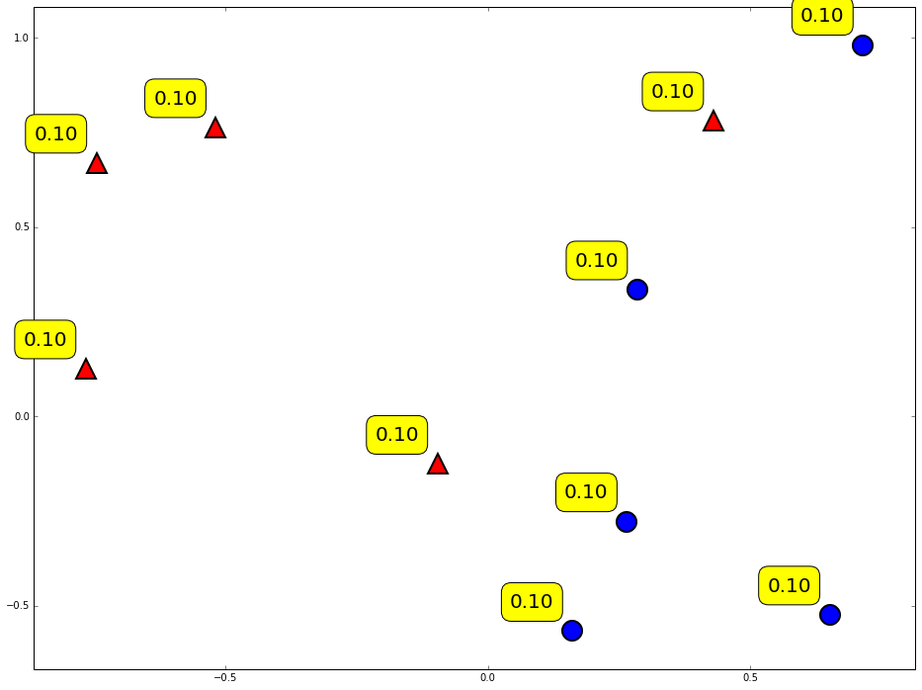
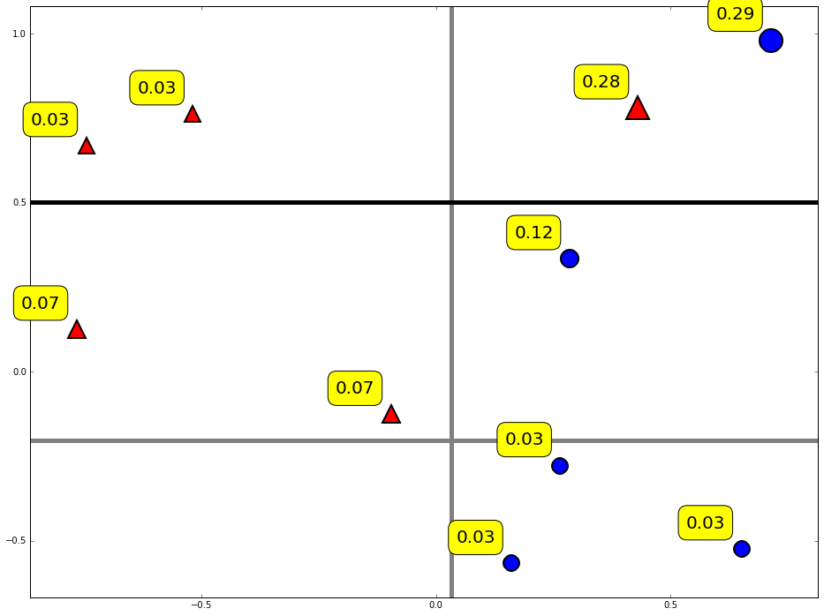
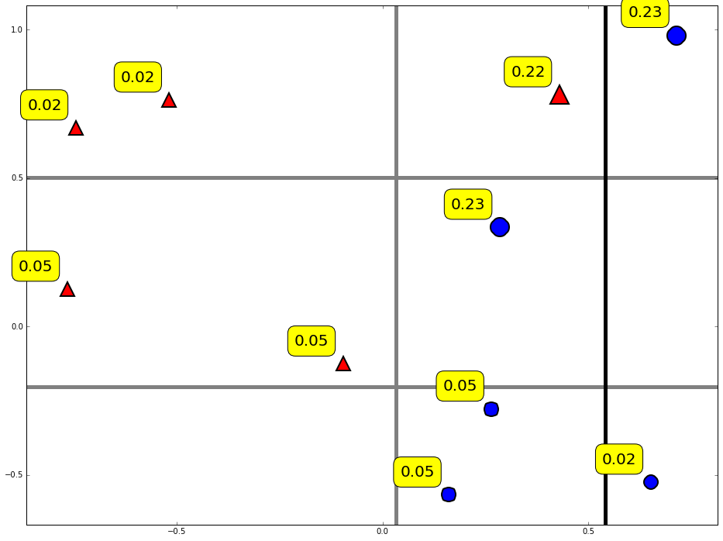
Reweight data

Slide 21
Weight of data

Slide 22
Weak classifier learner
Find the weak classifier with minimum error
Data
Weak classifier learner
Weak classifier
Weak classifier pool

Slide 23
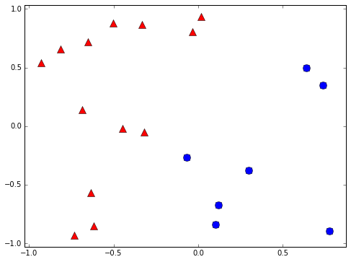
Binary classifier
Is it a car? { yes, no }
Will stock market go up or down? { up, down }
Will you sleep well or bad tonight? { well, bad }
+1
-1

Slide 24
Weak classifier example

Slide 25
Weak classifier
Error rate is better than random guessing
Strong classifier
Weak classifier
Error rate
0
1/2
1

Slide 26
The importance of diversity

Slide 28
Two heads are better than one

Slide 29

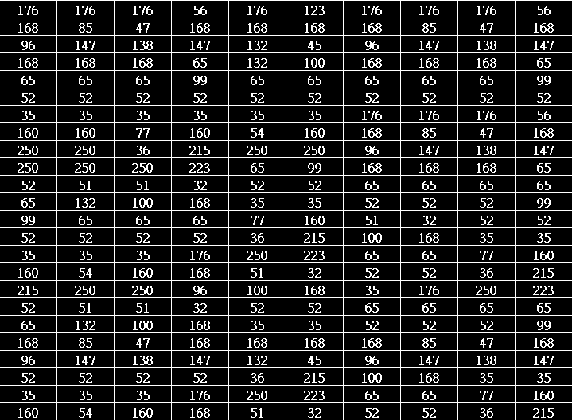
How to teach machine to see a car?
Rectangle shape
Symmetry
Entropy
Contrast
You
Computer

Slide 30
Thanks

