Slide 1
Vehicle Detection by using Adaboost Algorithm Leon 07-14-2015

Slide 2

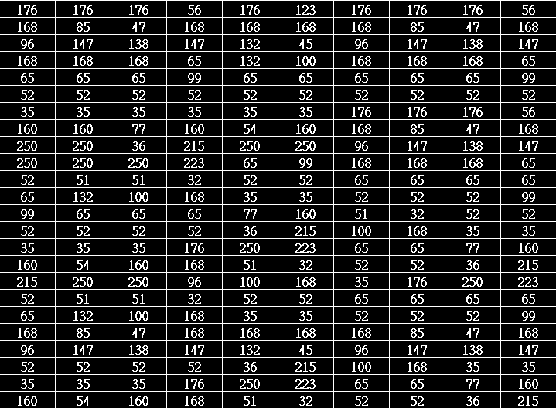
How do computers see a car?
Rectangle shape
Symmetry
Entropy
Contrast
Computer sees

Slide 3
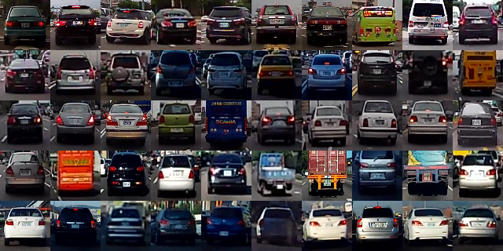
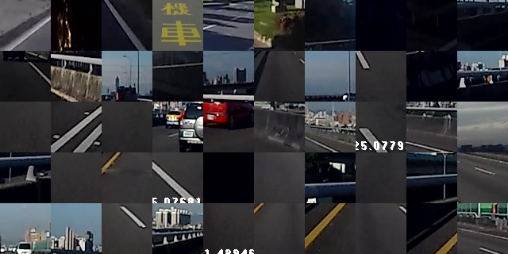
Learn from label data(supervised)
Cars
Background

Slide 4
Binary classifier
Is it a car? { yes, no }
Will stock market go up or down? { up, down }
Will you sleep well or bad tonight? { well, bad }
age | 30
gender | male
weight | 70kg
sleep last night | 7hours
how much exercise | 30 minutes

Slide 5
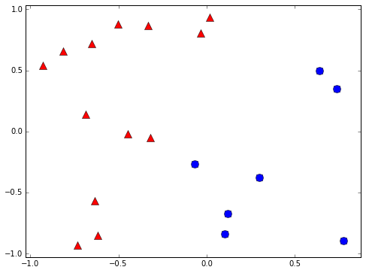
Binary classifier example
+1
-1

Slide 6
Weak classifier
Performance is slightly better than random guessing
Strong classifier
Weak classifier
Error rate
0
1/2
1
?

Slide 7
Weak classifier learner
Find the weak classifier with minimum error
A based learner in adaboost
Decision stump is a weak classifier example
Data
Weak classifier learner
Weak classifier g(x)

Slide 8
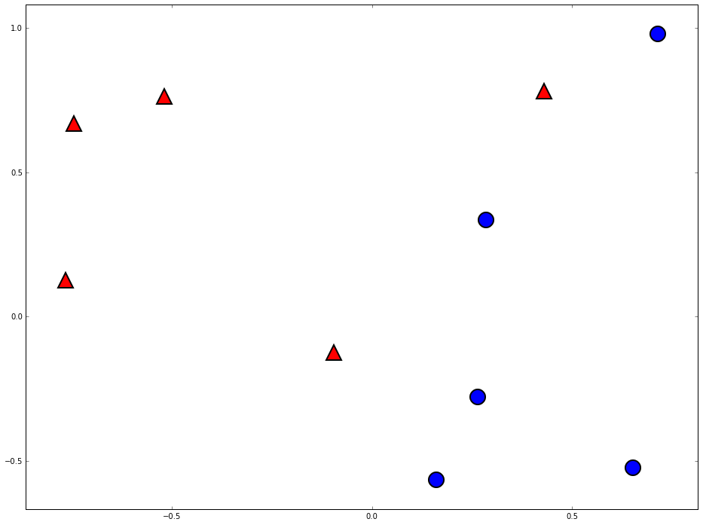
Decision stump
-1
+1

Slide 9
Can we do better?

Slide 10
Two heads are better than one

Slide 11
Space of data
Error of g1
Error of G(x)
Error of g2
Error of g3

Slide 12

The diversity is important

Slide 13
How to pick the diverse classifiers
T=1
Data
Classifier learner
Update data weights
T=2
Data
Classifier learner
Update data weights
T=3
Data
Classifier learner
T=N

Slide 14
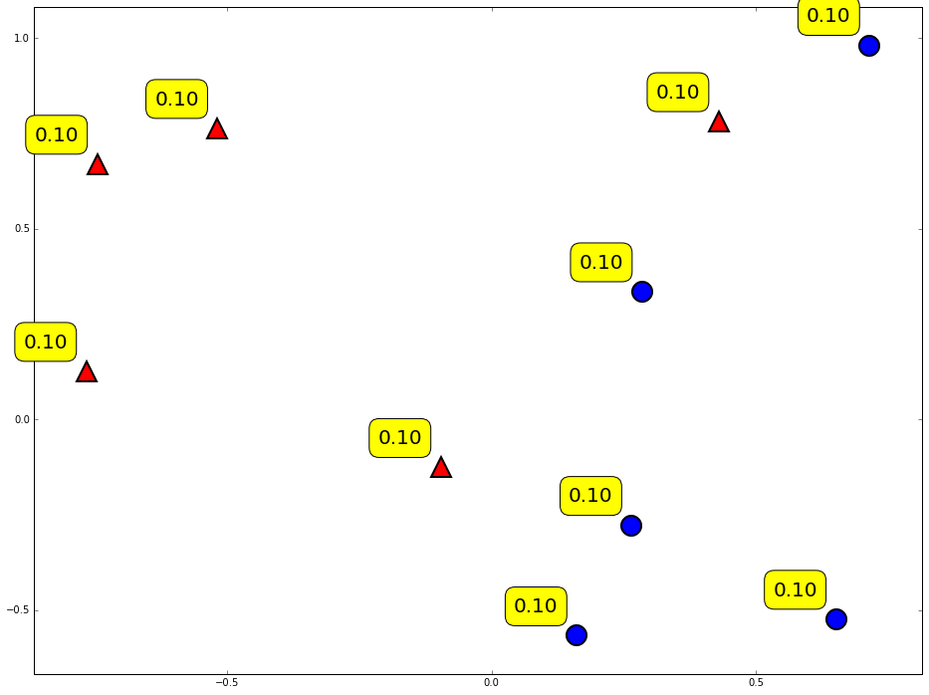
Weight of data

Slide 15
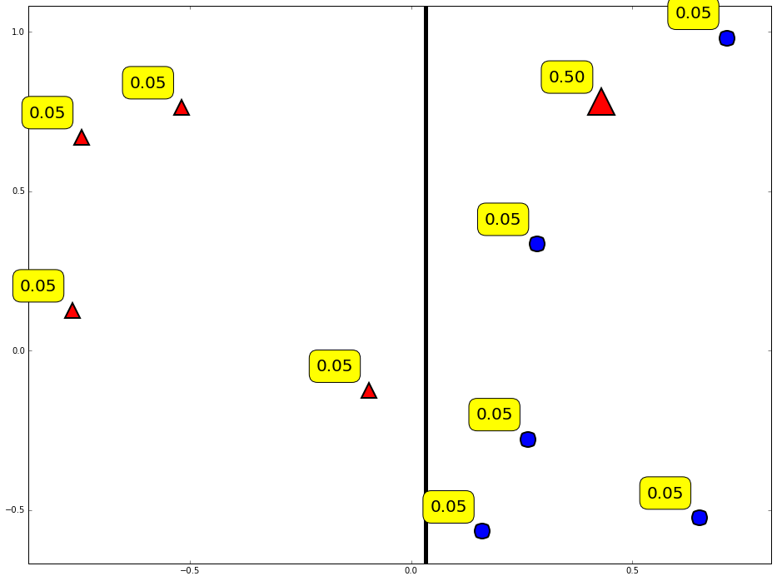
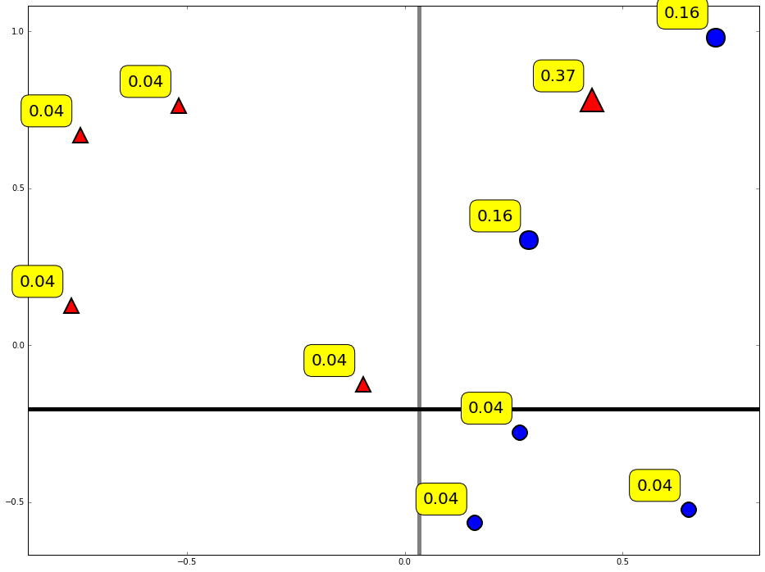
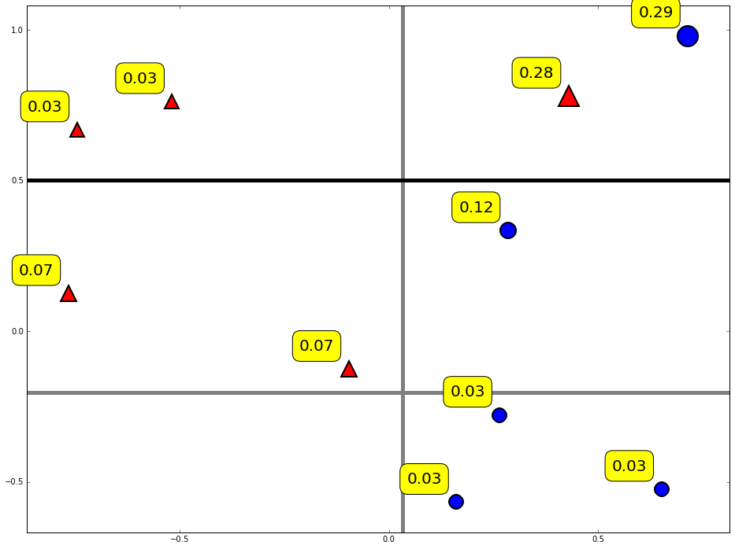
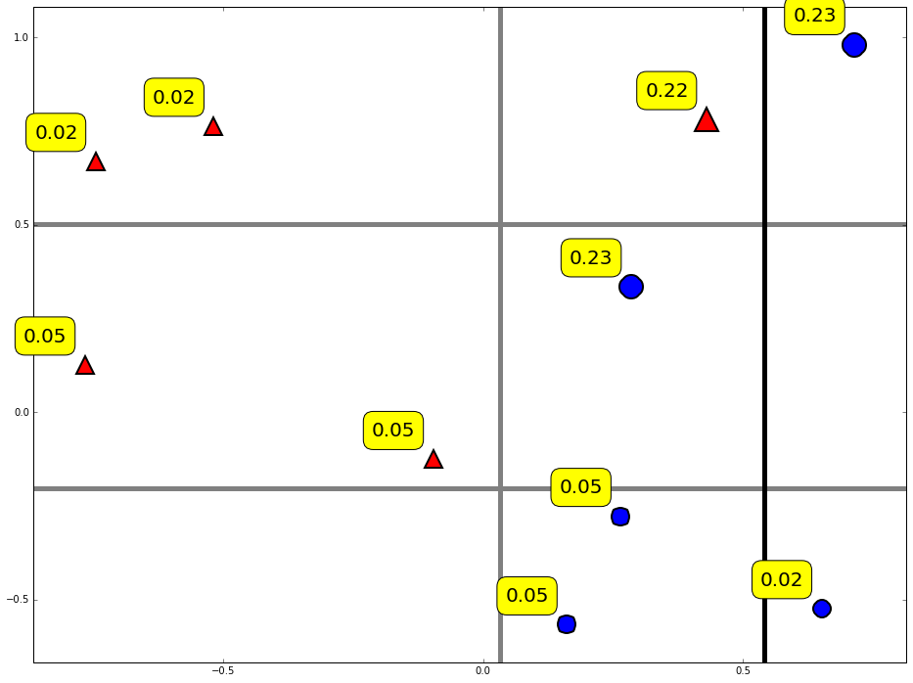
Reweight data

Slide 16
Combine weak classifiers into strong classifier
Final decision:
Weight of weak classifier

Slide 17
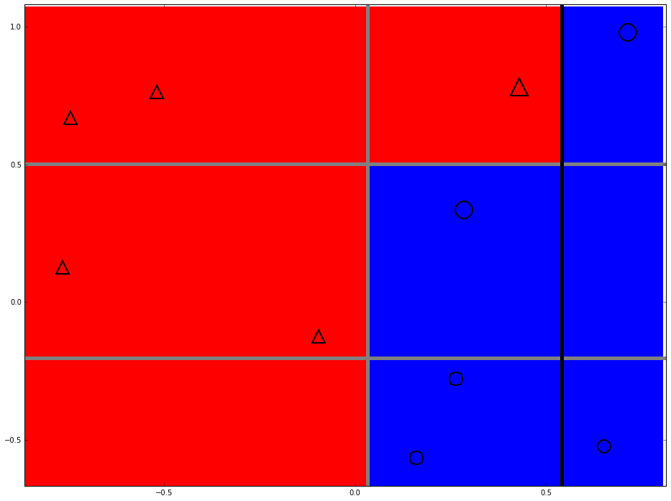
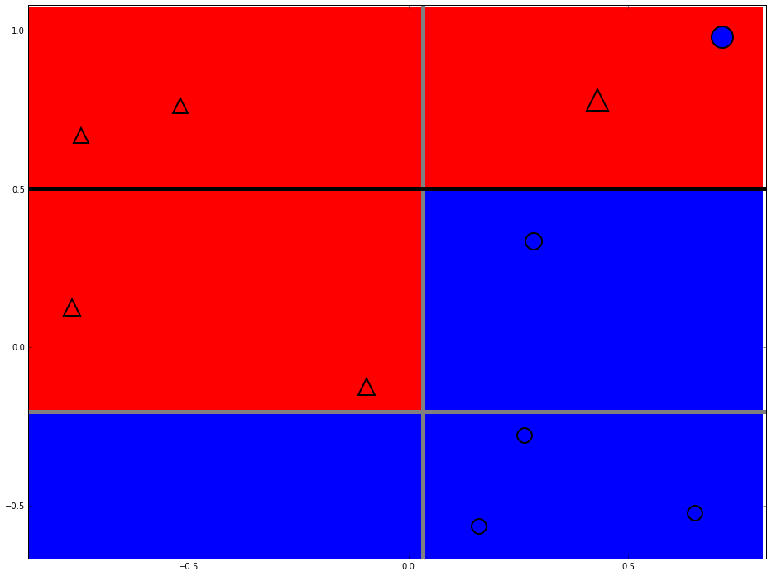
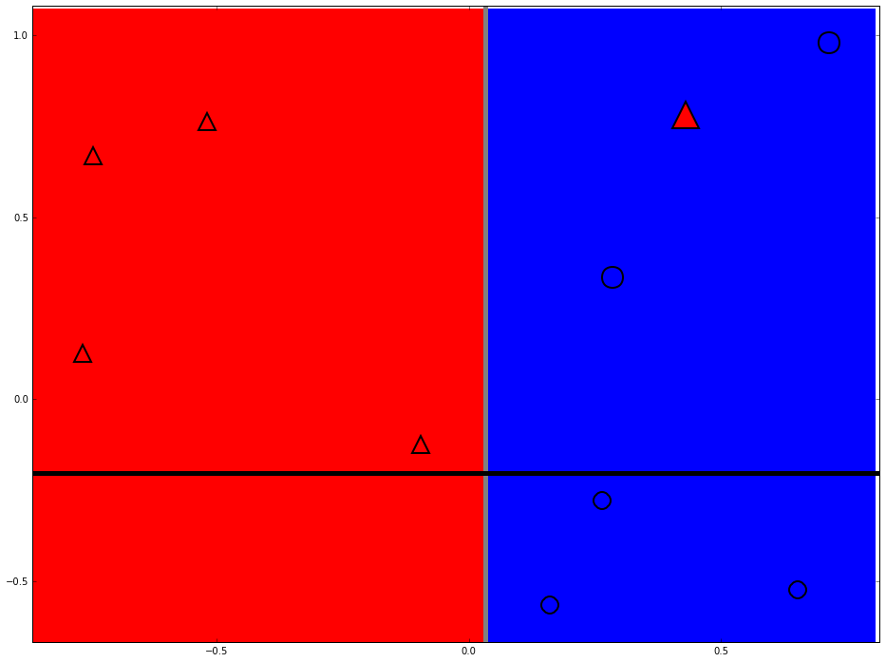
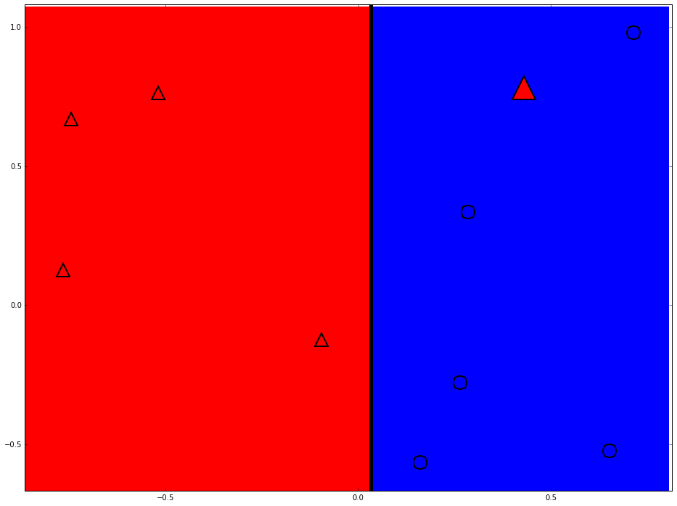
Strong classifier

Slide 18
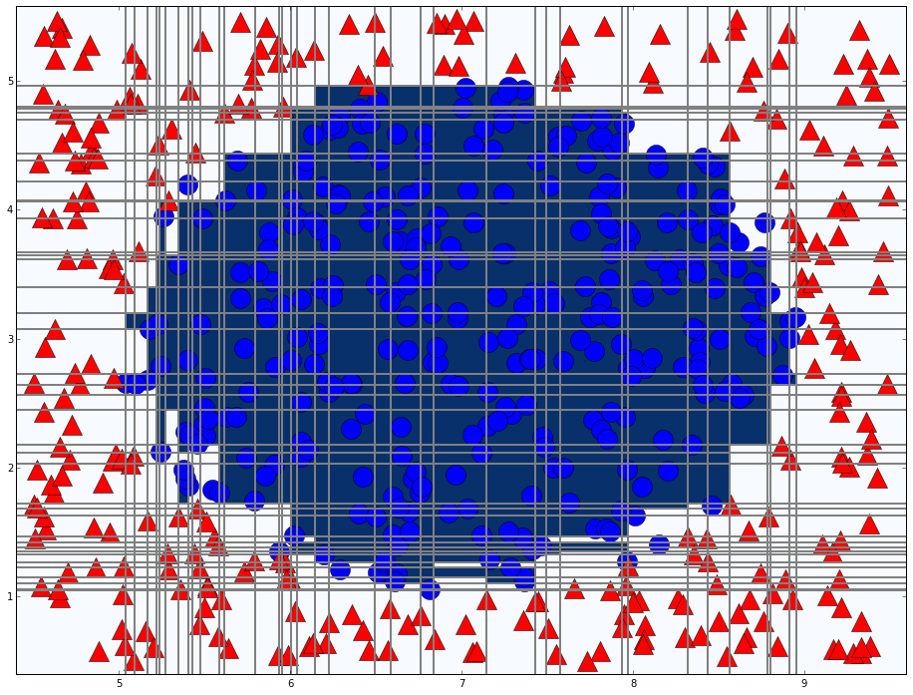
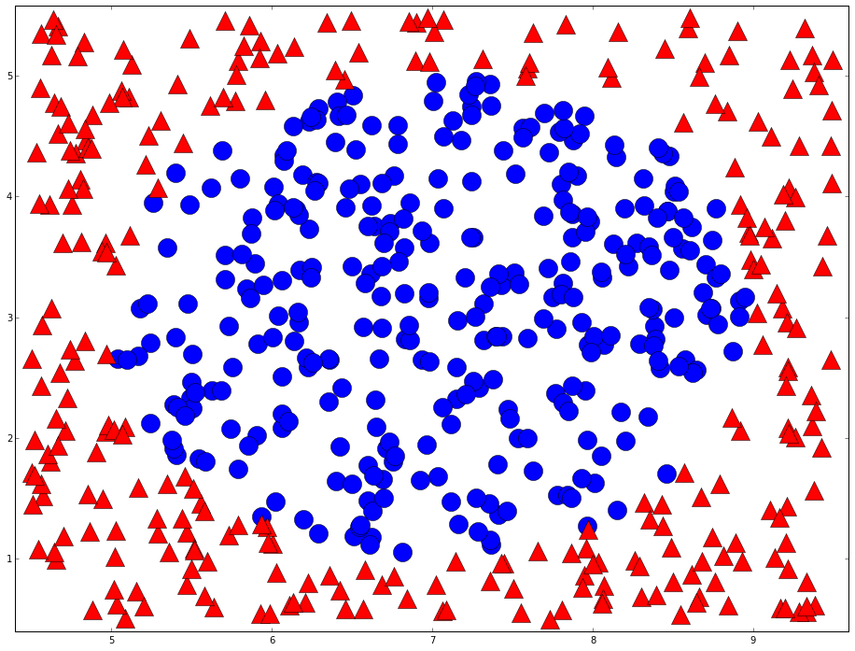
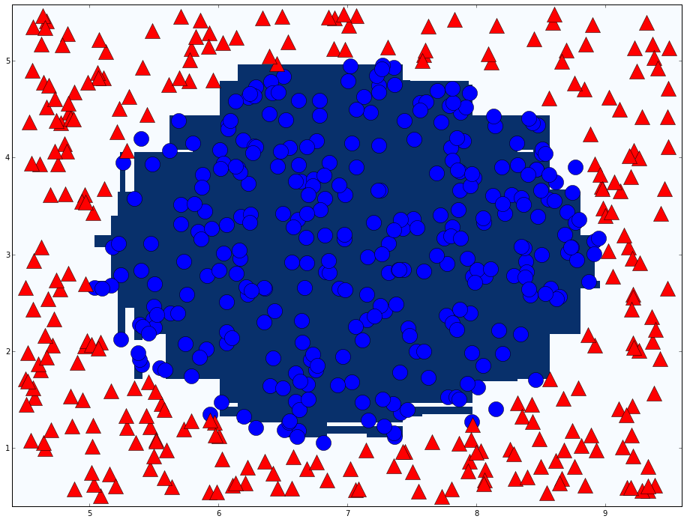
Adaboost in action
T=76

Slide 19

Weak classifier of vehicle detection
Haar like feature
Classifier number = (Type X Position X Size)

Slide 20
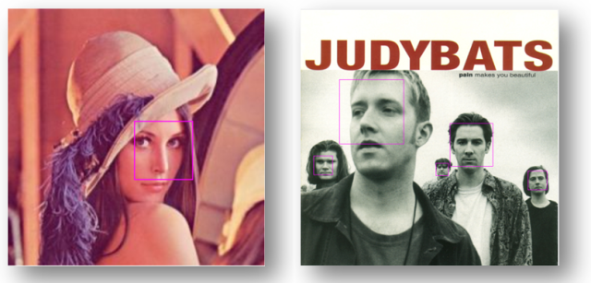
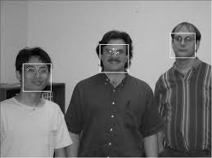
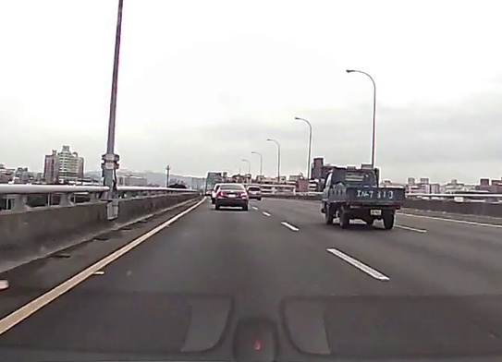
Cascade classifier
Robust Real-Time Face Detection
PAUL VIOLA / MICHAEL J. JONE

Slide 21
Cascade classifier
Remove false cases fast
…
Input
Output
Stage 0
Stage 1
Stage 2
Stage N-1
Stage N
False
False
False
False
False

Slide 22
Thanks

