Slide 1
Vehicle Detection by using Adaboost Algorithm Leon 07-14-2015

Slide 2
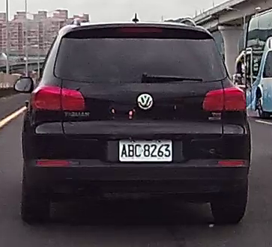
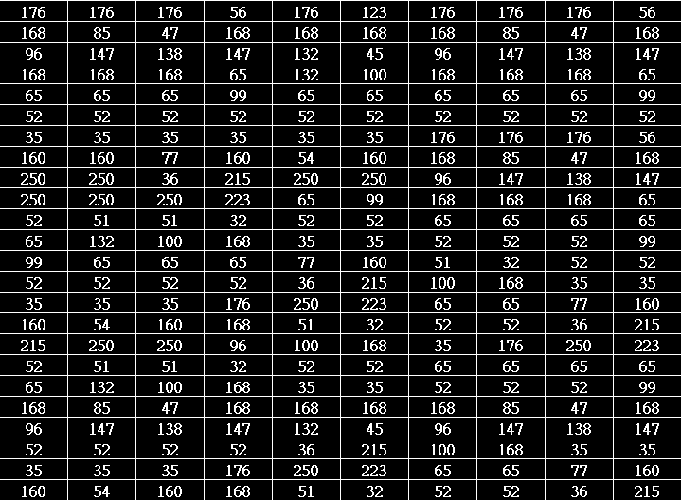
How to teach machine to see a car?
Rectangle shape
Symmetry
Entropy
Contrast
Computer sees

Slide 3
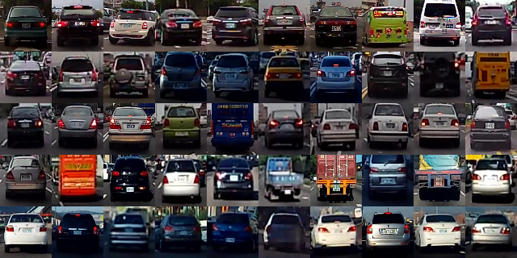
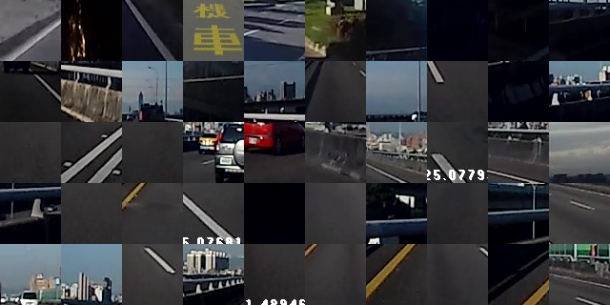
Learn from label data(supervised)
Cars
Background

Slide 4
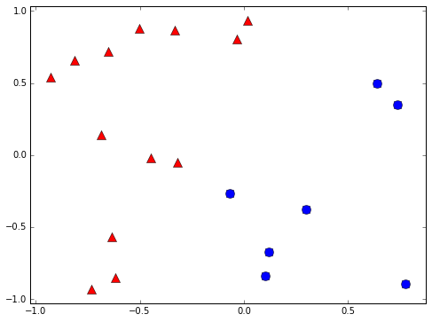
Binary classifier
Is it a car? { yes, no }
Will stock market go up or down? { up, down }
Will you sleep well or bad tonight? { well, bad }
+1
-1

Slide 5
Weak classifier
Performance is slightly better than random guessing
Strong classifier
Weak classifier
Error rate
0
1/2
1
?

Slide 6
Weak classifier learner
Find the weak classifier with minimum error
A based learner in adaboost
Decision stump is a weak classifier example
Data
Weak classifier learner
Weak classifier g(x)

Slide 7
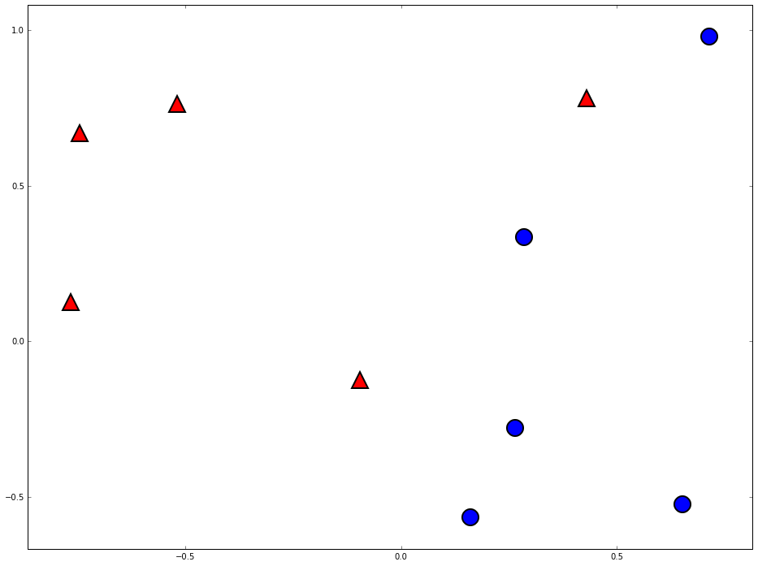
Decision stump
-1
+1

Slide 8
Can weak classifier combine to do better

Slide 9
Two heads are better than one

Slide 10
Space of data
Error of g1
Error of G(x)
Error of g2
Error of g3

Slide 11
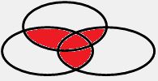
The diversity is important

Slide 12
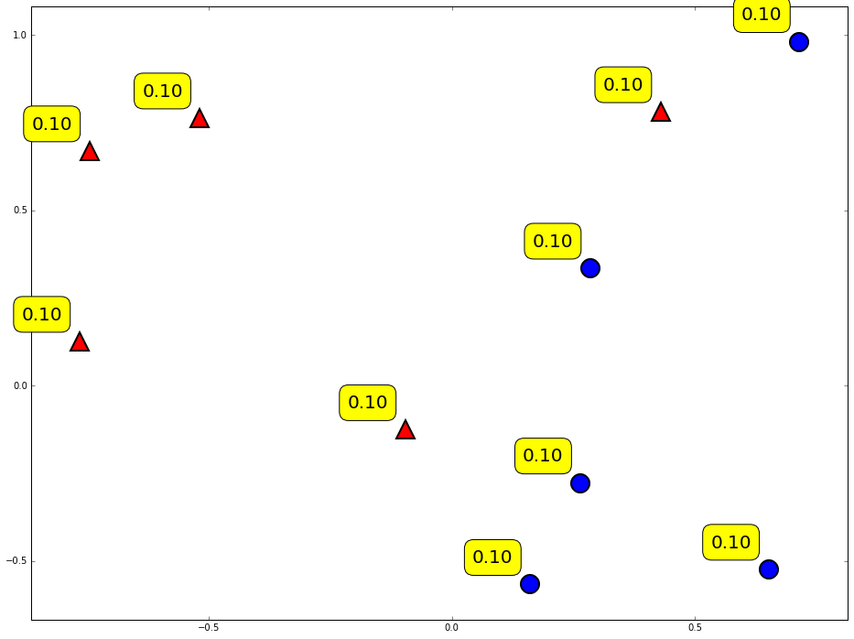
Weight of data

Slide 13
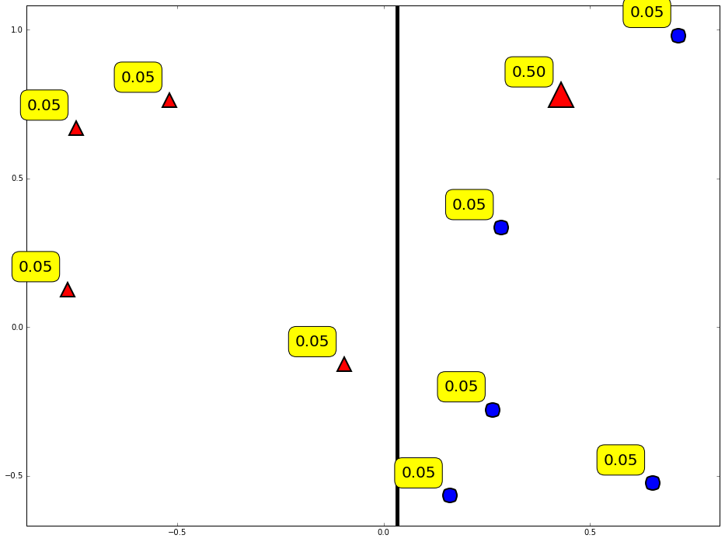
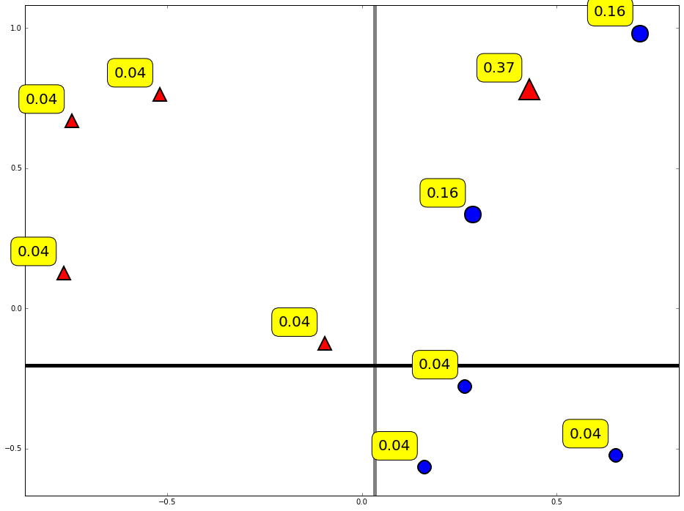
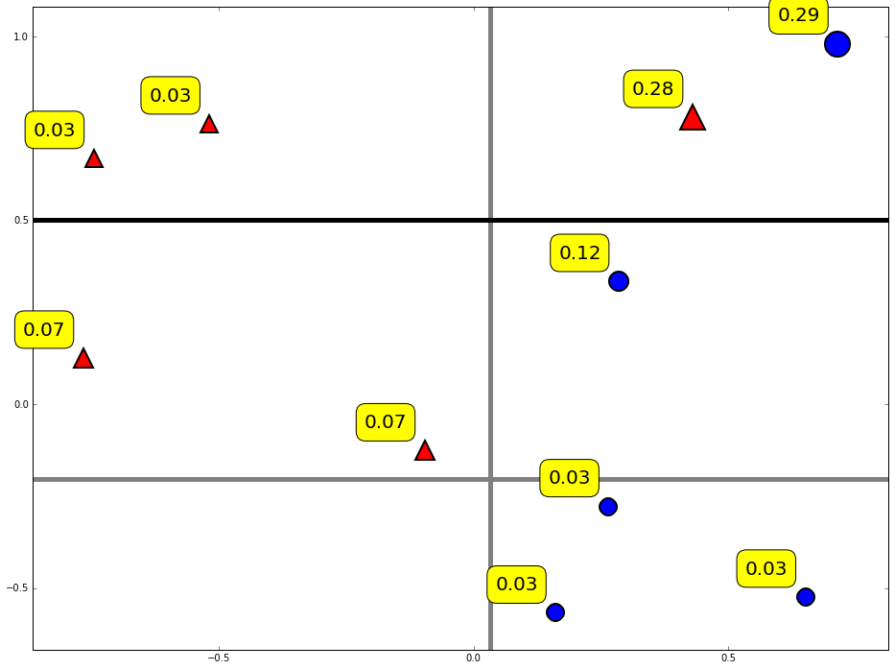
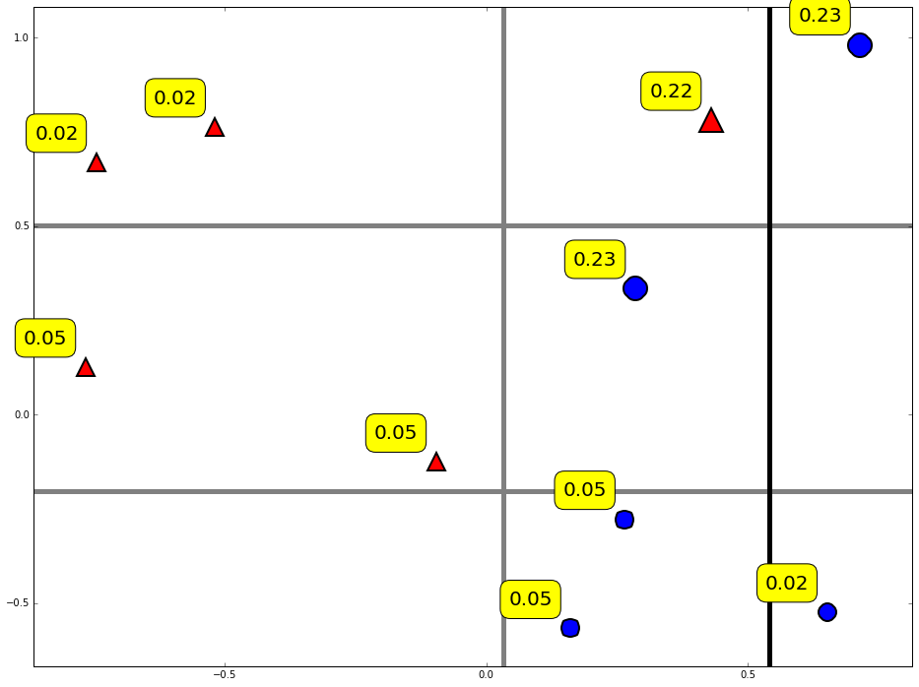
Reweight data

Slide 14
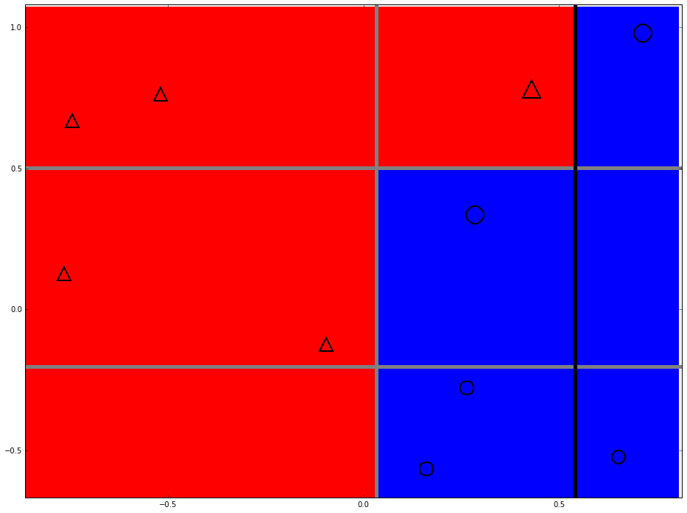
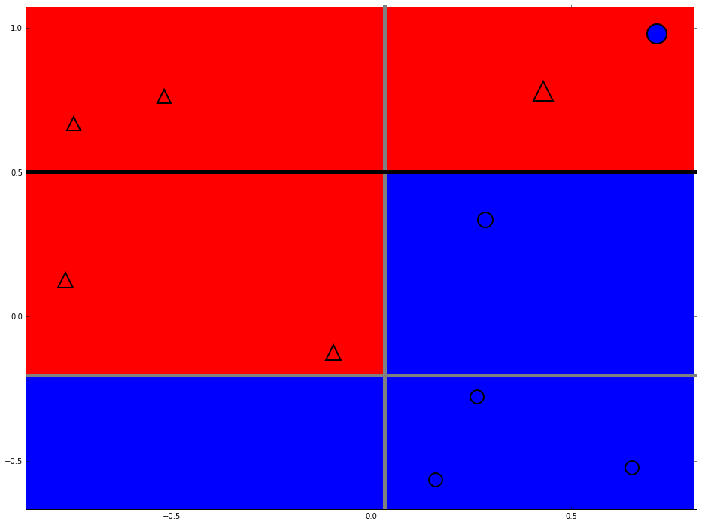
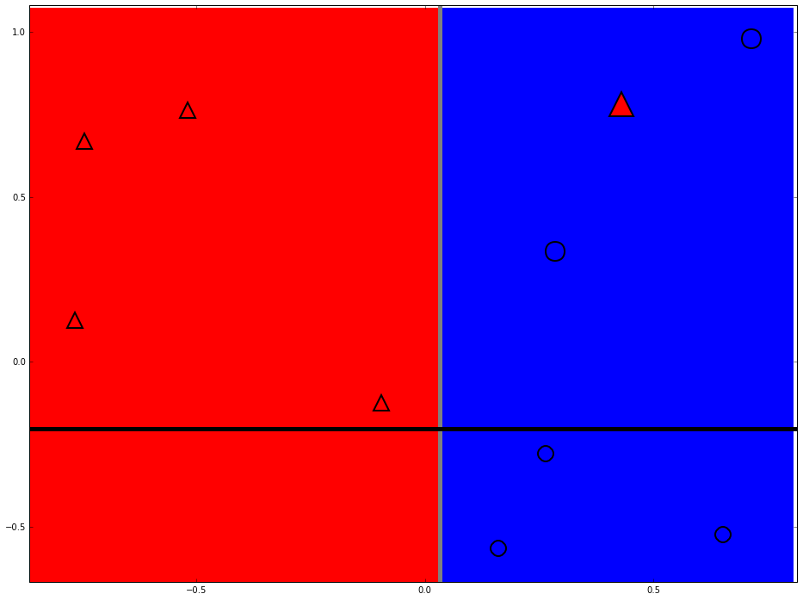
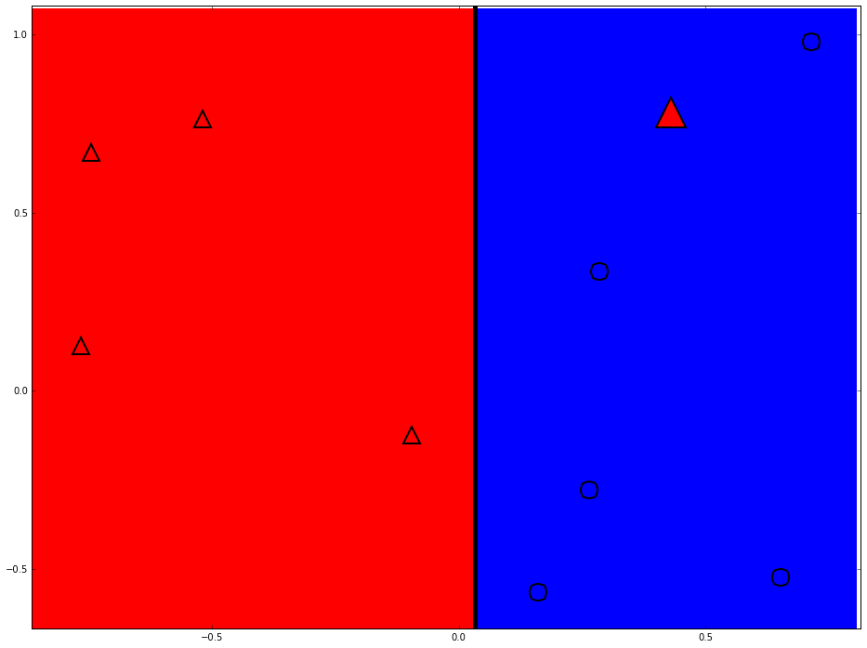
Strong classifier

Slide 15
Thanks

