Slide 1
Introduce to Adaboost Algorithm and Vehicle Detection
Leon 07-28-2015

Slide 2
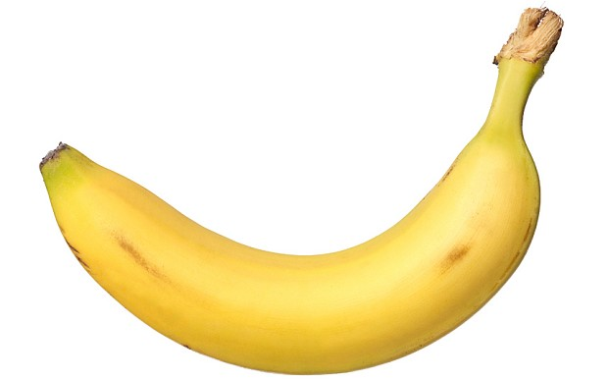
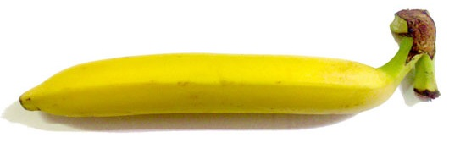
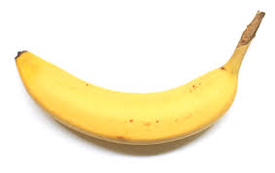
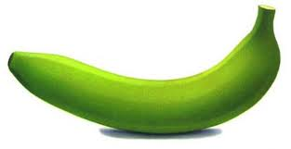
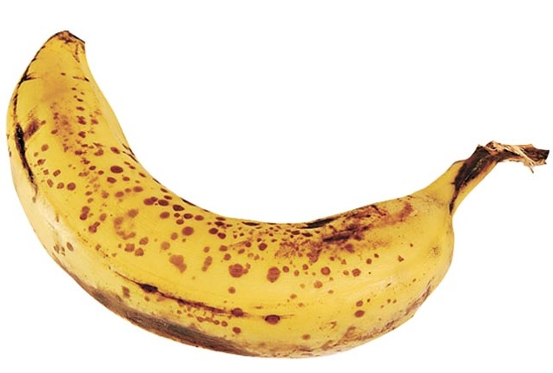
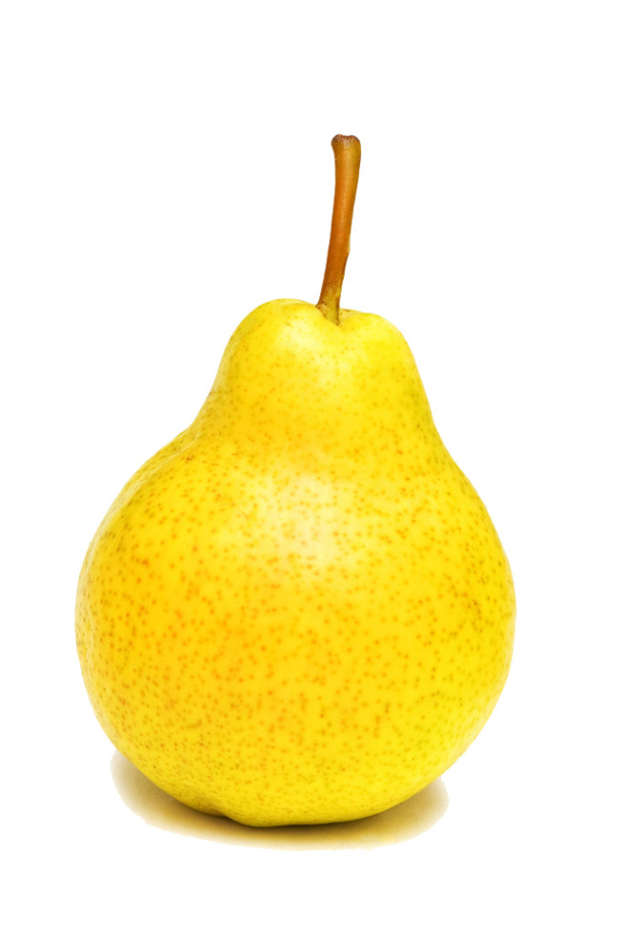
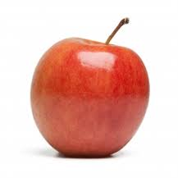
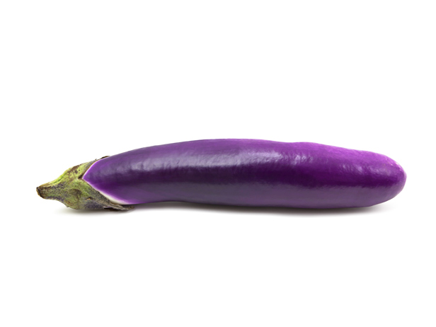
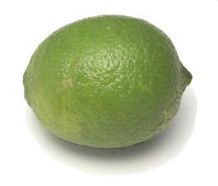
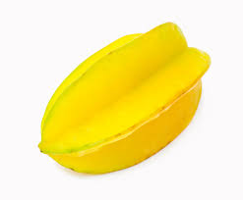
A Banana Classifier
Is this a picture of a banana?
Want to find some simple rules to describe a banana
Bananas
Non-bananas

Slide 3
A Banana Classifier
Rule 1: Bananas are yellow
Bananas
Non-bananas

Slide 4
A Banana Classifier
Rule 2: Bananas can be green
Bananas
Non-bananas

Slide 5
A Banana Classifier
Rule 3: Bananas are striped
Bananas
Non-bananas

Slide 6
A Banana Classifier
Rule 4: Bananas have brown spots
Bananas
Non-bananas

Slide 7
A Banana Classifier
Banana Classifier
Rule 1: Yellow
Picture
Rule 2: Green
Bananas
?
Rule 3: Striped
Non-bananas
Rule 4: Spots

Slide 8
Summary of the example
Example
Adaboost
The simple rules
Weak classifiers
Man learn from pictures
Weak classifier learner
Change the size of pictures
Re-weight data
Final Banana classifier
Strong classifier

Slide 9
Binary classification problems
Is it a car? { yes, no }
Will stock market go up or down? { up, down }
Will you sleep well or bad tonight? { good, bad }
Data: X
age | 30
gender | male
weight | 70 kg
sleep hours | 7 hours
exercise times | 30 minutes
Result: Y
good

Slide 10
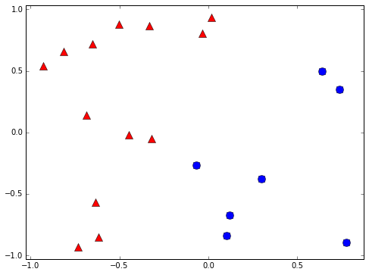
Binary classifier example
+1
-1

Slide 11
Learning Flow
Human
Observations
Human learning
Classification skill
Computers
Data
Machine learning
Classification skill
(classifier)

Slide 12
Weak classifier
Performance is slightly better than random guessing
Strong classifier
Weak classifier
Error rate
0
1/2
1
?

Slide 13
Decision stump
Classify by one attribute of data
If sleep hours >= 7 hours ➔ +1 else -1
If exercise time >= 1 hour ➔ +1 else -1
Often a weak classifier
Sleep hours | 7 hours
Exercise time | 30 minutes

Slide 14
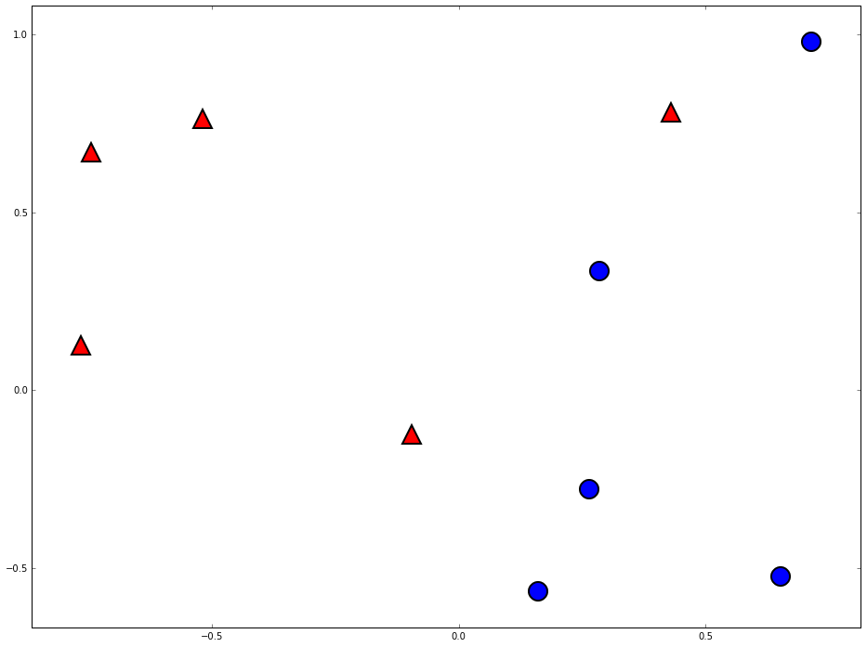
Decision stump are vertical/horizontal lines
-1
+1

Slide 15
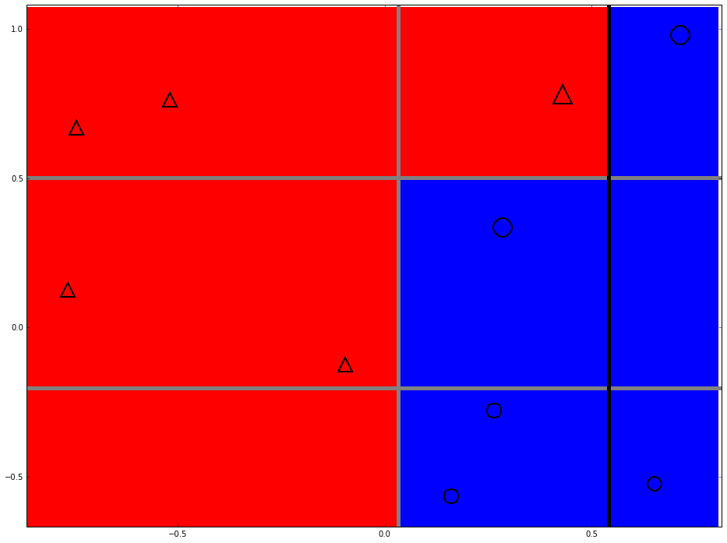
Can we do better?

Slide 16
Two heads are better than one

Slide 17
Space of data
Error of g1
Error of G(x)
Error of g2
Error of g3

Slide 18
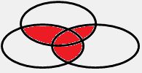
The diversity is important

Slide 19
How to pick the diverse classifiers
T=1
Data
Learning algorithm
Update data weights
T=2
Data
Learning algorithm
Update data weights
T=3
Data
Learning algorithm
T=N

Slide 20
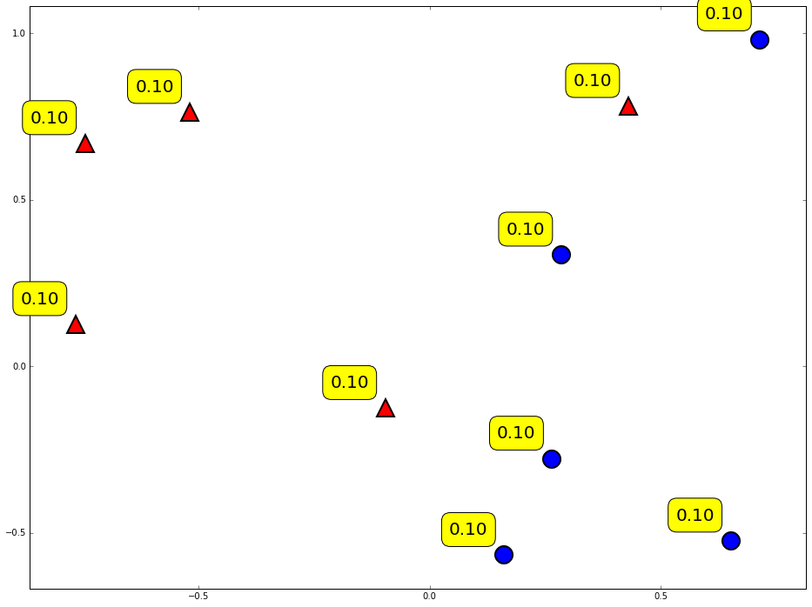
Weighting of data

Slide 21
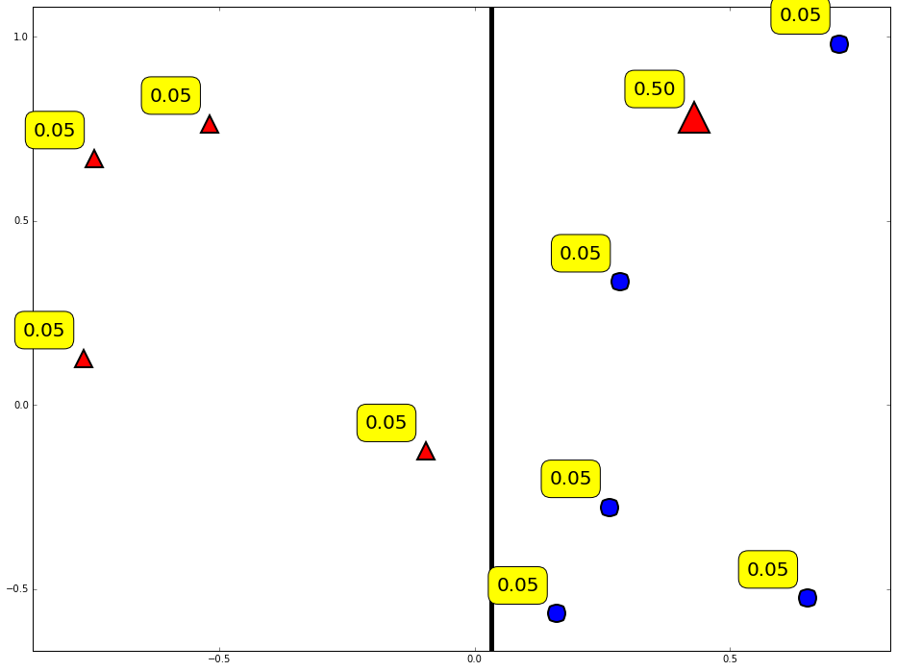
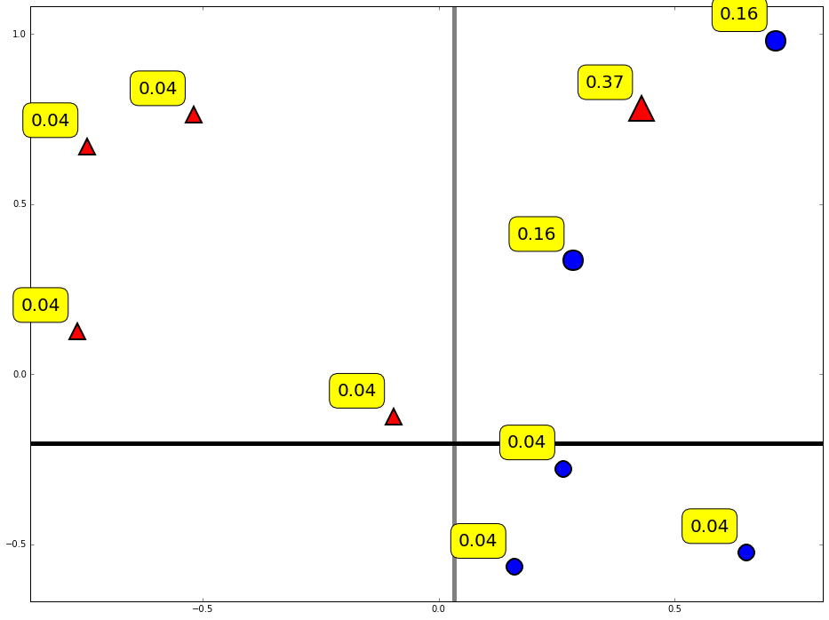
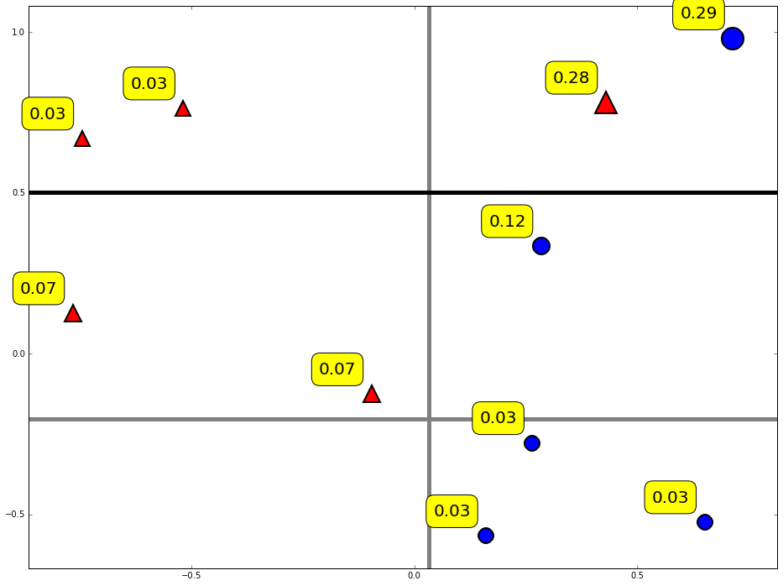
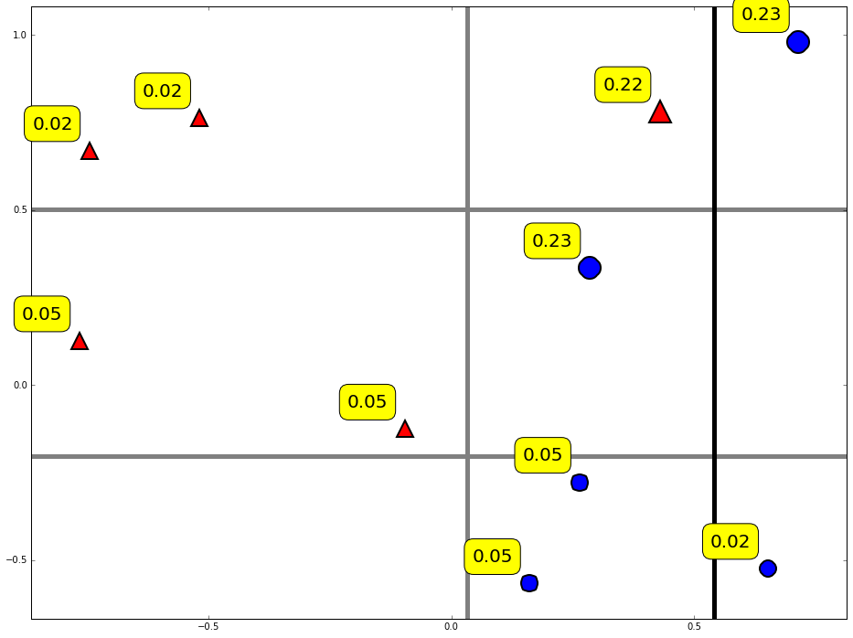
Diversity by re-weighting

Slide 22
Combine weak classifiers into strong classifier
Final decision:
Weight of weak classifier

Slide 23
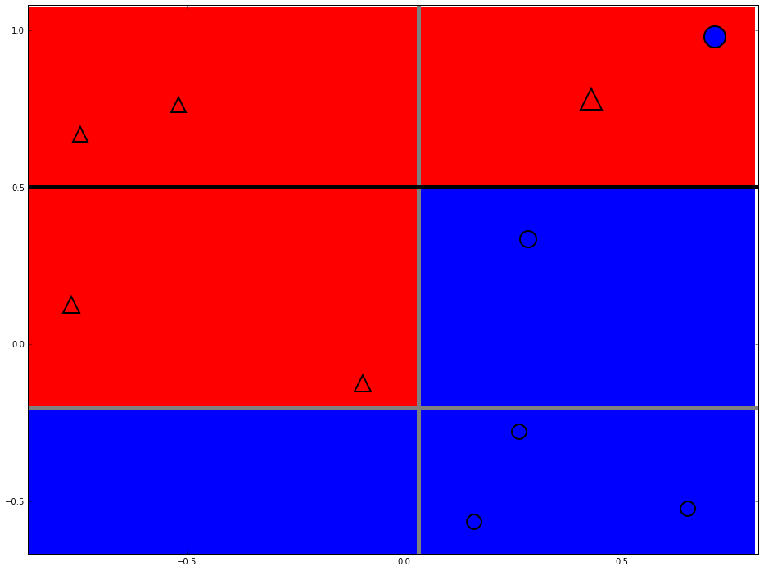
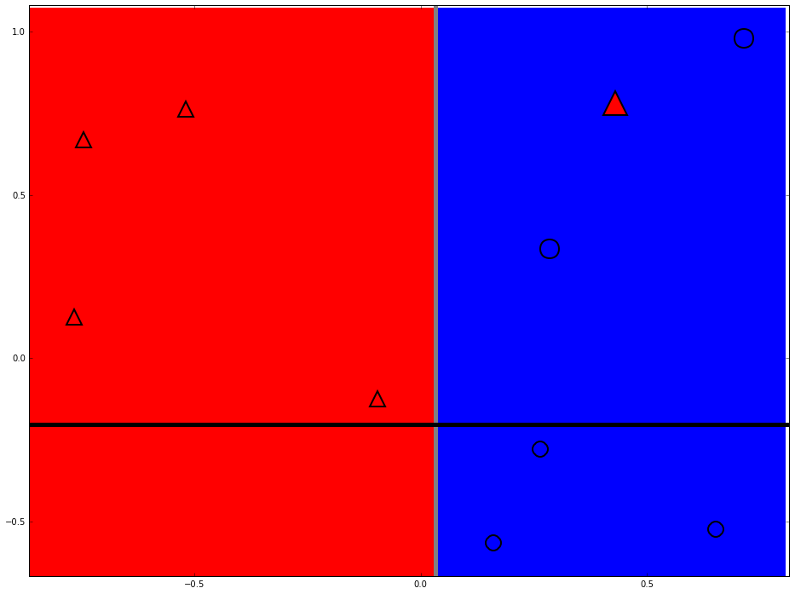
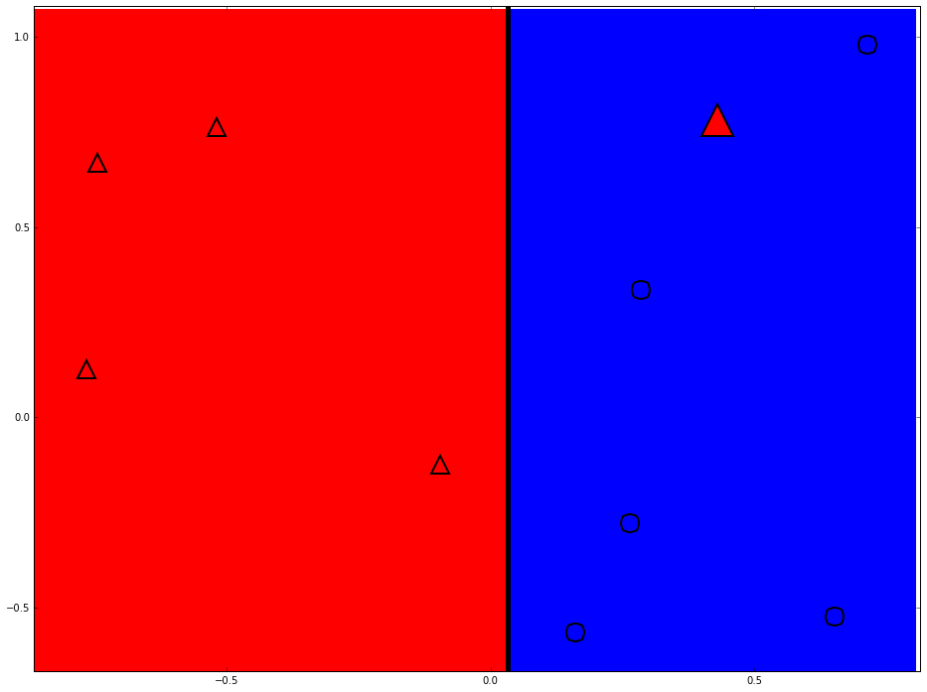
Strong classifier

Slide 24
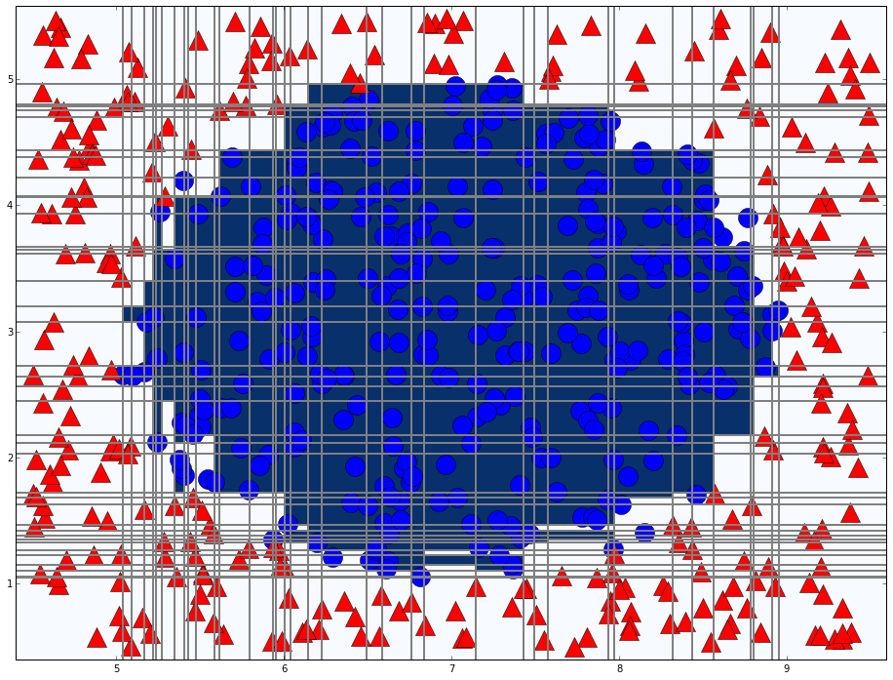
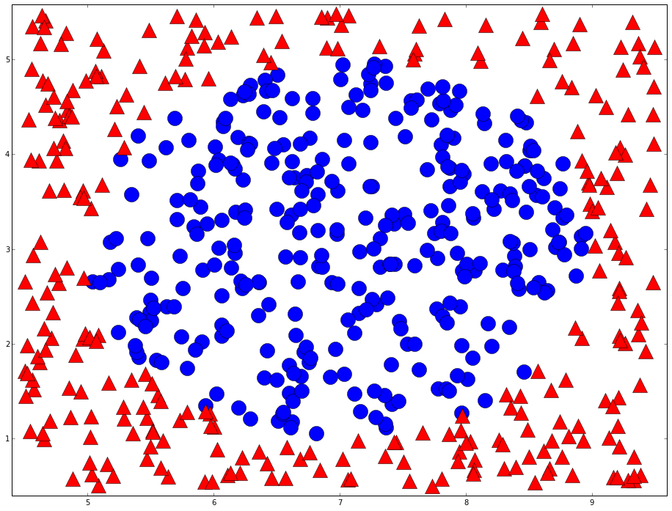
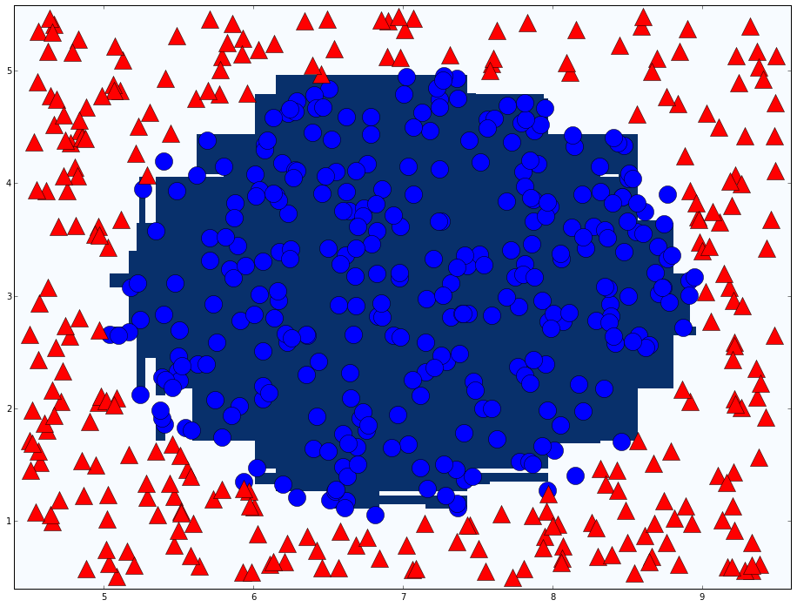
Adaboost in action
T=76

Slide 25

Weak classifier of vehicle detection
Haar like feature
Different types
Classifier number (Type X Position X Size) ≈ 160000

Slide 26
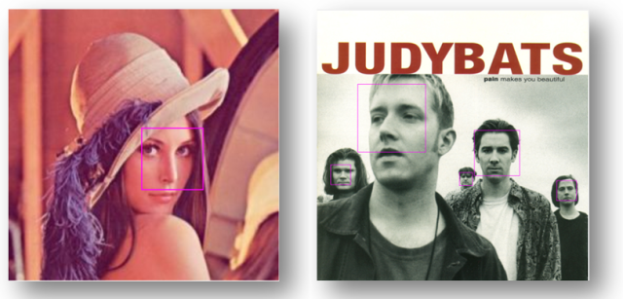
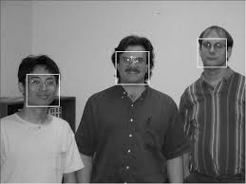
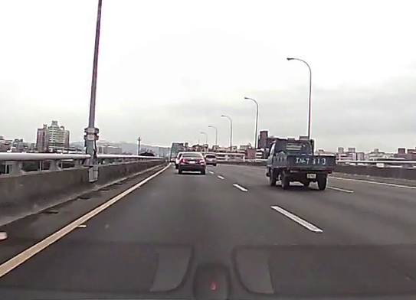
Cascade classifier
Robust Real-Time Face Detection
PAUL VIOLA / MICHAEL J. JONE

Slide 27
Cascade classifier
Remove false cases fast
…
Input
Output
Stage 0
Stage 1
Stage 2
Stage N-1
Stage N
False
False
False
False
False

Slide 28
Conclusion
Two heads are better than one
The diversity of weak classifier

Slide 29
Thanks

Slide 30
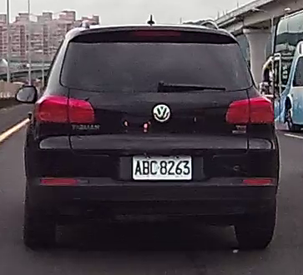
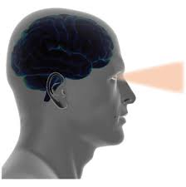
Human vision
What is this?
Classification skill
Hard to program the human classification skill
Notes:
Why use machine learning
Computer vision is difficult

Slide 31
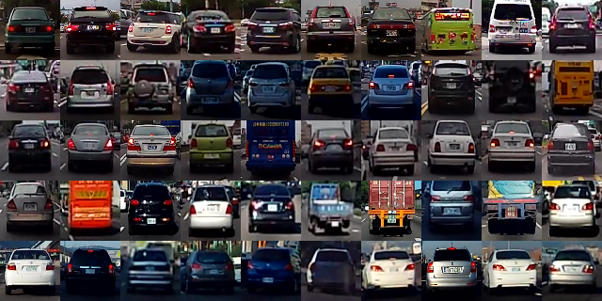
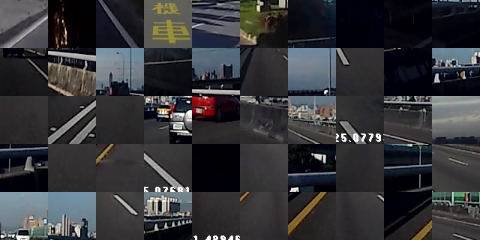
Learn from label data(supervised)
Cars
Background

Slide 32
The features of a car
Rectangle shape
Symmetry
Entropy
Contrast

Slide 33
Computer vision
How does an object look like to computers?
32 | 30 | 30 | 30 | 30 | 30 | 30 | 30 | 32 | 30 | 30 | 30 | 30
34 | 31 | 31 | 31 | 31 | 31 | 31 | 31 | 34 | 31 | 31 | 31 | 31
32 | 32 | 32 | 34 | 32 | 36 | 32 | 32 | 32 | 32 | 32 | 32 | 32
33 | 34 | 32 | 36 | 34 | 55 | 34 | 34 | 34 | 34 | 34 | 34 | 34
34 | 36 | 34 | 36 | 36 | 78 | 36 | 36 | 36 | 36 | 36 | 36 | 36
34 | 36 | 36 | 36 | 36 | 36 | 36 | 36 | 36 | 36 | 36 | 36 | 36
36 | 55 | 55 | 55 | 55 | 55 | 55 | 55 | 36 | 55 | 55 | 55 | 55
70 | 78 | 78 | 78 | 78 | 78 | 78 | 78 | 78 | 78 | 78 | 78 | 78
155 | 154 | 153 | 152 | 151 | 150 | 149 | 148 | 147 | 146 | 145 | 144 | 143
155 | 143 | 153 | 153 | 151 | 152 | 149 | 147 | 148 | 143 | 143 | 147 | 143
155 | 143 | 148 | 153 | 151 | 152 | 152 | 147 | 148 | 143 | 143 | 143 | 143
143 | 144 | 148 | 153 | 151 | 152 | 152 | 148 | 147 | 146 | 145 | 143 | 143
143 | 155 | 153 | 152 | 151 | 152 | 149 | 148 | 147 | 146 | 146 | 146 | 144
155 | 155 | 153 | 152 | 151 | 150 | 149 | 148 | 147 | 146 | 146 | 144 | 144
155 | 154 | 153 | 152 | 151 | 150 | 149 | 148 | 146 | 146 | 145 | 144 | 143
155 | 154 | 153 | 152 | 151 | 150 | 145 | 149 | 146 | 146 | 145 | 144 | 143
155 | 154 | 153 | 152 | 151 | 150 | 145 | 149 | 146 | 146 | 145 | 144 | 143
Computer sees…
Notes:
Computer vision is difficult

