Slide 1
Introduce to Adaboost Algorithm and Vehicle Detection
Leon 07-28-2015
Notes:
嗨 大家好
我今天要介紹一個在機器學習領域裡很有名的演算法，叫做Adaptive boosting
Adaboost，和如何應用在車輛偵測

Slide 2
Agenda
A toy example
Adaboost
Vehicle detection
Notes:
我今天會從一個很簡單的範例開始介紹，這整個範例的流程會使用很多adaboost演算法的精神

Slide 3
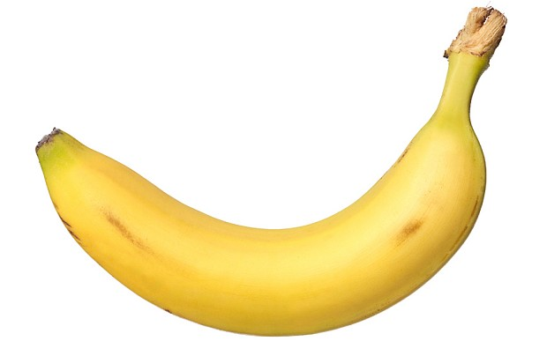
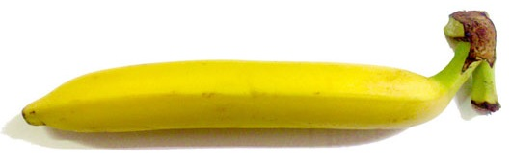
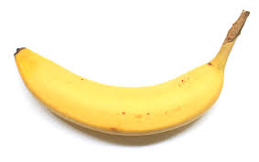
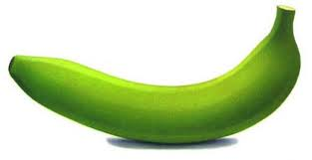
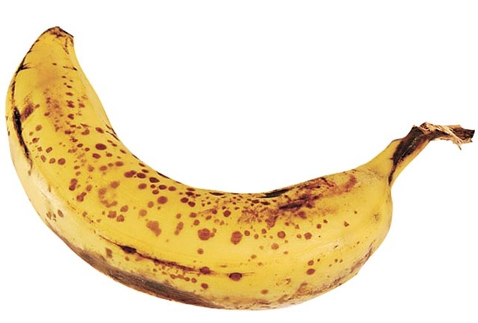
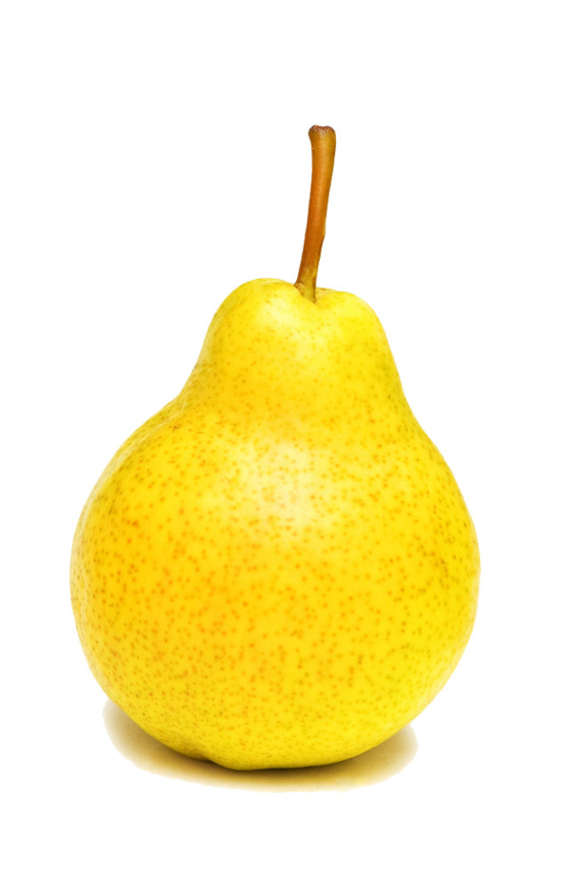
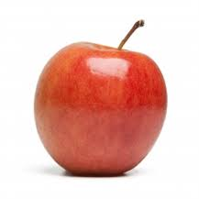
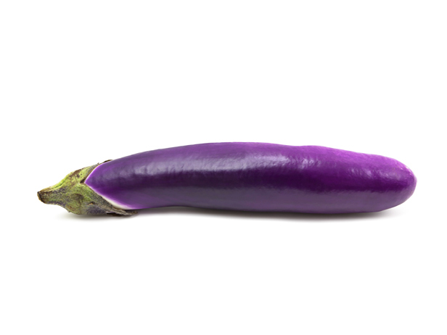
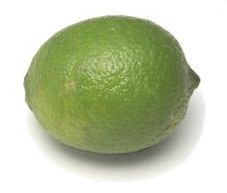
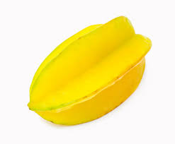
A Banana Classifier
Is this a picture of a banana?
Want to find some rules to describe a banana
Bananas
Non-bananas
Notes:
這個例子是這樣子的，想像今天是一對父母想要教會，他們的小孩子 怎麼分辨出一根香蕉
於是就從網路上找了很多圖片，圖片裡面有是香蕉的圖片，也有不是香蕉的圖片，然後請小朋友看一看這些圖片，然後告訴他說上面的是香蕉 下面的這排不是香蕉
請小朋友找出香蕉是長什麼樣子呢

Slide 4
A Banana Classifier
Rule 1: Bananas are yellow
Bananas
Non-bananas

Slide 5
A Banana Classifier
Rule 2: Bananas can be green
Bananas
Non-bananas

Slide 6
A Banana Classifier
Rule 3: Bananas are striped
Bananas
Non-bananas

Slide 7
A Banana Classifier
Rule 4: Bananas have brown spots
Bananas
Non-bananas

Slide 8
A Banana Classifier
Banana Classifier
Rule 1: Yellow
Picture
Rule 2: Green
Bananas
?
Rule 3: Striped
Non-bananas
Rule 4: Spots

Slide 9
Summary of the example
Example
Adaboost
The simple rules
Weak classifiers
Man learn from pictures
Weak classifier learner
Change the size of pictures
Re-weight data
Final Banana classifier
Strong classifier

Slide 10
Agenda
A simple example
Adaboost
Vehicle detection
Notes:
接下來會介紹adaboost演算法的一些細節
像是
adaboost能幫我們做什麼
我們什麼時候能用他
以及他是如何做到的

Slide 11
Binary classification problems
Is it a car? { yes, no }
Will stock market go up or down? { up, down }
Will you sleep well or bad tonight? { good, bad }
Data: X
age | 30
gender | male
weight | 70 kg
sleep hours | 7 hours
exercise times | 30 minutes
Result: Y
good

Slide 12
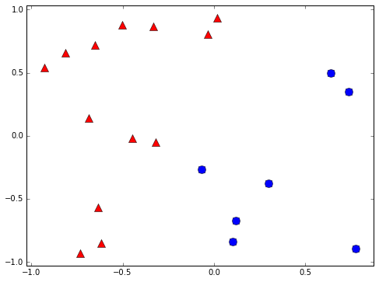
Binary classifier example
+1
-1

Slide 13
Learning Flow
Human
Observations
Human learning
Classification skill
Computers
Data
Machine learning
Classification skill
(classifier)

Slide 14
Weak classifier
Performance is slightly better than random guessing
Strong classifier
Weak classifier
Error rate
0
1/2
1
?

Slide 15
Decision stump
Classify by one attribute of data
If sleep hours >= 7 hours ➔ +1 else -1
If exercise time >= 1 hour ➔ +1 else -1
Often a weak classifier
Sleep hours | 7 hours
Exercise time | 30 minutes

Slide 16
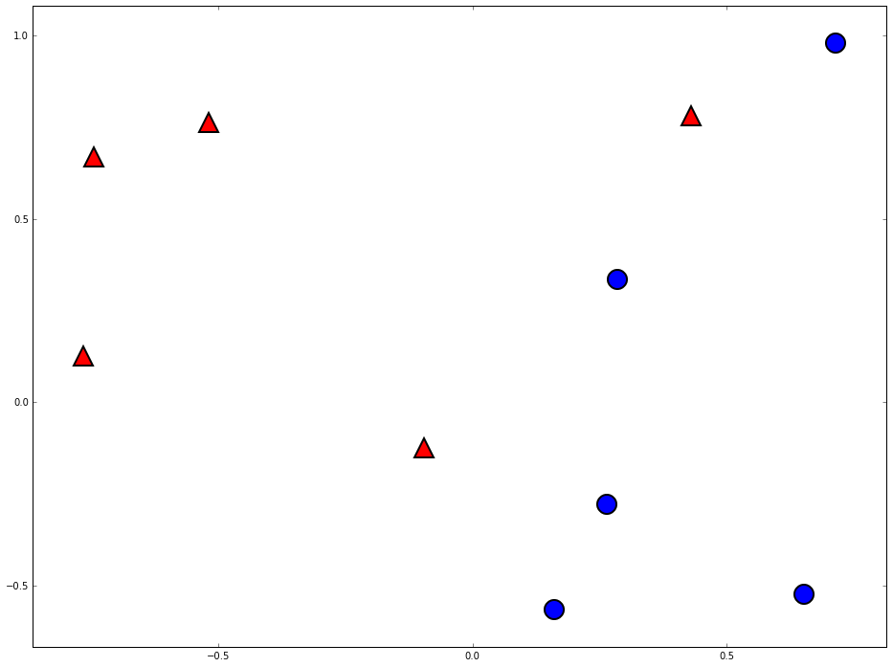
Decision stump are vertical/horizontal lines
-1
+1

Slide 17
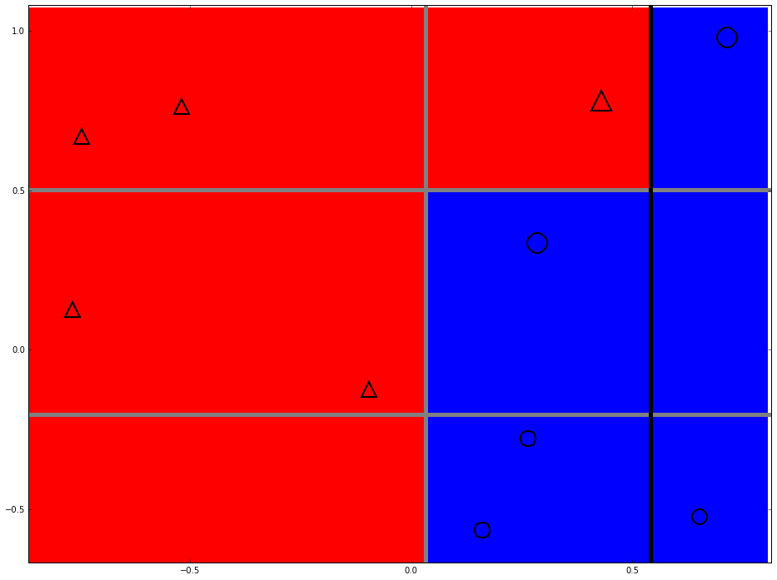
Can we do better?

Slide 18
Two heads are better than one

Slide 19
Space of data
Error of g1
Error of G(x)
Error of g2
Error of g3

Slide 20
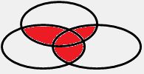
The diversity is important

Slide 21
How to pick the diverse classifiers
T=1
Data
Learning algorithm
Update data weights
T=2
Data
Learning algorithm
Update data weights
T=3
Data
Learning algorithm
T=N

Slide 22
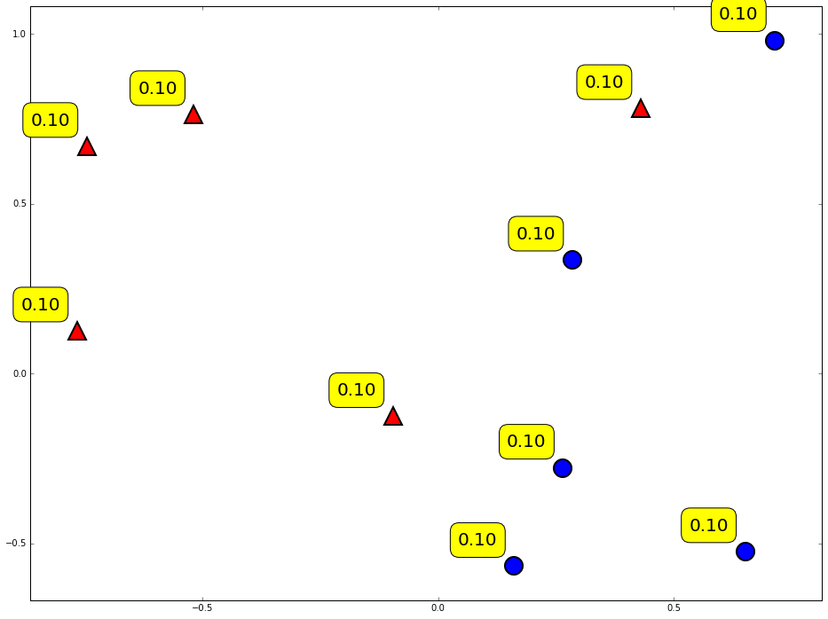
Weighting of data

Slide 23
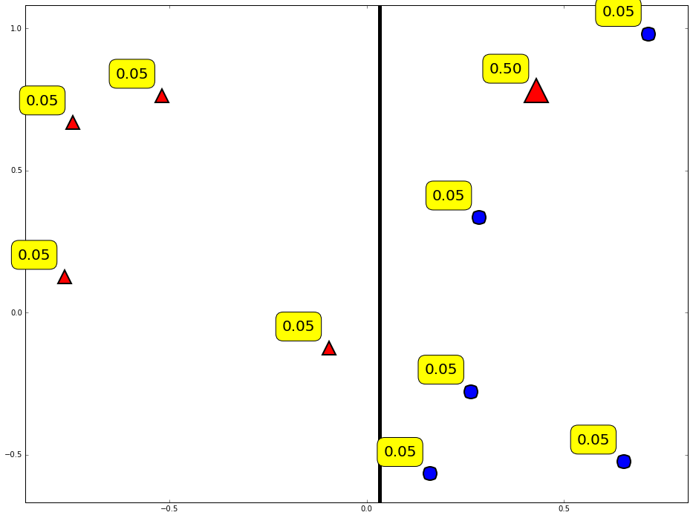
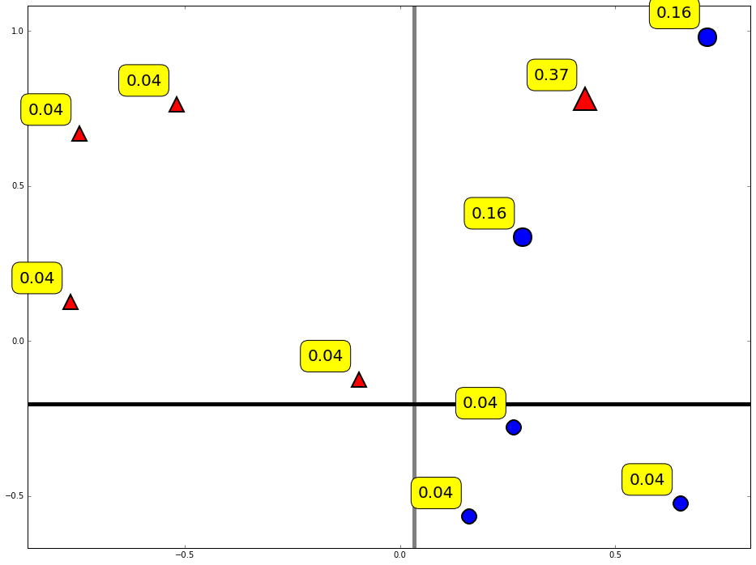
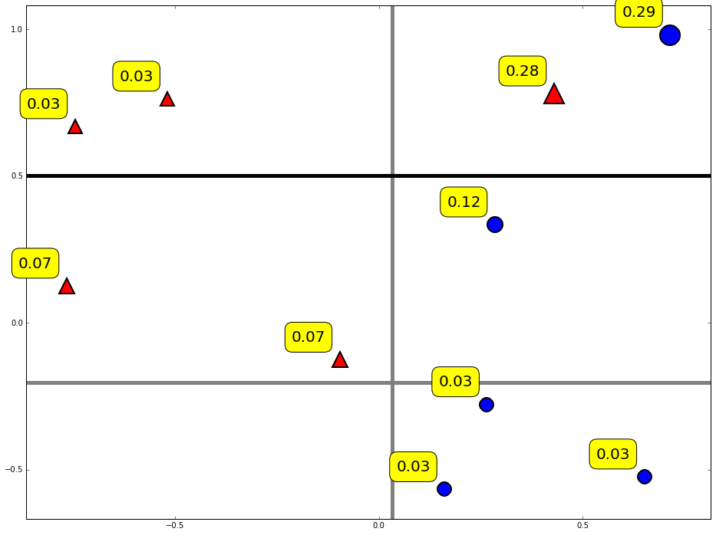
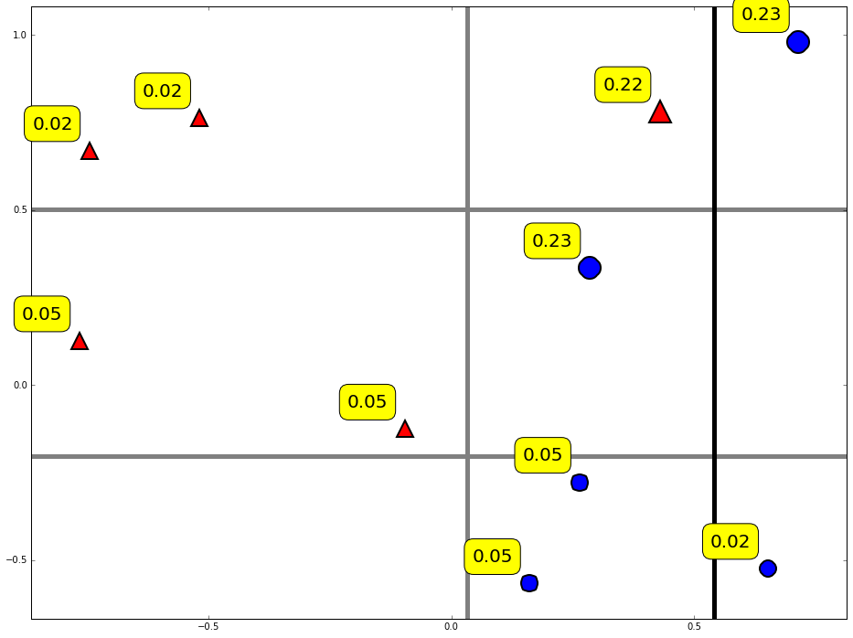
Diversity by re-weighting

Slide 24
Combine weak classifiers into strong classifier
Final decision:
Weight of weak classifier

Slide 25
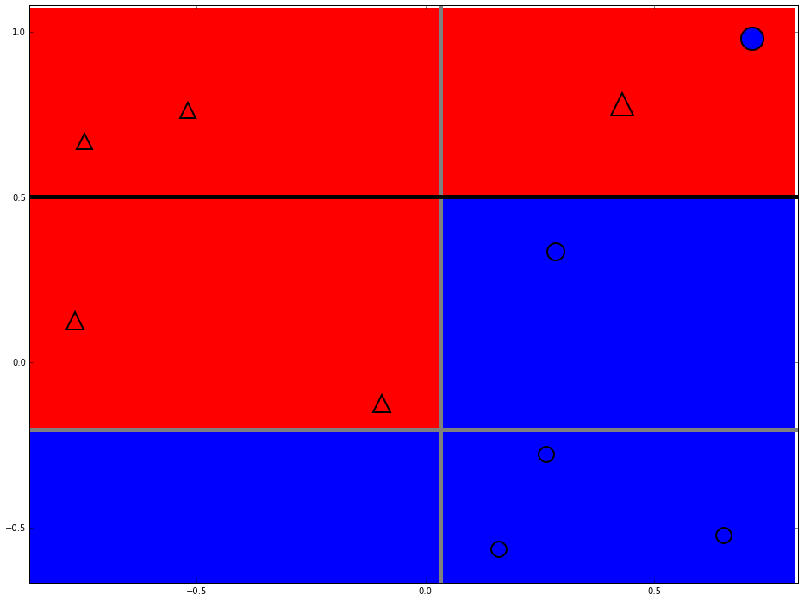
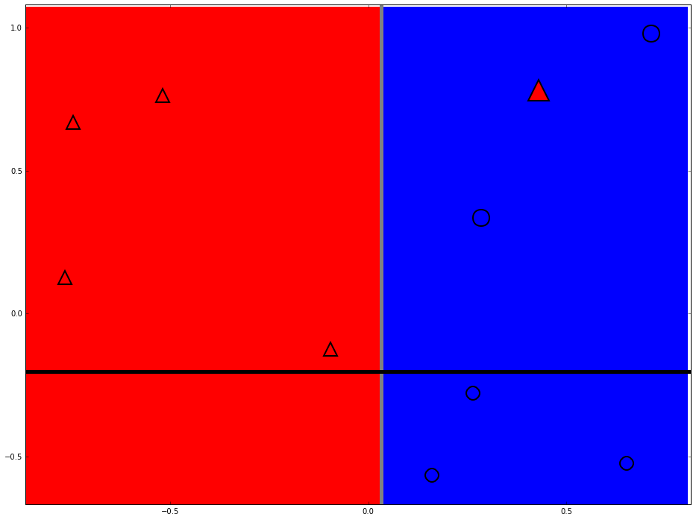
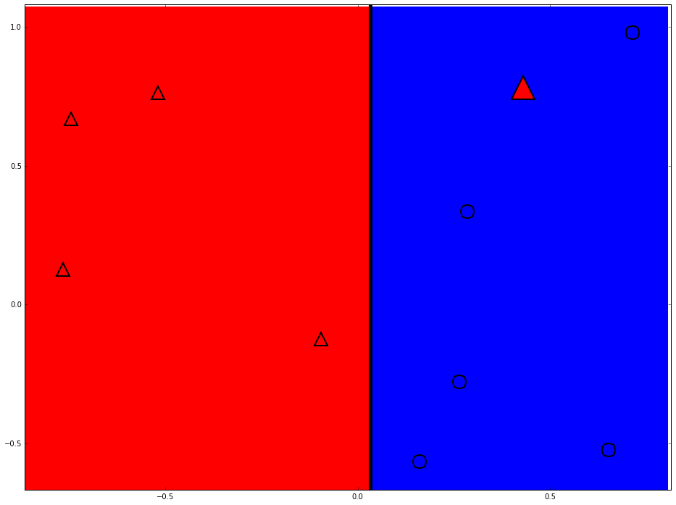
Strong classifier

Slide 26
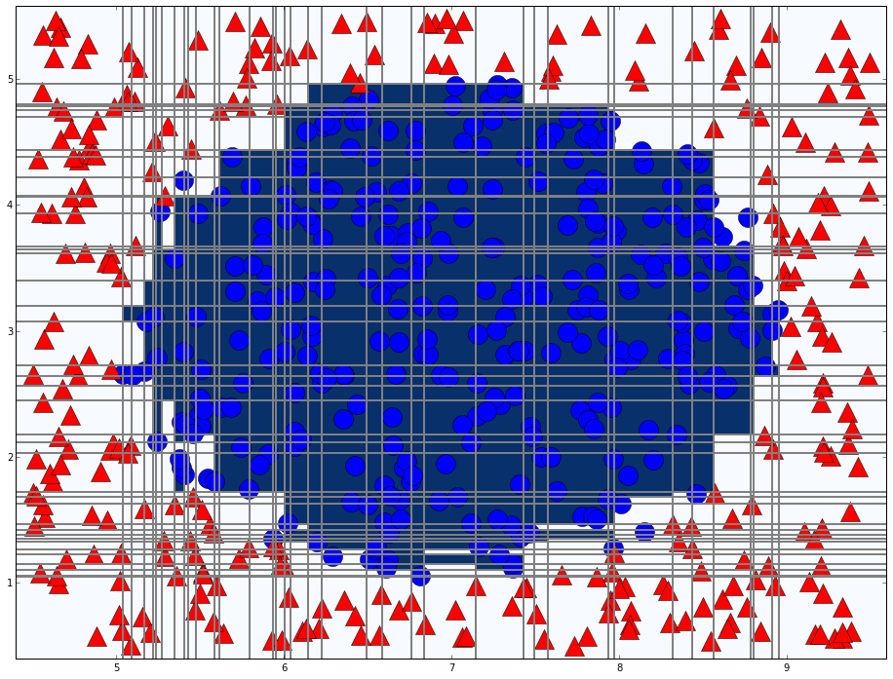
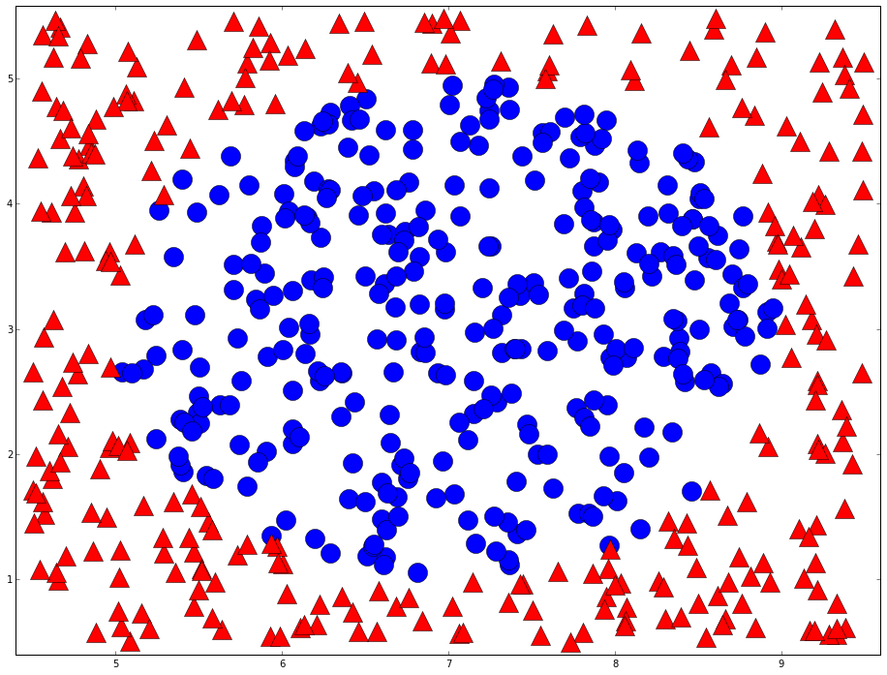
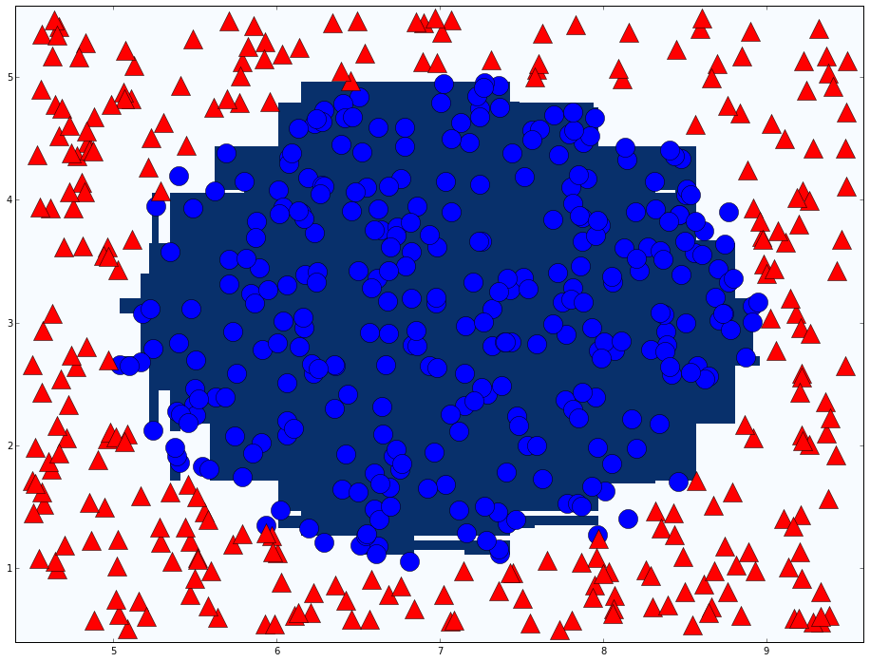
Adaboost in action
T=76

Slide 27
Agenda
A simple example
Adaboost
Vehicle detection

Slide 28
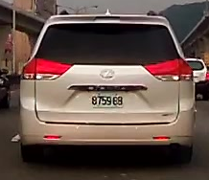
Weak classifier of vehicle detection
Haar like feature
Different types
Classifier number (Type X Position X Size) ≈ 160000

Slide 29
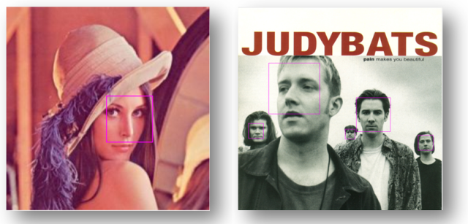
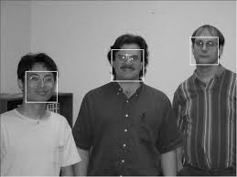
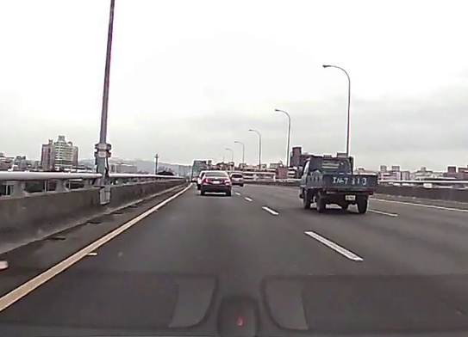
Cascade classifier
Robust Real-Time Face Detection
PAUL VIOLA / MICHAEL J. JONE

Slide 30
Cascade classifier
Remove false cases fast
…
Input
Output
Stage 0
Stage 1
Stage 2
Stage N-1
Stage N
False
False
False
False
False

Slide 31
Conclusion
Two heads are better than one
The diversity of weak classifier

Slide 32
Thanks

Slide 33
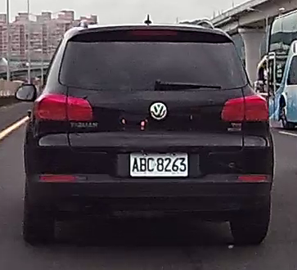
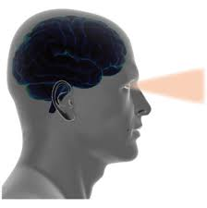
Human vision
What is this?
Classification skill
Hard to program the human classification skill
Notes:
Why use machine learning
Computer vision is difficult

Slide 34
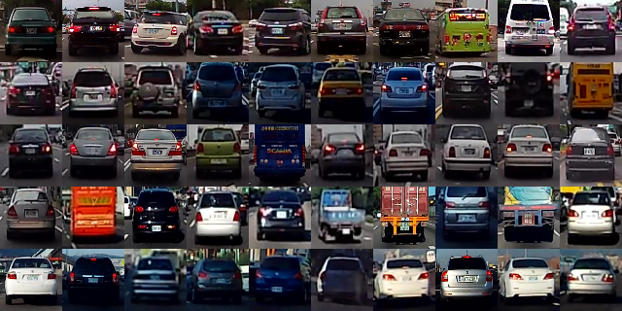
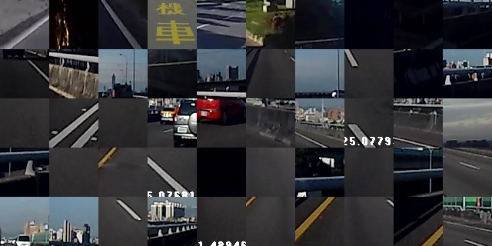
Learn from label data(supervised)
Cars
Background

Slide 35
The features of a car
Rectangle shape
Symmetry
Entropy
Contrast

Slide 36
Computer vision
How does an object look like to computers?
32 | 30 | 30 | 30 | 30 | 30 | 30 | 30 | 32 | 30 | 30 | 30 | 30
34 | 31 | 31 | 31 | 31 | 31 | 31 | 31 | 34 | 31 | 31 | 31 | 31
32 | 32 | 32 | 34 | 32 | 36 | 32 | 32 | 32 | 32 | 32 | 32 | 32
33 | 34 | 32 | 36 | 34 | 55 | 34 | 34 | 34 | 34 | 34 | 34 | 34
34 | 36 | 34 | 36 | 36 | 78 | 36 | 36 | 36 | 36 | 36 | 36 | 36
34 | 36 | 36 | 36 | 36 | 36 | 36 | 36 | 36 | 36 | 36 | 36 | 36
36 | 55 | 55 | 55 | 55 | 55 | 55 | 55 | 36 | 55 | 55 | 55 | 55
70 | 78 | 78 | 78 | 78 | 78 | 78 | 78 | 78 | 78 | 78 | 78 | 78
155 | 154 | 153 | 152 | 151 | 150 | 149 | 148 | 147 | 146 | 145 | 144 | 143
155 | 143 | 153 | 153 | 151 | 152 | 149 | 147 | 148 | 143 | 143 | 147 | 143
155 | 143 | 148 | 153 | 151 | 152 | 152 | 147 | 148 | 143 | 143 | 143 | 143
143 | 144 | 148 | 153 | 151 | 152 | 152 | 148 | 147 | 146 | 145 | 143 | 143
143 | 155 | 153 | 152 | 151 | 152 | 149 | 148 | 147 | 146 | 146 | 146 | 144
155 | 155 | 153 | 152 | 151 | 150 | 149 | 148 | 147 | 146 | 146 | 144 | 144
155 | 154 | 153 | 152 | 151 | 150 | 149 | 148 | 146 | 146 | 145 | 144 | 143
155 | 154 | 153 | 152 | 151 | 150 | 145 | 149 | 146 | 146 | 145 | 144 | 143
155 | 154 | 153 | 152 | 151 | 150 | 145 | 149 | 146 | 146 | 145 | 144 | 143
Computer sees…
Notes:
Computer vision is difficult

