Slide 1
Introduce to Vehicle Detection and Adaboost Algorithm Leon 07-28-2015

Slide 2
Binary classification problems
Is it a car? { yes, no }
Will stock market go up or down? { up, down }
Will you sleep well or bad tonight? { good, bad }
Data: X
age | 30
gender | male
weight | 70 kg
sleep hours | 7 hours
exercise times | 30 minutes
Result: Y
good

Slide 3
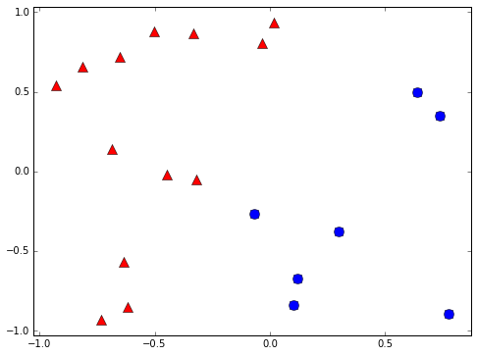
Binary classifier example
+1
-1

Slide 4
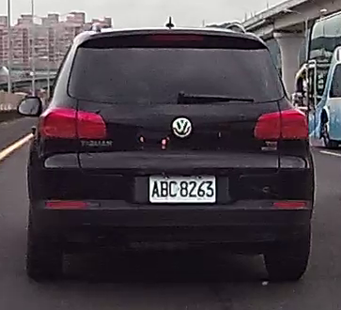
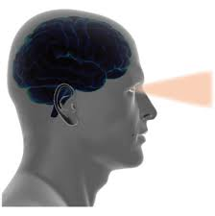
Human vision
What is this?
Classification skill
Hard to program the human classification skill
Notes:
Why use machine learning
Computer vision is difficult

Slide 5
Learning Flow
Human
Observations
Human learning
Classification skill
Computers
Data
Machine learning
Classification skill
(classifier)

Slide 6
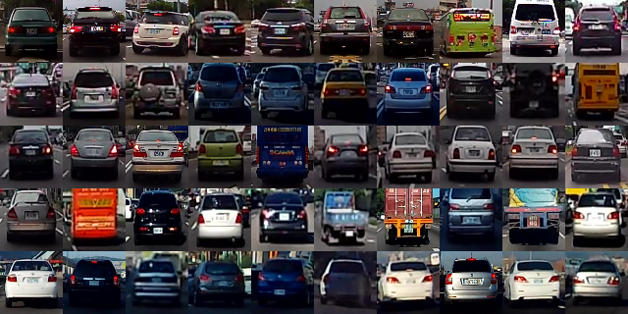
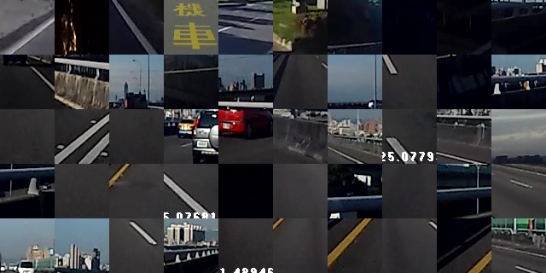
Learn from label data(supervised)
Cars
Background

Slide 7
Weak classifier
Performance is slightly better than random guessing
Strong classifier
Weak classifier
Error rate
0
1/2
1
?

Slide 8
Decision stump
Classify by one attribute of data
If sleep hours >= 7 hours ➔ +1 else -1
If exercise time >= 1 hour ➔ +1 else -1
Often a weak classifier
Sleep hours | 7 hours
Exercise time | 30 minutes

Slide 9
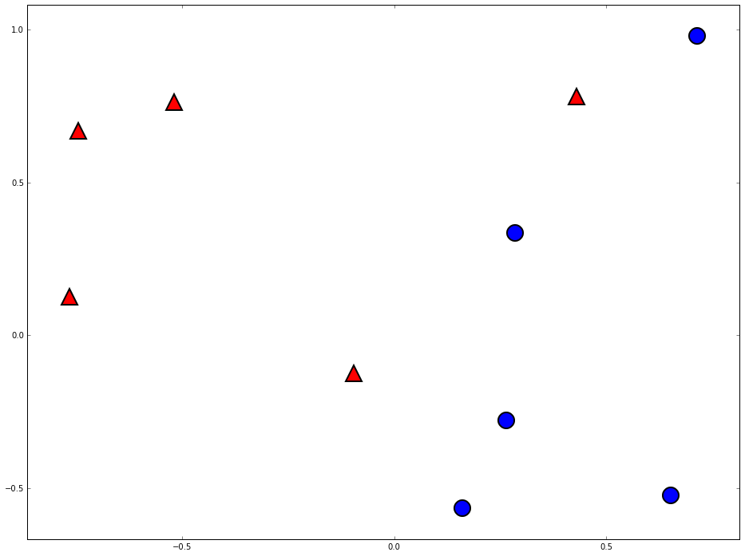
Decision stump are vertical/horizontal lines
-1
+1

Slide 10
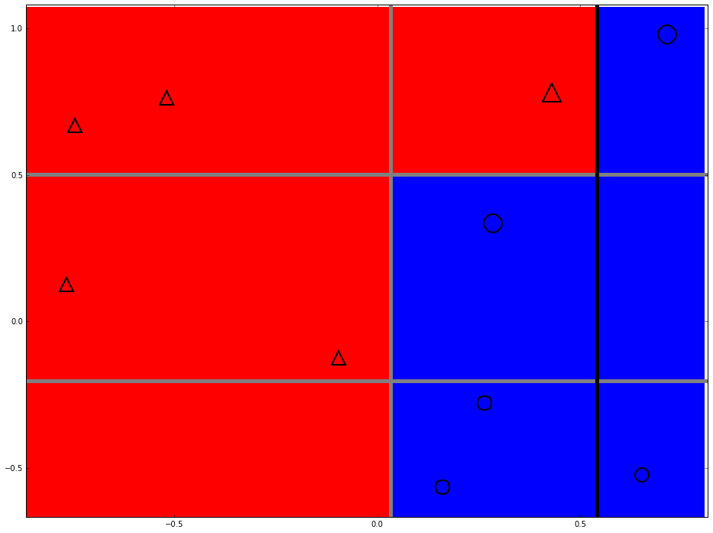
Can we do better?

Slide 11
Two heads are better than one

Slide 12
Space of data
Error of g1
Error of G(x)
Error of g2
Error of g3

Slide 13

The diversity is important

Slide 14
How to pick the diverse classifiers
T=1
Data
Learning algorithm
Update data weights
T=2
Data
Learning algorithm
Update data weights
T=3
Data
Learning algorithm
T=N

Slide 15
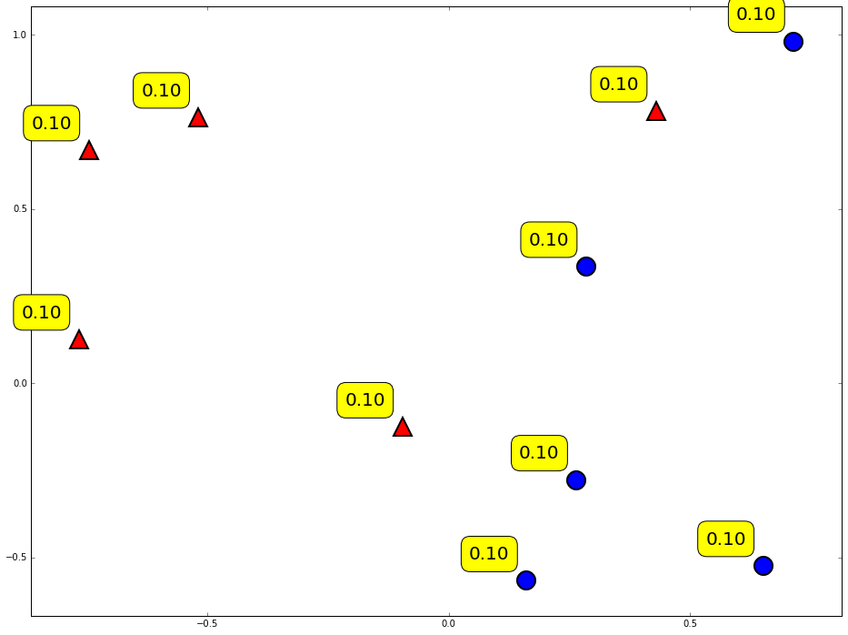
Weighting of data

Slide 16
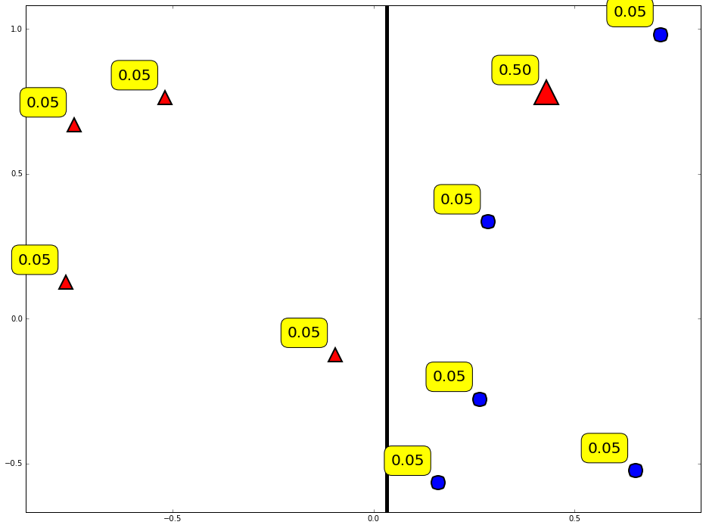
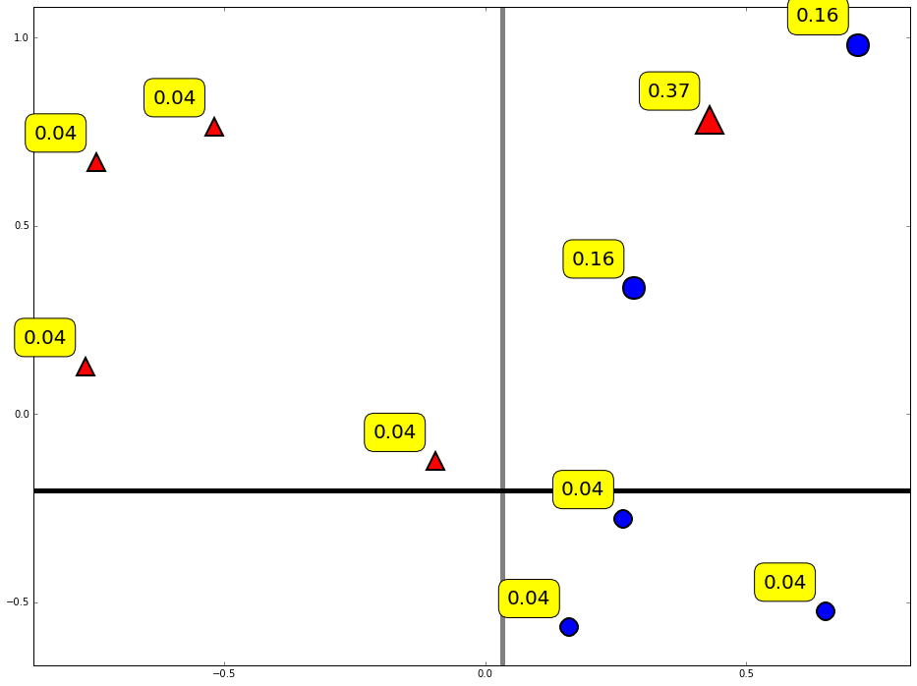
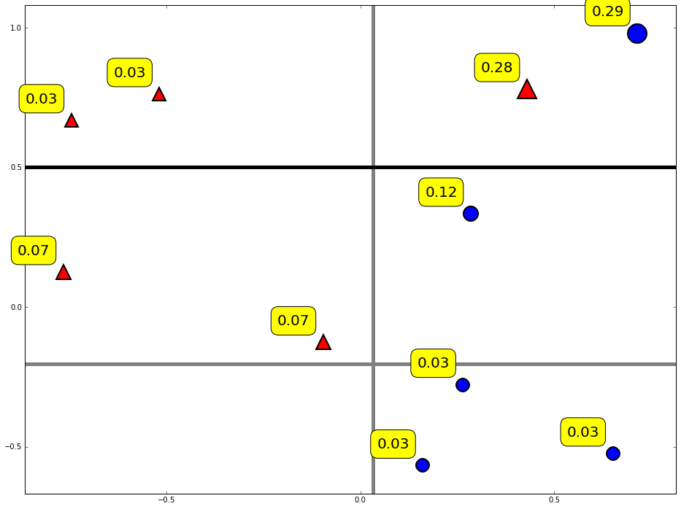
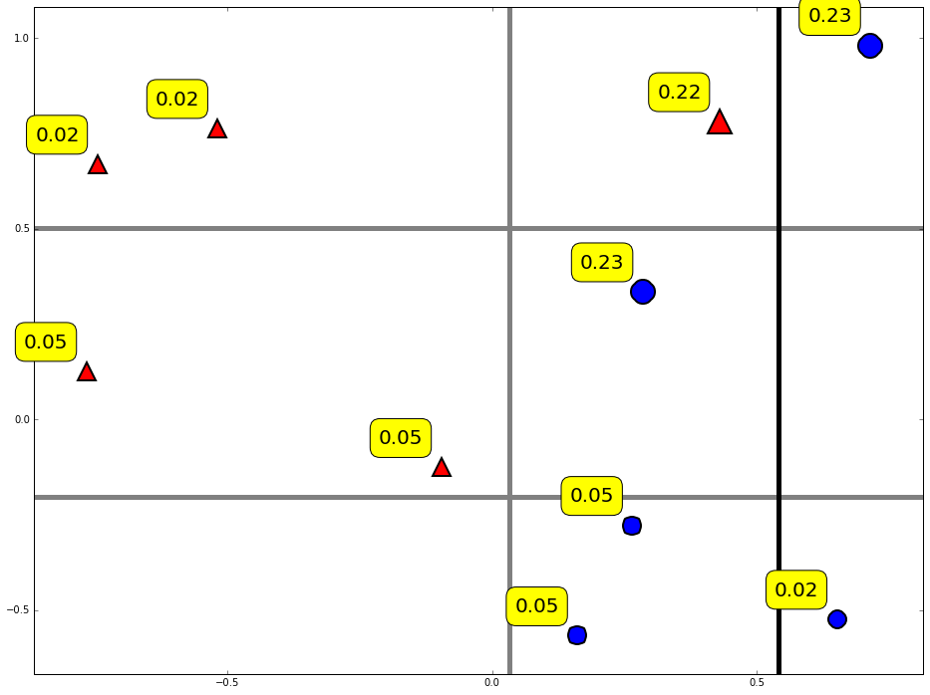
Diversity by re-weighting

Slide 17
Combine weak classifiers into strong classifier
Final decision:
Weight of weak classifier

Slide 18
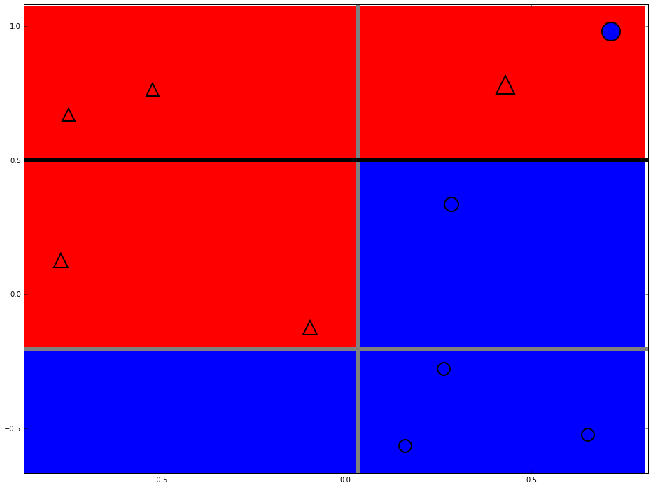
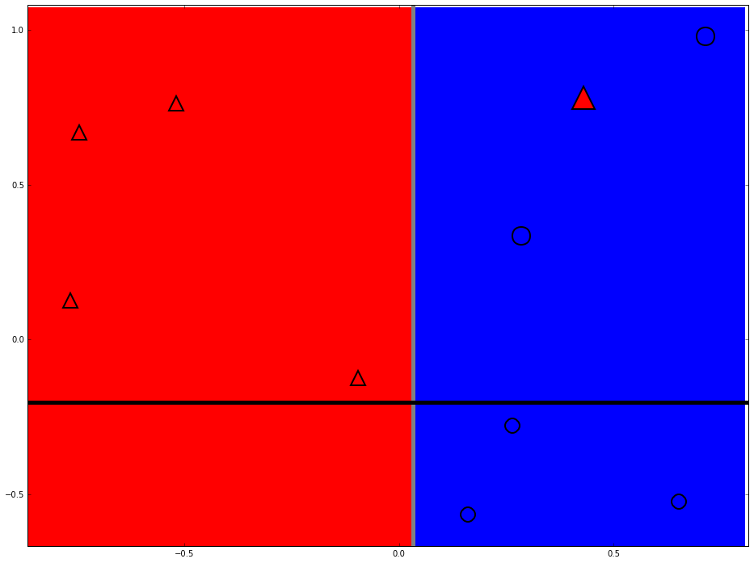
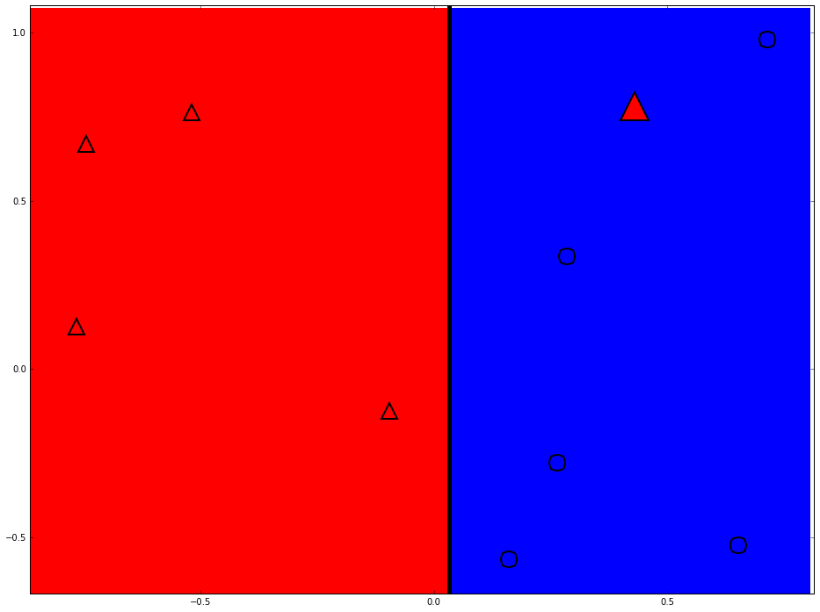
Strong classifier

Slide 19
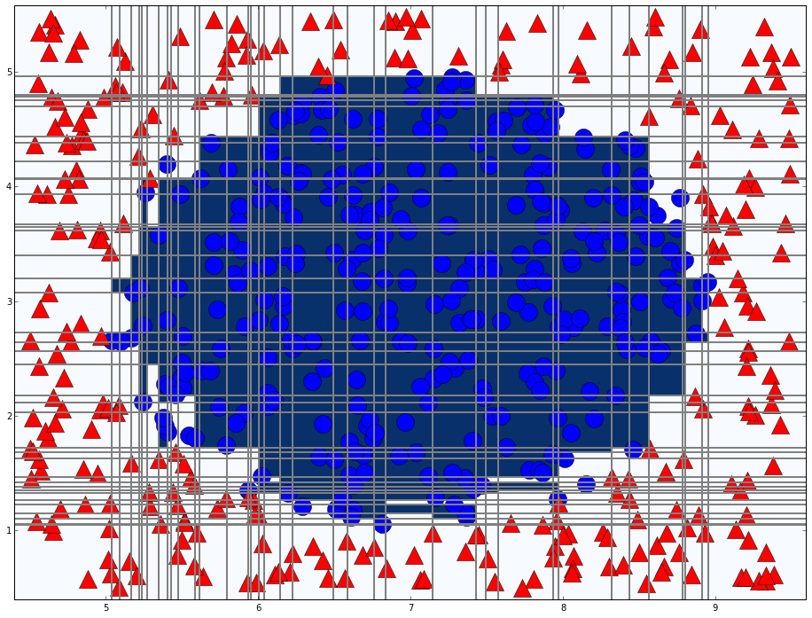
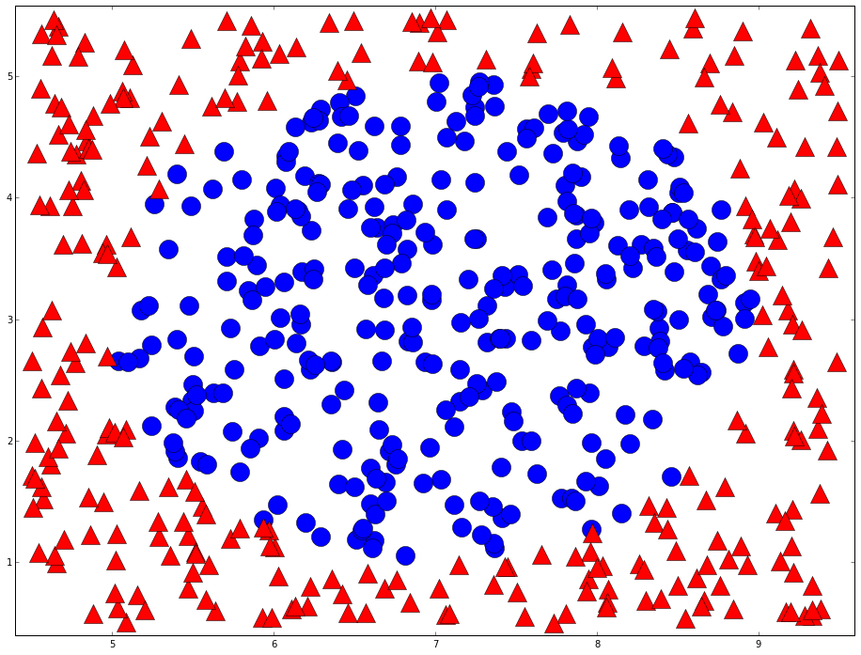
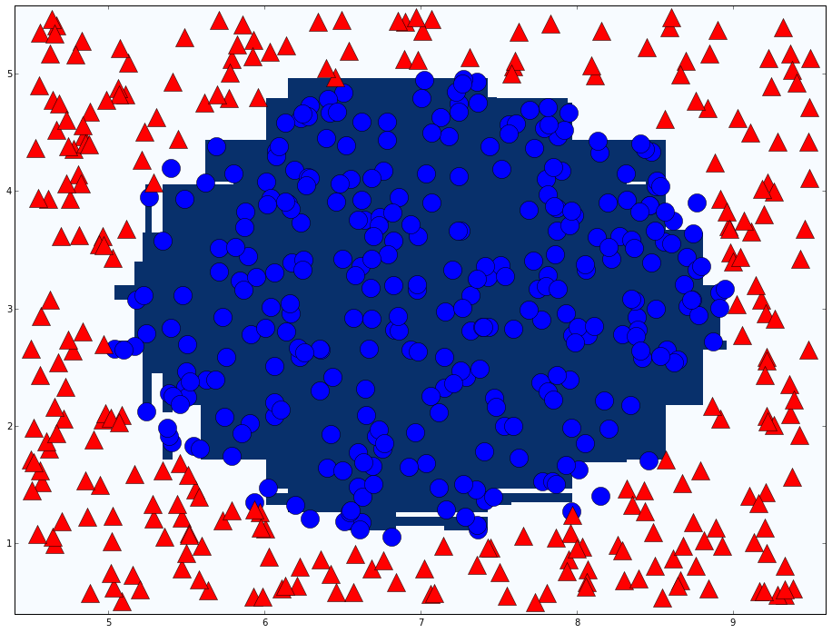
Adaboost in action
T=76

Slide 20
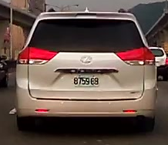
Weak classifier of vehicle detection
Haar like feature
Different types
Classifier number (Type X Position X Size) ≈ 160000

Slide 21
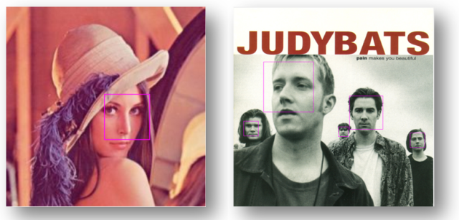
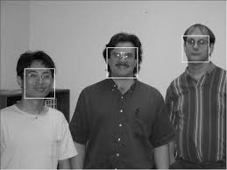
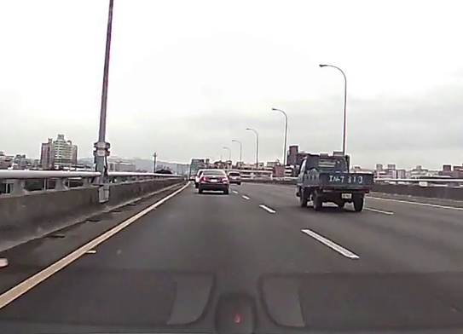
Cascade classifier
Robust Real-Time Face Detection
PAUL VIOLA / MICHAEL J. JONE

Slide 22
Cascade classifier
Remove false cases fast
…
Input
Output
Stage 0
Stage 1
Stage 2
Stage N-1
Stage N
False
False
False
False
False

Slide 23
Conclusion
Two heads are better than one
The diversity of weak classifier

Slide 24
Thanks

Slide 25
The features of a car
Rectangle shape
Symmetry
Entropy
Contrast

Slide 26
Computer vision
How does an object look like to computers?
32 | 30 | 30 | 30 | 30 | 30 | 30 | 30 | 32 | 30 | 30 | 30 | 30
34 | 31 | 31 | 31 | 31 | 31 | 31 | 31 | 34 | 31 | 31 | 31 | 31
32 | 32 | 32 | 34 | 32 | 36 | 32 | 32 | 32 | 32 | 32 | 32 | 32
33 | 34 | 32 | 36 | 34 | 55 | 34 | 34 | 34 | 34 | 34 | 34 | 34
34 | 36 | 34 | 36 | 36 | 78 | 36 | 36 | 36 | 36 | 36 | 36 | 36
34 | 36 | 36 | 36 | 36 | 36 | 36 | 36 | 36 | 36 | 36 | 36 | 36
36 | 55 | 55 | 55 | 55 | 55 | 55 | 55 | 36 | 55 | 55 | 55 | 55
70 | 78 | 78 | 78 | 78 | 78 | 78 | 78 | 78 | 78 | 78 | 78 | 78
155 | 154 | 153 | 152 | 151 | 150 | 149 | 148 | 147 | 146 | 145 | 144 | 143
155 | 143 | 153 | 153 | 151 | 152 | 149 | 147 | 148 | 143 | 143 | 147 | 143
155 | 143 | 148 | 153 | 151 | 152 | 152 | 147 | 148 | 143 | 143 | 143 | 143
143 | 144 | 148 | 153 | 151 | 152 | 152 | 148 | 147 | 146 | 145 | 143 | 143
143 | 155 | 153 | 152 | 151 | 152 | 149 | 148 | 147 | 146 | 146 | 146 | 144
155 | 155 | 153 | 152 | 151 | 150 | 149 | 148 | 147 | 146 | 146 | 144 | 144
155 | 154 | 153 | 152 | 151 | 150 | 149 | 148 | 146 | 146 | 145 | 144 | 143
155 | 154 | 153 | 152 | 151 | 150 | 145 | 149 | 146 | 146 | 145 | 144 | 143
155 | 154 | 153 | 152 | 151 | 150 | 145 | 149 | 146 | 146 | 145 | 144 | 143
Computer sees…
Notes:
Computer vision is difficult

