Slide 1
Introduce to Vehicle Detection and Adaboost Algorithm Leon 07-14-2015

Slide 2
Binary classification problems
Is it a car? { yes, no }
Will stock market go up or down? { up, down }
Will you sleep well or bad tonight? { good, bad }
Data: X
age | 30
gender | male
weight | 70 kg
sleep hours | 7 hours
exercise times | 30 minutes
Result: Y
good

Slide 3
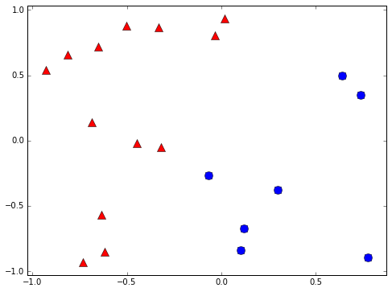
Binary classifier example
+1
-1

Slide 4
Learning Flow
Find the hypothesis with best performance
Data
Learning algorithm
g

Slide 5

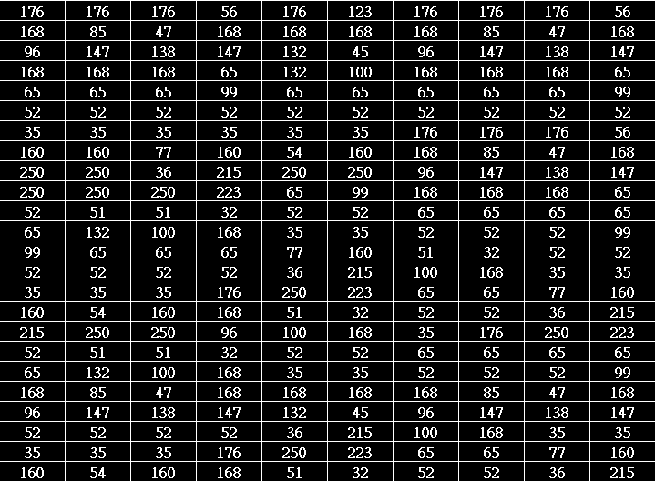
How does an object look like to computers?
Rectangle shape
Symmetry
Entropy
Contrast
Computer sees…

Slide 6
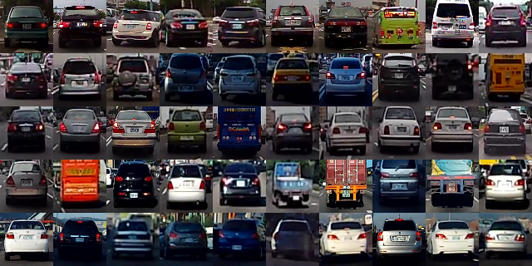
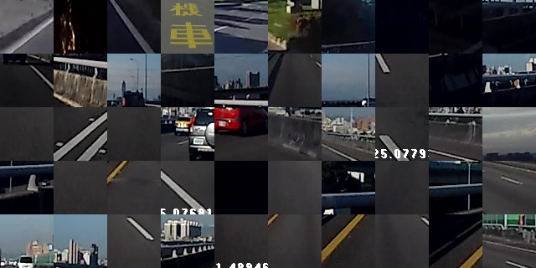
Learn from label data(supervised)
Cars
Background

Slide 7
Classifier Accuracy
Performance is slightly better than random guessing
Strong classifier
Weak classifier
Error rate
0
1/2
1
?

Slide 8
Decision stump
Classify by one attribute of data
If sleep hours >= 7 hours ➔ +1 else -1
If exercise time >= 1 hour ➔ +1 else -1
Often a weak classifier
Sleep hours | 7 hours
Exercise time | 30 minutes

Slide 9
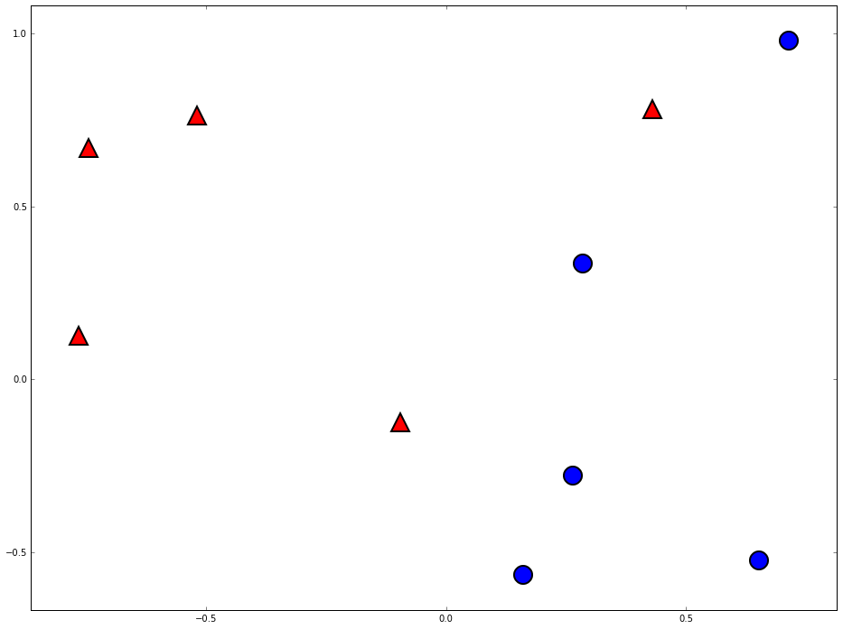
Decision stump are vertical/horizontal lines
-1
+1

Slide 10
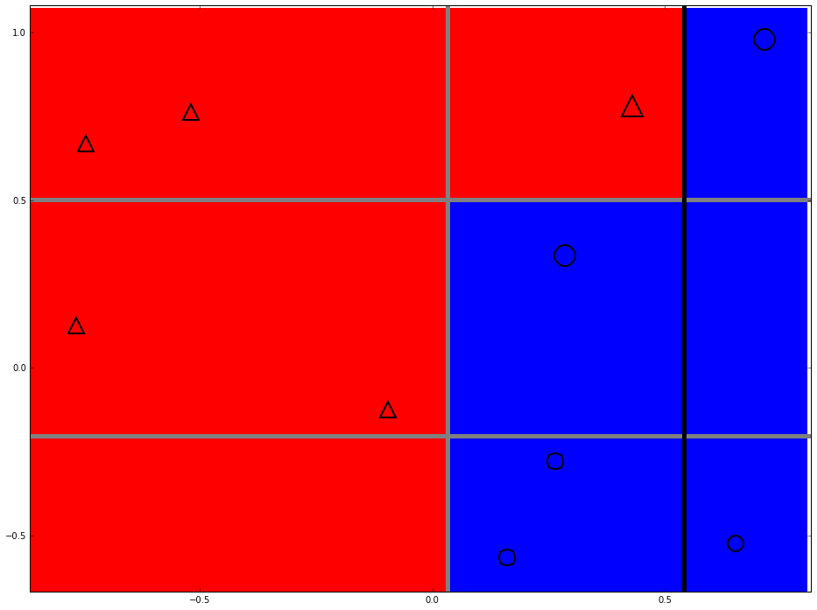
Can we do better?

Slide 11
Two heads are better than one

Slide 12
Space of data
Error of g1
Error of G(x)
Error of g2
Error of g3

Slide 13
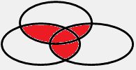
The diversity is important

Slide 14
How to pick the diverse classifiers
T=1
Data
Learning algorithm
Update data weights
T=2
Data
Learning algorithm
Update data weights
T=3
Data
Learning algorithm
T=N

Slide 15
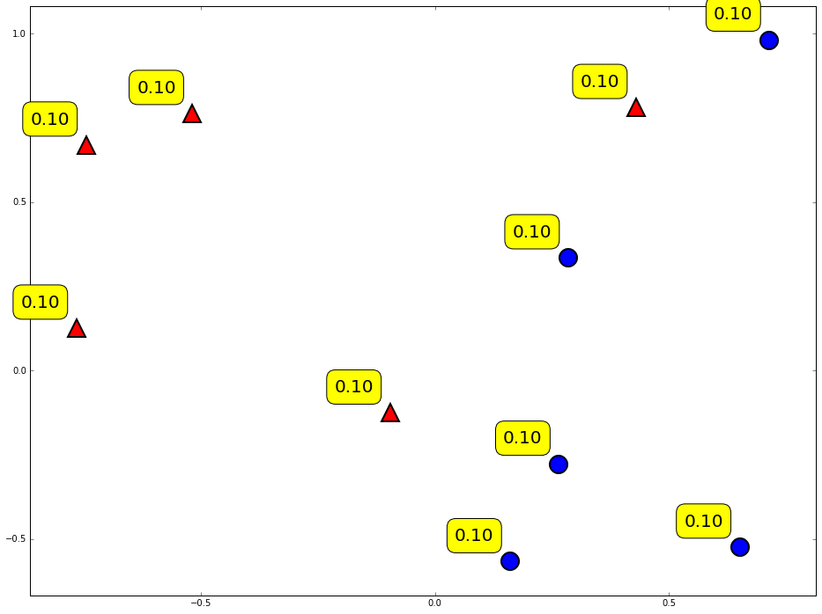
Weighting of data

Slide 16
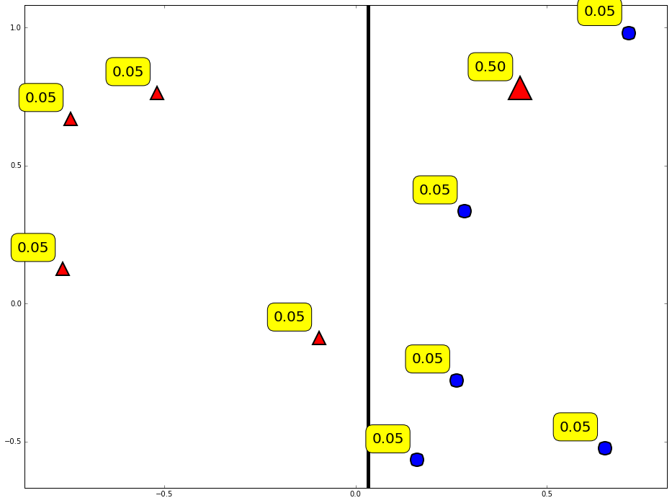
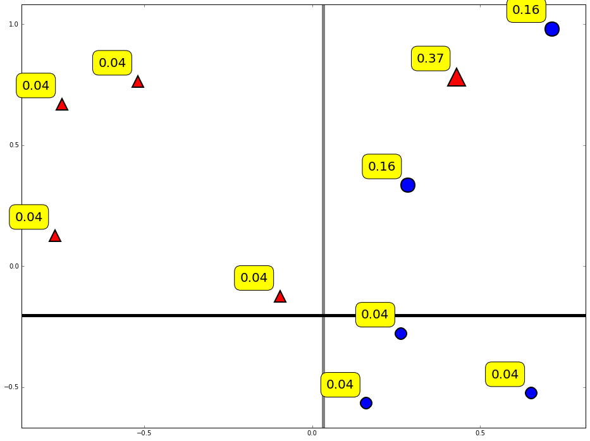
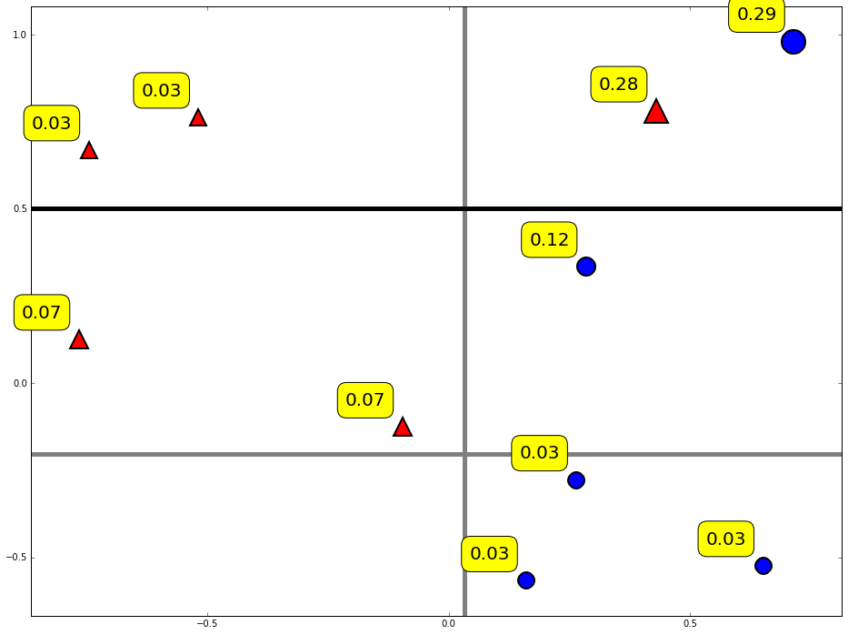
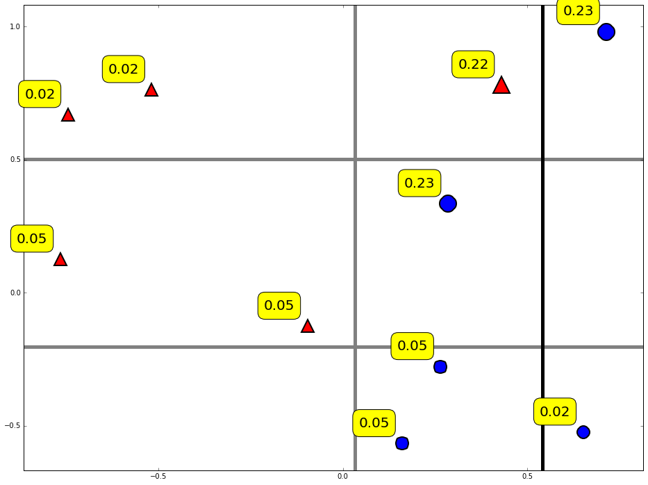
Diversity by re-weighting

Slide 17
Combine weak classifiers into strong classifier
Final decision:
Weight of weak classifier

Slide 18
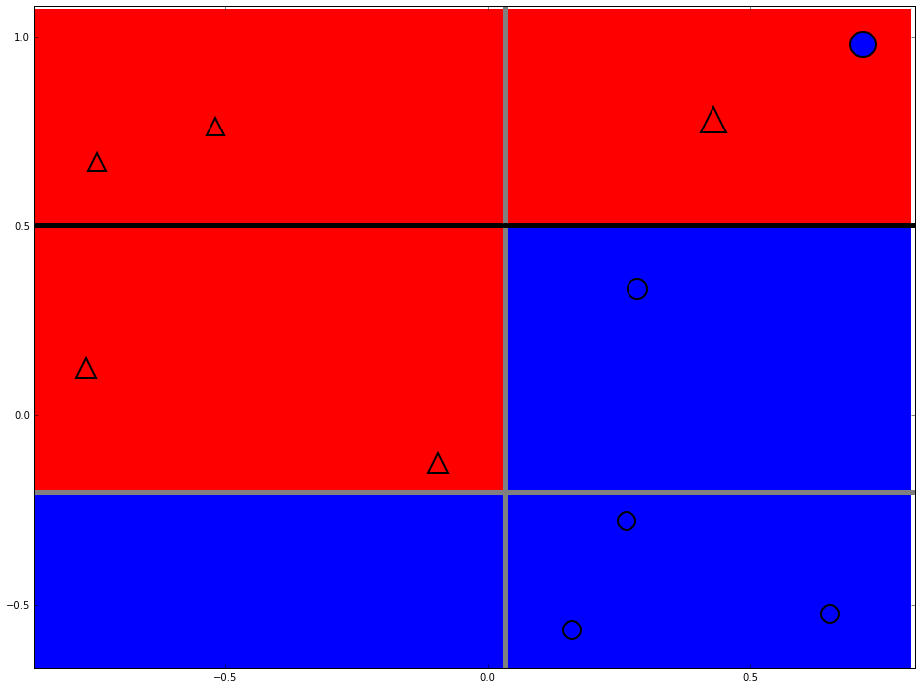
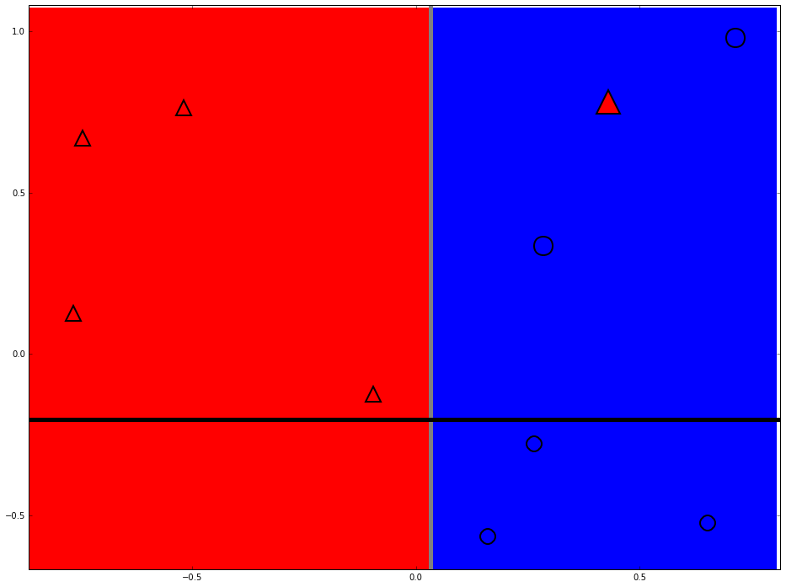
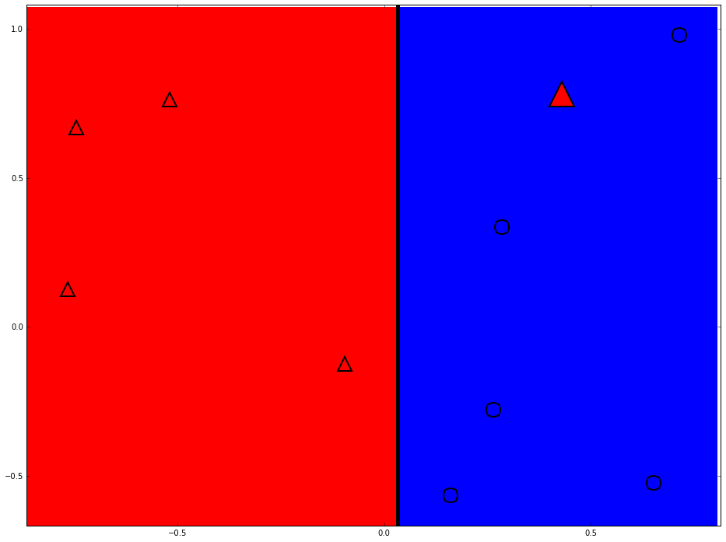
Strong classifier

Slide 19
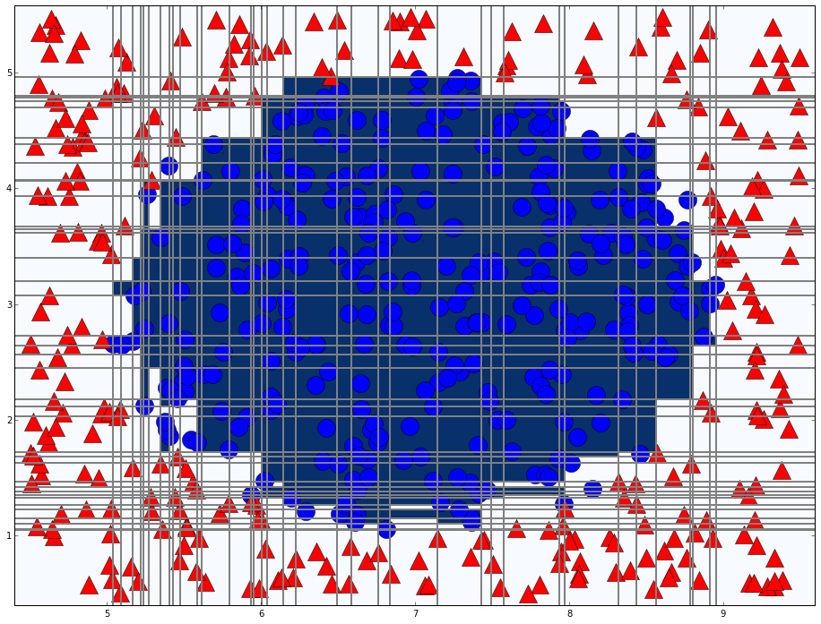
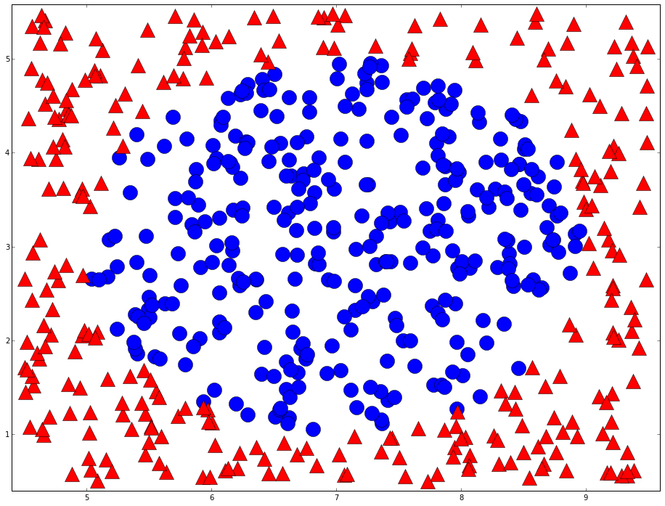
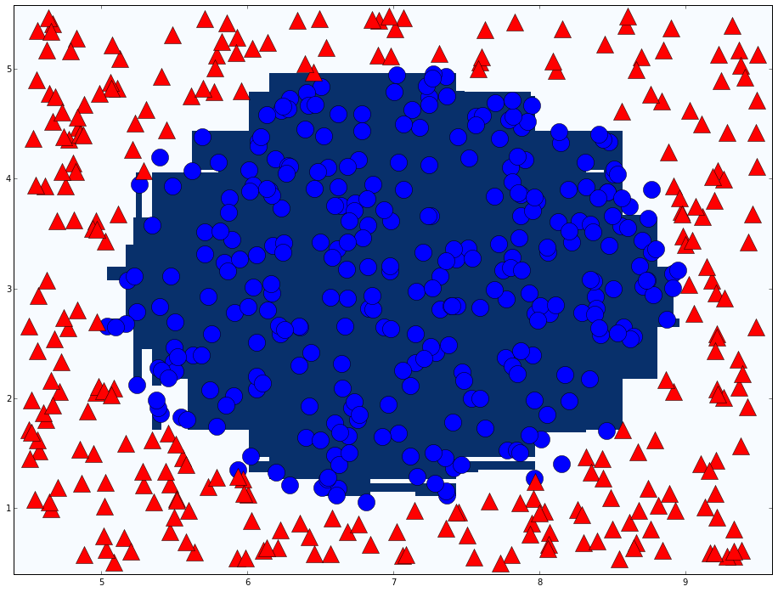
Adaboost in action
T=76

Slide 20
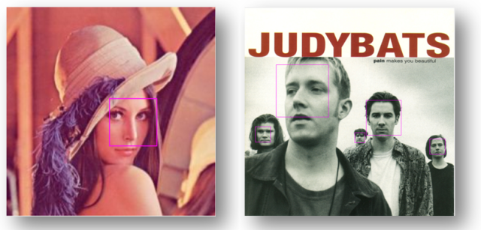
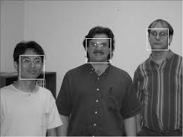
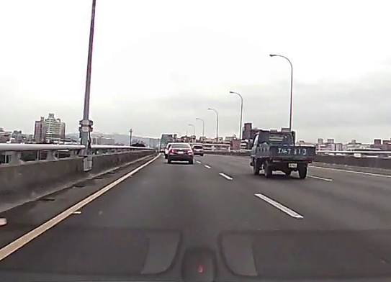
Cascade classifier
Robust Real-Time Face Detection
PAUL VIOLA / MICHAEL J. JONES, 2001

Slide 21

Weak classifier of vehicle detection
Haar like feature
Different types
Classifier number (Type X Position X Scale) ≈ 160000

Slide 22
Cascade classifier
Remove false cases fast
…
Input
Output
Stage 0
Stage 1
Stage 2
Stage N-1
Stage N
False
False
False
False
False

Slide 23
Conclusion
Two heads are better than one
The diversity of weak classifier

Slide 24
Thanks

