Slide 1
Introduce to Adaboost Algorithm and Vehicle Detection
Leon 07-28-2015

Slide 2
Agenda
A toy example
Adaboost
Vehicle detection

Slide 3
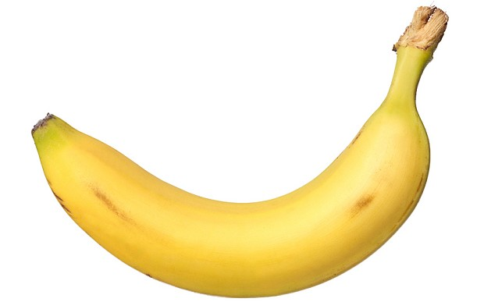
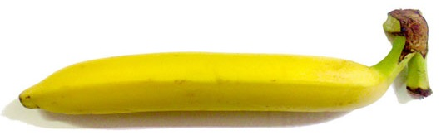
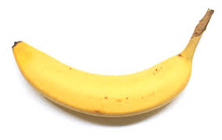
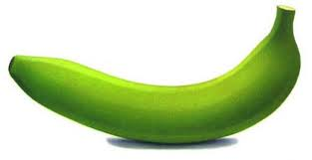
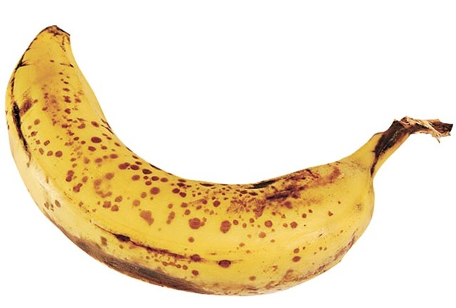
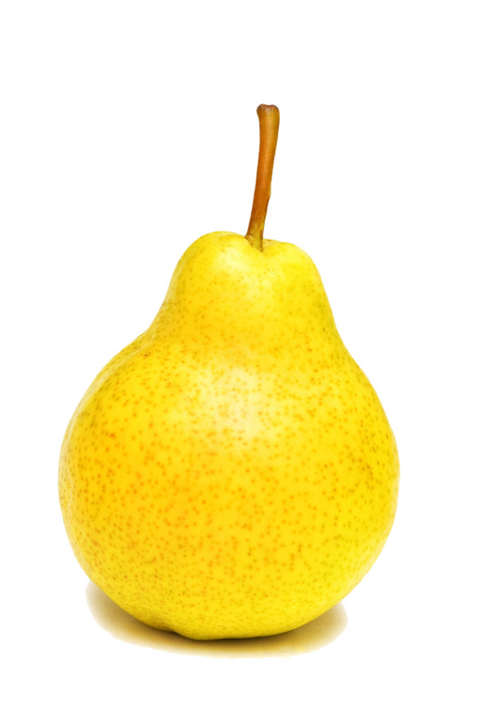
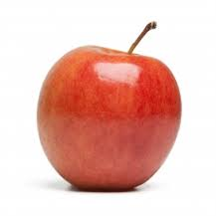
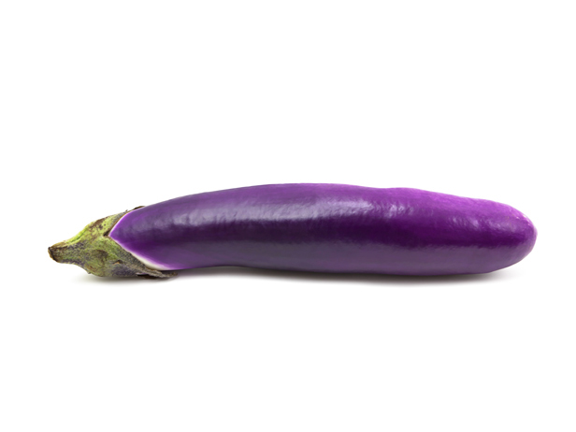
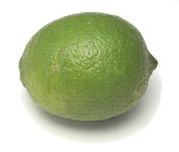
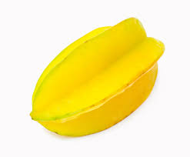
A Banana Classifier
Is this a picture of a banana?
Want to find some rules to describe a banana
Bananas
Non-bananas

Slide 4
A Banana Classifier
Rule 1: Bananas are yellow
Bananas
Non-bananas

Slide 5
A Banana Classifier
Rule 2: Bananas can be green
Bananas
Non-bananas

Slide 6
A Banana Classifier
Rule 3: Bananas are elongated
Bananas
Non-bananas

Slide 7
A Banana Classifier
Rule 4: Bananas have brown spots
Bananas
Non-bananas

Slide 8

A Banana Classifier
Banana Classifier
Rule 1: Yellow111
Rule 2: Green111
?
Rule 3: Elongated
Rule 4: Spots111

Slide 9
Summary of the example
Example
Adaboost
The simple rules
Weak classifiers
Kid learned from pictures
Weak classifier learner
Change the size of pictures
Re-weight data
Final Banana classifier
Strong classifier

Slide 10
Agenda
A toy example
Adaboost
Binary classification problems
Weak classifier learner
Weak classifiers
Re-weight data
Strong classifier
Vehicle detection

Slide 11
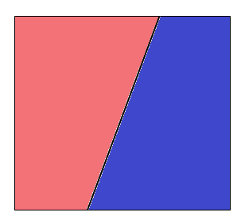
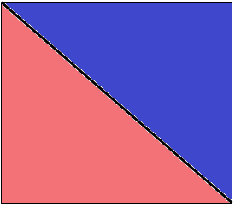
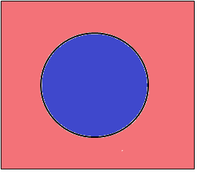
Binary classification problems
A banana? { yes, no }
Stock market ? { up, down }
Email? { spam, non-spam }
Sleep quality? { good, bad }
Binary classifier in 2D

Slide 12






Weak classifier learner
A base algorithm
Able to learn from weighted data
Decision stump
Classify by one feature of data
Data X = { x1, x2, x3, …, xd }
x2
feature $i$
threshold$θ$
direction $s$
$$s$$
x1
$$θ$$

Slide 13
Decision stump example
Sleep quality classifier
Data X ( sleep hours, turning in bed )
Output Y( good , bad )
If sleep hours >= 7 hours
return good
else
return bad
If turning in bed >= 20
return bad
else
return good
20
7

Slide 14
Weak classifier
Pros
Simple
Fast
Cons
Not accuracy ( slight better than 50% )
Strong classifier
Weak classifier
Error rate
0
50%
100%

Slide 15
Two heads are better than one
A strong classifier :
Three weak classifiers :
Voting and aggregation
<
g
Error G
Error g
Error h
Error k
G
h
k
Space of data
Space of data

Slide 16
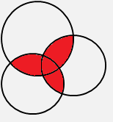
The importance of diversity
A strong classifier :
Three weak classifiers :
Voting and aggregation
<
Error G
g
Error g
Error h
Error k
G
k
h
Space of data
Space of data

Slide 17
How to pick the diverse classifiers
T=1
Weighted Data
Classifier learner
Update data weights
T=2
Weighted Data
Classifier learner
Update data weights
T=3
Weighted Data
Classifier learner
T=N

Slide 18
Re-weight data
Initially data weight = N: number of data
get
define scale factor : error of
incorrect
incorrect
scale factor
correct
correct
scale factor
If then scale factor

Slide 19
Combine weak classifiers into strong classifier
Strong classifier:
Weight of weak classifier

Slide 20
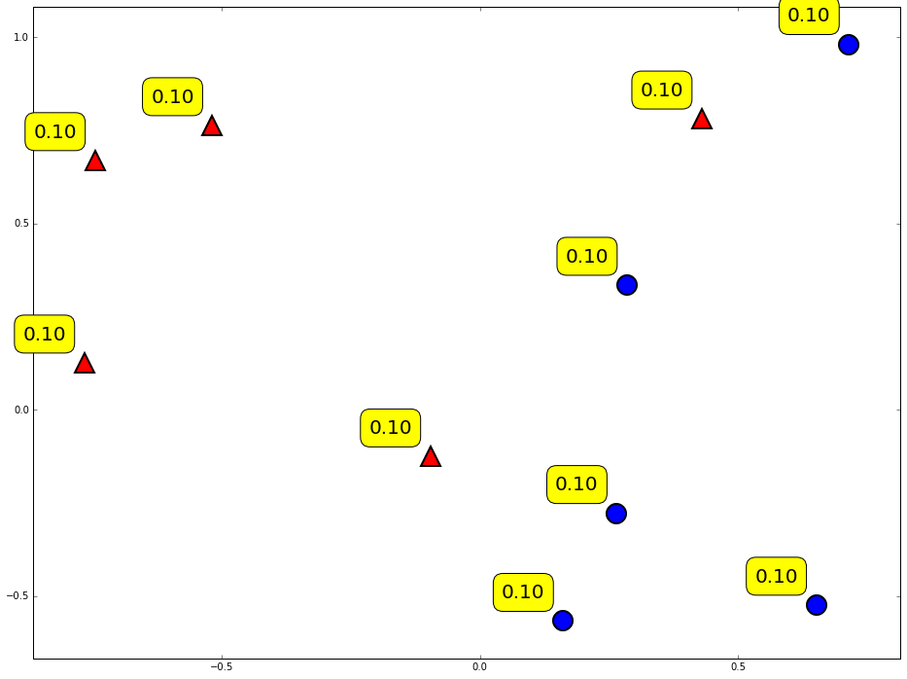
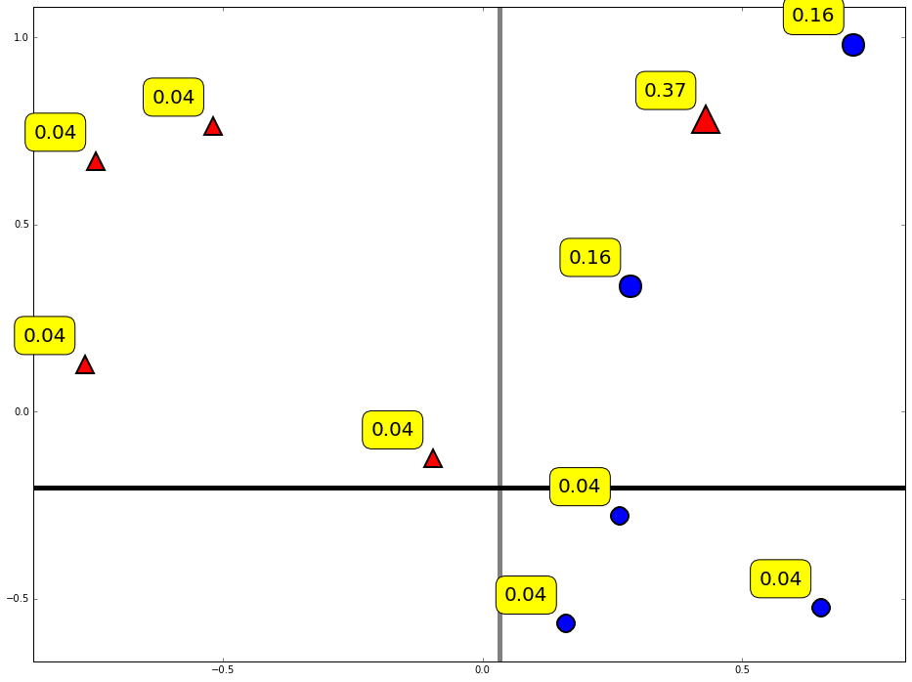
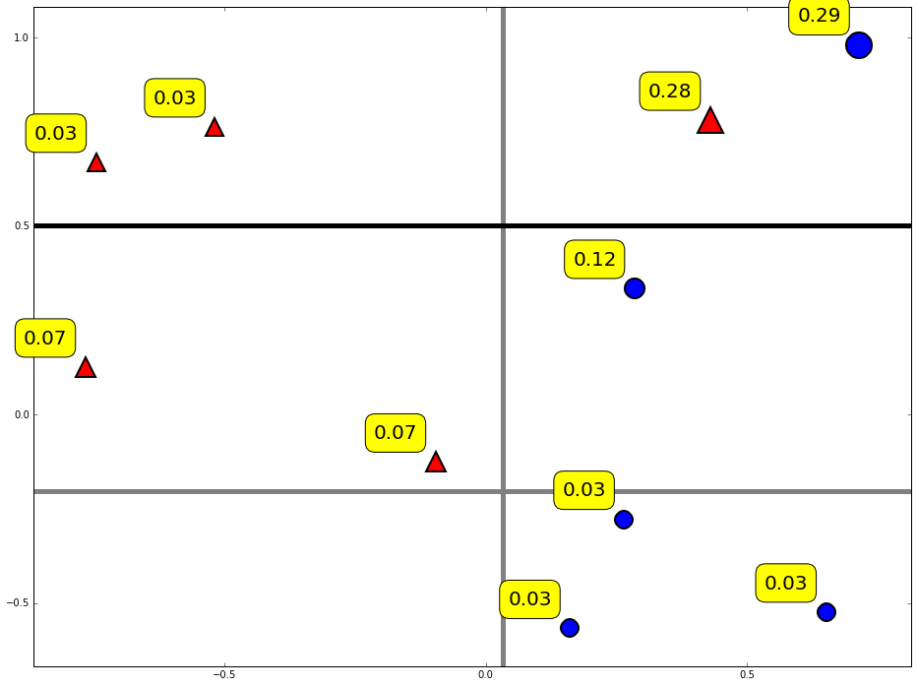
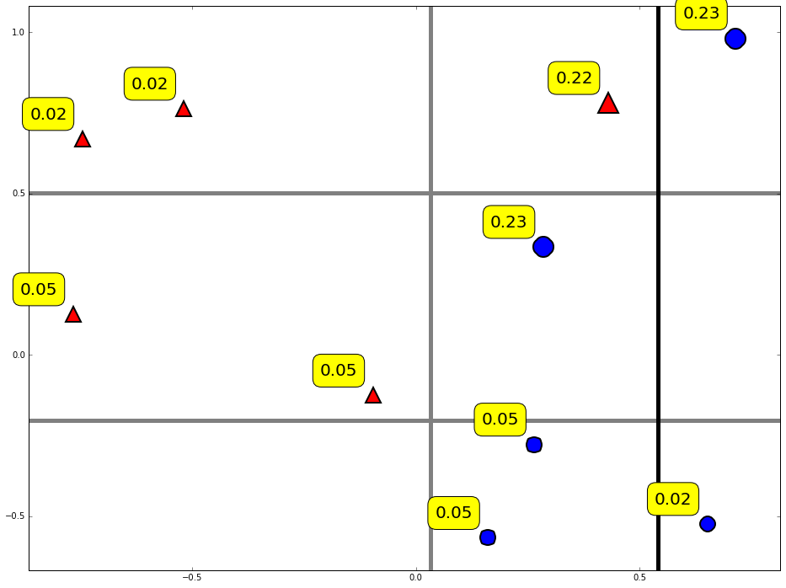
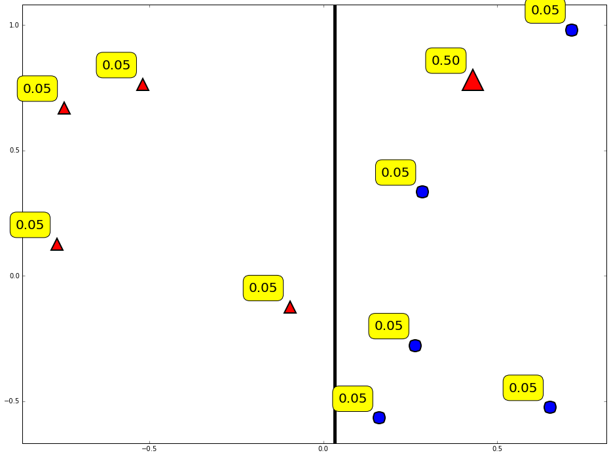
Diversity by re-weighting
Update the weight of data by previous classifier
T = 2
T = 3
T = 4
T = 1
Initially

Slide 21
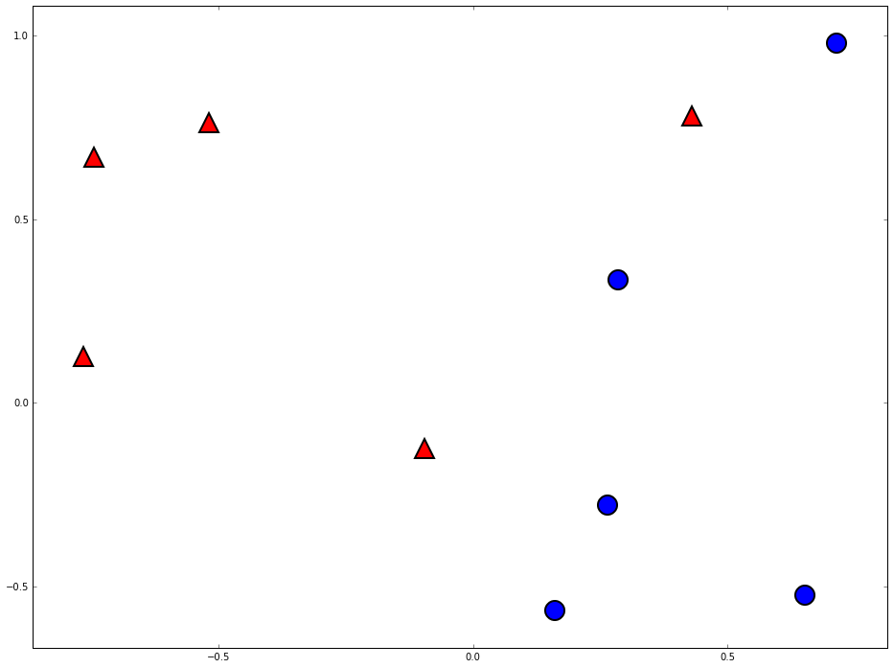
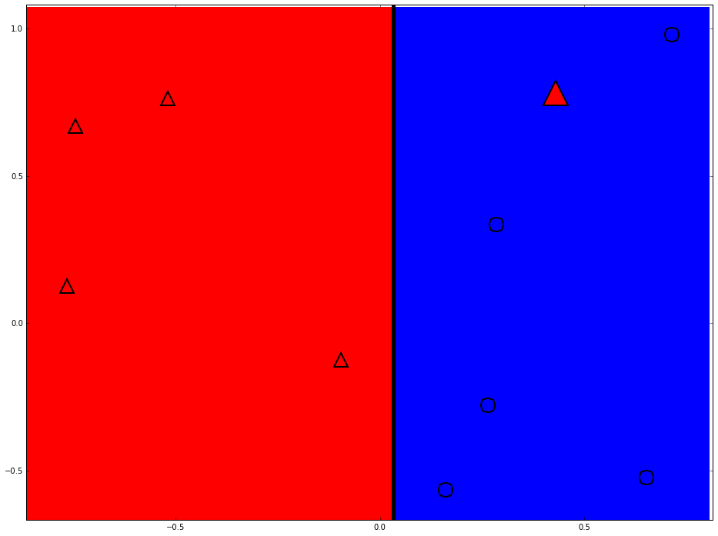
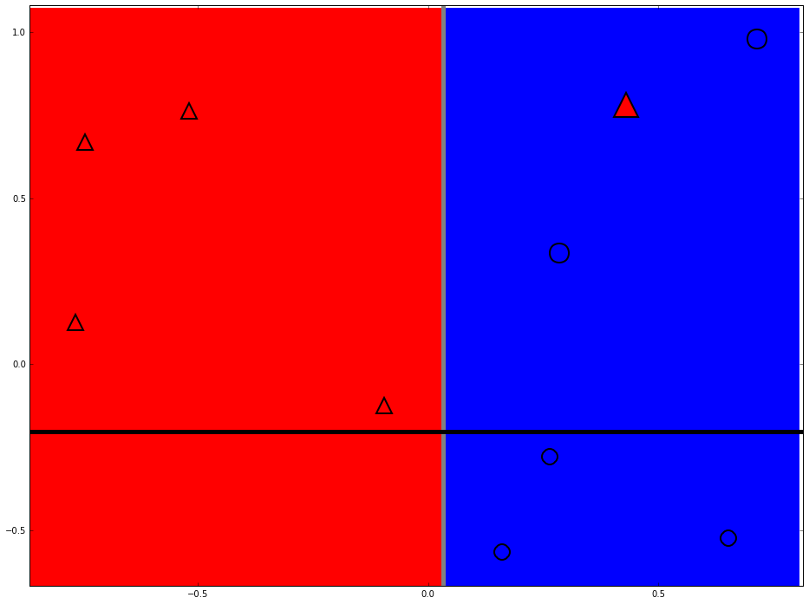
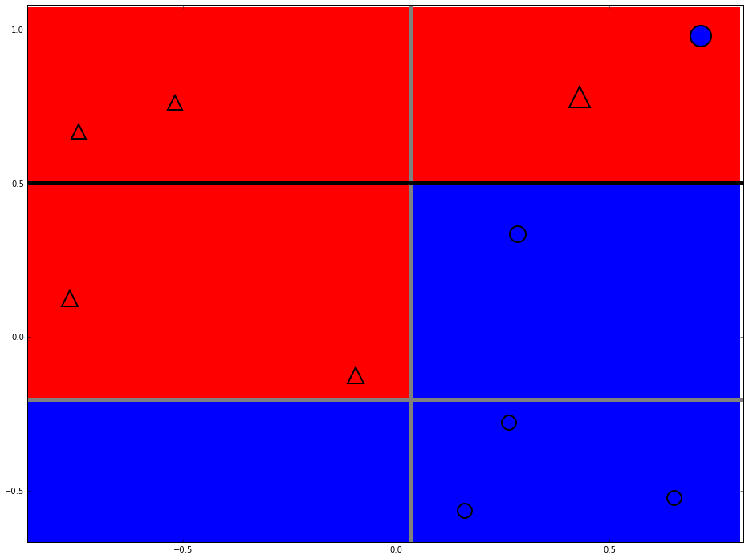
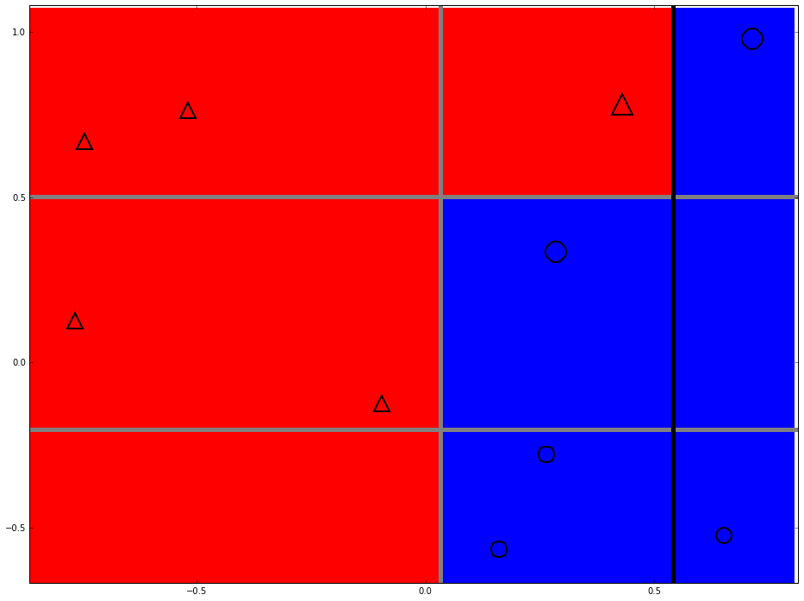
Strong classifier
Build complex boundary by horizontal and vertical lines
T = 2
T = 3
T = 4
T = 1

Slide 22
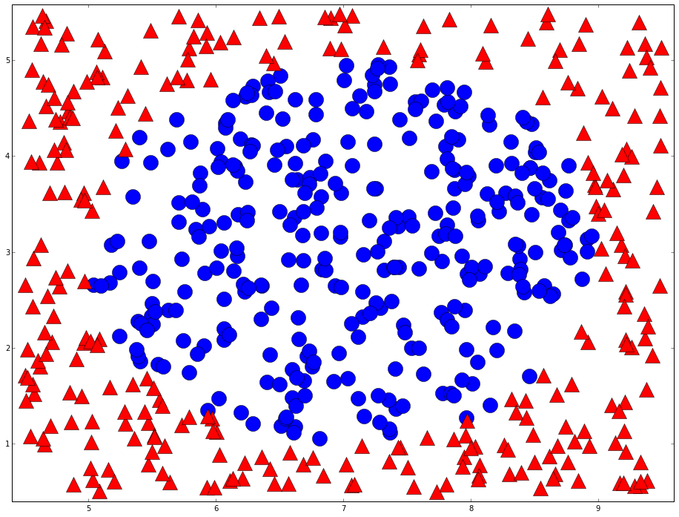
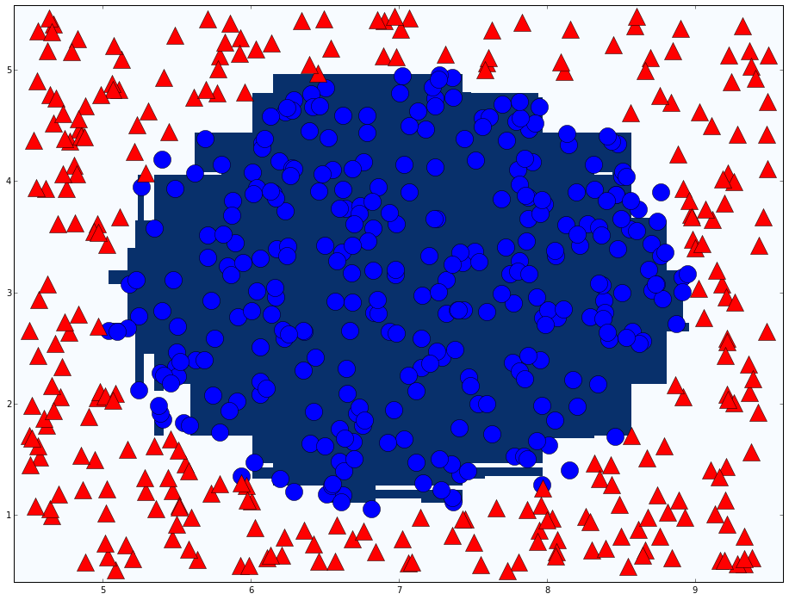
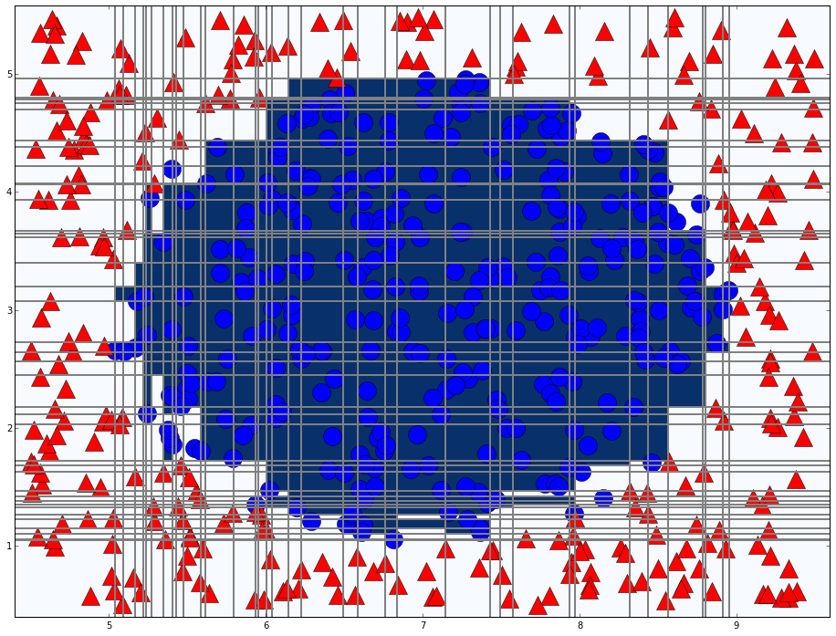
Adaboost in action
A more complicated example
T = 76

Slide 23
Agenda
A toy example
Adaboost
Vehicle detection

Slide 24
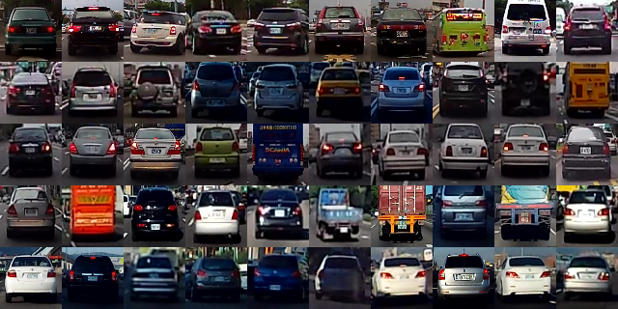
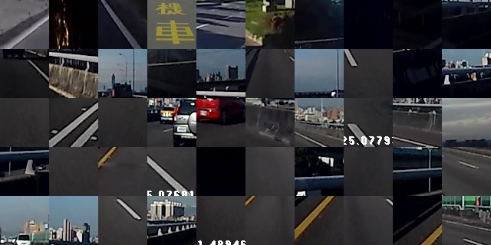
Learn from label data(supervised)
Cars
Background

Slide 25
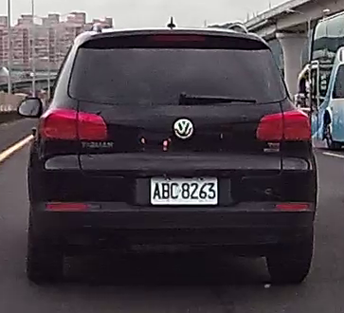
Vehicle detection
What features can we use to detect vehicle?
Rectangle shape
Symmetry
Entropy
Contrast

Slide 26
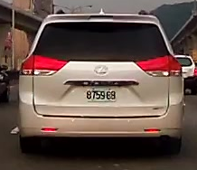
Haar-like feature
Difference of the sum of pixels of areas
Combination of different types, positions, and sizes
Types
(x, y, W, H)
Robust Real-Time Face Detection, 2001, Viola and Jones

Slide 27
Conclusion
Two heads are better than one
Re-weight data for the diversity of classifier

Slide 28
Thanks

Slide 29
Cascade classifier
1~2% target patches
Remove false cases fast
…
Input
Output
Stage 0
Stage 1
Stage 2
Stage N-1
Stage N
False
False
False
False
False
Stage 0

