Slide 1
Introduce to Adaboost Algorithm and Vehicle Detection
Leon 07-28-2015

Slide 2
Agenda
A toy example
Adaboost
Vehicle detection

Slide 3
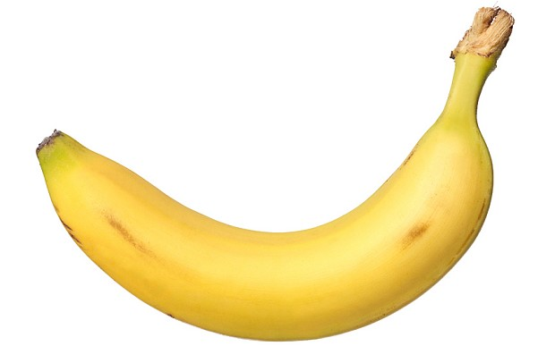
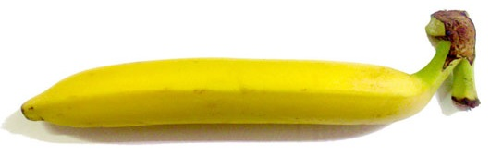
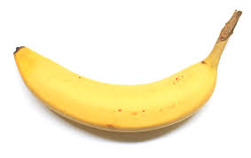
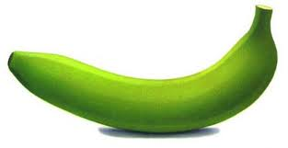
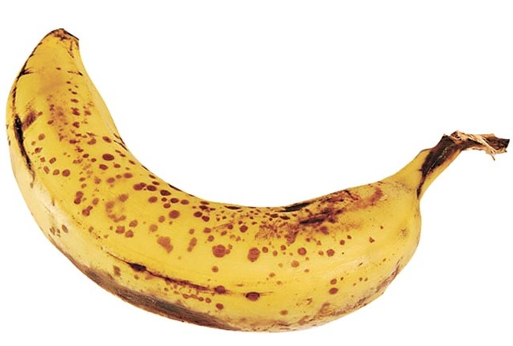
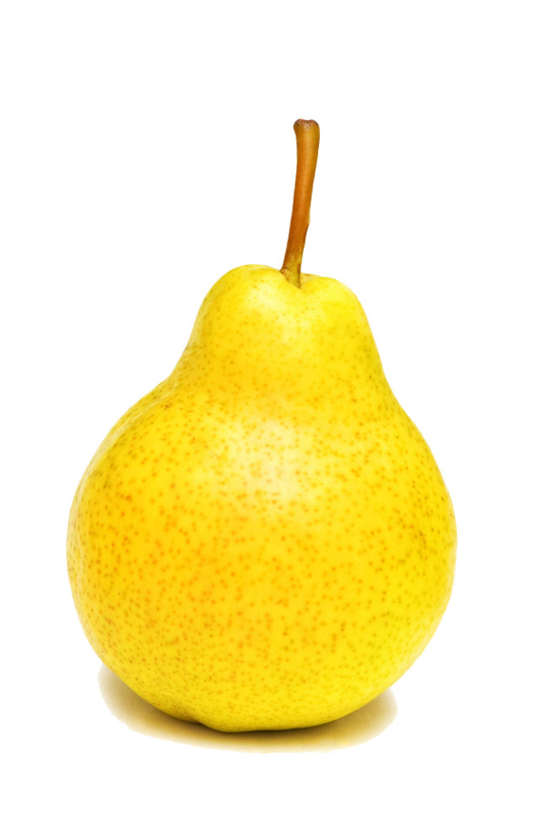
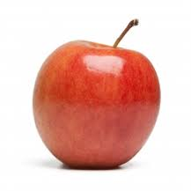
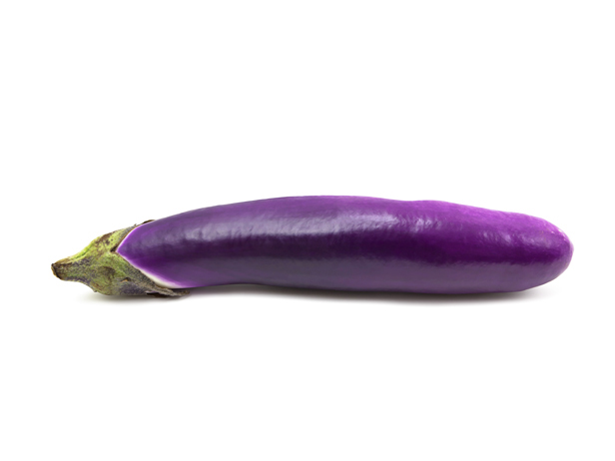
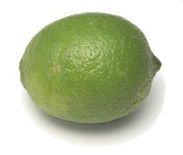
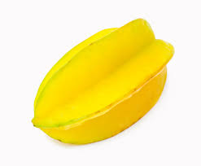
A Banana Classifier
Is this a picture of a banana?
Want to find some rules to describe a banana
Bananas
Non-bananas

Slide 4
A Banana Classifier
Rule 1: Bananas are yellow
Bananas
Non-bananas

Slide 5
A Banana Classifier
Rule 2: Bananas can be green
Bananas
Non-bananas

Slide 6
A Banana Classifier
Rule 3: Bananas are elongated
Bananas
Non-bananas

Slide 7
A Banana Classifier
Rule 4: Bananas have brown spots
Bananas
Non-bananas

Slide 8

A Banana Classifier
Banana Classifier
Rule 1: Yellow111
Rule 2: Green111
?
Rule 3: Elongated
Rule 4: Spots111

Slide 9
Summary of the example
Example
Adaboost
The simple rules
Weak classifiers
Kid learned from pictures
Weak classifier learner
Change the size of pictures
Re-weight data
Final Banana classifier
Strong classifier

Slide 10
Agenda
A simple example
Adaboost
Binary classification problems
Weak classifier learner
Weak classifiers
Re-weight data
Strong classifier
Vehicle detection

Slide 11
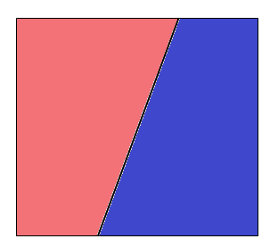
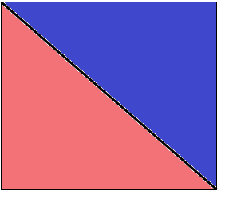
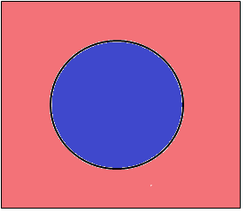
Binary classification problems
A banana? { yes, no }
Stock market ? { up, down }
Email? { spam, non-spam }
Sleep quality? { good, bad }
Binary classifier in 2D

Slide 12






Weak classifier learner
A base algorithm
Able to learn from weighted data
Decision stump
Classify by one feature of data
Data X = { x1, x2, x3, …, xd }
x2
feature $i$
threshold$θ$
direction $s$
$$s$$
x1
$$θ$$

Slide 13
Decision stump example
Sleep quality classifier
Data X ( sleep hours, turning in bed )
Output Y( good , bad )
If sleep hours >= 7 hours
return good
else
return bad
If turning in bed >= 20
return bad
else
return good
20
7

Slide 14
Weak classifier
Pros
Simple
Fast
Cons
Not accuracy ( slight better than 50% )
Strong classifier
Weak classifier
Error rate
0
50%
100%

Slide 15
Two heads are better than one
A strong classifier :
Three weak classifiers :
Voting and aggregation
<
g
Error G
Error g
Error h
Error k
G
h
k
Space of data
Space of data

Slide 16
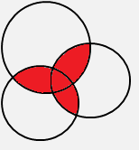
The importance of diversity
A strong classifier :
Three weak classifiers :
Voting and aggregation
<
Error G
g
Error g
Error h
Error k
G
k
h
Space of data
Space of data

Slide 17
How to pick the diverse classifiers
T=1
Weighted Data
Classifier learner
Update data weights
T=2
Weighted Data
Classifier learner
Update data weights
T=3
Weighted Data
Classifier learner
T=N

Slide 18
Re-weight data
Initially data weight = N: number of data
get
define scale factor : error of
incorrect
incorrect
scale factor
correct
correct
scale factor
If then scale factor

Slide 19
Combine weak classifiers into strong classifier
Strong classifier:
Weight of weak classifier

Slide 20
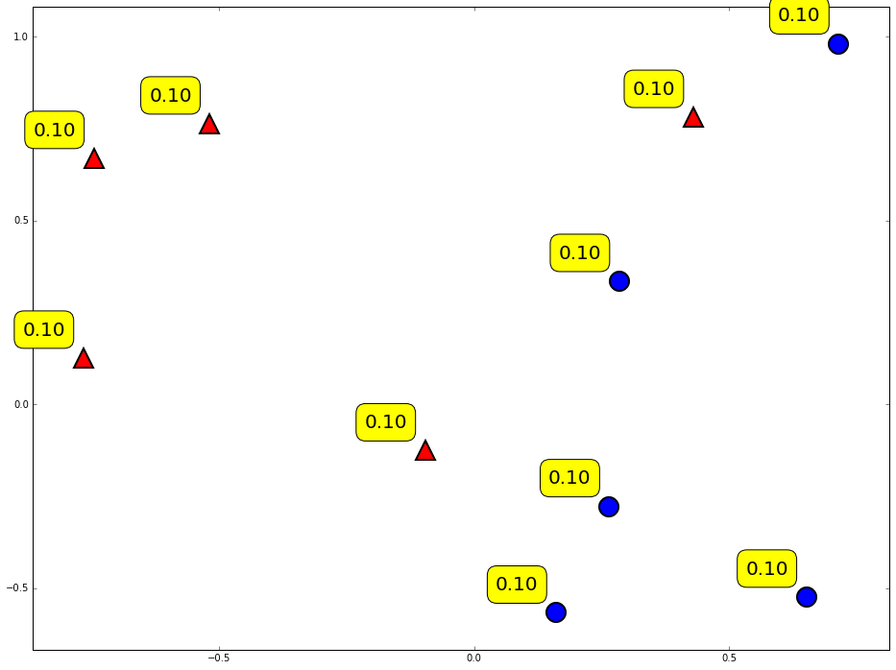
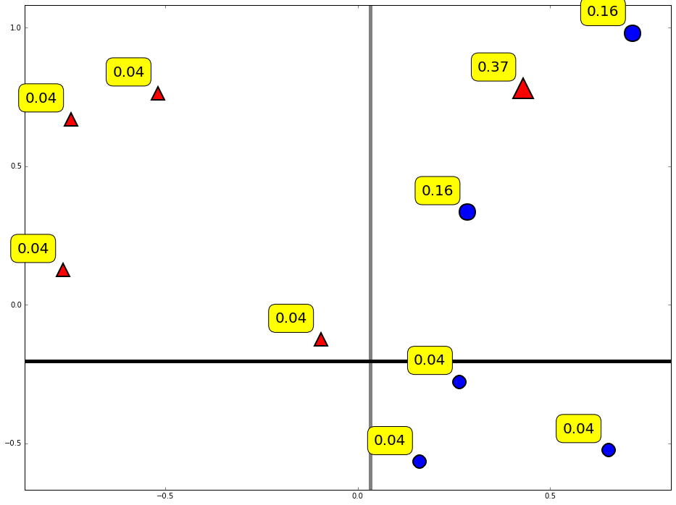
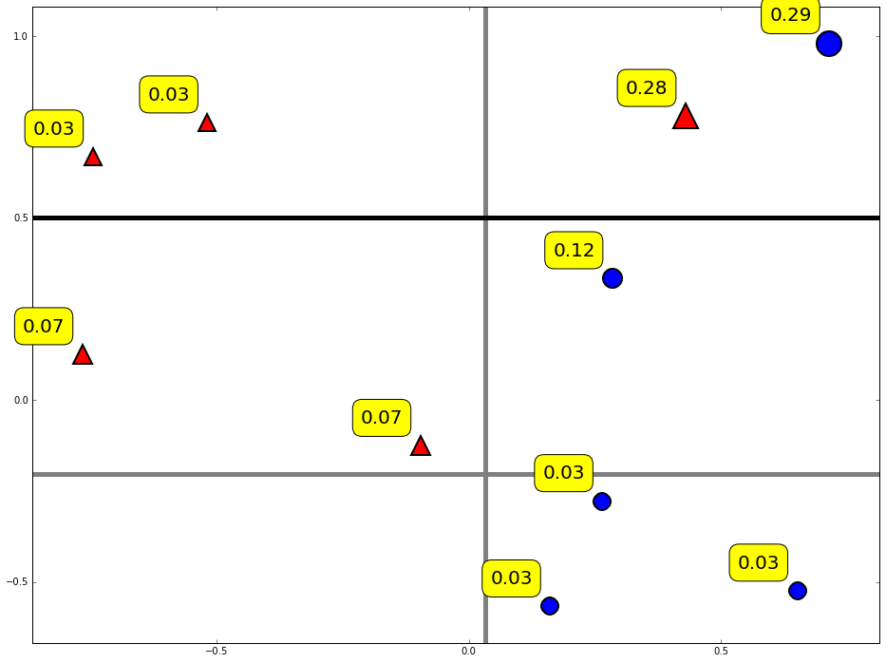
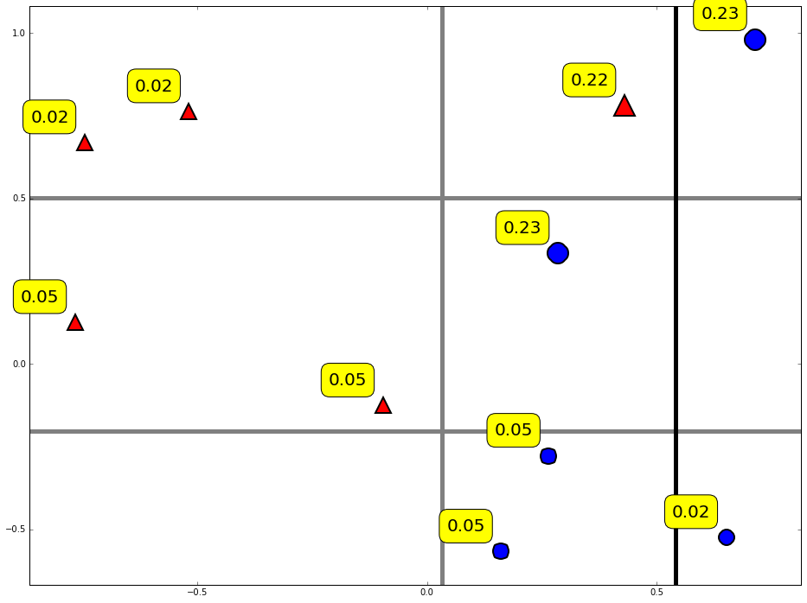
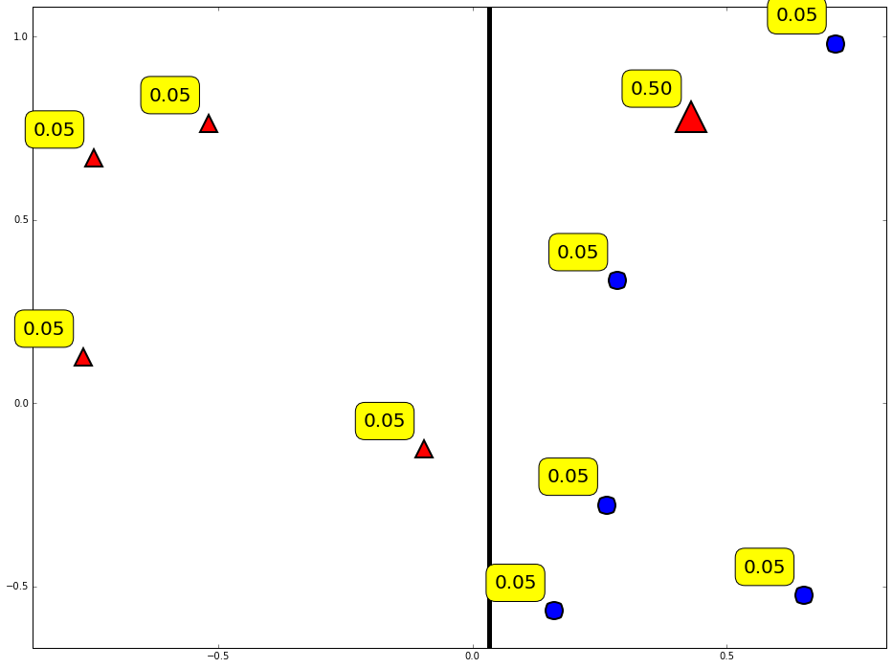
Diversity by re-weighting
Update the weight of data by previous classifier
T = 2
T = 3
T = 4
T = 1
Initially

Slide 21
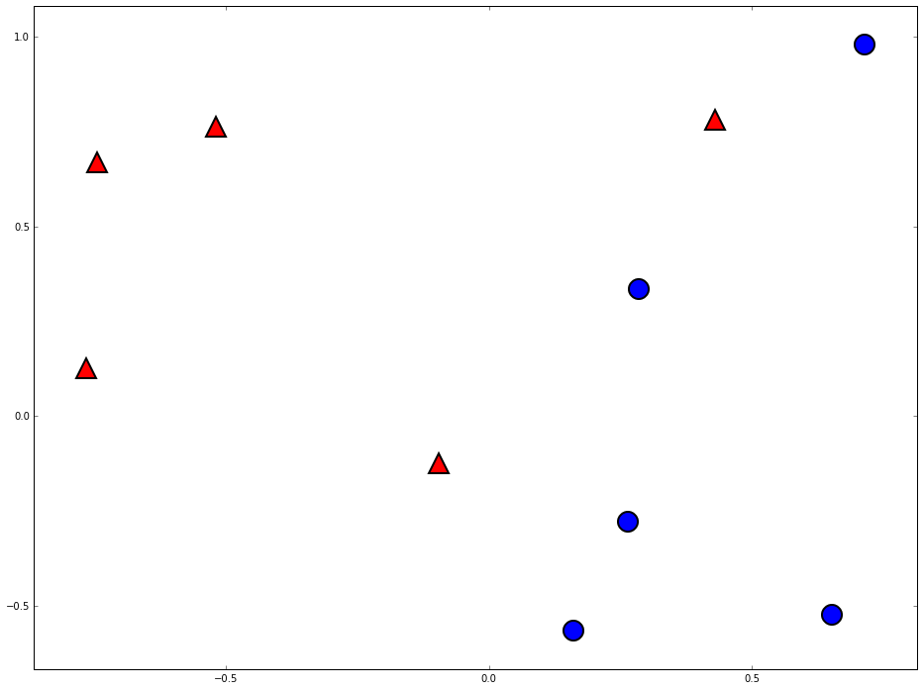
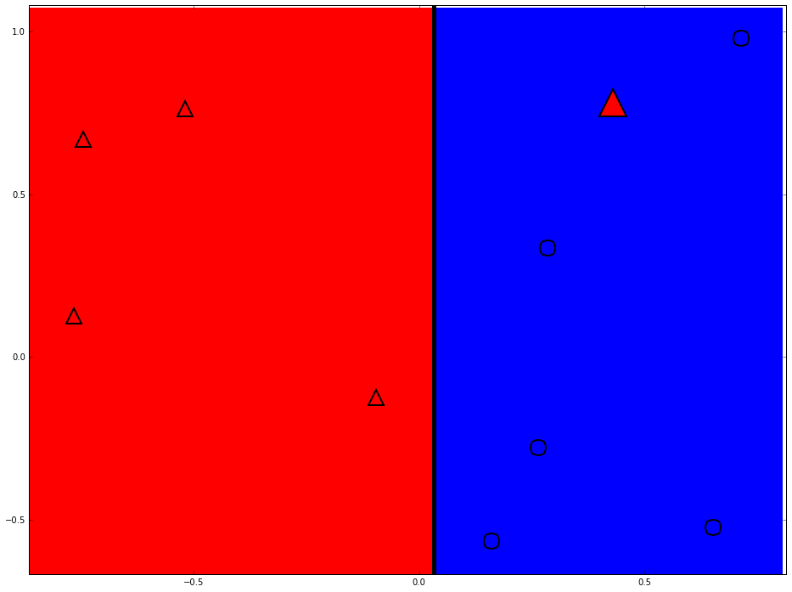
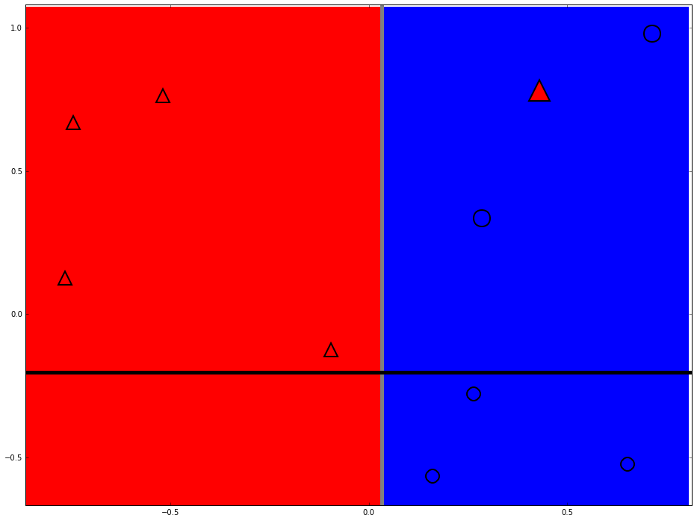
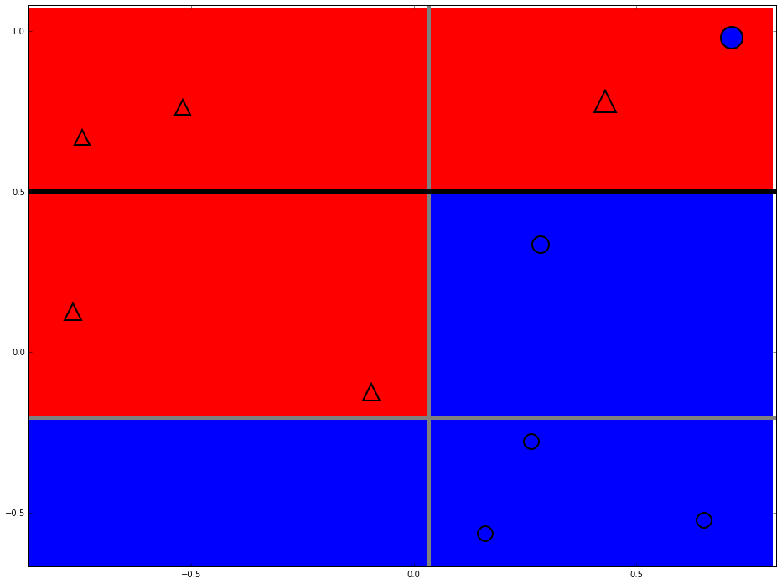
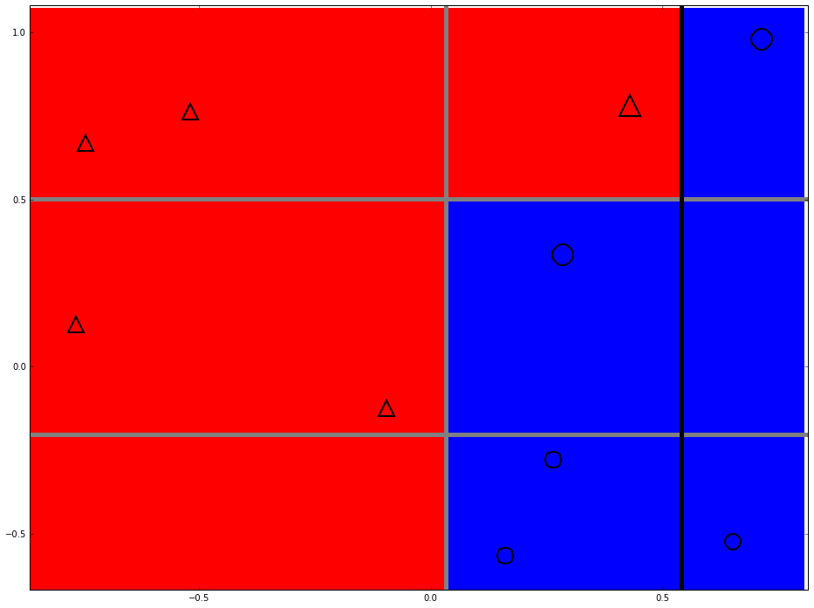
Strong classifier
Build complex boundary by horizontal and vertical lines
T = 2
T = 3
T = 4
T = 1

Slide 22
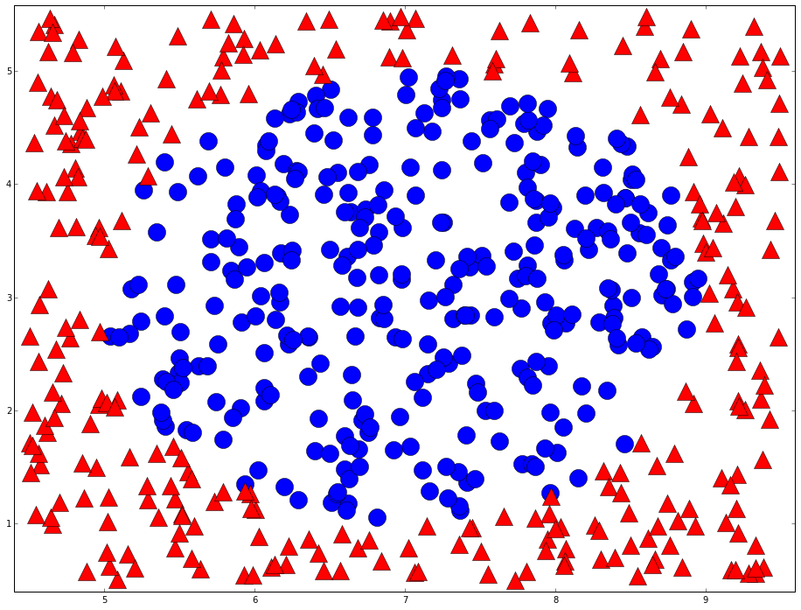
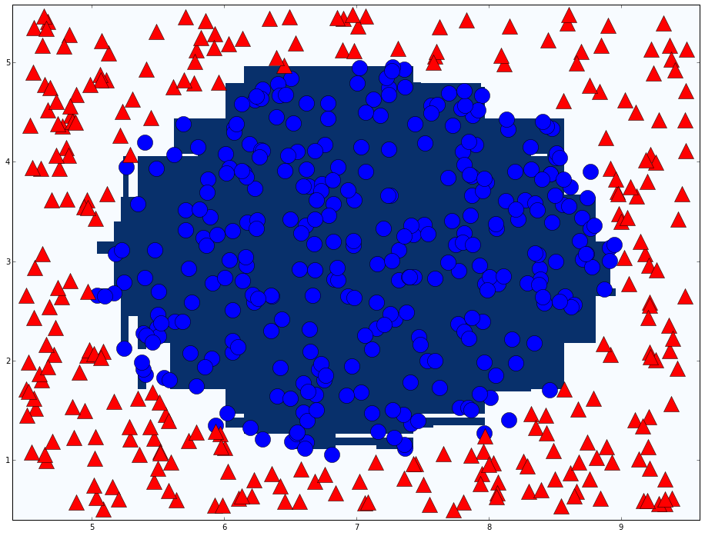
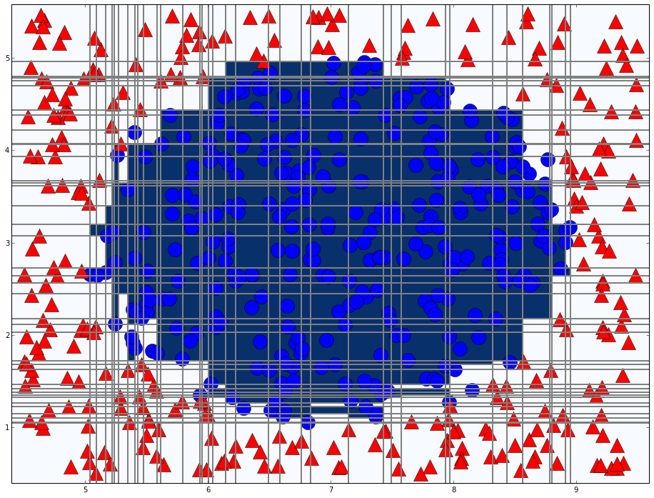
Adaboost in action
A more complicated example
T = 76

Slide 23
Agenda
A simple example
Adaboost
Vehicle detection

Slide 24
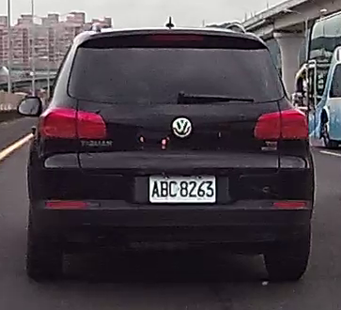
Vehicle detection
What features can we use to detect vehicle?
Rectangle shape
Symmetry
Entropy
Contrast

Slide 25
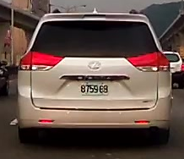
Haar-like feature
Difference of the sum of pixels of areas
Combination of different types, positions, and sizes
Types
(x, y, W, H)
Robust Real-Time Face Detection, 2001, Viola and Jones

Slide 26
Cascade classifier
1~2% target patches
Remove false cases fast
…
Input
Output
Stage 0
Stage 1
Stage 2
Stage N-1
Stage N
False
False
False
False
False
Stage 0

Slide 27
Conclusion
Two heads are better than one
Re-weight data for the diversity of classifier

Slide 28
Thanks

