Slide 1
MOCK INTERNET TRADER
15637 Sprint 2 Presentation
Mengran Wang, Liang Rao
Notes:
Newly add features

Slide 2
BACKGROUND
Mock Internet Trader (MIT) is a game for novices to practice stock investments.
It simulates real-world trading by allowing player to perform stock transactions with virtual currency.

Slide 3
COMPLETED FEATURES
Sprint 1
Sprint 2
Registration
Sign in
Find a Game
Create a Game
Overview of a Game
Join and Leave a Game
Show Stock Index Info
Support player create multiple games and join different games
Search for a specific stock
Display real-time stock quotes
Buy stock / Sell short functionality
Display player’s portfolio
List player’s transaction histories
Notes:
Sprint 1, set up the framework
Worth mentioning
My teammate Demo section
portfolio including statistics(remaining balance,, net worth) and stock performance
Using its symbol

Slide 4
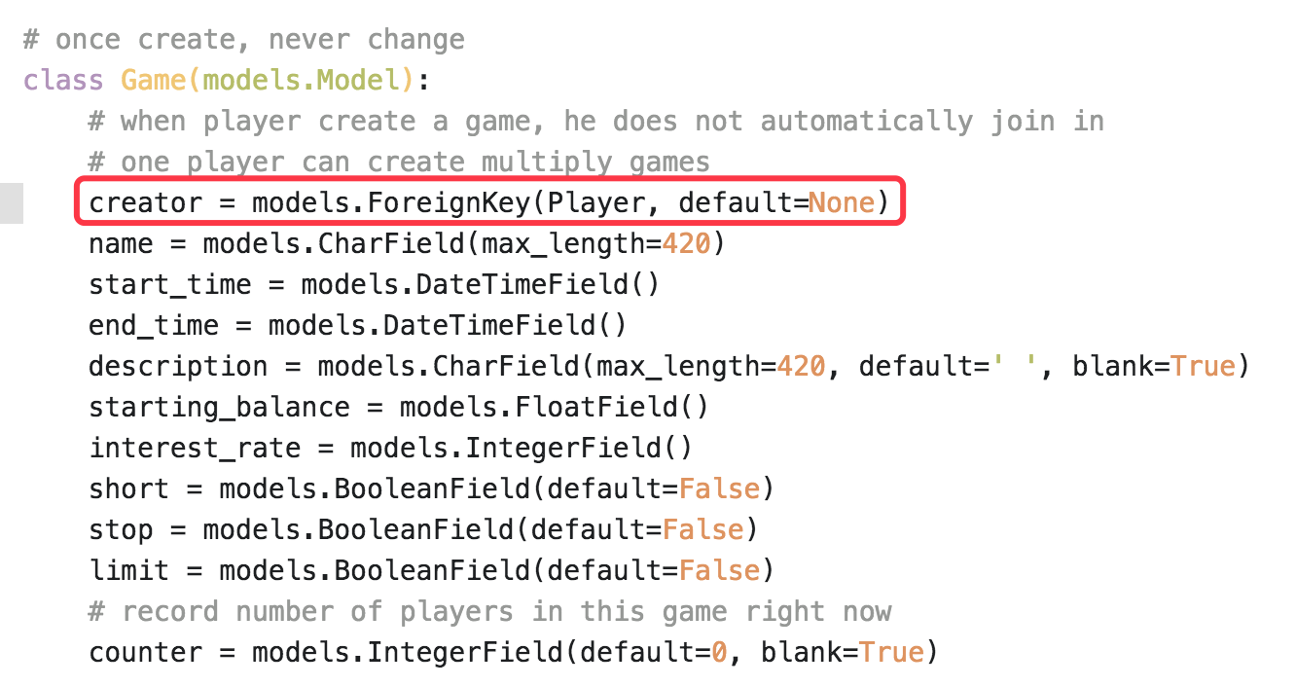
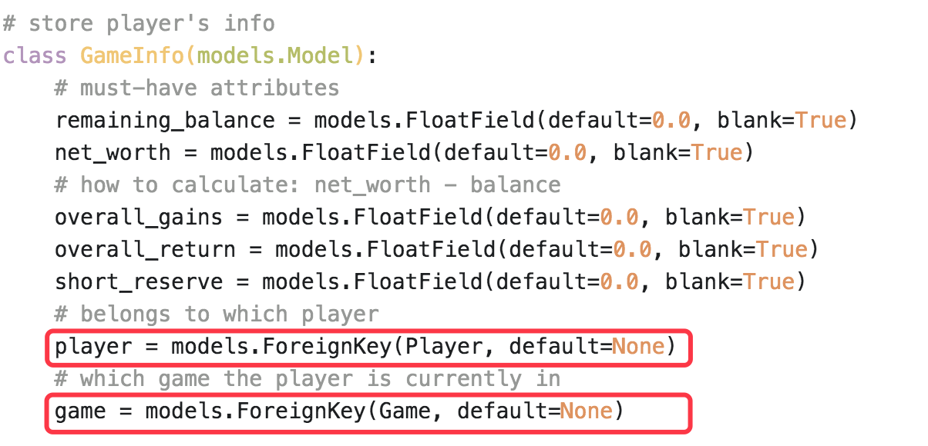
MODEL EXPLAINATION
Notes:
4 most import model in our system
In order to support, separate model
2 foreign keys

Slide 5
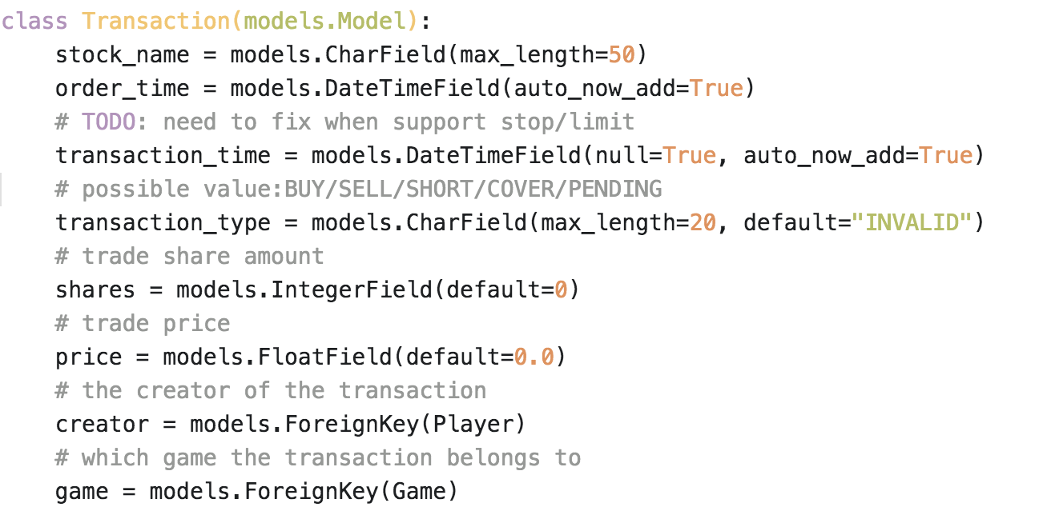
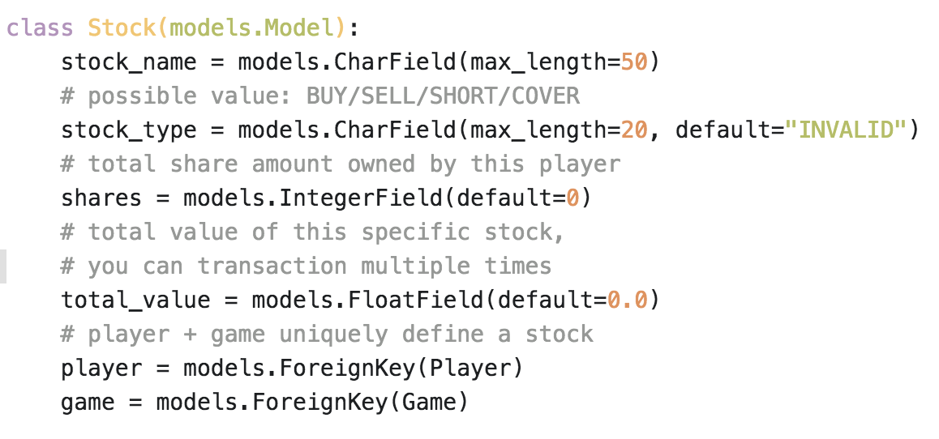
MODEL EXPLAINATION
Notes:
The other two is
Several Fields in common
The main reason is to decrease the amount of calculation
(buy stock A, buy stock A again)
You are suppose to have 2 different transaction records, but only one record in stock table(exactly same name/type/game/pkayer)

Slide 6
DEMO

Slide 7
PROBLEMS
Performance Efficiency
Instead of getting Real-Time Data From Google Finance API every time you refresh/reload page, store player’s statistics within database and automatically update every X minutes.
Notes:
Let’s say 10 minites

Slide 8
NEXT SPRINT
Support Sell stock/ cover functionality
Support stop-loss order & limit order
Show the Ranking of a Game among current players (based on net worth)

Slide 9
Questions?

