Slide 1
Optimization
Group 4
Presenter: Liang Shuang

Slide 2
Simulated Annealing
A trade-off between exploiting and exploring
Temperature
The higher the eager to explore
Decays exponentially
Cost Function
Defines how good the layout is
Update
Translation and rotation. Magnitude depends on T
Accept Distribution
Bolzmann Distribution
Bolzmann constant: how much SA prefers radical results

Slide 3
Cost Function
Decides the layout
Accessibility
Avoids collision
Makes a gap for passing
Prior Knowledge
“Bookshelf should be close to one wall”
Pairwise Relationship
“A chair should stay with a desk”

Slide 4
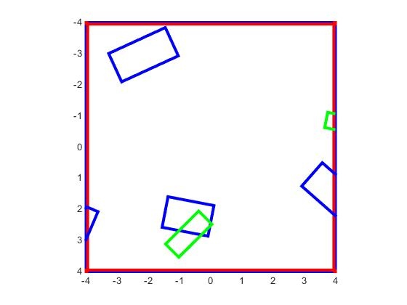
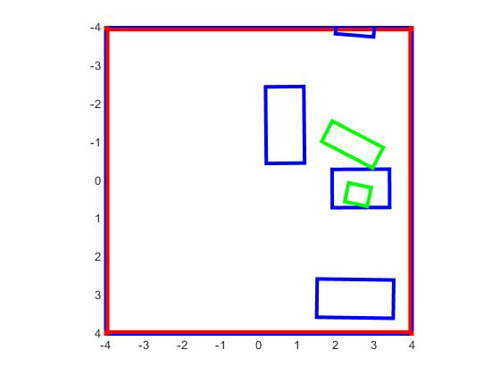
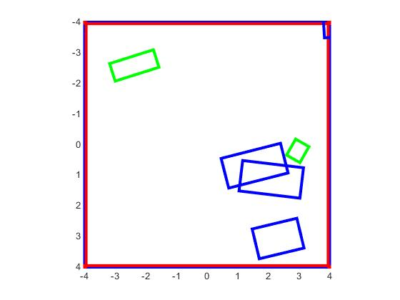
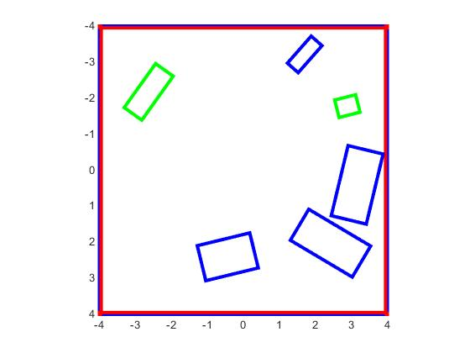
Results-1
What’s going on there?
T = 0
T = 200
T = 300
T = 400

Slide 5
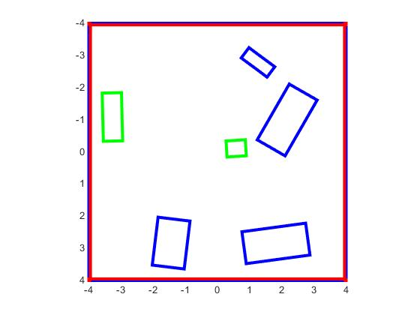
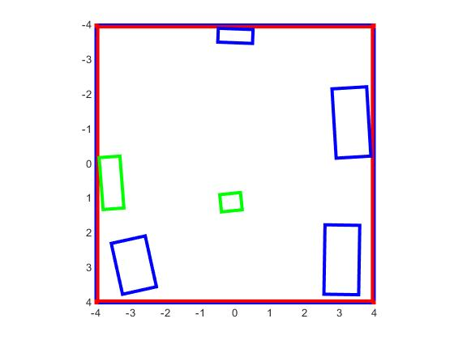
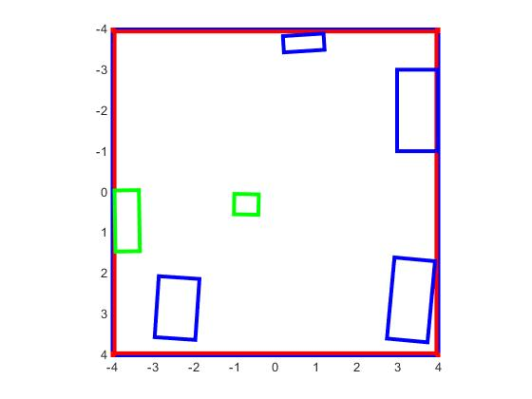
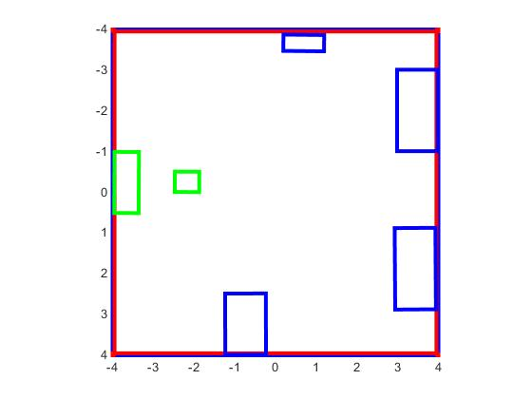
Results-2
What’s going on there?
T = 500
T = 600
T = 700
T = FINAL

Slide 6
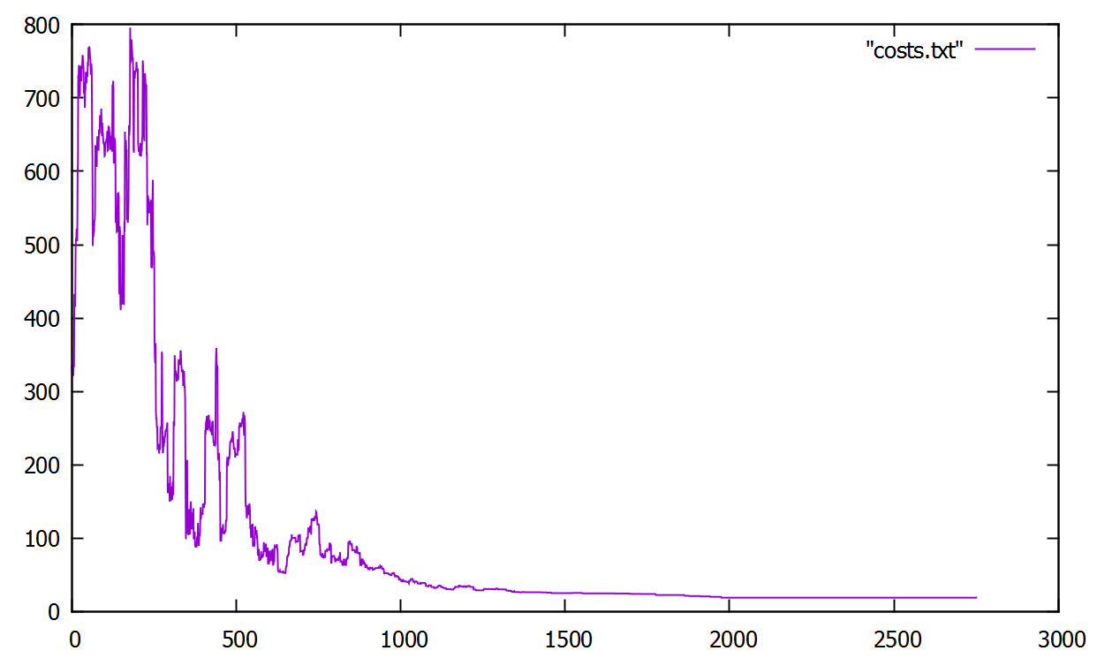
Track Costs
Take risks to get better future! Or not

Slide 7
Any Questions?

Slide 8
Thanks for your attention

