Slide 1
How to Aggregate and integrate data? 如何整合数据？ －以PSID数据为例
Liang Sun
Data Workshop
October 15, 2016

Slide 2
内容提要
认识数据结构
如何整合不同level的数据？
如何整合不同来源的数据？

Slide 3
1.认识数据结构
从研究问题出发，选择合适的数据
例如：
問題一：有大學學位與沒有大學學位的人相比，時薪會有不同嗎？
問題三：補助政策實施對於實驗組或者對照組的影響有因果關係存在嗎？
有时也需要根据现有的数据量体裁衣，来确定合适的研究问题。
需要考虑的两个主要维度：
Level
Time : are the data longitudinal? i.e., are variables time-variant?
Notes:
借用一下ANDY哥上周讲到的问题
问题一用的是student-level data
问题三用的是institution-level data , 并且是 longitudinal data

Slide 4
Level
Individual-level data
ELS 2002
Institution-level data
IPEDS: Integrated Postsecondary Education System
Family-level data
US Census IPUMS
Community/neighborhood-level data
NCDB: Neighborhood Change Database
Country-level data
OECD, World Bank, UIS
Notes:
IPUMS: Integrated Public Use Microdata Series https://usa.ipums.org/usa/
NCDB: Neighborhood Change Database http://www.geolytics.com/USCensus,Neighborhood-Change-Database-1970-2000,Products.asp
UIS: UNESCO Institute for Statistics http://www.uis.unesco.org/Education/Pages/default.aspx

Slide 5
Example: Panel Study of Income Dynamics (PSID)
Introduction
The study began in 1968 with a nationally representative sample of over 18,000 individuals living in 5,000 families in the United States. Information on these individuals and their descendants has been collected continuously, including data covering employment, income, wealth, expenditures, health, marriage, childbearing, child development, philanthropy, education, and numerous other topics.
Year: 1968-1996, 1997 (2) 2013
Notes:
https://psidonline.isr.umich.edu/

Slide 6
Data structure:
Single-year family file: 1968-1996,1997(2)2013
Yearly family interview ID, head/wife’s demographic characteristics, head/wife’s education, head/wife’s income, head/wife’s occupation, head/wife’s parents’ education, etc.
Individual file:
Single-year individual file: 1968-1996,1997(2)2013
Yearly family interview ID, sequence number, relation to head, age, current marital status, employment status, etc.
Cross-year individual file
1968 family Interview ID, 1968 person number, gender, number of marriages, time of first marriage, etc.
Notes:
Individual-level data

Slide 7
2. 整合不同level的数据
RQ: does one’s educational degree have impact on his/her choice of partner?
What level of data should we focus on?
How to make the data become what we need?
Read readme files and codebook
Find unique ID that can be used to link files of different levels
Be careful with variables with names that have changed over time
Merge files
It is always helpful to take a look at original data
Use merge command
Using Stata
next

Slide 8
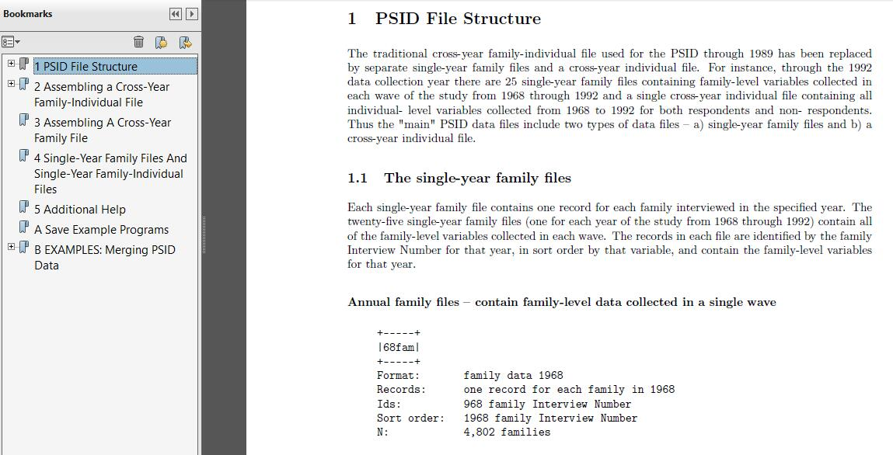
return

Slide 9
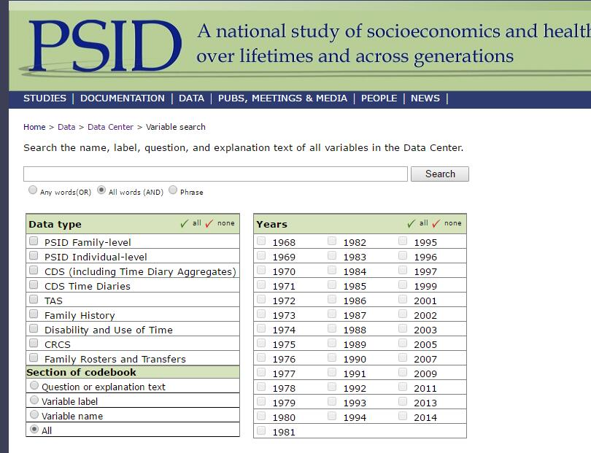
return
Notes:
http://simba.isr.umich.edu/VS/s.aspx

Slide 10
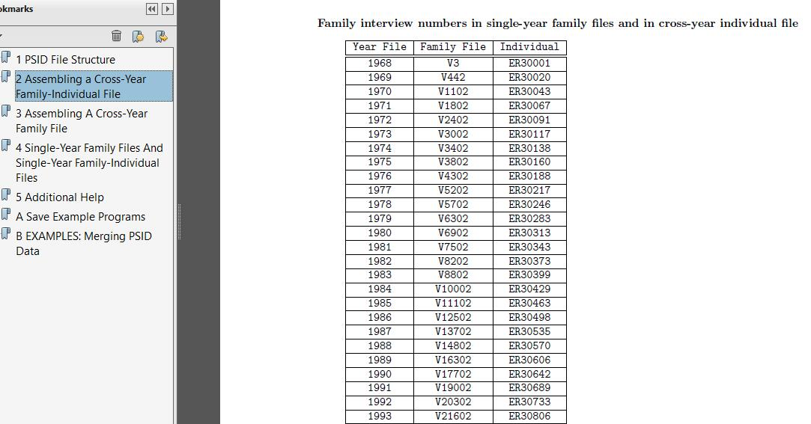
return

Slide 11
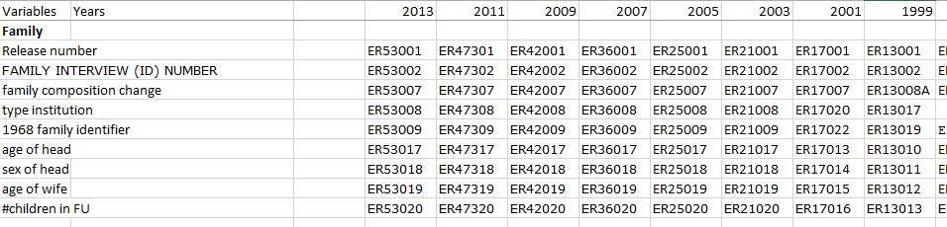
return

Slide 12


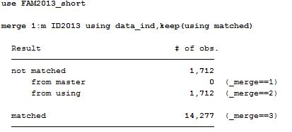
Merge and Append
Master data and using data
1:1 , 1:m , m:1, m:m
Check _merge

Slide 13
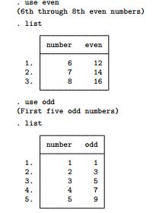


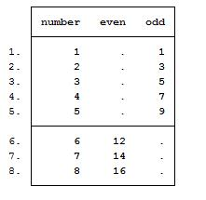
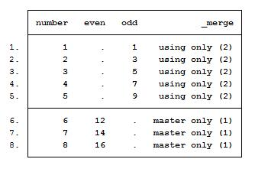
Append: 将数据粘贴到一起，但没有融合的过程。结果与merge有区别。
例1：数值相异的两个数据文件（ID变量和其他变量都无重合值）

Slide 14
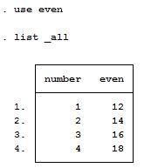
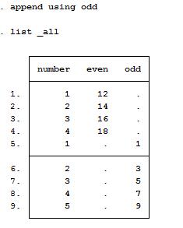
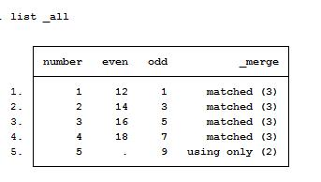
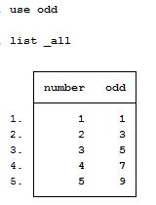
例2：两个数据文件中有相同的ID值

Slide 15
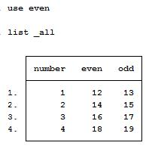
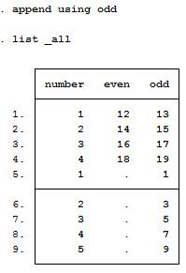
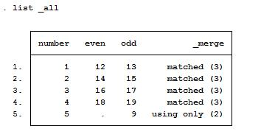
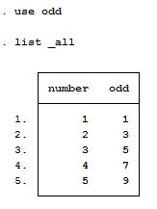
return
例3：两个数据文件中有相同的ID变量值和其他变量

Slide 16
3. 整合不同来源的数据
模型中需要考虑更多的variables
例1：个人所居住的区域特征(% of college-educated people in a neighborhood) 是否对choice of partner有影响
例2：个人所就读的大学质量(average sat scores of the institution) 是否对choice of partner有影响
需要将不同来源的数据与PSID数据结合起来
PSID restricted data have geographic information of households.
PSID restricted data have institution information of individuals who attend colleges.
What external data should we use to combine with PSID and answer our RQs?
NCDB
IPEDS
Find the right key variable that can link data

Slide 17
例1：PSID + NCDB
What do these two data sets have in common?
They both have geographic indicator!
CBSA: core-based statistical areas
Difference: structure
PSID: Individual level, wide format
NCDB: neighborhood level, long format

Slide 18
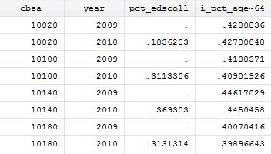
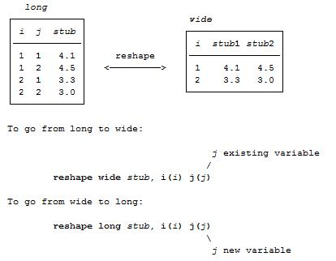
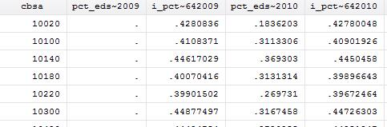
Wide format vs long format
Two formats

Slide 19
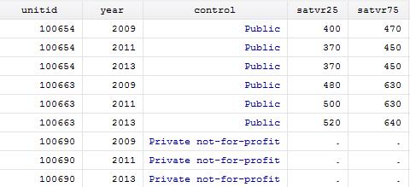
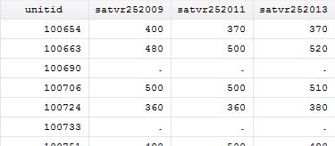
例2： PSID + IPEDS
What do they have in common?
Institution ID
Difference
PSID: Individual level, wide format
IPEDS: institution level, long format
Practice in Stata

Slide 20
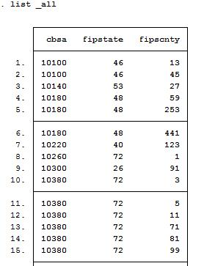
例3. PSID+ crosswalk +NCDB
What if there is no variable in common between two data files?
Suppose PSID doesn’t have the variable “cbsa”, but “fips codes”
We can use crosswalk
Notes:
FIPS: Federal Information Processing Standard codes which uniquely identifies counties and county equivalents in the United States, certain U.S. possessions, and certain freely associated states.
You can always search online for existing crosswalk files, such as:
CBSA to FIPS County Crosswalk
http://www.nber.org/data/cbsa-fips-county-crosswalk.html
Or look up any specific code:
http://county-codes.findthedata.com/

Slide 21
4.总结
根据研究问题选择合适的数据
了解数据结构，根据研究问题调整数据
充分利用不同的数据资源，整合数据，以更好地为研究问题服务

