Slide 1

复习题
CET6
Notes:
使用方法：
【更改文字】：将标题框及正文框中的文字可直接改为您所需文字
【更改图片】：点中图片》绘图工具》格式》填充》图片》选择您需要展示的图片
【增加减少图片】：直接复制粘贴图片来增加图片数，复制后更改方法见【更改图片】
【更改图片色彩】：点中图片》图片工具》格式》色彩（重新着色）》选择您喜欢的色彩
下载更多模板、视频教程：http://www.mysoeasy.com

Slide 2
深层
阅读理解
Passage 1
Notes:
使用方法：
【更改文字】：将标题框及正文框中的文字可直接改为您所需文字
【更改图片】：点中图片》绘图工具》格式》填充》图片》选择您需要展示的图片
【增加减少图片】：直接复制粘贴图片来增加图片数，复制后更改方法见【更改图片】
【更改图片色彩】：点中图片》图片工具》格式》色彩（重新着色）》选择您喜欢的色彩
下载更多模板、视频教程：http://www.mysoeasy.com

Slide 3
People often discuss the dangers of too much stress, but lately a very different view of stress is gaining popularity: this view of stress, held by members of the positive stress movement, argues that stress might actually be beneficial. The positive stress movement is made up of people such as Zachary Rapp who are looking for an edge in a competitive world, and Rapp’s routine is a good example of followers of the movement. He wakes up most mornings at dawn, goes for a run, sips black coffee while ripping through emails, and then steps into a freezing cold shower. This is a routine designed to reduce the stress of running simultaneously three different health and biotechnology companies for 18 hours a day.
46. What do we learn about followers of the positive stress movement?
A) They are usually quite sensitive to different types of stress.
B) They hold a different view on stress from the popular one.
C) They derive much pleasure from living a very hectic life.
D) They gain a competitive edge by enjoying good health.


Slide 4
Rapp’s routine is a good example of followers of the movement. He wakes up most mornings at dawn, goes for a run, sips black coffee while ripping through emails, and then steps into a freezing cold shower.
Although Rapp’s practices may sound extreme, he is part of a growing movement, consisting largely of tech industry workers who claim that such radical tactics will help them live better and longer. Inspired by influential figures in different fields, including entertainers, athletes, entrepreneurs and scientists, positive stress practitioners seek out some combination of extreme temperatures, restrictive diets, punishing exercise routines and general discomfort.
47. What do followers of the positive stress movement usually do to put their
ideas into practice?
A) They keep changing their living habits. B) They network with influential figures .
C) They seek jobs in tech industries. D) They apply extreme tactics.


Slide 5
Rapp argues that positive stress keeps him balanced. In addition to running and freezing showers, Rapp uses ice baths, hot yoga, and unconventional eating practices such as eliminating dairy, sugar, alcohol and various other foods high in carbohydrates. He believes that these practices, which put stress on his body, actually make him feel less stress from work. However, Rapp does not credit anyone in particular for his choices: he said he started using these methods in college, where he got into the habit of taking ice baths to recover from sports. He got back into it while trying to get his three companies off the ground.
48. What does Zachary Rapp say about his unconventional practices?
A) They help him combat stress from work.
B) They enable him to cut down living expenses.
C) They enable him to recover from injuries and illnesses.
D) They help him get three companies enlisted all at once..


Slide 6
Rapp works long hours and sleeps only five to seven hours a night but he said he only gets sick once a year. For him, the difference between day-to-day stress, like the kind we feel when moving apartments, and positive stress is that the latter involves pushing the body to extremes and forcing it to build up a tolerance.
49. What can be inferred from the passage about day-to day stress?
A) It is harmful to one’s physical and mental health.
B) It does not differ in essence from positive stress.
C) It is something everybody has to live with.
D) It doesn’t help build up one’s tolerance.


Slide 7
One thought leader in the positive stress world is Dutch extreme athlete Wim Hof, who earned the name “ice man” for his ability to withstand severe cold using deep breathing exercises. Hof’s ideas have become popular among tech industry elites and, thanks to Hof, cold showers are now a trend; indeed, some even call it a form of therapy.
But it is important to note that not everyone agrees with these practitioners; indeed, some medical professionals argue that positive stress is not for everyone, and that it might even be dangerous for people who are unhealthy or older.
50. What do some medical professionals think of positive stress?
A) Its true effect remains to be verified.
B) Its side effect should not be ignored.
C) Its effect varies considerably from person to person.
D) Its practitioners should not take it as a form of therapy.


Slide 8
深层
阅读理解
Passage 2
Notes:
使用方法：
【更改文字】：将标题框及正文框中的文字可直接改为您所需文字
【更改图片】：点中图片》绘图工具》格式》填充》图片》选择您需要展示的图片
【增加减少图片】：直接复制粘贴图片来增加图片数，复制后更改方法见【更改图片】
【更改图片色彩】：点中图片》图片工具》格式》色彩（重新着色）》选择您喜欢的色彩
下载更多模板、视频教程：http://www.mysoeasy.com

Slide 9
Is hunting good or bad for the environment? Like so many hot button issues, the answer to this question depends upon who you ask. On the one hand, some say, nothing could be more natural than hunting, and indeed just about every animal species--including humans--has been either predator or prey at some points in its evolution. And, ironic as it sounds, since humans have wiped out many animal predators, some see hunting as a natural way to reduce the herds of prey animals that now reproduce beyond the environment’s carrying capacity.
51. What does the author say sound ironic?
A) Some predators may often turn out to be prey of other predators.
B) Hunting may also be a solution to the problem caused by hunting.
C) The species of prey animals continue to vary despite humans’ hunting.
D) The number of prey animals keeps rising despite environmental change.


Slide 10
On the other hand, many environmental and animal advocates see hunting as savage, arguing that it is morally wrong to kill animals, regardless of practical considerations. According to Glenn Kirkof the California-based The Animals’ Voice, hunting “causes immerse suffering to individual wild animals...” and is “irrationally cruel because unlike natural predation, hunters kill for pleasure...” He adds that, despite hunters’ claims that hunting keeps wildlife populations in balance, hunters licence fees are used to “manipulate a few game species into overpopulation at the expense of a much larger number of non-game species, resulting in the loss of biological diversity, genetic integrity and ecological balance.”
52. What does Glenn Kirk think of charging hunters’ license fees?
A) It keeps game population under control.
B) It turns hunting into a sport of the rich.
C) It leads to ecological imbalance.
D) It helps stop killing for pleasure.


Slide 11
Beyond moral issues, others contend that hunting is not practical. According to the Humane Society of the United States, the vast majority of hunted species-- such as waterfowl, rabbits, upland birds and mourning doves-- “provide minimal nutrition and do not require population control.”
53. What is the argument of the Humane Society of the United States against
hunting?
A) Overpopulation is not an issue for most hunted animals.
B) Hunting deprives animal populations of their food sources.
C) Many birds and small animals are being irrationally killed.
D) Hunting is universally acknowledged as a savage behavior.


Slide 12
Author Gary E. Varner suggests in his book, In Nature’s Interests, that some types of hunting may be morally justifiable while others may not be. Hunting “designed to secure the aggregate welfare of the target species, the integrity of its ecosystem, or both”--what Varner terms “therapeutic hunting”--is defensible, while subsistence and sport hunting--both of which only benefit human beings--is not.
Regardless of one’s individual stance, fewer Americans hunt today than in recent history. Data gathered by the U.S. Fish & Wildlife Service in 2006 show that only five percent of Americans--some 12.5 million individuals-- consider themselves hunters today, down from nine percent in 2001 and 15 percent in 1996.
54. When is hunting morally justifiable according to Gary E. Varner?
A) When it benefits animals and their ecosystem.
B) When it serves both human and animal interests.
C) When it is indispensable to humans’ subsistence.
D) When it stabilizes the population of animal species.


Slide 13
Public support for hunting, however, is on the rise. A 2007 survey by Responsive Management Inc. Found that 8 percent of respondents agreed that “hunting has a legitimate place in modern society,” and the percentage of Americans indicating disapproval of hunting declined from 22 percent in 1995 to 16 percent in 2007.
Perhaps matching the trend among the public, green leaders are increasingly advocating cooperation between hunters and environmental groups. After all, both deplore urban sprawl and habitat destruction.
55. What concept are green leaders trying to promote?
A) Effective protection of animal habitats.
B) Strict control over urban development.
C) Coordinated efforts of hunters and environmentalists.
D) A compromise between development and animal protection.


Slide 14
深层
阅读理解
Passage 3
Notes:
使用方法：
【更改文字】：将标题框及正文框中的文字可直接改为您所需文字
【更改图片】：点中图片》绘图工具》格式》填充》图片》选择您需要展示的图片
【增加减少图片】：直接复制粘贴图片来增加图片数，复制后更改方法见【更改图片】
【更改图片色彩】：点中图片》图片工具》格式》色彩（重新着色）》选择您喜欢的色彩
下载更多模板、视频教程：http://www.mysoeasy.com

Slide 15
Many people associate their self-worth with their work. The more successful their career, the better they feel about themselves. Work-related self-esteem is therefore a worthy ideal to pursue with vigor, right? Well, not always. According to recent research, in which psychologists interviewed 370 full-time workers over a period of three weeks, the reality is a little more complicated. And it involves negative as well as positive consequences.
11. What does the author say about the pursuit of work-related self-esteem?
A) It may result in negative motivation.
B) It contributes to one’s accomplishments.
C) It can increase one’s vigor as one keeps trying.
D) It costs too much emotionally and psychologically.


Slide 16
It is natural to be drawn towards pleasure and to step away from pain. In the workplace, if that pleasure comes from a triumph which swells our self-respect, people will try to repeat the accomplishment. But repeating the accomplishment is often not realistic, which can lead to severe negative emotional consequences when it occurs. This form of motivation is widely regarded as a negative type of motivation. It can hinder other more positive motivation types, such as completing a task purely because it is fulfilling or enjoyable.

Slide 17
What consumes the employee instead is a pressing need to feel mighty and sure of themselves. They then take on only tasks and objectives which serve that ego-driven need. As a result, to avoid feelings of shame and worthlessness associated with failure, they extend themselves to such a degree that there is a subsequent adverse effect on their well-being. This internal pressure to succeed at all costs demands a lot of effort. It depletes their energy, culminating in disproportionate levels of damaging sentiment.
12. What do employees tend to do in pursuing work-related self-esteem?
A) Take on tasks well beyond their actual capabilities.
B) Strive to succeed at the expense of their well-being.
C) Resort to all means regardless of the consequences.
D) Exaggerate their sense of shame and worthlessness.


Slide 18
Those negative emotions mount into heightened anxiety, impacting their ability to make the most of their personal life. Their desire to avoid feeling inferior ends up making them feel inferior when it comes to their diminished capacity for friendship and leisure. They end up dissatisfied both at work and outside of it.
13. What do we learn about people over-concerned with work-related self-esteem?
A) They may often feel inferior to their colleagues .
B) They cannot enjoy their personal life to the full.
C) They are never satisfied with their achievements .
D) They have their own view of friendship and leisure.


Slide 19
But thankfully, for those people compelled almost entirely by this specific form of motivation, the news isn’t all bad, or bad at all. They study also discovered several positive outcomes that can actually outweigh the harmful ones. Though these types of employees are motivated by the desire to avoid negative consequences, they are also motivated by the excitement of pursuing emotional rewards. This excitement makes pursuing goals enjoyable and stimulates pleasure and pride that would result from success. An effect of the positive motivation is that it neutralizes the existence of negative motivation.
14. What is the good news we learn from the recent research?
A) The pursuit of goals may turn out to be enjoyable and pleasant.
B) The emotional rewards from goal pursuit are worth the pains taken.
C) The negative consequences of goal pursuit can mostly be avoided.
D) The goal of swelling self-esteem can be achieved if one keeps trying .


Slide 20
Sure, it affects people’s personal lives to what could be deemed an unhealthy extent, because leisure activities are often seen as a part of life that must be sacrificed to manage work and family demands. However, the way people feel about their work has less to do with whether they are motivated by the preservation of self-esteem but more with the fact that they are simply motivated. .
15. What can we infer from the last paragraph?
A) Workers have to make sacrifices to preserve self-esteem.
B) Self-esteem swells when workers are strongly motivated.
C) Pursuit of goals affects people’s personal lives to an unhealthy extent.
D) People feel positive about their work as long as they are motivated.


Slide 21
深层
阅读理解
Passage 4
Notes:
使用方法：
【更改文字】：将标题框及正文框中的文字可直接改为您所需文字
【更改图片】：点中图片》绘图工具》格式》填充》图片》选择您需要展示的图片
【增加减少图片】：直接复制粘贴图片来增加图片数，复制后更改方法见【更改图片】
【更改图片色彩】：点中图片》图片工具》格式》色彩（重新着色）》选择您喜欢的色彩
下载更多模板、视频教程：http://www.mysoeasy.com

Slide 22
Back in 1964, in his book Games People Play, psychiatrist Eric Berne described a pattern of conversation he called “Why Don’t You-Yes But”, which remains one of the most irritating aspects of everyday social life. The person adopting the strategy is usually a chronic complain-
er. Something is terrible about their relationship, job or other situation, and they moan about it ceaselessly, but find some excuse to dismiss any solution that’s proposed. The reason, of course, is that on some level they don’t want a solution; they want to be validated in their position that the world is out to get them. If they can “win” the game--dismissing every suggestion until their interlocutor gives up in annoyance-- they get to feel pleasurably righteous in their resentments and excused from any obligation to change.
51. What is characteristic of a chronic complainer, according to psychiatrist Eric Berne?
A) They only feel angry about their ill treatment and resent whoever tries to help.
B) They are chronically unhappy and ceaselessly find fault with people around them.
C) They constantly dismiss others’ proposals while taking no responsibility for tackling the
problem.
D) They lack the knowledge and basic skills required for successful conversations with their
interlocutors.


Slide 23
Part of the trouble here is the so-called responsibility/fault fallacy. When you’re feeling hard done by--taken for granted by your partner, say, obliged to work for a half-witted boss--it’s easy to become attached to the position that it’s not your job to address the matter, and that doing do would be an admission of fault. But there is a confusion here. For example, if I were to discover a newborn at my front door, it wouldn’t be my fault, but it most certainly would be my responsibility. There would be choices to make, and no possibility of avoiding them, since trying to ignore the matter would be a choice. The point is that what goes for the baby on the doorstep is true in all cases: even if the other person is 100% in the wrong, there is nothing to be gained, long-term, from using this as a justification to evade responsibility.
52. What does the author try to illustrate with the example of the newborn on one’s doorsteps?
A) People tend to think that one should not be held responsible for others’ mistakes.
B) It is easy to become attached to the position of overlooking one’s own fault.
C) People are often at a loss when confronted with a number of choices.
D) A distinction should be drawn between responsibility and fault.


Slide 24
Should you find yourself on the receiving end of this kind of complaining, there is an ingenious way to shut it down--which is to agree with it, ardently. Psychoth-erapist Lori Gottlieb describes this as “over-validation”. For one thing, you will be spared further moaning, since the other person’s motivation was to confirm her beliefs, and now you are confirming them. But for another, as Gottlieb notes, people confronted with over-validation often hear their complaints afresh and start arguing back. The notion that they are utterly powerless suddenly seems unrealistic--not to mention rather annoying-- so they’re prompted instead to generate ideas about how they might change things.
53. What does the author advise people to do to chronic complainers?
A) Stop them from going further by agreeing with them.
B) Listen to their complaints ardently and sympathetically.
C) Ask them to validate their beliefs with further evidence.
D) Persuade them to clarify the confusion they have caused.


Slide 25
Should you find yourself on the receiving end of this kind of complaining, there is an ingenious way to shut it down--which is to agree with it, ardently. Psychoth-erapist Lori Gottlieb describes this as “over-validation”. For one thing, you will be spared further moaning, since the other person’s motivation was to confirm her beliefs, and now you are confirming them. But for another, as Gottlieb notes, people confronted with over-validation often hear their complaints afresh and start arguing back. The notion that they are utterly powerless suddenly seems unrealistic--not to mention rather annoying-- so they’re prompted instead to generate ideas about how they might change things.
54. What happens when chronic complainers receive over-validation?
A) They are motivated to find ingenious ways to persuade their interlocutor.
B) They are prompted to come up with ideas for making possible changes.
C) They are stimulated to make more complaints.
D) They are encouraged to start arguing back.


Slide 26
“And then, sometimes, something magical might happen,” Gottlieb writes. The other person “might realise she is not as trapped as you are saying she is, or as she feels.” Which illustrates the irony of the responsibility/fault fallacy: evading responsibility feels comfortable, but turns out to be a prison; whereas assuming responsibility feels unpleasant, but ends up being freeing.
55. How can one stop being a chronic complainer according to the author?
A) Analysing the so-called responsibility/fault fallacy.
B) Avoiding hazardous traps in everyday social life.
C) Assuming responsibility to free oneself.
D) Awaiting something magical to happen.


Slide 27
深层
阅读理解
Passage 5
Notes:
使用方法：
【更改文字】：将标题框及正文框中的文字可直接改为您所需文字
【更改图片】：点中图片》绘图工具》格式》填充》图片》选择您需要展示的图片
【增加减少图片】：直接复制粘贴图片来增加图片数，复制后更改方法见【更改图片】
【更改图片色彩】：点中图片》图片工具》格式》色彩（重新着色）》选择您喜欢的色彩
下载更多模板、视频教程：http://www.mysoeasy.com

Slide 28
Why does social media trigger feelings of loneliness and inadequacy? Because instead of being real life, it is, for the most part, impression management, a way of marketing yourself, carefully choosing and filtering the pictures and words to put your best face forward.
46. What does the author imply social media may do to our life?
A) It may facilitate our interpersonal relationships.
B) It may filter our negative impressions of others.
C) It may make us feel isolated and incompetent.
D) It may render us vulnerable and inauthentic.


Slide 29
Online “friends” made through social media do not follow the normal psycholo-
gical progression of an interpersonal relationship. You share neither physical time nor emotional conversations over the Internet. You simply communicate photogr-aphs and catchy posts to a diverse group of people whom you have “friended” or “followed” based on an accidental interaction. This is not to say that your social media friends can’t be real friends. They absolutely can, but the two are not syno-
nymous. Generally speaking, there are no unfiltered comments or casually taken photos on our social media pages. And, rightfully so, because it wouldn’t feel safe to be completely authentic and vulnerable with some of our “friends” whom we don’t actually know or with whom trust has yet to be built.
47. Why do people post comments selectively on social media ?
A) They do not find all their online friends trustworthy.
B) They want to avoid offending any of their audience.
C) They do not want to lose their followers.
D) They are eager to boost their popularity.


Slide 30
Social media can certainly be an escape from the daily grind, but we must be cautioned against the negative effects, such as addiction, on a person’s overall psychological well-being.
As humans, we yearn for social connection. Scrolling through pages of pictures and comments, however, doesn’t provide the same degree of fulfillment as face to face interactions do. Also, we tend to idealize others’ lives and compare our downfalls to their greatest accomplishments, ending in feelings of loneliness and inadequacy.
48. What are humans inclined to do according to the passage ?
A) Exaggerate their life’s accomplishments.
B) Strive for perfection regardless of the cost.
C) Paint a rosy picture of other people’s lives.
D) Learn lessons from other people’s downfalls.


Slide 31
Social media can lead people on the unhealthy quest for perfection. Some people begin to attend certain events or travel to different places so that they can snap that “perfect” photo. They begin to seek validation through the number of people who “like” their posts. In order for it to play a psychological healthy role in your social life, social media should supplement an already healthy social network. Pictures and posts should be byproducts of life’s treasured moments and fun times, not the planned and calculated image that one is putting out into cyberspace in an attempt to fill insecurities or unmet needs.
49. What is the author’s view of pictures and posts on social media?
A) They should record the memorable moments in people’s lives.
B) They should be carefully edited so as to present the best image.
C) They should be shown in a way that meets one’s security needs.
D) They should keep people from the unhealthy quest for perfection.


Slide 32
Ultimately social media has increased our ability to connect with various types of people all over the globe. It has opened doors for businesses and allowed us to stay connected to people whom we may not otherwise get to follow. However, social media should feel like a fun experience, not one that contributes to negative thoughts and feelings. If the latter is the case, increasing face to face time with trusted friends, and minimizing time scrolling online, will prove to be a reminder that your social network is much more rewarding than any “like”, “follow”, “share” can be.
50. What does the author advise people to do when they find their online experience unconstructive?
A) Use social media to increase their ability to connect with various types of people.
B) Stay connected to those whom they may not otherwise get to know and befriend.
C) Try to prevent negative thoughts and feelings from getting into the online pages.
D) Strengthen ties with real-life friends instead of caring about their online image.


Slide 33
选词填空
1
Notes:
使用方法：
【更改文字】：将标题框及正文框中的文字可直接改为您所需文字
【更改图片】：点中图片》绘图工具》格式》填充》图片》选择您需要展示的图片
【增加减少图片】：直接复制粘贴图片来增加图片数，复制后更改方法见【更改图片】
【更改图片色彩】：点中图片》图片工具》格式》色彩（重新着色）》选择您喜欢的色彩
下载更多模板、视频教程：http://www.mysoeasy.com

Slide 34
A) assessed F) designated K) loopholes
B) assigned G) detrimental L) rapidly
C) consequences H) digestion M) redundant
D) conspicuously I) excelling N) regularly
E) deficits J) indulging O) similar
When considering risk factors associated with serious chronic disease, we often think about health indicators such as cholesterol, blood pressure, and body weight. But poor diet and physical inactivity also each increase the risk of heart disease and have a role to play in the development of some cancers. Perhaps worse, the 26__________ effects of an unhealthy diet and insufficient exercise are not limited to your body. Recent research has also shown that 27_______ in a high-fat and high-sugar diet may have negative effects on your brain, causing learning and memory 28_______ .
detrimental
indulging
deficits

Slide 35
A) assessed F) designated K) loopholes
B) assigned G) detrimental L) rapidly
C) consequences H) digestion M) redundant
D) conspicuously I) excelling N) regularly
E) deficits J) indulging O) similar
Studies have found obesity is associated with impairments in cognitive functioning, as 29______ by a range of learning and memory tests, such as the ability to remember a list of words presented some minutes or hours earlier. There is also a growing body of evidence that diet-induced cognitive impairments can emerge 30_______ --- within weeks or even days. For example, one study found healthy adults 31_______ to a high-fat diet for five days showed impaired attention, memory, and mood compared with a low-fat diet control group. Another study also found eating a high-fat and high-sugar breakfast each day for as little as four days resulted in problems with learning and memory 32______ to those observed in overweight and obese individuals.
assessed
rapidly
assigned
similar

Slide 36
A) assessed F) designated K) loopholes
B) assigned G) detrimental L) rapidly
C) consequences H) digestion M) redundant
D) conspicuously I) excelling N) regularly
E) deficits J) indulging O) similar
Body weight was not hugely different between the groups eating a healthy diet and those on high fat and sugar. So this shows negative 33____________ of poor dietary intake can occur even when body weight has not changed 34_____________ . Thus, body weight is not always the best indicator of health and a thin person still needs to eat well and exercise 35_______ .
consequences
conspicuously
regularly

Slide 37
选词填空
2
Notes:
使用方法：
【更改文字】：将标题框及正文框中的文字可直接改为您所需文字
【更改图片】：点中图片》绘图工具》格式》填充》图片》选择您需要展示的图片
【增加减少图片】：直接复制粘贴图片来增加图片数，复制后更改方法见【更改图片】
【更改图片色彩】：点中图片》图片工具》格式》色彩（重新着色）》选择您喜欢的色彩
下载更多模板、视频教程：http://www.mysoeasy.com

Slide 38
A) contrary
B) fatigue
C) heavily
D) heaving
E) hospitalized
F) labeled
G) legacies
H) mastering
I) momentum
J) obsessed
K) potential
L) realms
M) reciprocal
N) ruin
O) viciously
Overall, men are more likely than women to make excuses. Several studies suggest that men feel the need to appear competent in all _______, while women worry only about the skills in which they've invested _________. Ask a man and a woman to go diving for the first time, and the woman is likely to jump in, while the man is likely to say he is not feeling too well.
Ironically, it is often success that leads people to flirt with failure. Praise won for ________ a skill suddenly puts one in the position of having everything to lose .
L) realms
C) heavily
H) mastering

Slide 39
A) contrary
B) fatigue
C) heavily
D) heaving
E) hospitalized
F) labeled
G) legacies
H) mastering
I) momentum
J) obsessed
K) potential
L) realms
M) reciprocal
N) ruin
O) viciously
Rather than putting their reputation on the line again, many successful people develop a handicap--drinking, _________, depression--that allows them to keep their status no matter what the future brings. An advertising executive __________
for depression shortly after winning an award put it this way: “Without my depression, I'd be a failure now; with it, I'm a success 'on hold'.
In fact, the people most likely to become chronic excuse makers are those ______
with success. Such people are so afraid of being _______ a failure at anything that
B) fatigue
E) hospitalized
J) obsessed
F) labeled

Slide 40
A) contrary
B) fatigue
C) heavily
D) heaving
E) hospitalized
F) labeled
G) legacies
H) mastering
I) momentum
J) obsessed
K) potential
L) realms
M) reciprocal
N) ruin
O) viciously
they constanty develop one handicap or another in order to explain away failure.
Though self-handicapping can be an effective way of coping with performance anxiety now and then, in the end, researchers say, it will lead to ______ . In the long run, excuse makers fail to live up to their true ________ and lose the status they care so much about. And despite their protests to the _________, they have only themselves to blame.
N) ruin
K) potential
A) contrary

Slide 41
选词填空
3
Notes:
使用方法：
【更改文字】：将标题框及正文框中的文字可直接改为您所需文字
【更改图片】：点中图片》绘图工具》格式》填充》图片》选择您需要展示的图片
【增加减少图片】：直接复制粘贴图片来增加图片数，复制后更改方法见【更改图片】
【更改图片色彩】：点中图片》图片工具》格式》色彩（重新着色）》选择您喜欢的色彩
下载更多模板、视频教程：http://www.mysoeasy.com

Slide 42
A) aesthetic F) fiscal K) safeguarding
B) appropriate G) instances L) ship
C) clusters H) rehabilitated M) strategic
D) competitive I) reproduced N) transcend
E) exploiting J) revenues O) undergoing
The task of the global strategist of a business is to build a platform of capabili-
ties derived from the resources, experiences and innovations of units in multiple locations, to transplant those capabilities wherever 26__________ , and then to systematically upgrade and renew them– ahead of the competition.
Apple is an outstanding case of a company whose unique capabilities give it a worldwide 27_______ advantage, particularly with respect to its ability to build platforms from a product base that integrates functional and 28_______ .
design. Apple has been able to leverage and exploit its California-based design
B) appropriate
D) competitive
A) aesthetic

Slide 43
A) aesthetic F) fiscal K) safeguarding
B) appropriate G) instances L) ship
C) clusters H) rehabilitated M) strategic
D) competitive I) reproduced N) transcend
E) exploiting J) revenues O) undergoing
and marketing advantages successfully throughout the world. IKEA is another case. The do-it-yourself furniture and houseware company first developed a compelling set of capabilities to design, manufacture and 29__________ furniture at low cost and sell it in a novel way in Sweden. Later, IKEA successfully 30_______ this formula in many other countries.
By contrast, Telefonica, a Spanish telecommunications company that is now the world’s fifth largest telecom by 31_______ first developed its special advantage abroad. In 1989 and 1990, Telefonica had the opportunity to enter
L) ship
I) reproduced
J) revenues

Slide 44
A) aesthetic F) fiscal K) safeguarding
B) appropriate G) instances L) ship
C) clusters H) rehabilitated M) strategic
D) competitive I) reproduced N) transcend
E) exploiting J) revenues O) undergoing
Chile and Argentina, countries that shared many institutional and cultural characteristics with its home country but that were 32_______ more rapid market reform. Throughout the 1990s, Telefonica took what it learned in Chile and Argentina about reconstructing former state-owned telecoms to other Latin American countries that were privatizing their state telecoms and deregulating their telecom markets.
O) undergoing

Slide 45
A) aesthetic F) fiscal K) safeguarding
B) appropriate G) instances L) ship
C) clusters H) rehabilitated M) strategic
D) competitive I) reproduced N) transcend
E) exploiting J) revenues O) undergoing
These examples might lead the reader to believe that creating a global advantage is an easy task. But many other 33__________ of expensive failed experiments suggest that creating a lasting global advantage actually requires a great deal of 34_______ and operational finesse(技巧). Our research suggests that global winners typically create and sustain their international presence through a systematic process of 35_______ , renewing and enhancing their core capabilities.
G) instances
M) strategic
E) exploiting

Slide 46
选词填空
4
Notes:
使用方法：
【更改文字】：将标题框及正文框中的文字可直接改为您所需文字
【更改图片】：点中图片》绘图工具》格式》填充》图片》选择您需要展示的图片
【增加减少图片】：直接复制粘贴图片来增加图片数，复制后更改方法见【更改图片】
【更改图片色彩】：点中图片》图片工具》格式》色彩（重新着色）》选择您喜欢的色彩
下载更多模板、视频教程：http://www.mysoeasy.com

Slide 47
A) adore
B) appraise
C) assaults
D) chemistry
E) coincidence
F) cracks
G) deported
H) dismisses
I) illegally
J) lost
K) perpetually
L) prescribed
M) shrewd
N) skeptical
O) strives
The Sun Is Also a Star is a truly lovely story of love, romance, fate and destiny.
Natasha is a Jamaican-born immigrant living (26)________ in America, not by choice exactly. Her parents brought her over and created the situation she (27)________ to be out of.
Daniel is an Americann born of Korean immigrants. He believes in true love, fate and all that other nonsense that Natasha(28) __________ through scientific reasoning.
I) illegally
O) strives
H) dismisses

Slide 48
A) adore
B) appraise
C) assaults
D) chemistry
E) coincidence
F) cracks
G) deported
H) dismisses
I) illegally
J) lost
K) perpetually
L) prescribed
M) shrewd
N) skeptical
O) strives
Daniel and Natasha meet by (29)__________ on the streets of New York on the day that she is to be (30)________. She doesn’t tell him that but does allow him to keep her company while he tries to get her to fall in love with him over the course of the day.
Natasha is me. I found her so familiar to myself. She is scientifically-minded, practical, somewhat cynical, and always (31)_________. Her obsession with the universe through a scientific lens is infectious and I (32)________ Daniel seeing that too.
E) coincidence
G) deported
N) skeptical
A) adore

Slide 49
A) adore
B) appraise
C) assaults
D) chemistry
E) coincidence
F) cracks
G) deported
H) dismisses
I) illegally
J) lost
K) perpetually
L) prescribed
M) shrewd
N) skeptical
O) strives
Daniel is charming and passionate and has a way with words that even(33)_____
Natasha’s tough outer shell. By the end of the book I fell in love with both of them.
I used to find romance stories to always be cheap or laughable. I think now I can see the value in escaping into a story of pure optimism. I got (34)_______ in The Sun Is Also a Star and finished it cover to cover in a weekend. I couldn’t wait to get to what I hoped would be a happy ending.
F) cracks
J) lost

Slide 50
A) adore
B) appraise
C) assaults
D) chemistry
E) coincidence
F) cracks
G) deported
H) dismisses
I) illegally
J) lost
K) perpetually
L) prescribed
M) shrewd
N) skeptical
O) strives
It is nice every once in a while to give in to magic. It doesn’t have to be a hard fantasy novel with actual spells. It can be the magic found between two people who just have that special something. That (35)________ that causes them to react and spark when they are near each other.
D) chemistry

Slide 51
翻译
1
Notes:
使用方法：
【更改文字】：将标题框及正文框中的文字可直接改为您所需文字
【更改图片】：点中图片》绘图工具》格式》填充》图片》选择您需要展示的图片
【增加减少图片】：直接复制粘贴图片来增加图片数，复制后更改方法见【更改图片】
【更改图片色彩】：点中图片》图片工具》格式》色彩（重新着色）》选择您喜欢的色彩
下载更多模板、视频教程：http://www.mysoeasy.com

Slide 52
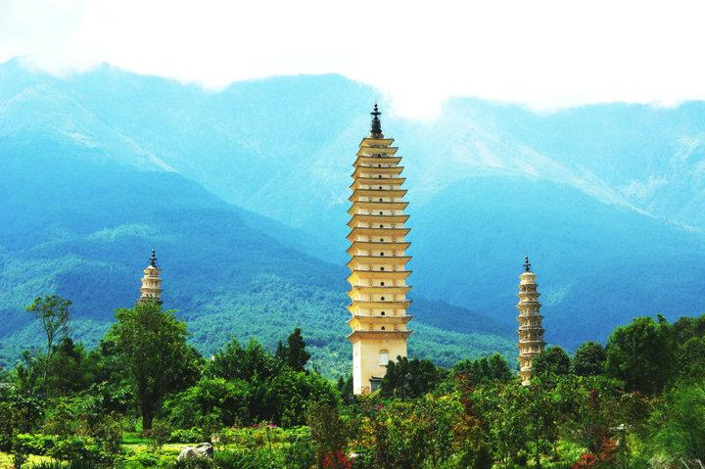
云南是位于中国西南的一个省份，平均海拔1500米。云南历史悠久，风景秀丽，气候宜人。云南生态环境优越，生物多种多样，被誉为野生动植物的天堂。云南还有多种矿藏和充足的水资源，为全省经济的可持续发展提供了有利条件。
云南居住着25个少数民族，他们大多有自己的语言、习俗和宗教。云南独特的自然景色和丰富的民族文化使其成为中国最受欢迎的旅游目的地之一，每年吸引着大批国内外游客前往旅游。

Slide 53

云南是位于中国西南的一个省份，平均海拔1500米。
Yunnan is a province
located in the southwest of China,
with an average altitude of 1500 meters.

Slide 54
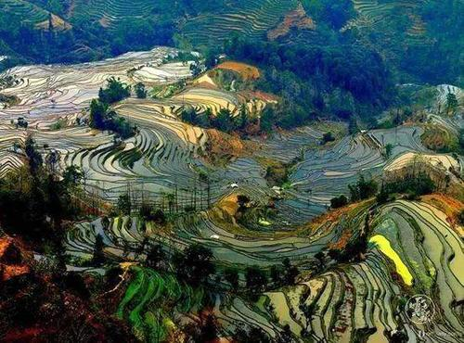

云南历史悠久，风景秀丽，气候宜人。
It boasts a long history, beautiful scenery and pleasant climate.

Slide 55
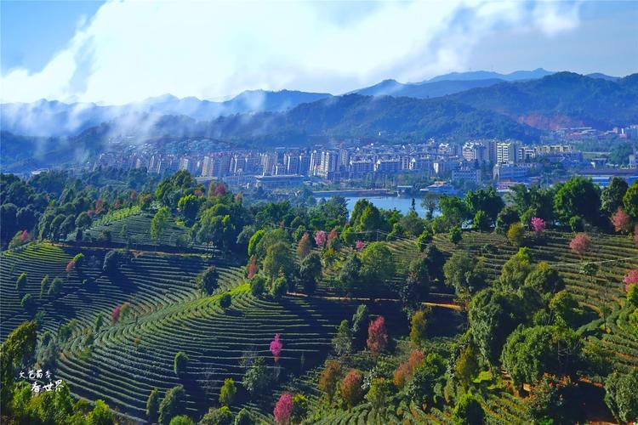
云南生态环境优越，生物多种多样，被誉为野生动植物的天堂。
Yunnan is known as a paradise for wild plants and animals
for its superior ecological environment and
a wide variety of living creatures.

Slide 56
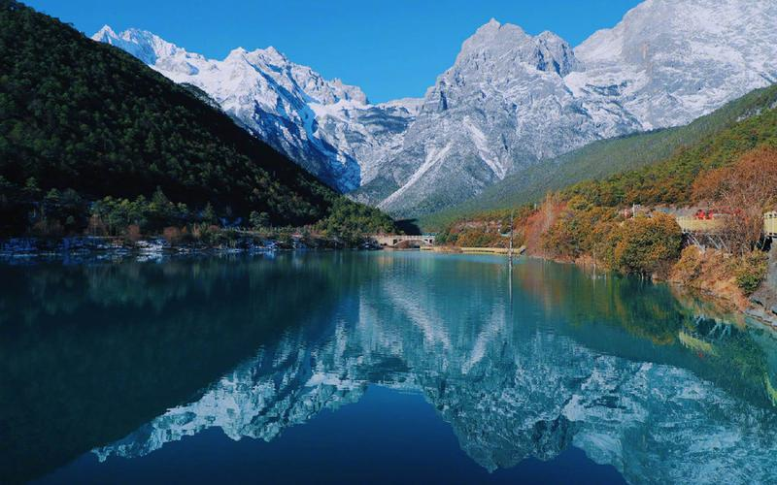

云南还有多种矿藏和充足的水资源，为全省经济的可持续发展提供了有利条件。
Yunnan also has a wide variety of mineral resources and adequate water resources,
providing favorable conditions for the sustainable development of the whole province’s economy.

Slide 57

云南居住着25个少数民族，他们大多有自己的语言、习俗和宗教。
Yunnan is inhabited by 25 minority ethnic groups,
most of whom have their own languages, customs and religions.

Slide 58

云南独特的自然景色和丰富的民族文化使其成为中国最受欢迎的旅游目的地之一，每年吸引着大批国内外游客前往旅游。
Yunnan’s unique natural scenery and rich ethnic cultures have made it one of the most popular tourist destinations in China,
attracting large numbers of tourists
from home and abroad every year.

Slide 59
翻译
2
Notes:
使用方法：
【更改文字】：将标题框及正文框中的文字可直接改为您所需文字
【更改图片】：点中图片》绘图工具》格式》填充》图片》选择您需要展示的图片
【增加减少图片】：直接复制粘贴图片来增加图片数，复制后更改方法见【更改图片】
【更改图片色彩】：点中图片》图片工具》格式》色彩（重新着色）》选择您喜欢的色彩
下载更多模板、视频教程：http://www.mysoeasy.com

Slide 60

中国盛产竹子，是最早开发利用竹资源的国家。竹子在中国分步广
泛，品种丰富。竹子实用性强，用于生产和生活的许多方面，如筷
子、桌椅的制作和桥梁、房屋的建造。中国人爱竹，自古以来就有
无数文人以竹子为主题，创作了绚丽多彩的文学和绘画作品。竹子
主干笔直，象征正值的品格。竹子具有强大的生命力和适应能力，
无论环境多么恶劣，都能够顽强生存，因而寓意坚韧不拔的精神。
几千年来，竹子一直被视为中华民族的象征。

Slide 61

中国盛产竹子，是最早开发利用竹资源的国家。
China, abundant in bamboo , is the earliest country to develop and make use of bamboo resources.

Slide 62
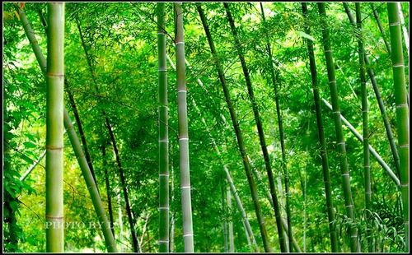
竹子在中国分步广泛，品种丰富。
Bamboo is widely distributed in China,
with a rich variety.

Slide 63
竹子实用性强，用于生产和生活的许多方面，如筷子、桌椅的制作和桥梁、房屋的建造。
As bamboo is very practical, it is used in many aspects of production and daily life, such as the making of chopsticks,tables and chairs, as well as the construction of bridges annd houses.

Slide 64


中国人爱竹，自古以来就有无数文人以竹子为主题，创作了绚丽多彩的文学和绘画作品。
Since ancient times, countless men of letters have created colorful literary and painting works with bambo as the theme.

Slide 65


竹子主干笔直，象征正值的品格。
Bamboo, with its straight stem, is a symbol of integrity.

Slide 66
竹子具有强大的生命力和适应能力，无论环境多么恶劣，都能够顽强生存，因而寓意坚韧不拔的精神。
Bamboo has powerful vitality and adaptability.
No matter how harsh the environment is, it can thrive,
thereby signifying the spirit of perseverance.

Slide 67
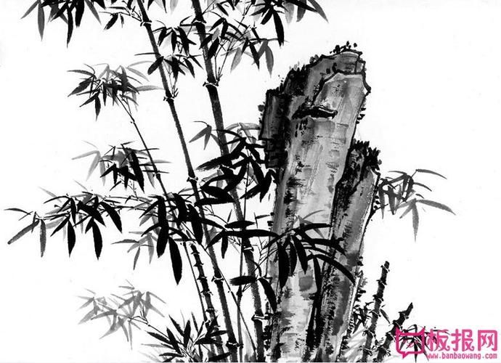
几千年来，竹子一直被视为中华民族的象征。
For thousands of years, bamboo has been viewed as a symbol of the Chinese nation.

Slide 68
翻译
3
Notes:
使用方法：
【更改文字】：将标题框及正文框中的文字可直接改为您所需文字
【更改图片】：点中图片》绘图工具》格式》填充》图片》选择您需要展示的图片
【增加减少图片】：直接复制粘贴图片来增加图片数，复制后更改方法见【更改图片】
【更改图片色彩】：点中图片》图片工具》格式》色彩（重新着色）》选择您喜欢的色彩
下载更多模板、视频教程：http://www.mysoeasy.com

Slide 69


近年来，随着互联网技术的迅猛发展，互联网经济已成为一个热门话题。以蓬勃发展的电子商务为代表的互联网经济已成为经济发展的重要引擎。我国政府高度重视发展互联网经济，提出了“互联网+”的概念，以推动互联网与医疗、交通、教育、金融、公共服务等领域的结合。这将为互联网经济的发展提供极大的发展潜力和更广阔的发展空间。随着“互联网+”战略的深入实施，互联网必将与更多传统行业进一步融合，助力打造“中国经济升级版”。

Slide 70
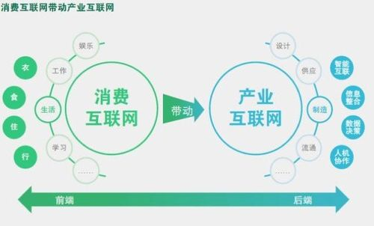

近年来，随着互联网技术的迅猛发展，互联网经济已成为一个热门话题。
In recent years, with the rapid development of Internet technology,
the Internet economy has become a hot issue.

Slide 71


以蓬勃发展的电子商务为代表的互联网经济已成为经济发展的重要引擎。
As represented by the thriving E-commerce,
the Internet economy has become a strong driving force for the economic develpoment.

Slide 72
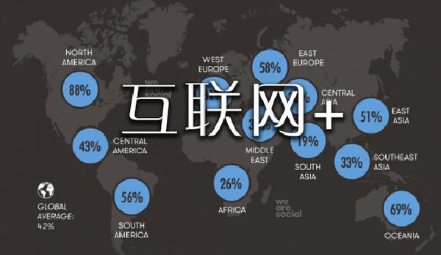
我国政府高度重视发展互联网经济，提出了“互联网+”的概念，以推动互联网与医疗、交通、教育、金融、公共服务等领域的结合。
Our government attaches great importance to developing the Internet economy and proposes the concept of “Internet Plus”,
aiming to push the integration of the Internet with other industries, such as health care, transportation, education, finance, and public service.

Slide 73


这将为互联网经济的发展提供极大的发展潜力和更广阔的发展空间。
This will create great potential and broader prospects for the development of the Internet economy.

Slide 74
随着“互联网+”战略的深入实施，互联网必将与更多传统行业进一步融合，助力打造“中国经济升级版”。
With the implementation of the “Internet Plus” strategy,
the Internet is bound to be further integrated with more traditional industries and help build “ the upgraded version of the Chinese economy.

