Slide 1


3.6 Some advanced SQL syntax
Another SQL Query?
1. UNION, INTERSECT and EXCEPT Operators
[1] form subquery {UNION [ALL] | INTERSECT [ALL]
| EXCEPT [ALL] subquery}
[2] Example 3.6.1 Find cids who order both products p01 and p07.
p01
p07
Intersect
/ cid in
New) (select distinct cid from orders where pid = ‘p01’ )
intersect (select cid from orders where pid = 'p07');
Old) select distinct cid from orders where pid = ‘p01’ and
cid in (select cid from orders where pid = 'p07’);

Slide 2
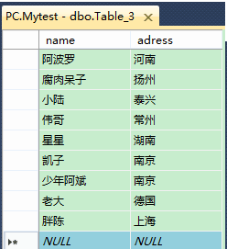
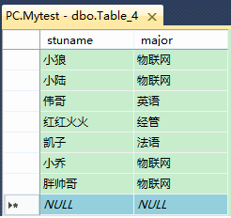
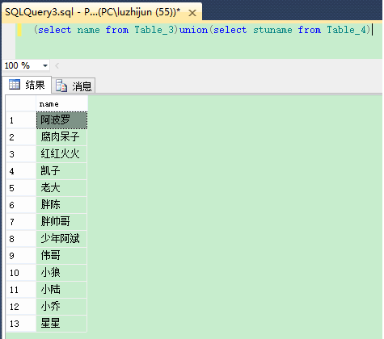
并集( UNION )—返回两个结果集的并集
(select name from Table_ 3 )union(select stuname from Table_ 4)
UNION操作是用于返回两个SELECT语句结果集的所有记录，除去重复的部分。

Slide 3
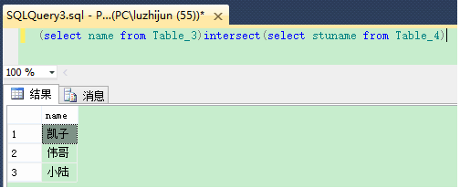
交集(INTERSECT )--返回两个结果集的交集(返回相同记录)
(select name from Table_ 3)intersect(select stuname from Table_ 4)
INTERSECT操作的两个SELECT语句必须返回相同数量的列，并且对应的列必须具有相似的数据类型。
INTERSECT操作会自动去除结果中的重复行。
不是所有的数据库系统都支持INTERSECT。例如，MySQL就不支持。

Slide 4
练习：查询计算机科学系的学生与年龄不大于19岁的学生的交集。
SELECT * FROM Student WHERE Sdept='CS‘
INTERSECT
SELECT * FROM Student WHERE Sage<=19
SELECT * FROM Student WHERE Sdept= 'CS' AND Sage<=19;

Slide 5
数据库intersect操作在许多场景中都非常有用。
1、数据匹配：当我们有两个或多个表，想要找到它们之间共同的数据时，可以使用intersect操作。例如，我们可以将两个客户表与相同ID的行进行匹配，以找到共同的客户。
2、数据交集：如果我们想要找到两个表之间的交集，即两个表中共同的行，intersect操作非常有用。这可以帮助我们快速识别出两个表之间的共同数据。
3、数据一致性验证：在某些情况下，我们可能有多个数据源，例如不同的数据库或文件，我们想要验证它们之间的数据一致性。使用intersect操作可以帮助我们比较不同数据源中的数据，找到不一致或缺失的数据。

Slide 6
在使用INTERSECT操作时，为了提高查询的性能，可以考虑以下几点：
1、尽可能在WHERE子句中添加条件，减少需要进行INTERSECT操作的记录数。
2、如果可能，尽量使用小的表进行INTERSECT操作。
3、如果查询的结果集非常大，可以考虑使用分页查询或者LIMIT子句来限制返回的记录数。
通过这些方法，可以有效地提高INTERSECT操作的性能。

Slide 7

3.6 Some advanced SQL syntax
[3] Example 3.6.2 (p116) Retrieve all cnames where the customer don’t place any order through agent a05.
Not exists
a05
Old) select c.cname from customers c where
not exists (select * from orders x where x.aid='a05’ and x.cid=c.cid);
New) select c.cname from customers c
except (select c.cname from customers c, orders x
where x.aid = 'a05’ and x.cid = c.cid );
[4] Operators in DBMS product
  ORACLE 8 : {UNION, UNION ALL, INTERSECT, EXCEPT}
  DB2 Version 5 : {UNION, INTERSECT, EXCEPT} [ALL]
  INFORMIX : UNION [ALL]

Slide 8
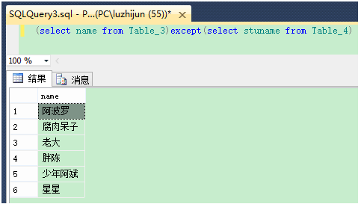
差集(EXCEPT )--返回两个结果集的差集(从前一个表中剔除两个表中相同的记录)
select name from Table_ 3)except(select stuname from Table_ 4)
EXCEPT操作则是返回在第一个SELECT语句结果集中存在，但在第二个SELECT语句结果集中不存在的记录。

Slide 9
练习：查询计算机科学系的学生与年龄不大于19岁的学生的差集。
SELECT * FROM Student WHERE Sdept ='CS‘
EXCEPT
SELECT * FROM Student WHERE Sage <=19
SELECT * FROM Student WHERE Sdept= 'CS' AND Sage>19

Slide 10
3.6 Some advanced SQL syntax
2. Join in advanced SQL
a) Join Predicate
Tableref := tablename [[AS] corr_name[(colname {, colname ...})]]
| (subquery) [AS] corr_name [(colname {, colname ...})]
| tableref1 [INNER | { LEFT | RIGHT | FULL}
[OUTER] JOIN tableref2 ON search_condition |
USING (colname {, colname . . .})}
b) FROM 子句中含Subquery
clause := FROM tableref {, tableref . . .}

Slide 11
3.6 Some advanced SQL syntax
[2]Example 3.6.3(p118) Retrieve all cnames where the customer places at least two orders for the same product.
Not same
same
S1) select cname from (select o.cid as spcid from orders o, orders x
    where o.cid=x.cid and o.pid=x.pid and o.ordno<>x.ordno) as y,
customers c where y.spcid = c.cid;
（from子句中出现Subquery : 先求View y，再作其它处理）
S2) select cname from customers c, orders o, orders x
    where c.cid=o.cid and o.pid=x.pid and o.ordno<>x.ordno;

Slide 12

JOIN操作是一种SQL 查询 , 用于根据表之间的相关字段，将来自两个或多个表的数据结合起来。JOIN操作的目标是生成-个包含来自不同表的列的结果集。
基本的JOIN语法如下:

Slide 13

3.6 Some advanced SQL syntax
[3] Example 3.6.4 (p119) Retrieve all customers who has buy at least one product costing less than $0.50.
<=0.5
a)Alg. ( ( (P where price <0.50)[pid]) ∞ O ∞ C ) [cname]
b)New1 select distinct cname from (O join P on O.pid = P.pid )
join C on O.cid = C.cid where P.price <0.50;
New2 select distinct cname from (O join P using(pid) )
join C using(cid) where price<0.50;
Old3 select cname from Customers C, Orders O, Products P
where C.cid=O.cid and O.pid=P.pid and P.price<0.50;

Slide 14

3.6 Some advanced SQL syntax
3. Outer Join
[1] Form: [ {LEFT | RIGHT | FULL} [OUTER] ] JOIN
[2] Example: (p120) We have two tables S and T
(a) select * from S full outer join T using(A) ;
(b) select * from S left outer join T using(A)
UNION select * from S right outer join T using(A);
(a) (b)
S.C | S.A | T.A | T.B
c1 | a1 | a1 | b1
c3 | a3 | a3 | b3
c4 | a4 | a4 a2 | b4 b2
S.C | S.A | T.B
c1 | a1 | b1
c3 | a3 | b3
c4 | a4 | b4
null | a2 | b2
?

Slide 15
内部连接
内连接主要有三种书写方式
    逗号+where子句
    [inner] join+on子句
    [inner] join+using子句
内连接的两个表之间是没有主从关系的，也就是说调整内连接的两个表的排列顺序，对内连接运行结果没有影响。内连接的运行结果的记录数分别与两个表没有直接关系，但是与两个表之间的数据的组合有一定的关系。只有公共列能完全匹配上的记录才会输出到查询结果中。

Slide 16
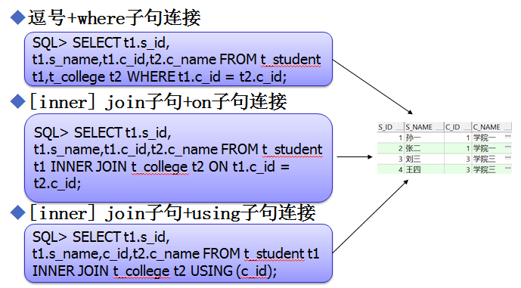
例：查询出学生信息与院系信息相关连的基础信息。

Slide 17

假设有两张表employees 和departments , 想要获取每个员工对应的部门名称。
在这个例子中,只有那些在employees 表中有记录且在departments 表中也有相应部门记录的员工会被返回。

Slide 18
外部连接
外部连接主要有三种书写方式
    逗号+where子句
    [outer] join+on子句
    [outer] join+using子句
外部连接类型：
    左外连接: LEFT [OUTER] JOIN
    右外连接： RIGHT [OUTER] JOIN
    全外连接： FULL [OUTER] JOIN

Slide 19
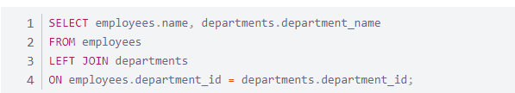
外部连接-左外连接
左外连接(LEFT [OUTER] JOIN)：
  左外连接的两个表之间是有主从关系的，左外连接中左表或者说写在逗号或者join前面的为左表，运行结果中将包含所有左表中的记录，右表记录根据匹配关系补充左表信息，如无关联记录则置NULL处理。
假设要获取所有员工的姓名以及他们的部门,即使有些员工还没有分配到任何部门。
在这个示例中,查询将返回所有员工及其所属部门的名称。如果某个员工没有部门,则部门名称将显示为NULL。
Notes:
[思路]先给出例子，引导学员如何写句子，出现问题，引出外联接，解释外联接的含义及其用法，解决问题
说明：对于比较难或比较新的知识点，都可通过这种思路讲解，以下不赘述

Slide 20
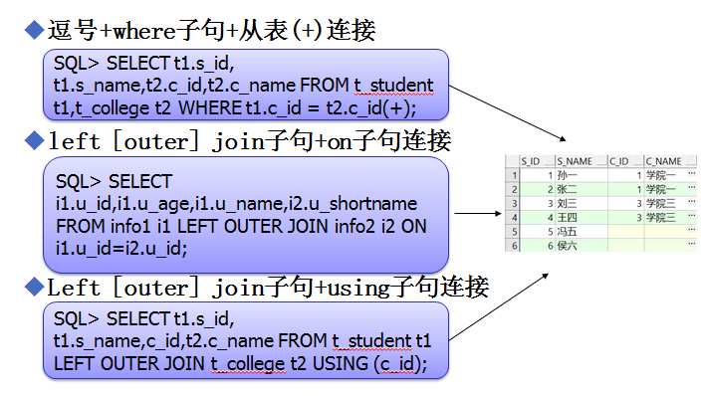
例：查询出学生信息与院系信息相关连的查询结果集，要求学生信息是全部的，学院信息作为补充。

Slide 21
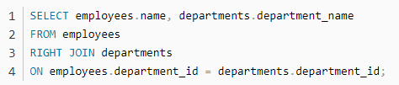
外部连接-右外连接
右外连接(RIGHT [OUTER] JOIN)：
  右外连接的两个表之间是有主从关系的，右外连接中右表或者说写在逗号或者join后面的为右表，运行结果中将包含所有右表中的记录，左表记录根据匹配关系补充右表信息，如无关联记录则置NULL处理。
假设想要获取所有部的名称以及他们的员工,即使有些部门还没有分配任何员工。
这个查询会返回所有部门,即使某些部门]还没有员工,员工姓名将显示为NULL。
Notes:
[思路]先给出例子，引导学员如何写句子，出现问题，引出外联接，解释外联接的含义及其用法，解决问题
说明：对于比较难或比较新的知识点，都可通过这种思路讲解，以下不赘述

Slide 22
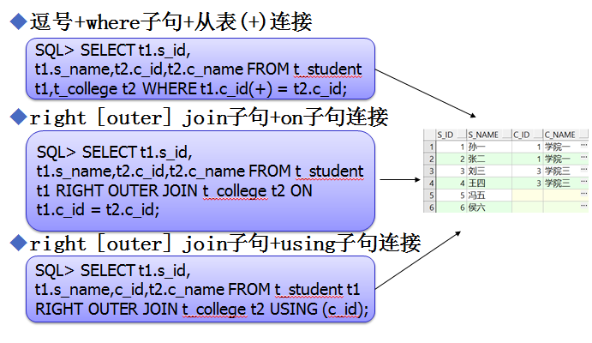
例：查询出学生信息与院系信息相关连的查询结果集，要求学院信息是全部的，学生信息作为补充。

Slide 23
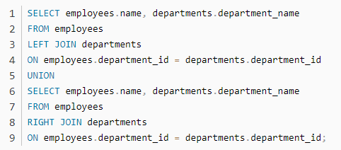
外部连接-全外联接
全外连接(RIGHT [OUTER] JOIN)：
  可以简单的理解为：FULL [OUTER] JOIN 相当于LEFT [OUTER] JOIN和RIGHT [OUTER] JOIN查询的结果集再通过UNION(不是UNION ALL)连接在一起。
假设要获取所有员工及部门信息,即使有些员工没有部门,或者有些部门没有员工。

Slide 24
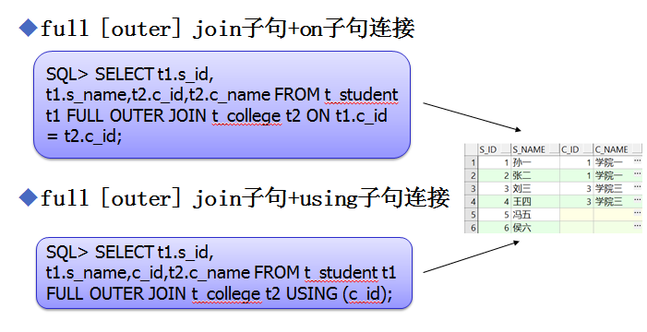

Slide 25
JOIN操作的应用场景
1.数据整合
JOIN操作用于将多个表中的数据整合在一起。 例如,在电子商务应用中,可以将订单表与客户表、产品表结合起来,以获取完整的订单信息。
2.数据分析
通过JOIN操作,可以对来自不同表的数据进行分析。例如,可以将销售数据与产品数据结合起来,以分析不同产品的销售表现。
3.数据清理
JOIN操作还可以用于数据清理。例如,可以使用LEFT JOIN找到没有匹配记录的数据,以确定是否有数据缺失或错误。

Slide 26
JOIN操作的性能优化
1.使用索引
在JOIN操作中,确保连接列上有索引,以提高查询性能。索可以显著减少数据库需要扫描的行数。
2.限制返回列
仅选择需要的列,以减少传输的数据量,从而提高查询性能。
3.使用表驱动
大表在JOIN操作中,确保小表在连接时驱动大表,以减少处理的数据量。
4.避免复杂的嵌套查询
尽量避免复杂的嵌套查询,因为它们会影响性能。可以尝试使用临时表或视图来简化查询。

Slide 27
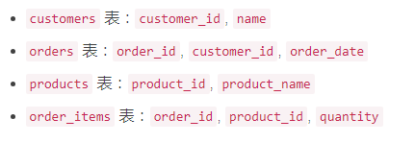
假设有四张表: orders (订单)、customers ( 客户)和products(产品)、order_items(子订单)。要查询每个客户的订单详情,包括订单中的产品信息
表的数据结构如下：

Slide 28
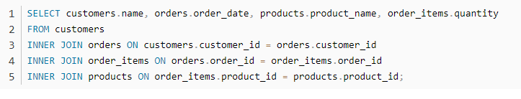
这个查询通过INNER JOIN将四张表连接在一起,返回每个客户的订单信息,包括订单中每个产品的名称和数量。

Slide 29
3.7 Set function in SQL
Is there some Functions in the SQL?
1.Set functions in SQL
[1] Set Functions
    Five types : count, max, min, sum, avg
    Operate on sets of values, return a single value
[2] Different terms in Products
    X/OPEN and INGRES refer to set function
    ANSI says aggregate functions
    ORACLE has group functions
    DB2 says column functions

Slide 30
3.7 Set function in SQL
[3] Set function syntax of SQL
  Select SET_functionName ([ ALL | DISTINCT ] colname) from…..
  Select COUNT(*) from……
Name Argument type Result type Description
count any (can be *) numeric count of occurrences
sum numeric numeric sum of arguments
max char or numeric same as arg. maximum value
min char or numeric same as arg. minimum value
avg numeric numeric average of arguments

Slide 31

3.7 Set function in SQL
2. Example 3.7.2 Please to determine the total quantity of product p03 that has been ordered.
求和
‘p03’
select sum(qty) as TOTAL from orders where pid = 'p03‘;
3. Example 3.7.4 Get number of cities where customers are based.
select count (distinct city) from customers;
Comparing:
select count(*) from customers; /* all the numbers of rows */
select count(cid) from customers; /* null values not counted, cid is PK of customers*/
select count(city) from customers; /* only if no null city values*/

Slide 32



3.7 Set function in SQL
4. Restriction !!! set functions are not allowed to appear in comparison of a WHERE clause
5. Example 3.7.5 List cids who have a discount less than maximum discount.
a)Invalid: select cid from customers where discnt < max(discnt);
先求max
b)Effective: select cid from customers
where discnt < (select max(discnt) from customers);
6. Example 3.7.6 Find products ordered by at least two customers.
卖了2人以上？
Count(distinct cid)
select pid from products
where 2 <= (select count(distinct cid) from order o
where o.pid=p.pid)

Slide 33
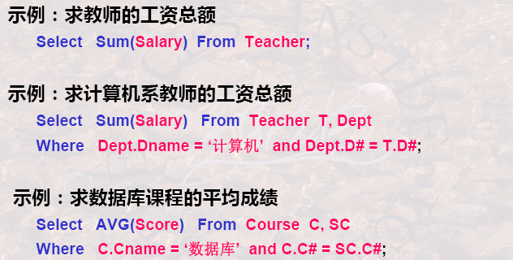
怎样表达求每门课程的平均成绩?

Slide 34
[练习1]查询学生总人数。
SELECT COUNT(*) FROM Student;
[练习2]查询选修了课程的学生人数。
SELECT COUNT(DISTINCT Sno) FROM SC;
[练习3]计算1号课程的学生平均成绩。
SELECT AVG(Grade) FROM SC WHERE Cno= '1 '

Slide 35
3.7 Set function in SQL
7.Handing NULL values
  null is a special constant(常数)
  meaningful a value that is UNKNOWN.
8.Example 3.7.8 After adding a row (c007, Windix, Dallas, null) to the customers table, Pose the query to retrieve this row.
a) SQL select * from customers where discnt is null;
b) wrong select * from customers where discnt<=10 and discnt>10;

Slide 36
NULL的特殊函数与操作
为了正确处理NULL值, SQL提供了一些特殊函数和操作符。IS NULL和IS NOT NULL用于检查字段是否为NULL。
例如: SELECT * FROM table WHERE column IS NULL 。此外, COALESCE函数可以用于替换NULL值。
例如:SELECT COALESCE(column, 'default_ value') FROM table , 这将在column为NULL时返回'default_ _value'。
找出年龄值为空的学生姓名
Select Sname From Student
Where Sage is null ;
注意:上例条件不能写为Where Sage=null;空值是不能进行运算的

Slide 37
3.7 Set function in SQL
9.Example 3.7.9 After adding the row (c007,Windix,Dallas,null) to customers table. We wish to find the average discount of all customers.
a) the null is discarded（抛弃，排除）
select avg(discnt) from customers;
b) A set function acting on a empty set
    count() returns zero for a empty set.
    sum(), avg(), max() and min() return the null value.

Slide 38
3.8 Group of rows in SQL
How to classify the Data in different groups?
1. GROUP and HAVING clause
    SELECT [ALL|DISTINCT] {*|expr [[AS] c_alias]{,expr [[AS] c_alias]...}}
        FROM tableref {, tabletrf...}
    [WHERE search_condition]
    [GROUP BY column {, column...} ] [HAVING search_condition]
    | subquery UNION [ALL] | INTERSECT [ALL] | EXCEPT [ALL]
    [CORRESPONDING [BY] (colname {, colname . . .})] subquery
2. Example 3.8.1 Let’s create a query to calculate the total product quantity ordered of each individual product by each individual customer. (查每个(pid, cid)对之间的销货数 ).
select pid, cid, sum(qty) as TOTAL from orders group by pid, cid;
两级分组
组内求和

Slide 39


3.8 Group of rows in SQL
3.Example 3.8.2 Print out the aname, aid, pname, pid together with the total quantity each agent supplies of that product to customers c002 and c003.
c002,c003
两级分组
组内求和
select aname, a.aid, pname, p.pid, sum(qty) as total_qty
from agent a, products p, orders x
where x.cid in (‘c002’,’c003’) and x.aid=a.aid and x.pid=p.pid
group by aid, pid;

Slide 40

3.8 Group of rows in SQL
4. Example 3.8.4 Provided pids purchased by (sell to) at least two customers.
pid分组
组内cid计数>=2
select pid from orders
group by pid having count(distinct cid) >= 2;
5. Example 3.8.5 Pose a query to find the average, over all agents, of the maximum dollar sales made by each agent.
aid分组;
找组内dollar最大
求avg(dollar)
select avg(t.x) from (select aid, max(dollars) as x
from orders group by aid) t;

Slide 41
必GROUP BY子句分组:
细化聚集函数的作用对象
■如果未对查询结果分组，聚集函数将作用于整个查询结果
■对查询结 果分组后，聚集函数将分别作用于每个组■按指定的一列或多列值分组，值相等的为一组

Slide 42
group by子句
  group by将查询结果的元组按指定的一列或多列分组，分组原则是值相等。然后在每一分组上使用聚集函数。
  分成几组查询结果就有几行。
  示例：查询各个课程号及相应的选课人数。
  SELECT cno, count(sno) as num FROM SC
  group by cno;
  对查询结果分组的目的是为了细化聚集函数的作用对象。分组后，聚集函数将作用于每一个组，即每一组都有一个函数值。

Slide 43
示例：查询各个课程号及相应的选课人数。
SELECT cno, count(sno) as num FROM SC group by cno;
Sno | Cno | Grade
95001 | 1 | 92
95001 | 2 | 85
95001 | 3 | 88
95002 | 2 | 90
95002 | 3 | 80
Cno | Sno | Grade
1 | 95001 | 92
2 | 95001 | 85
 | 95002 | 90
3 | 95001 | 88
 | 95002 | 80
group by cno
count(sno)
cno | count(Sno)
1 | 1
2 | 2
3 | 2
cno | num
1 | 1
2 | 2
3 | 2

Slide 44
grop by 子句后面可以跟上HAVING短语。HAVING短语用来指定条件，只有满足HAVING短语指定条件的组才输出。
例如：
查询平均成绩大于85分的各门课程的课号及平均成绩。
  Select Cno, avg(grade) from SC group by Cno
  HAVING avg(grade) > 85;

Slide 45
[练习]查询平均成绩大于等于90分的学生学号和平均成绩
下面的语句是不对的:
SELECT Sno,
AVG(Grade)
FROM SC
WHERE AVG(Grade)>=90
GROUP BY Sno;
因为WHERE子句中是不能用聚集函数作为条件
表达式正确的查询语句应该是:
SELECT Sno,
AVG(Grade)
FROM SC
GROUP BY Sno
HAVING AVG(Grade)>=90;

Slide 46
[练习]列出计算机系姓刘的同学的信息，按照学号大小排序
SELECT *
FROM Student
WHERE Sdept='CS' AND Sname LIKE‘刘%’
ORDER BY Sno;

Slide 47
[练习]按系并区分男女统计各系学生的人数、并按照人数降序排序
SELECT Sdept, Ssex, COUNT(Sno)
FROM Student
GROUP BY Sdept,Ssex
ORDER BY COUNT(Sno) DESC;

Slide 48
3.9 A complete description of Select
1. Experiments of making a Select statement
  The Cartesian Product of all tables in FROM clause is formed.
  Rows not satisfying in WHERE condition are eliminated (消去/限制).
  Rearranging rows are grouped in accordance with the GROUP BY.
  Groups not satisfying the HAVING clause are then eliminated.
  The expressions of the Select Clause target list are calculated.
  If the keyword DISTINCT is present, duplicate rows are eliminated. The UNION, INTERSECT, EXCEPT is taken after each subquery.
  If an ORDER BY is present that set of all selected rows is sorted.

Slide 49
3.9 A complete description of Select
2.Example 3.9.1 List all customers, agents and the dollar sales for pairs of customers and agents, and order the result from largest to smallest sales totals. Retain only those pairs for which the dollar amount is at least 900.
两级分组; 组内求和；>=900的、排序
select c.cname, c.cid, a.aname, a.aid, sum(o.dollars) as casales
from customers c, orders o, agents a
where c.cid = o.cid and o.aid = a.aid
group by (c.cname,) c.cid, (a.aname,) a.aid
having sum(o.dollars) >= 900.00
order by 5 desc;
Note: 5 is means to the fifth column “casales” is on descending.

Slide 50
3.9 A complete description of Select
3. Expressions, Predicates, Search_condition
[1] Expressions Form
expr = num-expr | strv-expr | date-xpr | intv-expr | con-dexpr
[2] Data Types
    Numeric value expressions
    String value expression
    Datetime expression
    Interval value expression
    Conditional expression
Note:
    Difference DBMS product provides difference function;
    Data types for columns defined in Appendix A.3

Slide 51
3.9 A complete description of Select
[3] Mathematical functions
abs(n), mod(n,b), sqrt(n). NOT standardized in SQL-99.
[4] Char & String functions
CHAR_LENGTH (str)
SUBSTRING (str FROM start [FOR length])
TRIM ([[LEADING|TRAILING|BOTH][set] FROM] str)
POSITION (str1 IN str2)
UPPER(strval), LOWER(strval)
[5] Logical Values
  TRUE/ FALSE/ UNKNOW (‘U’ is not equivalent to ‘F’)
AND | T | F | U | OR | T | F | U |  | NOT
T | T | F | U | T | T | T | T | T | F
F | F | F | F | F | T | F | U | F | T
U | U | F | U | U | T | U | U | U | U

Slide 52
3.9 A complete description of Select
[6] Predicates
a) Comparison predicate: expr1 { expr2 | expr1 (Subquery)}
b) Between predicate: c.discnt between 10 and 12
c) In predicate: expr [not] in (subquery)
d) Quantified predicate: expr [all |any |some] (subquery)
e) Exists predicate: [not] exists (subquery)
f) Is null predicate: columnname is [not] null
g) Like predicate: columnname [not] like 'pattern'

Slide 53
3.9 A complete description of Select
4. Summary of Predicates
[1]Comparison predicate expr1 | expr1 (Subquery){=, <>, >, <,>=, <=}
  Example 3.9.2 Listed cids with a discount less than the maximum discount.
S1 select cid from customers
where discnt < (select max(discnt) from customers);
S2 select cid from customers
where discnt < any(select discnt from customers);
  Example: Find orders made by customers whose city come after 'M' in the alphabetic. ( 选 ‘M’ 以后字母开头的city )
select * from orders o where
'M'<(select city from customers c where c.cid=o.cid);

Slide 54
3.9 A complete description of Select
[2] Between predicate: expr [NOT] BETWEEN expr2 and expr3
select * from products where price between 1 and 10
[3] Quantified predicate: expr [ ALL | ANY | SOME] (subquery)
  Example 3.9.3 Get maximum discount of all customer.
S1 select max(discnt) as maxdis from customers;
S2 select distinct discnt from customers c where discnt
>=all (select discnt from customers d where d.cid<>c.cid);
[4] Exists predicate [NOT] EXIST (subquery)
[5] In predicate expr [NOT] IN (subquery)
[6] Is null is [NOT] NULL

Slide 55
3.9 A complete description of Select
[7] Like predicate: columnname [NOT] LIKE 'pattern’
  Wildcards (通配符. Like windows file wildcards )
    Underscore (_) Any single character
    Percent (%) Zero or more characters of any form
    Escape character (\) Precedes quoted literal character
    All other characters Represent themselves
  Example 3.9.4 Retrieve all data of customers whose name begins with the letter ‘A’.
select * from customers where cname like ‘A%’ ;

Slide 56
3.9 A complete description of Select
  Example 3.9.6 Retrieve cids of customers whose cname begins ‘Tip_’ and arbitary(any) number of character .
select cid from customers
where cname like ‘Tip\_%’ escape ‘\’;
  Example 3.9.7 Retrieve cids of customers whose cname starts with the sequence ‘ab\’ .
select cid from customers
where cname like ‘ab\\%’ escape ‘\’;

Slide 57
3.10 Insert, Update and Delete statements
How to Updates the Data in DB?
    Update statements : Insert , Update , Delete
    Need update privilege on a table
1. Insert Statement
[1] Form
  标准式：INSERT INTO tablename [(column {, column…})]
{VALUES (expr | null { , expr | null…}) | subquery}
[2] Example 3.10.1 (p148) Add a row specified values to the orders table. (no qty or dollars, so on this new row they are null).
insert into orders (ordno, month, cid, aid, pid)
values('1107', 'aug', 'c006', 'a04', 'p01’);
select * from order where dollars is null;

Slide 58
3.10 Insert, Update and Delete statements
How to Updates the Data in DB?
    Update statements : Insert , Update , Delete
    Need update privilege on a table
1. Insert Statement
[1] Form
  标准式：INSERT INTO tablename [(column {, column…})]
{VALUES (expr | null { , expr | null…}) | subquery}
  插入子查询结果集
INSERT INTO tablename [ colname[, colname…]）
Subquery;
[2] Example 3.10.2 Create a new table Swcusts of customers, and insert into all customers from Dallas and Austin.
insert into swcusts (select * from customers where city in ('Dallas', 'Austin') );

Slide 59
3.10 Insert, Update and Delete statements
2. Update Statement
[1] Form: UPDATE tablename SET colname = {expr | null | (subquery)}
{, {column = expr |null | (subquery)…}}
[WHERE search_condition];
[2] Example 3.10.3 (p150) Give All agents in New York a 10% raise in the percent commission they earn on an order.
UPDATE agents SET percent = 1.1*percent
WHERE city = 'New York';

Slide 60
3.10 Insert, Update and Delete statements
[3] Example 3.10.5 Update the discnt values in rows of the Swcusts table created in Example 3.10.2 with more up-to-date discnt values from the customers table.
[2] Example 3.10.2 Create a new table Swcusts of customers, and insert into all customers from Dallas and Austin.
insert into swcusts (select * from customers
where city in ('Dallas', 'Austin') );
update swcusts s set discnt=(select discnt from customers c
where c.cid = s.cid );

Slide 61
3.10 Insert, Update and Delete statements
3. Delete Statement
[1] Form: DELETE FROM tablename [WHERE search_condition];
[2] Example 3.10.6 (p151) Delete all agents in New York.
delete from agents where city = 'New York';
[3] Example 3.10.7 Delete agents who have total orders of less than $600.
delete from agents where aid in
( select aid from orders
group by aid having sum(dollars) < 600 );
aid分组; 组内求和；<600的、aid
删除aid的行

Slide 62
3.10 Insert, Update and Delete statements
[4] Notice: Table Drop
drop table agents; (表结构+数据)
Suggestions for doing exercises:
(1) reading through Appendix B, and Appendix
C.2, C.3, C.4, C.14, C.17, C.25, C.28, and C.31
(2) Exercises: all exercises of charter 3 .
specialized for [3.1], [3.2], [3.5], [3.7], [3.8], [3.10], [3.11], [3.12], [3.14], [3.15], [3.16], [3.18], [3.19], [3.20]

Slide 63
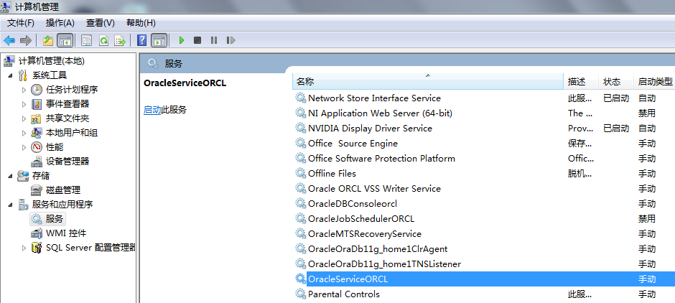
Additional：DBMS Example
1.DBMS Example ORACLE
  Setup ORACLE 11g ( for Windows 7 64bit )
  There are 7 Serves in Windows:

Slide 64
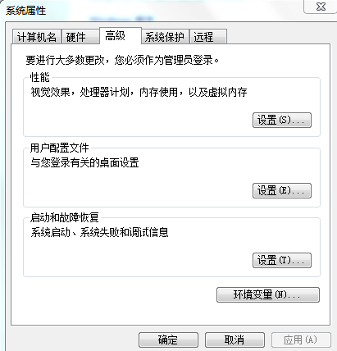
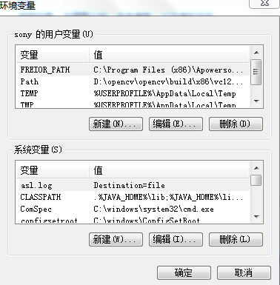
Additional：DBMS Example
1.DBMS Example ORACLE
  Setup the Environment variables

Slide 65
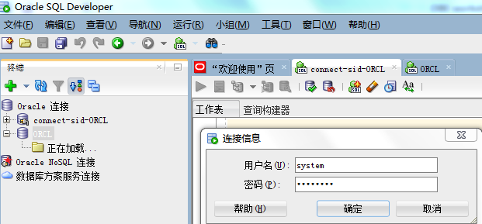
Additional：DBMS Example
1.DBMS Example ORACLE
  Start up ORACLE servies
  Start up SQL Plus or SQLdeveloper
  Login/Connect the ORACLE with Account & Password

Slide 66
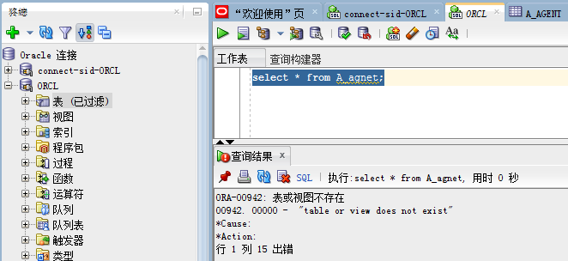
Additional：DBMS Example
1.DBMS Example ORACLE
  Input SQL statement

Slide 67
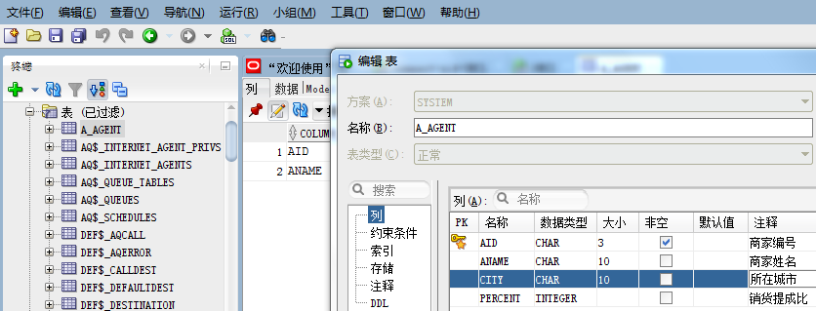
Additional：DBMS Example
1.DBMS Example： ORACLE
    Create table A_agent

Slide 68
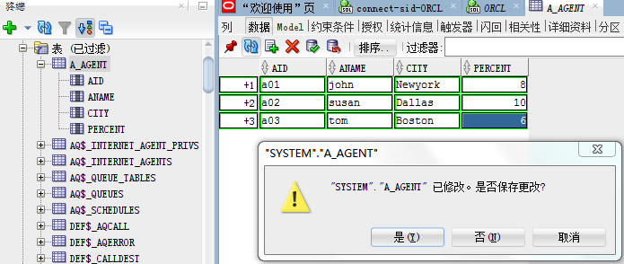
Additional：DBMS Example
1.DBMS Example ORACLE
  Insert the Data to the table by Visual box A_agent

Slide 69
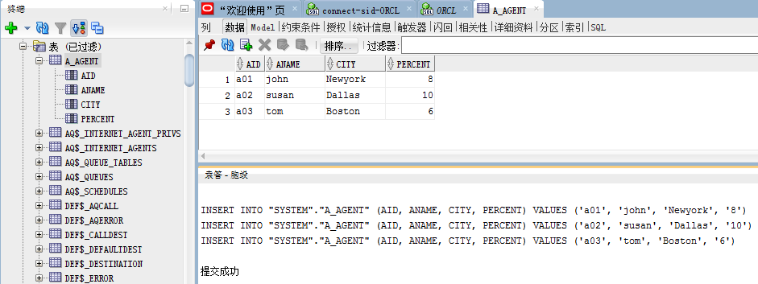
Additional：DBMS Example
1.DBMS Example ORACLE
  Insert the Data to the table using SQL A_agent

Slide 70
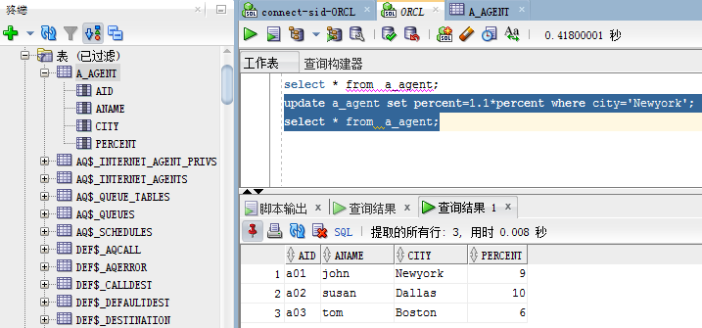
Additional：DBMS Example
1.DBMS Example ORACLE

